Slide 1
SwisTrack
A Computer Vision Processing Pipeline
Stefanie Tellex, MIT Media Lab, USA
Thomas Lochmatter, EPFL, Switzerland (current maintainer)
Pierre Roduit, EPFL, Switzerland
Daniel Abel, ELTE, Hungary
Nikolaus Correll, MIT, USA
Chris Cianci, EPFL, Switzerland
Iñaki Navarro, UPM, Spain
Julien Nembrini, EPFL, Switzerland
Clément Hongler, EPFL, Switzerland
Daniel Soltero, MIT, USA

Slide 2
SwisTrack
Computer vision processing pipeline.
  Modular.
  Reusable.
  Introspectable.
  Configurable.
Fast to develop new components.
Fast to build new pipelines.
Community!

Slide 3
Goals
Develop a new component.
Build a new tracking pipeline.
Understand SwisTrack's architecture.
Show some research results.

Slide 4
Developing a new component

Slide 5
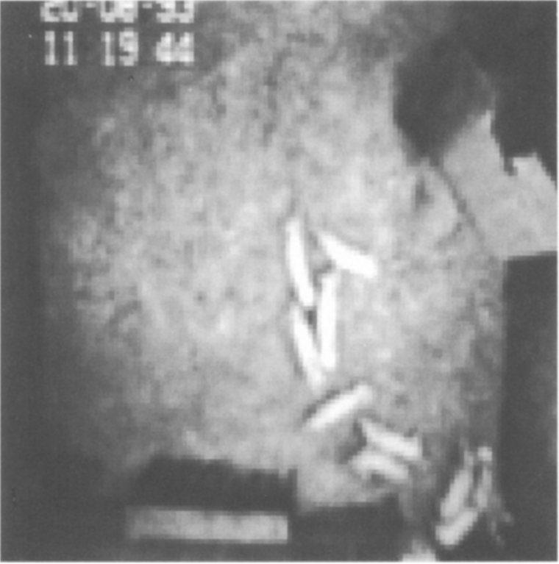
Adaptive Background Subtraction (Median)
Segmentation and Tracking of Piglets in Images (McFarlane and Schofield, 1995)

Slide 6
Adaptive Background Subtraction (Median)
1. Build a background model.
2. Subtract the background model from the input image.
3. Threshold.

Slide 7
Adaptive Background Subtraction (Median)
for iPixel, bPixel
in inputImage, backgroundModel:
if iPixel > bPixel:
bpixel += 1
else if iPixel < bPixel:
bpixel -= 1
else:
# Do nothing if equal

Slide 8
class ComponentAdaptiveBackgroundSubtractionMedian:
public Component {
public: ComponentAdaptiveBackgroundSubtractionMedian
(SwisTrackCore*stc);
~ComponentAdaptiveBackgroundSubtractionMedian();
// Overwritten Component methods
void OnStart();
void OnReloadConfiguration();
void OnStep();
void OnStepCleanup();
void OnStop();
Component * Create();
void UpdateBackgroundModel(IplImage * inputImage);
private:
IplImage * mBackgroundModel;
IplImage *mOutputImage;
Display mDisplayOutput;
};

Slide 9
class ComponentAdaptiveBackgroundSubtractionMedian:
public Component {
public: ComponentAdaptiveBackgroundSubtractionMedian
(SwisTrackCore*stc);
~ComponentAdaptiveBackgroundSubtractionMedian();
// Overwritten Component methods
void OnStart();
void OnReloadConfiguration();
void OnStep();
void OnStepCleanup();
void OnStop();
Component * Create();
void UpdateBackgroundModel(IplImage * inputImage);
private:
IplImage * mBackgroundModel;
IplImage *mOutputImage;
Display mDisplayOutput;
};

Slide 10
void THISCLASS::OnStep() {
IplImage *inputImage = mCore->mDataStructureImageColor.mImage;
if (! inputImage) {
AddError(wxT("No input image."));
return;
}
if (inputImage->nChannels != 3) {
AddError(wxT("The input image is not a color image."));
return;
}
if (!mBackgroundModel) {
mBackgroundModel = cvCloneImage(inputImage);
}
if (! mOutputImage) {
mOutputImage = cvCloneImage(inputImage);
}
UpdateBackgroundModel(inputImage);
mCore->mDataStructureImageColor.mImage = mOutputImage;
DisplayEditor de(&mDisplayOutput);
if (de.IsActive()) {
de.SetMainImage(mOutputImage);
}
}

Slide 11
void THISCLASS::OnStep() {
IplImage *inputImage = mCore->mDataStructureImageColor.mImage;
if (! inputImage) {
AddError(wxT("No input image."));
return;
}
if (inputImage->nChannels != 3) {
AddError(wxT("The input image is not a color image."));
return;
}
if (!mBackgroundModel) {
mBackgroundModel = cvCloneImage(inputImage);
}
if (! mOutputImage) {
mOutputImage = cvCloneImage(inputImage);
}
UpdateBackgroundModel(inputImage);
mCore->mDataStructureImageColor.mImage = mOutputImage;
DisplayEditor de(&mDisplayOutput);
if (de.IsActive()) {
de.SetMainImage(mOutputImage);
}
}

Slide 12
void THISCLASS::OnStep() {
IplImage *inputImage = mCore->mDataStructureImageColor.mImage;
if (! inputImage) {
AddError(wxT("No input image."));
return;
}
if (inputImage->nChannels != 3) {
AddError(wxT("The input image is not a color image."));
return;
}
if (!mBackgroundModel) {
mBackgroundModel = cvCloneImage(inputImage);
}
if (! mOutputImage) {
mOutputImage = cvCloneImage(inputImage);
}
UpdateBackgroundModel(inputImage);
mCore->mDataStructureImageColor.mImage = mOutputImage;
DisplayEditor de(&mDisplayOutput);
if (de.IsActive()) {
de.SetMainImage(mOutputImage);
}
}

Slide 13
void THISCLASS::OnStep() {
IplImage *inputImage = mCore->mDataStructureImageColor.mImage;
if (! inputImage) {
AddError(wxT("No input image."));
return;
}
if (inputImage->nChannels != 3) {
AddError(wxT("The input image is not a color image."));
return;
}
if (!mBackgroundModel) {
mBackgroundModel = cvCloneImage(inputImage);
}
if (! mOutputImage) {
mOutputImage = cvCloneImage(inputImage);
}
UpdateBackgroundModel(inputImage);
mCore->mDataStructureImageColor.mImage = mOutputImage;
DisplayEditor de(&mDisplayOutput);
if (de.IsActive()) {
de.SetMainImage(mOutputImage);
}
}
void THISCLASS::OnStep() {
IplImage *inputImage = mCore->mDataStructureImageColor.mImage;
if (! inputImage) {
AddError(wxT("No input image."));
return;
}
if (inputImage->nChannels != 3) {
AddError(wxT("The input image is not a color image."));
return;
}
if (!mBackgroundModel) {
mBackgroundModel = cvCloneImage(inputImage);
}
if (! mOutputImage) {
mOutputImage = cvCloneImage(inputImage);
}
UpdateBackgroundModel(inputImage);
mCore->mDataStructureImageColor.mImage = mOutputImage;
DisplayEditor de(&mDisplayOutput);
if (de.IsActive()) {
de.SetMainImage(mOutputImage);
}
}
void THISCLASS::OnStep() {
IplImage *inputImage = mCore->mDataStructureImageColor.mImage;
if (! inputImage) {
AddError(wxT("No input image."));
return;
}
if (inputImage->nChannels != 3) {
AddError(wxT("The input image is not a color image."));
return;
}
if (!mBackgroundModel) {
mBackgroundModel = cvCloneImage(inputImage);
}
if (! mOutputImage) {
mOutputImage = cvCloneImage(inputImage);
}
UpdateBackgroundModel(inputImage);
mCore->mDataStructureImageColor.mImage = mOutputImage;
DisplayEditor de(&mDisplayOutput);
if (de.IsActive()) {
de.SetMainImage(mOutputImage);
}
}

Slide 14
void THISCLASS::OnStep() {
IplImage *inputImage = mCore->mDataStructureImageColor.mImage;
if (! inputImage) {
AddError(wxT("No input image."));
return;
}
if (inputImage->nChannels != 3) {
AddError(wxT("The input image is not a color image."));
return;
}
if (!mBackgroundModel) {
mBackgroundModel = cvCloneImage(inputImage);
}
if (! mOutputImage) {
mOutputImage = cvCloneImage(inputImage);
}
UpdateBackgroundModel(inputImage);
mCore->mDataStructureImageColor.mImage = mOutputImage;
DisplayEditor de(&mDisplayOutput);
if (de.IsActive()) {
de.SetMainImage(mOutputImage);
}
}
void THISCLASS::OnStep() {
IplImage *inputImage = mCore->mDataStructureImageColor.mImage;
if (! inputImage) {
AddError(wxT("No input image."));
return;
}
if (inputImage->nChannels != 3) {
AddError(wxT("The input image is not a color image."));
return;
}
if (!mBackgroundModel) {
mBackgroundModel = cvCloneImage(inputImage);
}
if (! mOutputImage) {
mOutputImage = cvCloneImage(inputImage);
}
UpdateBackgroundModel(inputImage);
mCore->mDataStructureImageColor.mImage = mOutputImage;
DisplayEditor de(&mDisplayOutput);
if (de.IsActive()) {
de.SetMainImage(mOutputImage);
}
}
void THISCLASS::OnStep() {
IplImage *inputImage = mCore->mDataStructureImageColor.mImage;
if (! inputImage) {
AddError(wxT("No input image."));
return;
}
if (inputImage->nChannels != 3) {
AddError(wxT("The input image is not a color image."));
return;
}
if (!mBackgroundModel) {
mBackgroundModel = cvCloneImage(inputImage);
}
if (! mOutputImage) {
mOutputImage = cvCloneImage(inputImage);
}
UpdateBackgroundModel(inputImage);
mCore->mDataStructureImageColor.mImage = mOutputImage;
DisplayEditor de(&mDisplayOutput);
if (de.IsActive()) {
de.SetMainImage(mOutputImage);
}
}

Slide 15
void THISCLASS::UpdateBackgroundModel(IplImage * inputImage)
{
for (int y = 0; y < mBackgroundModel->height; y++) {
uchar * bgptr = (uchar *) (mBackgroundModel->imageData + y * mBackgroundModel->widthStep);
uchar * cptr = (uchar *) (inputImage->imageData + y * mBackgroundModel->widthStep);
for (int x = 0; x < mBackgroundModel->width; x++) {
for (int i = 0; i < 3; i++) {
int bgval = bgptr[3*x + i];
int imgval = cptr[3*x + i];
if (bgval < imgval) {
bgptr[3*x + i] += 1;
} else if (bgval > imgval) {
bgptr[3*x + i] -= 1;
} else {
// nothing if they are equal
}
}
}
}
cvAbsDiff(inputImage, mBackgroundModel, mOutputImage);
}

Slide 16
void THISCLASS::UpdateBackgroundModel(IplImage * inputImage)
{
for (int y = 0; y < mBackgroundModel->height; y++) {
uchar * bgptr = (uchar *) (mBackgroundModel->imageData + y * mBackgroundModel->widthStep);
uchar * cptr = (uchar *) (inputImage->imageData + y * mBackgroundModel->widthStep);
for (int x = 0; x < mBackgroundModel->width; x++) {
for (int i = 0; i < 3; i++) {
int bgval = bgptr[3*x + i];
int imgval = cptr[3*x + i];
if (bgval < imgval) {
bgptr[3*x + i] += 1;
} else if (bgval > imgval) {
bgptr[3*x + i] -= 1;
} else {
// nothing if they are equal
}
}
}
}
cvAbsDiff(inputImage, mBackgroundModel, mOutputImage);
}

Slide 17
void THISCLASS::UpdateBackgroundModel(IplImage * inputImage)
{
for (int y = 0; y < mBackgroundModel->height; y++) {
uchar * bgptr = (uchar *) (mBackgroundModel->imageData + y * mBackgroundModel->widthStep);
uchar * cptr = (uchar *) (inputImage->imageData + y * mBackgroundModel->widthStep);
for (int x = 0; x < mBackgroundModel->width; x++) {
for (int i = 0; i < 3; i++) {
int bgval = bgptr[3*x + i];
int imgval = cptr[3*x + i];
if (bgval < imgval) {
bgptr[3*x + i] += 1;
} else if (bgval > imgval) {
bgptr[3*x + i] -= 1;
} else {
// nothing if they are equal
}
}
}
}
cvAbsDiff(inputImage, mBackgroundModel, mOutputImage);
}

Slide 18
void THISCLASS::UpdateBackgroundModel(IplImage * inputImage)
{
for (int y = 0; y < mBackgroundModel->height; y++) {
uchar * bgptr = (uchar *) (mBackgroundModel->imageData + y * mBackgroundModel->widthStep);
uchar * cptr = (uchar *) (inputImage->imageData + y * mBackgroundModel->widthStep);
for (int x = 0; x < mBackgroundModel->width; x++) {
for (int i = 0; i < 3; i++) {
int bgval = bgptr[3*x + i];
int imgval = cptr[3*x + i];
if (bgval < imgval) {
bgptr[3*x + i] += 1;
} else if (bgval > imgval) {
bgptr[3*x + i] -= 1;
} else {
// nothing if they are equal
}
}
}
}
cvAbsDiff(inputImage, mBackgroundModel, mOutputImage);
}

Slide 19
Constructor
THISCLASS::ComponentAdaptiveBackgroundSubtractionMedian(SwisTrackCore *stc):
Component(stc, wxT("AdaptiveBackgroundSubtractionMedian")),
mBackgroundModel(0), mOutputImage(0),
mDisplayOutput(wxT("Output"), wxT("After background subtraction")) {
// Data structure relations
mCategory = &(mCore->mCategoryPreprocessingColor);
AddDataStructureRead(&(mCore->mDataStructureImageColor));
AddDataStructureWrite(&(mCore->mDataStructureImageColor));
AddDisplay(&mDisplayOutput);
// Read the XML configuration file
Initialize();
}

Slide 20
Constructor
THISCLASS::ComponentAdaptiveBackgroundSubtractionMedian(SwisTrackCore *stc):
Component(stc, wxT("AdaptiveBackgroundSubtractionMedian")),
mBackgroundModel(0), mOutputImage(0),
mDisplayOutput(wxT("Output"), wxT("After background subtraction")) {
// Data structure relations
mCategory = &(mCore->mCategoryPreprocessingColor);
AddDataStructureRead(&(mCore->mDataStructureImageColor));
AddDataStructureWrite(&(mCore->mDataStructureImageColor));
AddDisplay(&mDisplayOutput);
// Read the XML configuration file
Initialize();
}

Slide 21
XML Configuration
<?xml version="1.0"?>
<swistrackcomponent>
<friendlyname>Adaptive Background Subtraction (color, median)</friendlyname>
<description>Substract a background based on the prior images.</description>
<url>http://en.wikibooks.org/wiki/SwisTrack/Components/AdaptiveBackgroundSubtractionMedian</url>
<displayimage>Output</displayimage>
<configuration>
<!-- no parameters -->
</configuration>
</swistrackcomponent>

Slide 22
SwisTrackCore.cpp
...
mAvailableComponents.push_back(new ComponentHSVBackgroundSubtractionColor(this));
mAvailableComponents.push_back(new ComponentAdaptiveBackgroundSubtractionColor(this));
mAvailableComponents.push_back(new ComponentAdaptiveBackgroundSubtractionMedian(this));
...

Slide 23
Developing a new pipeline
(live demo)

Slide 24
<?xml version="1.0" encoding="utf-8"?>
<swistrack>
<components>
<component type="InputFileSquint">
<enabledinterval value="1"/>
</component>
<component type="ConvertToColor">
<enabledinterval value="1"/>
</component>
<component type="AdaptiveBackgroundSubtractionMedian">
<enabledinterval value="1"/>
</component>
<component type="ThresholdColorCommon">
<enabledinterval value="1"/>
<parameter name="Threshold" value="41"/>
</component>
<component type="OutputFramesImages">
<enabledinterval value="1"/>
<parameter name="FilePrefix" value="sequence"/>
</component>
</components>
<server>
<port>3000</port>
</server>
</swistrack>

Slide 25
mencoder mf://etc/stefie10/testing/*.png -mf w=960:h=960:fps=10:type=png \
-ovc lavc -lavcopts vcodec=mpeg4:mbd=2:trell -oac copy -o output.avi

Slide 27
<configuration>
<parameter type="integer">
<name>Threshold</name>
<label>Threshold</label>
<min>0</min>
<max>85</max>
<slider>true</slider>
<reloadable>true</reloadable>
</parameter>
<parameter type="checkbox">
<name>AverageBool</name>
<label>Using average value of the channels</label>
<default>1</default>
<reloadable>true</reloadable>
</parameter>
<parameter type="checkbox">
<name>InvertThreshold</name>
<label>Invert Threshold</label>
<default>0</default>
<reloadable>true</reloadable>
</parameter>
</configuration>

Slide 28
Tracking
Object Detection
  Where are the people?
Data Association
  Are these two detections the same object?

Slide 29
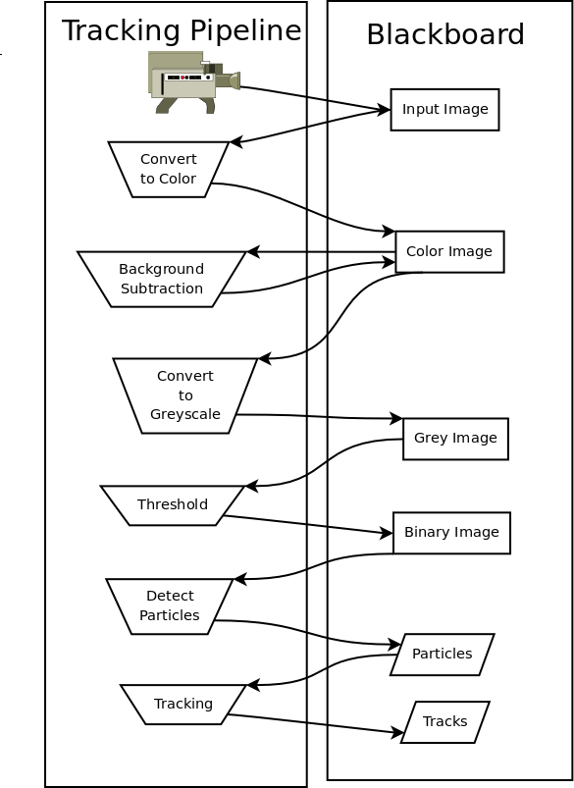

Slide 30


Slide 31
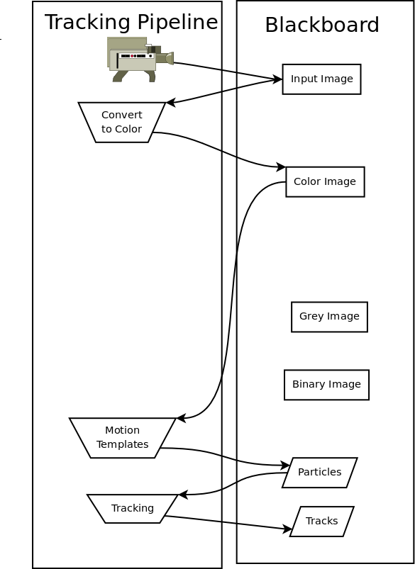

Slide 32
(live demo)

Slide 33
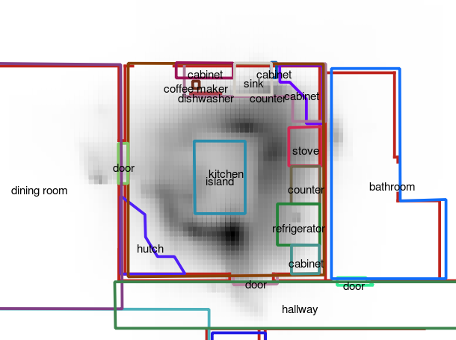

Slide 34
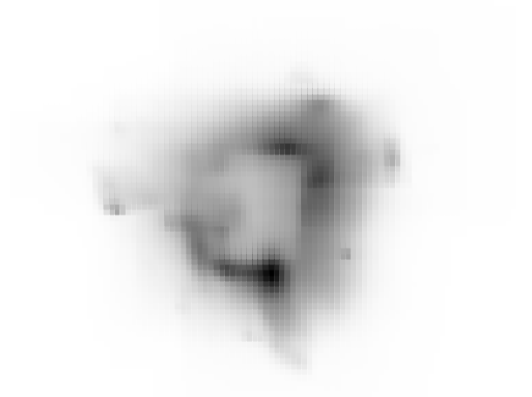

Slide 35
(across video)

Slide 36
Issues
C/C++ issues.
OpenCV issues.
  cvError calls exit, we don't know how to catch it.
  OpenCV/ffmpeg integration is broken on Ubuntu Jaunty.
Blackboard instead of a real pipeline.
No way to reuse parts of a pipeline.
Tracker doesn't work well compared to state-of-the-art.

Slide 37
Other Features
Batch mode, to run offline.
  Two weeks of Human Speechome Project video
  30+ hours of Epicenter video. (2 days x 2 cameras)
Python/Swig bindings.
  Call SwisTrack from python, get out IplImages.
Network mode, for getting live results.
  C, C++, Java, Perl, and Python examples.
Multi-camera mode.
Calibration.

Slide 38
Community
GPLv3
Mailing lists
  swistrack-devel@lists.sourceforge.net
  swistrack-commits@lists.sourceforge.net
  swistrack-users@lists.sourceforge.net
Wikibook
  http://en.wikibooks.org/wiki/SwisTrack
svn co https://swistrack.svn.sourceforge.net/svnroot/swistrack
We're looking for a good UROP!

