Slide 1
SwisTrack
A Multi-Object Tracking Pipeline
Stefanie Tellex
Thomas Lochmatter, EPFL, Switzerland (current maintainer)
Pierre Roduit, EPFL, Switzerland
Daniel Abel, ELTE, Hungary
Nikolaus Correll, MIT, US
Chris Cianci, EPFL, Switzerland
Iñaki Navarro, UPM, Spain
Julien Nembrini, EPFL, Switzerland
Clément Hongler, EPFL, Switzerland

Slide 2
Goals
Understand SwisTrack's architecture.
Design new tracking pipelines.
Run a tracker on your video.
Build new video processing components.

Slide 3
OpenCV camshiftdemo.c
if( track_object < 0 )
{
float max_val = 0.f;
cvSetImageROI( hue, selection );
cvSetImageROI( mask, selection );
cvCalcHist( &hue, hist, 0, mask );
cvGetMinMaxHistValue( hist, 0, &max_val, 0, 0 );
cvConvertScale( hist->bins, hist->bins, max_val ? 255. / max_val : 0., 0 );
cvResetImageROI( hue );
cvResetImageROI( mask );
track_window = selection;
track_object = 1;
cvZero( histimg );
bin_w = histimg->width / hdims;
for( i = 0; i < hdims; i++ )
{
int val = cvRound( cvGetReal1D(hist->bins,i)*histimg->height/255 );
CvScalar color = hsv2rgb(i*180.f/hdims);
cvRectangle( histimg, cvPoint(i*bin_w,histimg->height),
cvPoint((i+1)*bin_w,histimg->height - val),
color, -1, 8, 0 );
}
}
cvCalcBackProject( &hue, backproject, hist );
cvAnd( backproject, mask, backproject, 0 );
cvCamShift( backproject, track_window,
cvTermCriteria( CV_TERMCRIT_EPS | CV_TERMCRIT_ITER, 10, 1 ),
&track_comp, &track_box );
track_window = track_comp.rect;
if( backproject_mode )
cvCvtColor( backproject, image, CV_GRAY2BGR );
if( !image->origin )
track_box.angle = -track_box.angle;
cvEllipseBox( image, track_box, CV_RGB(255,0,0), 3, CV_AA, 0 );
}
if( select_object && selection.width > 0 && selection.height > 0 )
{
cvSetImageROI( image, selection );
cvXorS( image, cvScalarAll(255), image, 0 );
cvResetImageROI( image );
}
cvShowImage( "CamShiftDemo", image );
cvShowImage( "Histogram", histimg );

Slide 4
SwisTrack
Modular.
Reusable.
Introspectable.
Fast to develop new components.
Fast to run.

Slide 5
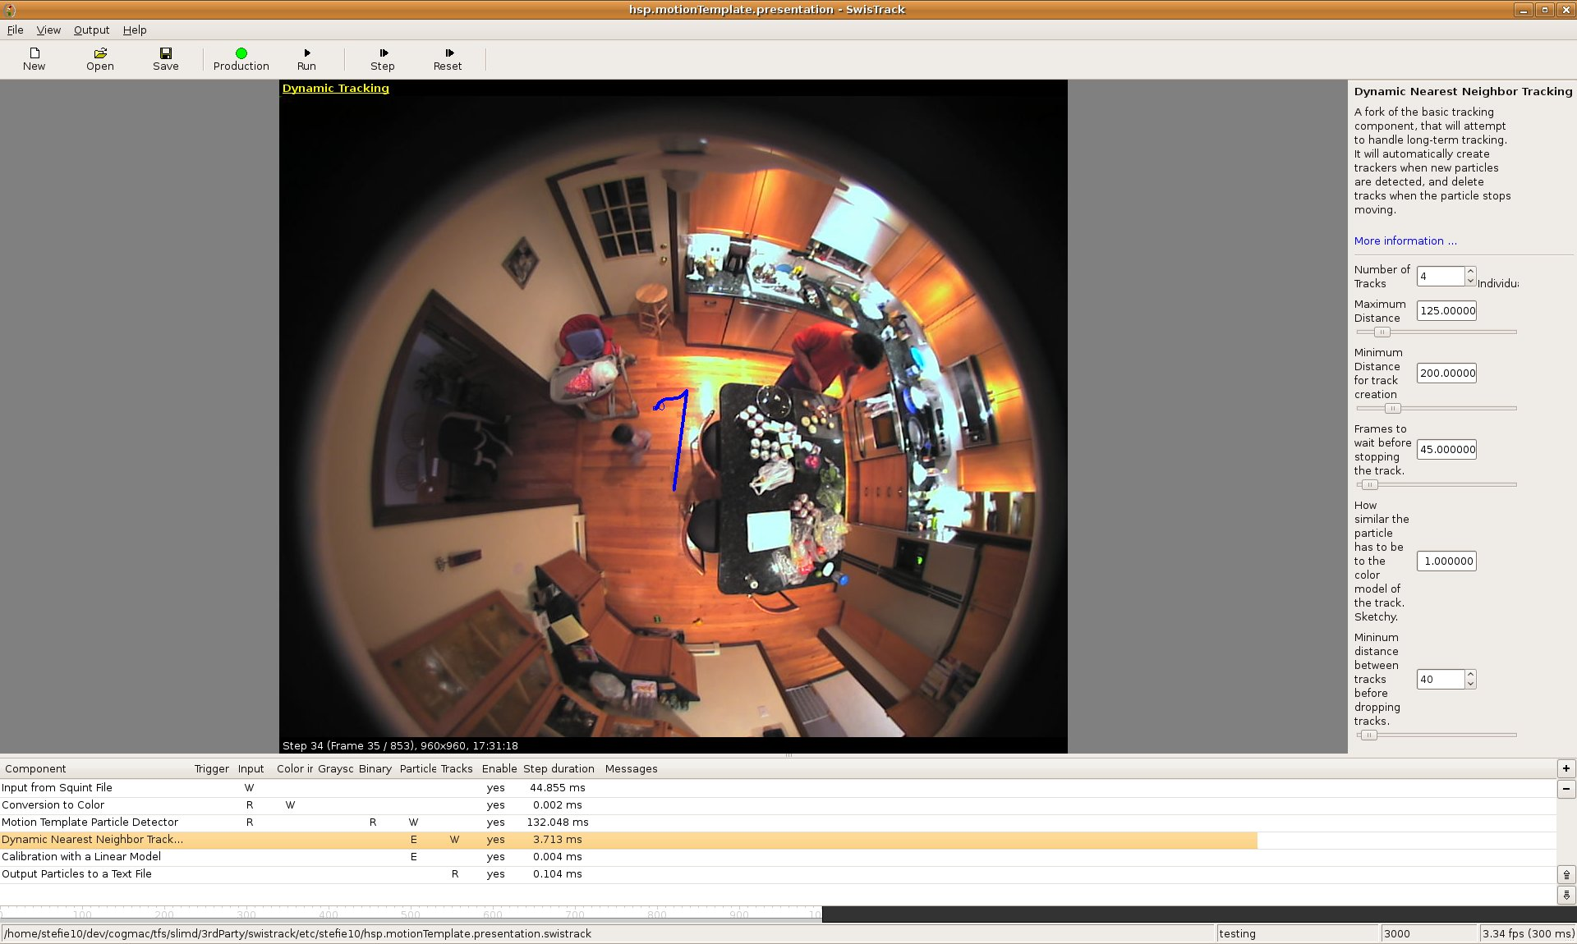
SwisTrack

