Slide 1
ATLAS AUTOENCODERS
Evaluation exercise for Google Summer of Code
NIHARIKA
niharikacpl@gmail.com

Slide 2
Introduction
For recording extensive information, storage is one of the limiting factors. Autoencoder has been leveraged for storing significant events in the ATLAS detector by compressing the data.
In the given dataset, we have rows of variable length which contains event-specifiers followed by the kinematic features for each object in the event. The task is to compress the four-momentum of a sample of simulated particles from 4 to 3 variables for jet particles in every event. This task has to be achieved using autoencoders.
An autoencoder is a type of artificial neural network used to generate numerically encoded representation of data. It is an encoder-decoder structure having the same number of nodes (neurons) in the input and output layer. The data passed into the autoencoder is first encoded (compressed) by the first half (encoder) of the neural network and then decoded (decompressed to original size) by the second half of the neural network called a decoder. There is always a possibility of information loss while encoding the dataset, which forms the basis of deciding the loss optimization (loss function) of the neural network.

Slide 3
Data Manipulation
We have read and processed one line at a time from the dataset to reduce memory usage.
Structure of data : and so on…
In an event there can be more than one type of objects. As per our objective, we need to extract the kinematics features of jet objects having
Pseudo code :
event ID; process ID; …
obj1, E1, pt1, eta1, phi1;
obj2, E2, pt2, eta2, phi2;
Id = ‘j’
Loop over each row in dataset
Dissect the row based on semicolons. This separates each jet details from the other
Loop over the dissected data and select the values against each jet only if its object id equals to ‘j’
Store the values in a dataset
Convert the dataset into Pandas DataFrame
Scale the variables to use in encoder machine learning model
Train and test the autoencoder model using the above dataset

Slide 4
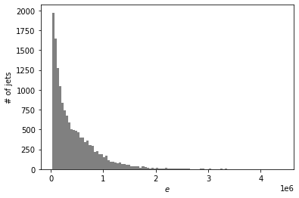
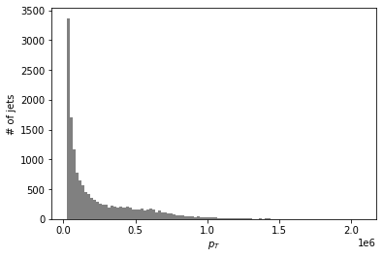
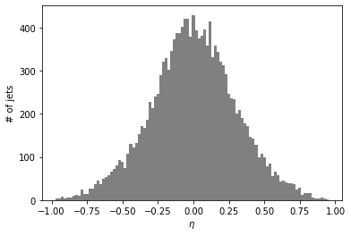
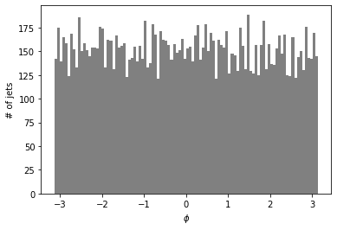
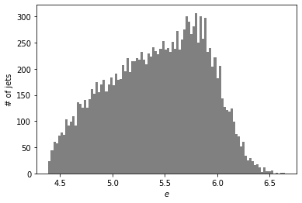
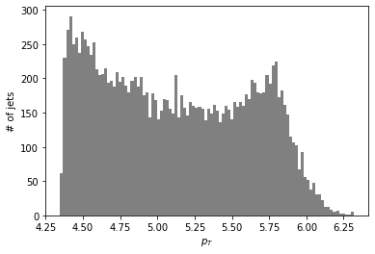


Approach
Normalizing features: On visualizing data distribution plots, we see that un-normalized features are skewed, so a scaling factor has been applied for appropriate training.
Un-normalized:
Normalized:
Train-test split: The dataset is split into two parts, namely train and test. From the dataset, 33% is chosen randomly as the testing dataset. The model is trained on the training set and later evaluated on the testing part.

Slide 5
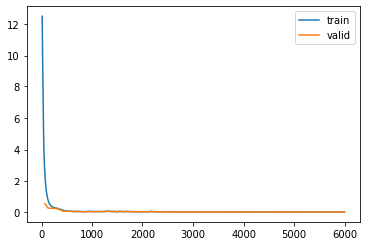
Approach continued..
Preparing data: The columns' data type has been changed to tensors for the implementation of the data loader to the dataset.
Training: The network has been trained on the 67% of the dataset. The number of input features in the network is 4, which has been reduced to 3 by encoders and then reconstructed back to 4 using decoders. The dataset is trained for 100 epochs. The parameters to the model can be experimented for better results.
Network performance: On observing the training and validation loss plot[1] we observe the network converges at a very high speed. As the loss is very low the model can be said to have high performance.
Testing: The test dataset is passed through the trained model, and the predictions are obtained. The predictions are in normalized form, so un-normalization has been performed on both the testing data and prediction output to compare with actual results. For each feature, histogram is plotted for the values of testing and and predicted data on the same graph.
[1] Train and Val loss

Slide 6
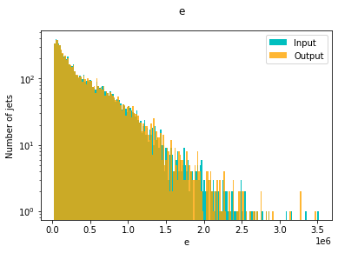
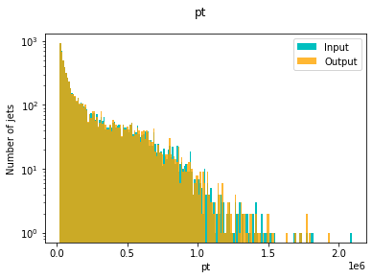
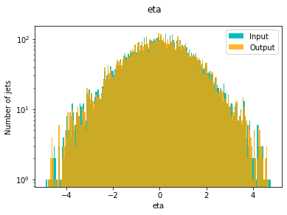
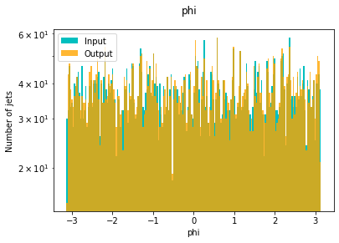
Network Outputs
The predicted output by the autoencoders have been plotted over the actual outputs of the test datasets. It has been observed that both the graphs overlap each other.
The high amount of overlapping of graphs can be interpreted as the process of encoding is happening with less loss of information.
This shows us the effectiveness of autoencoders as they can be used to compress the data, which can be reconstructed with minimum loss to data information.

