Slide 1
Database Design HR analysis
Hướng dẫn của Chip Heath và Dan Heath

Slide 2
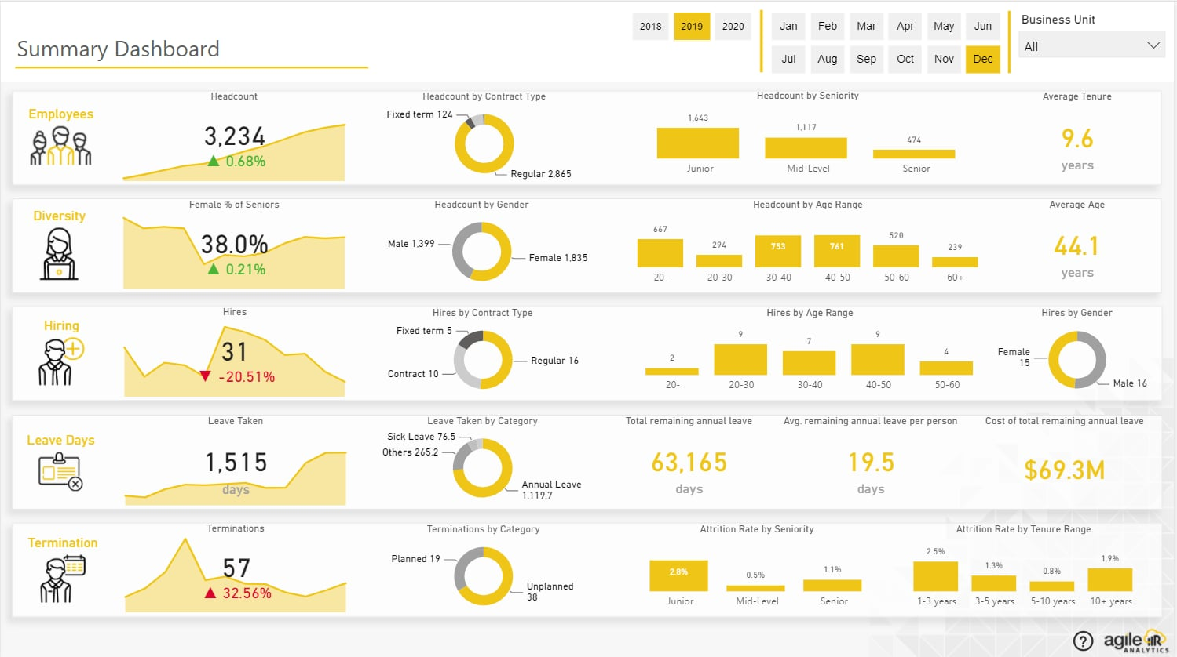
Database design Page

Slide 3
Database design Page

Slide 4
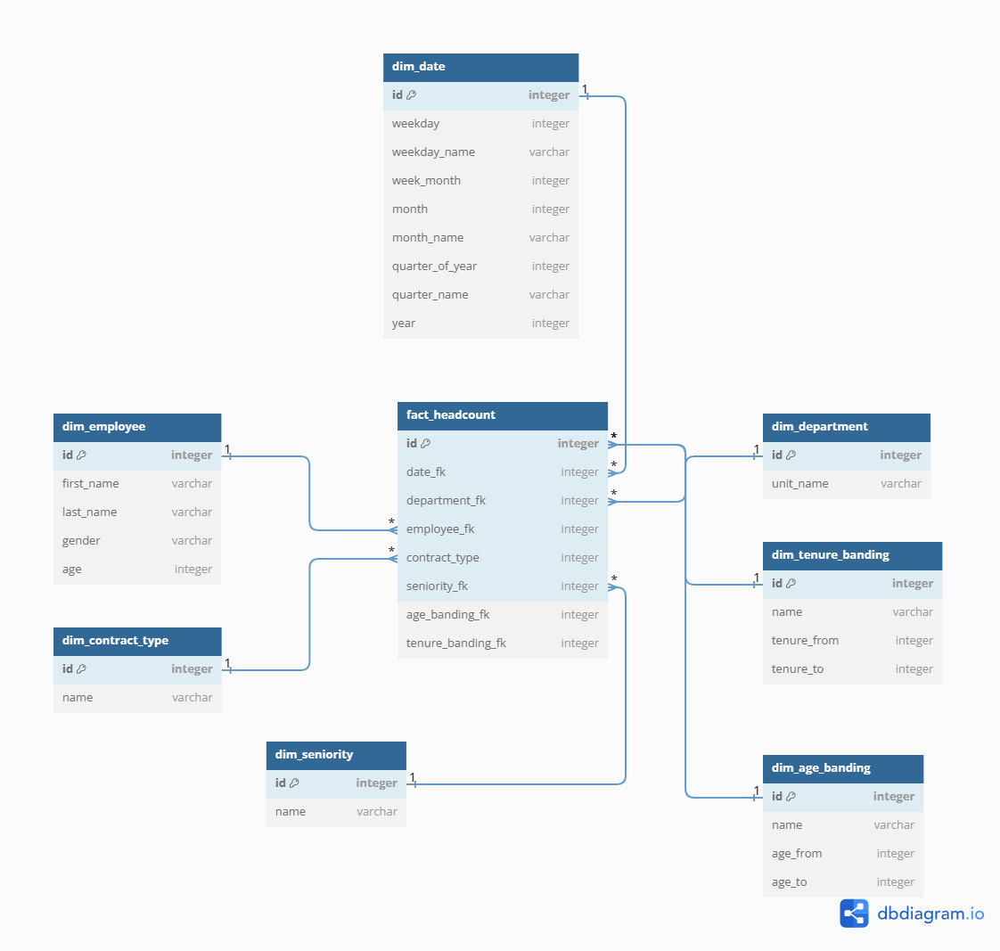
fact_headcount database design

Slide 5
Diversity database design

Slide 6
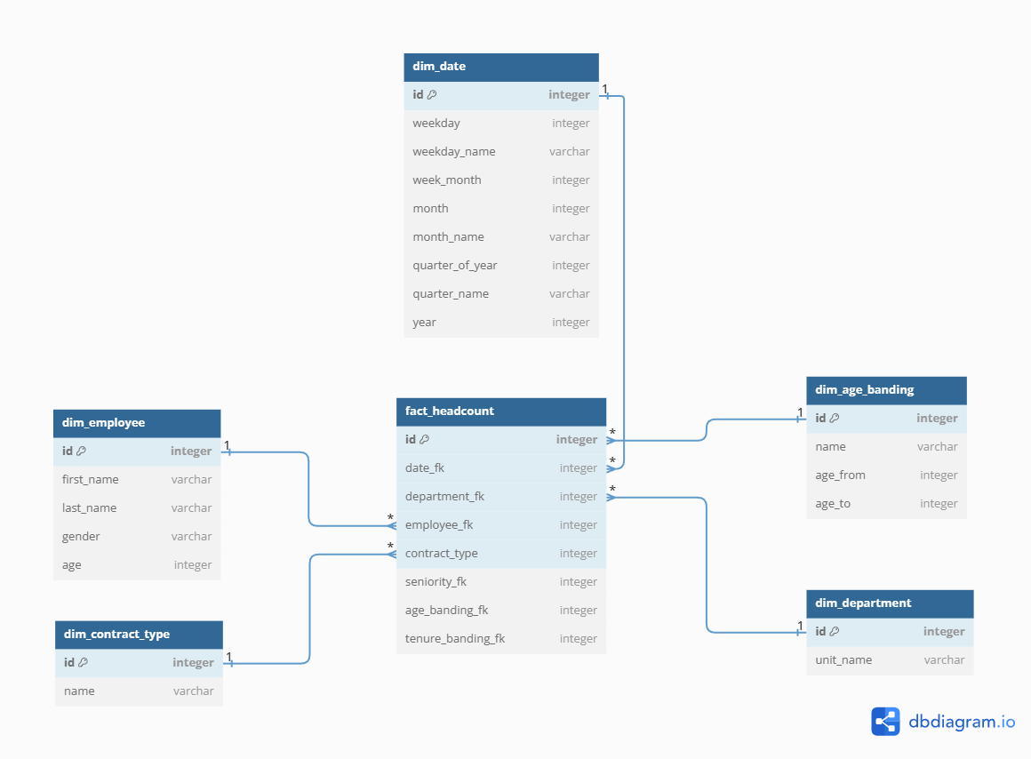
Diversity database design

Slide 7
Fact_hiring database design

Slide 8
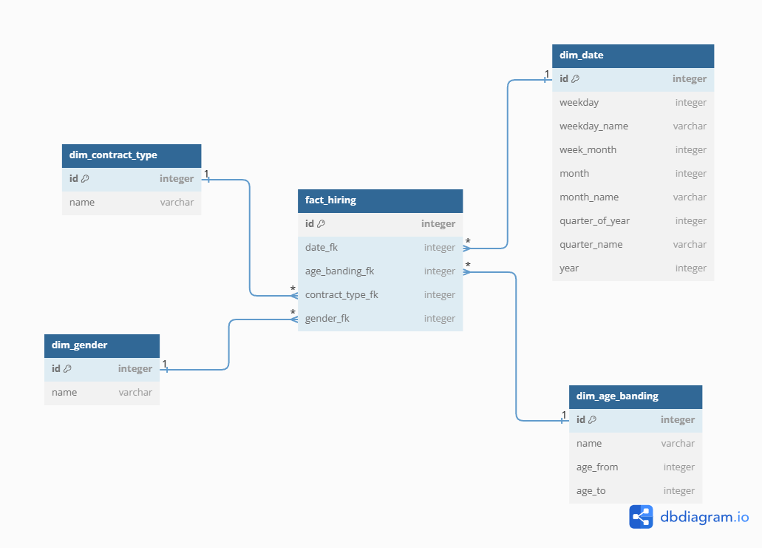
Fact_hiring database design

Slide 9
Fact_leave_days database design

Slide 10
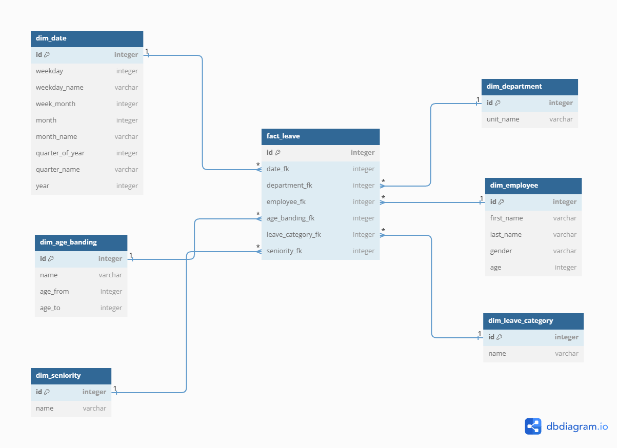
Fact_leave_days database design

Slide 11
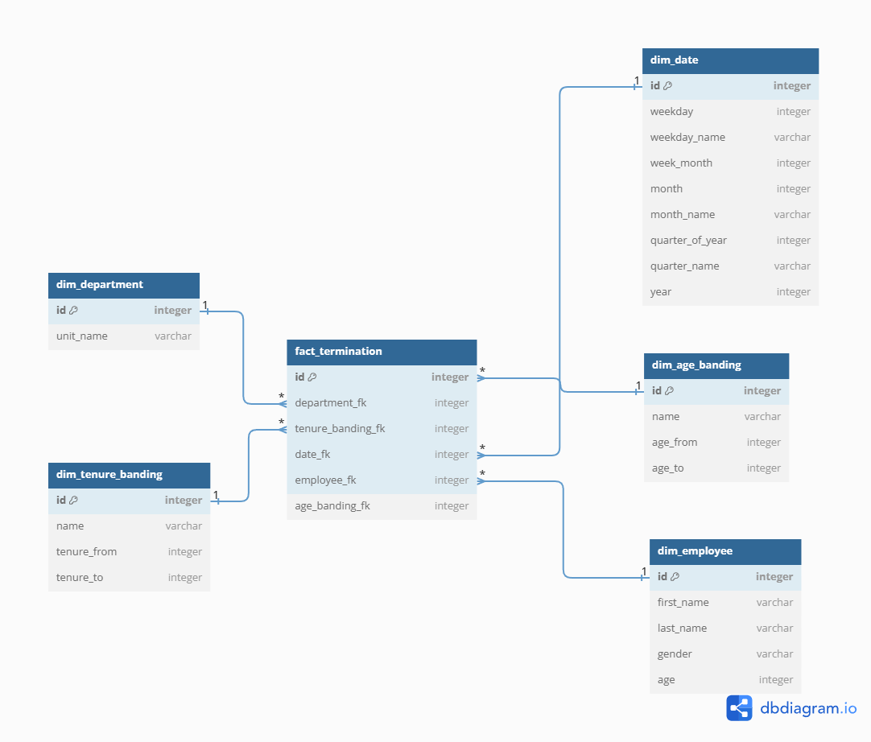
Fact_terminations database design

Slide 12


Thanks for watching

