Slide 1
Project : Parking Lot Management System CEN 3031 Software Engineering 1
Group 6: Travis Vaughn, David Giampa, Delikarl Jean Baptist

Slide 2
Project Proposal
Overview: Simply, create a parking lot management system, allowing a staff to track and issue parking passes and citations among students, staff, and faculty, as well as monitor and update the status of parking lots.
Expected users: University students, university faculty and staff, Parking Management System staff.
General features: Apply/remove parking passes/citations, add/remove cars from a permit, mark off parking lots for repairs.

Slide 3
Domain Modeling: Brainstorming
Brainstorming List | Classification Result | Rule
Vehicles | (C) Vehicle | 1(a)
Parking permit | (C) Parking Permit | 1(a)
Students | (C) Students | 1(a)
Acquire permits for a fee | (AS) Acquire permits for a fee | 3
Parking Management | (C) Parking Management | 1(a)
Campus Faculty and staff | (C) Campus Faculty and staff | 1(a)
Be monitored | (AS) Be monitored | 3
Authorized permits are parked | (A) Authorized Permits are parked | 4
Carried out by the parking police | (AS) Carried out by the parking police | 3
Parking Police | (C) Parking Police | 1(a)
Register | (AS) Register | 3
Up to three | (m,n) Up to three | 5(b)
Make | (A) make | 2(b)
Model | (A) model | 2(b)
Plate | (A) plate | 2(b)
Name | (A) name | 1(e)
Student number | (A) student number | 1(e)
Citation and fine | (A) citation | 2(b)
Search of the registry | (A) Search of the registry | 2(c)
Parking violators | (C) Parking Violators | 1(a)
Pay their fines | (A) Pay their fines | 3
Main office | (C) Main Office | 1(a)
Online | (A) Online | 1(e)
Reserved spots | (A) Reserved spots | 1(e)
With tenure or high priority duties | (A) Tenure or high priority duties | 1(e)
Restoring and maintaining | (AS) Restoring and maintaining | 3
Parking Lots | (C) Parking lots | 1(a)
Excessive Damage | (V) Excessive damage | 4
Scheduled for repairs | (V) Scheduled for repairs | 4
Closed off | (A) Closed off | 1(e)
Repairs | (A) Repairs | 1(e)
Track and monitor | (AS) Track and monitor | 1(c)
Peak class hours | (AS) Peak hours | 1(c)
Allowable permits altered | (AS) Allowable permits altered | 3
Necessary to regularly update | (AS) Necessary to regularly update | 3
Permit requirements change | (AS) Permit requirements change | 3

Slide 4
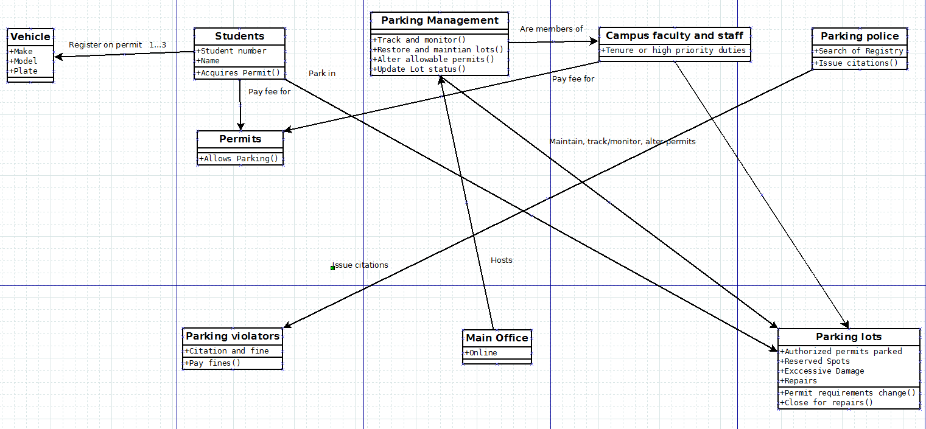
Domain Modeling: UML

Slide 5
Software Requirements Specification (SRS)
Scope: Allow the ready management and organization of lot maintenance, and issuance of parking passes and citations.
Term | Definition
User | Those who access the system
GB | Gigabyte
DMV | Department of Motor Vehicles
CPMS | Campus Parking System Management
DB | Database
Faculty/Staff | Users employed by the university
Students | Users who merely attend the university
Web portal | A website
Permit | Pass to park on campus parking lots
ID | Student or faculty identification number
Citation | Fine issued for unauthorized parking
RAM | Random Access Memory
Meter | Measure of how rigorously a feature will be tested
Must | Bare minimum success requirement of a feature
Plan | Intended goal success of a feature
Wish | Ideal success of a feature
Parking Police | Issue citations

Slide 6
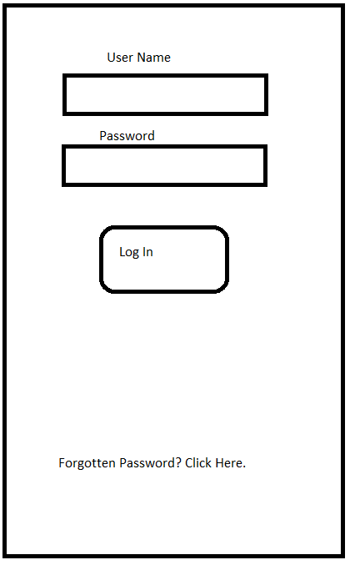
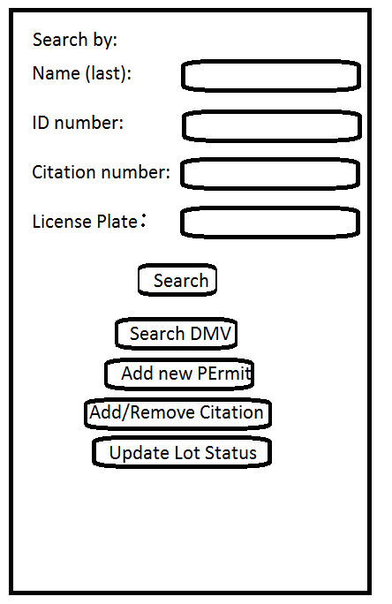
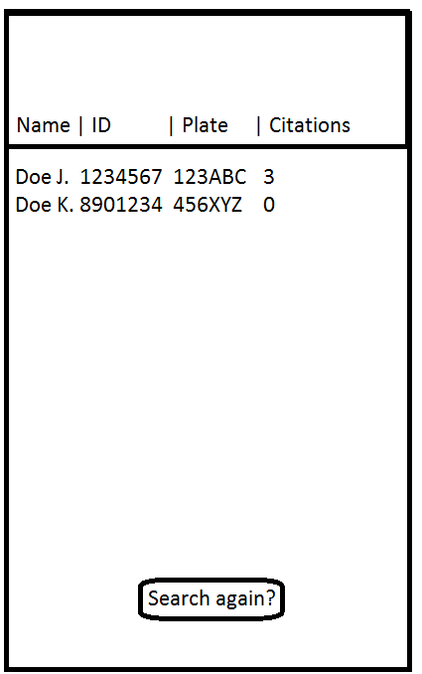
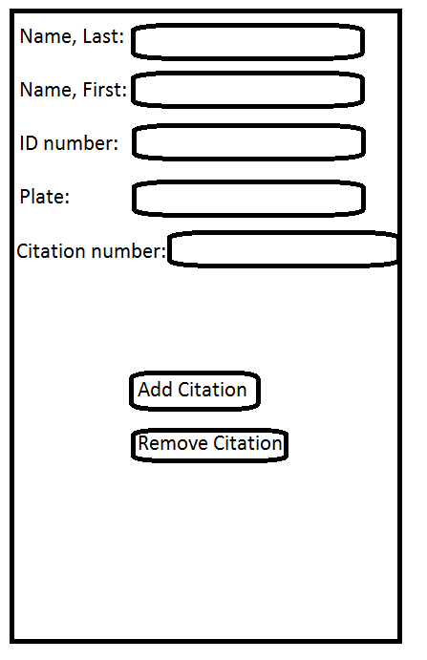
Hypothetical GUI (Barebones)

Slide 7
Use Case Samples
Use Case ID | UC1
Use Case | Issue Citations
Users | Parking Police
Summary | Parking police monitor the lots and issue parking violators citations
Rationale | To monitor lots to ensure only those with authorized permits are parked, and punish violator to create order within parking services.
Precondition | Vehicle is in parking violation
Postcondition | Vehicle has been cited
Basic Course of Events | Search registry for vehicle plate match Return student account associated with plate Issue citation to account Account tagged with citation Physical tag left to notify vehicle owner of citation
Alternative Paths | No match found in database Officer issues call for tow Tow request sent and responded to Vehicle towed
Use Case ID | UC2
Use Case Name | Pay off citation
Users | Students, staff, unauthorized users
Summary | Students and staff must be able to identify and view citation issued, online.
Rationale | This use case is necessary to view and pay citations that was issued to the account.
Preconditions | Must have citation on account User must be made aware of citation
Postcondition | Paid off citation removed from account
Basic Course of Events | User searched system for citation Citation returned User selects to pay off citation Prompts user for payment information User inputs payment information Prompts user to finalize User finalizes User charged, citation removed
Alternative paths | Payment declined User enters new payment Prompts user to finalize User finalizes User charged, citation removed

Slide 8
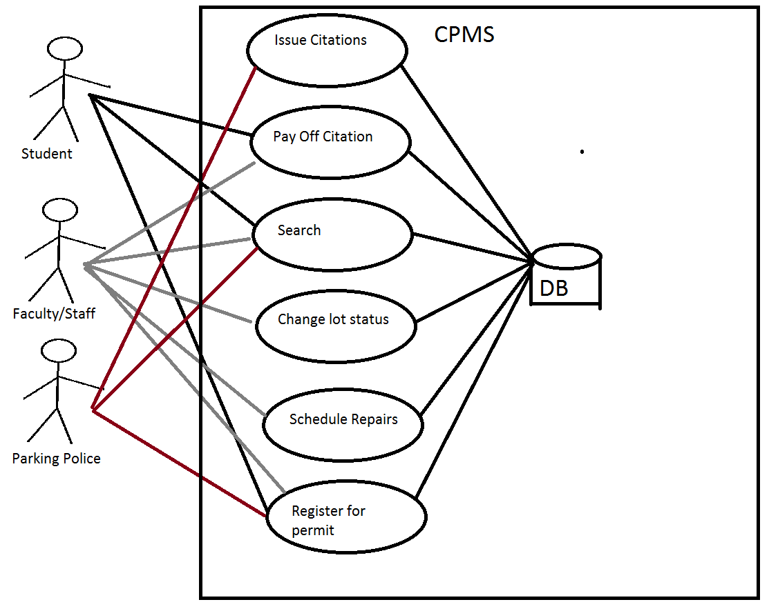
Use Case Diagram

Slide 9
Practical Demonstration
I yield the floor to DK and David.

Slide 10
Discussion
Questions?

