Slide 1

Universal Plug and Play protocol (UPnP)
Introduction, design and implementation
Thang Tran Manh
Department of Mathematics and Computer Science
Eindhoven University of Technology

Slide 2
UPnP Definition
A Connected Environment
What is Universal Plug and Play Technology
UPnP Features
UPnP Example
UPnP Position in the Internet Protocol Stack
How UPnP works
UPnP Components
UPnP Networking Media
UPnP Protocol Stack
- Addressing
- Discovery
- Description
- Control
- Eventing
- Presentation
UPnP Summary
Design Decision
Architectural Model
Device Overview
Control Point Overview
Prototype
Television Control
Coffee Machine
State Of The Art

Slide 3
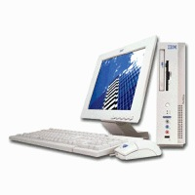
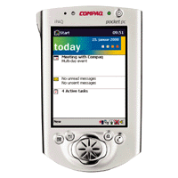
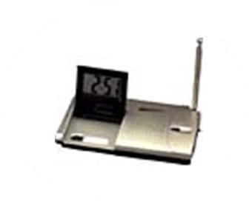
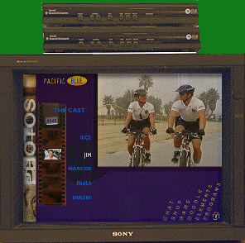
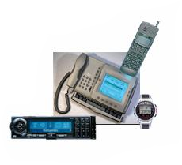
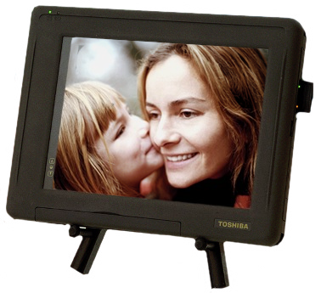
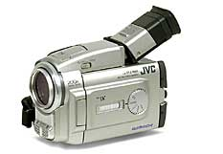
UPnP Definition
Services
A Connected Environment

Slide 4
UPnP Definition
Provide invisible home networking
Architectural framework for self-configuring,
self-describing devices
Leverages existing Internet technologies
Enables dynamic peer-to-peer networking
Key to making the connected home experiences
Affordable, mainstream reality for users
Significant opportunity for the industry
What is Universal Plug and Play Technology

Slide 5
UPnP Definition
Start simple
Build in only universal things that
everybody needs
Add as needed
Minimize requirements
Basic IP network connectivity
Common HTTP protocol stack
Leverage existing standards
HTTP, XML
UPnP Features

Slide 6

UPnP Definition
Living room
Children room
Office
UPnP Example

Slide 7
UPnP Definition
Application
Application(HTTP,SMTP)
UPnP API
Transport(TCP,UDP)
HTTP (extension)
Network(IP)
UPnP
Link(Ethernet,PPP)
Physical
UPnP Position in the Internet Protocol Stack

Slide 8
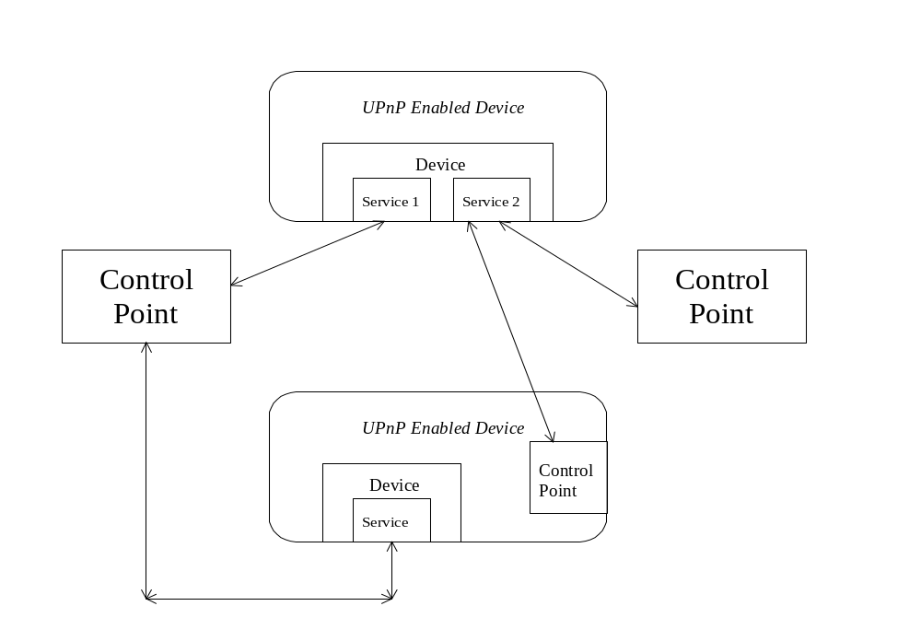
How UPnP works
UPnP Components

Slide 9
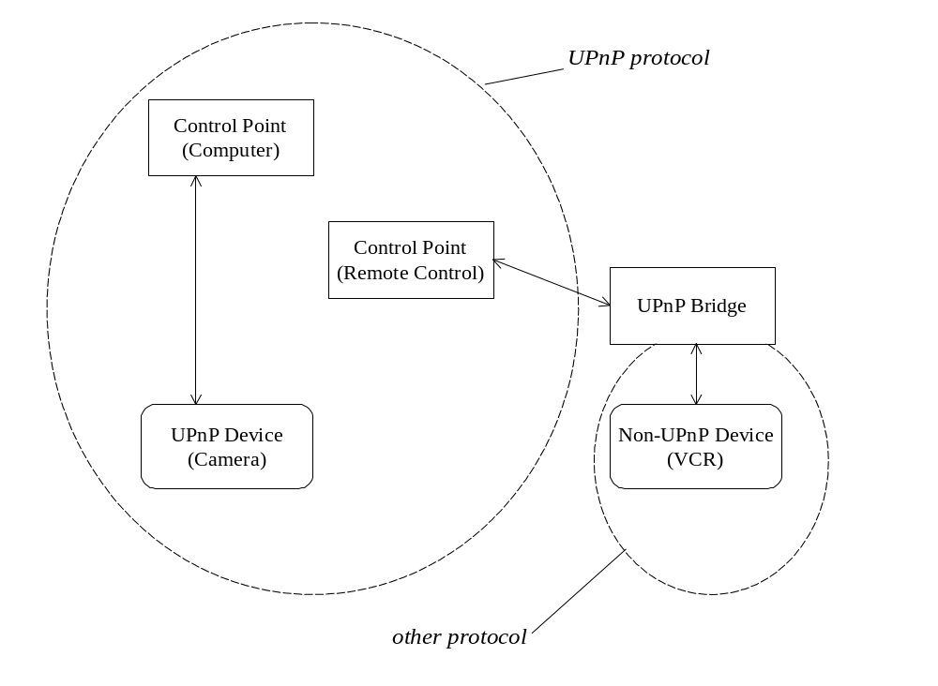
How UPnP works
UPnP Networking Media

Slide 10
How UPnP works
UPnP Vendor Defined
UPnP Forum Working Committee Defined
UPnP Device Architecture Defined
SOAP
(Control)
SSDP
GENA
SSDP
HTTP
HTTPMU
(Discovery)
HTTPU
(Discovery)
HTTP
(Description)
GENA
(Events)
UDP
TCP
IP
UPnP Protocol Stack

Slide 11
How UPnP works
3 Control
4 Eventing
5 Presentation
2 Description
1 Discovery
0 Addressing
0 Control point and device get addresses
1 Control point finds interesting device
2 Control point learns about device capabilities
3 Control point invokes actions on device
4 Control point listens to state changes of device
5 Control point controls device and/or views device status
using Web browser
Steps Involved In UPnP

Slide 12
How UPnP works
Control point and device get address
Use a DHCP server
Else use Auto IP
What is Auto IP?
IETF Draft Automatically Choosing an
IP Address in an IPv4 Network
What steps does it take?
Pick an address in 169.254/16 range
Check to see if it is use (ARP)
Periodically check for DHCP server
Addressing

Slide 13
How UPnP works
Control point
Search for interesting devices
Device
Advertise when added
Refresh advertisements
Cancel advertisements when removed
UPnP Vendor
UPnP Forum
UPnP Device Architecture
HTTPMU
HTTPU
GENA
SSDP
SSDP
UDP
Discovery: Protocol Stack

Slide 14
How UPnP works
What is SSDP?
IETF Draft Simple Service Discovery Protocol
Key design principles
Administratively-scoped multicast
Unicast responses
UDP
Very simple advertisements
Very simple search
Discovery: SSDP

Slide 15
How UPnP works
Advertise
NOTIFY * HTTP/1.1
HOST: 239.255.255.250:1900
CACHE-CONTROL: max-age = seconds until advertisement expires
LOCATION: URL for UPnP description for root device
NT: search target
NTS: ssdp:alive
USN: advertisement UUID
Search
Respond
M-SEARCH * HTTP/1.1
HOST: 239.255.255.250:1900
MAN: “ssdp:discover”
MX: seconds to delay response
ST: search target
HTTP/1.1 200 OK
CACHE-CONTROL: max-age = seconds until advertisement expires
LOCATION: URL for UPnP description for root device
ST: search target
USN: advertisement UUID
Discovery: Example

Slide 16
How UPnP works
Control point learns about:
Device capabilities
Services embedded in Device
UPnP Vendor
UPnP Forum
UPnP Device Architecture
HTTP
TCP
Description: Protocol Stack

Slide 17
How UPnP works
<?xml version="1.0"?>
<root xmlns="urn:schemas-upnp-org:device-1-0">
<specVersion>
<major>1</major>
<minor>0</minor>
</specVersion>
<URLBase>http://192.168.0.4:5431</URLBase>
<device>
<deviceType>urn:schemas-upnp-org:device:tvdevice:1</deviceType>
<friendlyName>UPnP Television Emulator</friendlyName>
<manufacturer>TV Manufacturer Name</manufacturer>
<manufacturerURL>http://www.manufacturer.com</manufacturerURL>
<modelDescription>UPnP Television Device Emulator 1.0</modelDescription>
<modelName>TVEmulator</modelName>
<modelNumber>1.0</modelNumber>
<modelURL>http://www.manufacturer.com/TVEmulator/</modelURL>
<serialNumber>123456789001</serialNumber>
<UDN>uuid:Upnp-TVEmulator-1_0-1234567890001</UDN>
<UPC>123456789</UPC>
………………..
Description: Example

Slide 18
How UPnP works
Control point invokes actions on device
based on the service descriptions
UPnP Vendor
UPnP Forum
UPnP Device Architecture
SOAP
HTTP
TCP
Control: Protocol Stack

Slide 19
How UPnP works
What is SOAP?
IETF Draft Simple Object Access Protocol
“Lightweight, XML-based protocol for exchange
of information in a decentralized, distributed
environments.”
  Envelope: define a frame work for describing
what is in a message and how to process it.
  Convention: represent remote procedure calls
  and responses.
Control: SOAP

Slide 20
How UPnP works
POST path of control URL HTTP/1.1
HOST: host of control URL:port of control URL
CONTENT-TYPE: text/xml; charset="utf-8"
SOAPACTION: "urn:schemas-upnp-org:service:serviceType:v#actionName"
<s:Envelope xmlns:s="http://schemas.xmlsoap.org/soap/envelope/"
s:encodingStyle="http://schemas.xmlsoap.org/soap/encoding/">
<s:Body>
<u:actionName xmlns:u="urn:schemas-upnp-org:service:serviceType:v">
<argumentName>in arg value</argumentName>
other in args and their values (if any) go here
</u:actionName>
</s:Body>
</s:Envelope>
Control: Control point invokes Action

Slide 21
How UPnP works
Control point listens to state changes of Device
UPnP Vendor
UPnP Forum
UPnP Device Architecture
HTTP
GENA
TCP
Eventing: Protocol Stack

Slide 22
How UPnP works
What is GENA?
IETF Draft General Event Notification Architecture
“Send and receive notifications using HTTP over
TCP/IP and administratively-scoped multicast UDP.”
- SUBSCRIBE to notifications
- UNSUBSCRIBE
- NOTIFY:
of device availability
of state variable changes
Eventing: GENA

Slide 23
How UPnP works
Subscribing
SUBSCRIBE publisher path HTTP/1.1
HOST: publisher host:publisher port
CALLBACK: <delivery URL>
NT: upnp:event
TIMEOUT: Second-requested subscription duration
Notify
NOTIFY delivery path HTTP/1.1
HOST: delivery host:delivery port
CONTENT-TYPE: text/xml
NT: upnp:event
NTS: upnp:propchange
SID: uuid:subscription-UUID
SEQ: event key
<e:propertyset xmlns:e="urn:schemas-upnp-org:event-1-0">
<e:property>
<variableName>new value</variableName>
</e:property>
Other variable names and values (if any) go here
</e:propertyset>
Eventing: Example

Slide 24
How UPnP works
Control point controls device and/or views
device status using Web browser
UPnP Vendor
UPnP Forum
UPnP Device Architecture
HTTP
TCP
Presentation: Protocol Stack

Slide 25
UPnP Summary
UPnP says
  Just send data
  Keep implementation private
  Agree on content/format of data
UPnP is
  Web-based protocols
  Tailored by a Forum for device (service) types
  That are API, OS, physical network neutral
  For discovery, description, control, eventing
and presentation
For more information
http://www.upnp.org

Slide 26
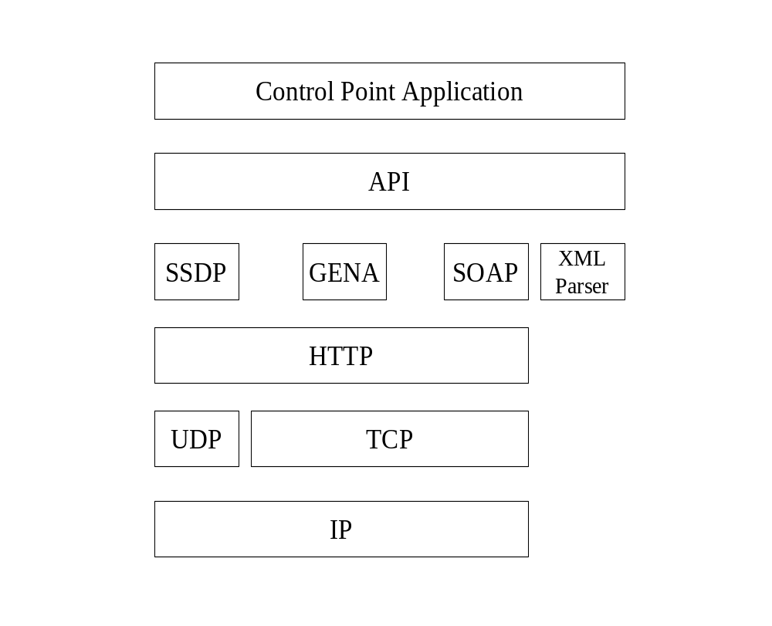
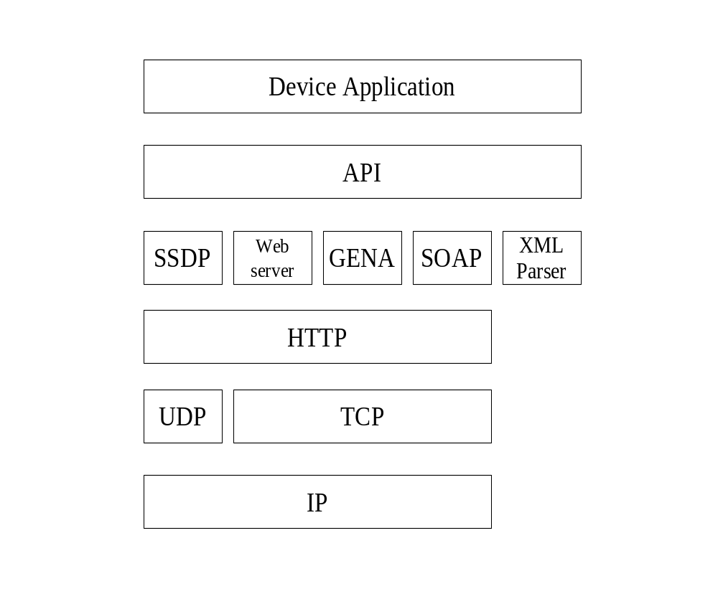
Design Decision
Architectural Model

Slide 27
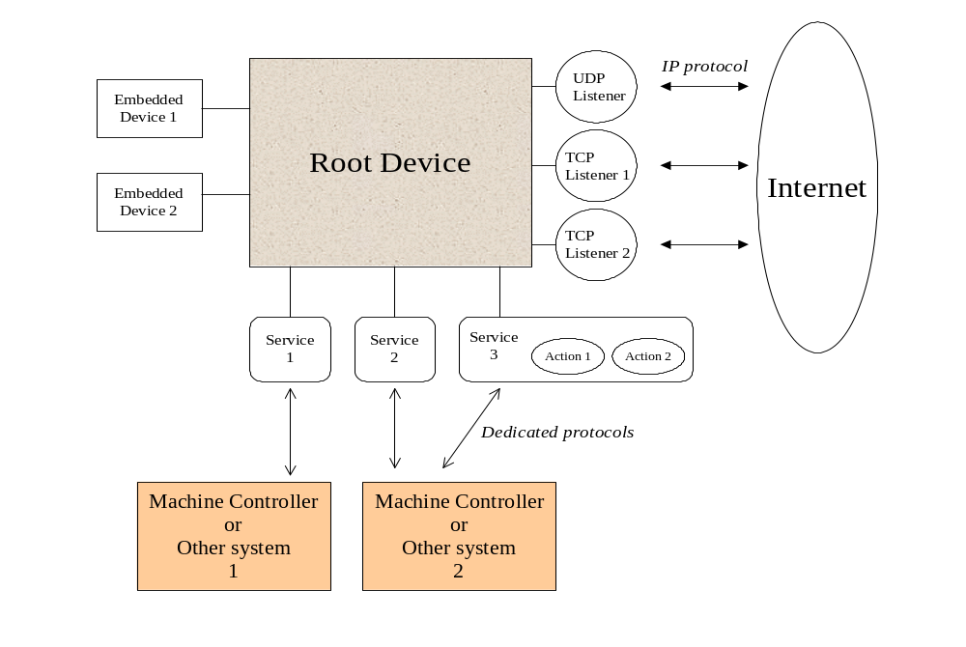
Design Decision
Device Overview

Slide 28
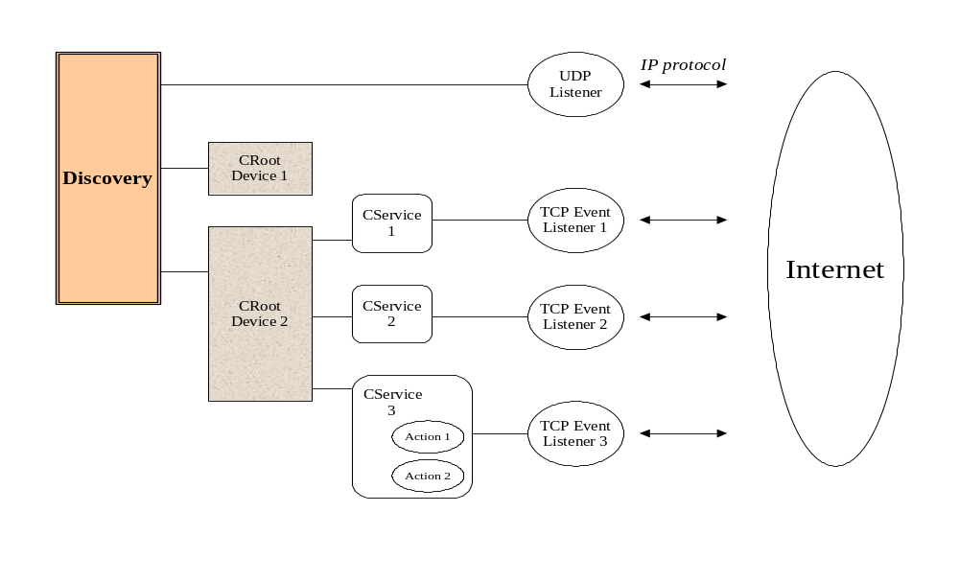
Design Decision
Control Point Overview

Slide 29
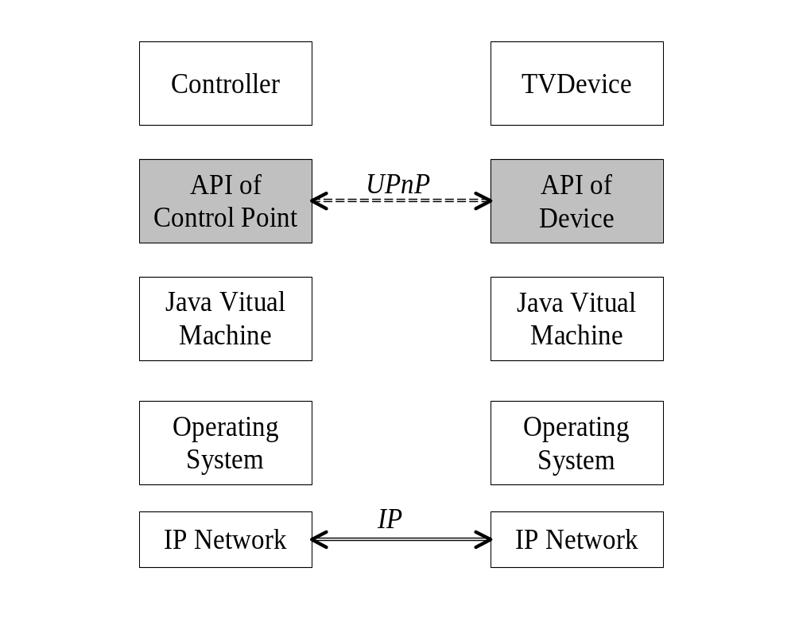
Prototype
Television Control: API

Slide 30
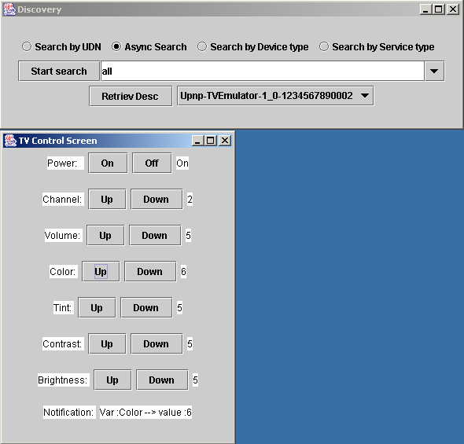
Prototype
Television Control: GUI

Slide 31
Prototype
Coffee Server PC
Coffee maker
UPnP
Bridge
Device
Server
Actuators
HTTP
Sensors
DMCP
HTTP
Server
UPnP
Coffee
Controller
Coffee Machine

Slide 32
State Of The Art
UPnP API has been constructed
Characteristics of embedded systems, home networking
environment have been taken into account
Two prototypes has been built
Further research on UPnP, other protocols (Jini, Havi,…)
in “Middle Ware”
Draw back from UPnP:
  - Number of devices is limited
  - Eventing requires TCP -> limit the number of Control points
  - Searching for devices is less structure
  “Context-based XML” requires more memory for parser,
  in compare with “method-driven” protocols – Jini
  - Question for “extensibility” , “security”

