Slide 1
Data Literacy – Project Status Is street traffic in the UK more dangerous than in Germany?

Slide 2
Datasets
Germany
Accidents: Unfallatlas Deutschland
Regions: Germany, Munich, Hamburg, Berlin
Population: Germany, Munich, Hamburg, Berlin
Traffic volume: Bundesanstalt für Straßen- und Verhekrswesen
UK
Accidents: GOV UK
Regions: Office for National Statistics
Population: Office for National Statistics
Traffic volume:

Slide 3
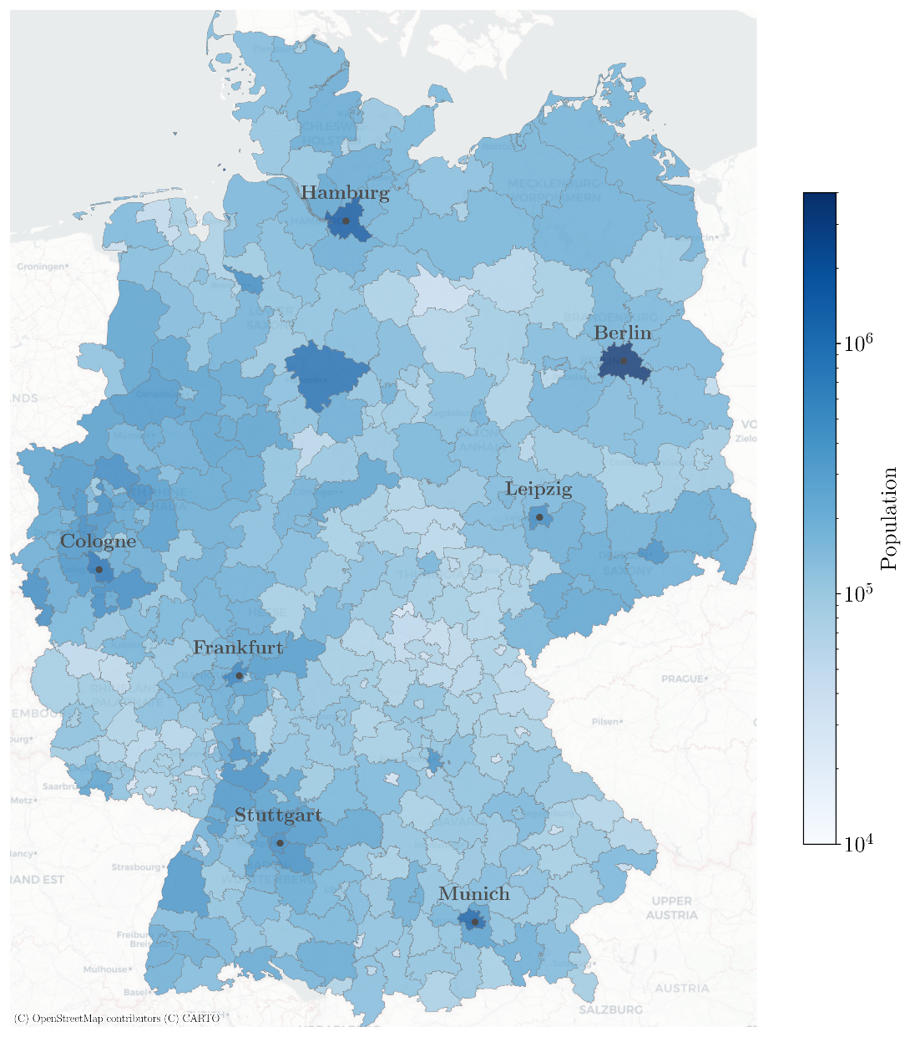

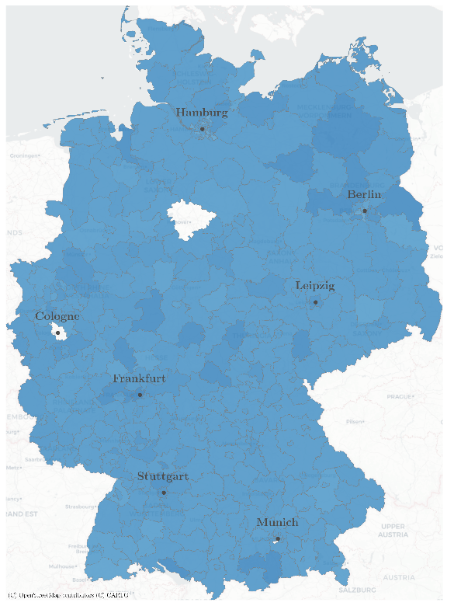
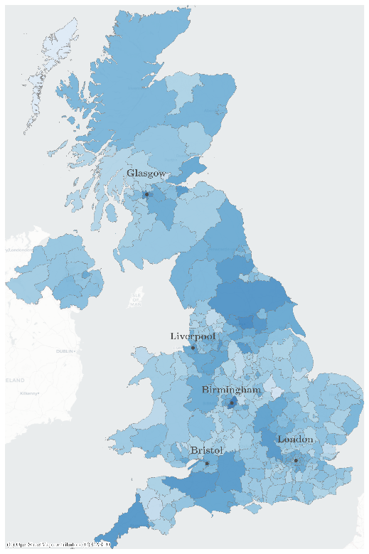
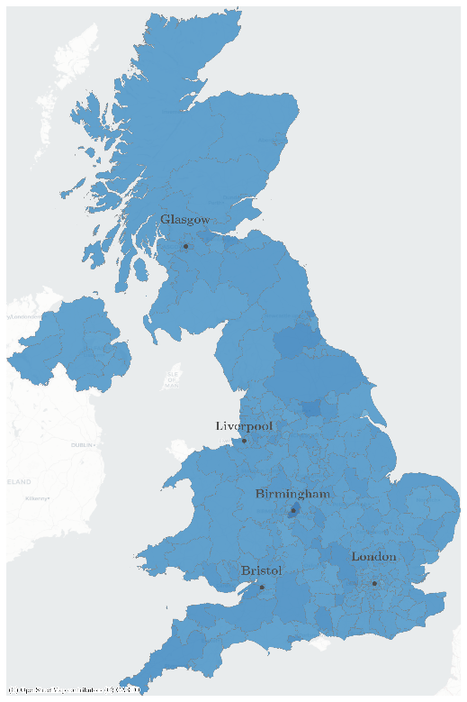
Normalization
a) Germany regional population
a) Germany merged-regional population
a) UK regional population
a) UK merged-regional population

Slide 4
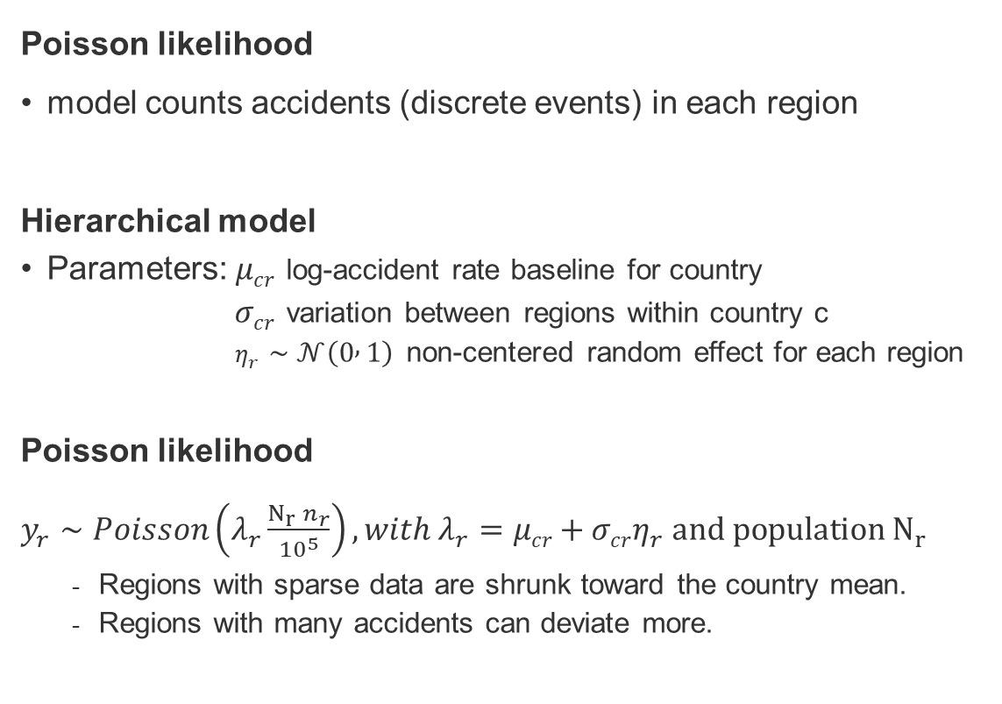
Expected accident rates per region
Poisson likelihood
model counts accidents (discrete events) in each region
Hierarchical model
Parameters: $μcr$ log-accident rate baseline for country
$σcr$ variation between regions within country c
$η_{r}∼𝒩\left(0 , 1\right)$ non-centered random effect for each region
Poisson likelihood
$y_{r}∼Poisson\left(λ_{r}\frac{N_{r} n_{r}}{{10}^{5}}\right),with λ_{r}=μcr+σcrη_{r} and population N_{r}$
Regions with sparse data are shrunk toward the country mean.
Regions with many accidents can deviate more.

Slide 5
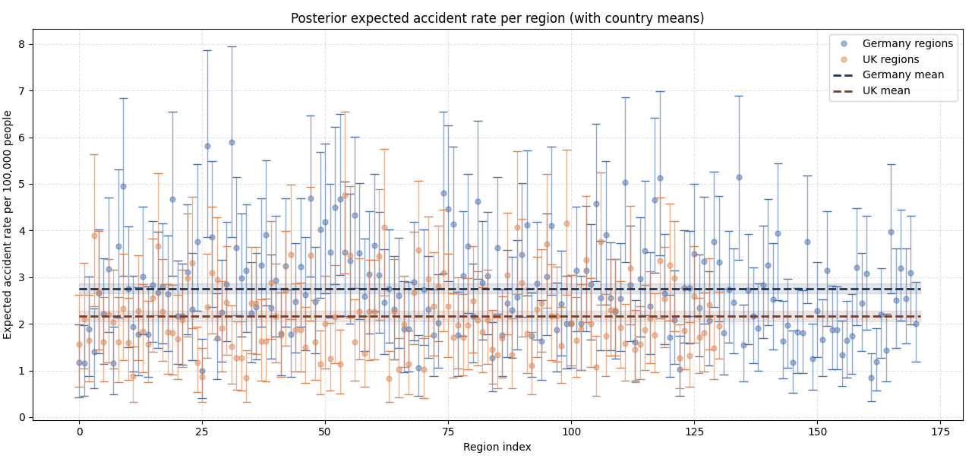
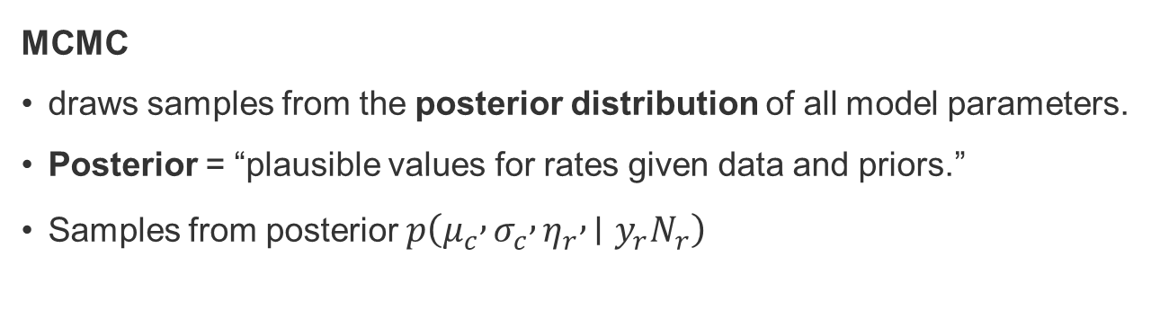
Expected accident rates per region
MCMC
draws samples from the posterior distribution of all model parameters.
Posterior = “plausible values for rates given data and priors.”
Samples from posterior $p\left(μ_{c} , σ_{c} , η_{r} , ∣y_{r}N_{r}\right)$

Slide 6
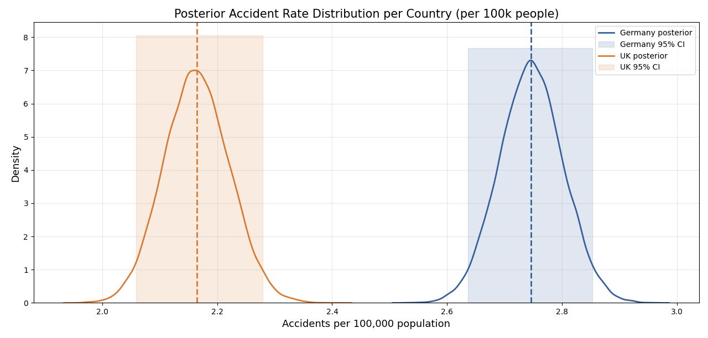
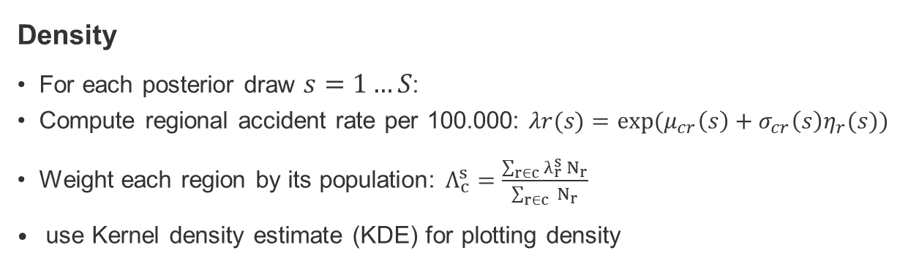
Expected accident rates per country
Density
For each posterior draw $s=1…S$:
Compute regional accident rate per 100.000: $λr(s)​=exp⁡(μ_{cr}\left(s\right)​+σ_{cr}\left(s\right)​η_{r}(s)​)$
Weight each region by its population: $Λ_{c}^{s}=\frac{\sum_{r∈c}{λ_{r}^{s} N_{r}}}{\sum_{r∈c}{ N_{r}}}$
$​​$ use Kernel density estimate (KDE) for plotting density

Slide 7
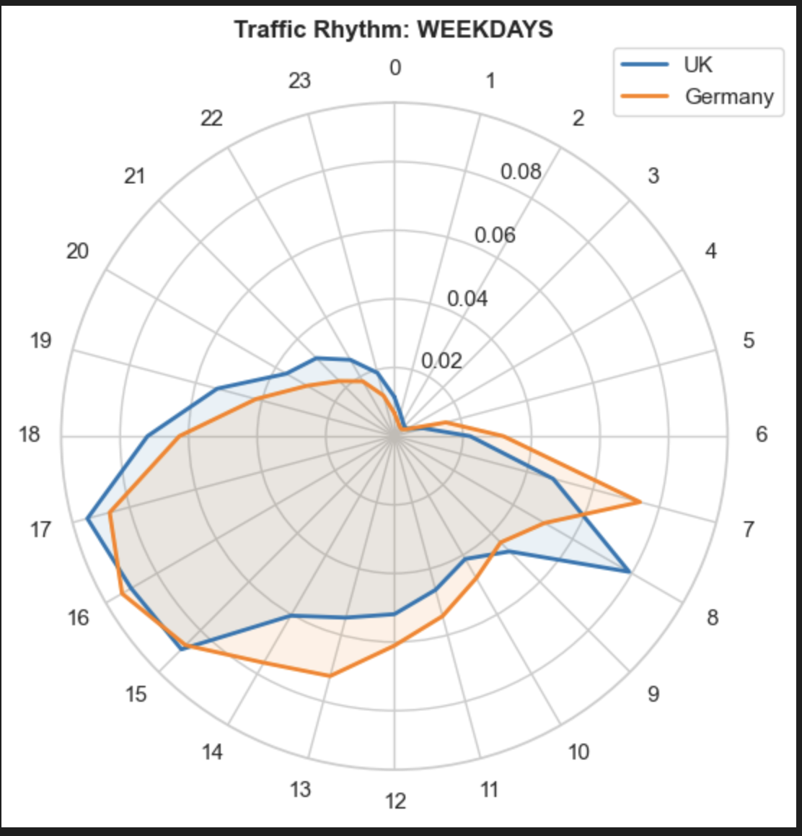
When do the most accidents happen?
Shows percentage of all accidents happening on a specific time.
One plot for only weekdays. It can be extended to months, or weekend days…
Idea: Find specific motorbike time slots and compare the output after erasing some motorbike peaks

Slide 8
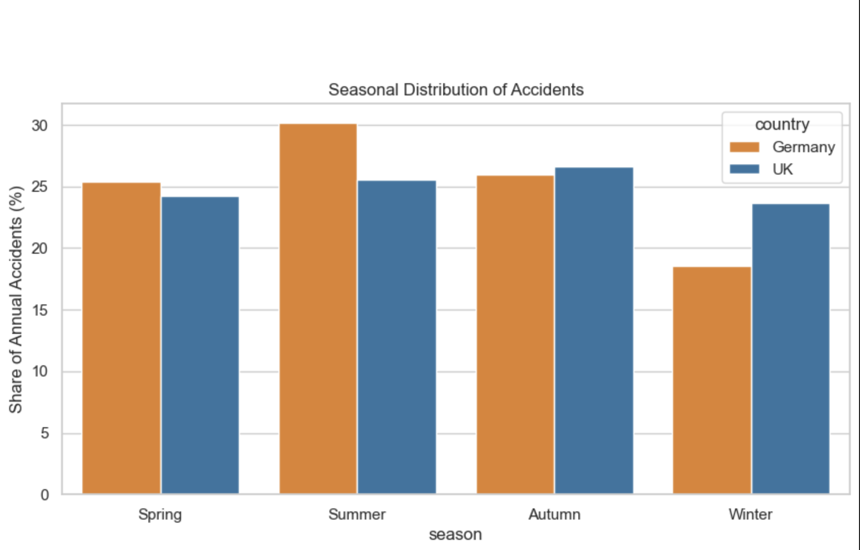
Season distribution of accidents
During which season happen the most accidents.
Idea: Find motorbike season and try to erase accidents and compare germany with uk

Slide 9
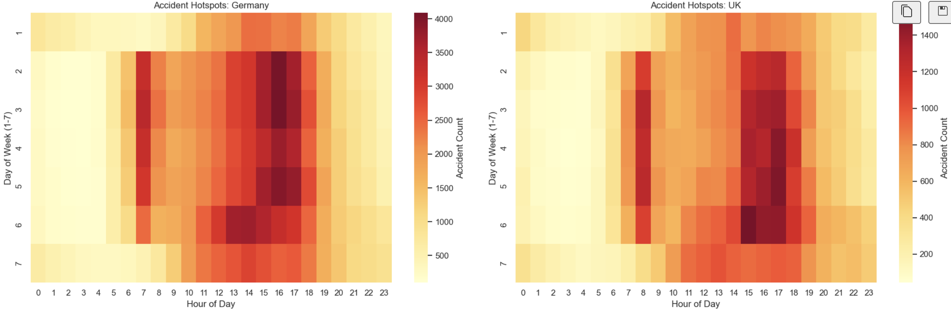
Absolute accident count per weekday and hour

