Slide 1


Hostel management
Prepared By:
Kachhiya Patel Dhaval Dilipbhai (Roll Number: 2983 )
Patel Hemang Alpesh (Roll Number: 2973)

Slide 2
CURRENT SYstem:
In our college they didn’t have a web site for the our hostel so we make a dynamic website for our hostel so we call this project as a “hostel management project”.
Our defination of project is : hostel management.

Slide 3
OUR SYSTEM FEATURE
Students firstly need to register to get rooms.
Hostel Admin can maintain the rooms through the system.
Bill will be automatically calculated
We Provide E-LIBARY.

Slide 4
Software Requirement specification
1. Client(Minimum) Software Requirement:
Just Need Only Standard Browser Like Google Chrome,Microsoft Edge,Etc..
2. Admin(Minimum) Software Requirement:
Operating System : Windows,Linux,Mac,etc..
Browser : Google Chrome,Microsoft Edge,etc..
Web Server : Apache,Xammp,Wammp,etc..
Database : Mysql.

Slide 5
hardware requirement
1. Client(Minimum) Hardware Requirement :
Minimum Processor : Intel Pentium IV Processor.
Minimum Ram : 512 mb RAM.
Minimum Rom : 512 mb ROM.
Minimum Resolution Of Screen : 480 pixel.
2. Admin(Minimum) Hardware Requirement :
Processor : Intel Duo core(Minimum)
RAM : 2 GB.
ROM ; 5 GB.

Slide 6
project develop under this languages.
HTML
CSS
BOOTSTRAP
JAVA SCRIPT
PHP
SQL
JQuery

Slide 7
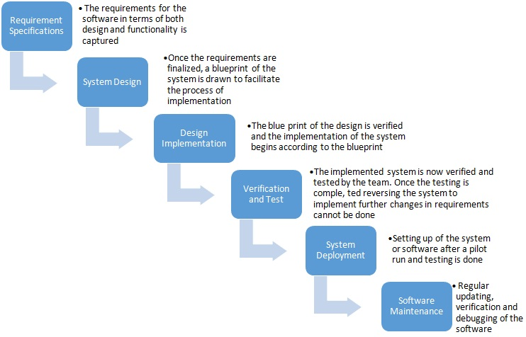
PROCESS MODEL FOR THIS PROJECT
WATERFALL MODEL

Slide 8
why we use waterfall model ?
The Waterfall Model was first Process Model to be introduced. It is also referred to as a linear-sequential life cycle model. It is very simple to understand and use. In a waterfall model, each phase must be completed fully before the next phase can begin. This type of software development model is basically used for the project which is small and there are no uncertain requirements.
We are choosing waterfall model, because in our system requirement are clear .In this model our project divided into small parts that’s why erroe would also be less.And our project requirement are stable so it is perfectly suitable for us.

Slide 9
modules:
USER
ADMIN

Slide 10
user
.
A student has to get room by Register/Login.
Then Student can Apply for Room.
Then Registration form will appear if there left a vacancy
Then the system will pending for a while as the notification is sent to the admin
Then one will receive a message of conformation or rejection.
A Conformation/Rejection Saw on Their View Room Details Section.

Slide 11
admin
.
The admin checks and accepts the requested form then give their data along with the notification back to the user side
Student’s details are recorded in the database.
Admin can also handle the roomS & data and history.

Slide 12
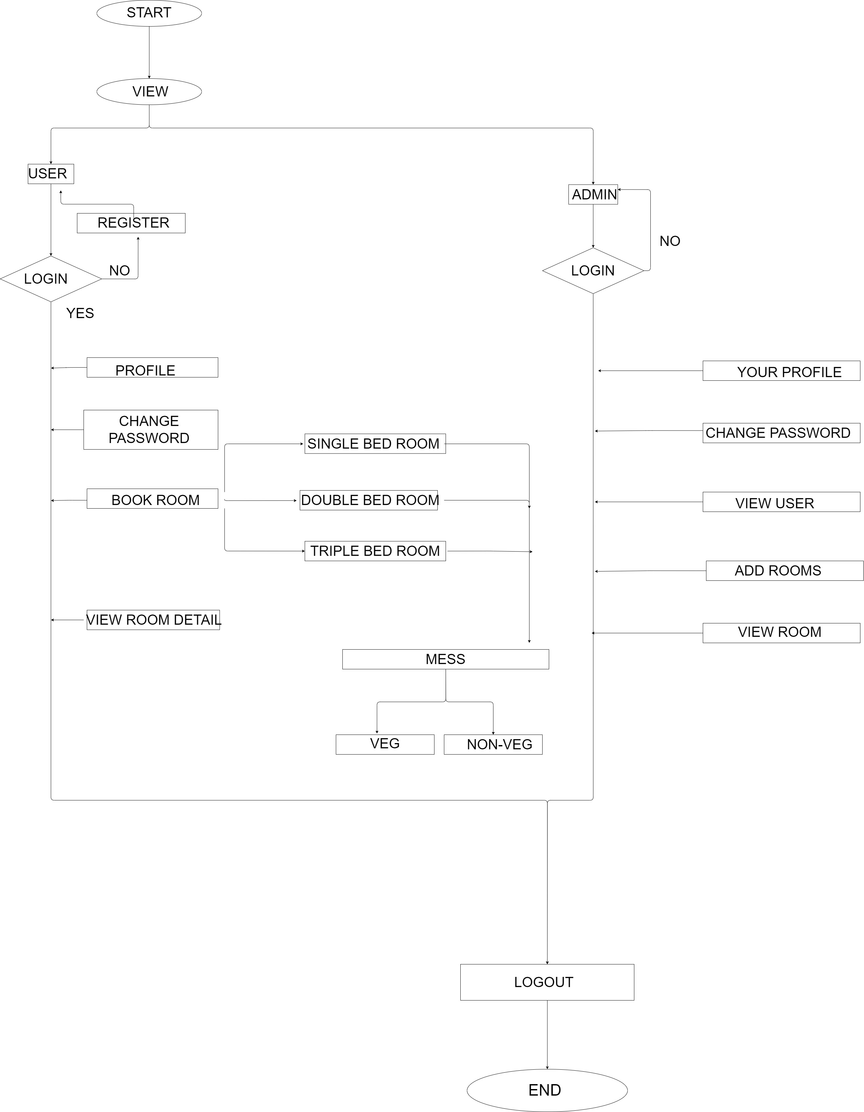
SFD
SYSTEM FLOW DIAGRAM

Slide 13
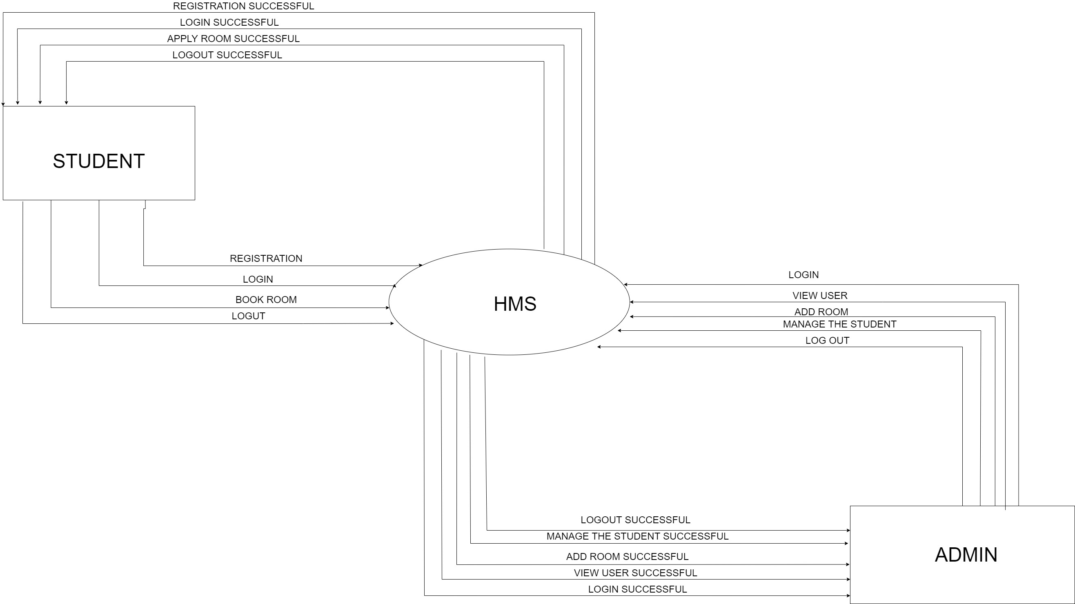
DFD
DATA FLOW DIAGRAM

Slide 14
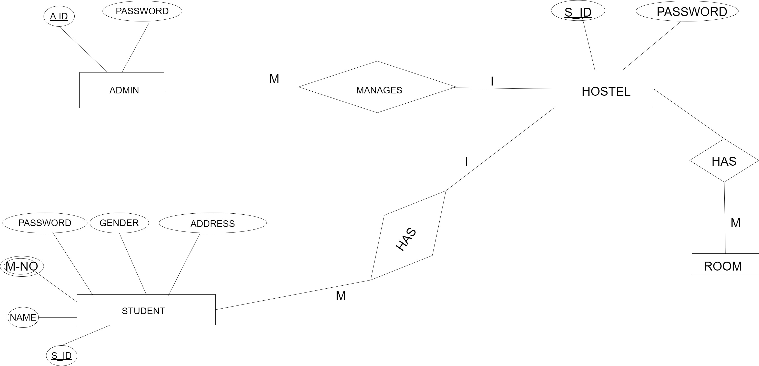
ER DIAGRAM
ENTITY-RELATIONSHIP DIAGRAM

Slide 15
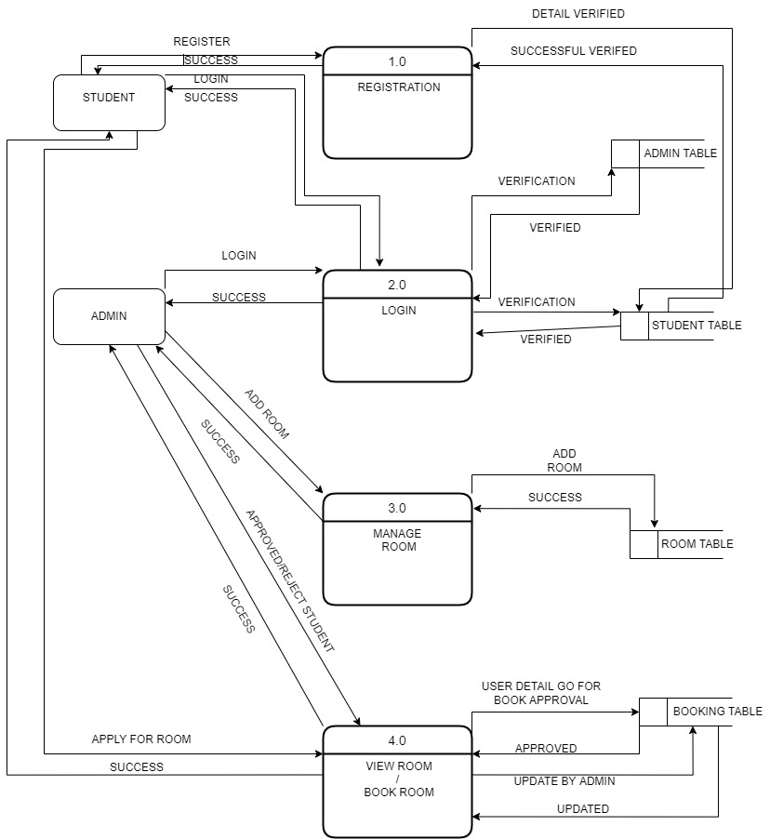
DFD LEVEL 1
DATA FLOW DIAGRAM LEVEL 1

Slide 16
DATA DICTIONARY

Slide 17
ADMIN TABLE
FIELD | DATA TYPE | CONSTRAINT | SIZE | DESCRIPTION | EXAMPLE
EMAIL ID | VARCHAR | PRIMARY | 50 | EMAIL ID | ADMIN@GMAIL.COM
NAME | VARCHAR | NOT NULL | 50 | ADMIN NAME | HEMANG
PASSWORD | VARCHAR | NOT NULL | 50 | ADMIN PASSWORD | A1234
MOBILE | VARCHAR | NOT NUL | 12 | ADMIN MOBILE NO | +91990223568

Slide 18
STUDENT TABLE
FIELD | DATA TYPE | CONSTRAINT | SIZE | DESCRIPTION | EXAMPLE
NAME | VARCHAR | NOT NULL | 100 | NAME OF USER | DHAVAL
MOBILE NO | VARCHAR | NOT NULL | 12 | MOBILE NO | +918563321470
EMAIL | VARCHAR | PRIMARY | 30 | EMAIL | D@GMAIL.COM
PASSWORD | VARCHAR | NOT NULL | 30 | PASSWORD | D12345
GENDER | VARCHAR | NOT NULL | 10 | GENDER | MALE
ADDRESS | VARCHAR | NOT NULL | 500 | ADDRESS | DHOLKA, AHMEDABAD, GUJARAT

Slide 19
BOOKING TABLE
FIELD | DATA TYPE | CONSTRAINT | SIZE | DESCRIPTION | EXAMPLE
BOOKING ID | INT | PRIMARY | 11 | BOOKING ID | 11
BLOCK | VARCHAR | NOT NULL | 10 | BLOCK NAME | A,B,C
ROOM_TYPE | VARCHAR | NOT NULL | 30 | ROOM TYPE | SINGLE,DOUBLE,
BOOKING_FROM | VARCHAR | NOT NULL | 20 | BOOKING FROM | 13-02-2022
ROOM CHARGE | INT | NOT NULL | 10 | ROOM CHARGE | 5000
ROOM NO | VARCHAR | NOT NULL | 10 | ROOM NO | 101
STUDENT NAME | VARCHAR | NOT NULL | 100 | NAME | DHAVAL
MOBILE | VARCHAR | NOT NULL | 12 | MOBILE NO | 918905612345
EMAIL | VARCHAR | NOT NULL | 30 | EMAIL | D@GMAIL.COM
STATUS | VARCHAR | NOT NULL | 30 | STATUS OF ROOM | PENDING,APPROV,REJECT
BOOKING DATE | TIMESTAMP | NOT NULL | 8 | BOOKING DATE | 14-05-2022
FOOD TYPE | VARCHAR | NOT NULL | 25 | TYPE OF FOOD | VEG,NON-VEG
MESS CHARGE | INT | NOT NULL | 255 | CHARGE OF MESS | 3000

Slide 20
ROOM TABLE
FIELD | DATA TYPE | CONSTRAINT | SIZE | DESCRIPTION | EXAMPLE
ID | INT | PRIMARY | 11 | ROOM ID | 12
TYPE | VARCHAR | NOT NULL | 30 | ROOM TYPE | SINGLE,DOUBLE,
BLOCK | VARCHAR | NOT NULL | 20 | BLOCK OF ROOM | A,B,C,D
ROOM_NO | VARCHAR | NOT NULL | 10 | NO OF ROOM | 101
CHARGE | INT | NOT NULL | 10 | CHARGE OF ROOM | 5000
ROOM_FOR | VARCHAR | NOT NULL | 10 | ROOM FOR | MALE
TOTAL_BED | VARCHAR | NOT NULL | 10 | TOTAL BED | 3
AVAILABLE_BED | VARCHAR | NOT NULL | 10 | LEFT BED | 2

Slide 21
wire framework

Slide 22
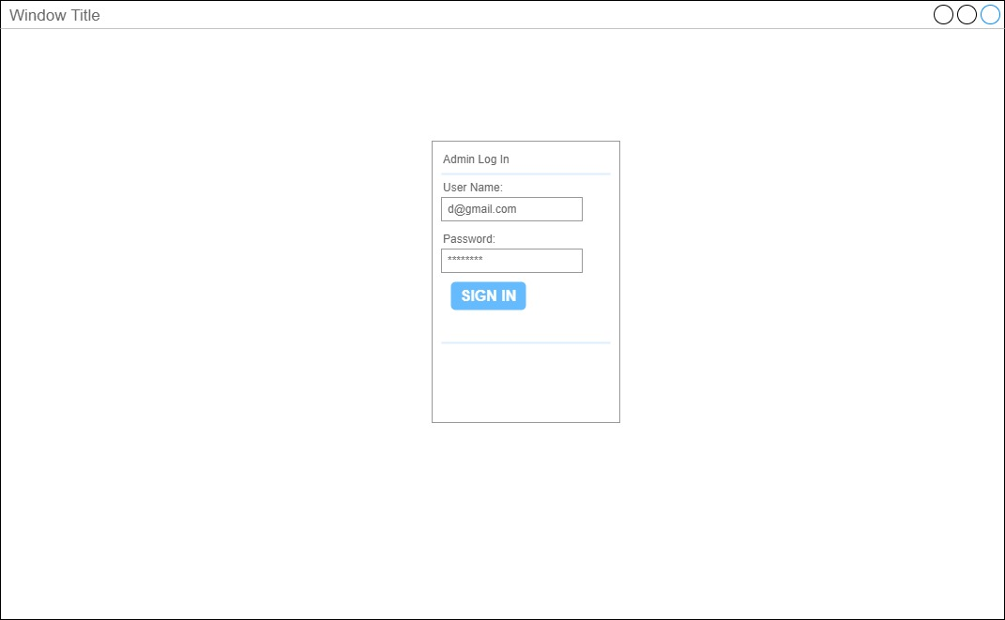
admin login
.

Slide 23
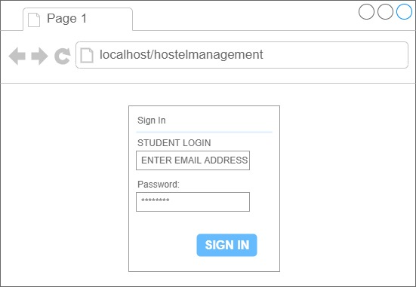
user login
.

Slide 24
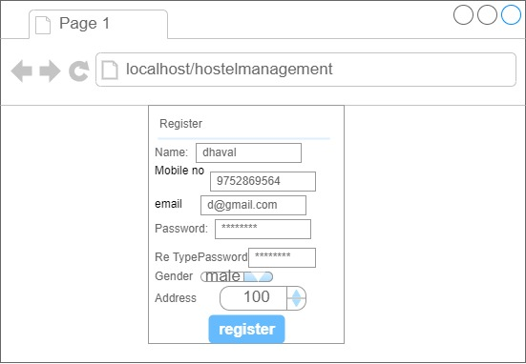
user register
.

Slide 25
Front-end Design

Slide 26
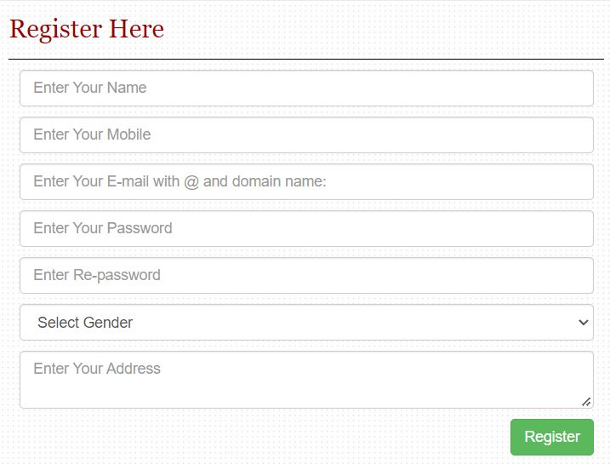
register form
.

Slide 27
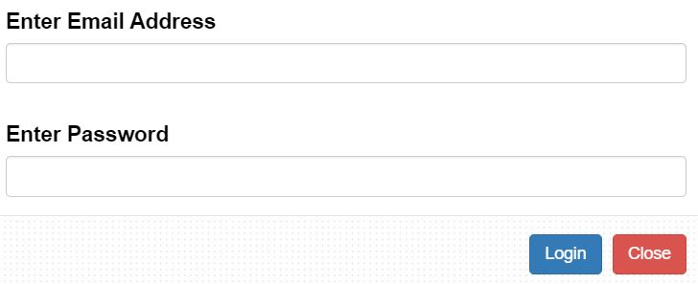
user/admin login
.

Slide 28
Screen Shorts of project:

Slide 29
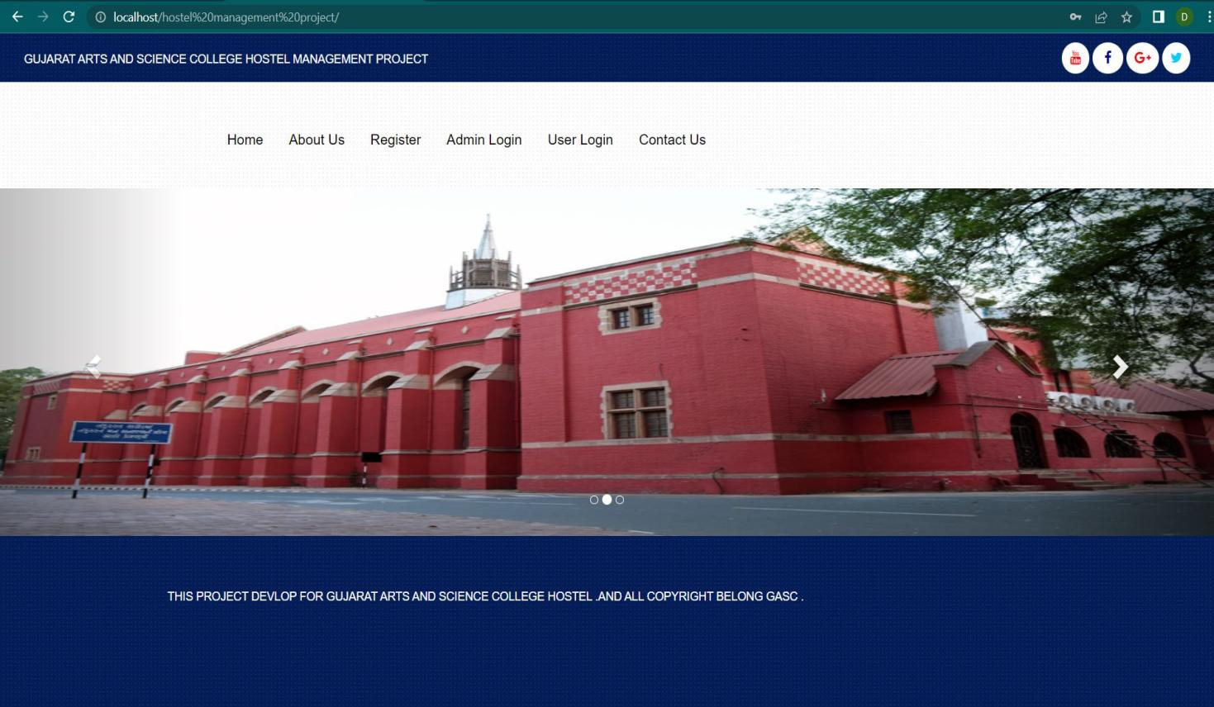
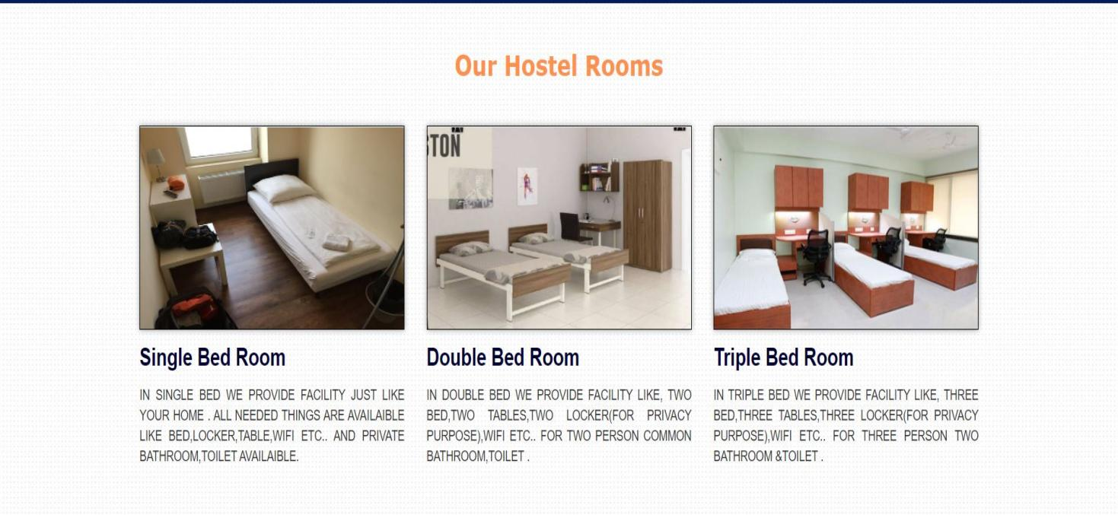

Slide 30
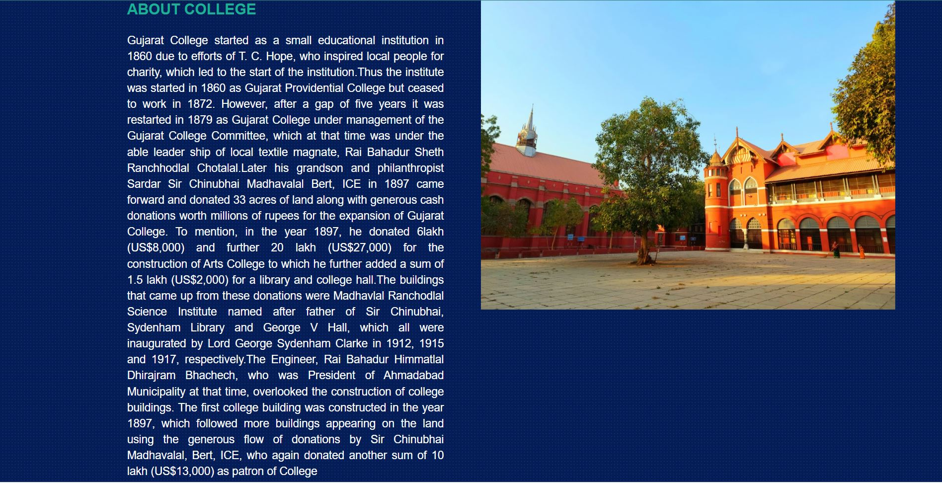
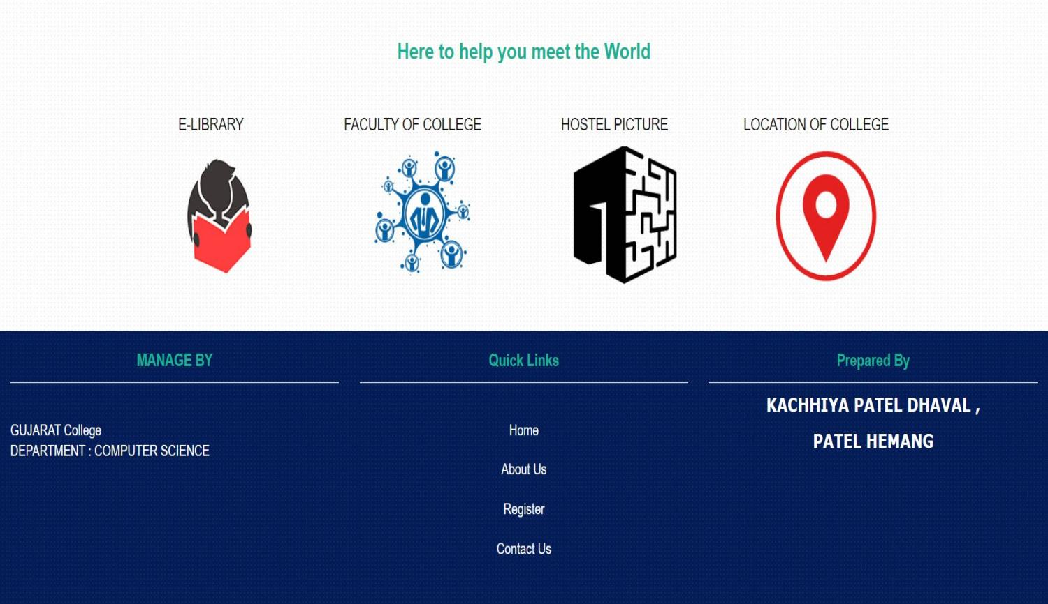

Slide 31
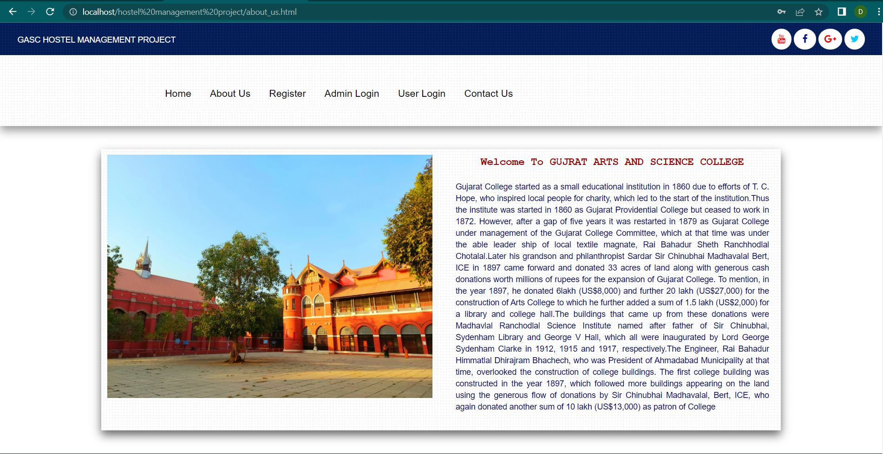
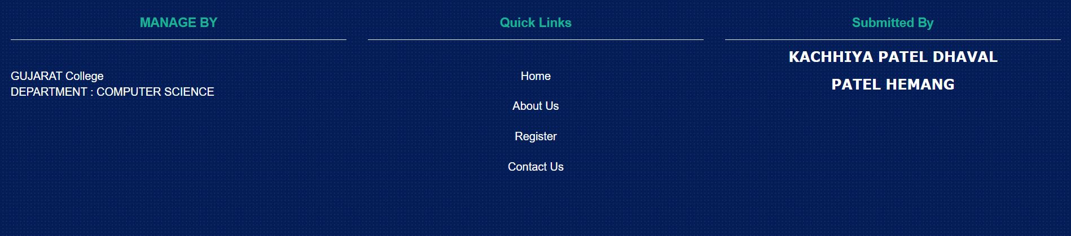
About us page:

Slide 32
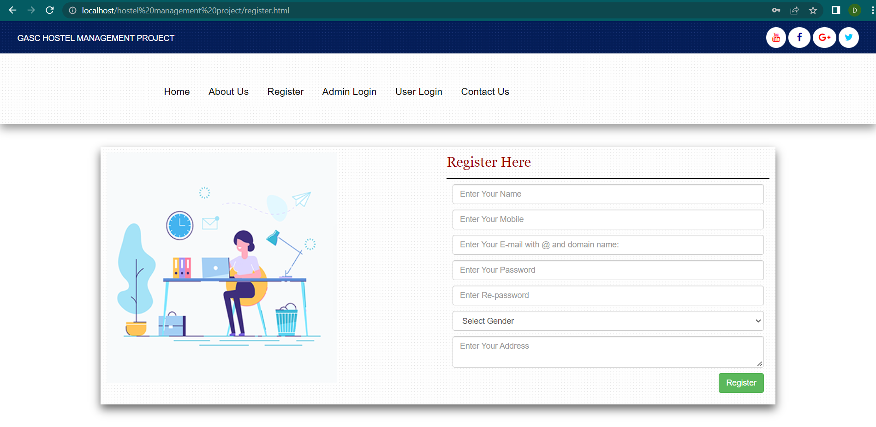
Register Page:

Slide 33
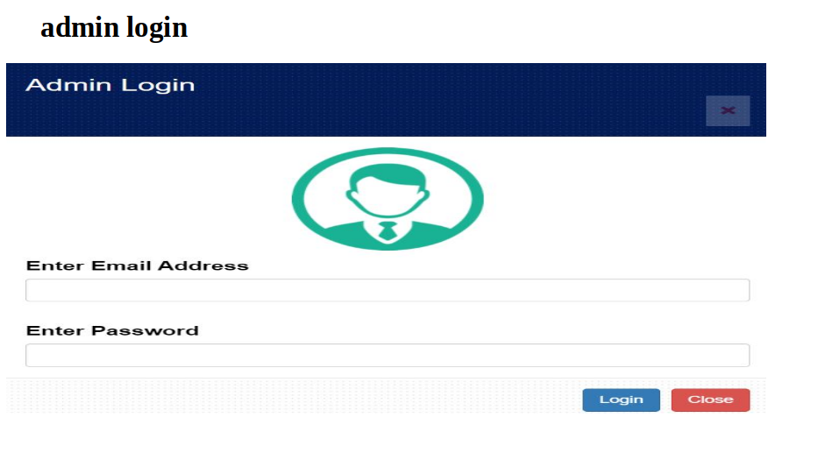

Slide 34
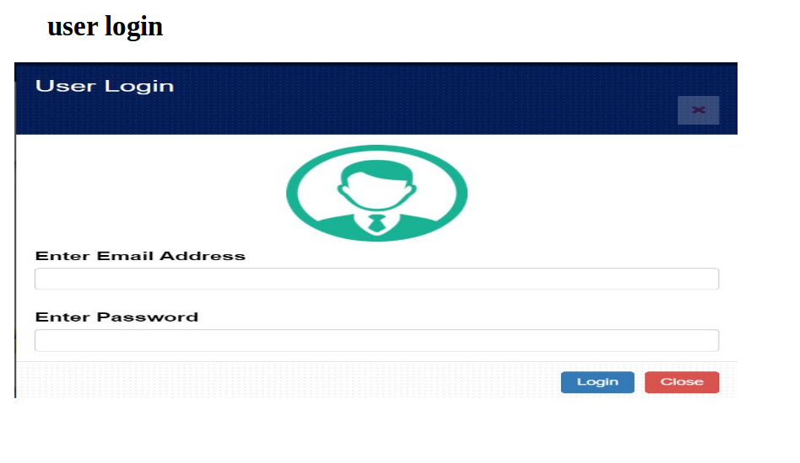

Slide 35
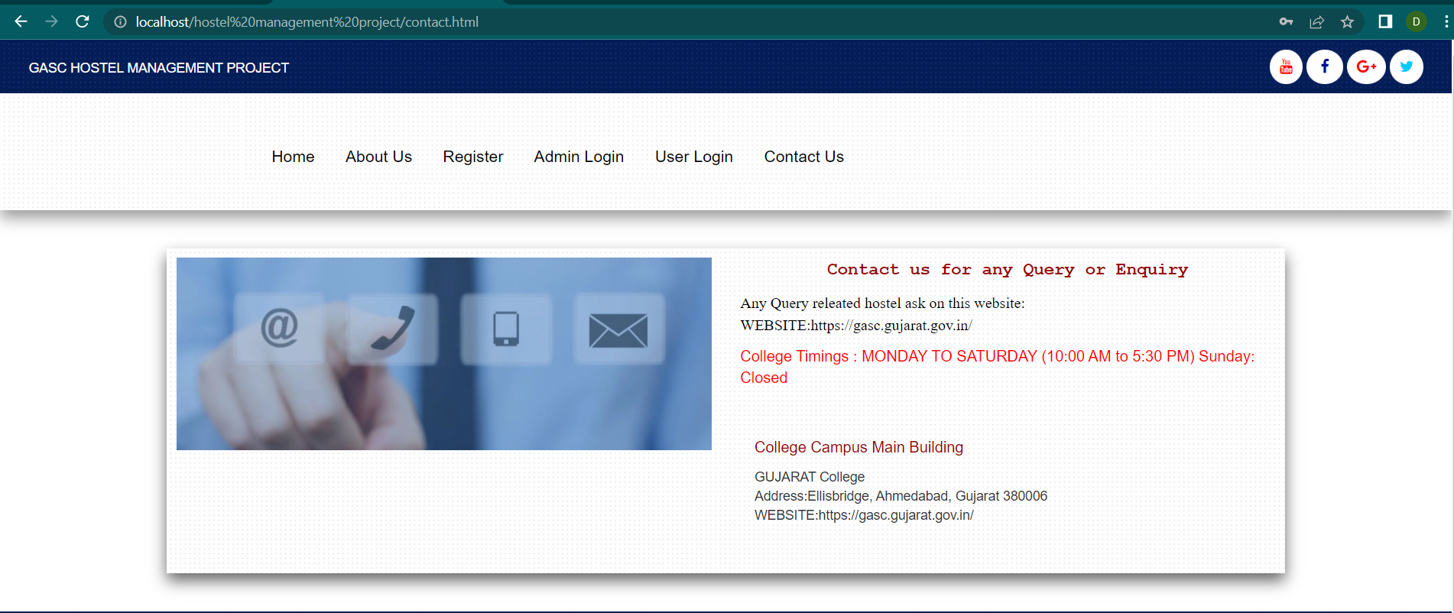
Contact Page:

Slide 36
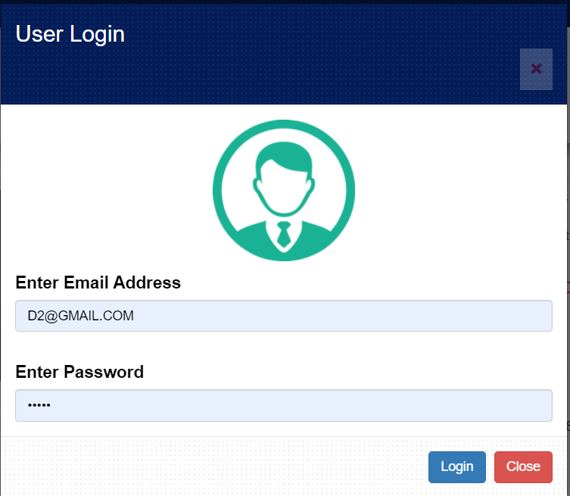
User Login Module:

Slide 37
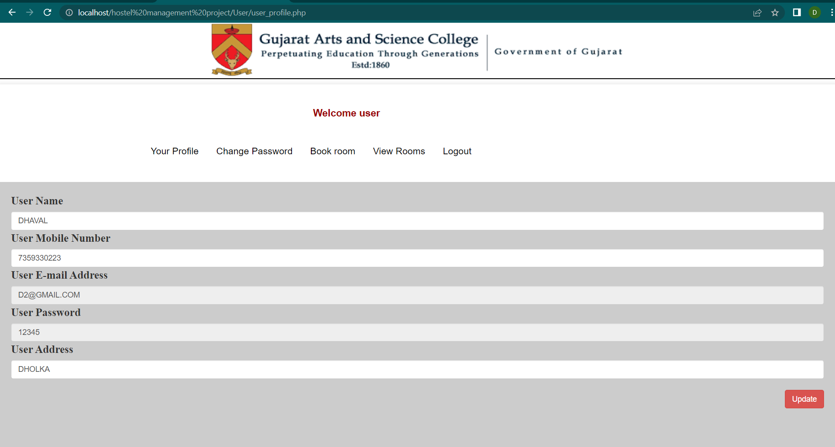
User Profile Page:

Slide 38
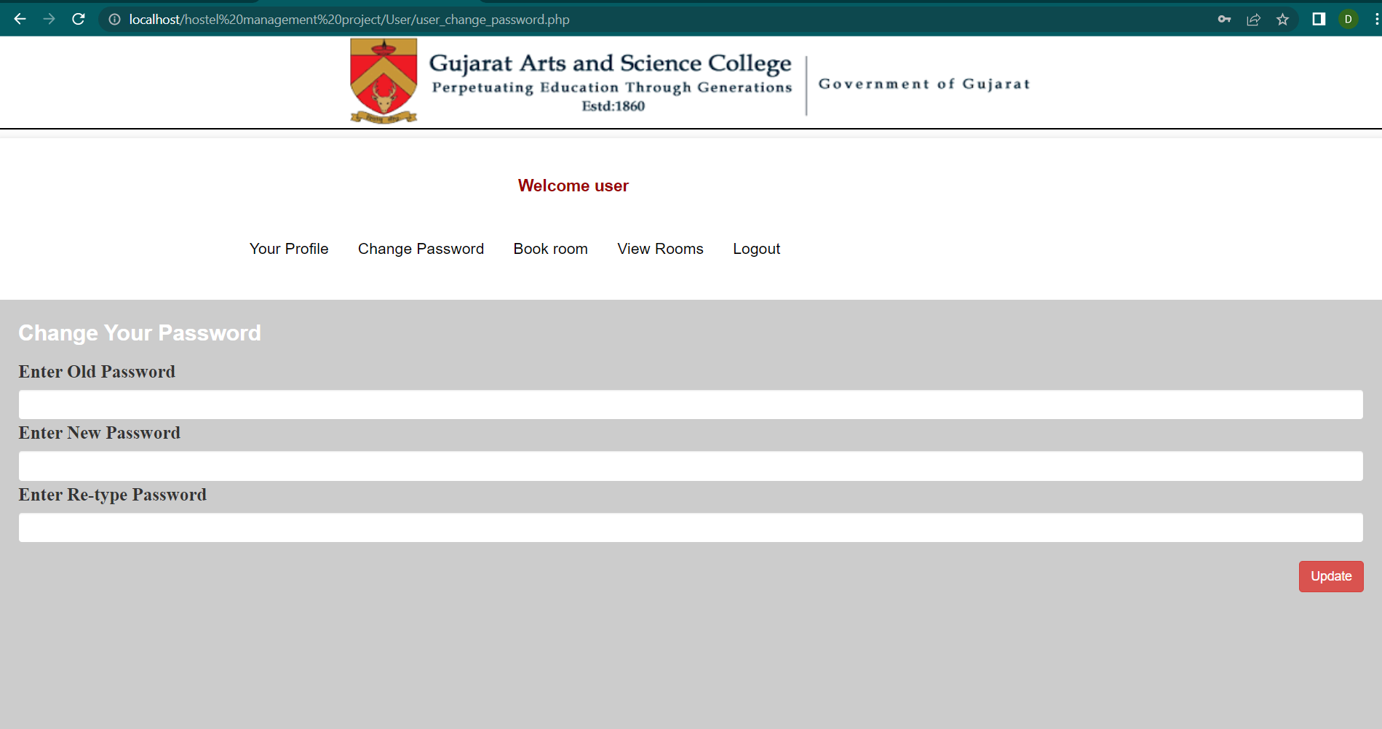
User Change Password Page:

Slide 39
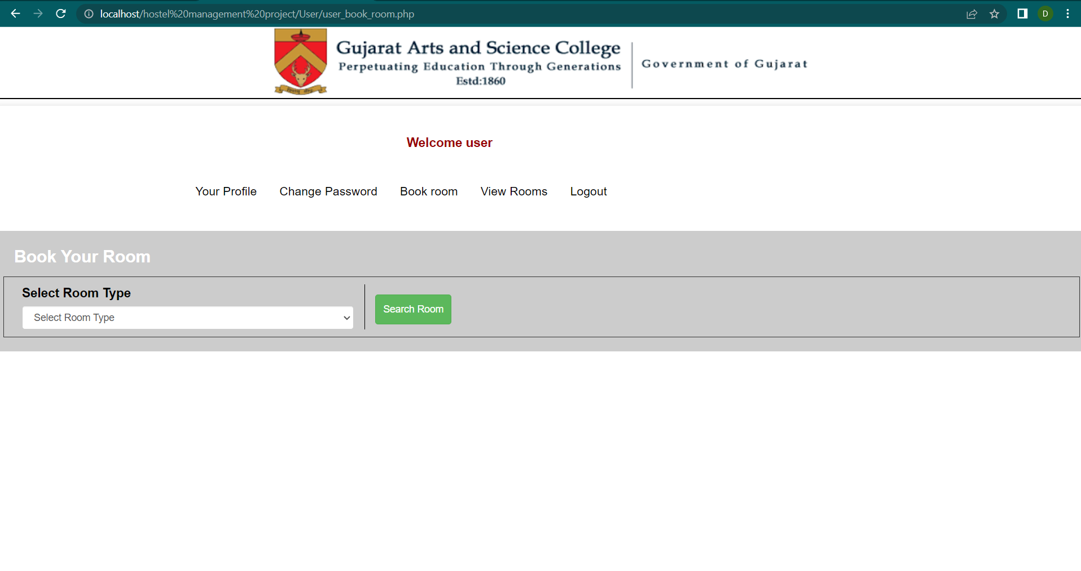
User BookRoom page

Slide 40
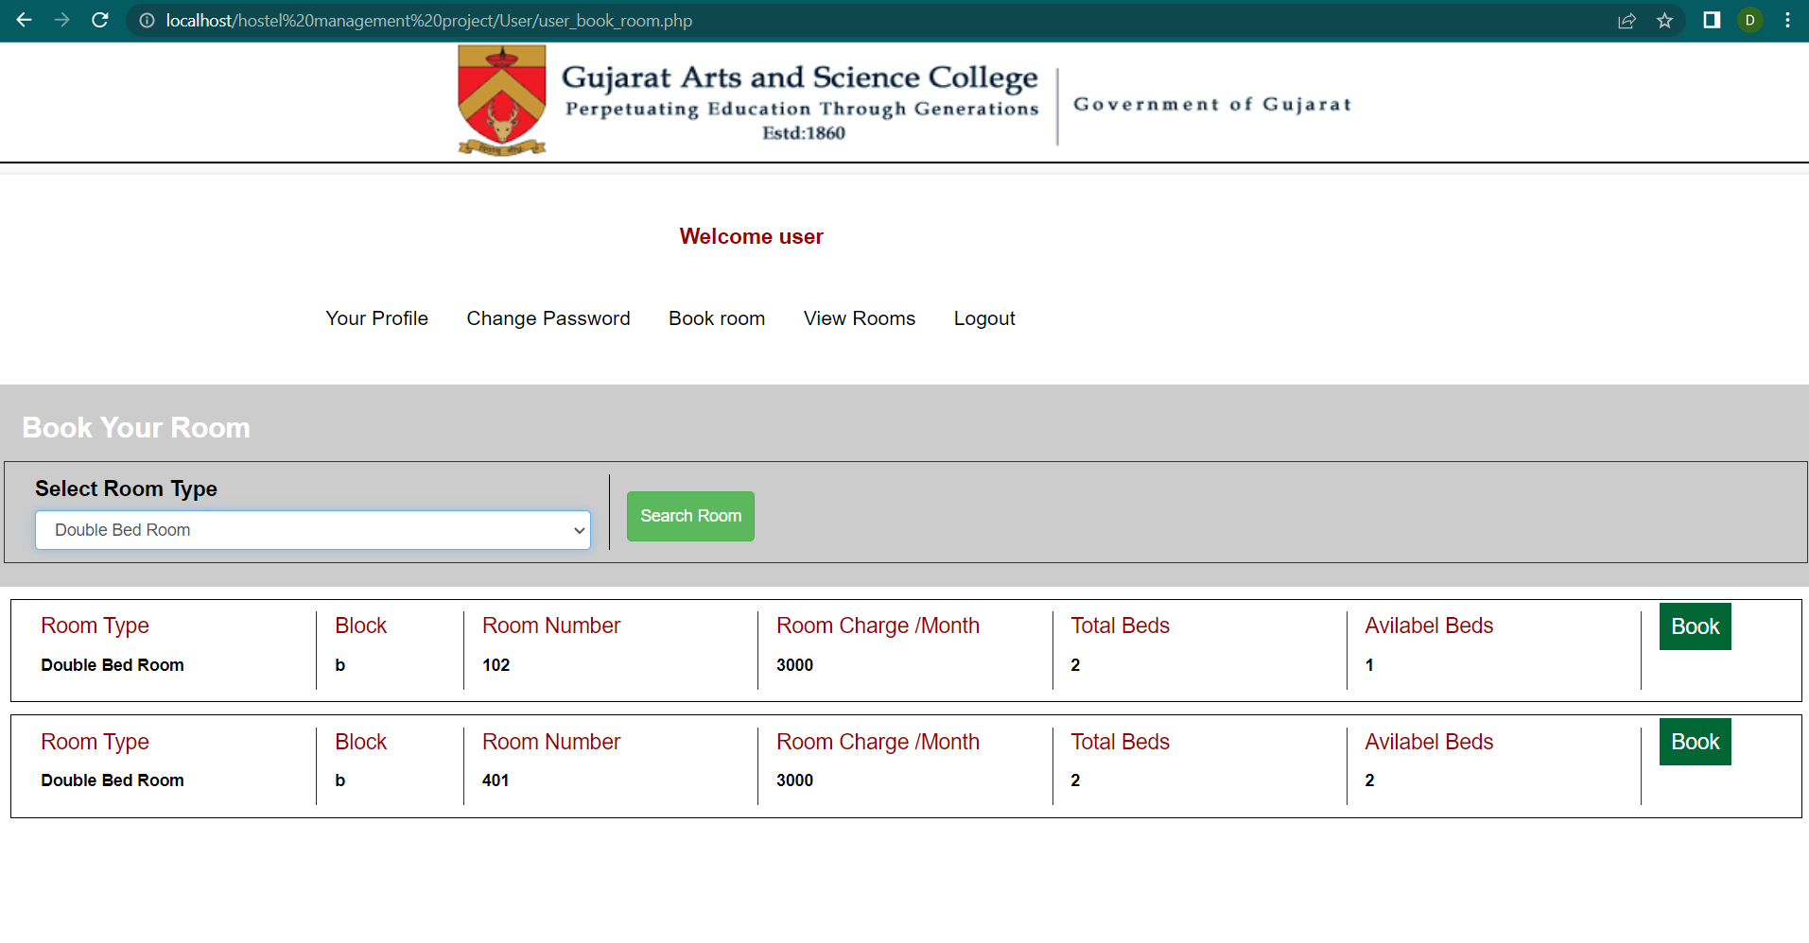
Choose Room page:

Slide 41
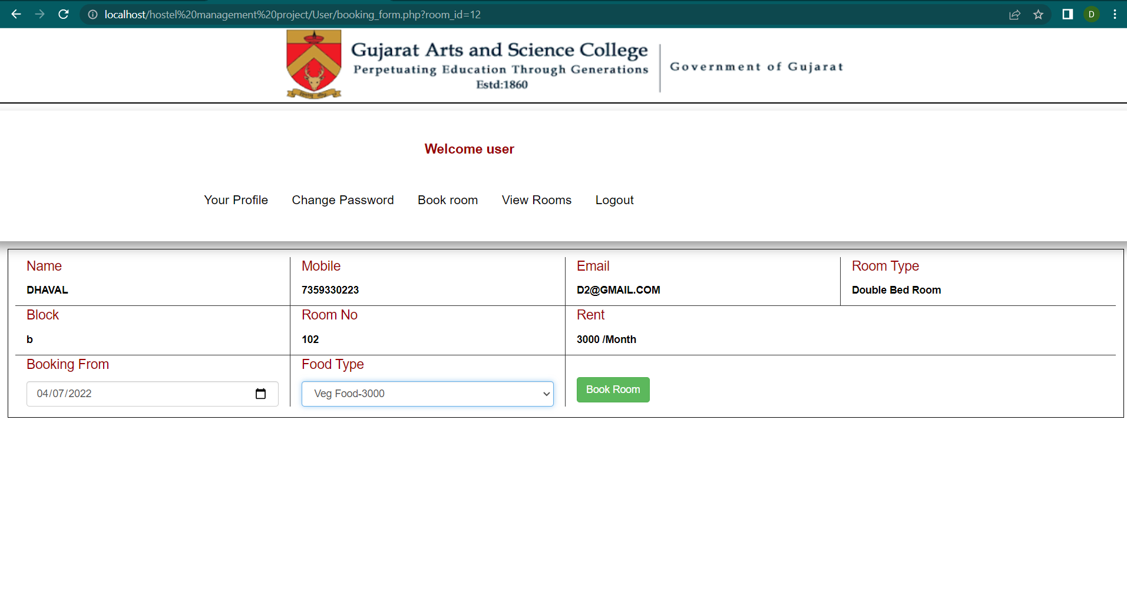
After Select Room form List Then Book Room:

Slide 42
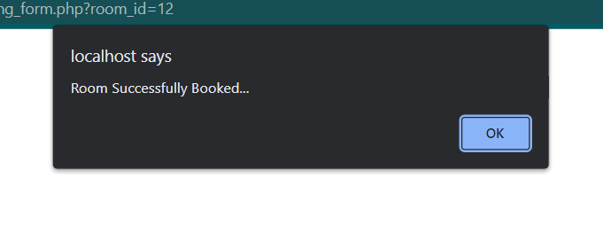
After Book Room User Get Message :

Slide 43
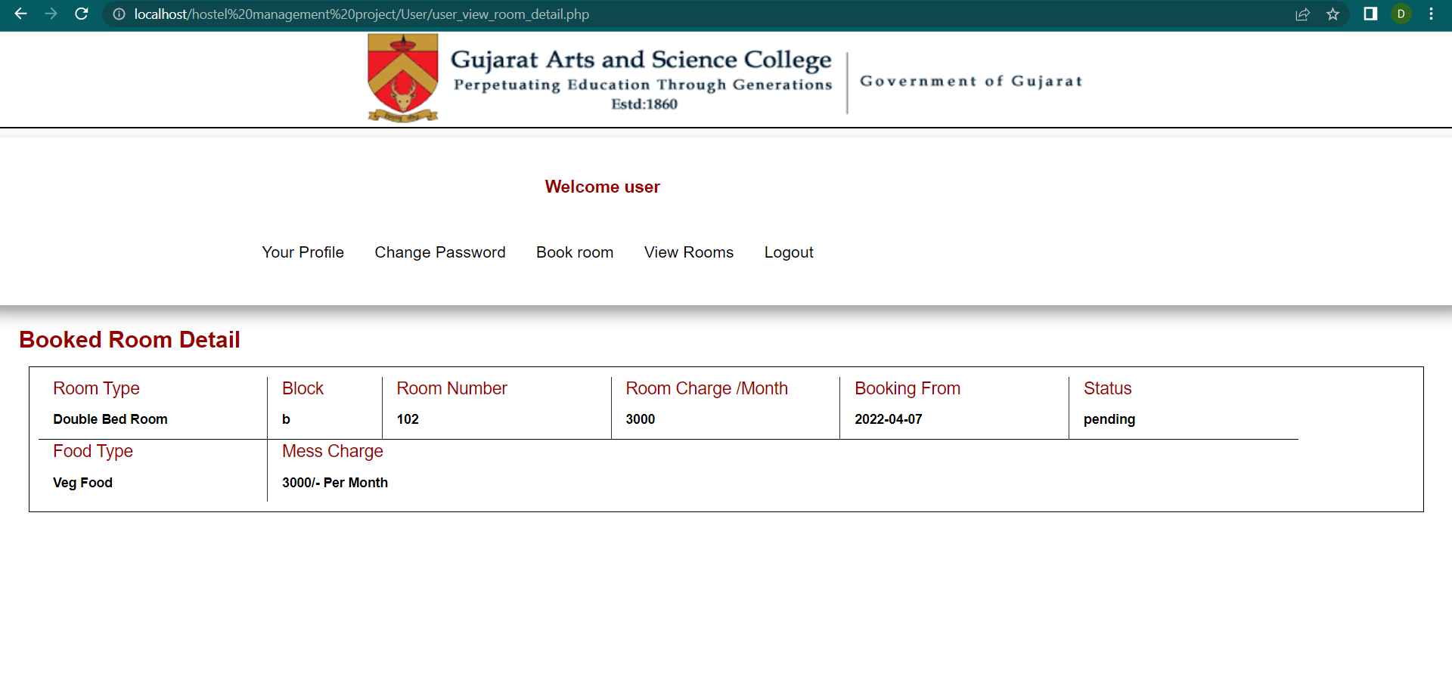
View Rooms Page:

Slide 44
WHENEVER YOU CLICK LOGOUT BUTTON THEN YOU DIRECTLY LOGOUT AND GO BACK TO HOMEPAGE.

Slide 45

Admin Login Page:

Slide 46
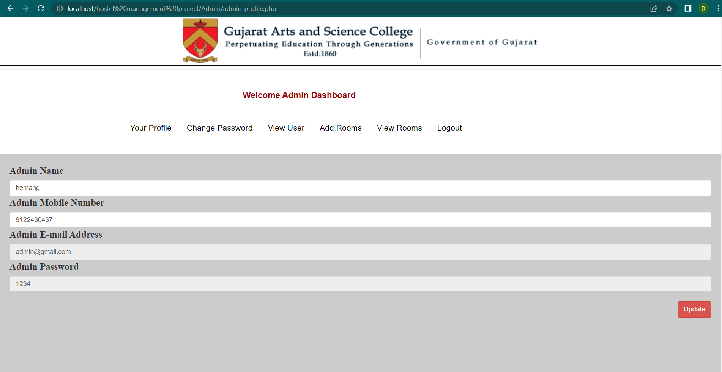
Admin Profile Page:

Slide 47
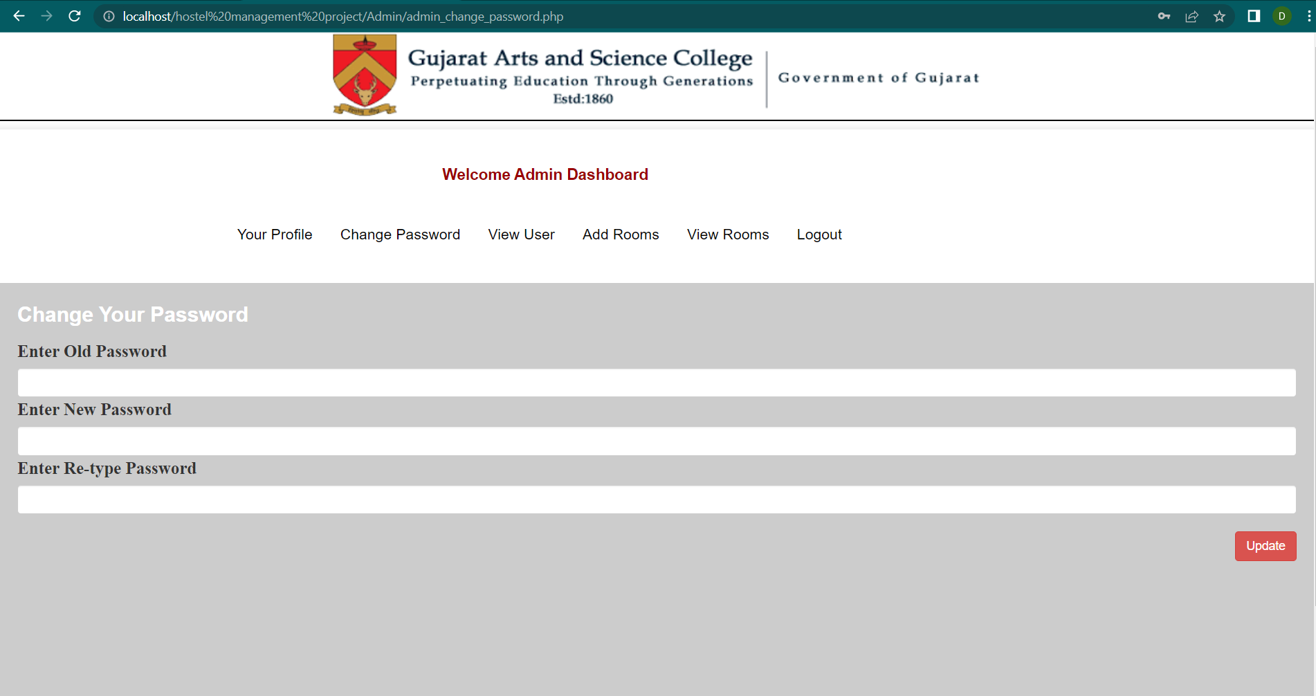
Admin Change Password Page:

Slide 48
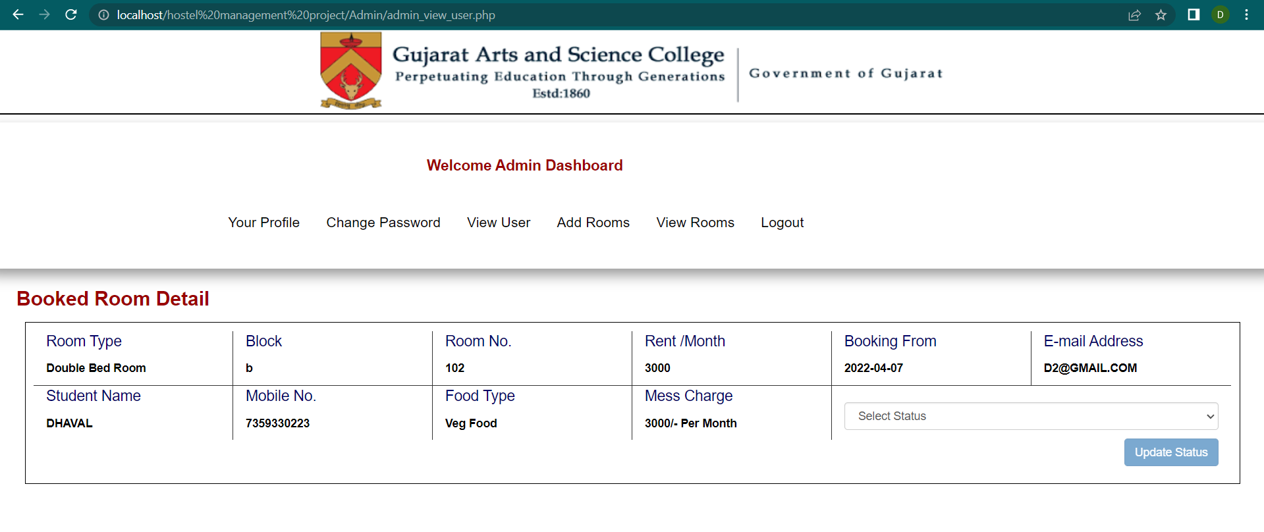
Admin View User Page:
This button is disabled as long as no status is selected on it.

Slide 49
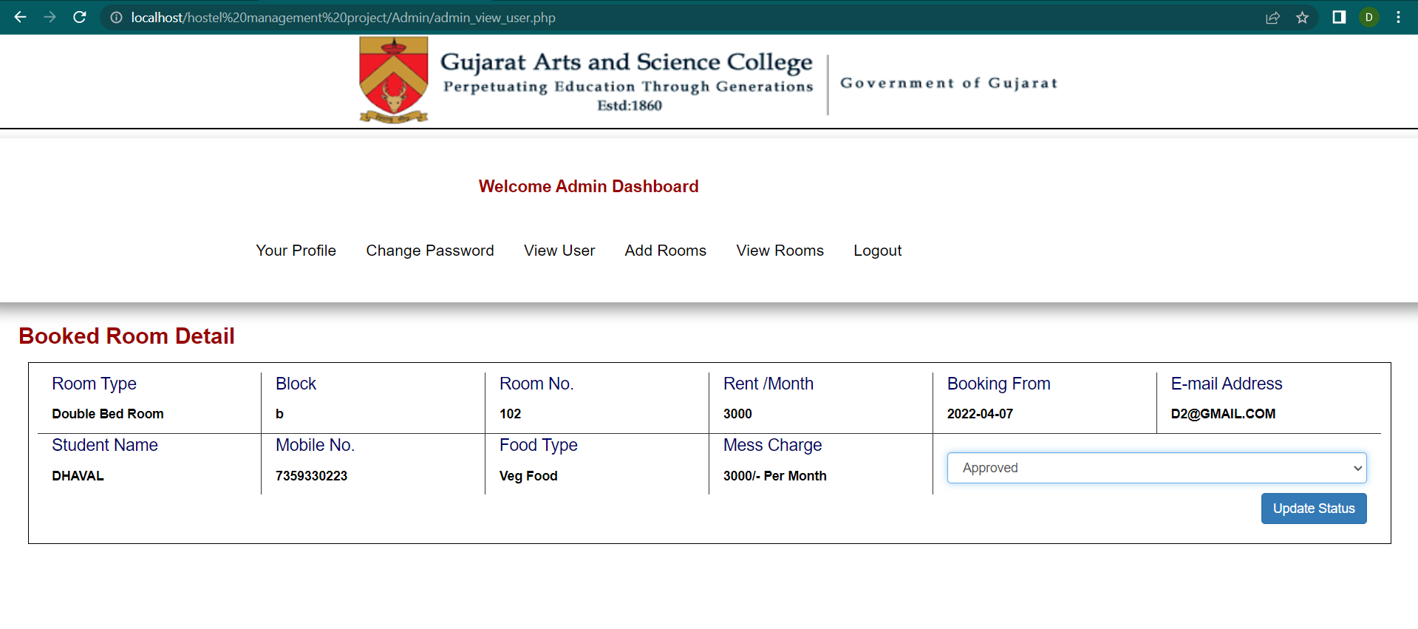
Button After Selection:

Slide 50
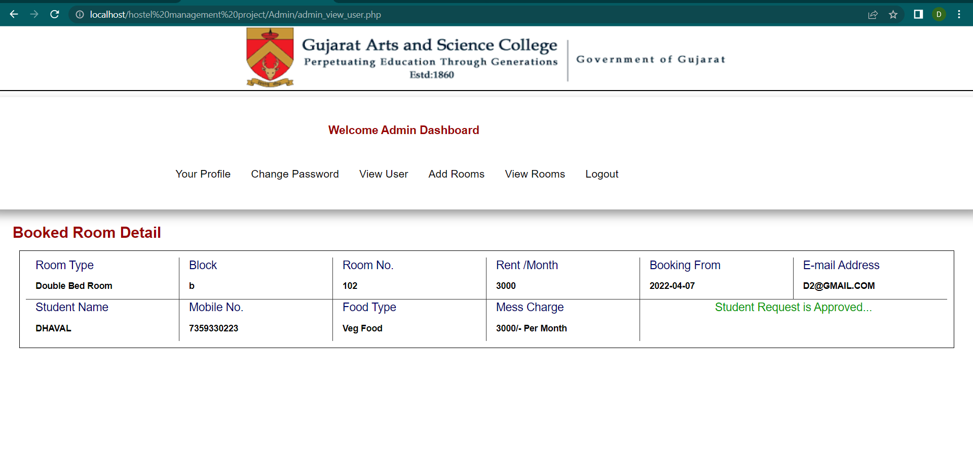
After Choose List And Update Status Page :

Slide 51
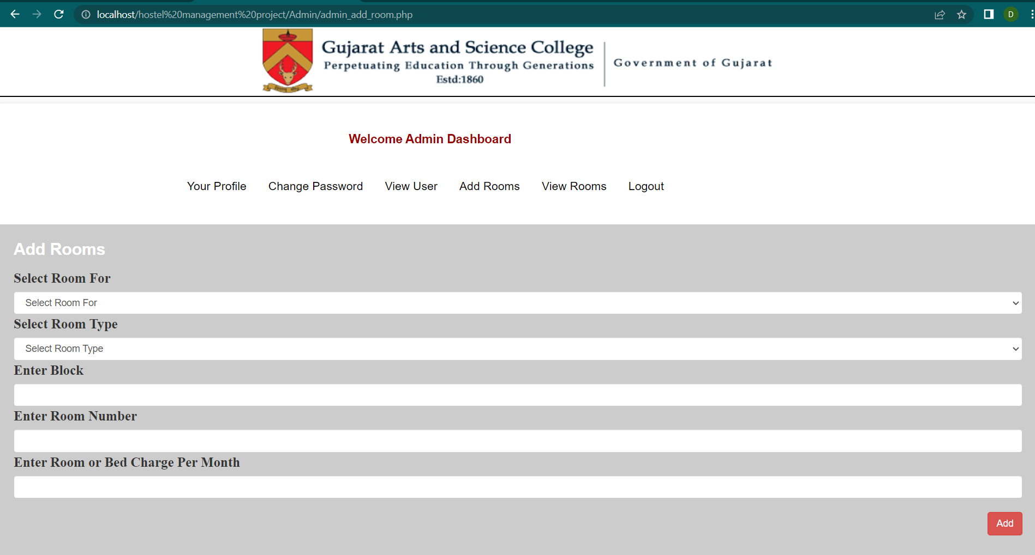
Admin Add Room Page:

Slide 52
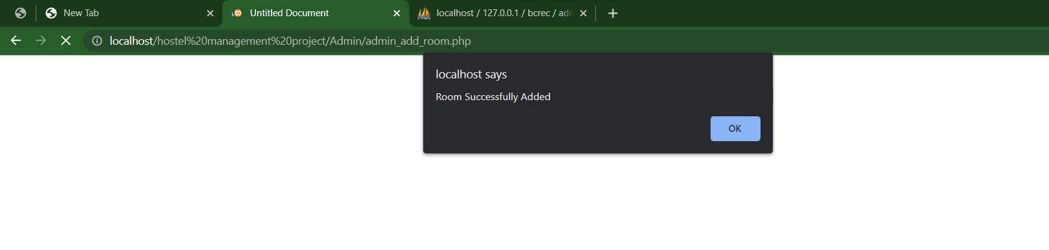
After Fill-Up Add Room Page Detail And Add Button Select That Message Will be Pass.

Slide 53
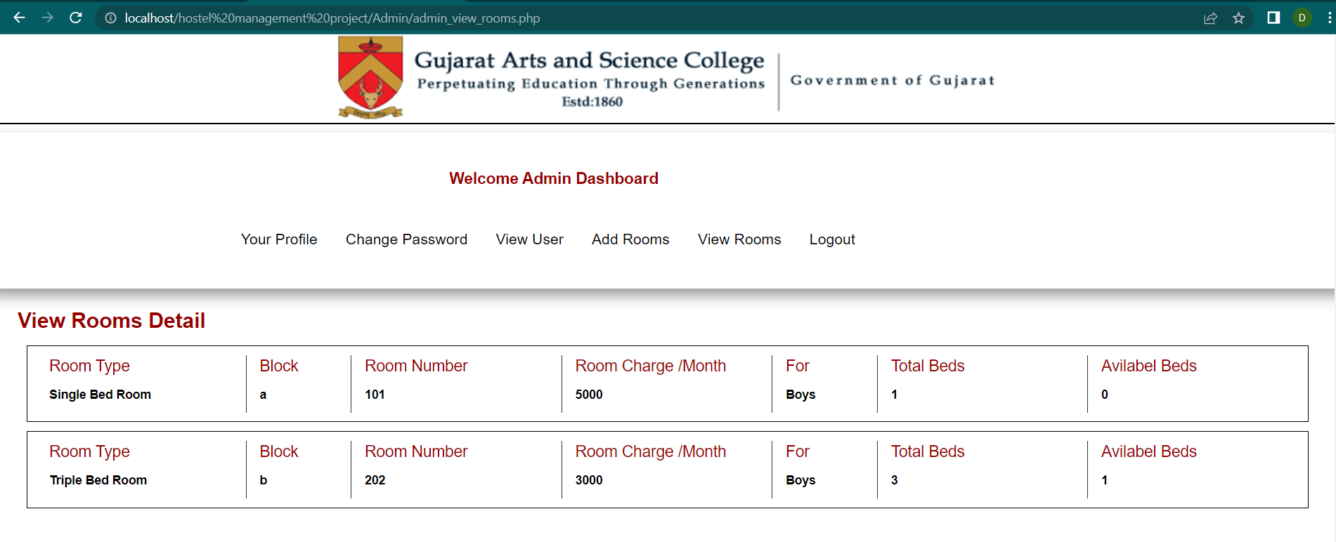
Admin View Room Page:

Slide 54
WHENEVER YOU CLICK LOGOUT BUTTON THEN YOU DIRECTLY LOGOUT AND GO BACK TO HOMEPAGE.

Slide 55
Test Plan
A test plan is a detailed document which describes software testing that test the input before execution of any module.To develop Test Plan it contains test steps, test data, precondition, postcondition developed for specific test scenario to verify any requirement.
The test case includes specific variables or conditions, using which a testing engineer can compare expected and actual results to determine whether a software product is functioning as per the requirements of the customer.
If any defect or bug occurs in software, Provide guidelines and schedule meeting between developer team and client. Project team will communicate with each other through different medium and if any changes required in software it can be resolve by developer team.

Slide 56
Testing Methods
Black Box Testing:
Black box testing also known as behavioral testing, is a software testing method in which the internal structure or implementation of the item being tested is not known to the tester.
This method is named black box because the software program is in the eyes of the tester, is like a black box inside which one cannot see and tester doesn’t have access to the source code they can only interact with user interface by inserting input and study the output without knowing the backend process of it.
White Box Testing:
White box testing also known as clear box testing, glass box testing or transparent box testing, structural testing is software testing method in which the internal structure or implementation of item being tested is known for tester.
White box testing is testing beyond the user interface and internal perspective of the system.
Developers do White box testing where, they will test every line of code of the program.
The main aim of white box testing is to focus on the flow of inputs and outputs through the software and strengthening the security of the software.

Slide 57
User Test Case:
Test case | Test case description | Test case input | Test Data | Post Condition | Expected Output | Actual Result | Pass/Fail
1. | Verify login functionality of login page | Enter valid E-mail and Password | E-mail: Password: Test@12343 | User should be view The User Profile Page | Successfully Login | Valid | Pass
2. | Verify registration functionality of registration page | Enter all details Correct | E-mail: Password: Test@123 | User should be view Login page | Successfully register | Valid | Pass
3. | Logout | - | - | User should directly directed to home page | Successfully Logout | Valid | Pass

Slide 58
Admin Test Case:
Test case | Test case description | Test case input | Test Data | Post Condition | Expected Output | Actual Result | Pass/Fail
1. | Verify login functionality of login page | Enter valid E-mail and Password | E-mail: adminPassword: Test@12345 | Admin should be view the Admin Profile Page | Successfully Login | Valid | Pass
2. | Verify registration functionality of registration page | Enter all details Correct | E-mail: Password: Test@123 | User should be view Login page | Successfully register | Valid | Pass
3 | Verify Accept & Reject Feature | If Admin Select The Accept or Reject Button When Only Update Button Enable | Select Button Approved | User Must Be Approved | Successfully Approved | Valid | Pass
3. | Logout | - | - | User should directly directed to home page | Successfully Logout | Valid | Pass

Slide 59
Future Enhancement
· OTP service during the Registration.
· Online payment option for booking hostel .
· Improve the Security in future regarding.
· Also we will improve a new GUI for the User and Admin for the Better interaction.

Slide 60
Thank you!!

