Slide 1
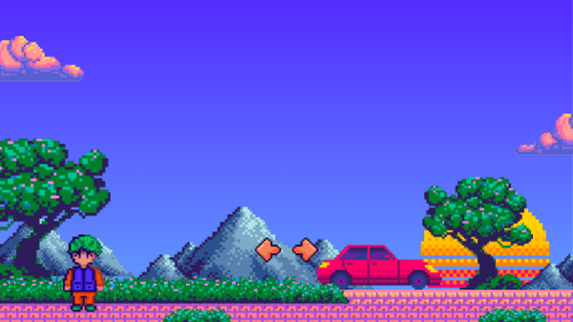
Assignment 4
Multimedia Technologies
Team: Salima Zimbekkyzy, Azhar Saparzholova, Nurassyl Oralbekov Group: SE-2623 Course: ICT

Slide 2
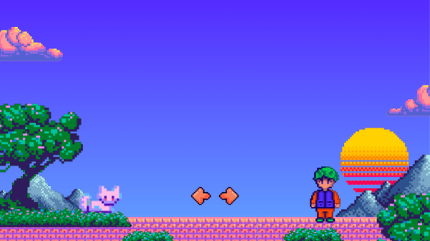
Part A
FORMAT
KEY TRAIT
BEST FIT
Multimedia
formats
PNG
Lossless; supports transparency
Screenshots and graphics where crisp text or edges matter
JPEG
Lossy; compact for photographs
Photos and images where a smaller file is more important than perfect detail
In our prototype
WebP for the attendance preview; inline SVG for interface icons.
WebP
Lossy or lossless; compact
Web images and the attendance preview used in our prototype

Slide 3
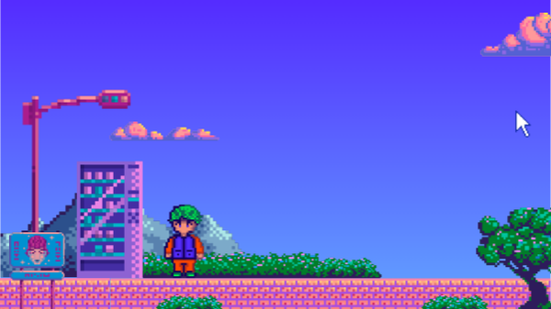
A1. Format comparison
Format
Type
Compression
Alpha / motion
Typical size
Support
Project use
PNG
Image
Lossless
Alpha; APNG
Large photos
Broad
UI evidence
JPEG
Image
Lossy
Neither
Small photos
Broad
Photos
WebP
Image
Both modes
Alpha + motion
Compact
Modern
App preview
SVG
Image
Vector / text
Alpha + motion
Tiny icons
Broad
UI icons
MP3
Audio
Lossy
N/A
Small
Broad
Speech / music
AAC (M4A)
Audio
Lossy
N/A
Small
Broad*
Narration
WAV (PCM)
Audio
Uncompressed
N/A
Large
Broad*
Editing master
MP4 H.264
Video
Usually lossy
Motion; no alpha
Bitrate-based
Broad*
Demo delivery
WebM VP9
Video
Usually lossy
Motion; alpha*
Bitrate-based
Modern*
Web playback
MOV H.264
Video
Usually lossy
Motion; no alpha
Bitrate-based
Limited web
Editing / transfer
A container (MP4) packages tracks and metadata; a codec (H.264) encodes and decodes the media.
*Codec, OS and device support vary. File size depends on content, resolution, bitrate and duration.
Sources: MDN, Image file type guide and Media container formats.

Slide 4
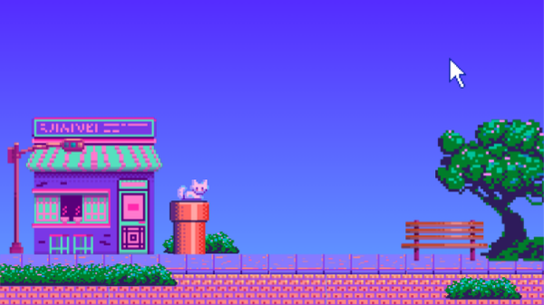
A2. Measured experiment
PNG · original
58.39 KiB
WebP Q80 · in app
15.75 KiB
attendance-preview.png · 390 × 844 px
attendance-preview.webp · 390 × 844 px
42.64 KiB saved · 73.0% smaller
10-second clip · pending
JPEG exports · pending
Version 1: proposed MP4 H.264, 720p.
Version 2: same clip, lower video bitrate.
Files not supplied; compare text and motion.
attendance-preview.jpg — JPEG Q80
attendance-preview-low.jpg — JPEG Q40
Both: 390 × 844 px. Files not supplied; export and inspect.
Visual quality checks are still pending. JPEG and clip entries are a test plan, not completed measurements.
Source: supplied project inventory, 23 Oct 2026. 1 KiB = 1024 bytes.

Slide 5

A2. Visual quality check
Compare like for like
Use the same attendance screen in all four exports. Compare an identical crop at 100% zoom so text edges and calendar lines remain comparable.
Four exports
PNG
JPEG Q80
JPEG Q40
WebP Q80
Evidence still needed
One side-by-side screenshot, JPEG file sizes, and two exports of the same 10-second clip. Rate each result as sharp, acceptable or poor after inspection.
Comparison images and recording are not included in this deck. Quality ratings remain pending.

Slide 6
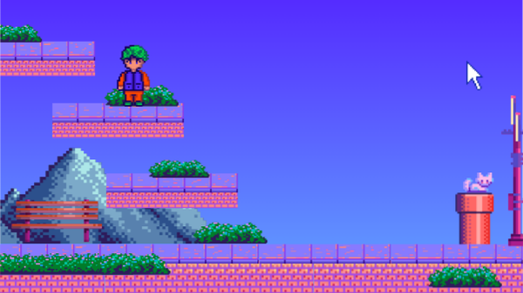
A2. Our format choices
For the My AITU / LMS bridge
73%
WebP Q80 supplies the attendance preview at 390 × 844 px. PNG remains the original evidence image because it preserves text and edges without lossy compression.
Inline SVG keeps icons sharp at different sizes and shares the HTML response. CSS provides the login pulse without a separate video download.
smaller preview file
Same pixels. Less data.
PNG 58.39 KiB → WebP 15.75 KiB
42.64 KiB saved at the same resolution.
Planned demonstration
MP4 with H.264 video and AAC audio for broad playback support. JPEG settings and the ten-second clip still need measured comparison before we can report their quality or size.
Measured file sizes only.
Network speed needs its own test.

Slide 7
B1. Interface icons
#
Asset
Where used
Vector viewBox
Markup size
3
Book
Courses / navigation
SVG 300 × 300
740 B
4
Calendar
Tasks / attendance
SVG 300 × 300
1,162 B
5
Graduation
Grades
SVG 300 × 300
857 B
6
User
Account button
SVG 300 × 300
869 B
7
Menu
Navigation button
SVG 300 × 300
561 B
8
Close
Navigation controls
SVG 300 × 300
441 B
9
Down
Account menu
SVG 300 × 300
391 B
10
Sign-out
Account menu
SVG 300 × 300
906 B
11
Refresh
Reload
SVG 300 × 300
945 B
12
Search
Course search
SVG 300 × 300
669 B
13
Eye
Password visibility
SVG 300 × 300
935 B
14
Check
Attendance
SVG 300 × 300
366 B
All icons: Flaticon Uicons Regular Rounded. Free licence with visible footer attribution.
Inline symbols share the HTML response; these are source sizes, not separate requests.

Slide 8
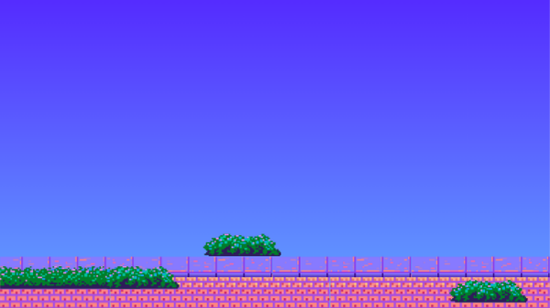
B1. Media asset inventory
#
Asset
Where used
Format / dimensions
Size
Source / licence
15
Absent icon
Attendance
SVG 300 × 300
442 B
Flaticon¹
16
Clock icon
Attendance time
SVG 300 × 300
777 B
Flaticon¹
17
Minus icon
Unmarked attendance
SVG 300 × 300
284 B
Flaticon¹
18
Left arrow icon
Previous month
SVG 300 × 300
416 B
Flaticon¹
19
Next arrow icon
Next month
SVG 300 × 300
404 B
Flaticon¹
20
List icon
Attendance status
SVG 300 × 300
1,010 B
Flaticon¹
1
Attendance preview
Sign-in
WebP 390 × 844
15.75 KiB
Own + icons¹
2
LMS wordmark
Sign-in
CSS / text, 68 × 68
Embedded
Own
21
Login pulse
Login progress
CSS, 2 s loop
Embedded
Own
22
Entrance motion
Transitions
CSS, 0.4 s
Embedded
Own
23
Campus map
Map section
Responsive iframe
Variable
Yuujiso / MIT²
24
Inter font
Interface text
Web font / weights
Variable
Inter / OFL³
25
Remote view
Optional support
JPEG Q70, 1100 × 800
Variable
Private session
¹ Flaticon attribution in footer. ² github.com/Yuujiso/aitumap (MIT), author beside map.
³ github.com/rsms/inter (SIL OFL 1.1). Remote session views must stay out of the submitted demo.
Unused ui-right / ui-stats and evidence PNG files are not loaded by the running interface.

Slide 9
B2. Integration and optimisation
What is integrated
−73.0%
Preview image
WebP preview: 390 × 844 px, displayed at 250 px wide.
18 inline SVG icons and a CSS login pulse.
Reduced-motion preference disables animation.
The full page still needs a 360 px browser check.
59,787 B → 16,126 B
−30.8%
4 front-end files + preview
141,601 B → 97,941 B
DevTools measurements: still required
Controlled local payload excludes headers, compression, API, fonts and map traffic. Stage 1: <3 s per request at 1,000 users remains unverified.
Disable cache, select Fast 4G and reload the same screen before and after. Capture transferred bytes, request count and Finish/Load time. Image-request delta should be 0; verify the total.

Slide 10
B3. Accessibility of media
Meaningful images have alt text
The test attendance preview describes the month and status counts. Decorative SVGs use aria-hidden="true"; controls retain text or accessible labels.
Motion follows user preference
Progress is visible as text and a pulse. Animation and transitions are disabled when reduced motion is requested.
<img src="/attendance-preview.webp"
width="390" height="844"
alt="Тестовый экран посещаемости: календарь за октябрь 2026 года и счётчики — 0 присутствий, 1 пропуск, 0 опозданий, 1 запись без отметки.">
@media (prefers-reduced-motion: reduce) {
*, *::before, *::after { animation: none !important;
transition: none !important;
scroll-behavior: auto !important; } }
No speech media or sound playback: captions and sound equivalents are currently N/A. No live text sits over raster images, so the 4.5:1 text-over-image test is N/A. Source: supplied part_b.md, B3.

Slide 11
Part C — Multimedia presentation

Slide 12
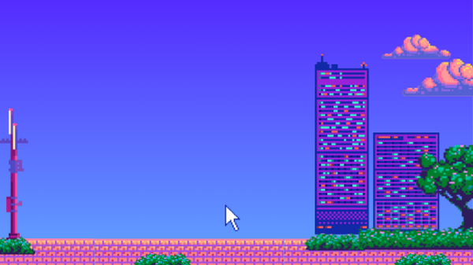
C1. Storyboard
01 · 0:00–0:30
Login screen
02 · 0:30–1:10
Nurassyl: how the login process looks
Main pages, burger menu and references from Stage 1
Salima: website content and design decisions
03 · 1:10–1:40
Statistics and survey from Stage 1
04 · 1:40–2:10
Azhar: the purpose of the project
Demo sketches
Azhar: the future of the project

Slide 13
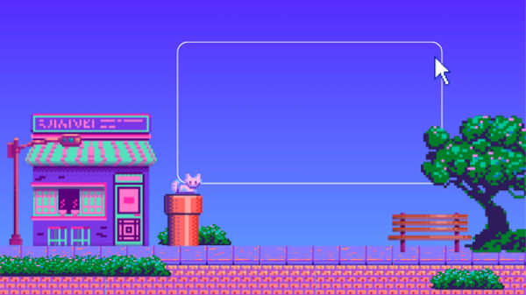
C2. The video
https://drive.google.com/drive/folders/1izH4jyb1Ooi-pvghCGhOfCXmk6A6rqKn?usp=sharing

Slide 14
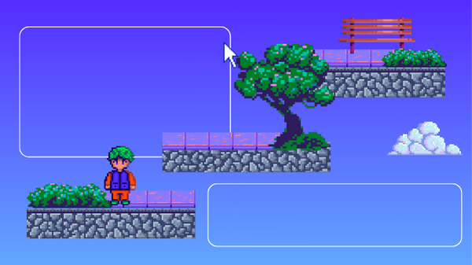
C3. Production note
In 80–120 words, state the tools you used to record and edit, and your export settings — container, codec, resolution, frame rate, bitrate and final file size — and explain why you chose them rather than a higher or lower setting.

Slide 15
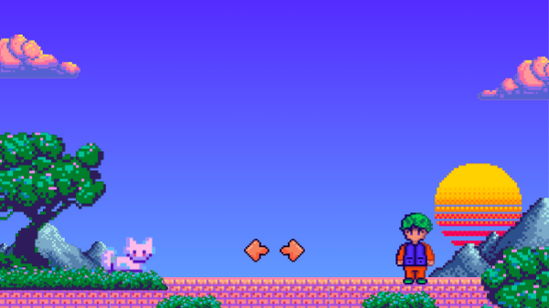
Part D — Integration with the project

Slide 16
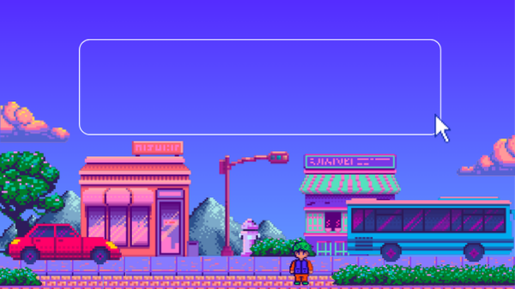
D1. Updated prototype
Run the prototype
github.com/d30mantcoder/ICTProject
01 Clone the repository
02 Create a virtual environment
03 Install requirements.txt
04 Run bridge-test/app.py with Python

Slide 17

D2. Change log
01 Real LMS data
Added fetching from LMS to make the website usable.
Status: using real LMS data.
02 A more usable interface
The original LMS UX was uncomfortable. The redesigned interface places the most useful buttons on the main page.
03 Multi-user sessions
Data → interface → concurrent use
Previously, more than one person could not work at the same time. Asynchronous sessions now let the server handle multiple users.

Slide 18
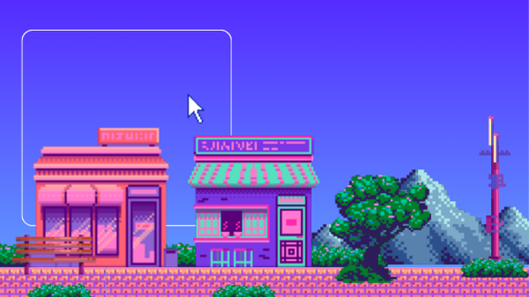
D3. Team contributions
C, D
A, D
B, D
Salima
Azhar
Nurassyl
CONTRIBUTION
CONTRIBUTION
CONTRIBUTION
Editing the video
Comparing formats
Multimedia integration

Slide 19
Thank You

