Slide 1
web-dev workshop
developing a full stack application

Slide 2
Day 1
Introduction to web development
Basic of HTML & CSS

Slide 3
Introduction to web-dev
Process of creating web-application
A web application is a type of application which runs on the browser and accessed using the internet

Slide 4


How web works ?
The modern web is based on client server architecture.
The client send a request to server and then server process the request and send back a response
Request
Response
Client (Web browser)
Server

Slide 5
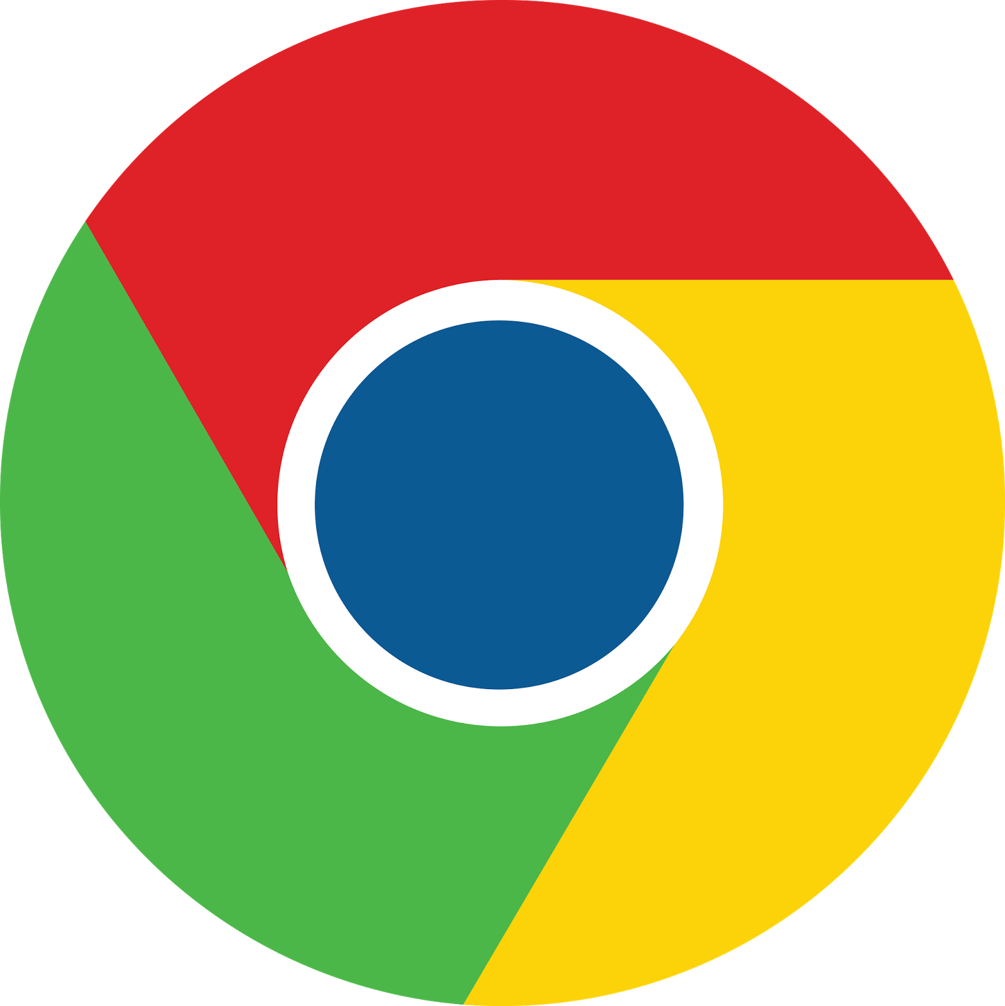

Example
GET youtube.com
1.
index.html
GET youtube.com/api/videos
2.
json data
Reference: YouTube API

Slide 6
HTML
HTML is a markup language which is used to define the DOM (Document Object Model) in the browser.
A markup language is used for storing and retrieving representational data from a file easily. E.g. HTML, XML, YAML, TOML are some data representational language.
DOM is a node representation of element in the browser. Which is rendered by the browser’s render engine.

Slide 7
Basic Syntax of HTML
<!-- Comments -->
<element prop="value" another-prop="other-value">
<!-- Some other element
or elements -->
</element>
<!-- Self closing elements -->
<element props="value"/>

Slide 8

Example
<div
id="top-logo"
class="container">
<img src="logo.png" />
<h2>HTML</h2>
</div>
HTML

Slide 9
Example
<div
id="top-logo"
class="container">
<img src="logo.png" />
<h2>HTML</h2>
</div>
HTML

Slide 10
Some Common HTML Element
body
div
h1, h2, h3 … h6
input
button
text area
a
img
span, p
form
head
script
meta
link
title
style

Slide 11
Practical Time !

Slide 12
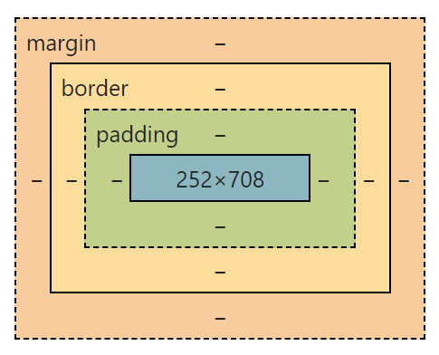
CSS
Styling language used to decorate elements in the DOM for example its position, color, spacing etc.
CSS is based on concept of content box i.e. every element in the DOM is treated as a box
content

Slide 13
Basic Syntax of CSS
/* Comments */
selector {
/* Declaration */
property: value;
other-properties: some-other-values;
}

Slide 14
Example
.container {
padding: 16px;
border: 2px solid green;
background: lightgreen;
}
.container p {
font-family: Manrope;
color: white;
font-size: 2em;
font-weight: bold;
}
<div class="container">
<p>Some Text</p>
</div>
Some Text

Slide 15
Some Common Properties
position, background, border, border-radius, margin, padding, font-size,
font-family, display, gap, text-decoration, text-alignment, align-items,
justify-content, transform, transition, animation, width, height,
min max-width, min max-height

Slide 16
Practical Time !

Slide 17
Some Great Resource
Mozilla developer network
W3School
freeCodeCamp - YouTube

Slide 18
Day 2
Introduction to JavaScript

Slide 19
JavaScript
JavaScript is prototype-based, multi-paradigm, single-threaded, dynamic.
JavaScript is designed to make interactive and dynamic website and webapps.
JavaScript can run on client side via web browser as well as on server side via NodeJS
NodeJS is JavaScript runtime based on chrome’s V8 engine
NodeJS can be download from https://nodejs.org/ or using any package manager
JavaScript has noting to do with Java

Slide 20
Important Concept
Constants, Variables and Data types
Object and Array
Loops
Conditional Statements
Functions
Asynchronous JavaScript

Slide 21
Practical Time !

Slide 22
Some Great Resource
Mozilla Developer Network
freeCodeCamp - YouTube

Slide 23
Day 3
NodeJS, NPM & NPX
Intro to React
Basics of express

Slide 24
NodeJS, NPM & NPX
NodeJS is JavaScript runtime built on top of Chrome’s V8 Engine
Contains an interpreter and lots of modules like fs, path, http …
NPM is package manager used to manage third party packages written by someone else

Slide 25
Practical Time !

Slide 26
React
A JavaScript library for building user interfaces.
Keeps the application state and UI in sync, It reacts whenever any state in the app changes.
State is some data that can change overtime, e.g. user, likes count on a post, etc.
UI is made using reusable components
Components are encapsulated UI element that manage their own state, then gets composed to make complex UIs.
Visuals of the components are defined with JSX which is compiled to JavaScript using babel.

Slide 27
Why React ?
Opensource and free to use
Blazing fast performance in web & great improvement over time
Easy to learn and easy to implement
Large ecosystem of libraries and tools
Develop cross-platform mobile application with react-native
Widely used by popular webapp like Instagram, whatsapp-web, flipkart, discord, piniterest and many more…

Slide 28
Defining a React Component
function MyComponent(props){
const name = "World"
return (
<h1 id={props.id} className="heading">
Hello, {name}!
<h1/>
)
}
<div>
<MyComponent name="component-1"/>
</div>

Slide 29
How React Works ?
React create a virtual DOM using the nesting of react components
Each components has its own independent logic and state
The virtual Dom is used to modify only the part of the actual Dom which uses that state

Slide 30
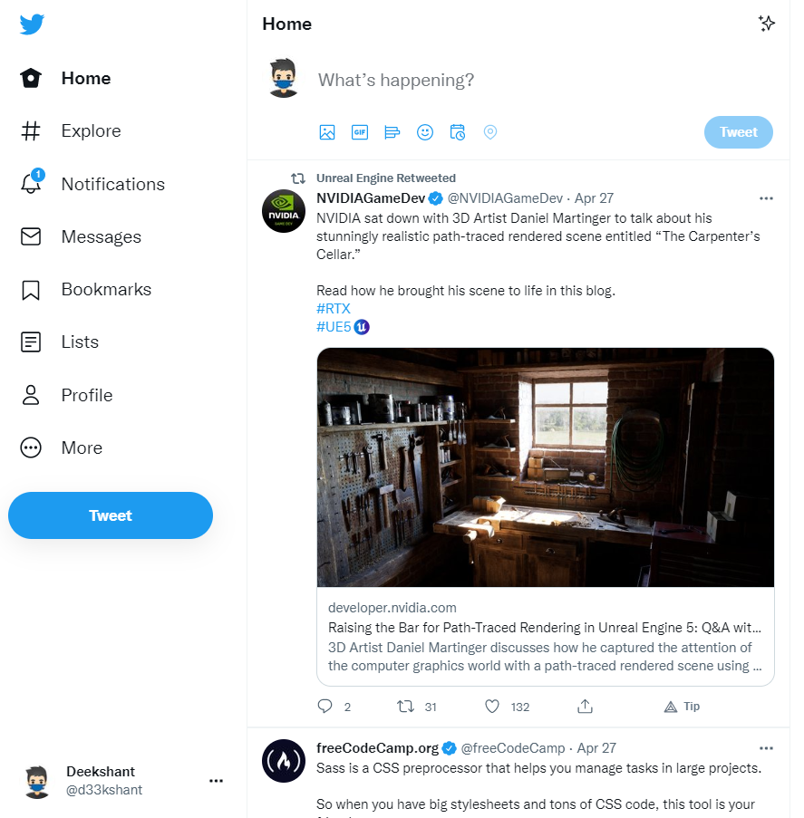
Example
Now consider the Homepage of the Twitter

Slide 31
Example
Now consider the Homepage of the Twitter
App
Side Bar
Feed

Slide 32
Example
Now consider the Homepage of the Twitter
App
Side Bar
Feed
Options

Slide 33
Example
Now consider the Homepage of the Twitter
App
Side Bar
Feed
Options
InputBox

Slide 34
Example
Now consider the Homepage of the Twitter
App
Side Bar
Feed
Options
InputBox
PostList

Slide 35
Example
App
App
Side Bar
Feed
Side Bar
Feed
input
posts
Options
InputBox
Post List
Option
InputBox
Post List
Post 1
Post 2
…
Post 1
Post 2
…
Actual DOM
Virtual DOM

