Slide 1
AIRCANVAS
BY: KHUSHI 2401201102
TEESHA 2401201039
VIVAN 2401201099
DEEPAK 2401201071

Slide 2
PROBLEM STATEMENT
Traditional drawing apps require physical input devices like mouse, stylus, or touchscreens.
These tools limit accessibility, hygiene, and natural user interaction.
There’s a growing need for contactless, gesture-based drawing systems using simple hardware like a webcam.
Existing solutions are either complex or lack real-time air-drawing capability.
AirCanvas addresses this gap by enabling users to draw in the air using hand gestures tracked in real time

Slide 3
OBJECTIVE
To develop a web-based application that enables users to draw in the air using hand gestures.
To implement real-time hand tracking using a standard webcam and MediaPipe.
To allow users to select colors, clear the canvas, and save their drawings.
To provide user authentication and personalized drawing gallery access.
To promote a contactless, intuitive drawing experience using accessible technolog
To explore the potential of computer vision and gesture recognition in user interfaces.

Slide 4
TECHNOLOGY STACK
Frontend: • HTML5 – Structure of the web interface • CSS3 – Styling and layout • JavaScript – Interactivity and event handling • Jinja2 – Dynamic content rendering in Flask
Backend: • Python 3.11 – Core programming language • Flask – Web framework for server-side logic • Flask-SQLAlchemy – ORM for database communication
Computer Vision: • OpenCV – Real-time webcam feed and canvas rendering • MediaPipe – Hand tracking and gesture recognition
Database: • PostgreSQL – Stores user data and saved drawings
Tools & Platforms: • Visual Studio Code / PyCharm – Code editors • Git – Version control • Replit (optional) – Online testing environment • Browser (Chrome/Firefox) – User access interface

Slide 5
KEY FEATURES
Draw in the air using only a webcam—no physical input devices required.
Multiple color options for creative flexibility.
Canvas control tools – clear, draw, and switch colors easily. •
User authentication system – secure login and registration.
Save and view drawings in a personal gallery.
Responsive web interface compatible with modern browsers.
Built with open-source technologies – Python, Flask, OpenCV, PostgreSQL.

Slide 6
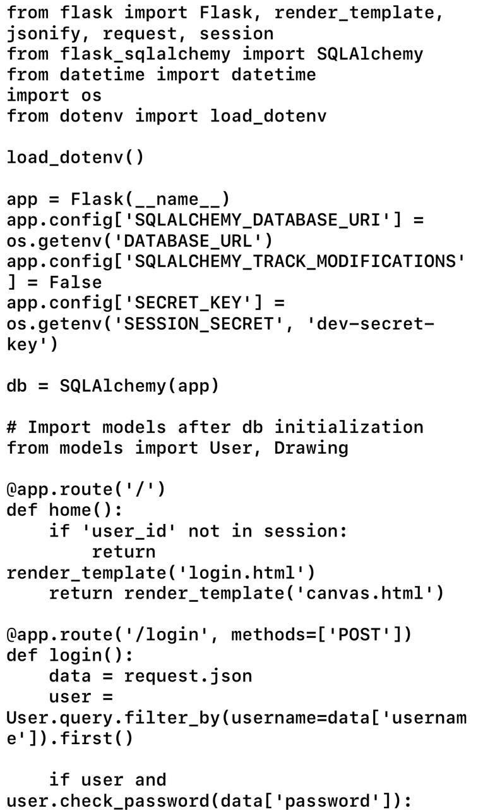
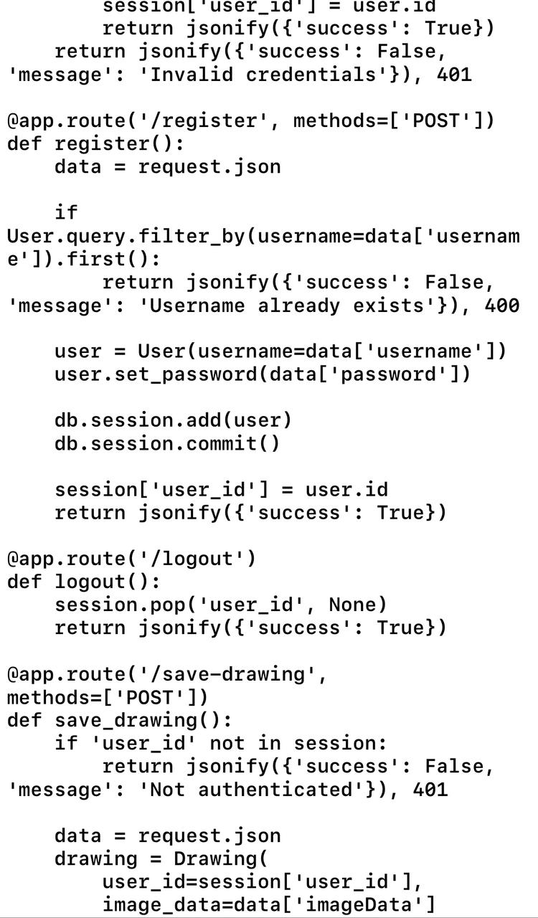
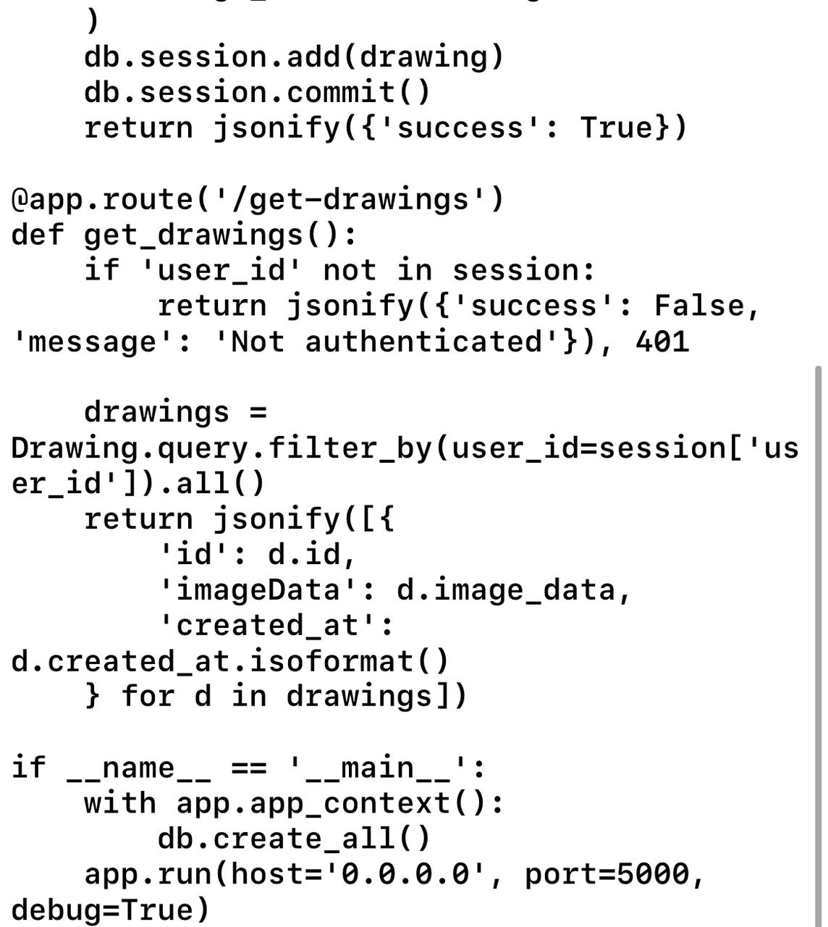
CODING

Slide 7
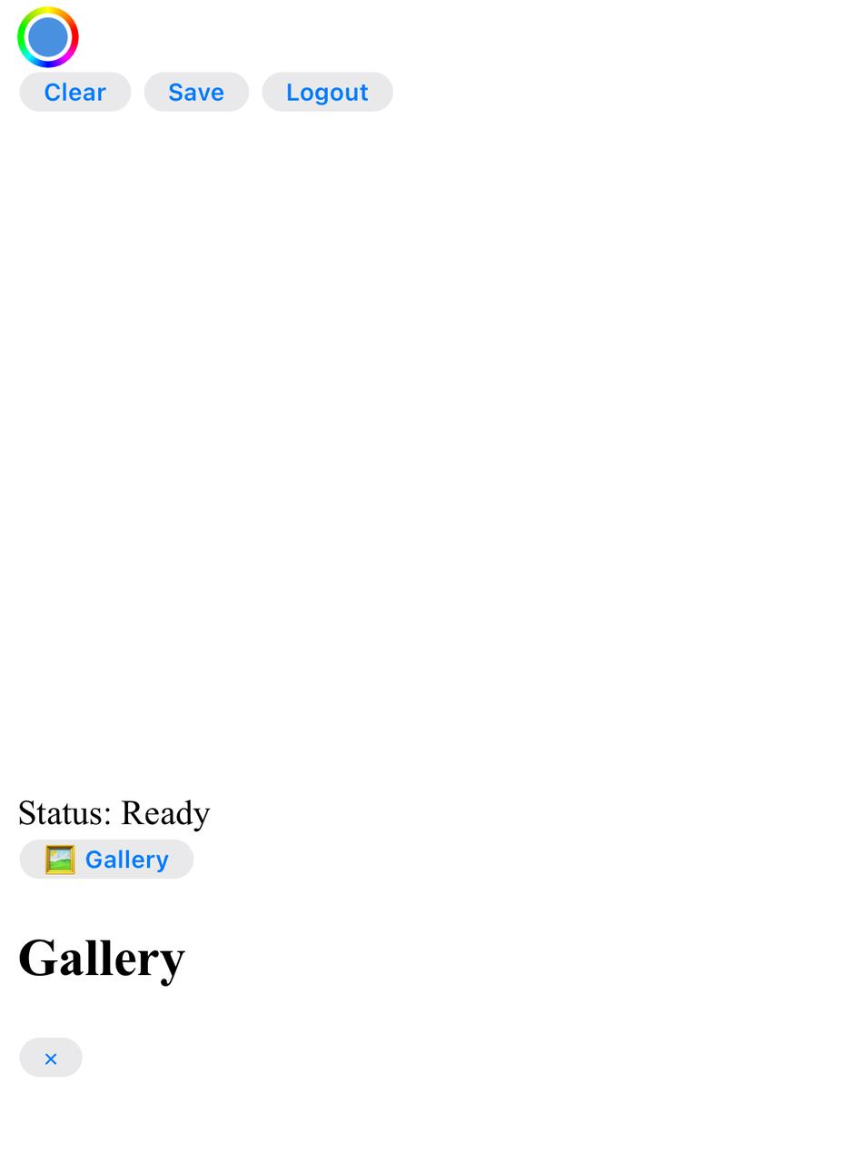
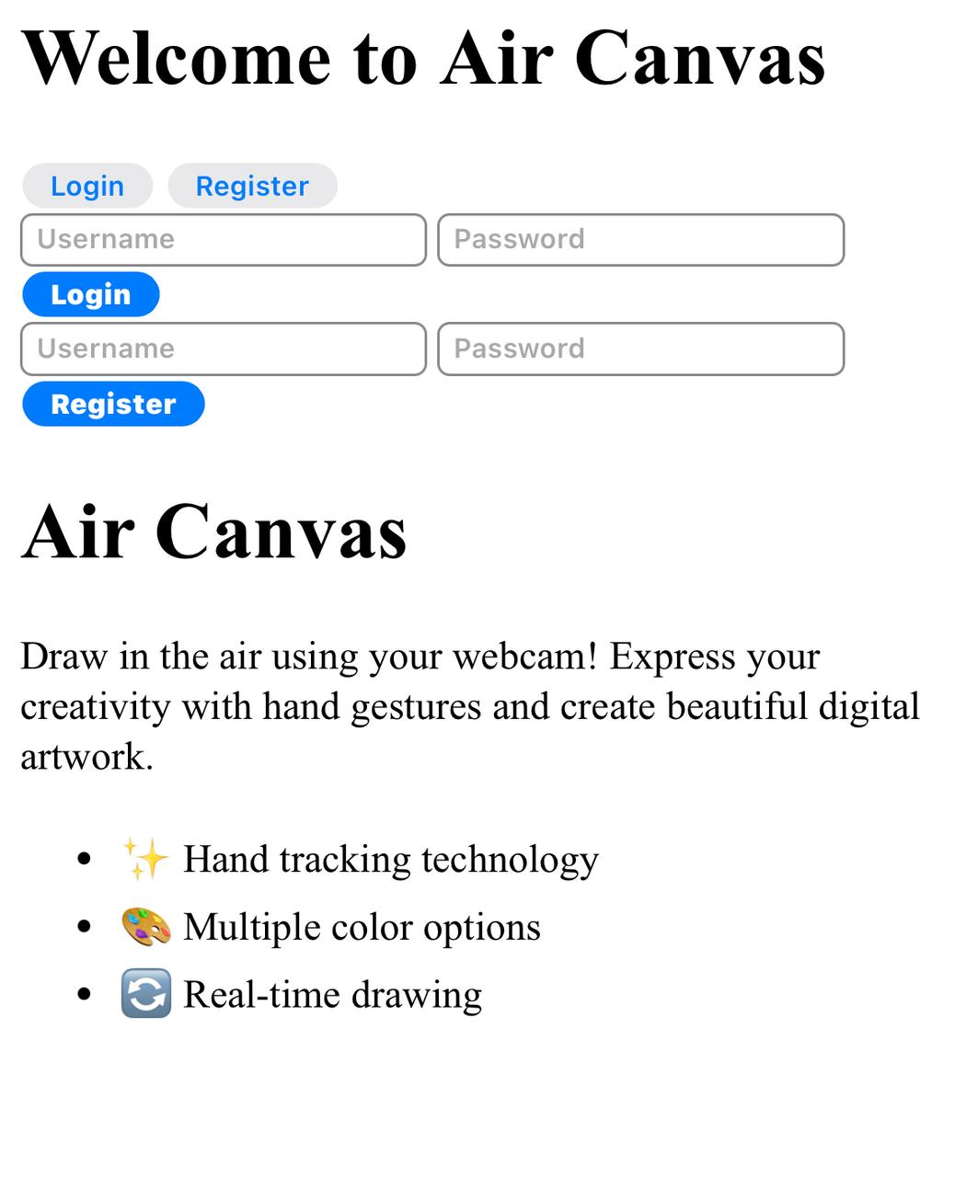
OUTPUT

Slide 8
FUTURE SCOPE
Develop a mobile app version for Android and iOS platforms.
Add AI-powered gesture recognition for detecting shapes and commands.
Enable real-time collaborative drawing between multiple users online.
Integrate with cloud storage services for saving and sharing artwork.
Implement voice commands for tool selection and canvas control.
Extend to Augmented Reality (AR) environments for immersive drawing.
Add features like undo/redo, eraser tool, and custom brush styles.

Slide 9
CONCLUSION
AirCanvas provides an innovative, contactless way to create digital drawings using hand gestures.
It combines computer vision, web development, and gesture tracking into a user-friendly platform.
The system works efficiently with minimal hardware—a webcam and a browser.
It enhances accessibility, encourages creativity, and reflects the future of intuitive user interfaces.
The project demonstrates practical knowledge of Flask, OpenCV, MediaPipe, and database integration.
Offers strong potential for future development in education, art, and user-interface design

Slide 10
THANKYOUUUUUUU☺

