Slide 1
fM-os
By,
Gaurav kachare 18bcy10035

Slide 2
Index
Basic Diagram of OS
Inspiration
File Management
--Structure
--It’s need
--Modules
--Advantages
Multi User
--Security Features
--Advantages
--Scratch Code
Conclusion

Slide 3
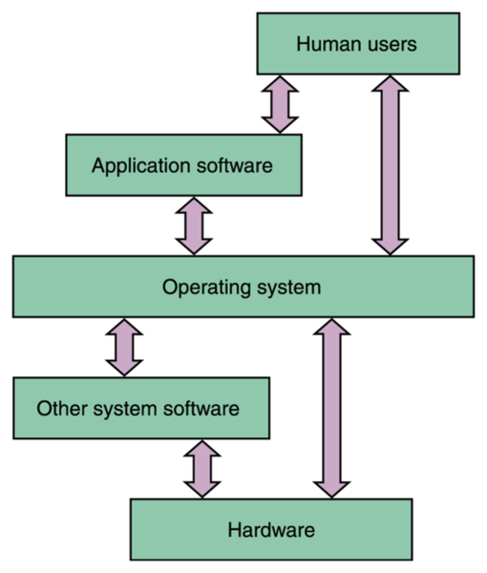
Basic diagram of os
The diagram shows the relationship between the user, the device and the hardware through the O.S.
The operating system acts as a medium through which the user can use and access various functions of the device.

Slide 4
Inspiration
Cleese is a project to build a functioning operating system written almost entirely in Python. The basic idea is to have a microkernel mostly based on the Python VM and all other operating system functionality written in Python.

Slide 5
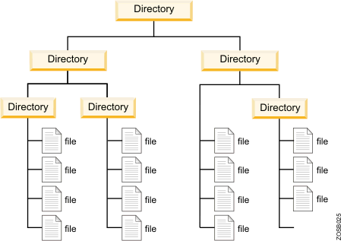
File management
File system used by windows is “NTFS”, New Technology File System.
Windows uses “ADS”, Advanced Directory Services.
The file system used by linux is ext* file system

Slide 6
WHY Do we need file management system in Operating system
It makes the process of sharing of files among different users very easy and user friendly.
These directories help users to search file quickly or to manage the files according to their types or uses
It helps the users to modify the data of files or to modify the name of the file in the directories.

Slide 7
Modules
Name It specifies the name or title of the file which is specified by the user at the time of saving of it. The name is used to specify the title detail of the file.
File type It specifies the type of the file such as a word document or an excel document or any other type. Type of the file is important in recognizing the requirement and function of a file.
Location It specifies the location of the file where it is stored in memory.
Size It specifies the size of the files in bytes. It specifies the memory taken by any data file in the disk.
Date and Time It specifies the date and time when the file was created, last accessed and last modified also.
Read Only It specifies that the file can be open only for reading purpose.

Slide 8
Contd..
2) File Operations:-
File operations are the various tasks that are performed on files. A user can perform these operations by using the commands provided by the operating system. The following are some of the typical file operations:
Creating It helps in creating a new file at the specified location in a computer system. The new file could be a word document, an image file or an excel worksheet.
Saving It helps in saving the content written in a file at some specified location. The file can be saved by giving it a name of our choice.
Opening It helps in viewing the contents of an existing file.
Modifying It helps in changing the existing content or adding new to an existing file.
Closing It helps in closing an already open file.
Renaming It helps in changing the name of an existing file.
Deleting It helps in removing a file from the memory of the computer system.

Slide 9
advantages
A file management system allows admins to set limits, permissions and roles for files.
It includes granting different levels access to files and assigning roles for specific users
It increases efficiency, as the right user receives the correct files.
It strengthens system security with modern file management software
It offers encryptions for logins and supports secure connections.
It allows other users to receive data reports which help them improve their work efficiency.

Slide 10
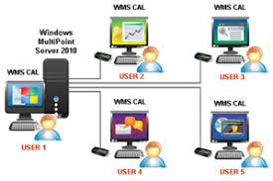
Multi User
A multi-user operating system (OS) is a computer system that allows multiple users that are on different computers to access a single system's OS resources simultaneously.
Multi-user operating systems were originally used for time-sharing and batch processing on mainframe computers.

Slide 11
Security features
Since multi-user OS have several users accessing the system resources simultaneously, it is very important for the system administrators to implement security features within the system.
These features could include account separation, user groups, roles and permissions.
Account separation is one of the most important security features that needs to be implemented.
This is vital in order to maintain file and content protection, integrity and privacy.
Each user must have their own separate account, giving them private work and storage space within the system.
Also, user groups, roles and permissions should be created and assigned to each user to ensure others do not interfere with or delete other users' work, purposefully or accidentally.

Slide 12
Advantages
• Allows many different users to take advantage of computer's resources simultaneously
• It is used as a single server and multiple number of clients- The time shared system allows multiple users to share the system simultaneously
• The system switches from one user to another rapidly, giving the impression that each user has full control of the system
• Store the information about the number of user’s connected to the server and provides security to data from unauthorized access
• Each user has a private set of programs and access techniques for accessing the data.
• Example : Windows 2000, Novell Netware, Windows NT, Unix, VMS (Virtual Memory System), MVS (Multiple virtual Storage- for mainframe systems)

Slide 13
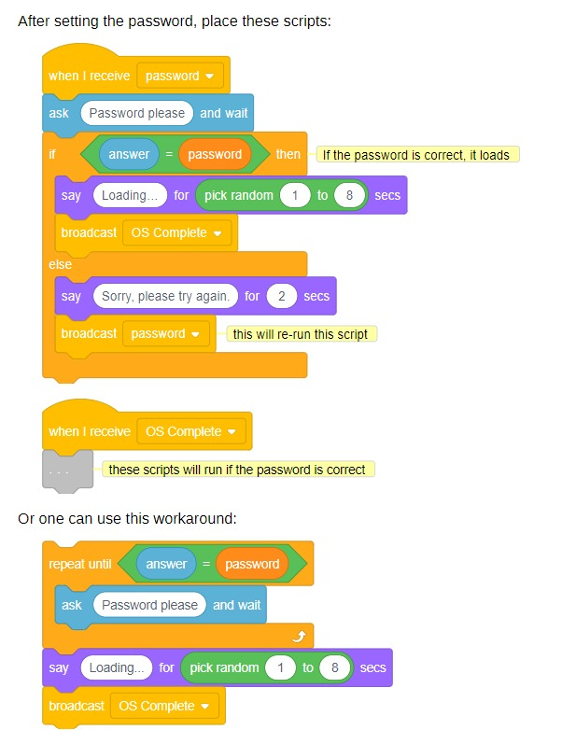
Scratch code for multi-user

Slide 14
ConClusion
As we all know that there are many functions of an os including both external that is visible to user as well as internal that runs and processes at the background interacting with the cpu that is hidden from the user .
Here we selected some of its functions that is visible to the user and managed by the user And also we found it somewhat easy to perform and implement in our os .
so, therefore we are planning to implement these os functions which are both easy and one of the most necessary and basic functions of an os made for an user to use it for their different purpose .

Slide 15
THANK YOU

