Slide 1
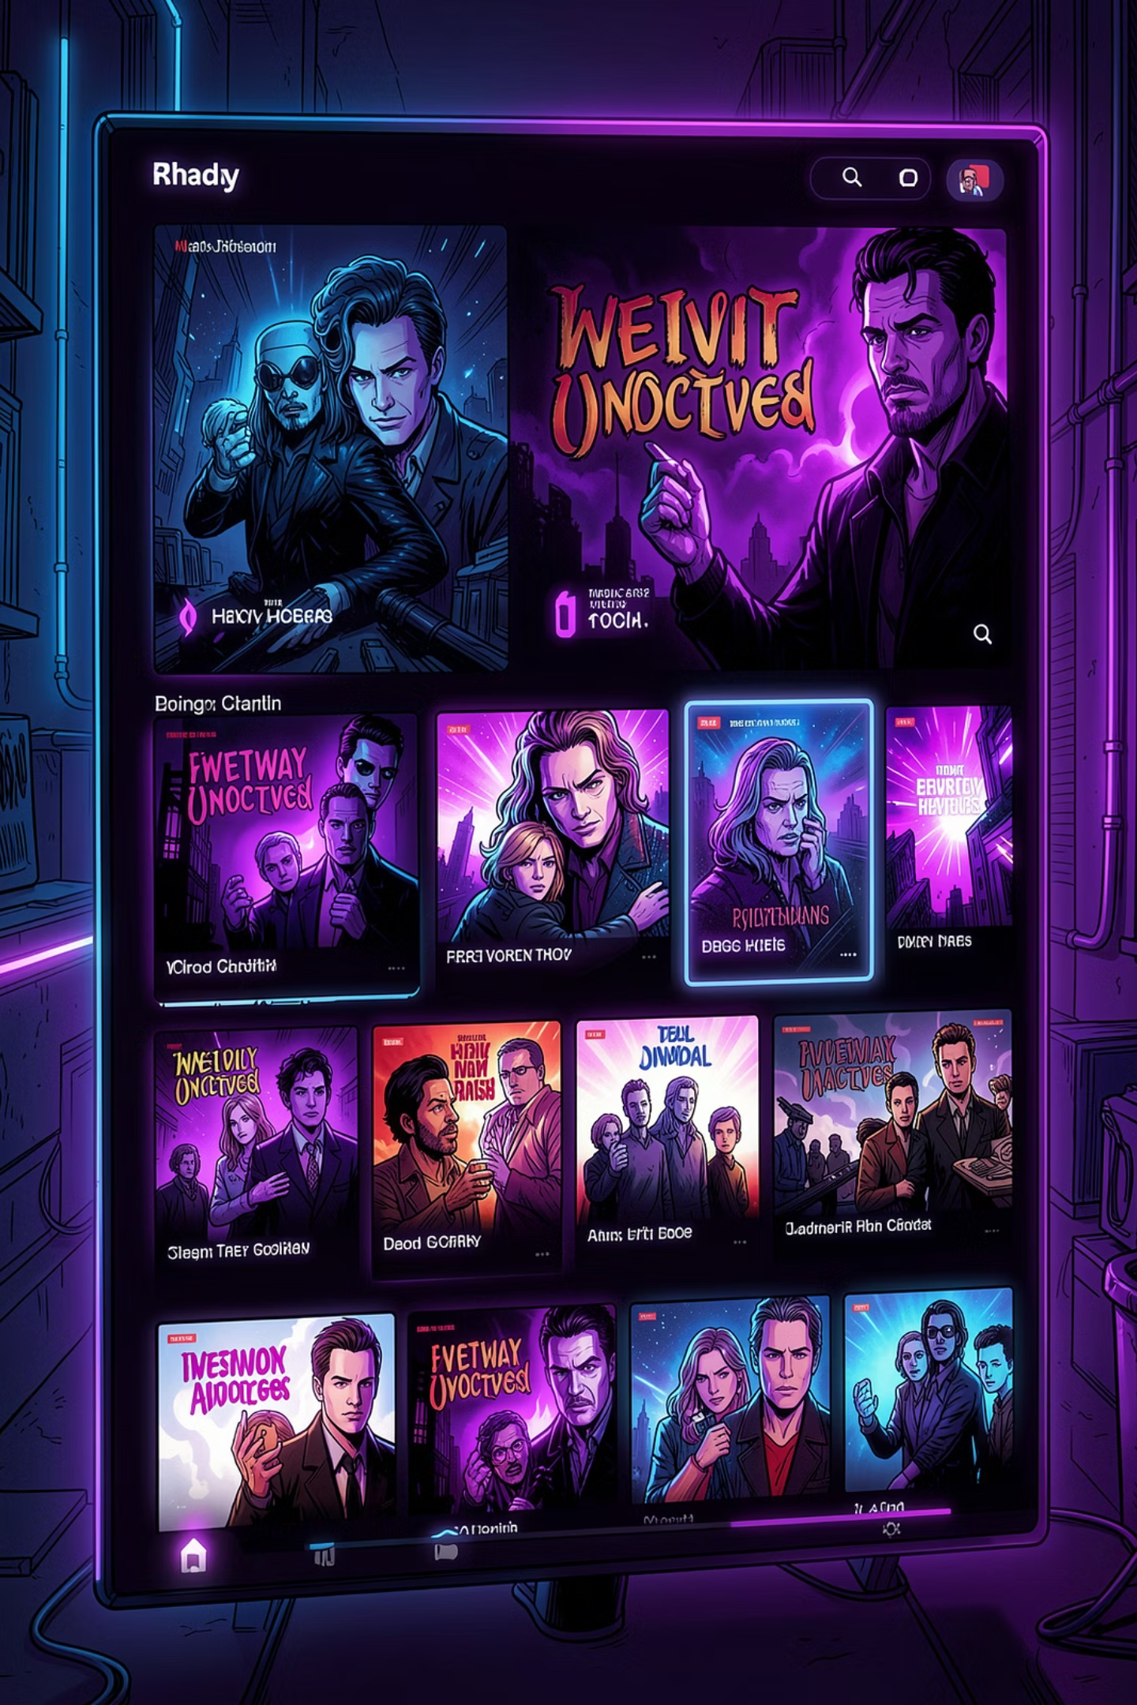
Netflix Movies Analysis
End-to-End Data Analytics Project — uncovering trends, patterns, and insights from 9,800+ movies using Python, PostgreSQL, and Power BI.
PYTHON
POSTGRESQL
POWER BI

Slide 2
Project Overview
This project analyzes Netflix movie data to discover trends in ratings, popularity, genres, and languages — transforming raw data into actionable business insights through a complete analytics pipeline.
01
02
03
Clean & Preprocess
Exploratory Data Analysis
Store in PostgreSQL
Handle missing values, duplicates, and data types
Visualize distributions, trends, and correlations
Load cleaned data into a relational database
04
05
SQL Business Insights
Power BI Dashboard
Write queries to extract meaningful patterns
Build an interactive, stakeholder-ready report

Slide 3
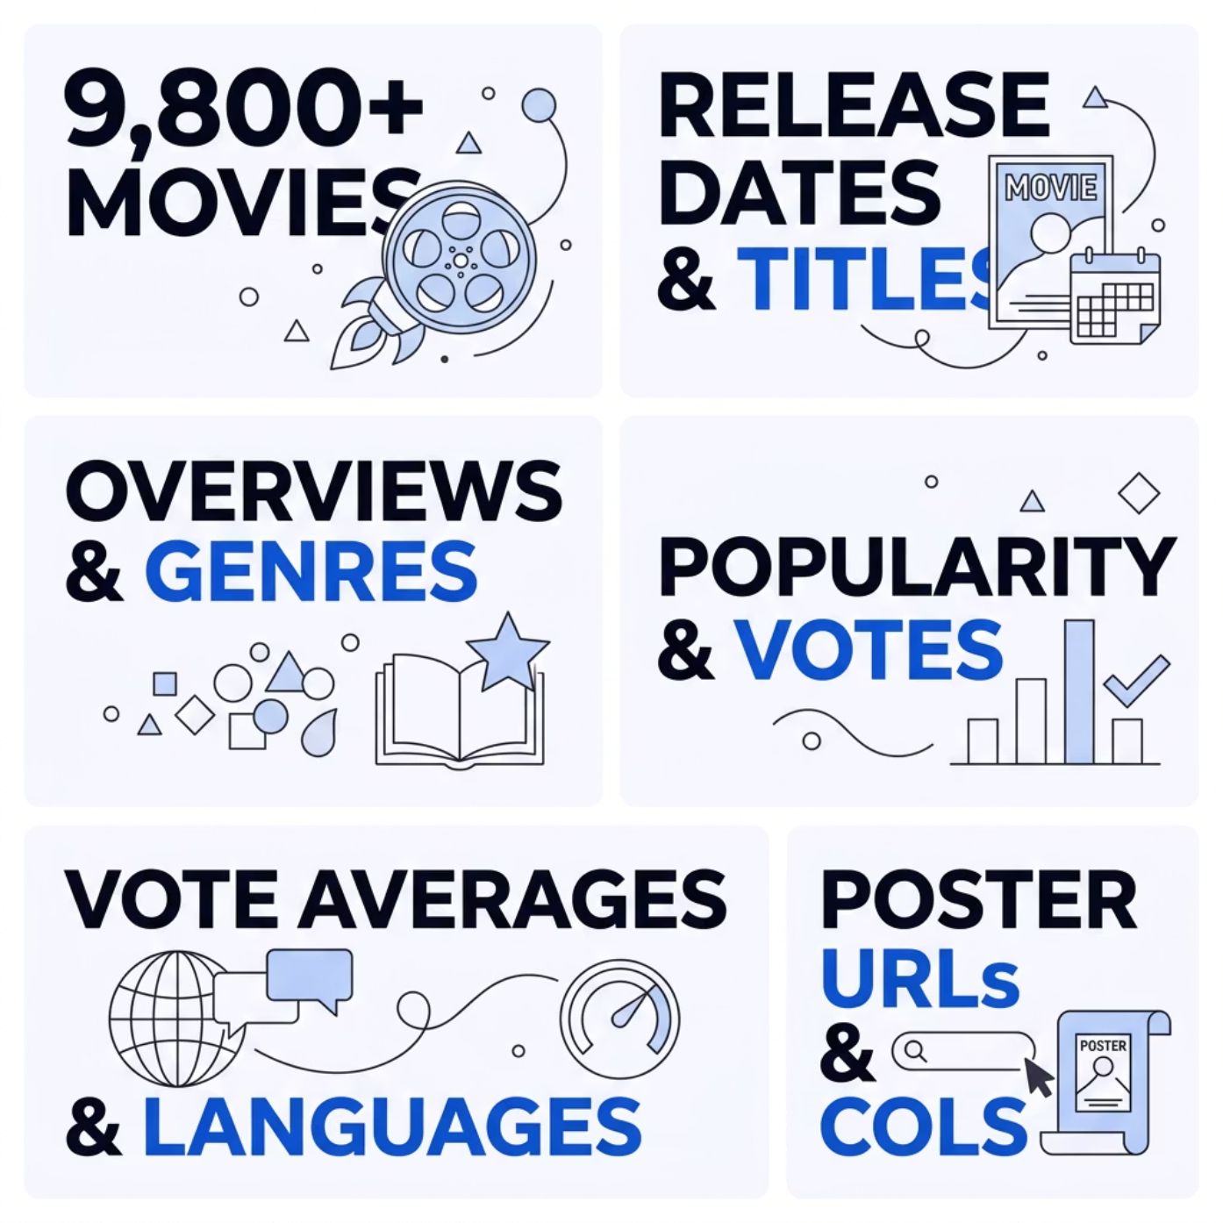
Dataset at a Glance
What's Inside
The dataset captures a rich snapshot of Netflix's movie catalog — spanning release metadata, audience ratings, popularity scores, and genre classifications across nearly 10,000 titles.
~9,800 Movies
9 Columns
Comprehensive global catalog
Rich feature set per title

Slide 4

Technology Stack
A modern, industry-standard toolkit spanning the full data analytics lifecycle — from data wrangling to interactive dashboards.
Python
PostgreSQL
Pandas, NumPy, Matplotlib, Seaborn — data manipulation and visualization
pgAdmin for relational data storage and SQL querying
Power BI
Gamma
Interactive dashboards with drill-down and filter capabilities
Modern presentation design for portfolio delivery

Slide 5

Data Cleaning & Preprocessing
Inspect
Transform
Validate
Export
A rigorous cleaning pipeline ensured data reliability before any analysis. All null records were removed, data types were standardized, and release dates were parsed to enable year-level extraction. The final dataset is 100% complete with no duplicates.

Slide 6
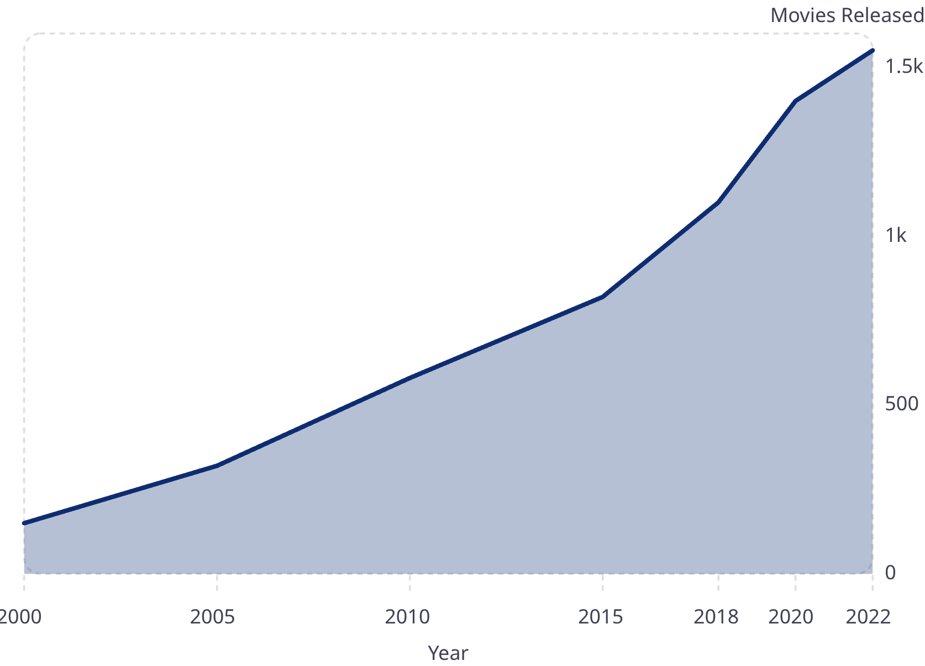
Exploratory Data Analysis
Analyses Performed
Movies Released Per Year
Release Trends
Movie volume by year
Genre Distribution
Most common categories
Language Breakdown
Global content spread
Popularity vs Ratings
Correlation analysis
Movie releases grew sharply after 2000, peaking in 2020–2022 as streaming content expanded rapidly.

Slide 7
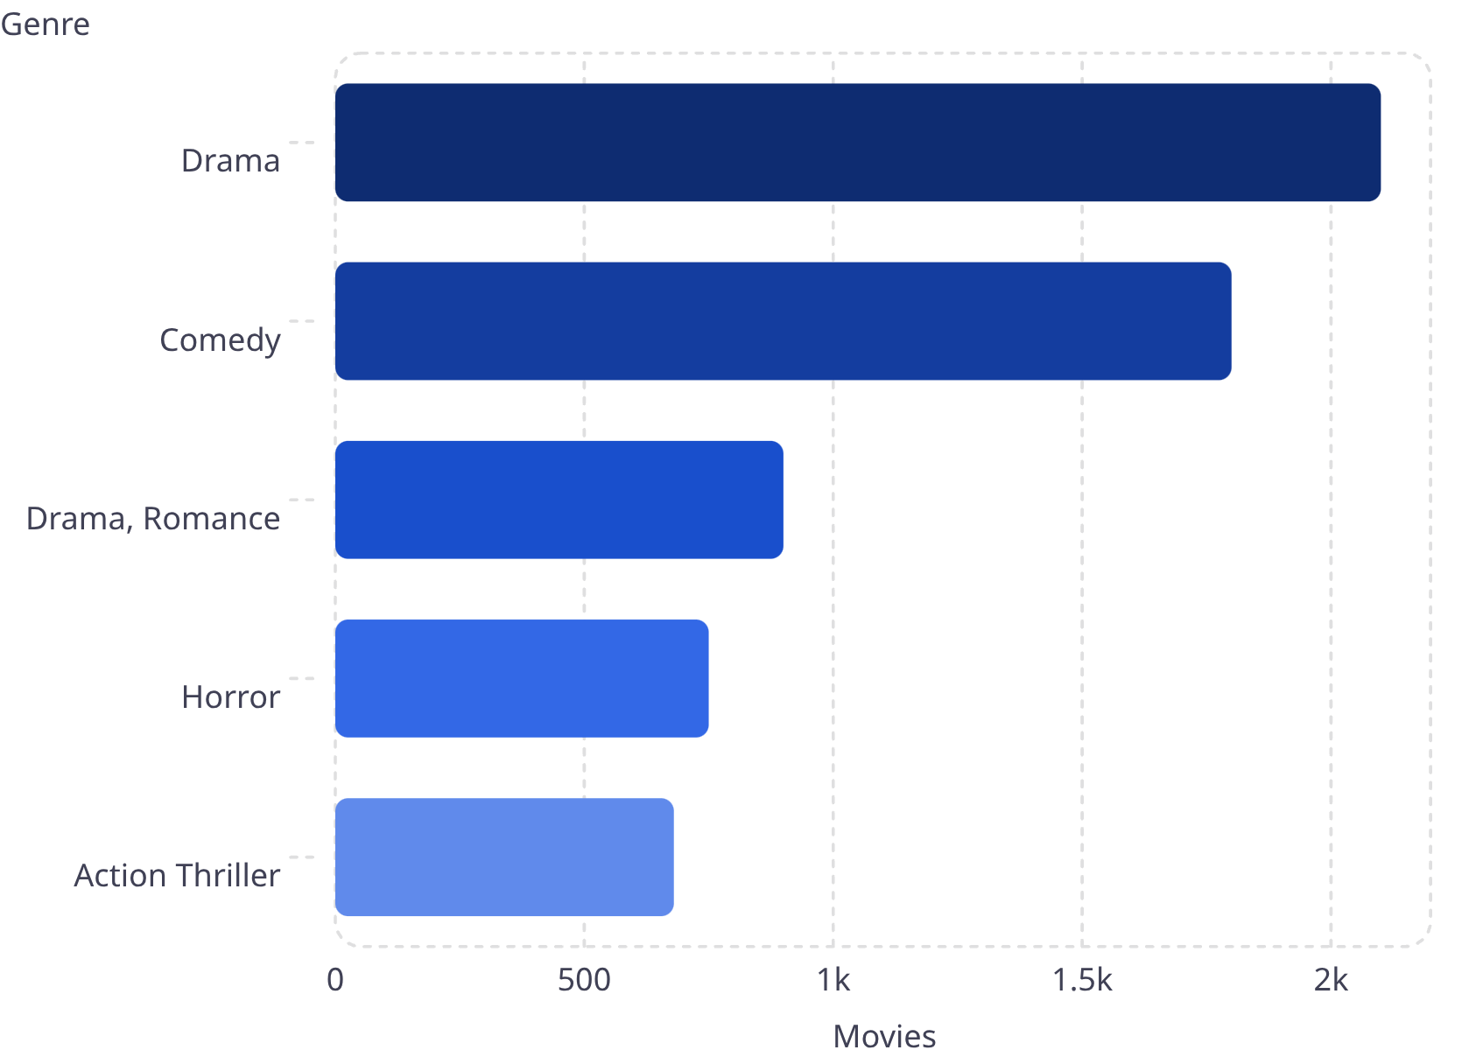
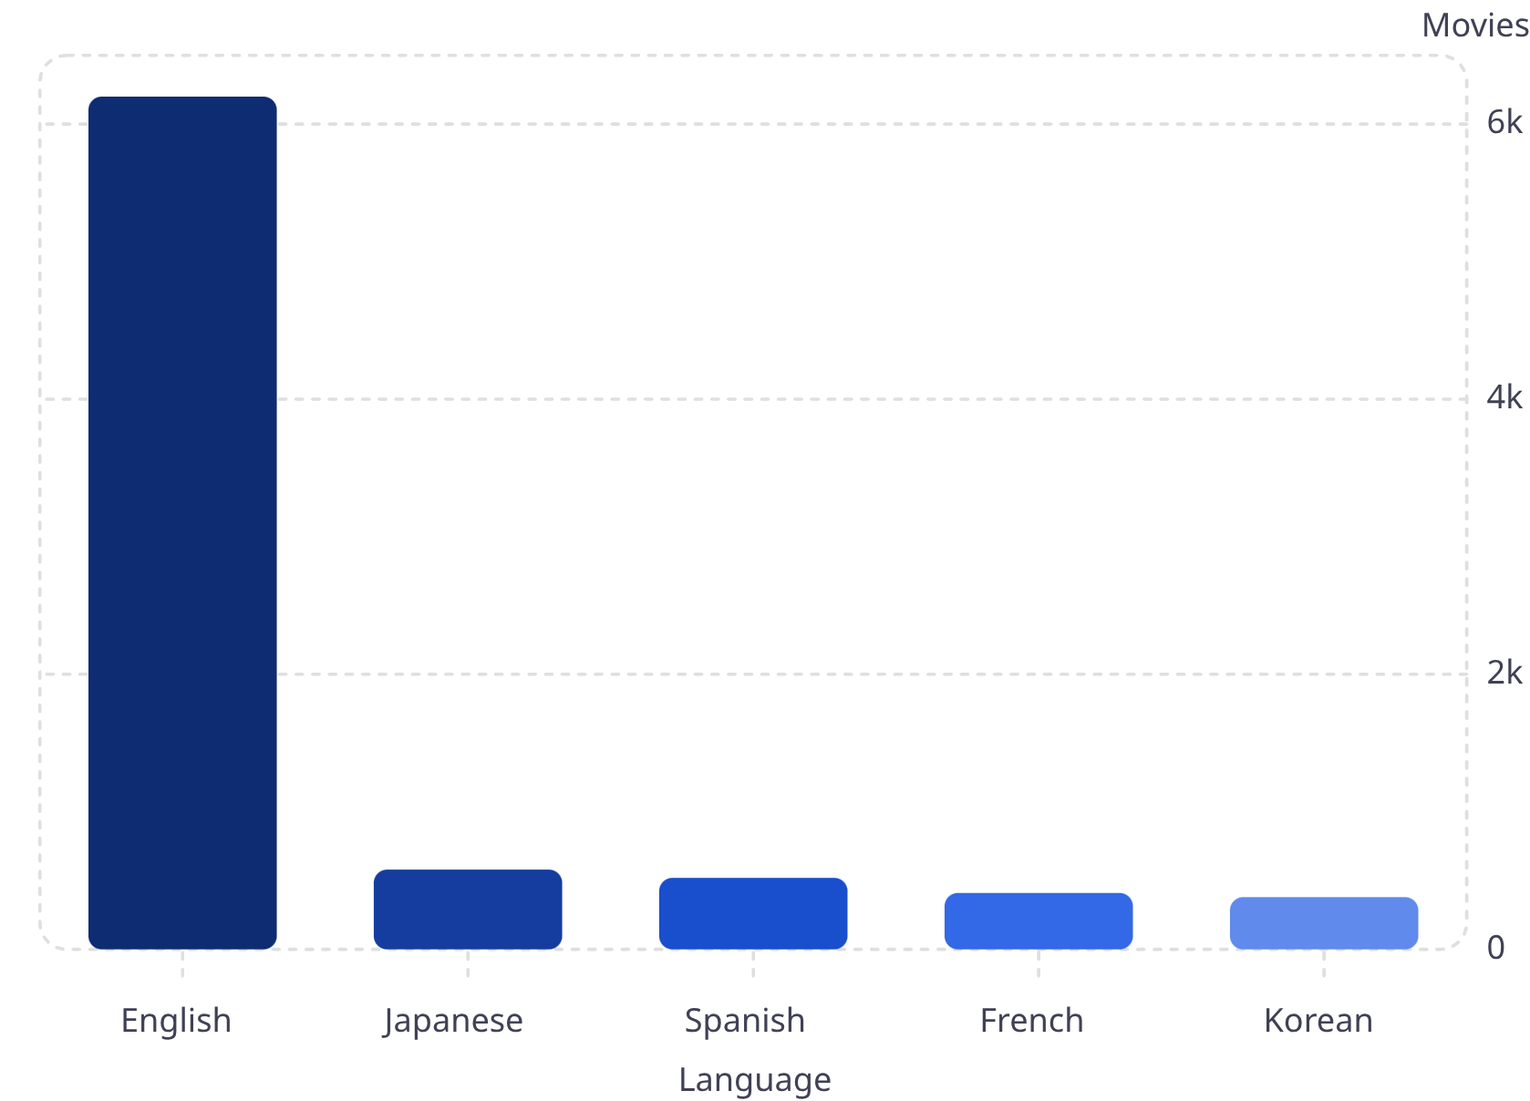
Genre & Language Insights
Top Genres by Volume
Top Languages
English dominates the catalog with over 63% of all titles. Drama and Comedy together represent the largest share of content genres.

Slide 8
SQL Analysis & Power BI Dashboard
SQL Queries Executed
Power BI Dashboard Pages
Total Movies
Top Genres & Languages
Page 1
Page 2
Aggregate count by category
Executive Overview — KPIs and high-level trends
Language Analysis — geographic content breakdown
Ranked by volume
Most Popular & Highest Rated
Avg Rating by Language
Page 3
Top-N by popularity and vote average
Cross-language quality comparison
Detailed Movie Analysis — drill-down by genre, year, rating

Slide 9
Key Insights & Business Value
63%
2
English Content
Leading Genres
Dominant language across the Netflix catalog
Drama & Comedy drive the majority of titles
10x
~0
Release Growth
Popularity–Rating Correlation
Movie volume grew ~10x from 2000 to 2022
High ratings do not guarantee high popularity
These findings support data-driven content decisions — from genre investment and language localization to understanding what truly drives audience engagement on the platform.

Slide 10
Conclusion & Thank You
This project demonstrates end-to-end data analytics capability — from raw data to interactive insights — using Python, PostgreSQL, and Power BI in a cohesive, production-style workflow.
Data Cleaning
EDA
PostgreSQL
SQL Queries
Power BI
Questions & Discussion Welcome
LINKEDIN: [WWW.LINKEDIN.COM/IN/YUG-CHAUDHARY-401647291]
GITHUB: [HTTPS://GITHUB.COM/D3ADYUG]

