Slide 1
Zephyr:
Clock Management Subsystem
Dylan Velasco
10.09.2026

Slide 2
Clock Management Subsystem
Subsystem for managing clock tree reconfiguration, abstracting implementation details (static and dynamic).
Peripherals request specific clock tree configuration/frequency via the framework.
States:
  Specific configuration of a clock tree path.
  Specific output frequency
Requires knowledge of the SoC clock tree architecture

Slide 3
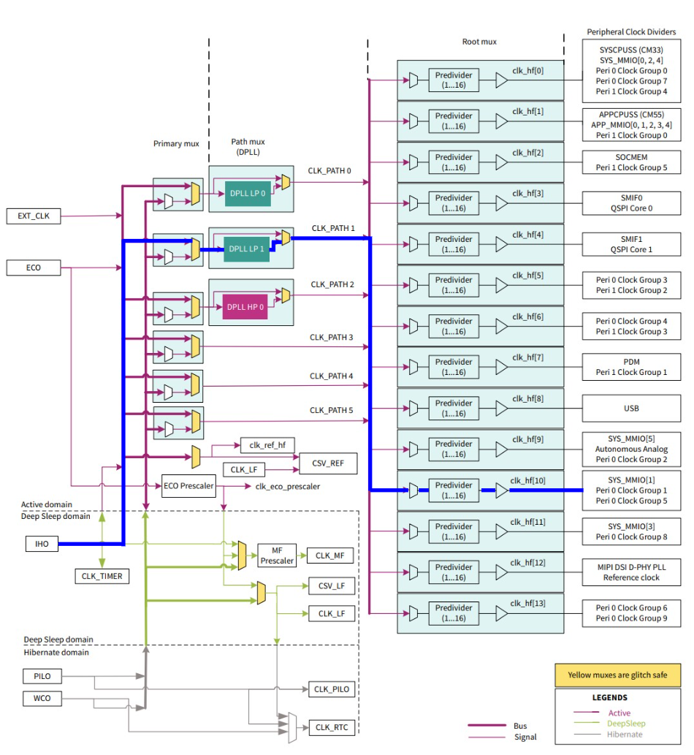
Clock Management Subsystem
App developer defines the specific configuration of a clock path.
As many configurations as needed.
Described through Zephyr's devicetree.
It creates a dependency chain.

Slide 4
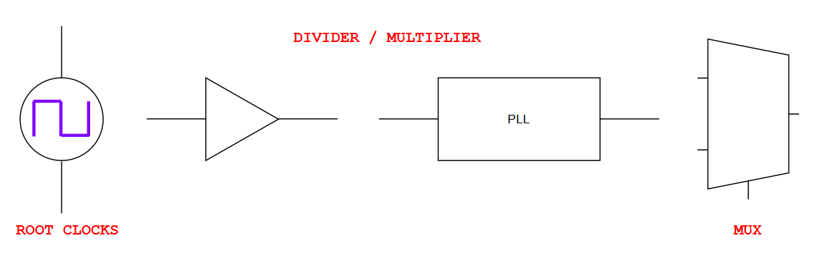
Clock Tree: Producers
Any element whose main function is to take one or multiple input frequencies and produce an output frequency.

Slide 5
Clock Tree: Producers
Each producer is represented as a device tree node.
The clock tree is defined through references between producers.
Each reference specifies the parent of a given producer.
The complete clock tree topology is statically described at compile time.

Slide 6
Clock Tree: Producers
clk_iho: clk_iho {
clock-frequency = < 0x2faf080 >;
system-clock = < 0x1 >;
status = "okay";
#clock-cells = < 0x1 >;
compatible = "infineon,clock-root";
};
path_mux1: path_mux1 {
system-clock = < 0xb >;
instance = < 0x1 >;
compatible = "infineon,clock-mux";
input-sources = < &clk_iho >;
};
dpll_lp1: dpll_lp1 {
compatible = "infineon,clock-pll";
system-clock = < 0x18 >;
reference-div = < 0x7 >;
clock-frequency = < 0x17d78400 >;
feedback-div = < 0x38 >;
output-div = < 0x1 >;
input = < &path_mux1 >;
};
clk_hf10: clk_hf10 {
system-clock = < 0x12 >;
instance = < 0xa >;
compatible = "infineon,clock-hf";
clock-div = < 0x3 >;
input-sources = < &dpll_lp1 >;
};

Slide 7
Clock Tree: Producers
The subsystem classifies each producer into one of three logical types based on its function:
    Standard: Scales the input frequency by a configurable factor.
    Mux: Selects one input signal from multiple available sources.
    Root: Generates the base clock signal
What does it mean?
The clock tree is split into the smallest possible logical components.
Each producer encapsulates a single operation and has its own driver.

Slide 8
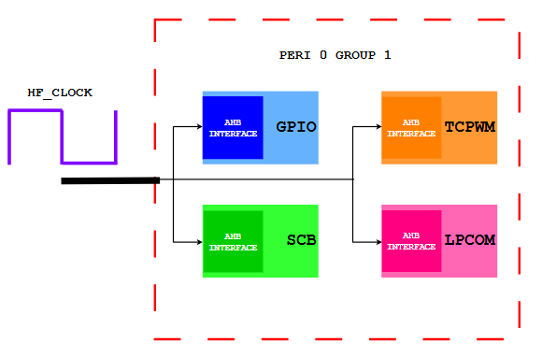
Clock Tree: Consumers
Any element that uses the frequency produced by the clock tree.
May request states ≈ specific operation frequencies.

Slide 9
Clock Tree Consumers
SCB or GPIO peripherals request their operating frequency.
The subsystem reconfigures the clock path.

Slide 10
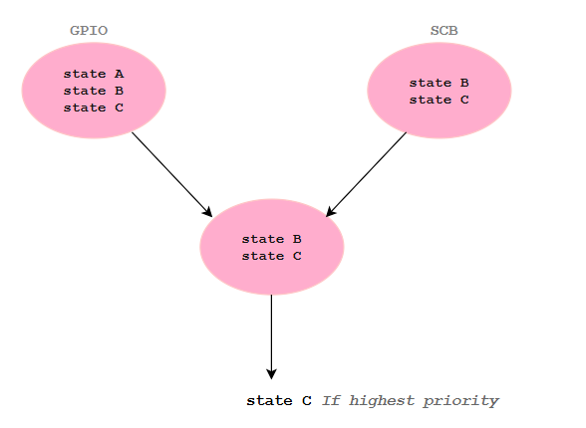
Clock Tree Consumers
Each consumer can request not just one state, but a set of states
The subsystem intersects all requests and picks the highest-priority state
If none matches all consumers, it returns a negative error code that must be handled by the developer

Slide 11
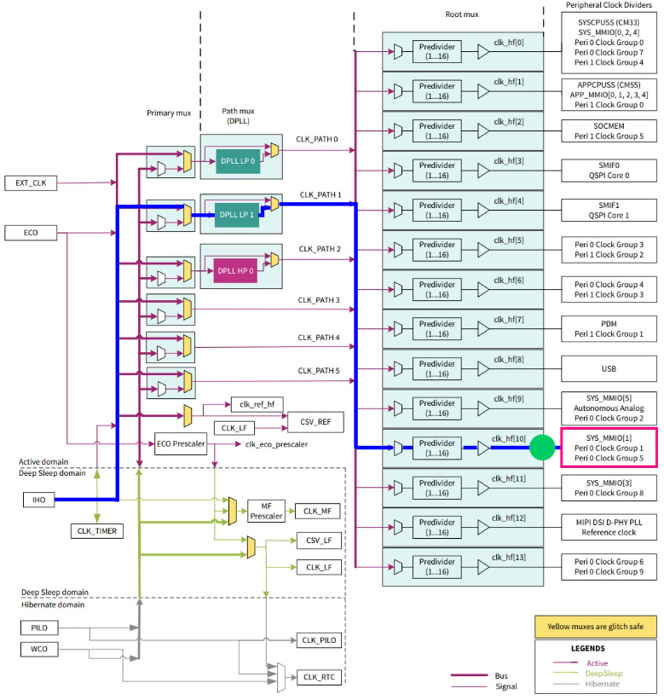
Clock Tree: Clock Output
Represent logical connection points between producers and consumers.
Define the states that consumers can request and producers can generate.
They are the communication interface between both worlds.

Slide 12
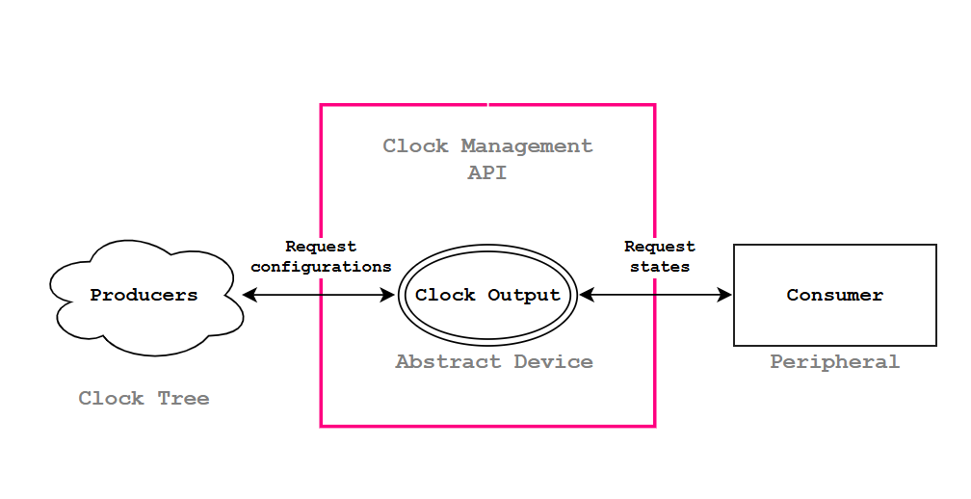
Framework Architecture
Consumers request specific clock tree configurations.
Reference a clock output node to identify the clock path to configure.
The subsystem recursively applies configuration from nearest producer up to to the root.

Slide 13
Clock Tree: Producer Driver
Producers are represented by a dedicated structure, struct clk:
  Hardware-specific data
  A reference to the clock's API
  Lists of the clock’s parents and children
Driver follows Zephyr’s style, but use _CLOCK_ macros instead of _DEVICE_ macros:
Has a smaller memory footprint.

Slide 14
Clock Tree: Output Nodes
Must be defined as leaf nodes in the device tree:
  Child of the last producer node in the clock tree
  Its compatible needs to be ‘clock-output’.
  Its driver is implemented by the subsystem, since it's an abstract node.
  Clock consumers will reference these nodes to request states.
&clk_hf10 {
clk_output_hf10: clk_output_hf10 {
#clock-cells = <0>;
compatible = "clock-output";
};
};

Slide 15
Clock Tree: Output Nodes
Each clock output defines a set of states:
  Different specific configurations of the clock path associated with that output.
  Consumers choose one or more of these available states to get a frequency.
  For many chosen states, the subsystem chooses the best according to a rank specifier.
  Producers within the clock path are reconfigured when a new state is selected
&clk_output_hf10: clk_output_hf10 {
clk_output_hf10_default_state: clk_output_hf10_default_state {
compatible = "clock-state";
clocks = <&clk_iho 0x2faf080>, <&path_mux1 0>, <&dpll_lp1 1 0 56 7 1 1 0>, <&clk_hf10 0 3>;
rank = <0>;
};
};

Slide 16
Clock Tree: Consumers
Consumers set request to get specific frequencies:
  Are a set of chosen available states in the clock output they belong to.
  Consumers choose one or more of these available states to get a frequency.
  The subsystem selects the lowest ranked state.
&scb2 {
compatible = "infineon,scb_uart";
clock-outputs = <&clk_output_hf10>;
clock-output-names = "uart_clk";
clock-request-0 = <&clk_output_hf10_default_state>;
clock-request-names = "default";
};

Slide 17
Clock Tree: Consumer Driver
It needs to define and initialize a clock_management_data structure:
  Reference to its clock output
  Clock requests declared by the consumer
  Stored within the device's config structure
This structure is then passed to the API functions to access the clock tree.
int clock_management_on(const struct clock_management_data *data, clock_output_t clk)

Slide 18
Call Stack Example
Thread Name Thread ID CPU Mode Timestamp Function(s)
------------------------------------------------------------------------------------------------
main 0x3403a240 0) 0 | 1829940 ns | instrumentation_trigger(); → User function
main 0x3403a240 0) 0 | 1988990 ns | ifx_cat1_uart_clk_on() { → User function
main 0x3403a240 0) 0 | 2032660 ns | clock_management_on() { → Framework entry point function
main 0x3403a240 0) 0 | 2078945 ns | arch_irq_lock();
main 0x3403a240 0) 0 | 2160865 ns | clock_management_onoff() { → Main function that handles powering on and off of clock producers
main 0x3403a240 0) 0 | 2205315 ns | clock_onoff() {
main 0x3403a240 0) 0 | 2251635 ns | hf_clock_onoff() {
main 0x3403a240 0) 0 | 2297555 ns | Cy_SysClk_ClkHfEnable(); → HF clock enable function
main 0x3403a240 0) 0 | 2375765 ns | }; /* hf_clock_onoff */
main 0x3403a240 0) 0 | 2414060 ns | }; /* lock_onoff */
main 0x3403a240 0) 0 | 2456800 ns | clock_get_type(); → Type of producer (Standard, root, mux)
main 0x3403a240 0) 0 | 2533830 ns | clock_get_type();
main 0x3403a240 0) 0 | 2613145 ns | clock_get_parent() { → Gets parent of HF clock
main 0x3403a240 0) 0 | 2654155 ns | ifx_hf_get_parent();
main 0x3403a240 0) 0 | 2731690 ns | }; /* clock_get_parent */
main 0x3403a240 0) 0 | 2775615 ns | clock_onoff() {
main 0x3403a240 0) 0 | 2820415 ns | pll_on_off() {
main 0x3403a240 0) 0 | 2867605 ns | Cy_SysClk_DpllLpEnable(); → PLL enable function
main 0x3403a240 0) 0 | 2951550 ns | }; /* pll_on_off */
main 0x3403a240 0) 0 | 2988975 ns | }; /* clock_onoff */
main 0x3403a240 0) 0 | 3026700 ns | clock_get_type();
main 0x3403a240 0) 0 | 3101900 ns | clock_get_type();
main 0x3403a240 0) 0 | 3179540 ns | clock_onoff() {
main 0x3403a240 0) 0 | 3221935 ns | mux_clock_onoff();
main 0x3403a240 0) 0 | 3304170 ns | }; /* clock_onoff */
main 0x3403a240 0) 0 | 3343390 ns | clock_get_type();
main 0x3403a240 0) 0 | 3418595 ns | clock_get_type();
main 0x3403a240 0) 0 | 3493845 ns | clock_get_parent() { → Gets parent of PLL
main 0x3403a240 0) 0 | 3534695 ns | ifx_cat1_mux_get_parent() {
main 0x3403a240 0) 0 | 3581245 ns | Cy_SysClk_ClkPathGetSource();
main 0x3403a240 0) 0 | 3662350 ns | }; /* ifx_cat1_mux_get_parent */
main 0x3403a240 0) 0 | 3702315 ns | }; /* clock_get_parent */
main 0x3403a240 0) 0 | 3740010 ns | clock_onoff() {
main 0x3403a240 0) 0 | 3785110 ns | root_clock_onoff(); → Root‘s ON function
main 0x3403a240 0) 0 | 3870970 ns | }; /* clock_onoff */
main 0x3403a240 0) 0 | 3910190 ns | clock_get_type();
main 0x3403a240 0) 0 | 3985060 ns | }; /* clock_management_onoff */
main 0x3403a240 0) 0 | 4023960 ns | arch_irq_unlock();
main 0x3403a240 0) 0 | 4099110 ns | }; /* clock_management_on */
main 0x3403a240 0) 0 | 4136345 ns | }; /* ifx_cat1_uart_clk_on */
main 0x3403a240 0) 0 | 4178180 ns | instrumentation_stopper();

Slide 19
Personal Feedback
Simpler than other subsystems (e.g., Power Management).
Powerful tool for static and dynamic reconfiguration of the clock tree.
Still under development: documentation is not very clear and the subsystem is prone to changes.

