Slide 1
NPRG044: OSGi framework
Michal Malohlava & Pavel Parízek
& Jiří Vinárek
vinarek@d3s.mff.cuni.cz

Slide 2
Step #1:
Download Eclipse 4.5 (Mars) RCP
http://www.eclipse.org/downloads/packages/release/Mars/2

Slide 3
Do you use JARs?

Slide 4
JAR advantages and disadvantages
+ Includes class files and additional resources
+ Deployment
No information hiding
No runtime meaning
Cannot specify required JARs
No versioning
OK, it’s not completely true, but JARs classpath is almost entirely useless

Slide 5
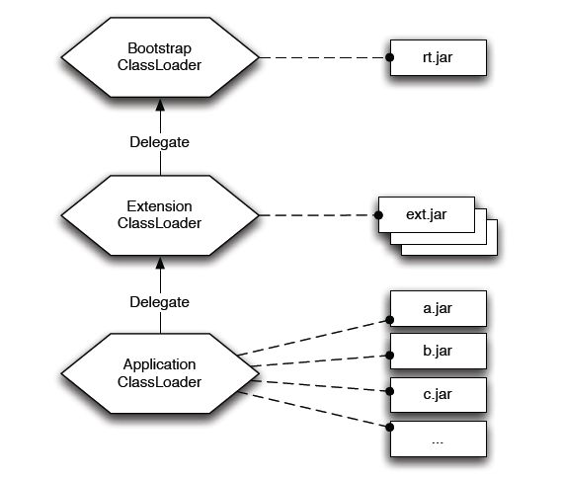
Common Java classloading
Cannot handle different versions of the same class
The picture was taken from the book “OSGi in Practice” written by Neil Bartlett
See http://njbartlett.name/osgibook.html

Slide 6
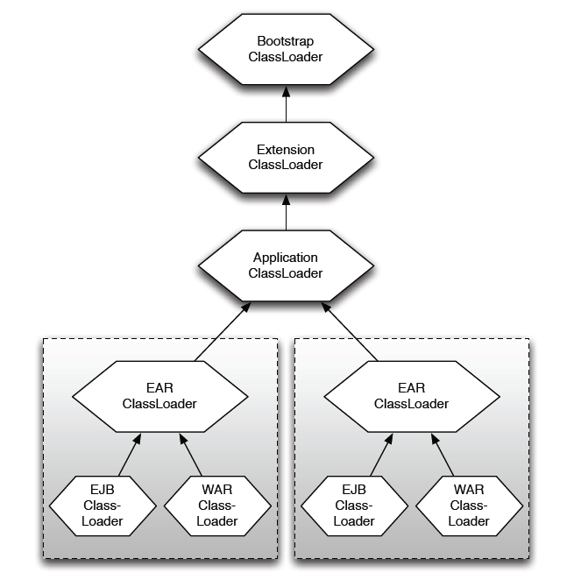
J2EE classloading
The classloader has precedence over all classloaders below =>
all applications have to use the same version of the core library
The picture was taken from the book “OSGi in Practice” written by Neil Bartlett
See http://njbartlett.name/osgibook.html

Slide 7
OSGi
OSGi is a specification
Open Service Gateway initiative
Current version R6 (see http://www.osgi.org/)
Five parts + Java API + execution environment specification
Core
Compendium
Enterprise
Residential
Mobile
Specifies
Framework
Modules
Provided services
Additional functionality

Slide 8

OSGi framework
Framework to build modular applications
“LEGO principle”
Fine-grained modules which are
Reusable
Scalable
Isolated
Bringing separation of concepts
Modules should be “easily” testable, manageable, maintainable, repairable, exchangeable
Bringing abstraction

Slide 9
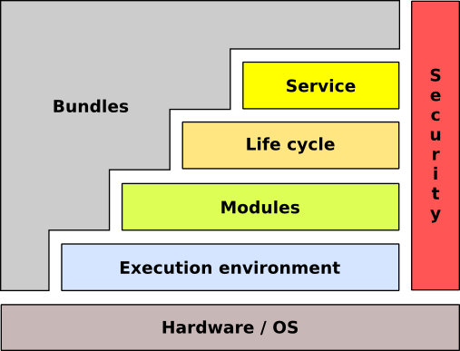
OSGi framework conceptual architecture
The picture was taken from the book “OSGi in Practice” written by Neil Bartlett
See http://njbartlett.name/osgibook.html

Slide 10
OSGi basic concepts
Bundle
Module
Unit of deployment
Service
Communication between components

Slide 11
Bundle
Unit of deployment
Classical JAR with meta-information
Class files
Additional resources (images, videos, source code, …)
Directories containing meta-information (META-INF, OSGI-INF)
Bundle is versioned
Major, minor, micro, qualifier (1.0.3_rc2)
Multiple versions at runtime are allowed
Bundle can export/hide packages
Recommended practice: ”Exposing only API not implementation”
Declarative dependencies
Bundles
Packages
Range of version [1.0, 2.0)

Slide 12
Bundle meta-information
Manifest META-INF/MANIFEST.MF
Manifest-Version: 1.0
Bundle-ManifestVersion: 2
Bundle-Name: LogTargetBundle
Bundle-Activator: LogTargetActivator
Bundle-SymbolicName: cz.cuni.mff.d3s.LogTargetBundle
Bundle-Version: 1.0.0.qualifier
Bundle-Vendor: D3S MFF UK
Bundle-RequiredExecutionEnvironment: JavaSE-1.6
Import-Package: cz.mff.cuni.d3s.nprg044.tut1.test01.api, org.osgi.framework;version="1.5.0", org.osgi.service.component;version="1.1.0", org.osgi.service.log;version="1.3.0“
Service-Component: OSGI-INF/componentOne.xml, OSGI-INF/factory.xml
The length of each line is limited to 72 bytes
by the design of JVM

Slide 13
Bundle dependencies
Export-Package: cz.*;
exclude=”*Impl”
Export packages
List all of packages + versions + attributes
Fine-grained package filtering
exclude, include, parameters
Import package
Require specific version(s)
e.g. [1.0, 2.0)
Resolution: optional/mandatory
Require bundle
Not recommended because it restricts further changes in the API
Import-Package: cz.mff.*;
version=”[1.0,1.3.1)”;resolution=optional
Require-Bundle: logger-api-bundle

Slide 14
MANIFEST.MF headers
Bundle-ClassPath
Way to bundle third-party JAR libraries
Bundle-Activator
Name of the class implementing BundleActivator
The class is called when the bundle is activated
Bundle-SymbolicName
Bundle ID
Bundle-Version
1.0.3.qualifier (qualifier corresponds to timestamp)
Bundle-RequiredExecutionEnvironment
Enforces the execution context
DynamicImport-Package
On-the-fly import
Bundle-NativeCode
Import .so, .dll

Slide 15
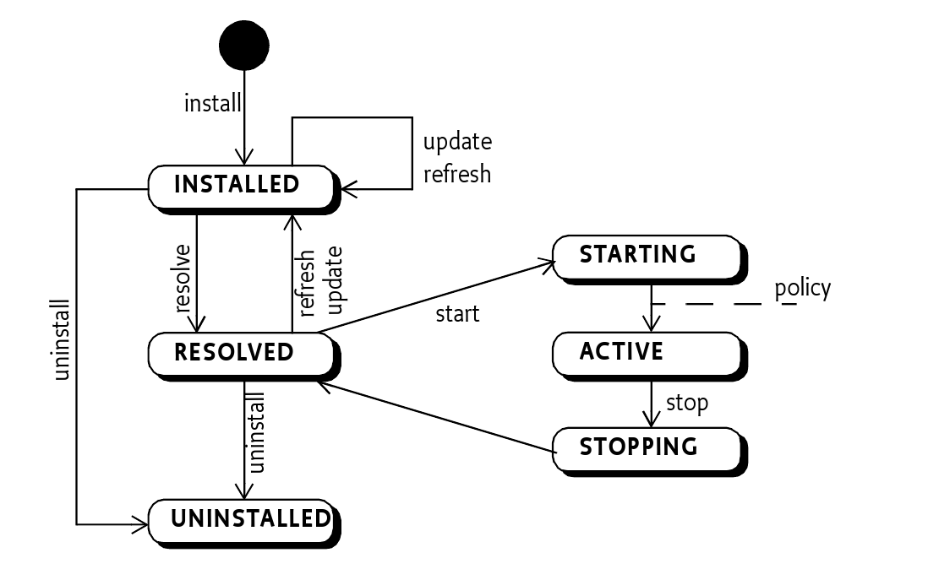
Bundle lifecycle
The picture was taken from the book “OSGi in Practice” written by Neil Bartlett
See http://njbartlett.name/osgibook.html

Slide 16
Bundle lifecycle - activation
Manage the bundle lifecycle
class BundleActivator
void start(BundleContext ctx)
Register services and listeners, look for services
void stop(BundleContext ctx)
Stop trackers and listeners, …
class BundleContext
Properties
Services
Bundles
Filters
Listeners
public class SimpleLogTargetActivator extends Activator {
@Override
public void start(BundleContext ctx){
/* ... */
}
@Override
public void stop(BundleContext ctx) {
/* ... */
}
}

Slide 17
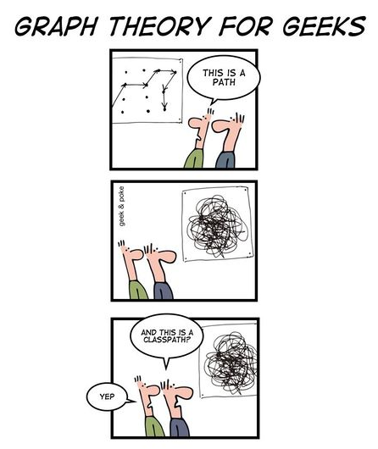
OSGi classloading
The picture was taken from the OSGi wiki
See http://wiki.osgi.org/wiki/Main_Page

Slide 18
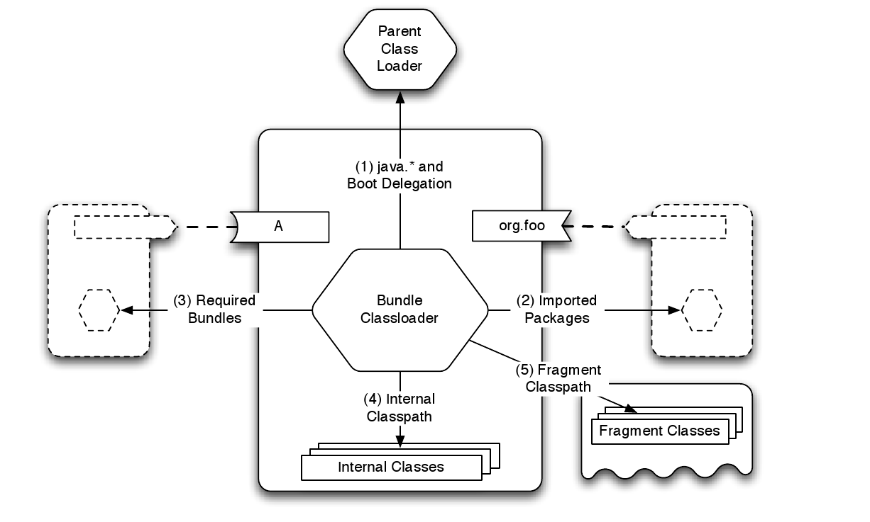
OSGi classloading
Separated classloader per bundle
Classloaders do not compose a tree, but a general graph
Lookup order
Parent
only for classes from the java.* packages
Imported packages
Required bundles
Local bundle classpath
The picture was taken from the book “OSGi in Practice” written by Neil Bartlett
See http://njbartlett.name/osgibook.html

Slide 19
Bundle classpath
Bundle classpath is composed of classes from
Imported packages
Provisions of required bundles
Local classpath specified via Bundle-Classpath

Slide 20
OSGi Console
Important commands
help
ss
Displays installed bundles
services
Displays published services
status
exit
Shutdown the OSGi framework
start/stop <bundle-id>
update <bundle-id>
packages
Shows exported packages
diag
Run diagnostic

Slide 21
Demo #01
Download Eclipse 4.5 (Mars) RCP
http://www.eclipse.org/downloads/packages/release/Mars/2
Create a simple bundle with activator
Via wizard in “New > Project > Plug-in Project”
Select “an OSGi framework” and “Equinox” as Target Platform
Run the bundle
Create new OSGi launch configuration & launch it
Add bundle org.eclipse.osgi
Add bundles needed for OSGi console: org.apache.felix.gogo.command, org.apache.felix.gogo.runtime, org.apache.felix.gogo.shell and org.eclipse.equinox.console
Check that all dependencies are satisfied using “Validate Bundles” button
In “Arguments > VM arguments” delete “-XX:MaxPermSize=256m” if you are using JRE 1.8
Observe its state in the console

Slide 22
Service
Communication layer for bundles
Well-defined communication points
Inherent dynamic nature
Can appear/disappear any time at runtime
Multiple providers can provide the same service
The service has additional properties (e.g., priority)
Service
Service is an object registered by a bundle in a ServiceRegistry
Programmatically
Declaratively
Service has associated properties
E.g., service.ranking

Slide 23
Registering service (1)
Programmatically in BundleActivator
Problems
Semantics spread over the code
dependencies, properties, implementation versus interface
public void start(BundleContext context) {
SimpleLogTargetImpl logTargetImpl = new SimpleLogTargetImpl();
registration = context.registerService(
ILogTarget.class.getName(),
logTargetImpl,
null);
}

Slide 24
Registering service (2)
Declarative services (DS)
Declaratively
Services provided by components
Automated service management by DS framework
Dependency injection of required services
Life-cycle management
<scr:component name="logger-component“
enable=“true” activate=“activate”>
<implementation class="cz.cuni...LoggerImpl"/>
<service>
<provide interface="cz...ILogger"/>
</service>
</scr:component>

Slide 25
Service components
Component is a normal Java class contained within a bundle
Defined in a separate XML file in the OSGI-INF directory
MANIFEST.MF
has to contain component file reference: Service-Component: OSGI-INF/component.xml
Activation
Declared method
Parameters: ComponentContext, BundleContext,
Map, component property type
Service provider
Specify name of the provided service
<scr:component name=“logger-component”
activate=“activate”>
<implementation class="cz.cuni...LoggerImpl"/>
<service>
<provide interface="cz...ILogger"/>
</service>
</scr:component>

Slide 26
Component factories
A component can be declared as a factory
ComponentFactory service is registered
newInstance(Dictionary d) method
The user tracks for the ComponentFactory service and creates a new instance
A component factory can provide a service
Registered for each created instance

Slide 27
Demo #02
Create a bundle that defines some API
API: a set of Java interfaces
Implement two bundles implementing the API
Register API services
Programmatically
Declaratively
Launch configuration has to contain the bundle ‘org.eclipse.equinox.ds’
Observe provided services in console (command services)

Slide 28
Service consumption (1)
Bundle can search for a service that implements a specific interface
Several bad solutions
context.getService(...)
Nasty code with active waiting
Service registry listeners
Recommended solutions (thread-safe)
Service tracker
Components
ServiceReference ref =
context.getServiceReference(“cz.bar”);
if (ref!=null) {
Bar bar = (Bar) context.getService(ref);
if (bar != null) {
...
context.ungetService(ref)
}
}

Slide 29
Service tracker – white board pattern
Service dependencies
Content provider versus consumers
e.g., consume a new service if and only if the specified service appears
“Don't look for content providers, let them to register as services and track for the services”
ServiceTracker captures the service life-cycle
via ServiceTrackerCustomizer
Captures the process of adding/removing/modifying services

Slide 30
Service tracker
Service Tracker
Tracking for services
Filters (name, id, property, owning bundle, ...)
LDAP syntax (e.g. (&(objectName=”foo”)(property1=”Xyz”)) )
//In Bundle Activator - start
tracker = new ServiceTracker(context,
ILogger.class.getName(), null);
tracker.open();
// get the service(s)
ILogger log = (ILogger) tracker.getService();
ILogger log = (Ilogger) tracker.waitForService(1000);
// stop tracking
tracker.close();

Slide 31
Service tracker
Construction determines attributes
ServiceTracker methods
open()/close() – start/stop tracking for a service
getService()
addingService/removedService/modifiedService
Parameter: ServiceReference rf
Interface ServiceTrackerCustomizer
Can be overridden by the user
ServiceTracker(
BundleContext context, java.lang.String clazz, ServiceTrackerCustomizer customizer)

Slide 32
Service consumption (2)
Declaratively via service components
Service reference
Name
Interfaces
Bind/unbind methods
Target
Policy: static/dynamic
Cardinality: M..N
1..1 – if multiple services are accessible then the one with the highest service.ranking is used
<scr:component name=”getServiceComp”>
<implementation class=”GetLoggerService”>
<reference name=”log”
interface=”org.osgi...LogService”
bind=”setLog”
unbind=”unsetLog”
</scr:component>

Slide 33
Service lookup
Lookup strategy
Look for the service during component activation
Event strategy
Let the DS framework inject the service via defined methods
Bind/unbind attributes of the reference declaration
<?xml version="1.0" encoding="UTF-8"?>
<scr:component name="example.listen"
xmlns:scr="http://www.osgi.org/xmlns/scr/v1.1.0">
<implementation class="com.acme.LogLookupImpl"/>
<reference name="LOG"
interface="org.osgi.service.log.LogService"/>
</scr:component>
public class LogLookupImpl {
private void activate(ComponentContext ctxt) {
LogService log = (LogService)
ctxt.locateService("LOG");
}
}

Slide 34
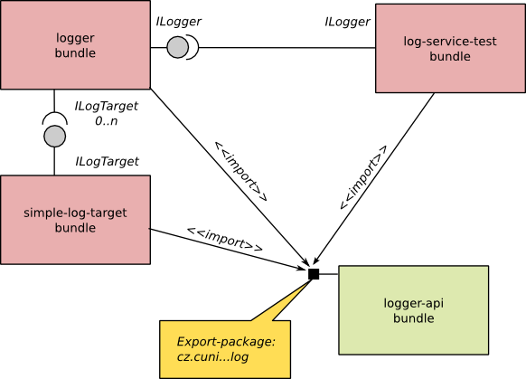
Demo #03
Write a new bundle with a tester component consuming declared services
Possible scenario
Try to call the update command in the console

Slide 35
OSGi services
Logging (LogService)
Http (HttpService)
Exposing registered servlets
Event
Messaging Producer <-> Consumer
Device manager
Diagnostics/Monitoring
JMX
Application manager
Application package – set of resources (bundles, data,...)
Can be deployed/installed
Location/measurement services
Remote services

Slide 36
Demo #04
Use HttpService as an additional implementation of ILogTarget
Introduce a new bundle with a component exposing ILogTarget and requiring HttpService
Register HTTP servlet
Launch configuration has to introduce web-server bundles
Don’t forget on
javax.servlet
org.eclipse.equinox.http.servlet
org.eclipse.equinox.http.jetty
org.eclipse.jetty.*
... and few others (check the error messages)
Specify JVM property: -Dorg.osgi.service.http.port=8080

Slide 37
OSGi 4.2 features
Framework launching
Remote services
Blueprint services
Bundle tracker
Service hooks
Conditional permissions
Enterprise features
Bundling (WAR), JPA, JNDI, JDBC integration

Slide 38
OSGi 4.3 features
Introduction of generics into the OSGi API
Capabilities
Weaving hook
Bytecode modification
and many others

Slide 39
OSGi 5 features
OSGi Bundle Repository (OBR)
Integration with Java ServiceLoader

Slide 40
OSGi applications
Existing applications
BMW service platform
Eclipse
Virgo server (Spring dm Server)
GlassFish J2EE application server
IBM WebSphere J2EE application server
Newton
JBoss, JOnAS
Apache Karaf
Users
Bombardier, Volvo, Siemens, BMW, IBM, Red Hat, Siemens AG, NEC, Oracle

Slide 41
OSGi implementations
Open source
Eclipse Equinox
Many extensions of OSGi (bundle aspects, extension points)
Apache Felix
Based on Oscar (implementation of OSGi R3)
Compliant to OSGi specification R4.2
Knopflerfish
Concierge
Implementation of OSGi R3, optimized for embedded devices
Commercial
ProSyst, Knopflerfish Pro

Slide 42
Bundles repositories
OBR
http://bundles.osgi.org
OSGi compendium implementation
Spring
http://sigil.codecauldron.org/spring-external.obr
http://sigil.codecauldron.org/spring-release.obr
Knopflerfish
http://www.knopflerfish.org/repo/bindex.xml

Slide 43
Resources
OSGi specification
http://www.osgi.org/
Wikipedia
http://en.wikipedia.org/wiki/OSGi
NPRG044 source code
https://github.com/d3slect/nprg044-eclipse-platform

