Slide 1
NPRG044: OSGi framework
michal malohlava
michal.malohlava@d3s.mff.cuni.cz

Slide 2
Step #1:
Download Eclipse RCP
http://www.eclipse.org/downloads/

Slide 3
Do you use JARs?

Slide 4
JAR advantages and disadvantages
+ Includes class files and additional resources
+ Deployment
No information hiding
No dynamicity
Cannot specify required JARs
No versioning
OK, it’s not completely true, but JARs classpath is almost entirely useless

Slide 5
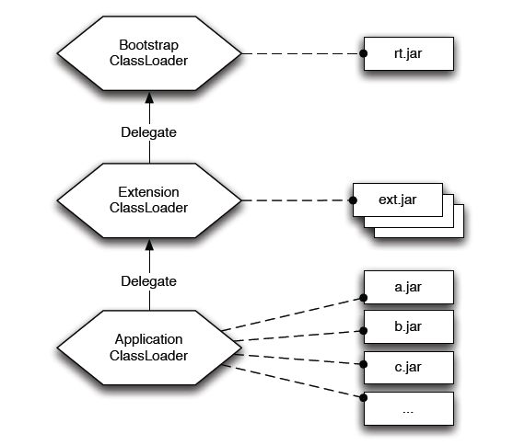
Common Java classloading
Cannot handle different versions of same class
The picture was taken from the book “OSGi in Practice” written by Neil Bartlett
See http://njbartlett.name/osgibook.html

Slide 6
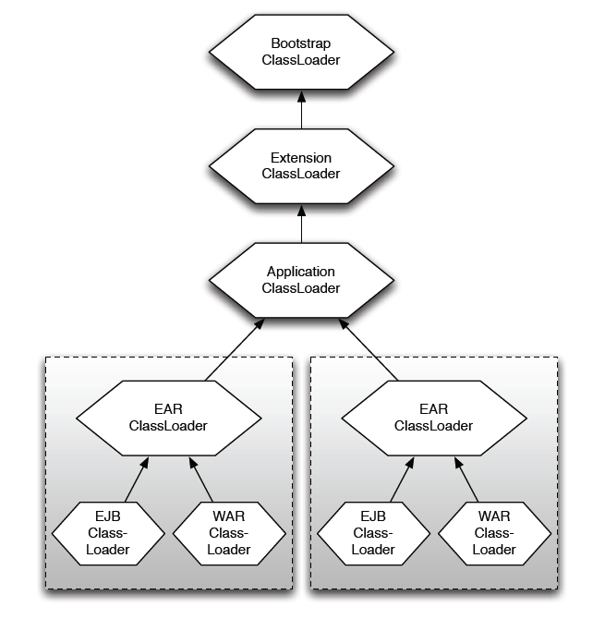
J2EE classloading
The classloader has precedence over classloaders below => all applications have to use the same version of the shared library
The picture was taken from the book “OSGi in Practice” written by Neil Bartlett
See http://njbartlett.name/osgibook.html

Slide 7
OSGi
OSGi is a specification
Open Service Gateway Initiative
Current version R4.3 (see http://www.osgi.org/)
3 parts + Java API + execution environment specification
Core
Compendium
Enterprise
Specifies
Framework
Modules
Provided services
Additional functionality

Slide 8

OSGi framework
Framework to build modular applications
“LEGO principle”
Fine-grained modules which are
Reusable
Scalable
Isolated
Bringing separation of concepts
Modules should be “easily” testable, manageable, maintainable, repairable, exchangeable
Bringing abstraction

Slide 9
OSGi applications
Existing applications
BMW service platform
Eclipse
Virgo server (Spring dm Server)
GlassFish J2EE application server
IBM WebSphere J2EE application server
Newton
JBoss, JOnAS
Apache Karaf
Users
Bombardier, Volvo, Siemens, BMW, IBM, Red Hat, Siemens AG, NEC, Oracle

Slide 10
OSGi implementations
Open source
Eclipse Equinox
Many extensions of OSGi, e.g. bundle aspects, extension points
Apache Felix
Based on Oscar (implementation of OSGi R3)
Compliant to OSGi specification R4.2
Knopflerfish
Concierge
Implementation of OSGi R3, optimized for embedded devices
Commercial
ProSyst, Knopflerfish Pro

Slide 11
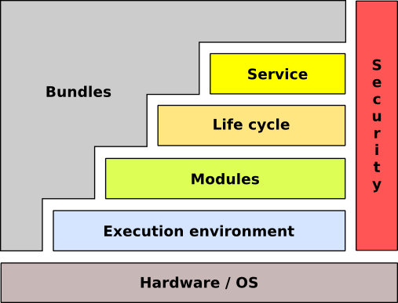
OSGi framework conceptual architecture
The picture was taken from the book “OSGi in Practice” written by Neil Bartlett
See http://njbartlett.name/osgibook.html

Slide 12
OSGi Basic concepts
Bundle
Module
Unit of deployment
Service
Communication between components

Slide 13
Bundle
Unit of deployment
Classical JAR with meta-information
Class files,
Additional resources (images, videos, source code, …)
META-INF, OSG-INF directories containing meta-information
Bundle is versioned
Major, minor, micro, qualifier (1.0.3_rc2)
Multiple versions at runtime are allowed
Bundle can export/hide packages
Recommended practice: ”Exposing only API not implementation”
Declarative dependencies
Bundles
Packages
Range of version [1.0, 2.0)

Slide 14
Bundle meta-information
Manifest META-INF/MANIFEST.MF
Manifest-Version: 1.0
Bundle-ManifestVersion: 2
Bundle-Name: LogTargetBundle
Bundle-Activator: LogTargetActivator
Bundle-SymbolicName: cz.cuni.mff.d3s.LogTargetBundle
Bundle-Version: 1.0.0.qualifier
Bundle-Vendor: D3S MFF UK
Bundle-RequiredExecutionEnvironment: JavaSE-1.6
Import-Package: cz.mff.cuni.d3s.nprg044.tut1.test01.api, org.osgi.framework;version="1.5.0", org.osgi.service.component;version="1.1.0", org.osgi.service.log;version="1.3.0“
Service-Component: OSGI-INF/componentOne.xml, OSGI-INF/factory.xml
Each line is limited 72bytes by design of JVM

Slide 15
Bundle dependencies
Export-Package: cz.*;
exclude=”*Impl”
Export packages
List all of packages + versions + attributes
Fine grained package filtering
Exclude,include, parameters
Import package
Require specific version(s)
e.g. [1.0, 2.0)
Resolution: optional/mandatory
Require bundle
Not recommended because it restricts further changes in API
Import-Package: cz.mff.*;
version=”[1.0,1.3.1)”;resolution=optional
Require-Bundle: logger-api-bundle

Slide 16
MANIFEST.FM headers
Bundle-ClassPath
Way to bundle 3rd party JAR libraries
Bundle-Activator
Name of class implementing BundleActivator
The class is called when the bundle is activated
Bundle-SymbolicName
Bundle ID
Bundle-Version
1.0.3.qualifier (qualifier corresponds to timestamp)
Bundle-RequiredExecutionEnvironment
Enforces the execution context
DynamicImport-Package
On-the-fly import
Bundle-NativeCode
Import .so, .dll

Slide 17
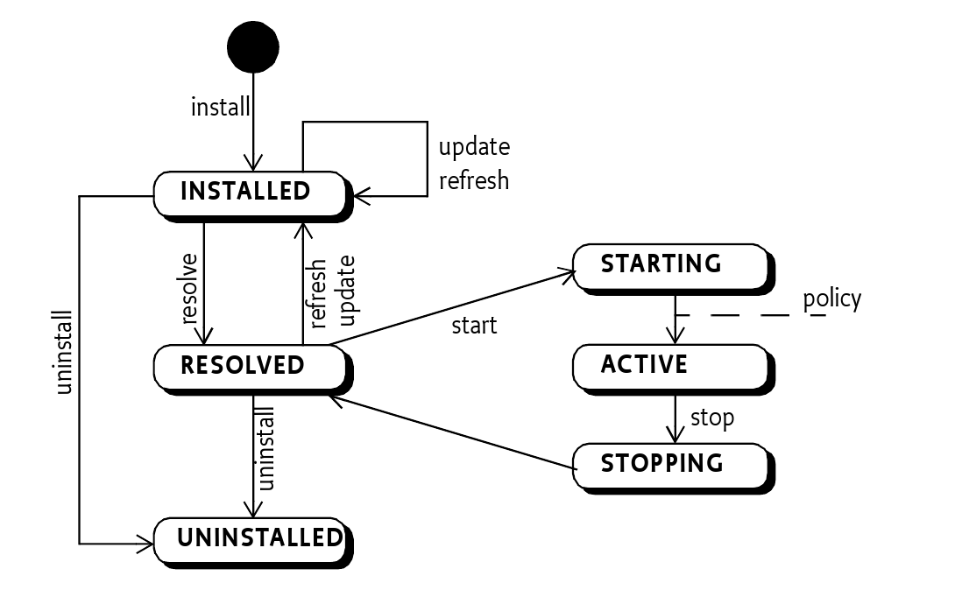
Bundle lifecycle
The picture was taken from the book “OSGi in Practice” written by Neil Bartlett
See http://njbartlett.name/osgibook.html

Slide 18
Bundle lifecycle - activation
Manage bundle lifecycle
class BundleActivator
void start(BundleContext ctx)
Register service, listeners, look for services
void stop(BundleContext)
Stop trackers, listeners, …
class BundleContext
Properties
Services
Bundles
Filters
Listeners
public class SimpleLogTargetActivator extends Activator {
@Override
public void start(BundleContext context){
/* ... */
}
@Override
public void stop(BundleContext context) {
/* ... */
}
}

Slide 19
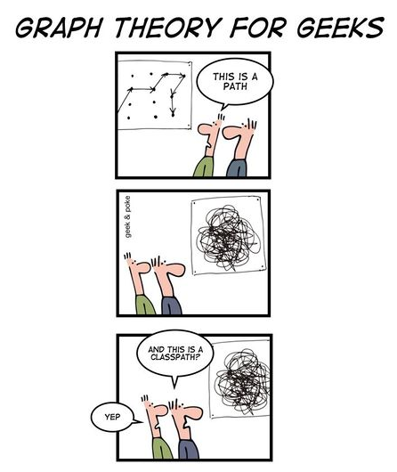
OSGi classloading
The picture was taken from the OSGi wiki
See http://wiki.osgi.org/wiki/Main_Page

Slide 20
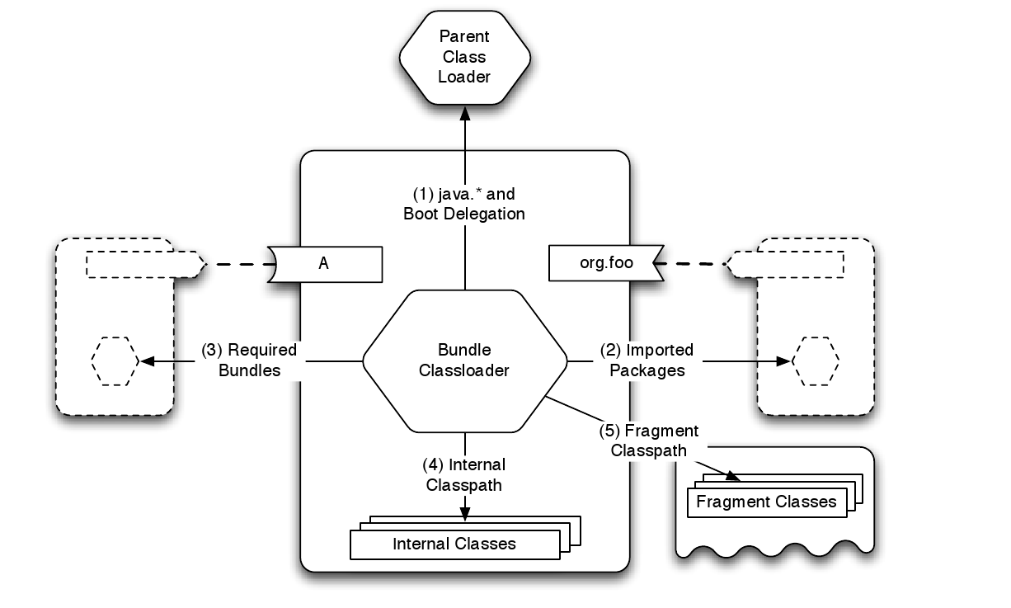
OSGi classloading
Separated class loader per bundle
Classloaders do not compose a tree, but a general graph
Lookup order
Parent
only for classes from java.* package
Imported packages
Required bundles
Local bundle classpath
The picture was taken from the book “OSGi in Practice” written by Neil Bartlett
See http://njbartlett.name/osgibook.html

Slide 21
Bundle classpath
Bundle classpath is composed of classes from
Imported packages
Provisions of required bundles
Local classpath specified via Bundle-Classpath

Slide 22
Demo #01
Download Eclipse RCP
http://www.eclipse.org/downloads/
Create a simple bundle with activator
Via wizard in “New > Project > …”
Bundle the bundle
Deploy bundle
Create new OSGi launch configuration & launch it
Package org.eclipse.osgi is required to be selected
Use “Add required bundles”
Observe its state in the console

Slide 23
OSGi Console
Important commands
help
ss
Display installed bundles
services
Display published services
status
exit
Shutdown OSGi framework
start/stop <bundle-id>
Update <bundle-id>
packages
Shows exported packages
diag
Run diagnostic

Slide 24
Service
Communication layer for bundles
Well-defined communication points
Inherent dynamic nature
Can appear/disappear any time at runtime
Multiple providers can provide the same services
The service has additional properties which can for example specify its priority
Service
Service is an object registered by a bundle in a ServiceRegistry
Programmatically
Declaratively
Service has associated properties
E.g., service.ranking

Slide 25
Registering service (1)
Programmatically in BundleActivator
Problems
Code
Services semantics is spread over code
dependencies, properties, implementation v. provided interface
public void start(BundleContext context) {
SimpleLogTargetImpl logTargetImpl = new SimpleLogTargetImpl();
registration = context.registerService(
ILogTarget.class.getName(),
logTargetImpl,
null);
}

Slide 26
Registering service (2)
Declarative services (DS)
Declaratively
Services provided by components
Automated service management by DS framework
Dependency injection of required services
Life-cycle management
<scr:component name="logger-component“
enable=“true” activate=“activate”>
<implementation class="cz.cuni...LoggerImpl"/>
<service>
<provide interface="cz...ILogger"/>
</service>
</scr:component>

Slide 27
Service components
Component is a normal Java class contained within a bundle
Defined in separated XML file in OSGI-INF directory
MANIFEST.FM
Has to contain component file reference: Service-Component: OSGI-INF/component.xml
Activation
Declared method
ComponentContext, BundleContext, Map as parameters
Service provider
Specify name of provided service
<scr:component name="logger-component“
activate=“activate”>
<implementation class="cz.cuni...LoggerImpl"/>
<service>
<provide interface="cz...ILogger"/>
</service>
</scr:component>

Slide 28
Demo #02
Implement a bundle with API
Implement two bundles implementing API
Register API services
Programmatically
Declaratively
Launch configuration has to contain ‘org.eclipse.equinox.ds’ bundle
Observe provided services in console (command services)

Slide 29
Service consumption (1)
Bundle can search for service which implements specific interface
Several bad solution
context.getService(...)
Nasty code with active waiting
Service registry listeners
Recommended solutions (thread-safe)
Service tracker
Components
Service reference ref =
context.getServiceRef(“cz.bar”);
if (ref!=null) {
Bar bar = (Bar) context.getService(ref);
if (bar != null) {
...
context.ungetService(ref)
}
}

Slide 30
Service tracker – white board pattern
Services dependencies
Content provider v. consumers
e.g., consume a new service if and only if the specified service appears
“Don't look for content providers, let them to register as services and track for the services”
ServiceTracker capture service life-cycle
via ServiceTrackerCustomizer
Capture process of adding/removing/modifying service

Slide 31
Service tracker
Service Tracker
Tracking for service
Filters (name, id, property, owning bundle, ...)
LDAP syntax (e.g. (&(objectName=”foo”)(property1=”Xyz”)) )
//In Bundle Activator - start
tracker = new ServiceTracker(context,
ILogger.class.getName(), null);
tracker.open();
// get the service(s)
ILogger log = (ILogger)tracker.getService();
ILogger log = (Ilogger) tracker.waitForService(1000);
// stop tracking
tracker.close();

Slide 32
Service tracker
Construction determines attributes
ServiceTracker methods
open()/close() – start/stop tracking for a service
getService()
addingService/removedService/modifiedService(ServiceReference rf)
Interface ServiceTrackerCustomizer
Can be overridden by user
ServiceTracker(
BundleContext context, java.lang.String clazz, ServiceTrackerCustomizer customizer)

Slide 33
Service consumption (2)
Declaratively via service components
Service reference
Name
Interfaces
Bind/unbind method
Target
Policy: static/dynamic
Cardinality: M..N
1..1 – if multiple services is accessible then the one with the highest service.ranking is used
<scr:component name=”getServiceComp”>
<implementation class=”GetLoggerService”>
<reference name=”log”
interface=”org.osgi...LogService”
bind=”setLog”
unbind=”unsetLog”
</scr:component>

Slide 34
Services lookup
Lookup strategy
Look for service during component activation
Event strategy
Let the DS framework to inject the service via defined methods
Bind/unbind attributes of reference declaration
<?xml version="1.0" encoding="UTF-8"?>
<scr:component name="example.listen"
xmlns:scr="http://www.osgi.org/xmlns/scr/v1.1.0">
<implementation class="com.acme.LogLookupImpl"/>
<reference name="LOG"
interface="org.osgi.service.log.LogService"/>
</scr:component>
public class LogLookupImpl {
private void activate(ComponentContext ctxt) {
LogService log = (LogService)
ctxt.locateService("LOG");
}
}

Slide 35
Component factories
A component can be declared as a factory
ComponentFactory service is registered
newInstance(Dictionary d) method
The user tracks for Component Factory service and create a new instance
A component factory can provide a service
Registered for each created instance

Slide 36
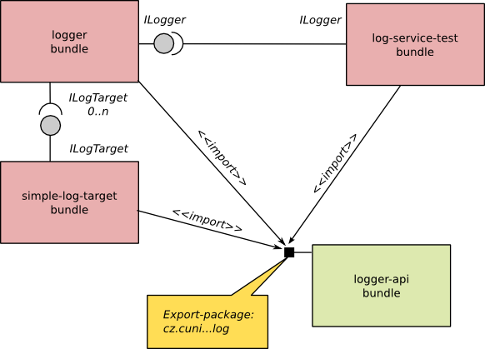
Demo #03
Write a new bundle with a tester component consuming declared services in demo #02
Possible scenario
Try to call update command in console

Slide 37
OSGi services
Logging (LogService)
Http (HttpService)
Exposing registered servlets
Event
Messaging Producer <-> Consumer
Device manager
Diagnostics/Monitoring
JMX
Application manager
Application package – set of resource (bundles, data,...)
Can be deployed/install
Location/measurement services
Remote services

Slide 38
Demo #04
Use HttpService as an additional implementation of ILogTarget
Introduce a new bundle with a component exposing ILogTarget and requiring HttpService
Register HTTP servlet
Launch configuration has to introduce web-server bundles (e.g., Jetty). Don’t forget on
javax.servlet
org.eclipse.equinox.http.servlet
org.eclipse.equinox.http.jetty
Specify JVM property: -Dorg.osgi.service.http.port=8080

Slide 39
OSGi 4.2 features
Framework launching
Remote services
Blueprint services
Bundle tracker
Service hooks
Conditional permissions
Enterprise features – bundling (WAR), JPA, JNDI, JDBC integration

Slide 40
OSGi 4.3 features
Introduction of generics into OSGi API
Capabilities
Requirements
Adapt concept
Bundle can be adapted to another type
Weaving hook
Bytecode modification
Resolver, bundle, service events hooks

Slide 41
Bundles repositories
OBR
http://bundles.osgi.org
OSGi compendium implementation
Spring
http://sigil.codecauldron.org/spring-external.obr
http://sigil.codecauldron.org/spring-release.obr
Knopflerfish
http://www.knopflerfish.org/repo/bindex.xml

Slide 42
Resources
OSGi specification
http://www.osgi.org/
OSGi tooling
http://en.wikipedia.org/wiki/OSGi-Tooling
NPRG044 source code
http://code.google.com/a/eclipselabs.org/p/nprg044-eclipse-platform/

Slide 43
OSGi tools
Pax
Bnd
Scribids

Slide 44
OSGi Alternatives
Jigsaw
Java modules

Slide 45
Blueprint specification
Since OSGi R4.2
Permits external dependency injection
E.g., cooperation with DI frameworks (Spring, Guice)
To support application servers

