Slide 1
Introduction to MATLAB
MAT 1011 – Calculus for Engineers
Department of Mathematics
School of Advanced Sciences
Vellore Institute of Technology, Vellore

Slide 2
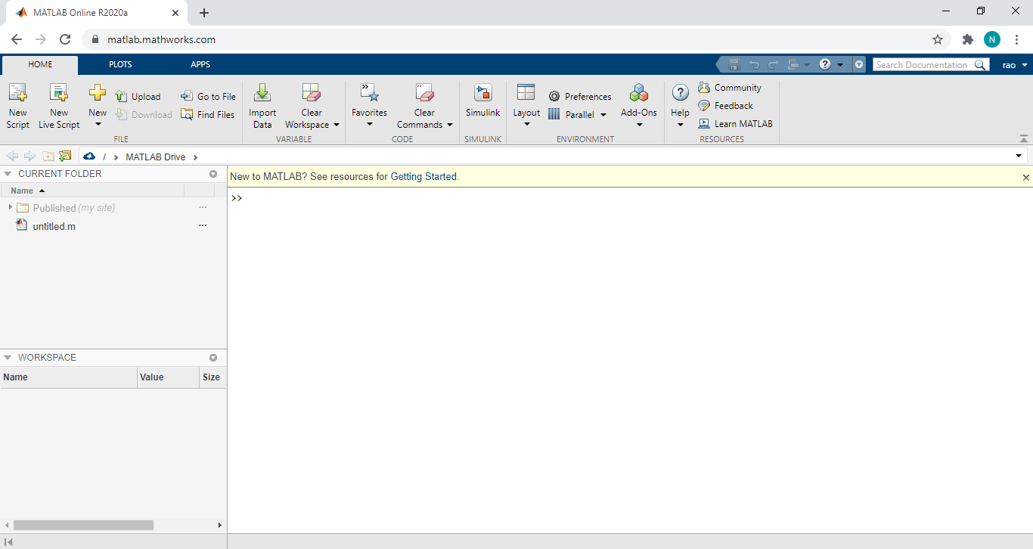
Desktop Basics
Current Folder
(Access your files
from here)
Workspace
(Explore data that you create or import from files)
Command Window
(Enter commands here)

Slide 3
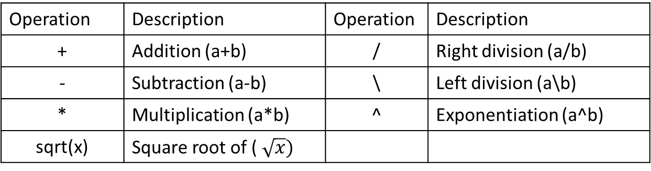
Basic arithmetic Operations
A scalar is a 1×1 matrix.
A row vector of length (say 5) is a 1×5 matrix.
A column vector of length (say 5) is a 5×1 matrix.
MATLAB can work as a calculator.
The below table summarizes the arithmetic operators available in MATLAB.
Operation | Description | Operation | Description
+ | Addition (a+b) | / | Right division (a/b)
- | Subtraction (a-b) | \ | Left division (a\b)
* | Multiplication (a*b) | ^ | Exponentiation (a^b)
sqrt(x) | Square root of ($\sqrt{x})$

Slide 4
Basic MATLAB Commands
For assigning a variable to an expression, the syntax is
variable_name = a value (or an expression)
Eg. x=5 (Assigns the number 5 to the variable x)
To overwrite on a variable which has been already created,
Eg. >> x=x+1 (Rewrites x by incrementing by 1)
Semicolon (;) suppresses the output being displayed. Eg. >> x=x+1;
MATLAB does numerical calculations in double precision, which is 15 digits.
To display in short we can use the command
>>format short
>> x=-163.6667
To see all the 15 digits use the command format long
>> format long
>> x= -1.636666666666667e+002

Slide 5
Workspace Variables
The workspace contains variables that you create within or import into MATLAB from
data files or other programs.
You can view the contents of the workspace using
>> whos (which gives the detailed information of the variables in the workspace)
while the variables in short can be viewed with the command >> who.
The clc function clears the Command Window ( >> clc )
To clear all the variables from the workspace, use the clear command (>> clear)
To get help on any command of MATLAB, type >> help <Type a command>.

Slide 6
Matrices and Arrays
All MATLAB variables are multidimensional arrays, no matter what type of data.
To create an array with four elements in a single row, separate the elements with either a comma ( , ) or a space.
>> a = [1,2,3,4] or >> a = [1 2 3 4]
To create a matrix that has multiple rows, separate the rows with semicolons.
>> a = [1,2,3;4,5,6;7,8,10] or >> a = [1 2 3;4 5 6;7 8 10]
Some inbuilt functions, namely, ones, zeros and eye etc., may be also used.
For example to create a 5x1 matrix of zeros, we type >> z = zeros(5,1)
To create a 5x1 matrix of ones, we type >> z = ones(5,1)
To create an identity matrix of order 3, we type >> z = eye(3)

Slide 7
Matrix Operations
Operation | Syntax | Remarks
Addition | >> C=A+B | Matrices A and B must be of same order
Subtraction | >> D=A-B | Matrices A and B must be of same order
Mulitiplication | >> C=A*B | Matrices A and B must be compatible for multiplication (A is of order mxp and B is pxn, then C is of order mxn.)
Element-wise multiplication | >> C=A.*B | Eg. A=[x, y]; B=[a, b], then A.*B=[xa, yb] Matrices A and B must be of same order
Element-wise division | >> C=A./B | Eg. A=[x, y]; B=[a, b], then A./B=[x/a, y/b] Matrices A and B must be of same order
Element-wise exponentiation | >> C=A.^p | Eg. A=[x, y]; p=2; then A.^p=[x², y²]
Matrix Transpose | >> C=A’

Slide 8
Generating/Referencing Matrix Elements
Operation | Syntax | Remarks
To create an array | >> x=linspace(x1,xn,n) | Creates an array of n numbers from x1 to xn.
 | >> C=a:h:b | Creates an array from a to b with spacing h.
Length of a vector | >> n=length(X) | Displays the number of elements in the vector X
Size of an Array | >> [m,n]=size(A) | Displays the number of rows & columns of the matrix.
Referencing an element | >> A(i,j) | To pick out the (i, j)th element of matrix A.
Referencing a column | >> A(:,j) | To reference all the elements in the jth column of A. Similarly, a row can be referenced by >> A(i,:)
Referencing some rows/columns | >> A(k:m,j) | To reference jth column, restricted to rows k to m. Similarly numbers of columns can be restricted.

Slide 9
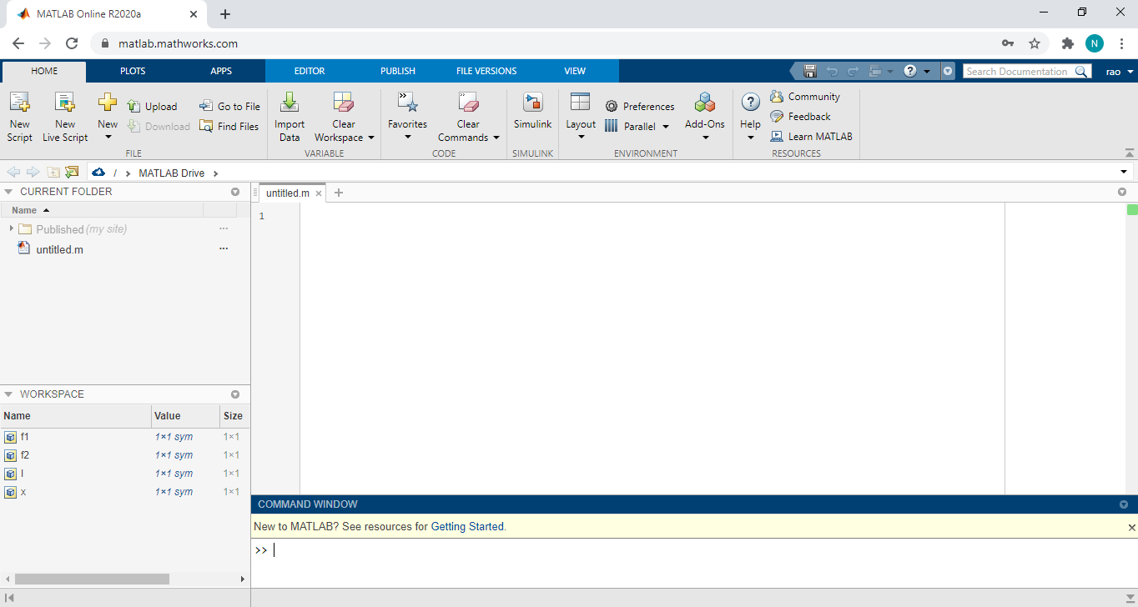
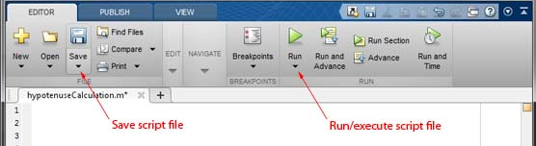
Scripts
We can write a series of commands to a file called a script file (*.m) that then execute.
Use the MATLAB Editor to create your own scripts.
Upload a script file to MATLAB drive
Create a new script file
The existing script files in MATLAB drive can be opened from here.

Slide 10
Symbolic math computations

Slide 11
Creating Symbolic Variables
There are two ways to create symbolic variables, syms and sym.
To create symbolic variables x and y using syms and sym respectively.
>> syms x
>> y = sym('y')
With syms, you can create multiple variables in one command. Create the variables a, b,and c.
>> syms a b c
To create many numbered variables, namely a1, ..., a10 try as below:
>> A = sym('a', [1,10])
A =
[ a1, a2, a3, a4, a5, a6, a7, a8, a9, a10]

Slide 12
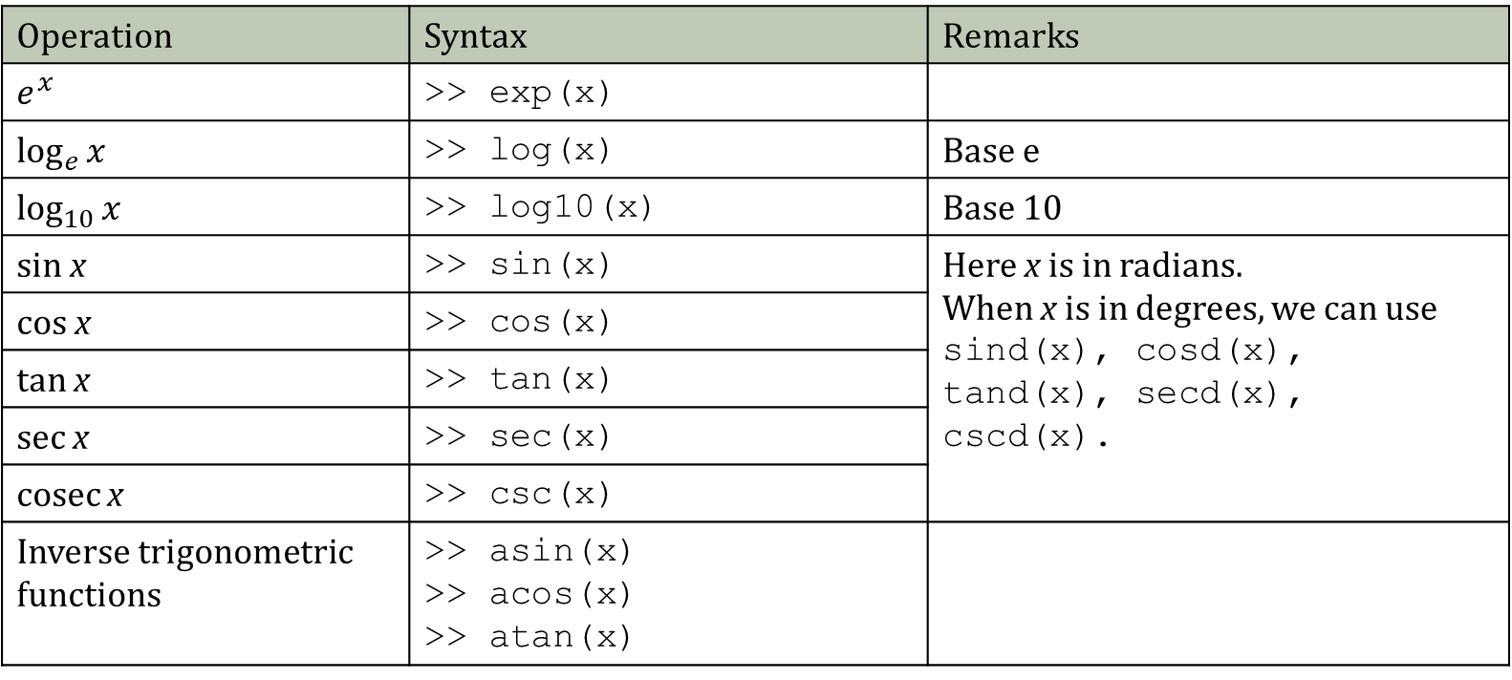
Transcendental functions
Operation | Syntax | Remarks
$$e^{x}$$ | >> exp(x)
$$\log_{e}{x}$$ | >> log(x) | Base e
$$\log_{10}{x}$$ | >> log10(x) | Base 10
sin x | >> sin(x) | Here x is in radians. When x is in degrees, we can use sind(x), cosd(x), tand(x), secd(x), cscd(x).
cos x | >> cos(x)
tan x | >> tan(x)
sec x | >> sec(x)
cosec x | >> csc(x)
Inverse trigonometric functions | >> asin(x) >> acos(x) >> atan(x)

Slide 13
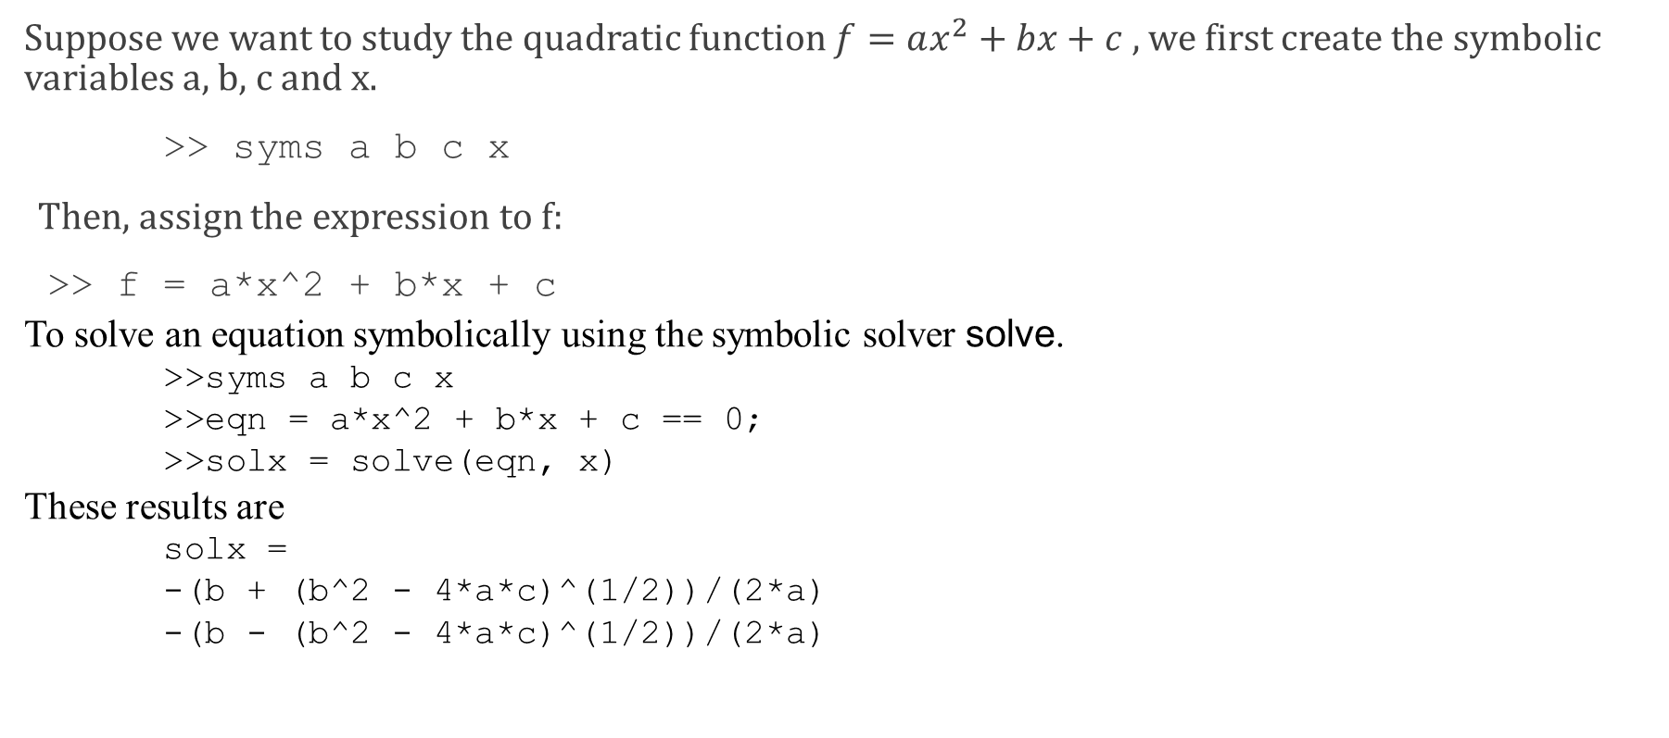
Creating Symbolic Expressions
Suppose we want to study the quadratic function $f=ax^{2}+bx+c ,$we first create the symbolic variables a, b, c and x.
>> syms a b c x
Then, assign the expression to f:
>> f = a*x^2 + b*x + c
To solve an equation symbolically using the symbolic solver solve.
>>syms a b c x
>>eqn = a*x^2 + b*x + c == 0;
>>solx = solve(eqn, x)
These results are
solx =
-(b + (b^2 - 4*a*c)^(1/2))/(2*a)
-(b - (b^2 - 4*a*c)^(1/2))/(2*a)

Slide 14
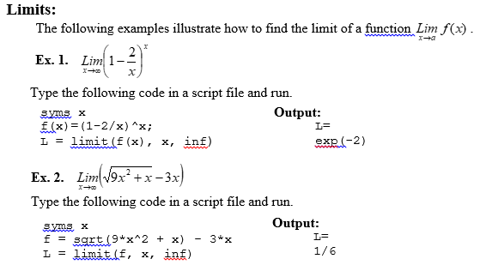
Calculus with Symbolic Math

Slide 15
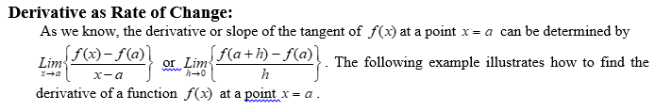
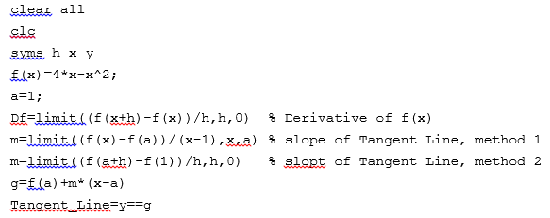
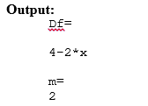


Slide 16
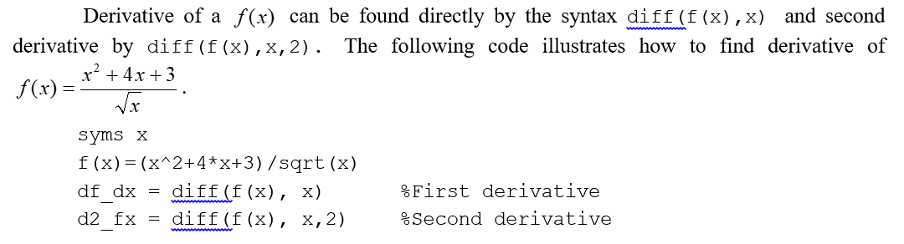
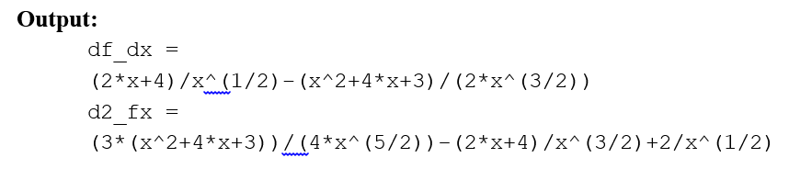

Slide 17
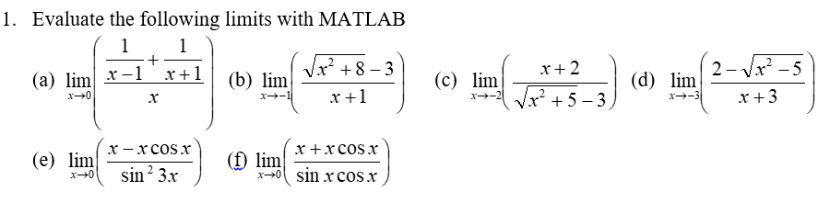
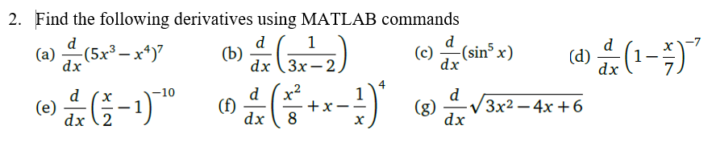
Exercise

