Slide 1
Plotting of Curves in MATLAB
MAT 1011 – Calculus for Engineers
Department of Mathematics
School of Advanced Sciences
Vellore Institute of Technology, Vellore

Slide 2
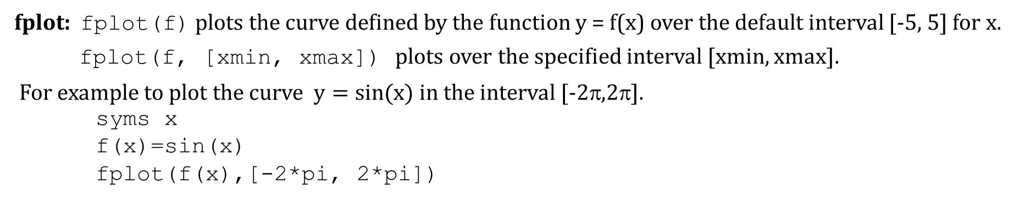
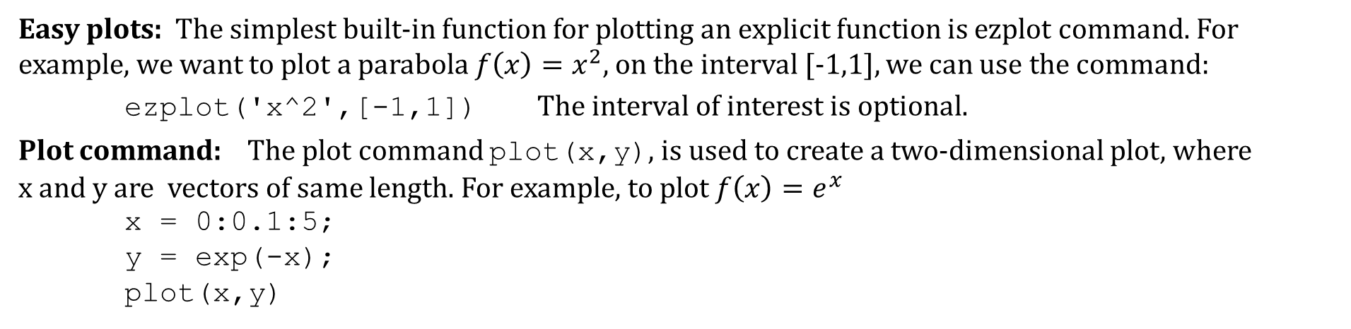
Plotting Graphs:
.
Easy plots: The simplest built-in function for plotting an explicit function is ezplot command. For example, we want to plot a parabola $f\left(x\right)=x^{2},$on the interval [-1,1], we can use the command:
ezplot('x^2',[-1,1]) The interval of interest is optional.
Plot command: The plot command plot(x,y), is used to create a two-dimensional plot, where x and y are vectors of same length. For example, to plot $f\left(x\right)=e^{x}$
x = 0:0.1:5;
y = exp(-x);
plot(x,y)
fplot: fplot(f) plots the curve defined by the function y = f(x) over the default interval [-5, 5] for x.
fplot(f, [xmin, xmax]) plots over the specified interval [xmin, xmax].
For example to plot the curve $y=sin(x)$ in the interval [-2π,2π].
syms x
f(x)=sin(x)
fplot(f(x),[-2*pi, 2*pi])

Slide 3
Line Specifiers (linespec):
Line specifiers are optional and can be used to define the style and color of the line and the type of markers (if markers are desired).
Line Color | Specifier
red | r
green | g
blue | b
cyan | c
magenta | m
yellow | y
black | k
white | w
Line style | Specifier
solid (default) | -
dashed | --
dotted | :
dash-dot | -.

Slide 4
Marker type Specifiers
The specifiers are typed inside the plot command as strings. Within the string, the specifiers can be typed in any order and the specifiers are optional. For example:
x = 0:5; y = 2.^x; plot(x,y,'-or')
This command creates a plot with solid red line and the marker is a circle.
Marker Type | Specifier | Marker Type | Specifier
plus sign | + | square | s
circle | o | diamond | d
asterisk | * | five-pointed star | p
point | . | sixed-pointed star | h
cross | x | triangle (pointed left) | <
triangle (pointed up) | ^ | triangle (pointed right) | >
triangle (pointed down) | v

Slide 5
Property Name and PropertyValue:
Properties are optional and can be used to specify the thickness of the line, the size of the marker, and the colors of the marker’s edge line and fill.
The Property Name is typed as a string, followed by a comma and a value for the property, all inside the plot command. For example, the command:
x=linspace(0,pi,50);
y=exp(-x).*sin(8*x);
plot(x,y,’--sb', 'linewidth', 2, 'markersize',8, 'markerfacecolor', 'g')
creates a plot with a blue dashed line and squares as markers. The linewidth is 2 points and the size of the square markers is 8 points. The marker has green filling.
Property Name | Description
linewidth | the width of the line (default 0.5, possible values are 1,2,3,...)
markersize | the size of the marker (e.g., 5,6,... )
Markeredgecolor | the color of the edge line for filled marker (e.g., r, b)
Markerfacecolor | the color of the filling for filled markers (e.g, r, b)

Slide 6
Formatting a plot:
Plots can be formatted by using MATLAB command that follow the plot or interactively by using the plot editor in the Figure Window. Here we will explain the first method which is more useful since a formatted plot can be created automatically every time the program is executed.
The xlabel and ylabel command
xlabel and ylabel create description on the x- and y-axes, respectively after we have plotted a graph. The usages are:
xlabel('text as string')
and:
ylabel('text as string')
The title command: A title can be added to the plot with the command:
title('text as string')
The text will appear on the top of the figure as a title.

Slide 7
Formatting a plot-continued
The text command: A text label can be placed in the plot with the text or gtext commands:
text(a,b,'text as string')
gtext('text as string')
The text command places the text in the figure such that the first character is positioned at the point with the coordinates a,b(according to the axes of the figure). The gtext command places the text at a position specified by the user (with the mouse).
The legend command: The legend command places a legend on the plot. The legend shows a sample of the line type of each graph that is plotted, and places a label, specified by the user, beside the line sample.
The usage is: legend('string 1','string 2',... ) For example,
t=linspace(0,10,100)
s=t.^2/2;
plot(t,s);
xlabel('Time (sec)');
ylabel('distance (m)');
title('Distance as a function of t');
legend('distance’);

Slide 8
Axis Command:
When the plot(x,y) command is executed, MATLAB creates axes with limits that are based on the minimum and maximum values of the elements of x and y. The axis command can be used to change the range of the axes. Here are some possible forms of the axis command:
Commands | Description
axis([xmin, xmax, ymin, ymax]) | sets the limits of both x and y
axis equal | sets the same scale for both axes
axis square | sets the axes region to be square
axis tight | sets the axis limits to the range of the data
The grid command: ‘grid on’ adds grid lines to the plot. grid off removes grid lines from the plot.
For example:
fplot(@(x) x.^2+4*sin(2*x)-1,[-3,3])
grid on
axis([-2 2 -5 5])

Slide 9

.
Plotting Piecewise Functions
f(x)=piecewise(I1,f1,I2,f2,...) can be used to define a piecewise function $f(x)$
whose value is f1 in the interval I1 and f2 in the interval I2.
The following script illustrates to plot the piecewise function
syms f(x)
f(x)=piecewise( -2<=x<=-1,-x-2,-1<x<=1,x,1<x<=2,-x+2);
figure
fplot(f(x), [-2,-1], 'b', 'LineWidth', 2);
grid on; hold on;
fplot(f(x), [-0.999, 1], 'b', 'LineWidth', 2);
fplot(f(x), [1.001, 2], 'b', 'LineWidth', 2);
plot(-1, f(-1), 'bo', 'MarkerFaceColor', 'w', 'MarkerSize', 10);
plot(1, f(1), 'bo', 'MarkerFaceColor', 'w', 'MarkerSize', 10);
axis equal; axis([-2 2 -2 2]);
xlabel('x'); ylabel('y');

Slide 10
Plotting multiple graphs:
There are two methods to plot multiple graphs in one figure. One is by using the plot command, the other is by using the hold on, hold off commands.
Using the plot command: Two or more graphs can be created in the same plot by typing pairs of vectors inside the plot command. For example:
plot(x,y,u,v,s,t)
creates 3 graphs: y vs x, v vs u, and t vs s, all in the same plot. The vector of each pair must have the same length. MATLAB automatically plots the graphs in different colors so that they can be identified.
It is also possible to add line specifiers following each pair. For example:
plot(x,y,'-bo',u,v,'--rx',s,t,'g:s')
plots y vs x with a solid blue line and circles, v vs u with a dashed red lines with cross signs, t vs s with a dotted green line and square markers.

Slide 11
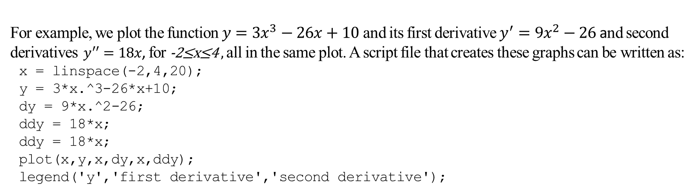
Plotting multiple graphs:
For example, we plot the function $y={3x}^{3}−26x+10$ and its first derivative $y^{′}={9x}^{2}−26$ and second derivatives $y^{′′}=18x$, for -2≤x≤4 , all in the same plot. A script file that creates these graphs can be written as:
x = linspace(-2,4,20);
y = 3*x.^3-26*x+10;
dy = 9*x.^2-26;
ddy = 18*x;
ddy = 18*x;
plot(x,y,x,dy,x,ddy);
legend('y','first derivative','second derivative');

Slide 12
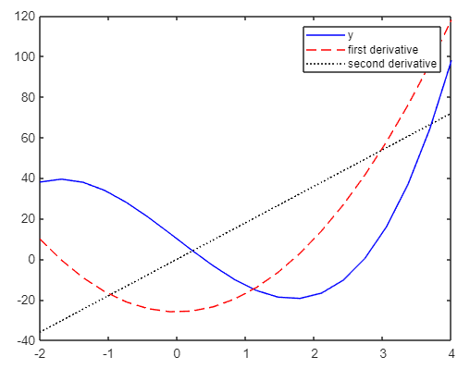
Plotting multiple graphs:
Using the hold on, hold off command
To plot several graphs using the hold on, hold off commands, one graph is plotted first with the plot command. Then the hold on command is typed. This keeps the Figure Window with the first plot open, including the axis properties and the formatting. Additional graphs can be added with plot commands that are typed next. The hold off command
stops this process.
It returns MATLAB to the default mode in which the plot command
erases the previous plot and resets the axis properties.
With the data from the previous example, we can plot y and its
derivatives by typing commands shown in the script:
plot(x,y,'-b');
hold on
plot(x,dy,'--r');
plot(x,ddy,':k');
hold off

Slide 13
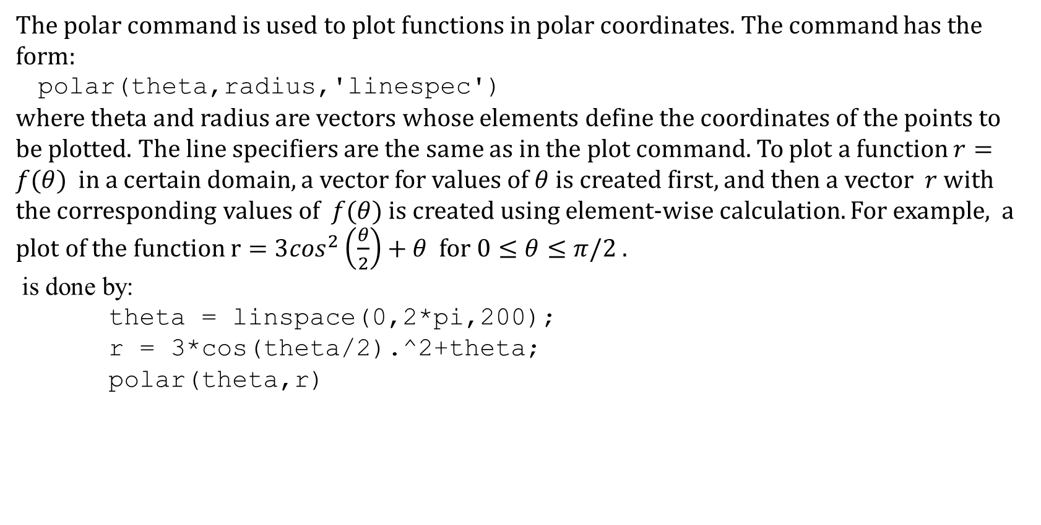
Polar plots:
The polar command is used to plot functions in polar coordinates. The command has the form:
polar(theta,radius,'linespec')
where theta and radius are vectors whose elements define the coordinates of the points to be plotted. The line specifiers are the same as in the plot command. To plot a function $r=f(θ)$ in a certain domain, a vector for values of $θ$ is created first, and then a vector $r$ with the corresponding values of $f(θ)$ is created using element-wise calculation. For example, a plot of the function $r=3\cos^{2}\left(\frac{θ}{2}\right)+θ$ for $0≤θ≤π/2$ .
is done by:
theta = linspace(0,2*pi,200);
r = 3*cos(theta/2).^2+theta;
polar(theta,r)

Slide 14
Subplots
Multiple plots on the same page can be created with the subplot command, which has the form:
subplot(m,n,p)
The command divides the Figure Window into mxn rectangular subplots where plots will be created. The subplots are arranged like elements in a mxn matrix where each element is a subplot. The subplots are numbered from 1 through mn.
The number increases from left to right within a row, from the
first row to the last. The command subplot(m,n,p) makes the
subplot p current. This means that the next plot command will
create a plot in this subplot
For example, we create a plot that has 2 rows and 2 columns:
subplot(2,2,1);ezplot('sin(x)');
subplot(2,2,2);ezplot('exp(-x)');
subplot(2,2,3);ezplot('x^2');
subplot(2,2,4);ezplot('sin(x)/x');

Slide 15
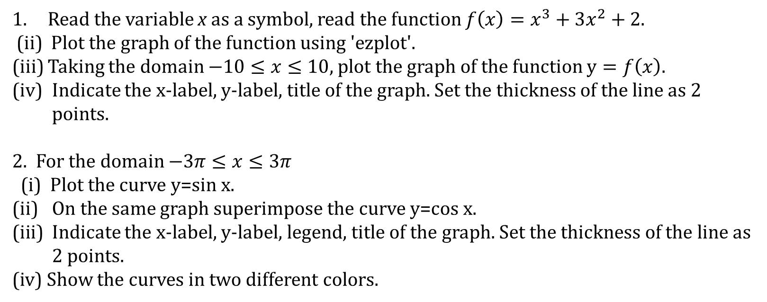
Exercise
Read the variable x as a symbol, read the function $f\left(x\right)=x^{3}+3x^{2}+2$.
(ii) Plot the graph of the function using 'ezplot'.
(iii) Taking the domain $−10≤x≤10$, plot the graph of the function $y=f\left(x\right)$.
Indicate the x-label, y-label, title of the graph. Set the thickness of the line as 2 points.
2. For the domain $−3π≤x≤3π$
(i) Plot the curve y=sin x.
On the same graph superimpose the curve y=cos x.
Indicate the x-label, y-label, legend, title of the graph. Set the thickness of the line as 2 points.
(iv) Show the curves in two different colors.

