Slide 1
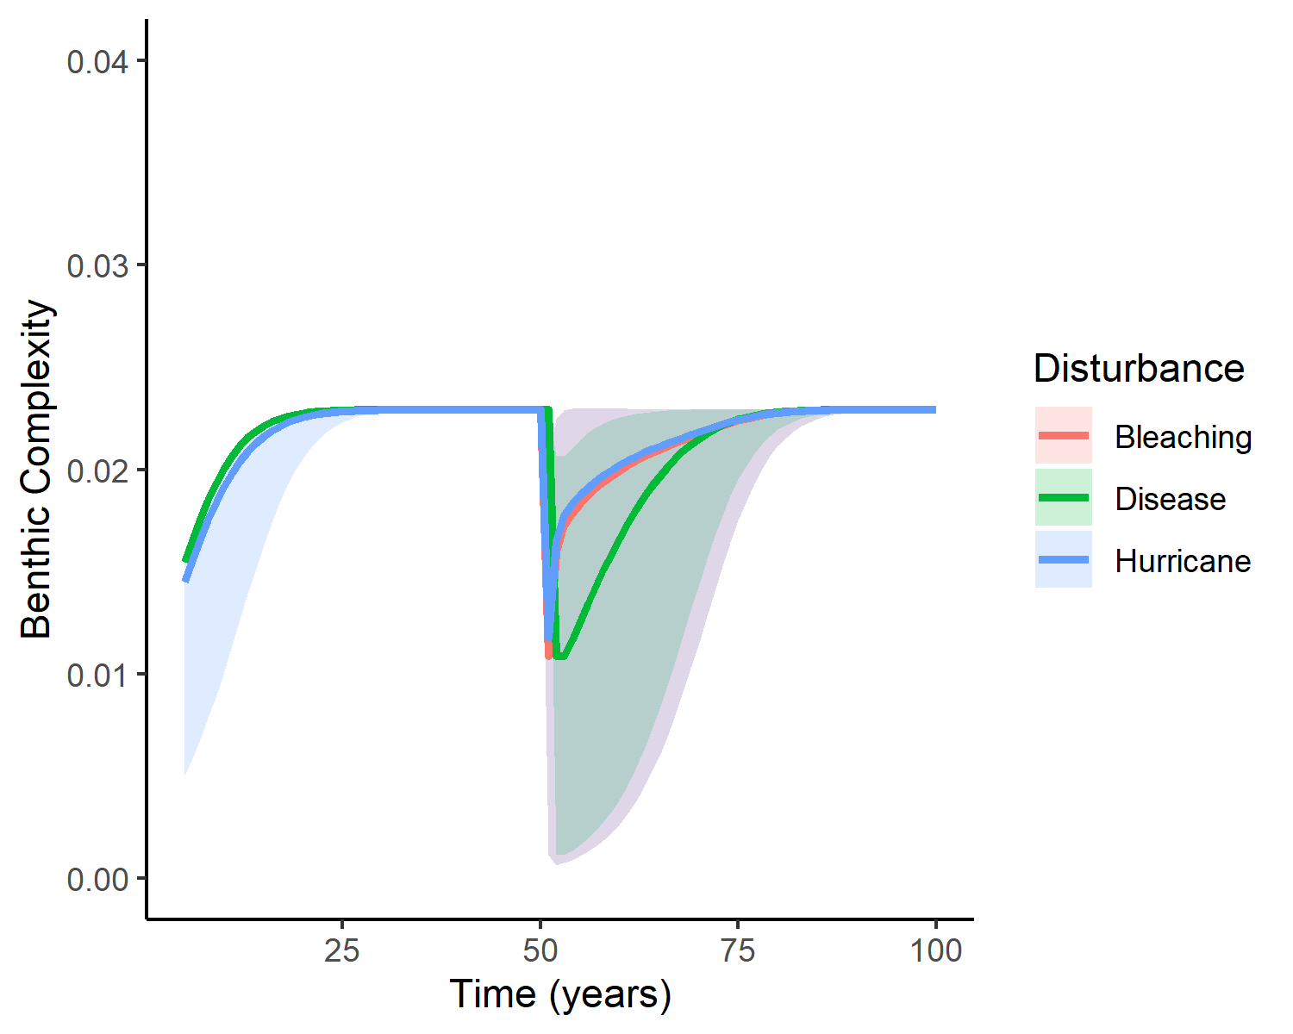
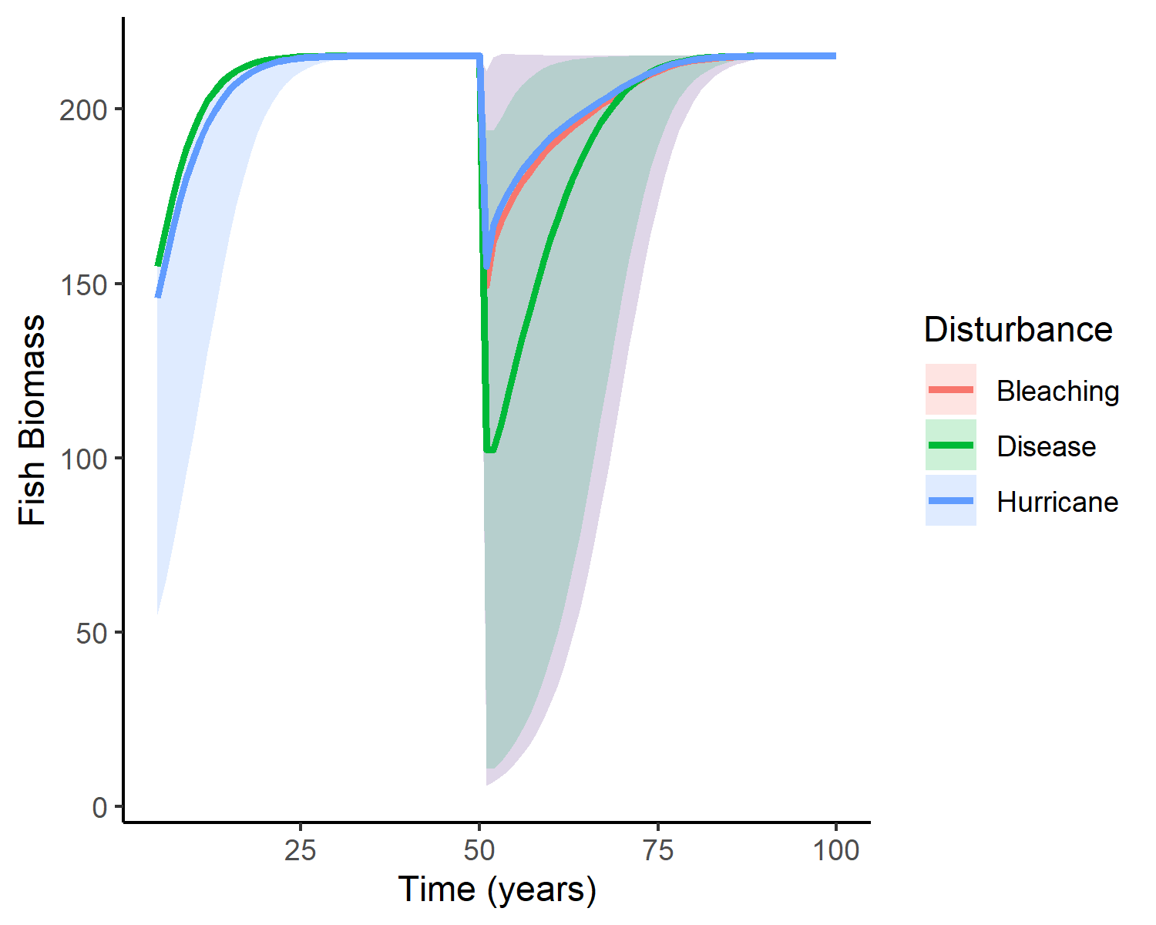
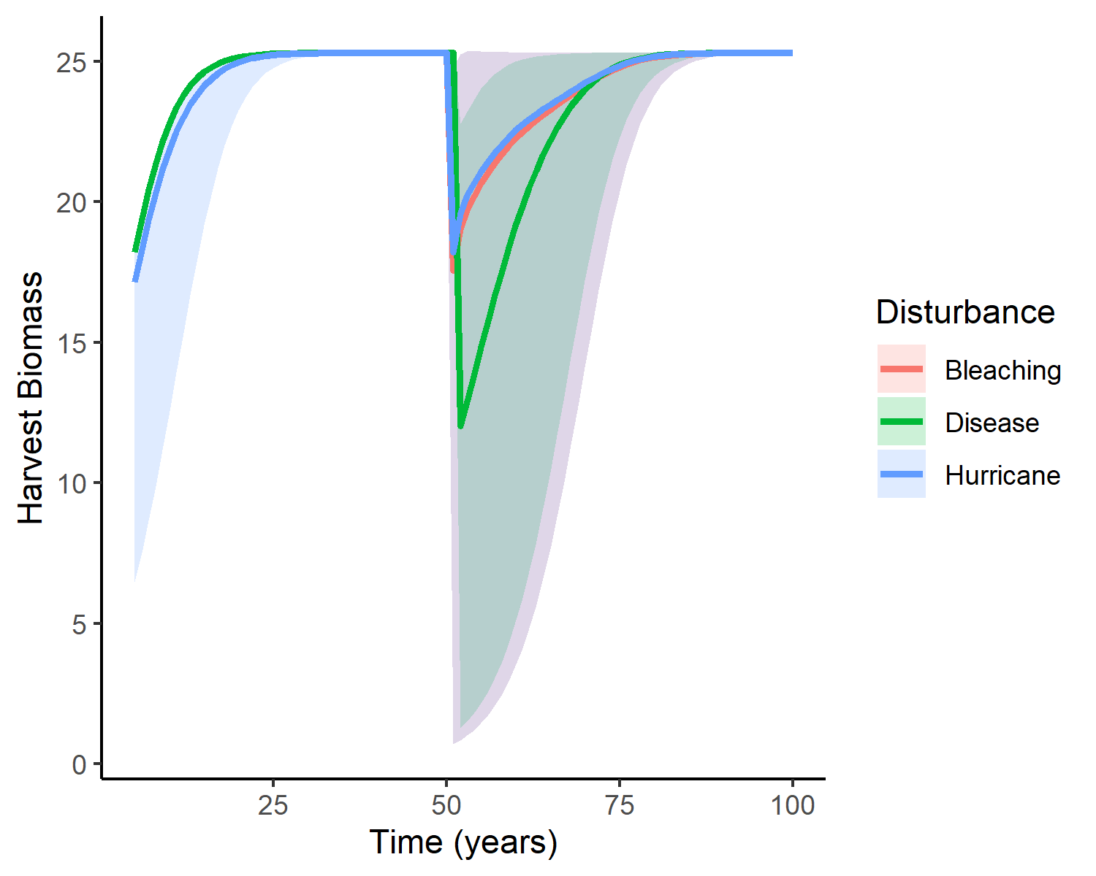
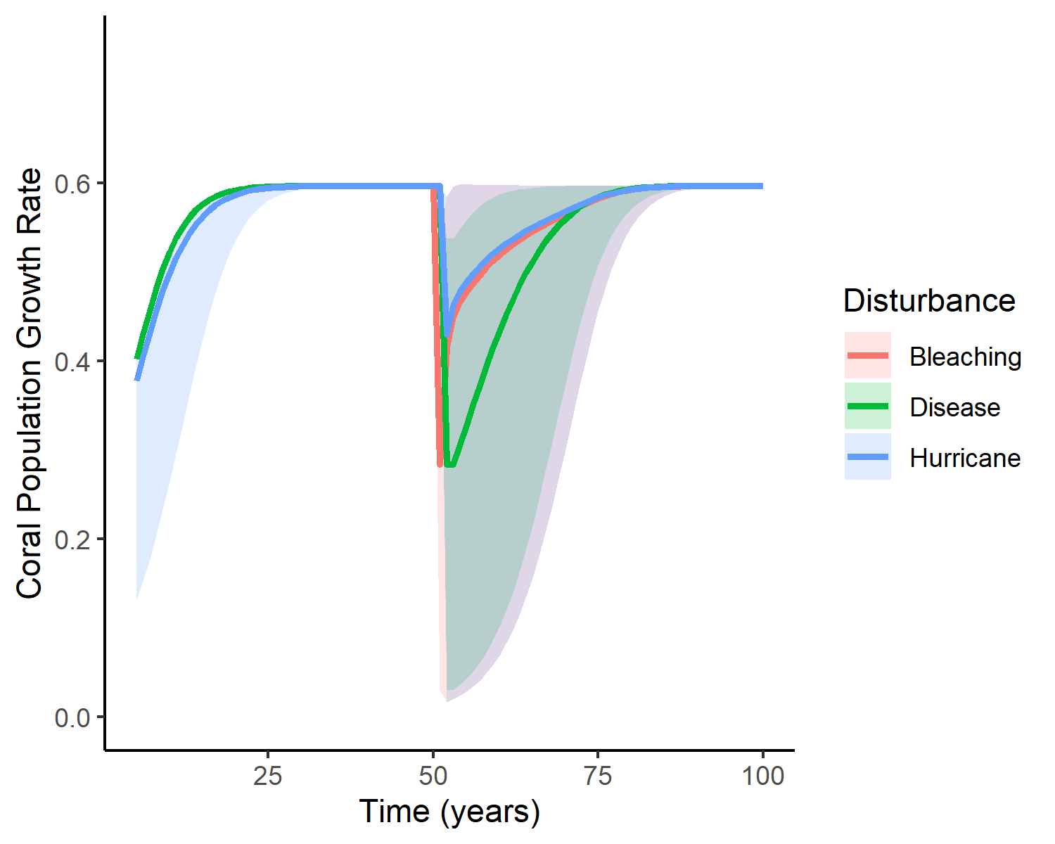
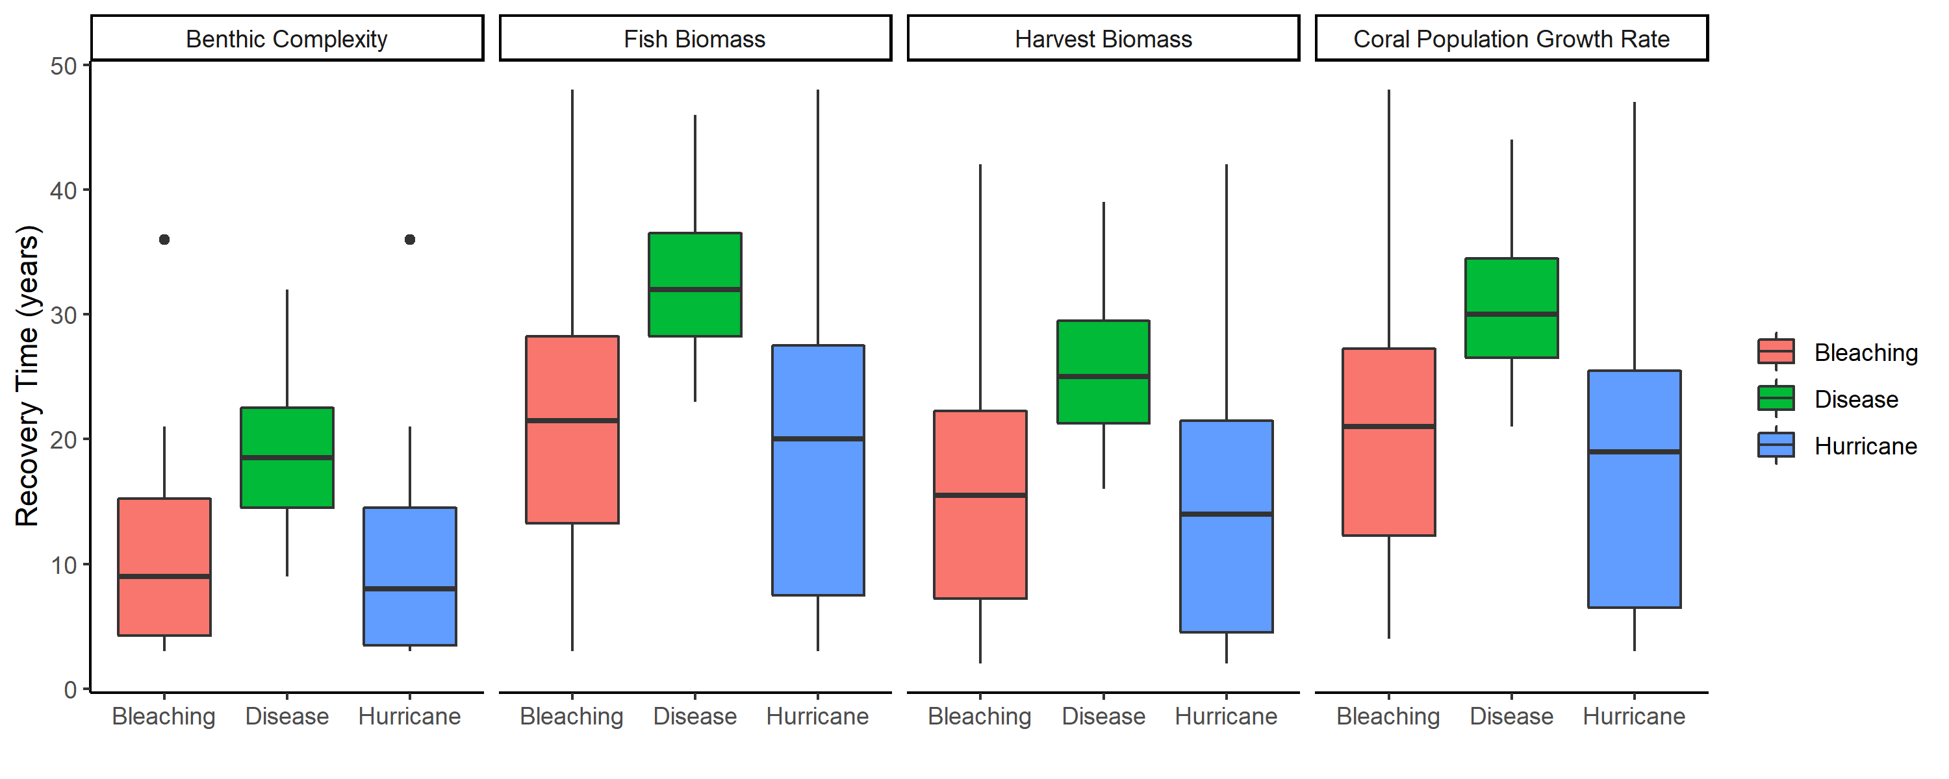

Slide 2
A)
0.04
25
200
0.03
20
0.6
150
15
0.4
0.02
Harvest Biomass
Benthic Complexity
Fish Biomass
Coral Population Growth Rate
100
10
0.01
50
0.2
5
0.00
0
0
0.0
25
50
75
100
25
50
75
100
25
50
75
100
25
50
75
100
Time (years)
B)

Slide 3
Benthic Complexity
Fish Biomass
0.6
Harvest Biomass
0.4
Coral Population Growth Rate
0.2
0.0
25
50
75
100
Time (years)

Slide 4
Fish Biomass
25
Benthic Complexity
20
15
25
10
20
5
15
0
Harvest Biomass
25
50
75
100
10
5
0
Coral Population Growth Rate
25
50
75
100
Time (years)

Slide 5
25
50
75
100
200
150
Fish Biomass
Harvest Biomass
100
50
0.04
0
25
50
75
100
0.03
0.02
0.6
Benthic Complexity
0.01
0.4
Coral Population Growth Rate
0.00
0.2
25
50
75
100
0.0

Slide 8
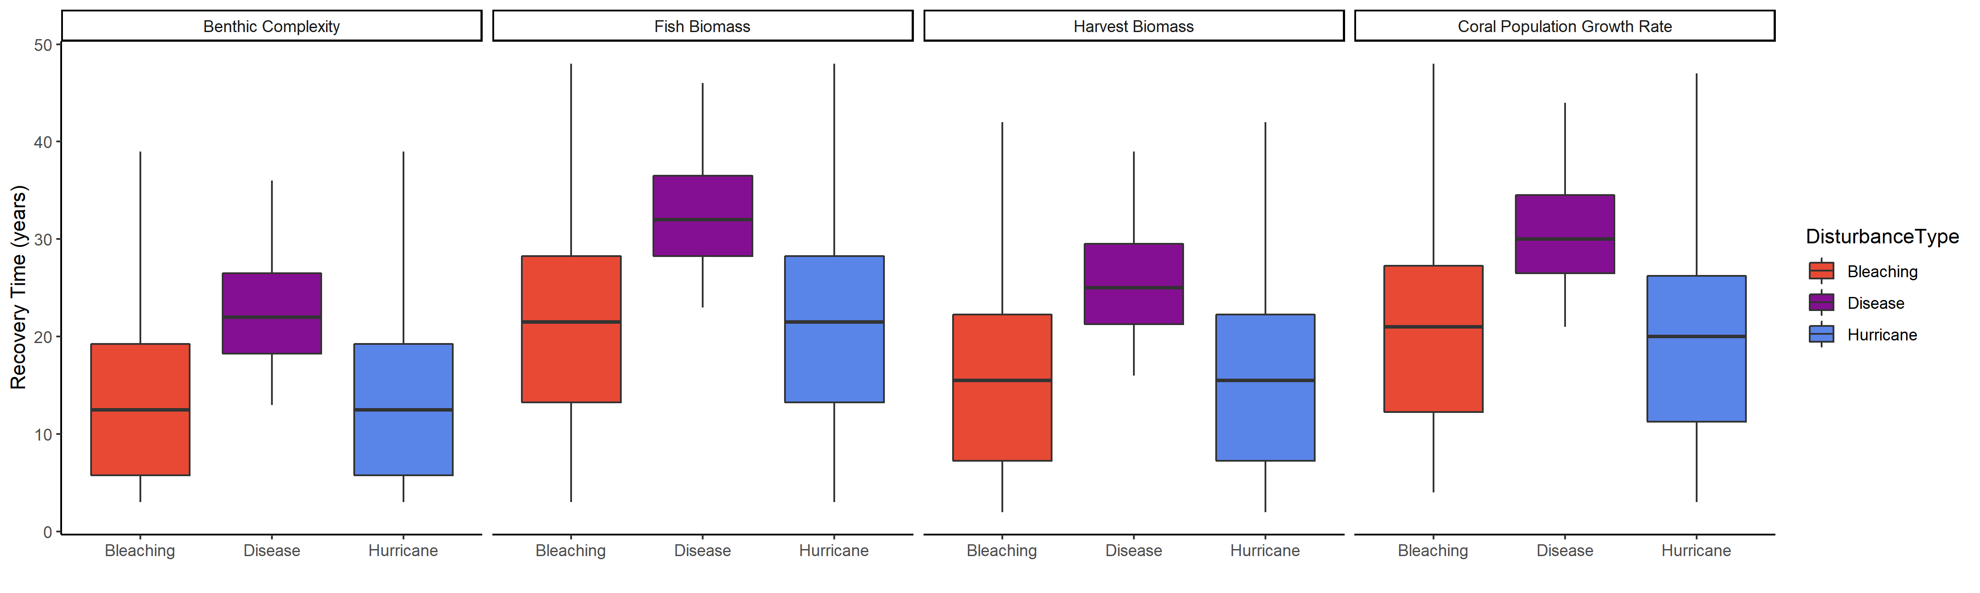
Bleaching
Disease
Hurricane
40
30
Recovery Time (years)
20
10
0
Bleaching
Disease
Hurricane
Bleaching
Disease
Hurricane
Bleaching
Disease
Hurricane
Bleaching
Disease
Hurricane

Slide 9
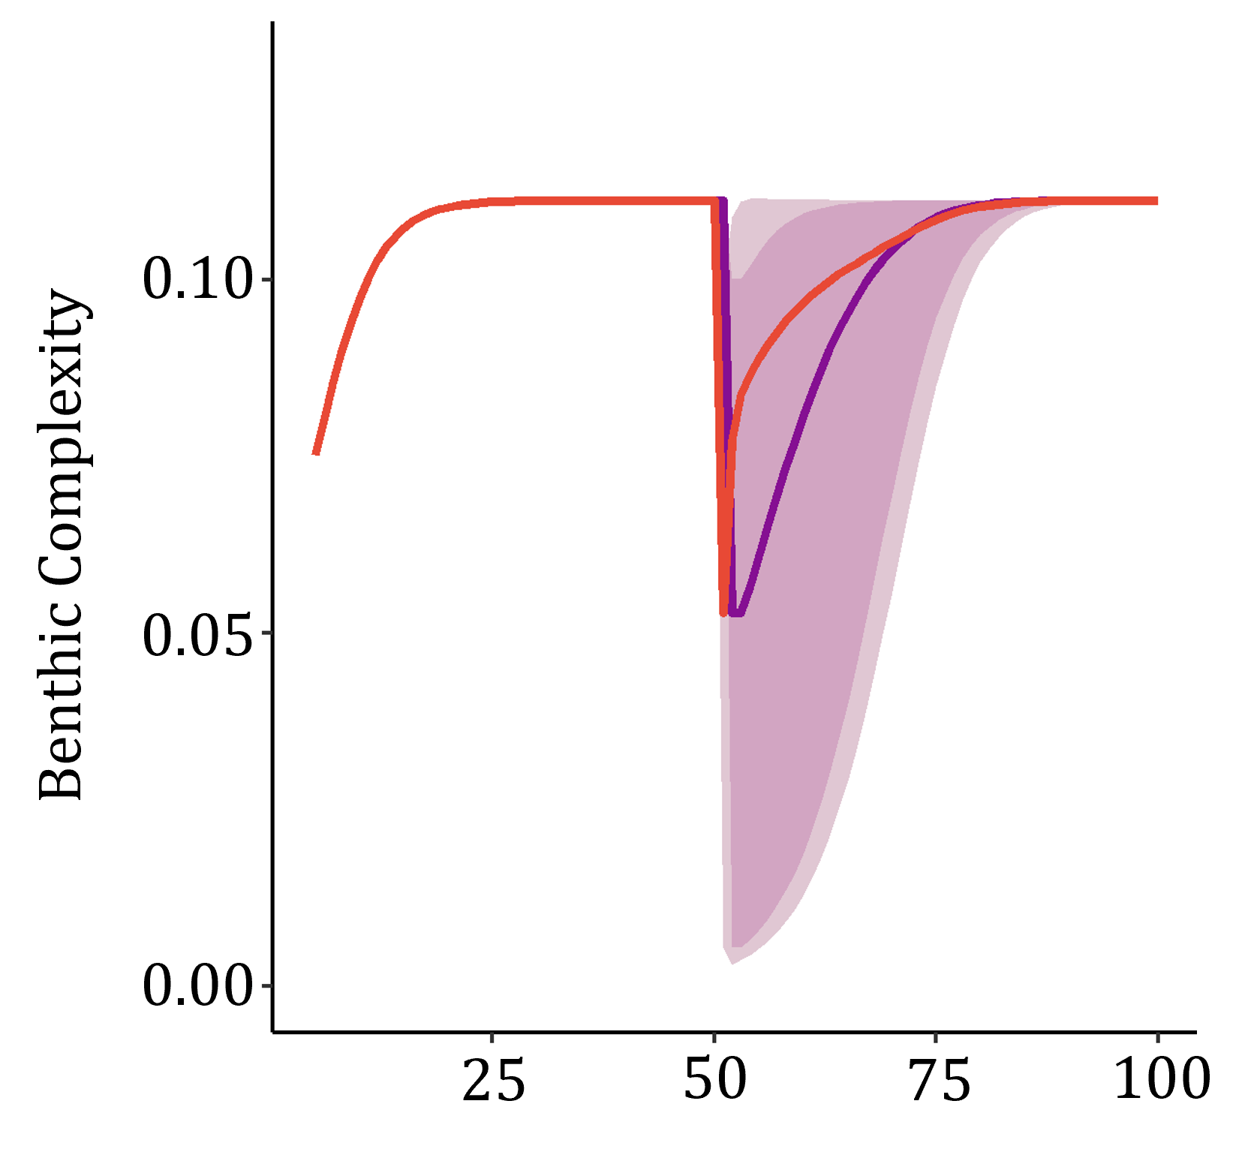
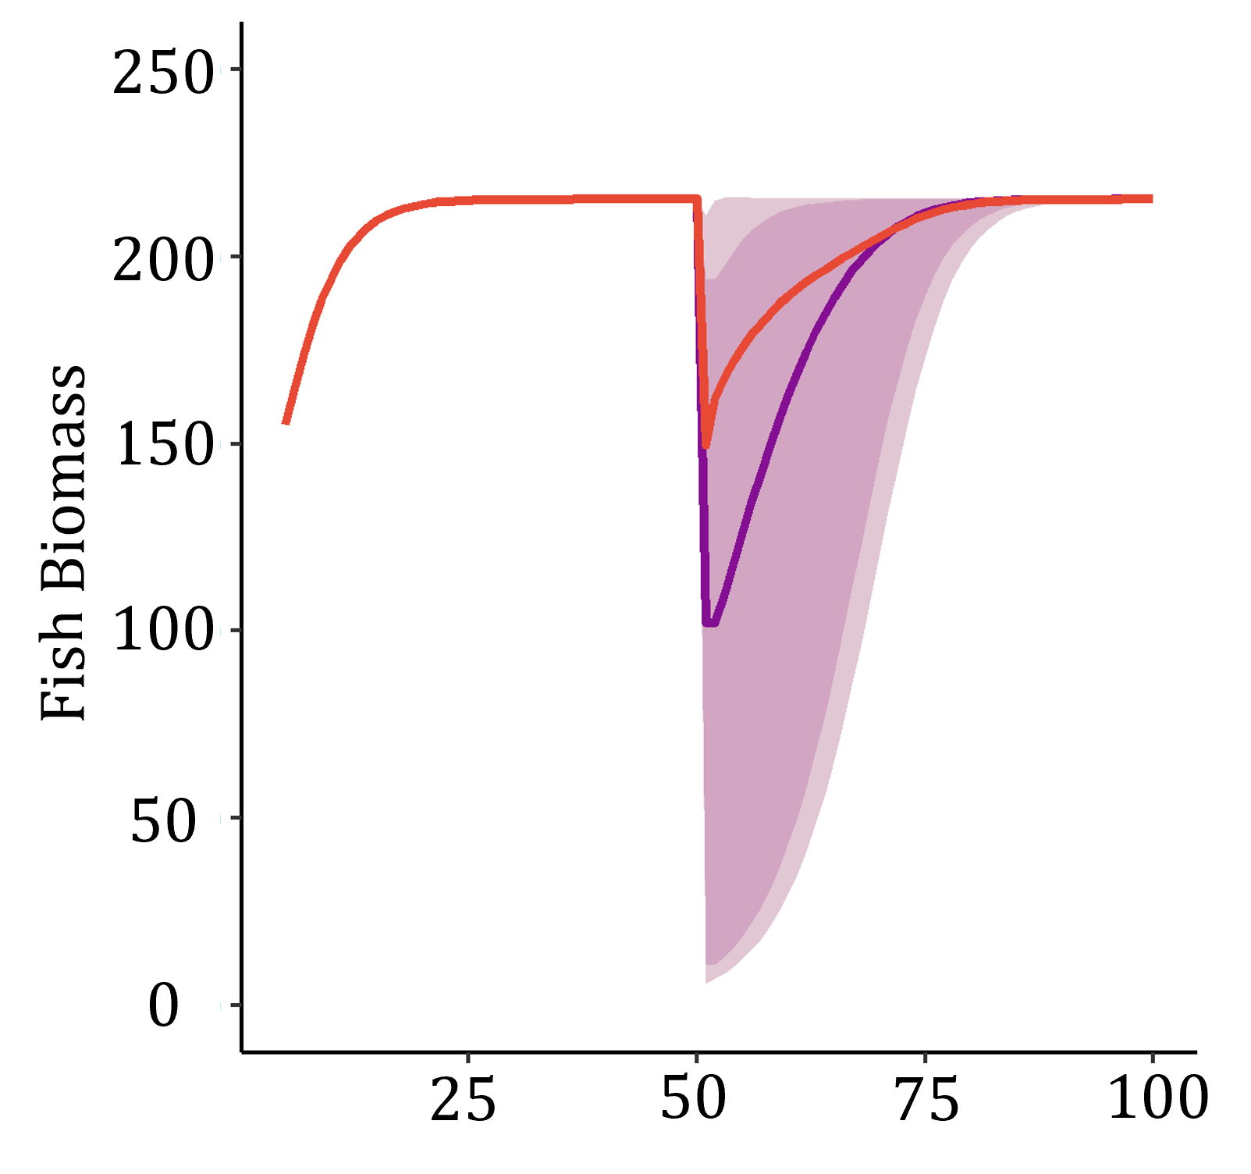
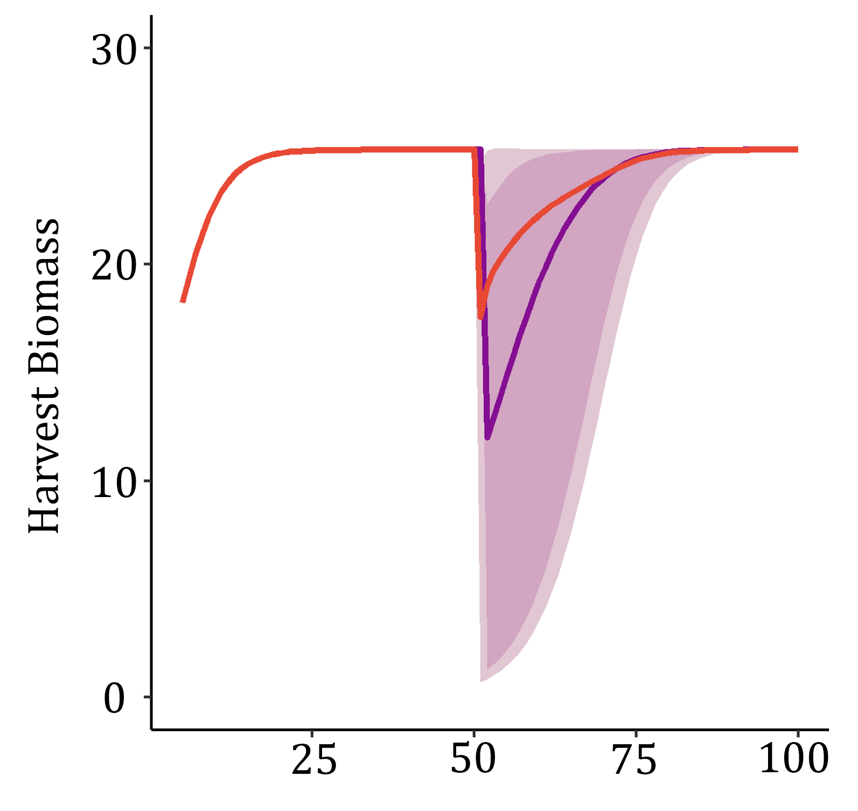
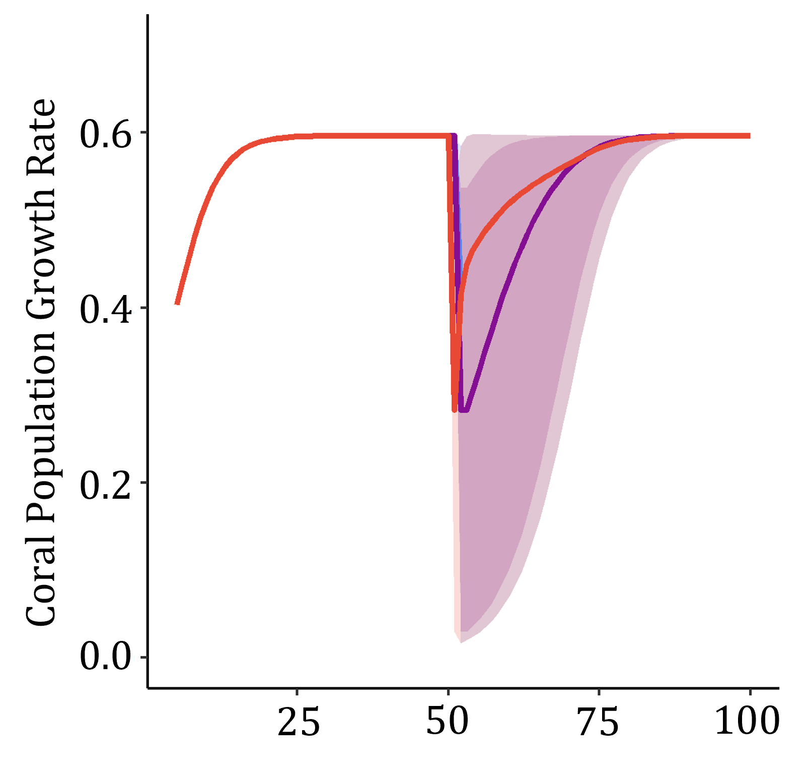
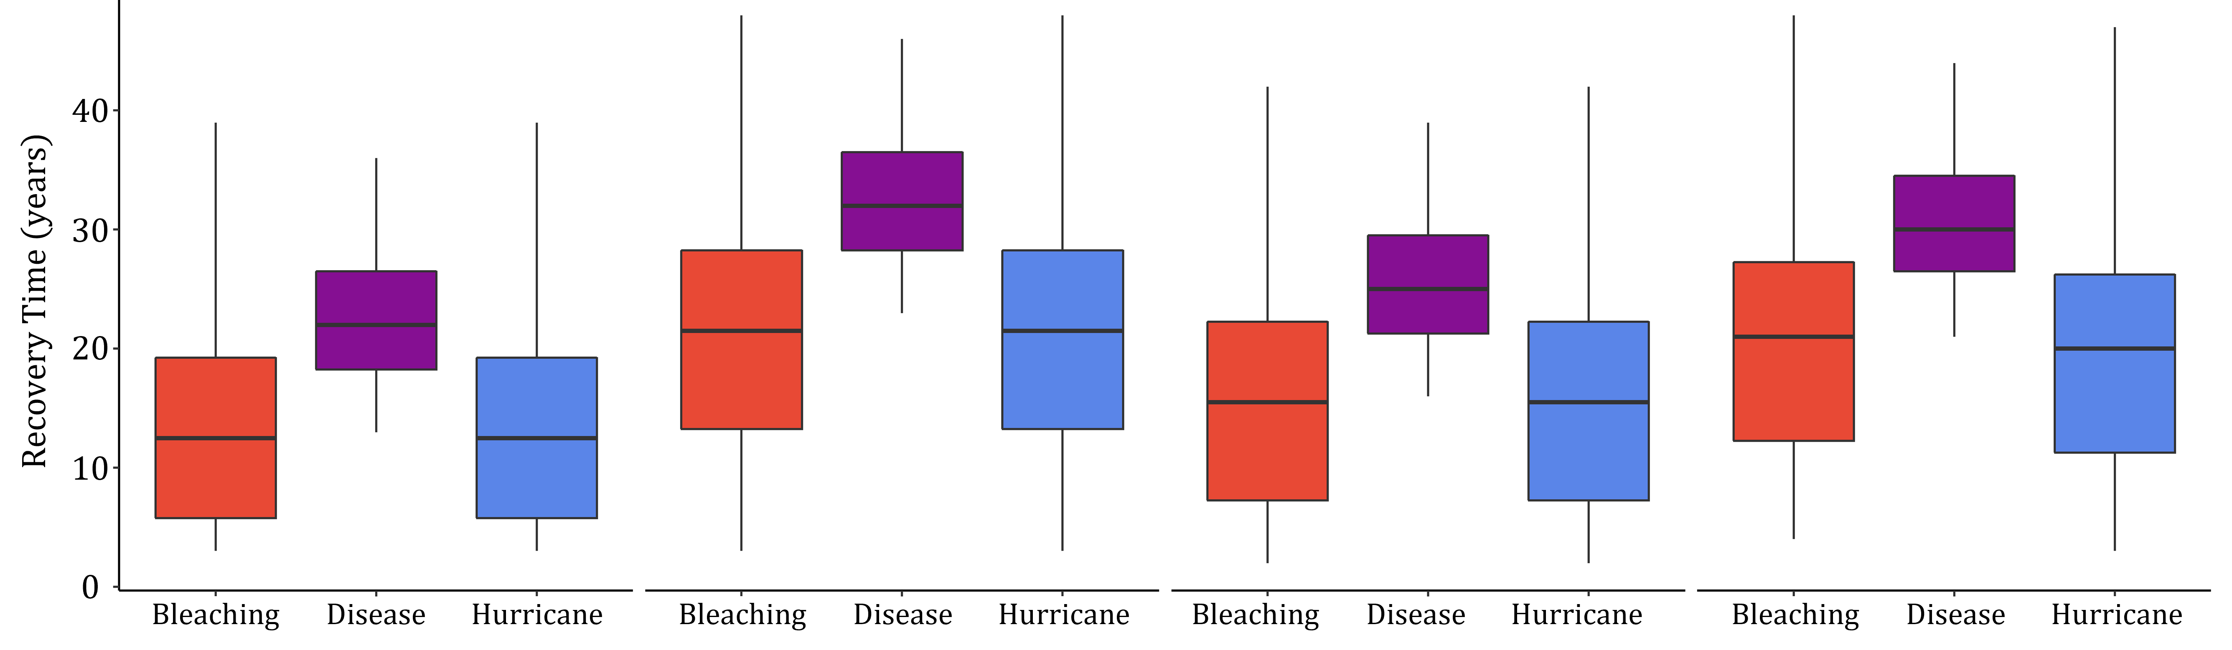



25
50
75
100
A)
Benthic Complexity
Fish Biomass
Harvest Biomass
Coral Population Growth Rate
B)
Time (years)

Slide 10
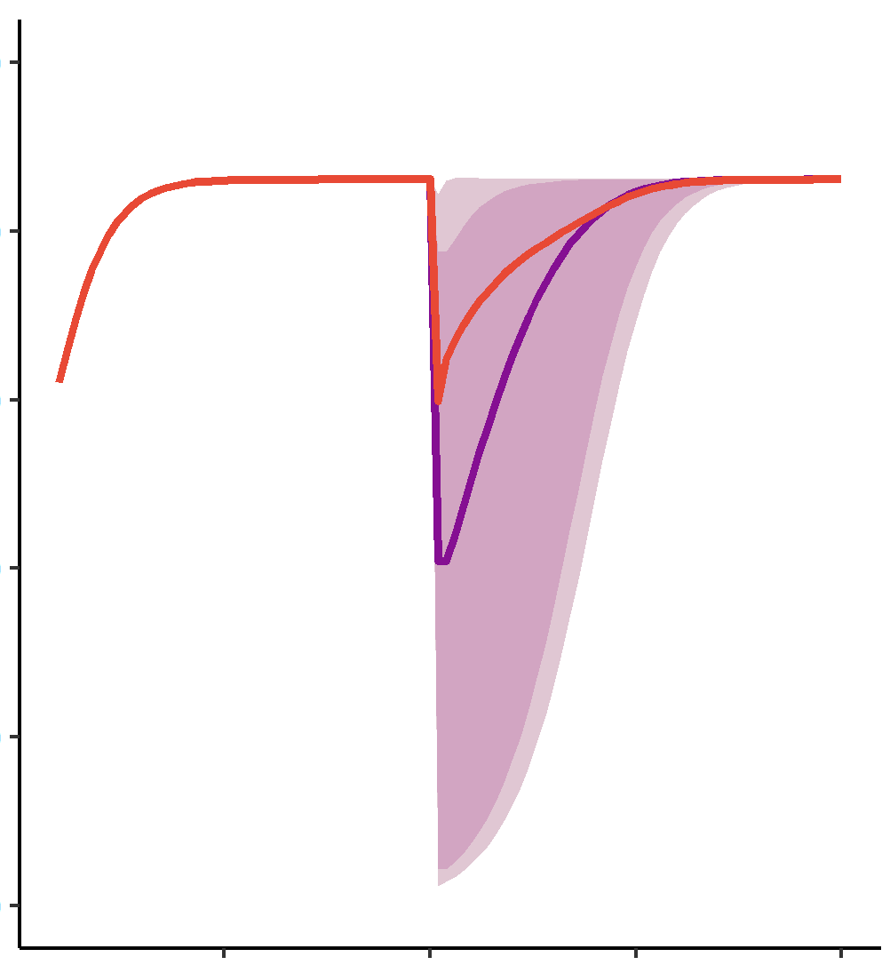
250
200
150
Fish Biomass
100
50
0
25
50
75
100

Slide 11
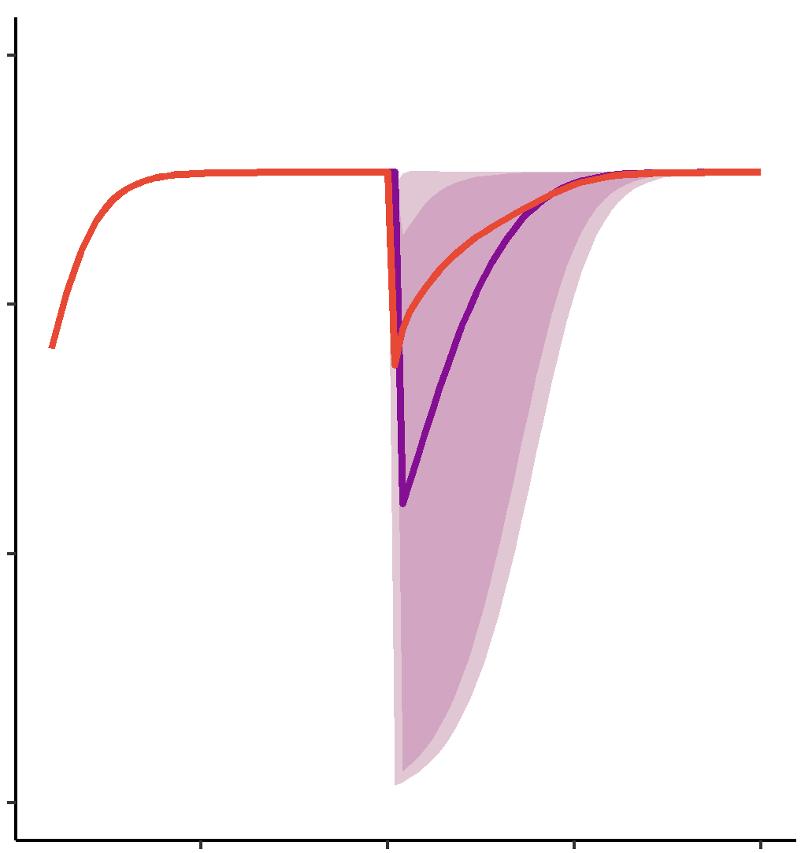
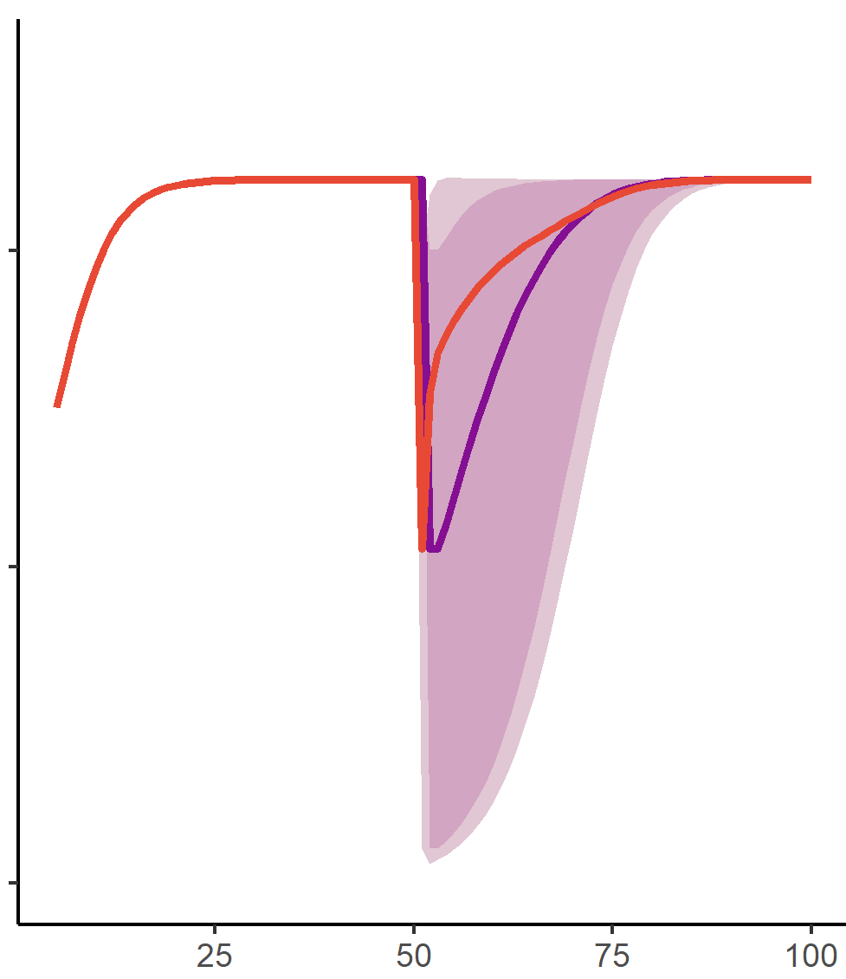
30
0.10
20
Harvest Biomass
Benthic Complexity
0.05
10
0
0.00
25
50
75
100
25
50
75
100

Slide 12
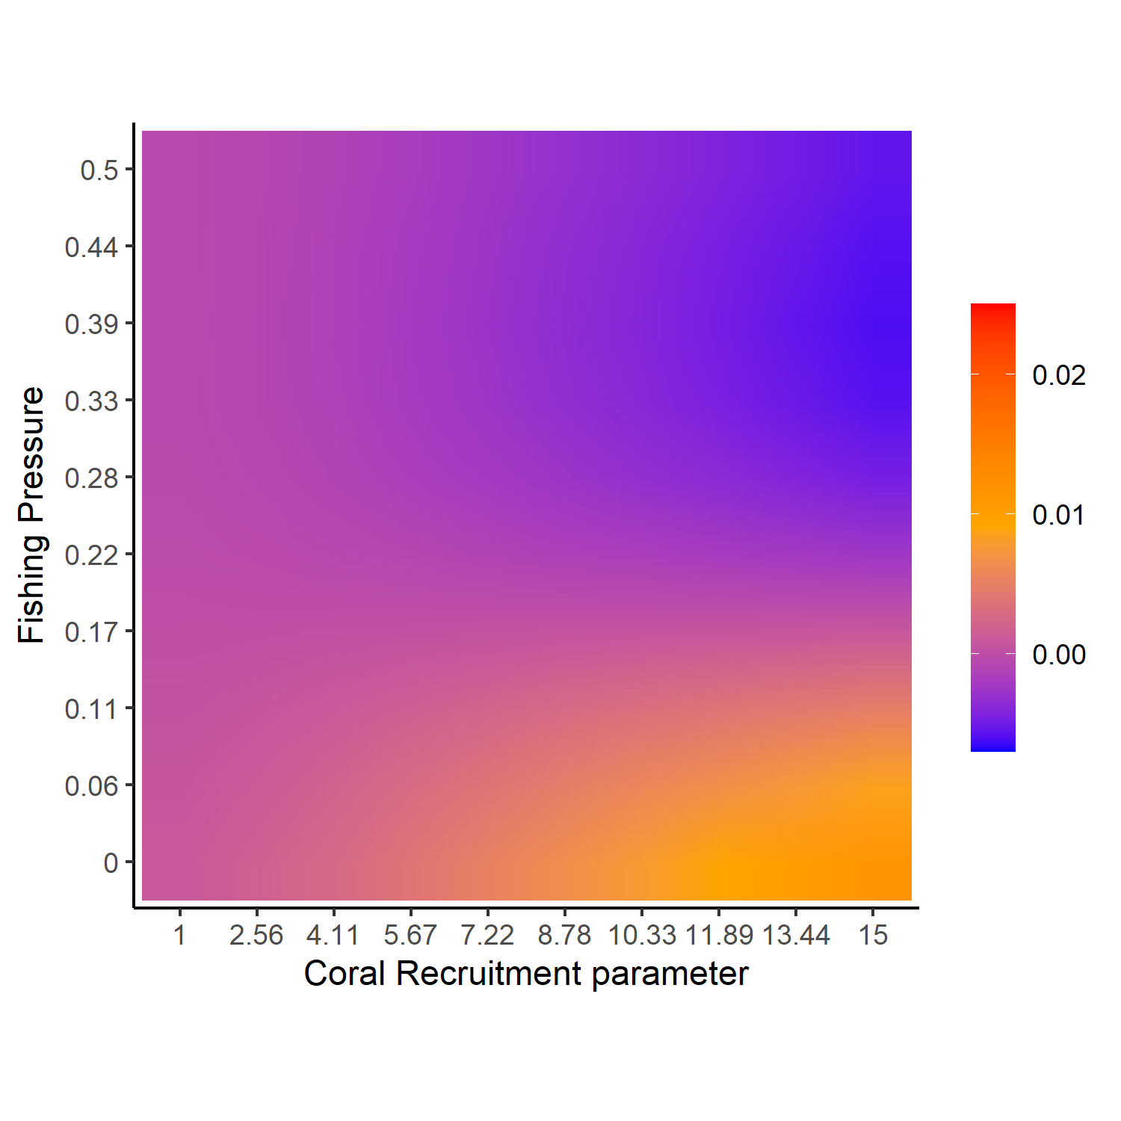
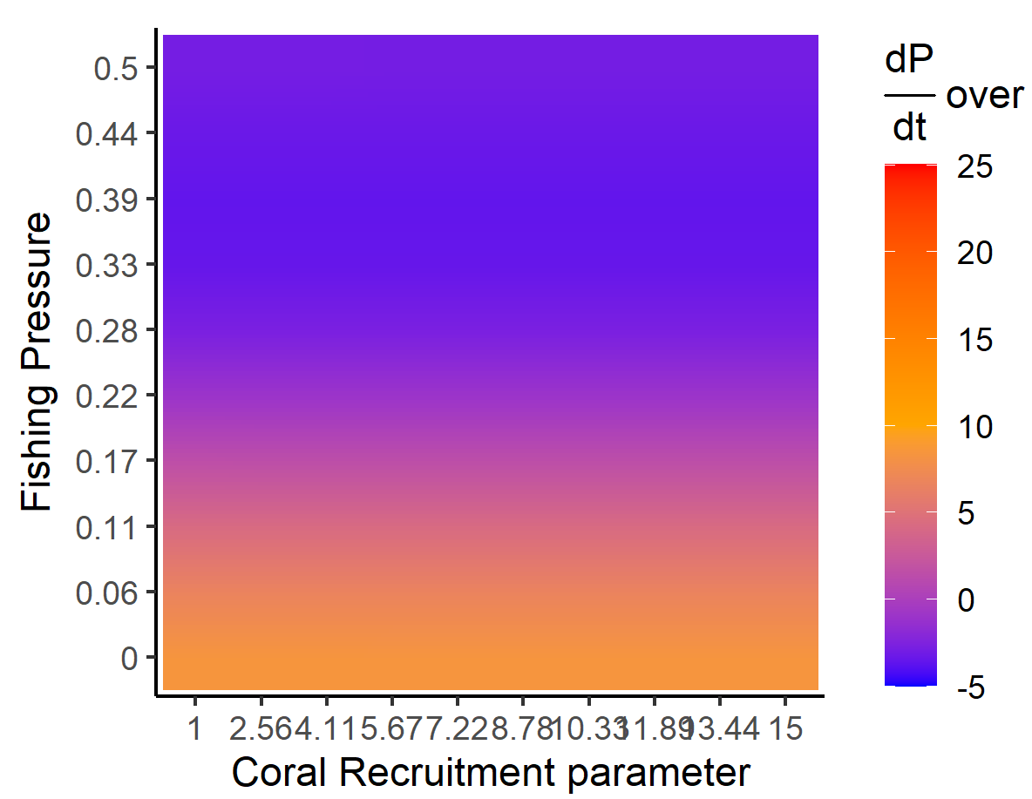
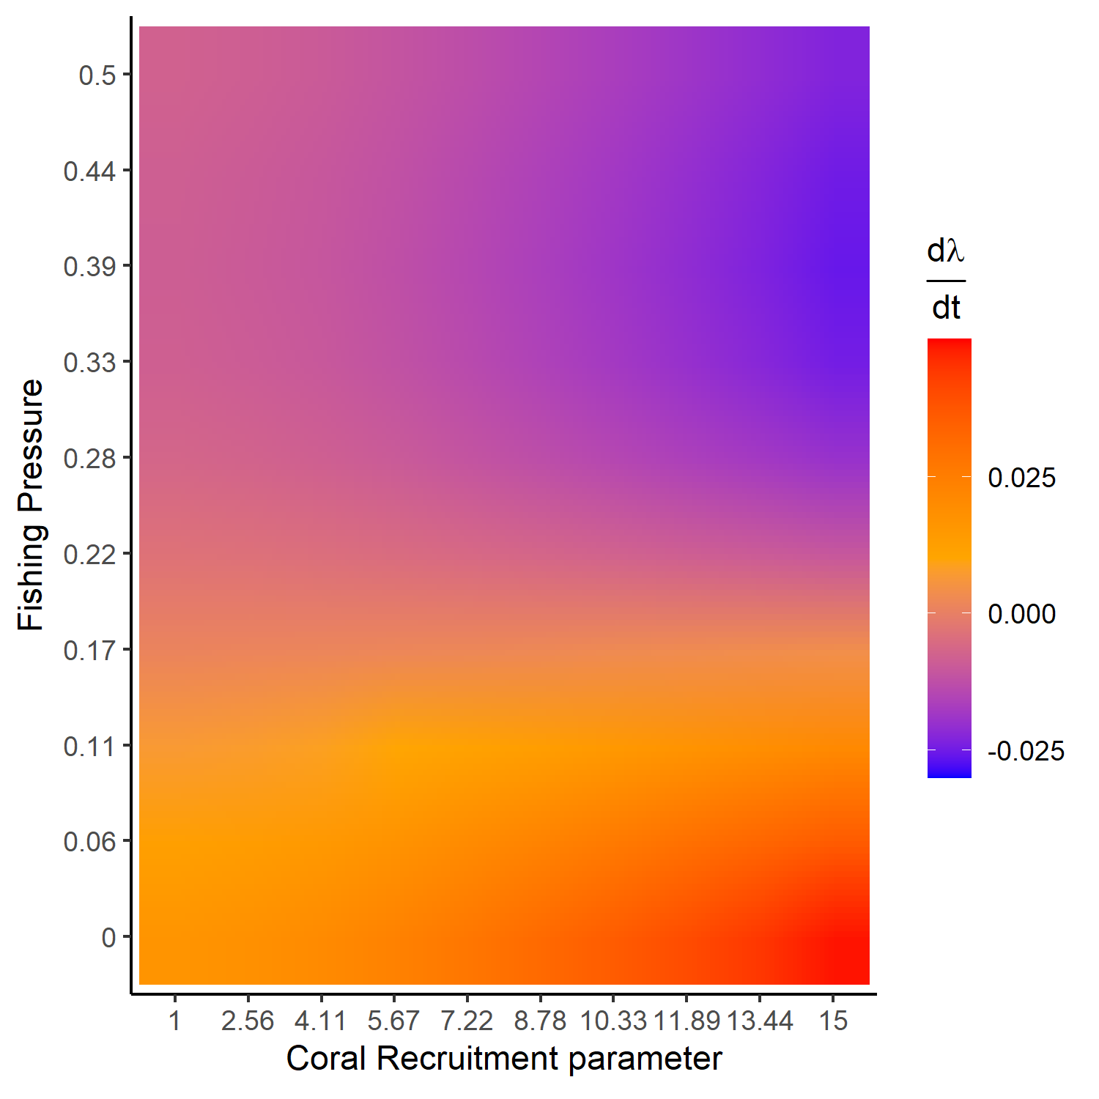
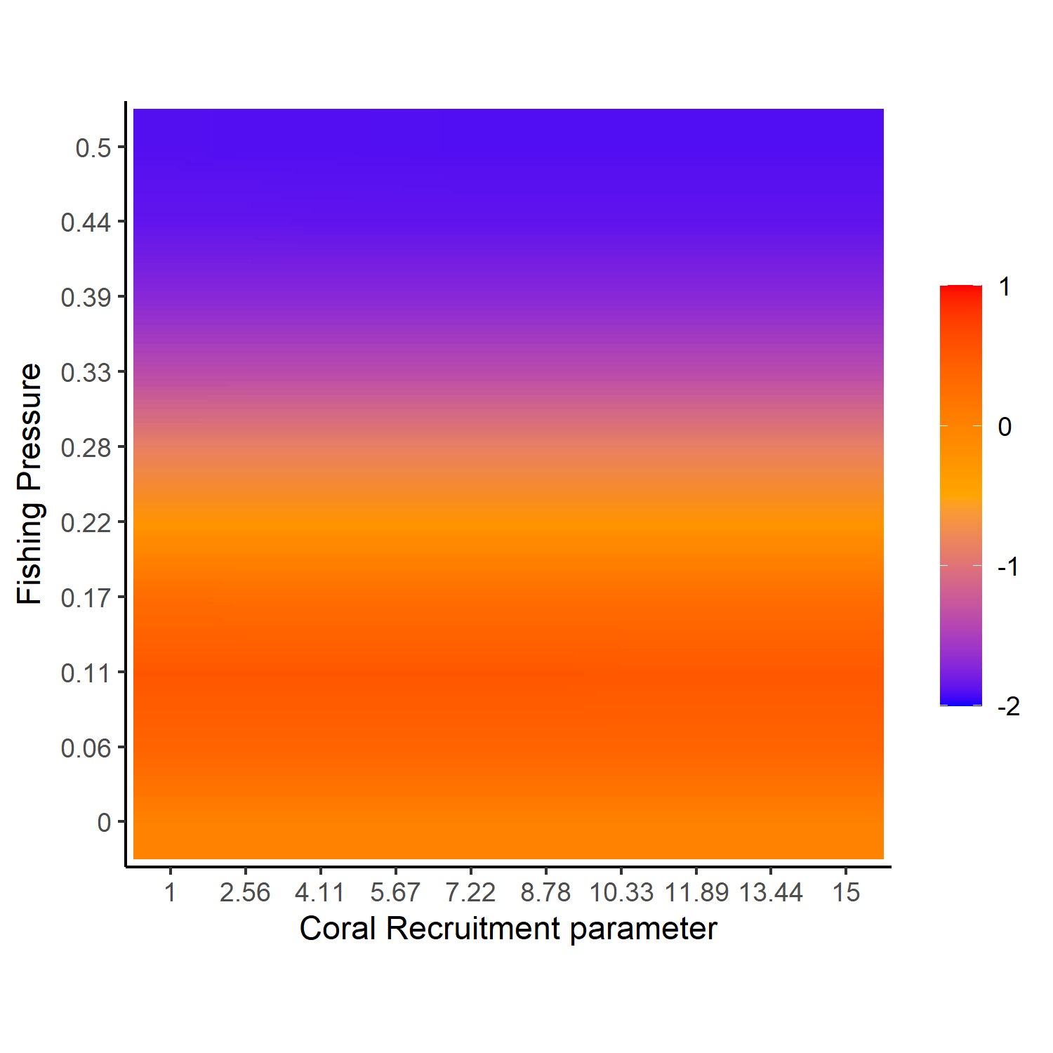

Slide 13
