Slide 1
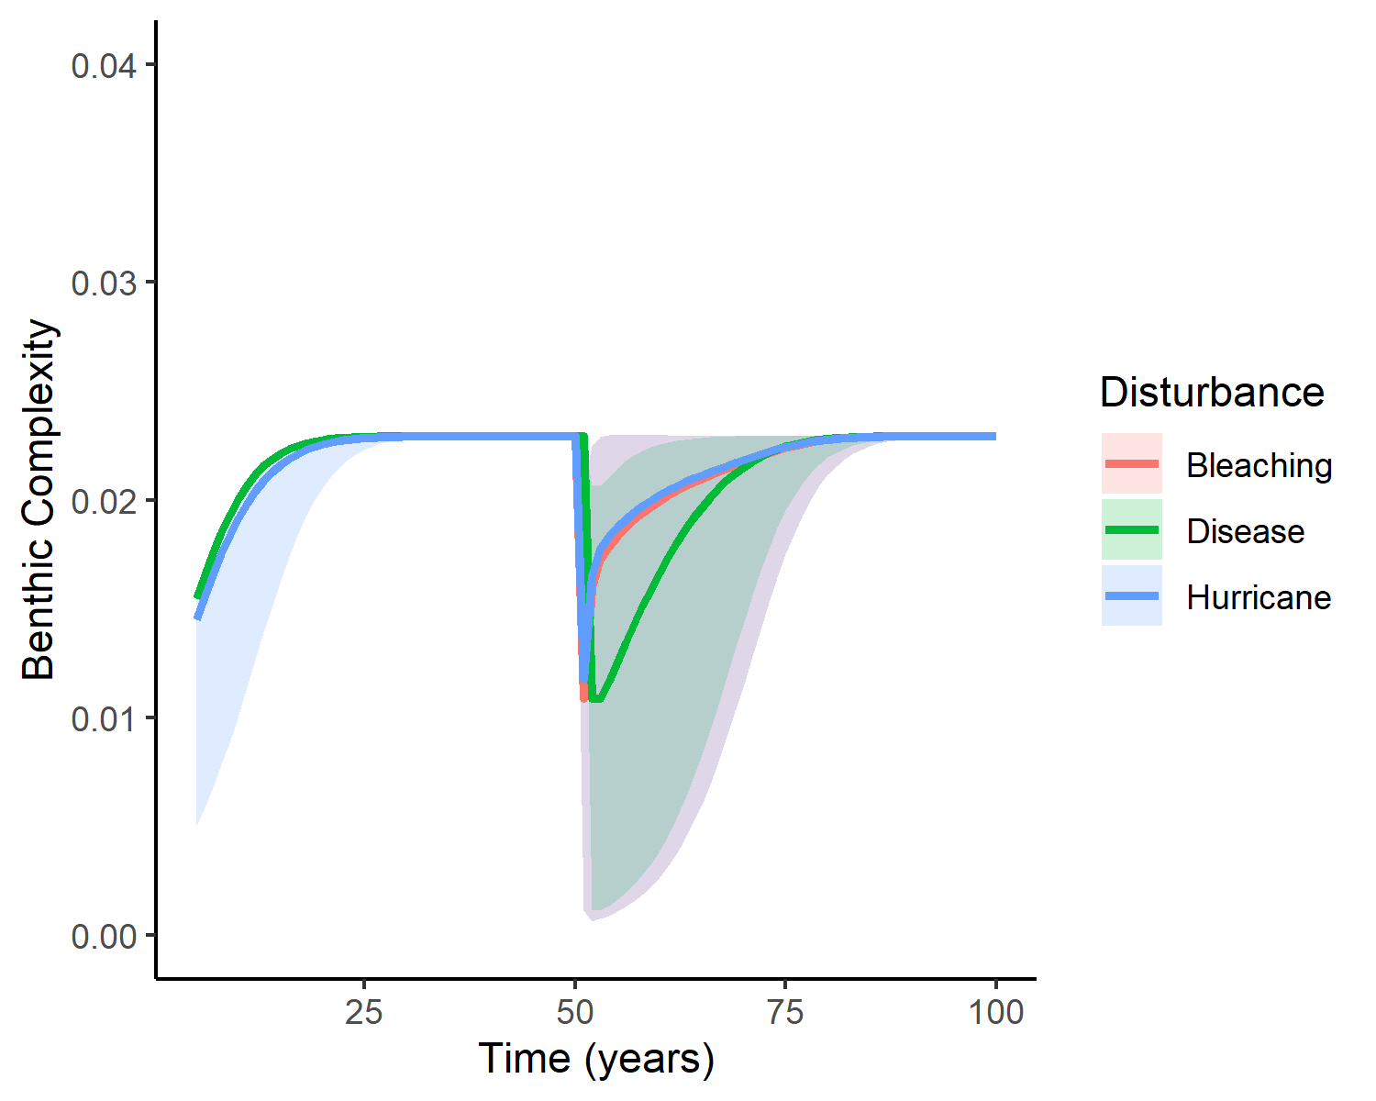
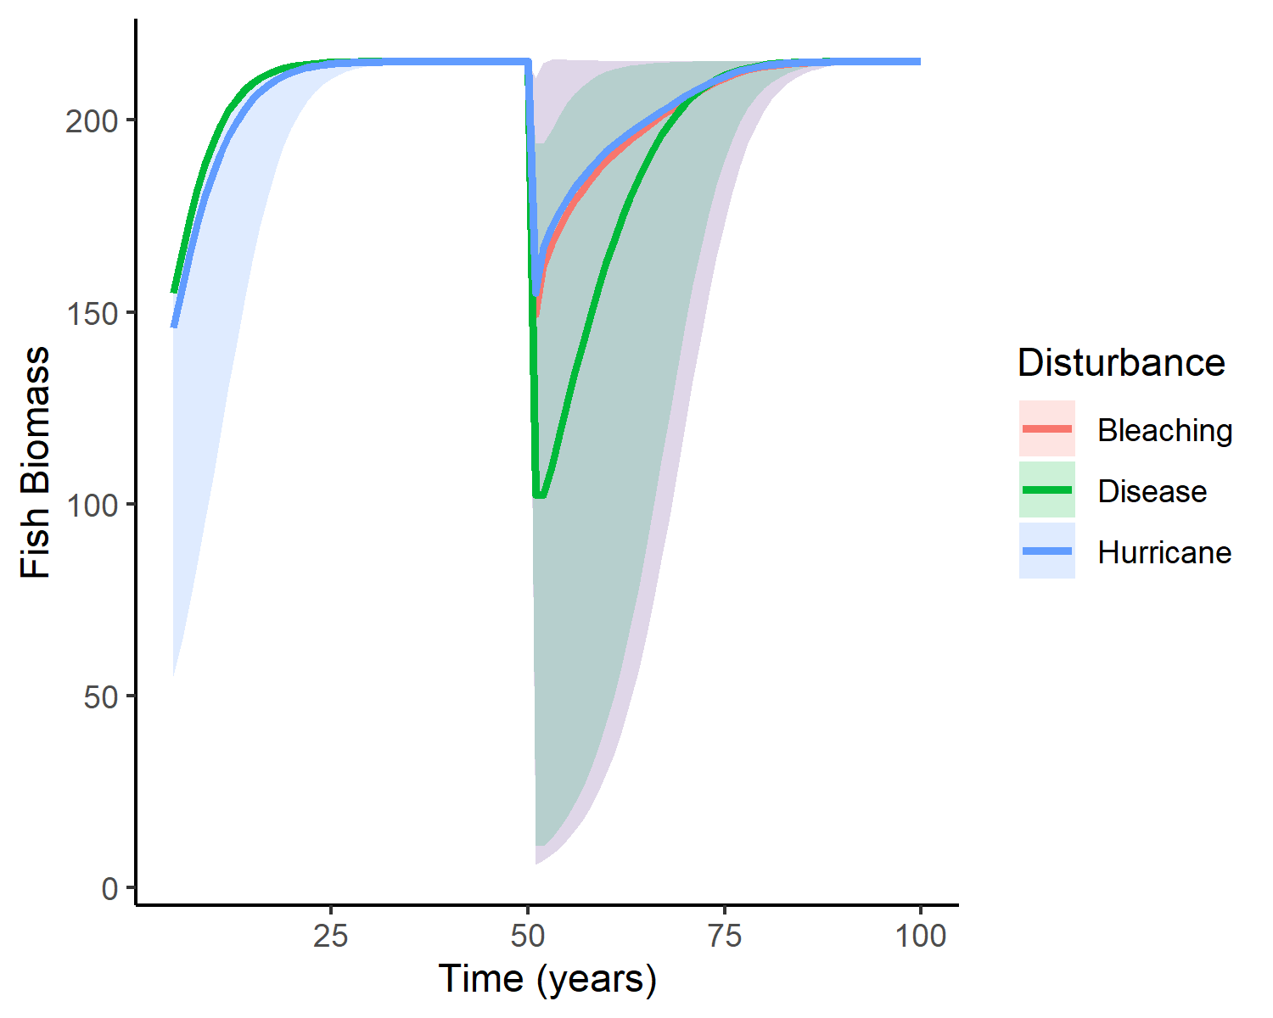
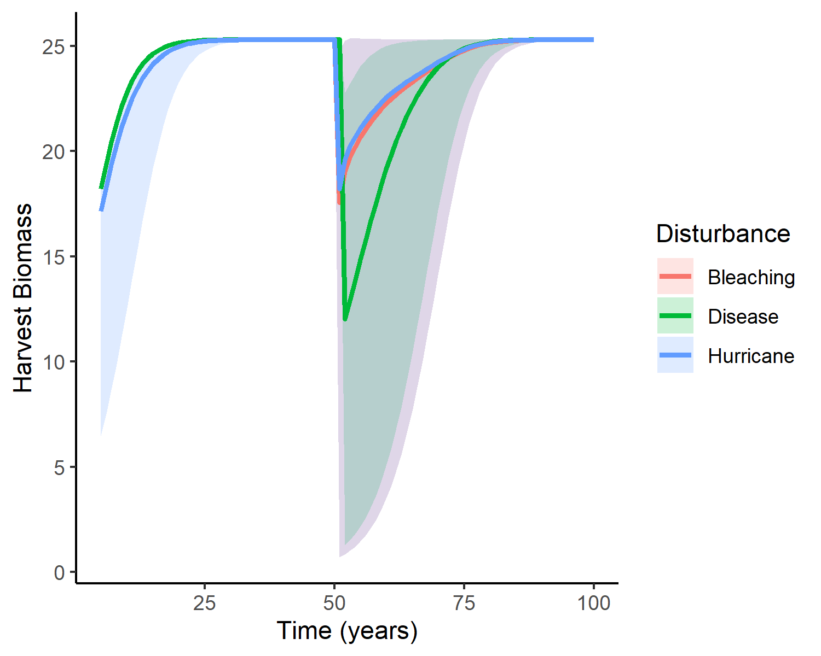
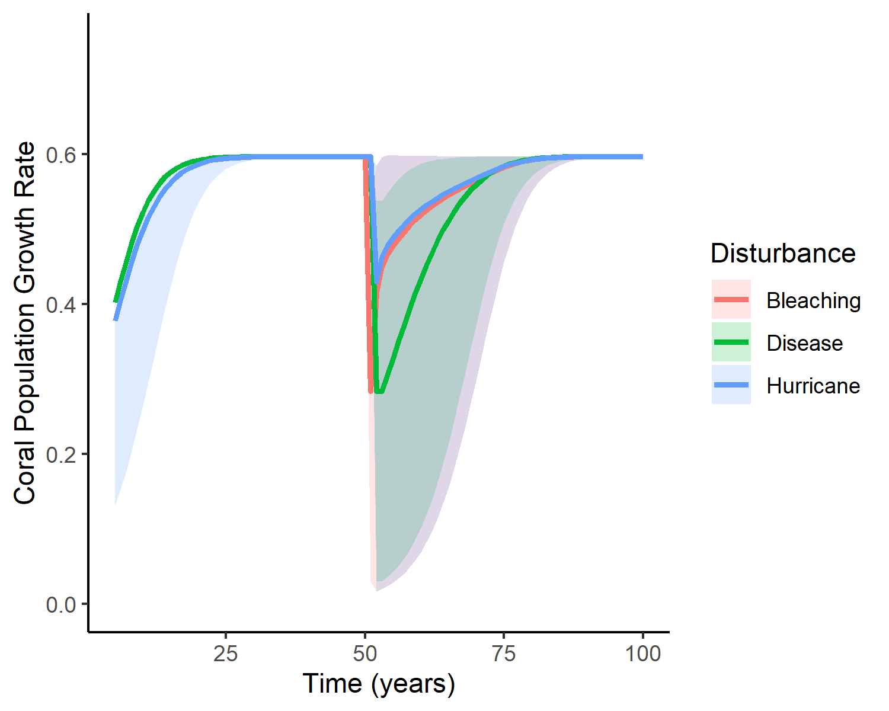
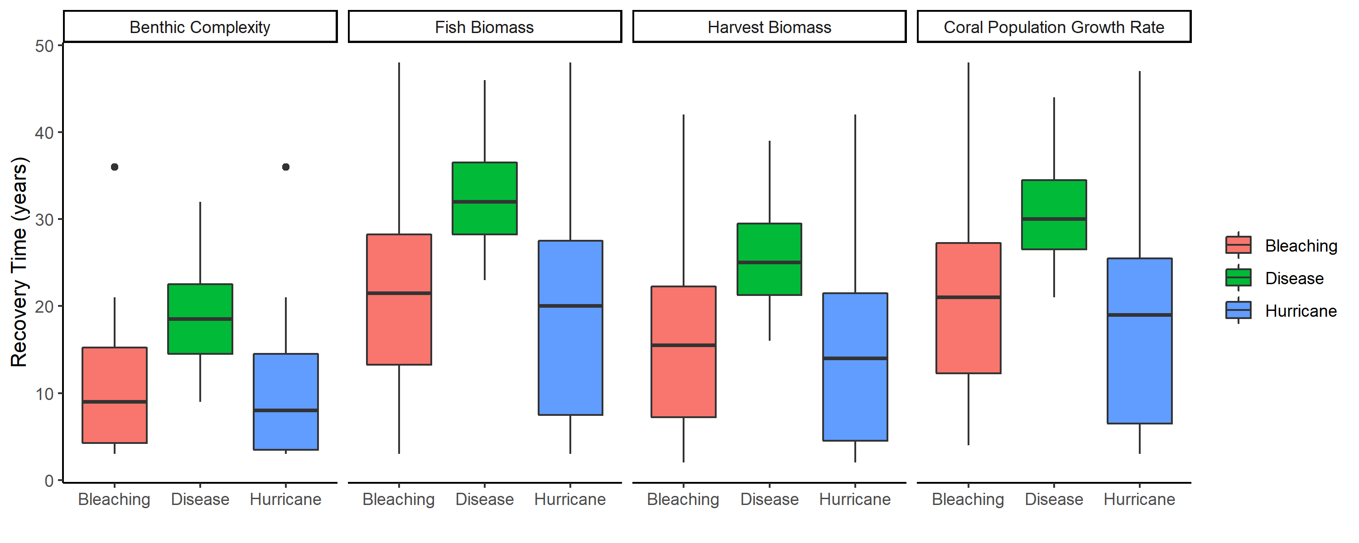

Slide 2
A)
0.04
25
200
0.03
20
0.6
150
15
0.4
0.02
Harvest Biomass
Benthic Complexity
Fish Biomass
Coral Population Growth Rate
100
10
0.01
50
0.2
5
0.00
0
0
0.0
25
50
75
100
25
50
75
100
25
50
75
100
25
50
75
100
Time (years)
B)

Slide 3
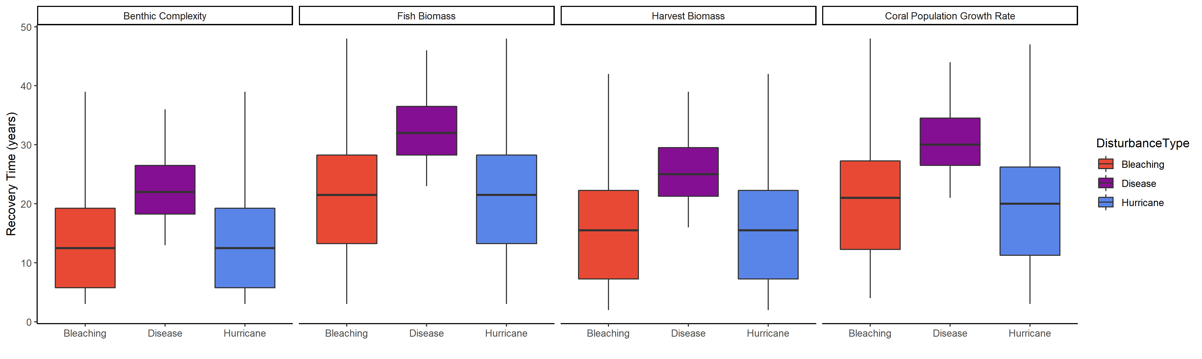
Bleaching
Disease
Hurricane
40
30
Recovery Time (years)
20
10
0
Bleaching
Disease
Hurricane
Bleaching
Disease
Hurricane
Bleaching
Disease
Hurricane
Bleaching
Disease
Hurricane

Slide 4
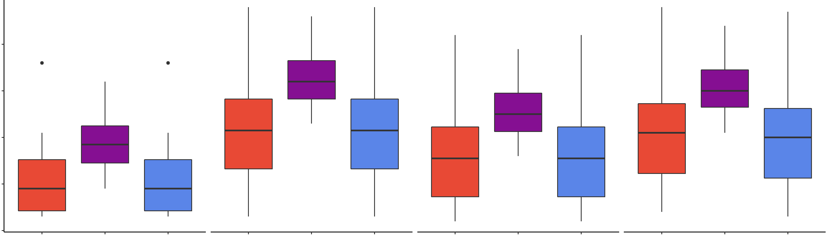
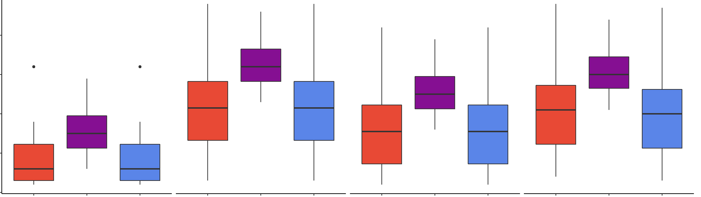
40
30
Recovery Time (years)
20
10
0
Bleaching
Disease
Hurricane
Bleaching
Disease
Hurricane
Bleaching
Disease
Hurricane
Bleaching
Disease
Hurricane

Slide 5
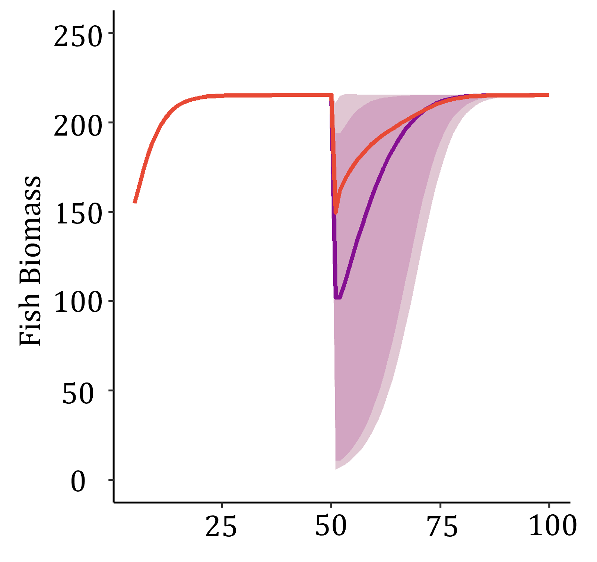
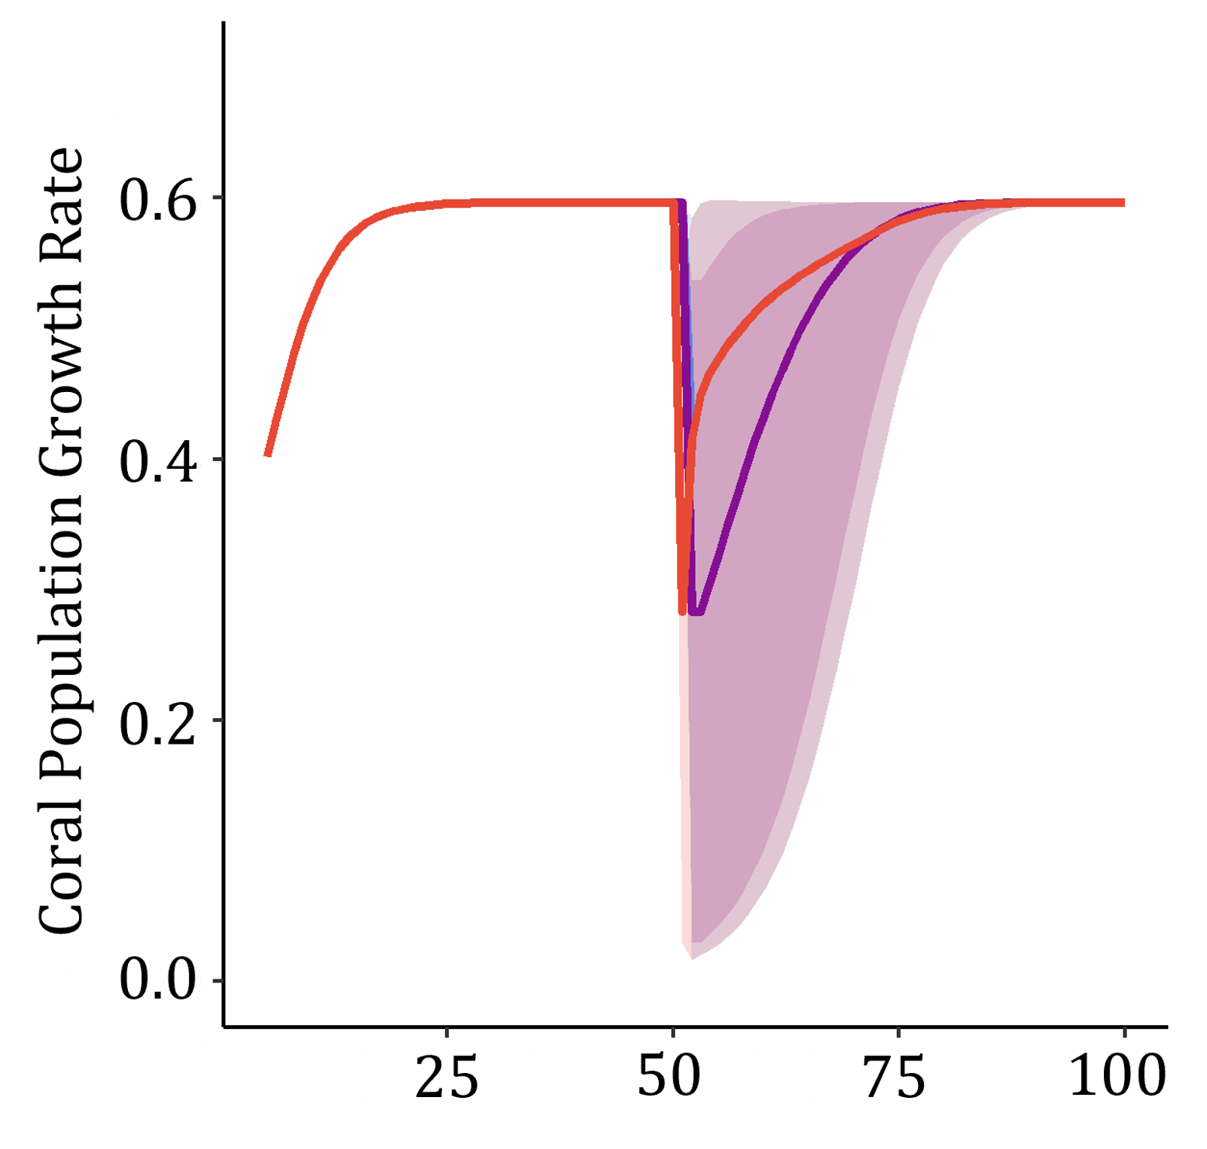
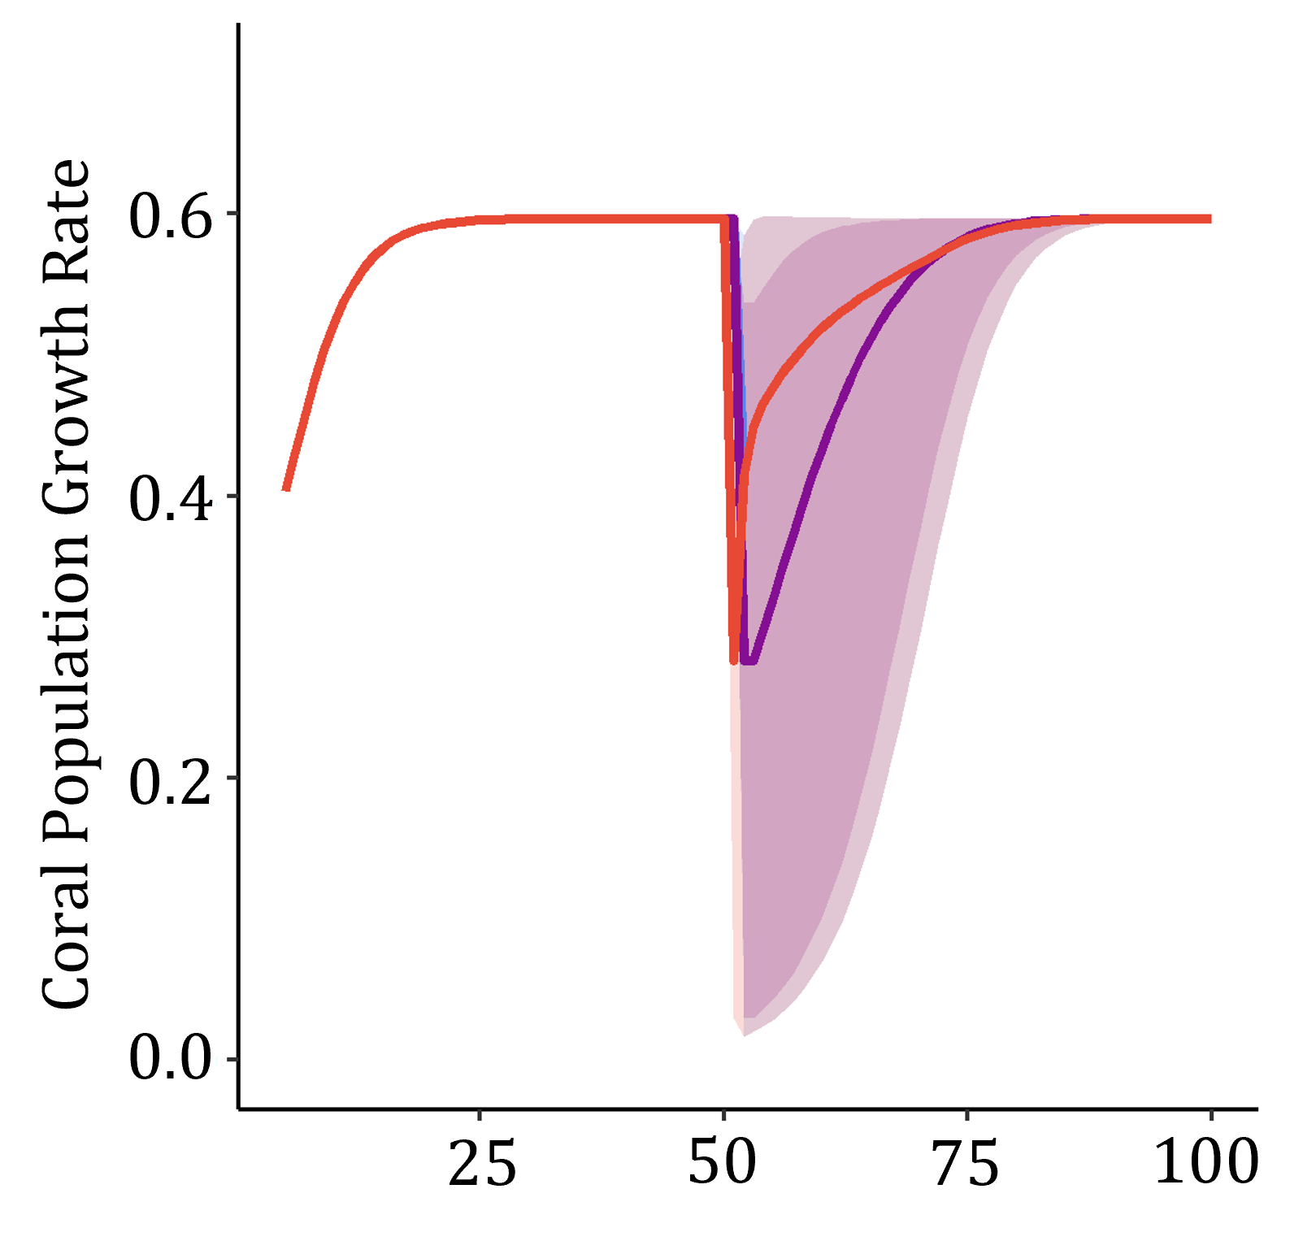
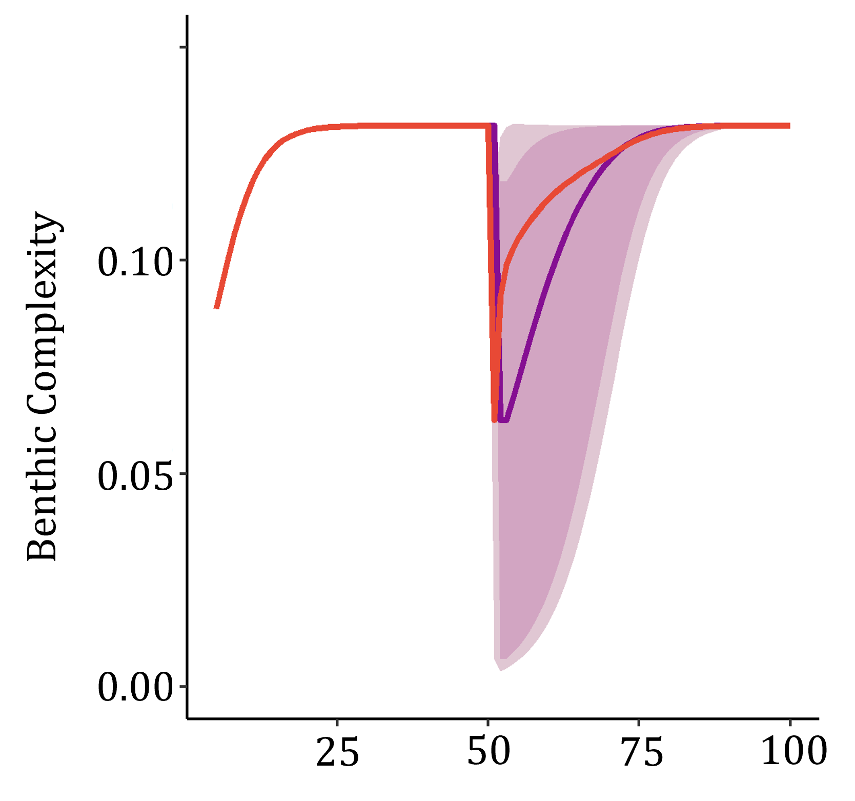
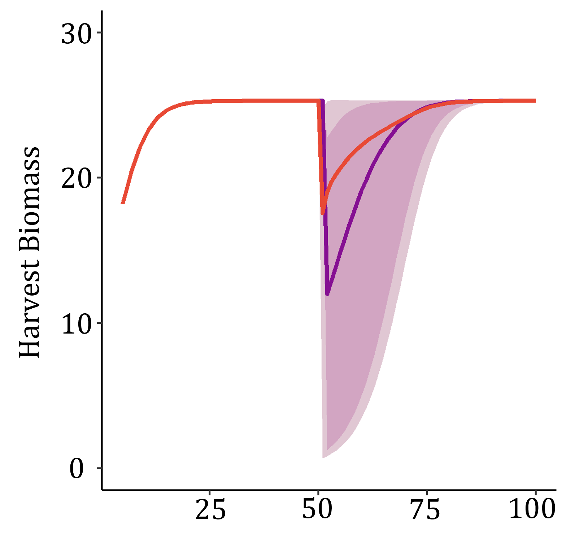

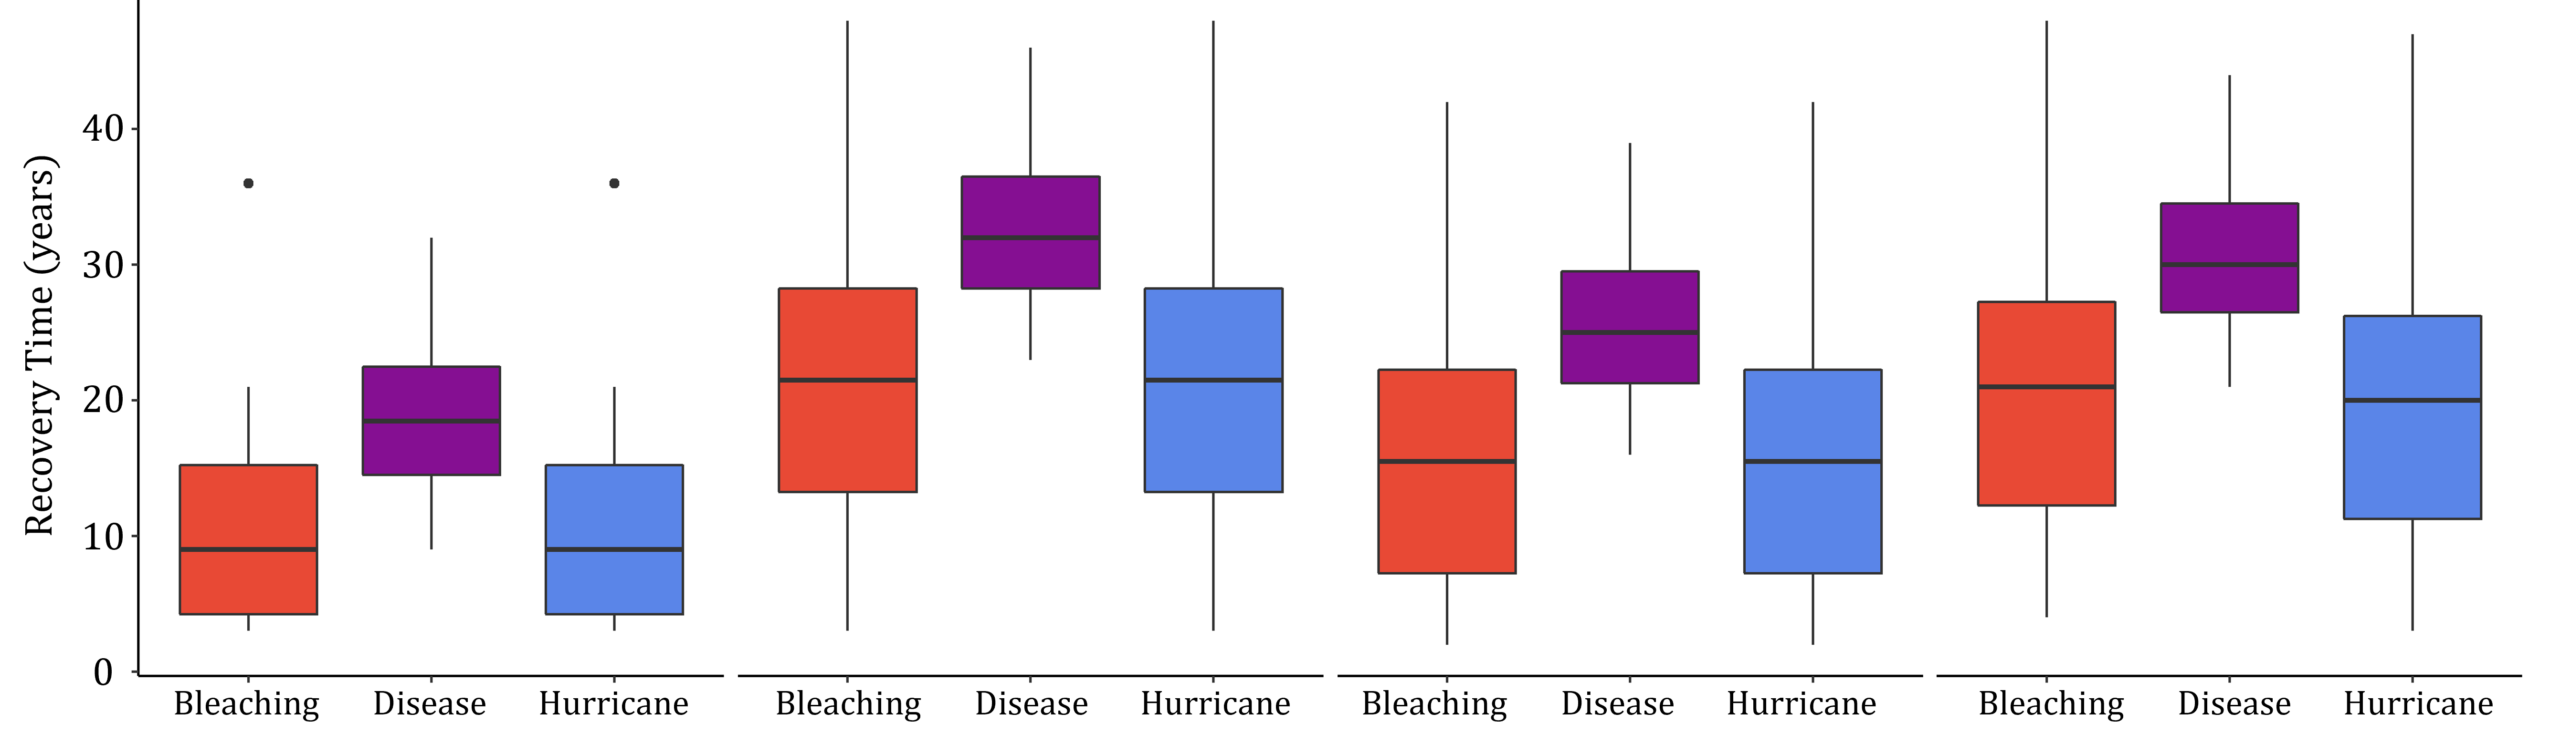
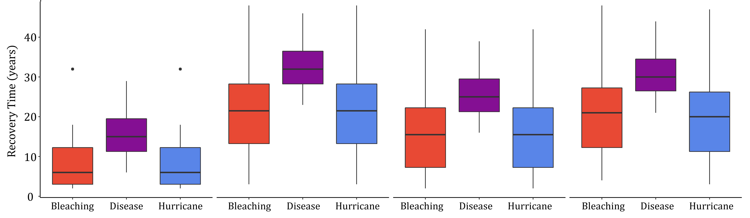
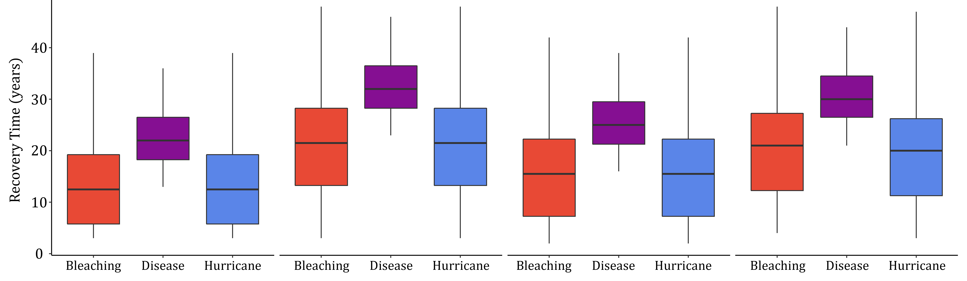



A)
Benthic Complexity
Fish Biomass
Harvest Biomass
Coral Population Growth Rate
B)
Time (years)

Slide 6
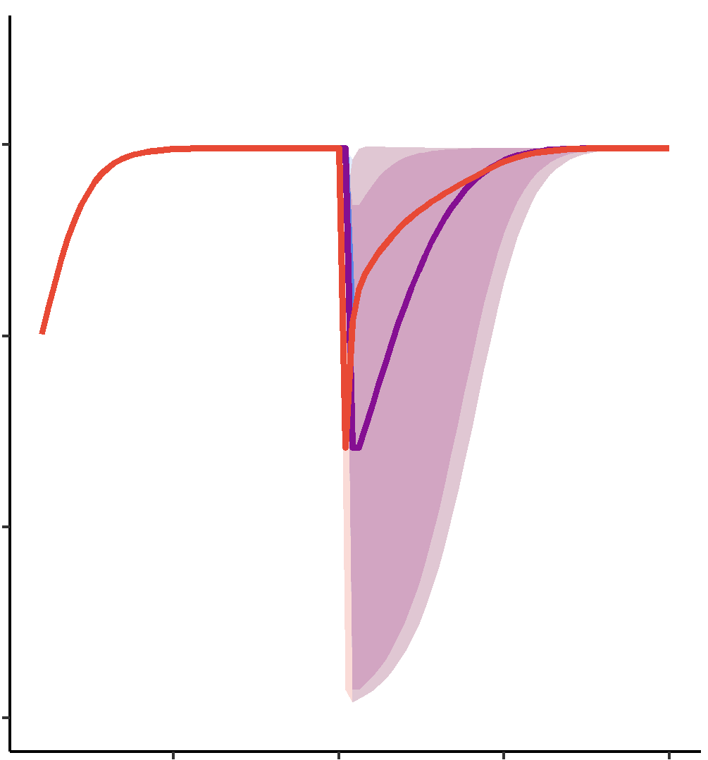

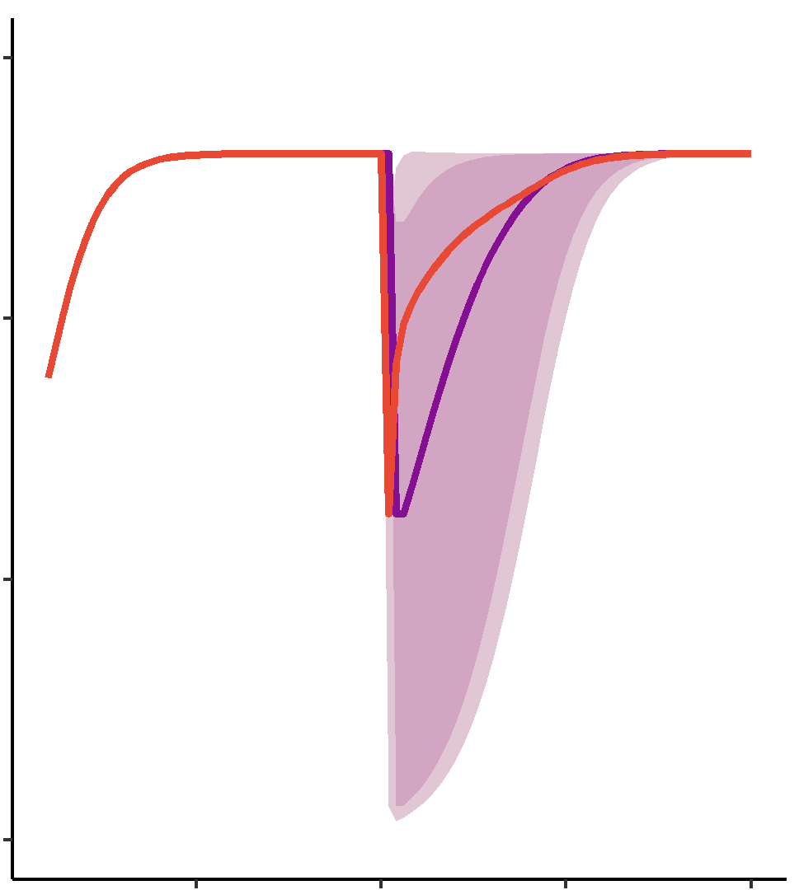
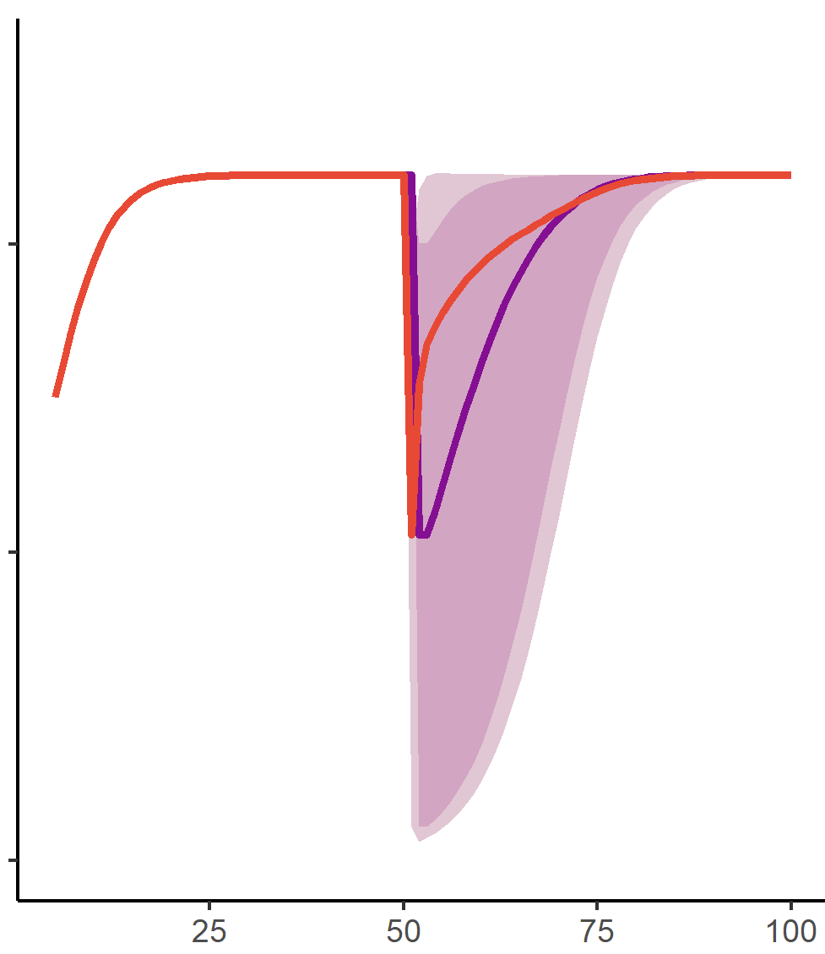
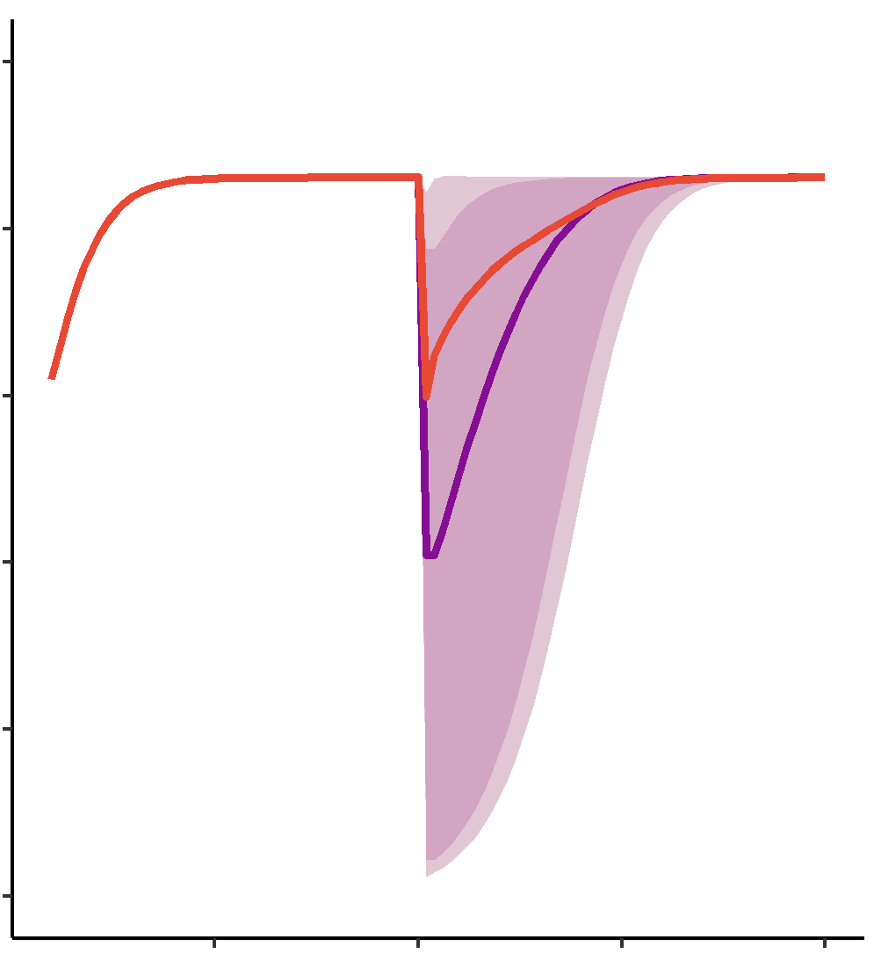
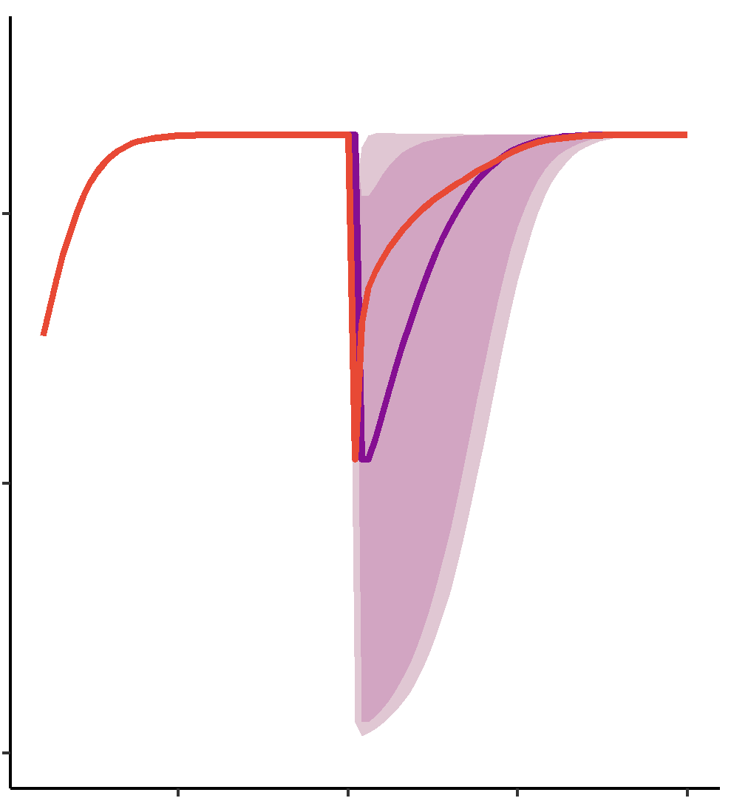
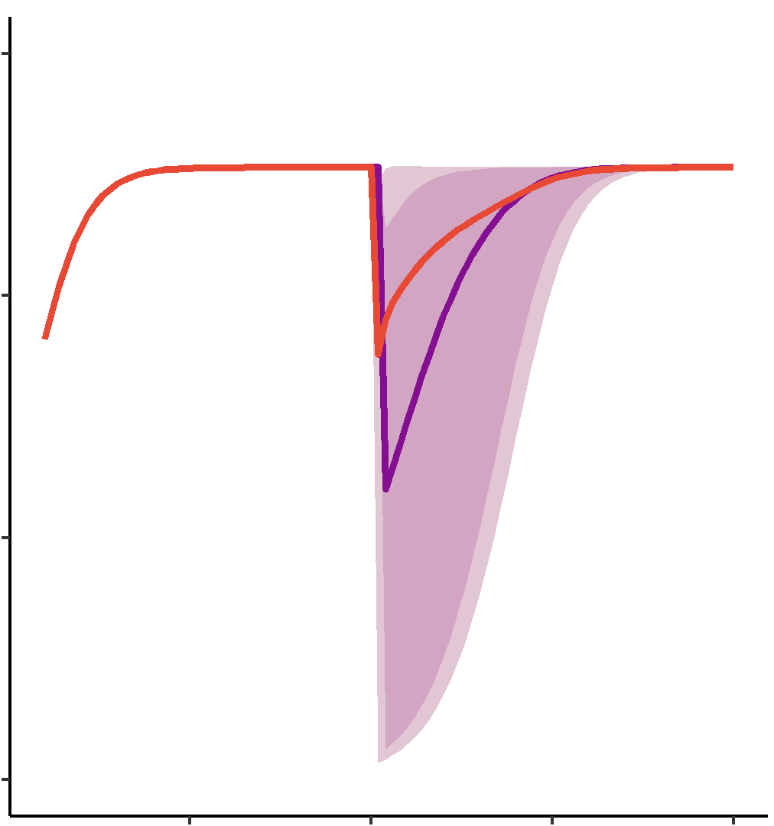



30
250
200
20
0.10
150
Fish Biomass
Harvest Biomass
Benthic Complexity
100
10
0.05
50
0
0.00
0
25
25
50
50
75
75
100
100
25
50
75
100

Slide 7
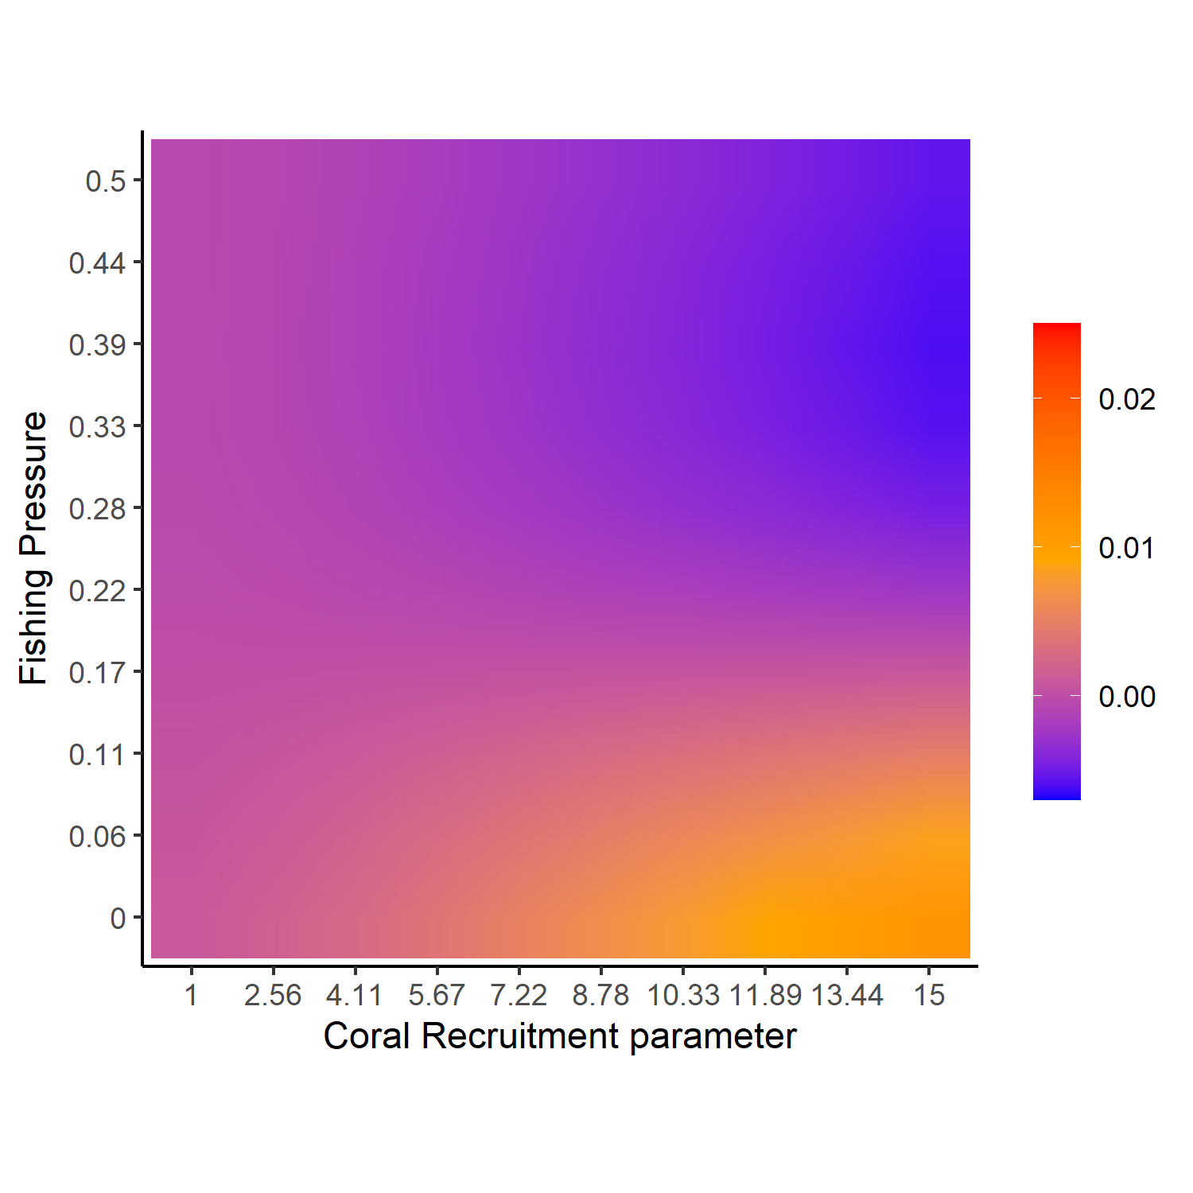
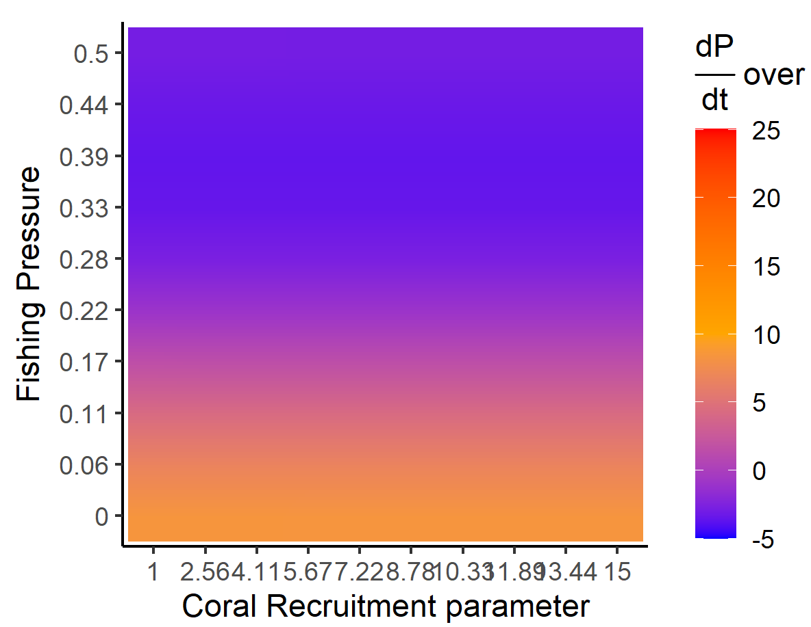
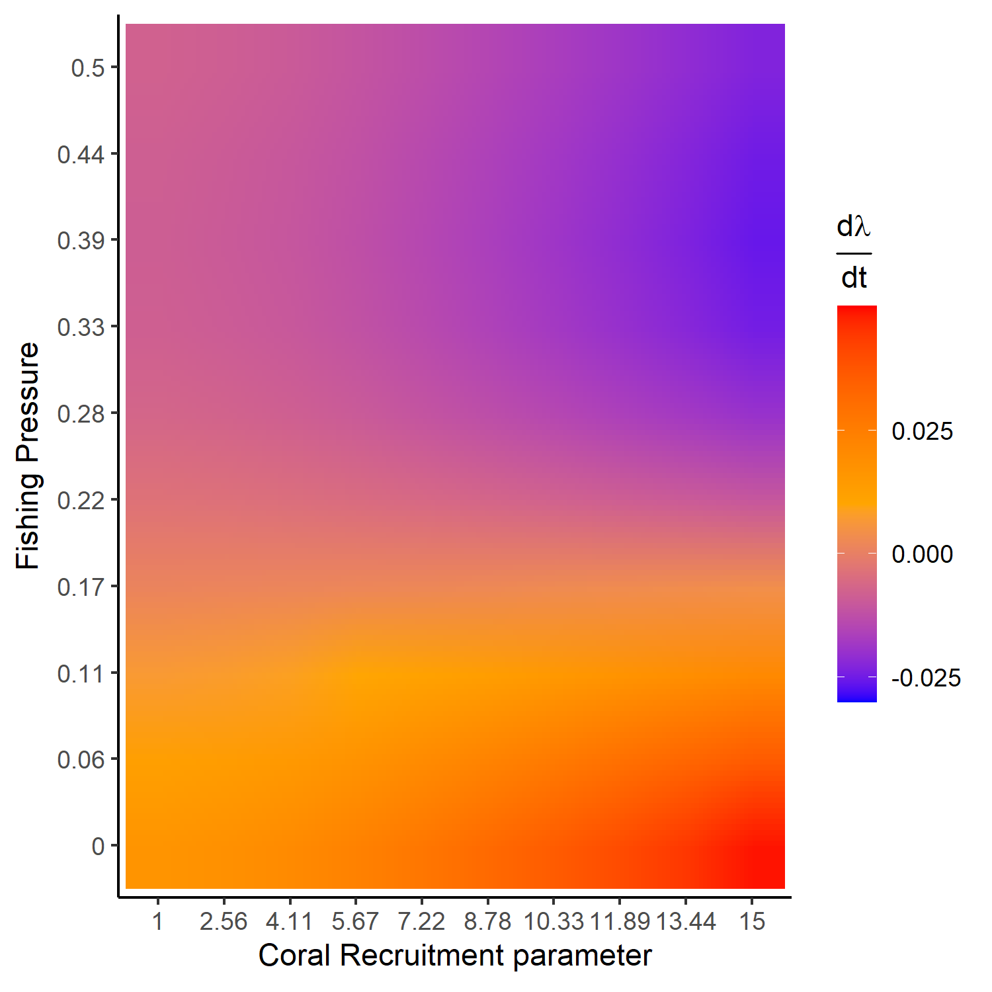
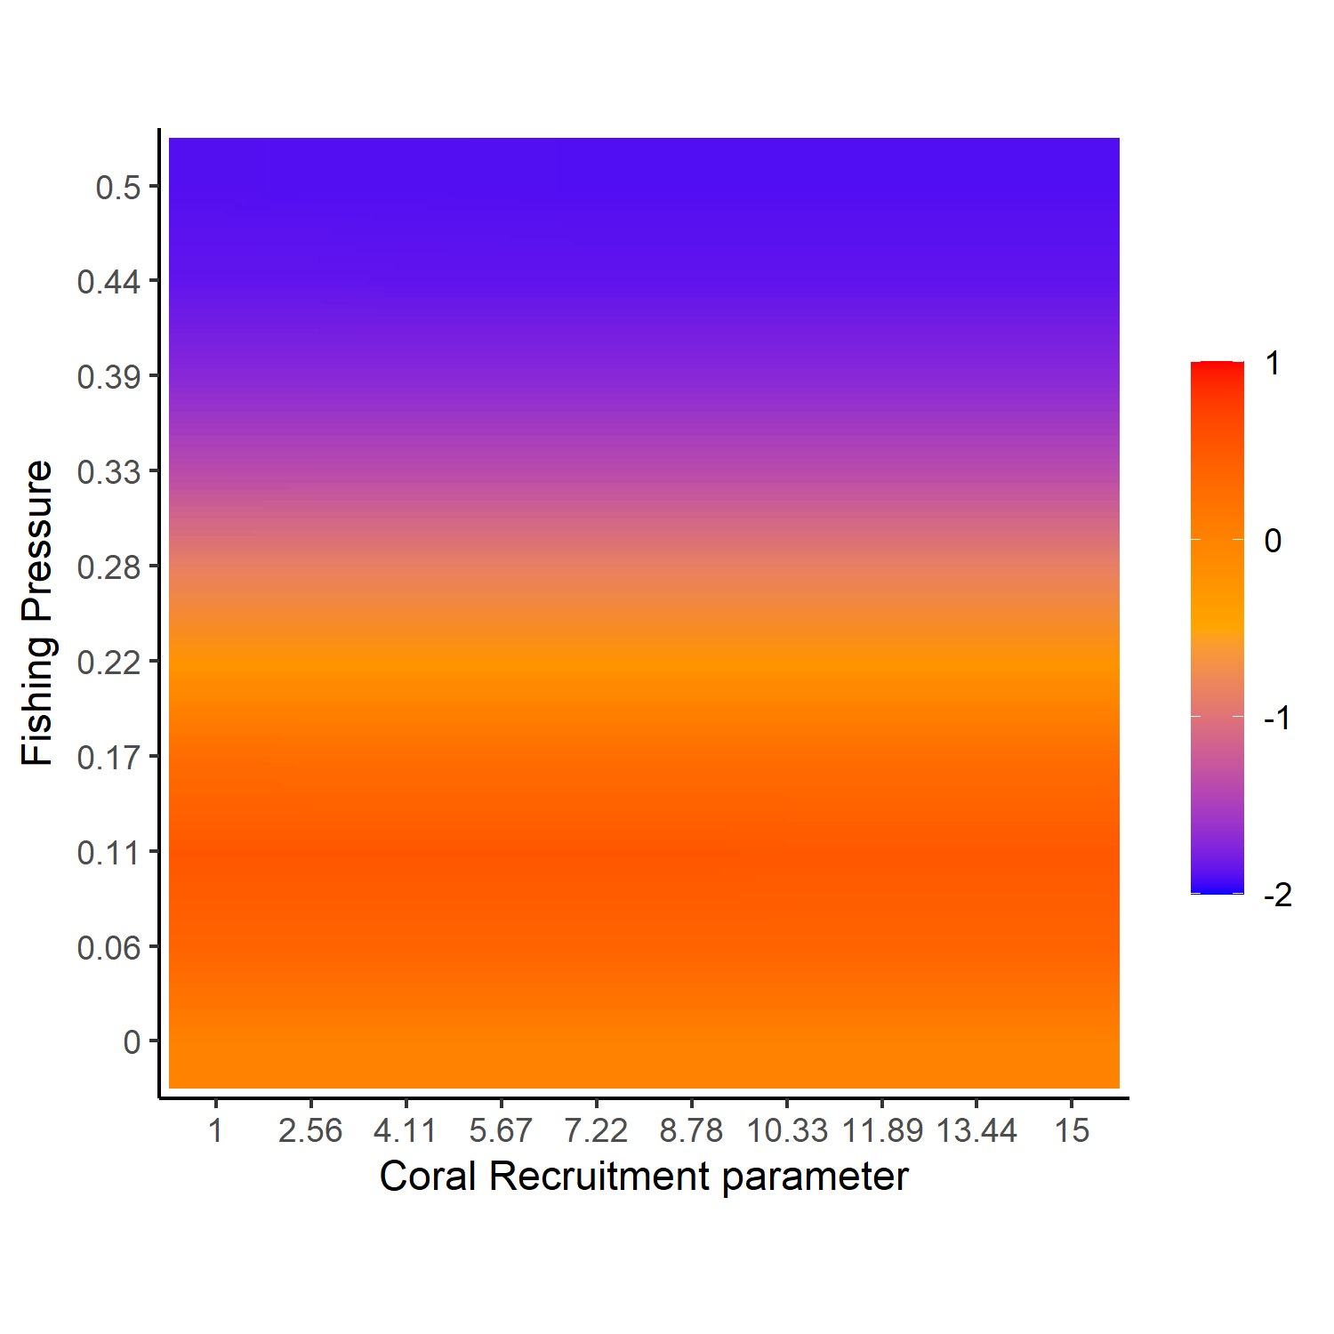

Slide 8
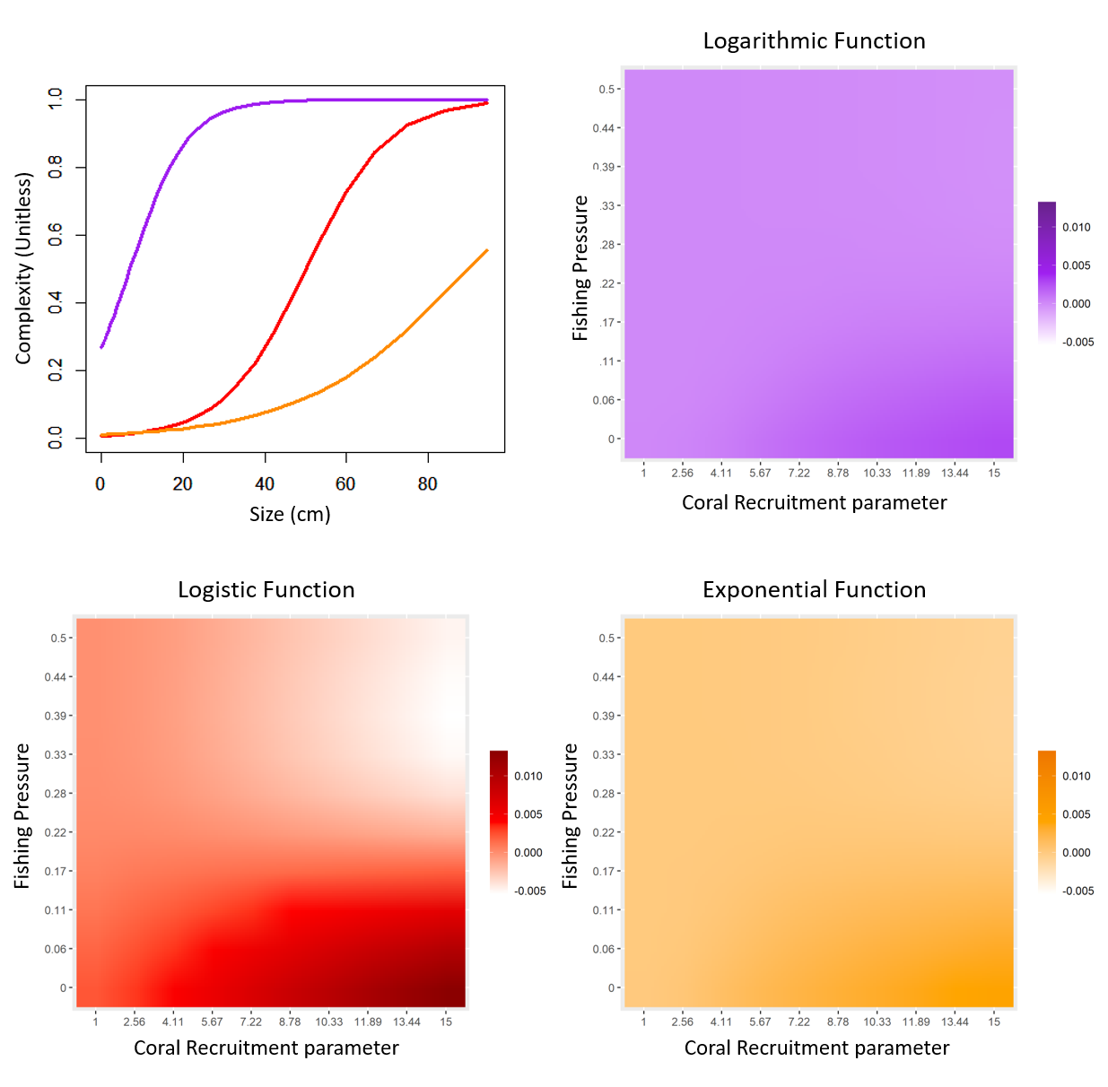

Slide 9
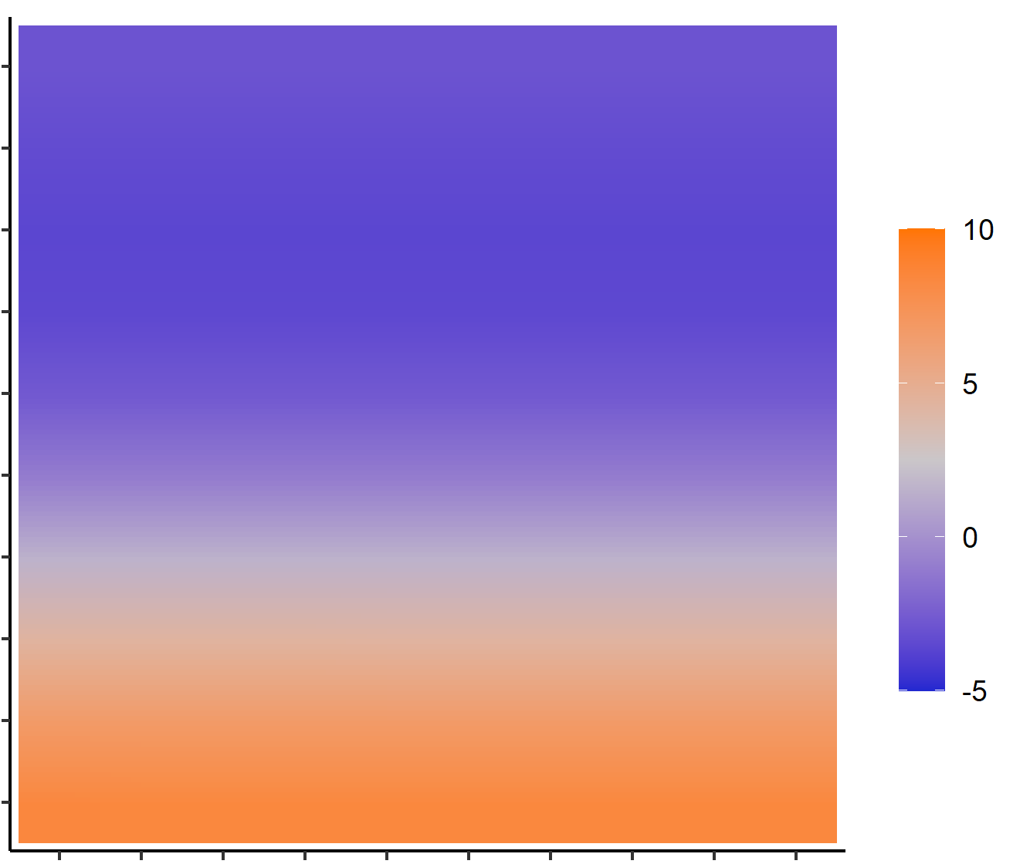


0.5
0.5
0.44
0.39
10
0.33
0.28
5
Fishing Pressure
0.22
0.17
0
0.11
-5
0.06
0
Notes:
Fish pop slope (logit, log, exp)

Slide 10
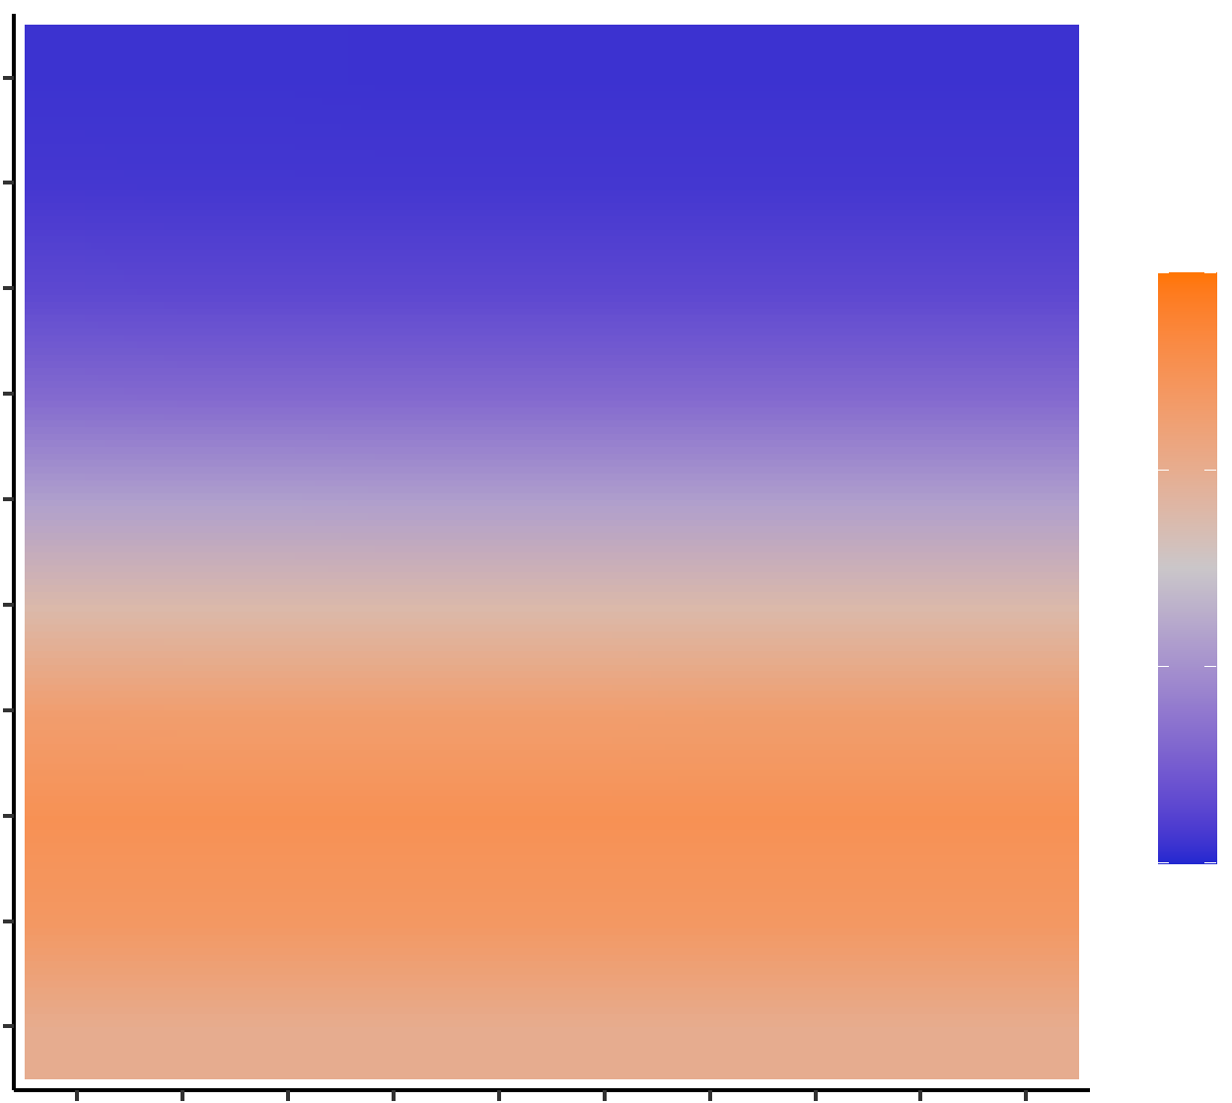
Harvest slope over initial 20 years
0.5
0.44
1
0.39
0.33
0
0.28
Fishing Pressure
0.22
-1
0.17
0.11
-2
0.06
0
Notes:
Harvest slope (logit, log, exp)

Slide 11
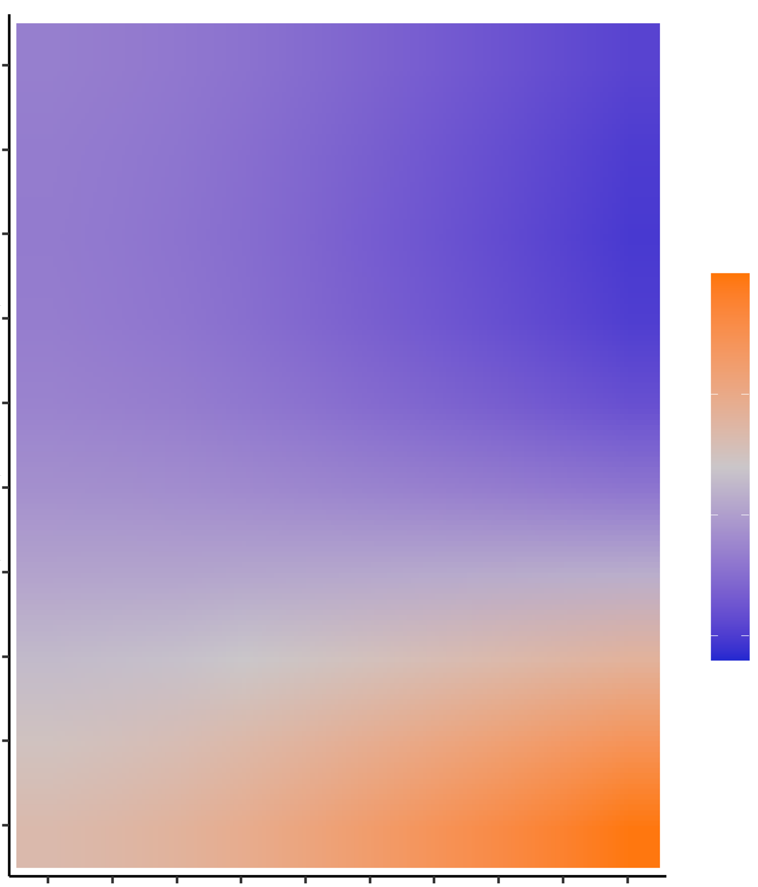
Lambda slope over initial 20 years
0.5
0.44
0.39
0.33
Fishing Pressure
0.025
0.28
0.22
0.000
0.17
-0.025
0.11
0.06
0
1
2.56
4.11
5.67
7.22
8.78
10.33
11.89
13.44
15
Coral Recruitment Parameter

Slide 12
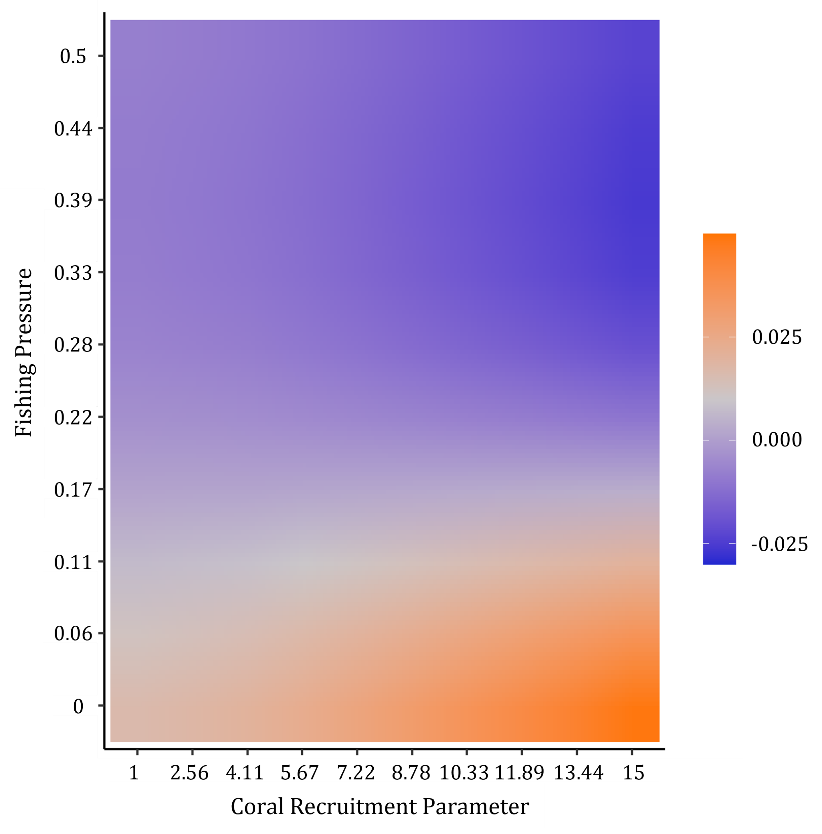
Notes:
Figure 2 (logit, log, exp)

