Slide 1
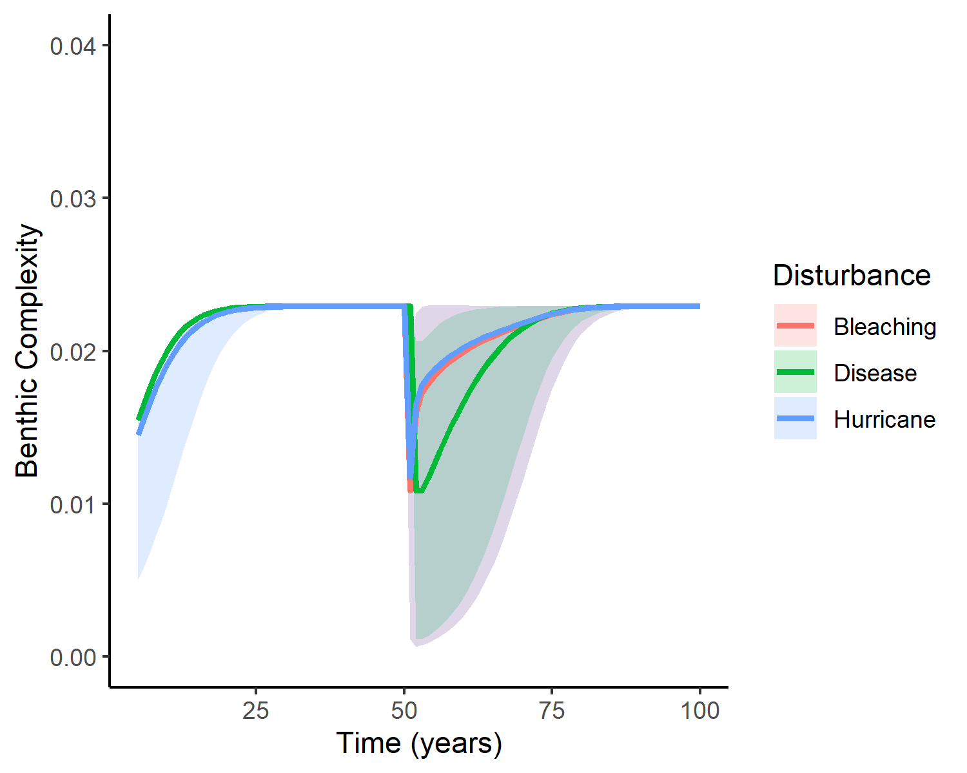
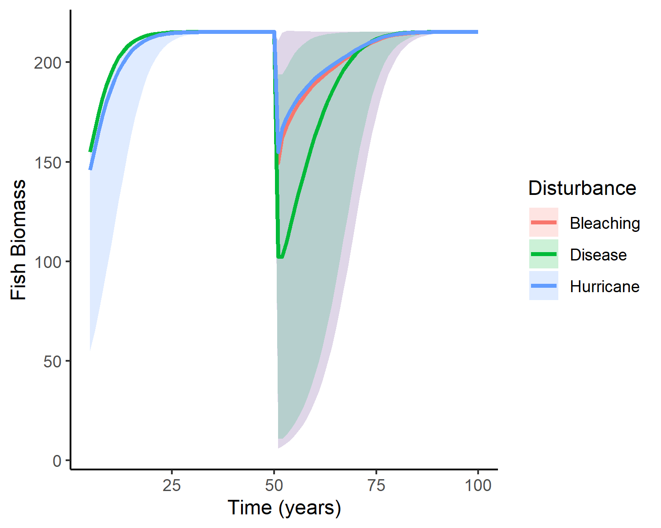
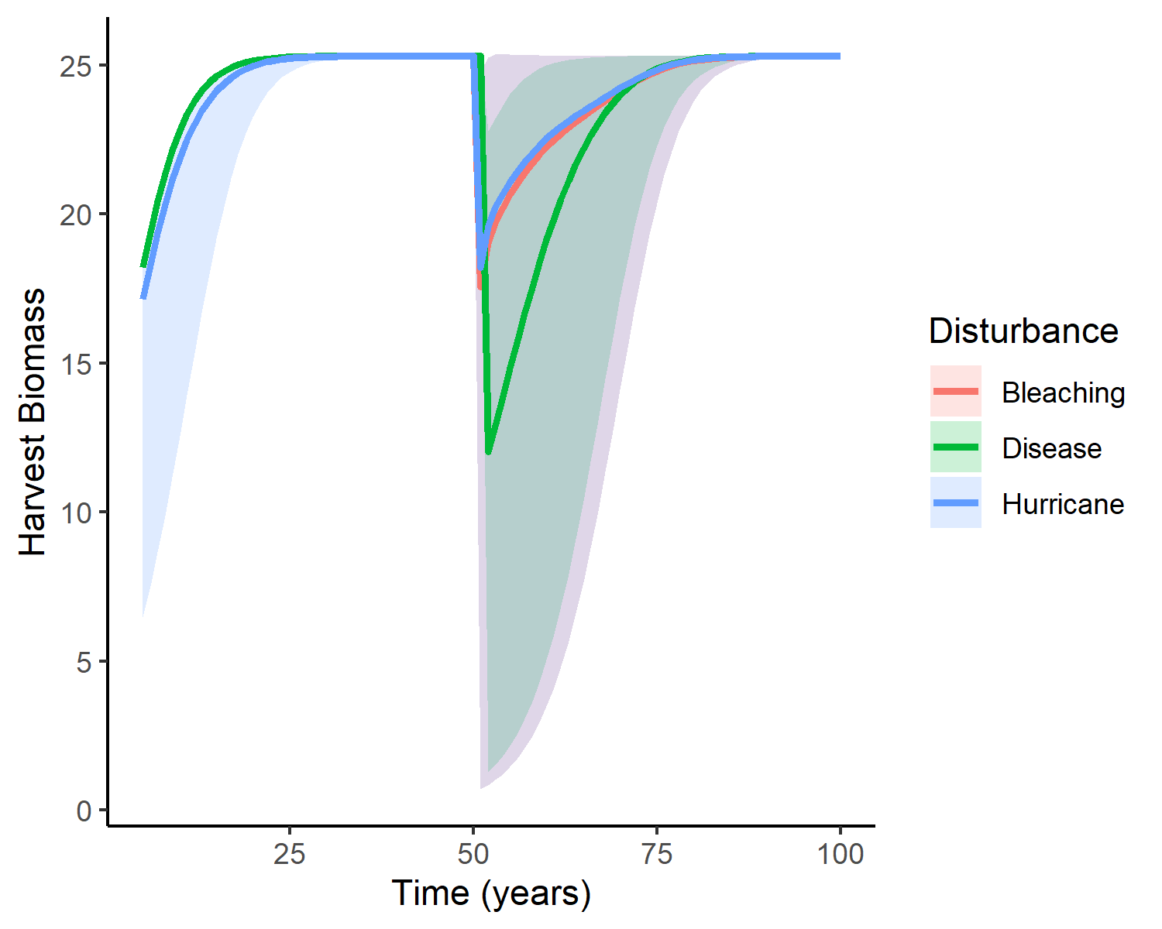
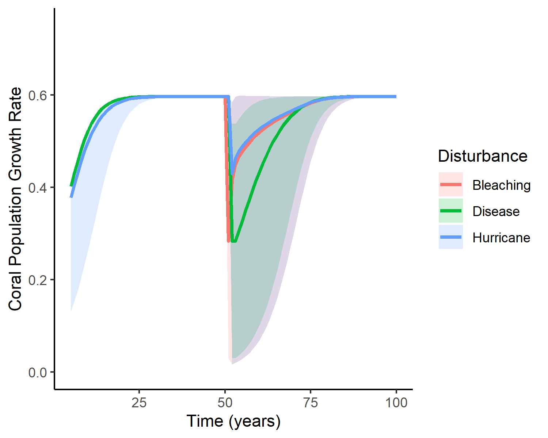
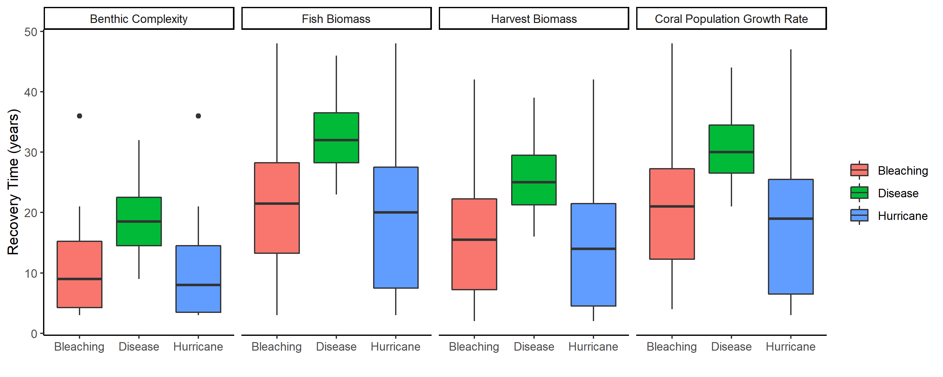

Slide 2
A)
0.04
25
200
0.03
20
0.6
150
15
0.4
0.02
Harvest Biomass
Benthic Complexity
Fish Biomass
Coral Population Growth Rate
100
10
0.01
50
0.2
5
0.00
0
0
0.0
25
50
75
100
25
50
75
100
25
50
75
100
25
50
75
100
Time (years)
B)

Slide 3
Benthic Complexity
Fish Biomass
0.6
Harvest Biomass
0.4
Coral Population Growth Rate
0.2
0.0
25
50
75
100
Time (years)

Slide 4
Fish Biomass
25
Benthic Complexity
20
15
25
10
20
5
15
0
Harvest Biomass
25
50
75
100
10
5
0
Coral Population Growth Rate
25
50
75
100
Time (years)

Slide 5
25
50
75
100
200
150
Fish Biomass
Harvest Biomass
100
50
0.04
0
25
50
75
100
0.03
0.02
0.6
Benthic Complexity
0.01
0.4
Coral Population Growth Rate
0.00
0.2
25
50
75
100
0.0

Slide 8
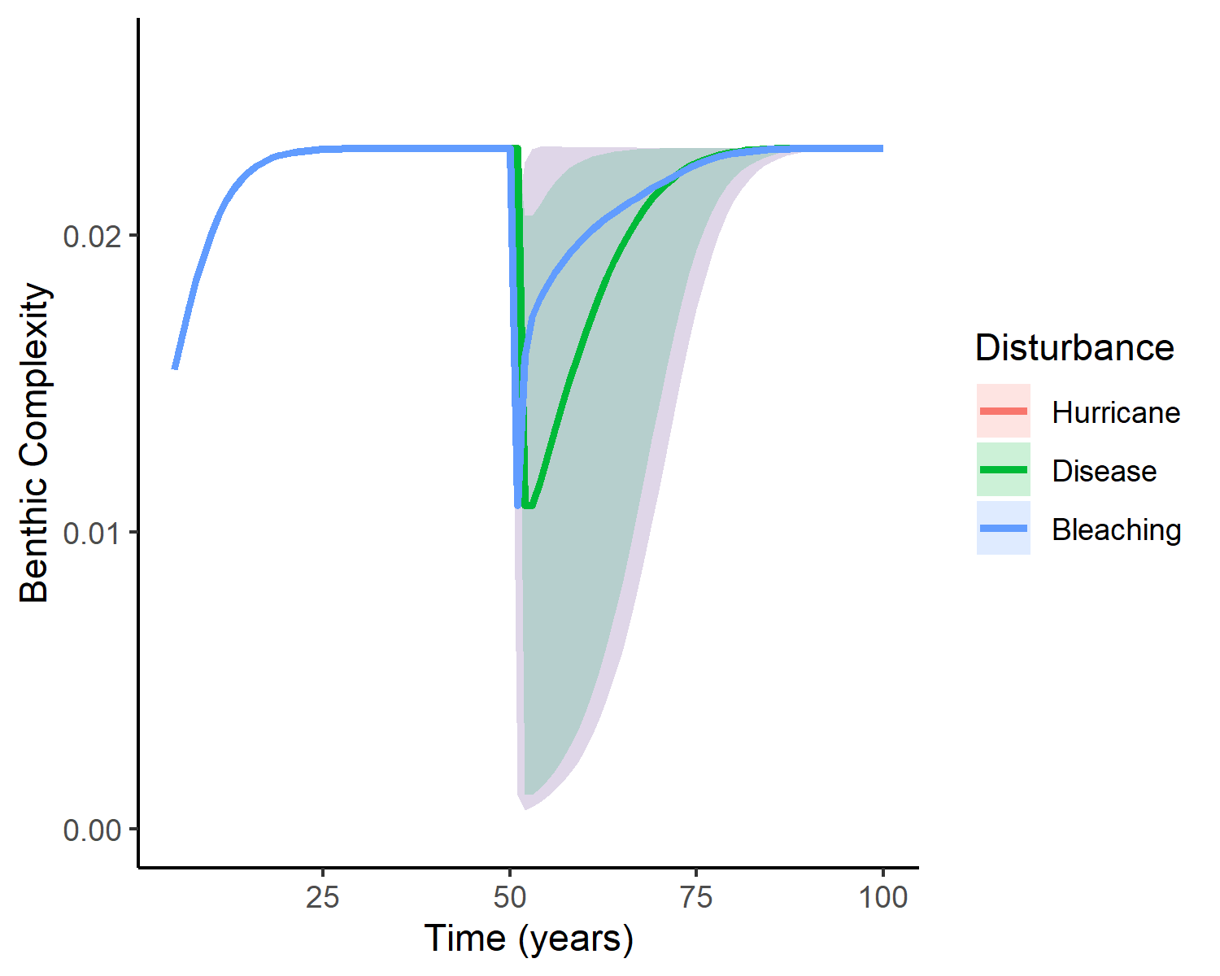
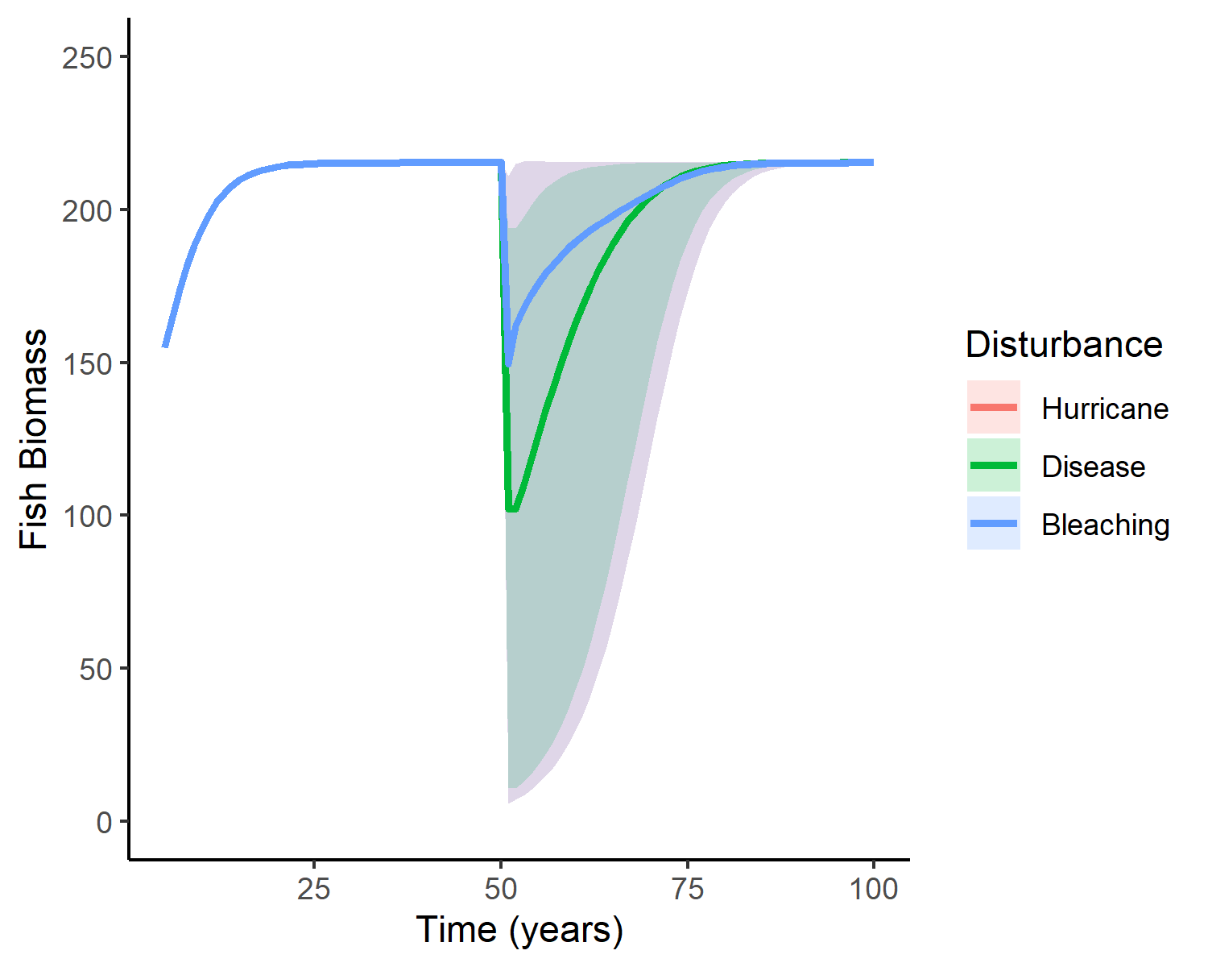
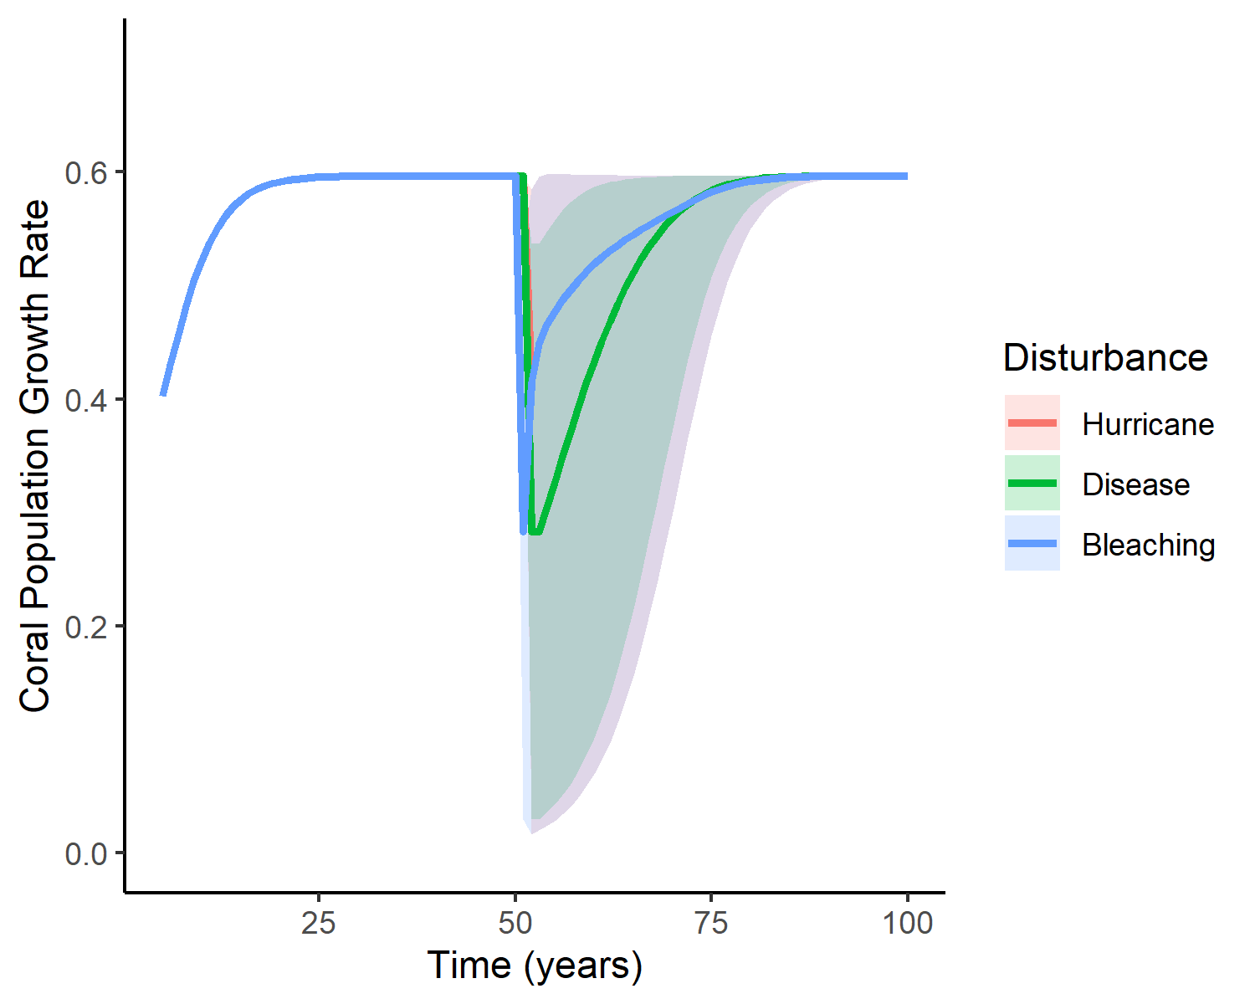

Slide 9
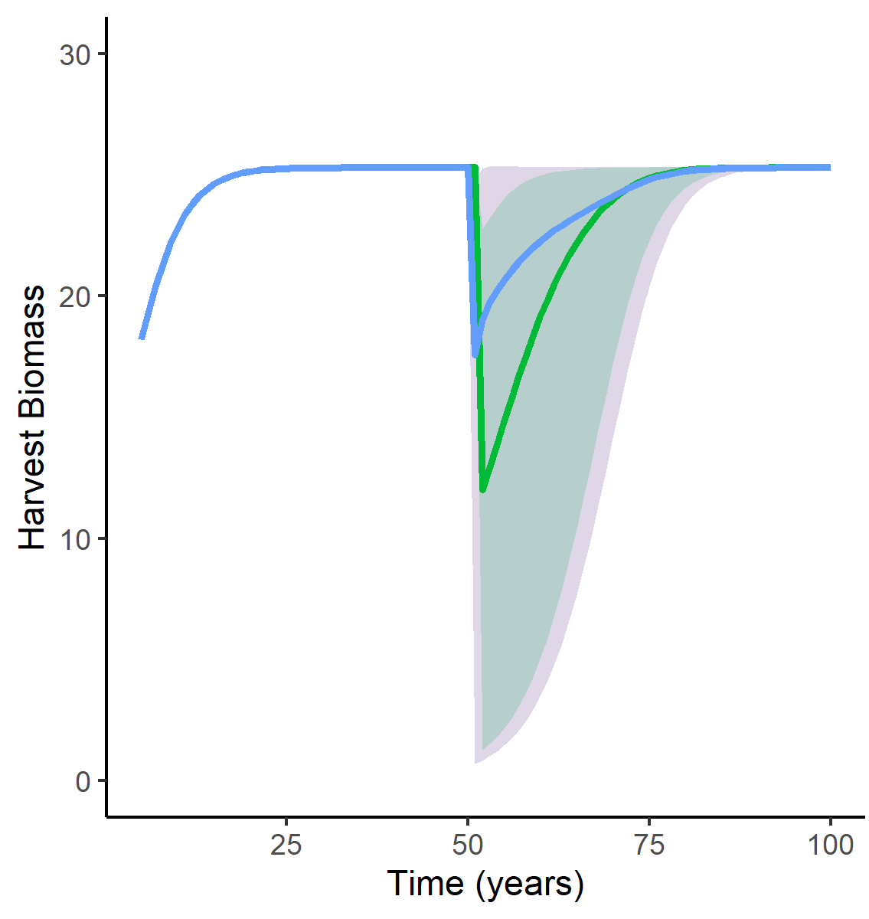
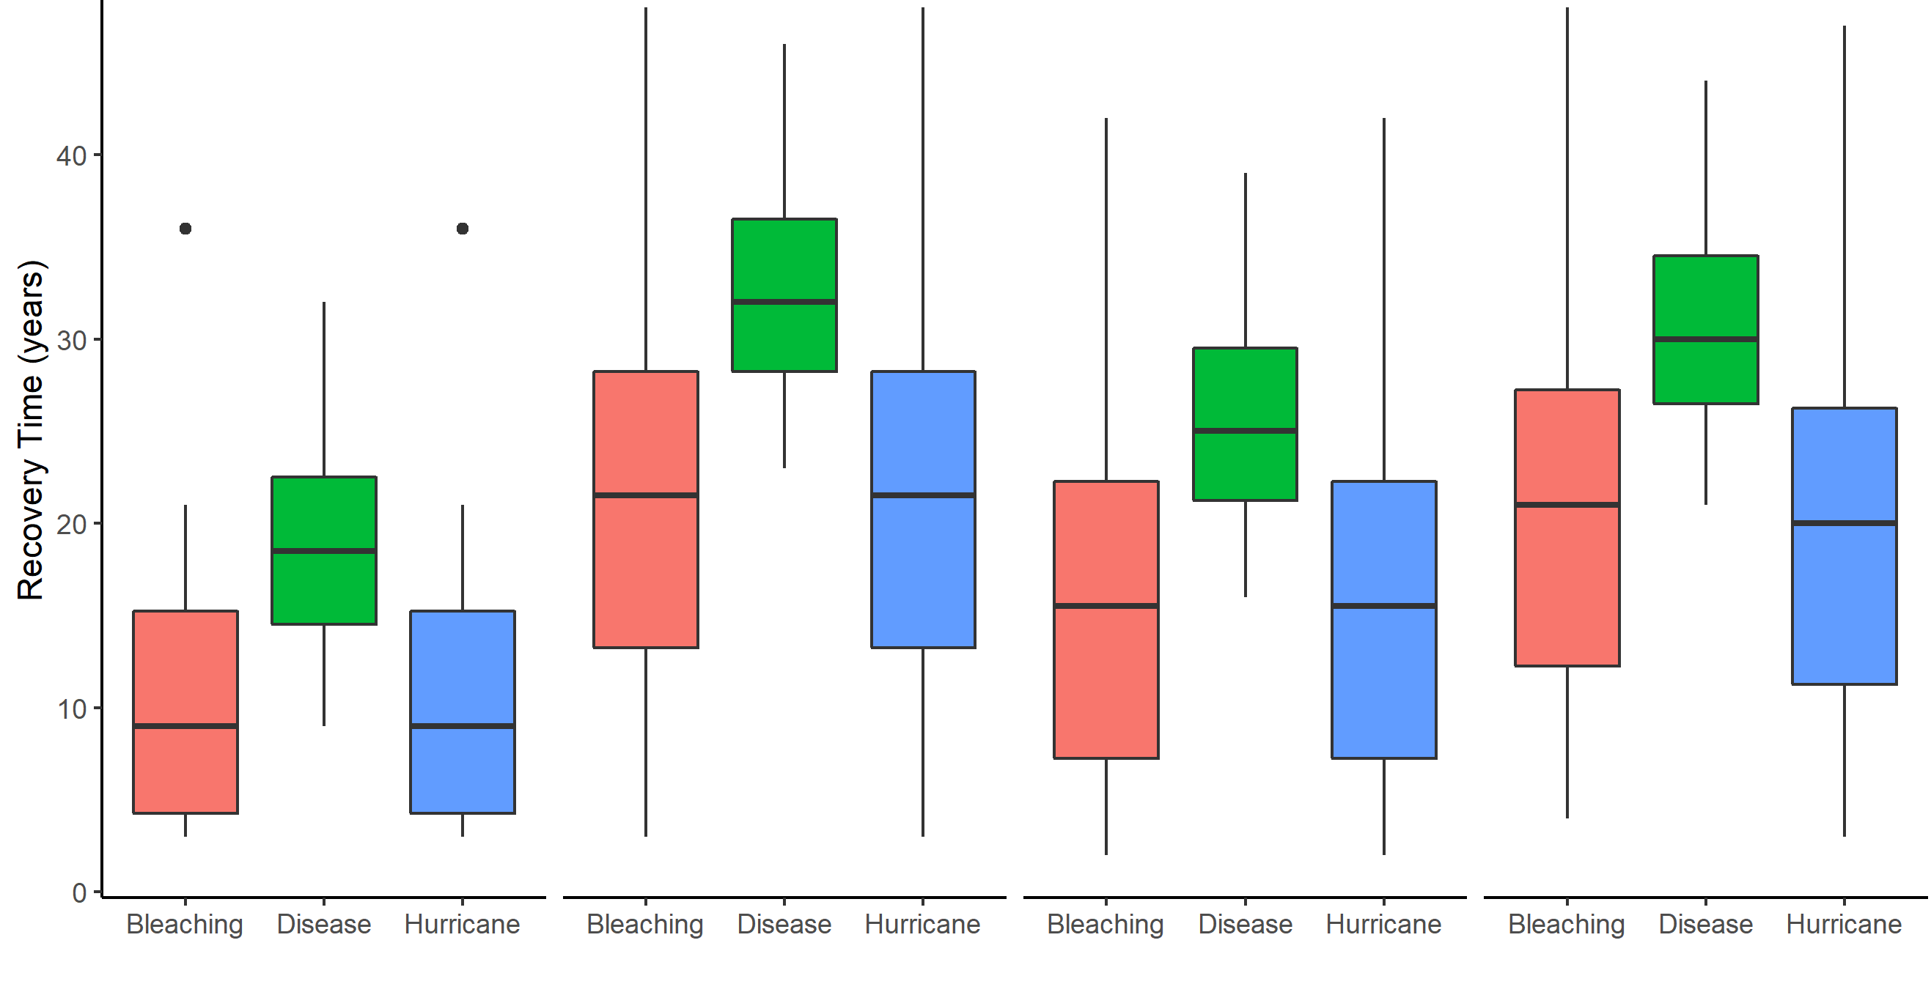
A)
25
50
75
100
Time (years)

Slide 10
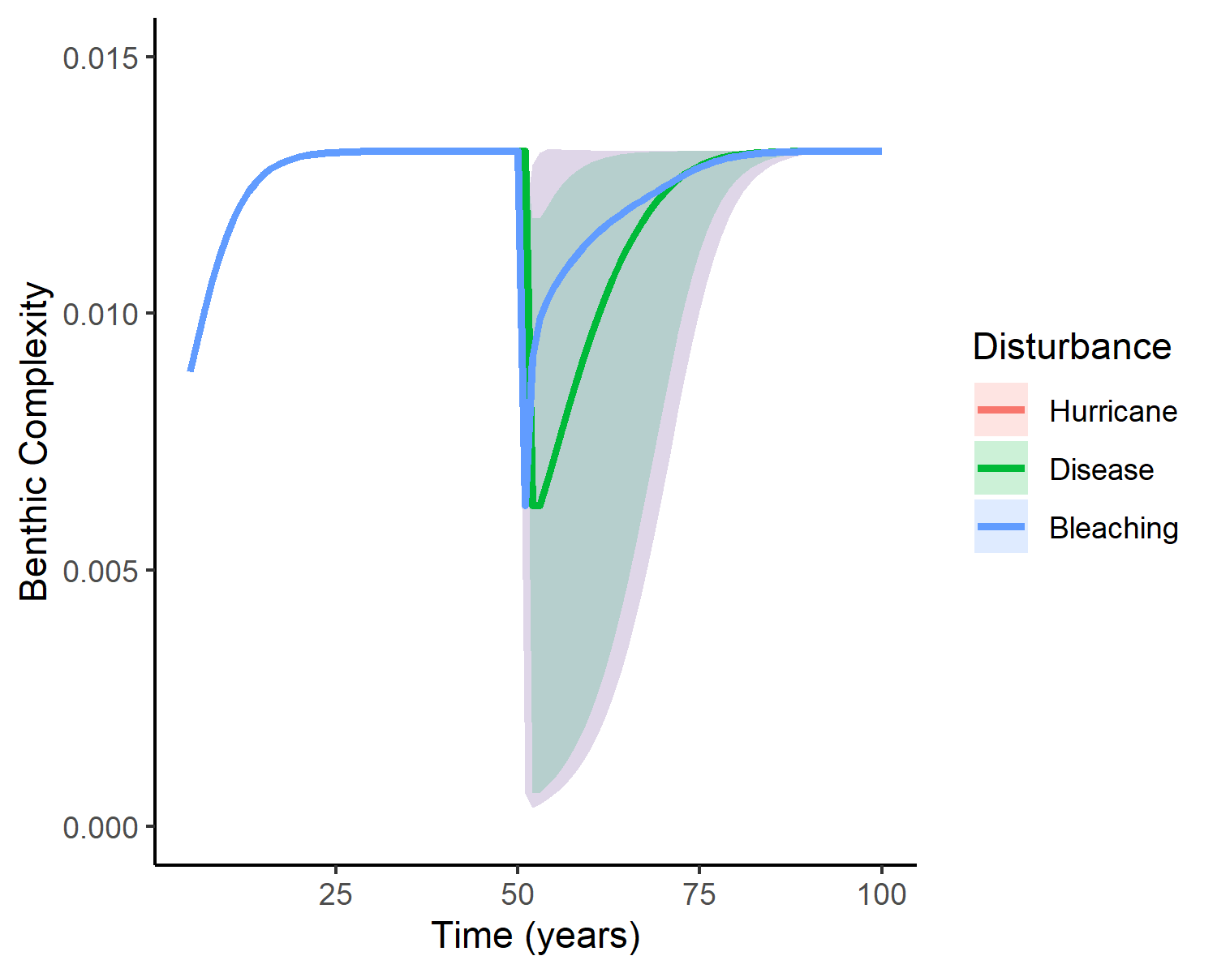


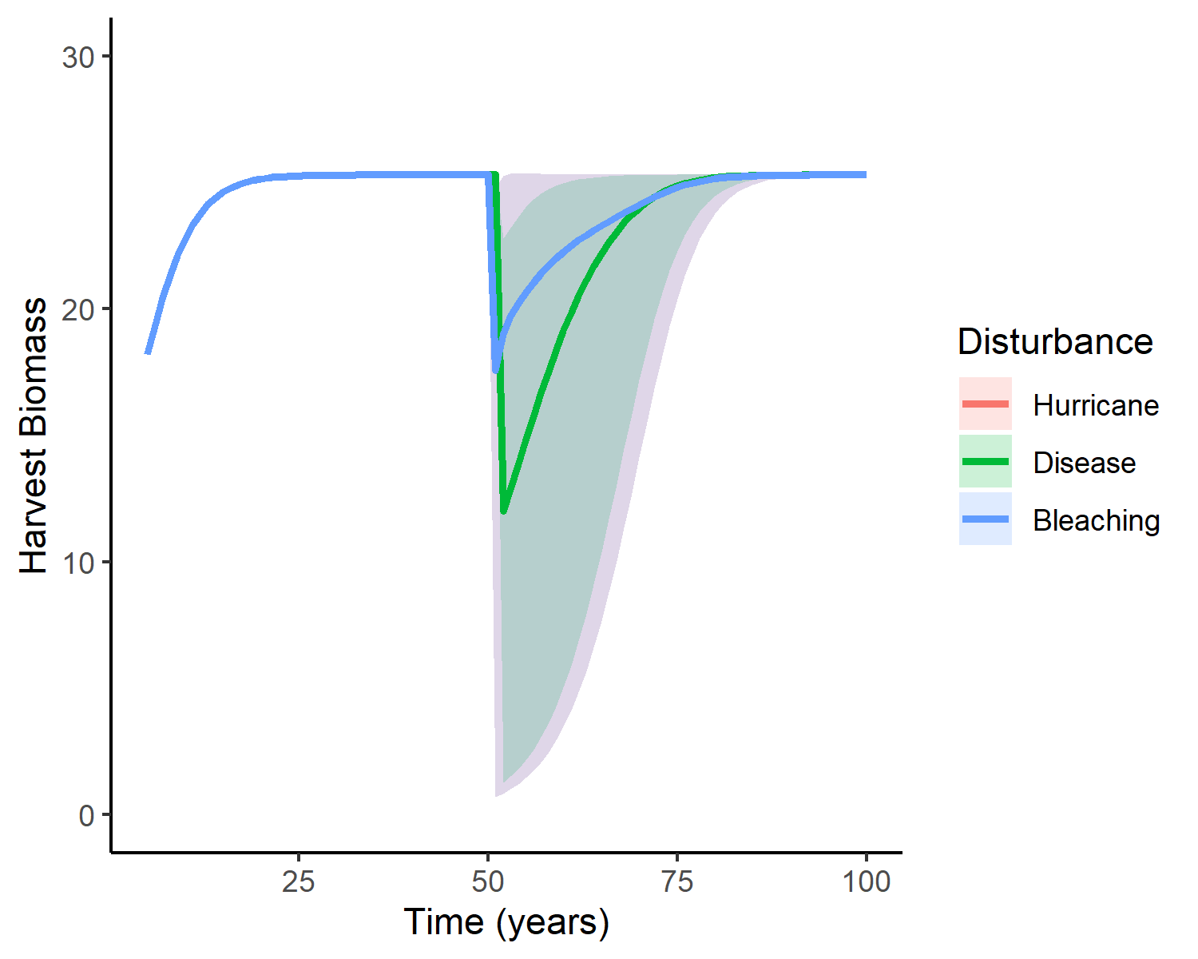

Slide 11
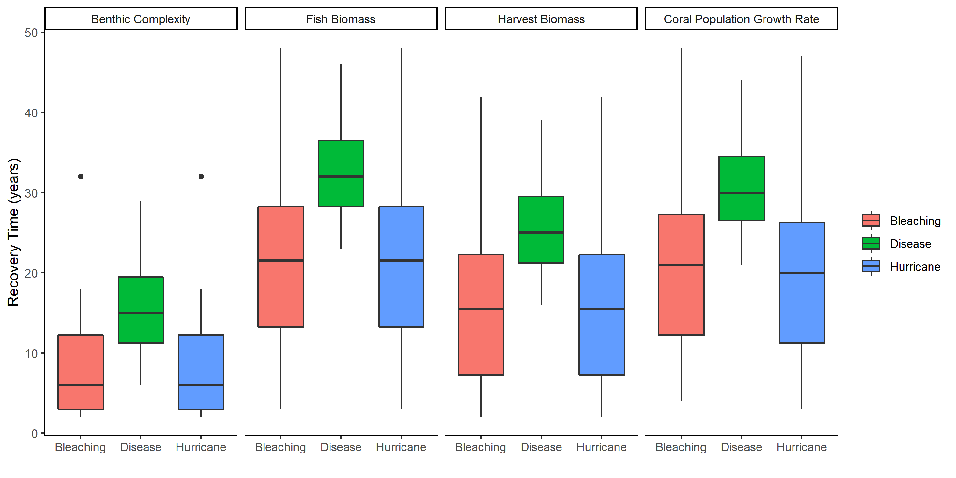

Slide 12
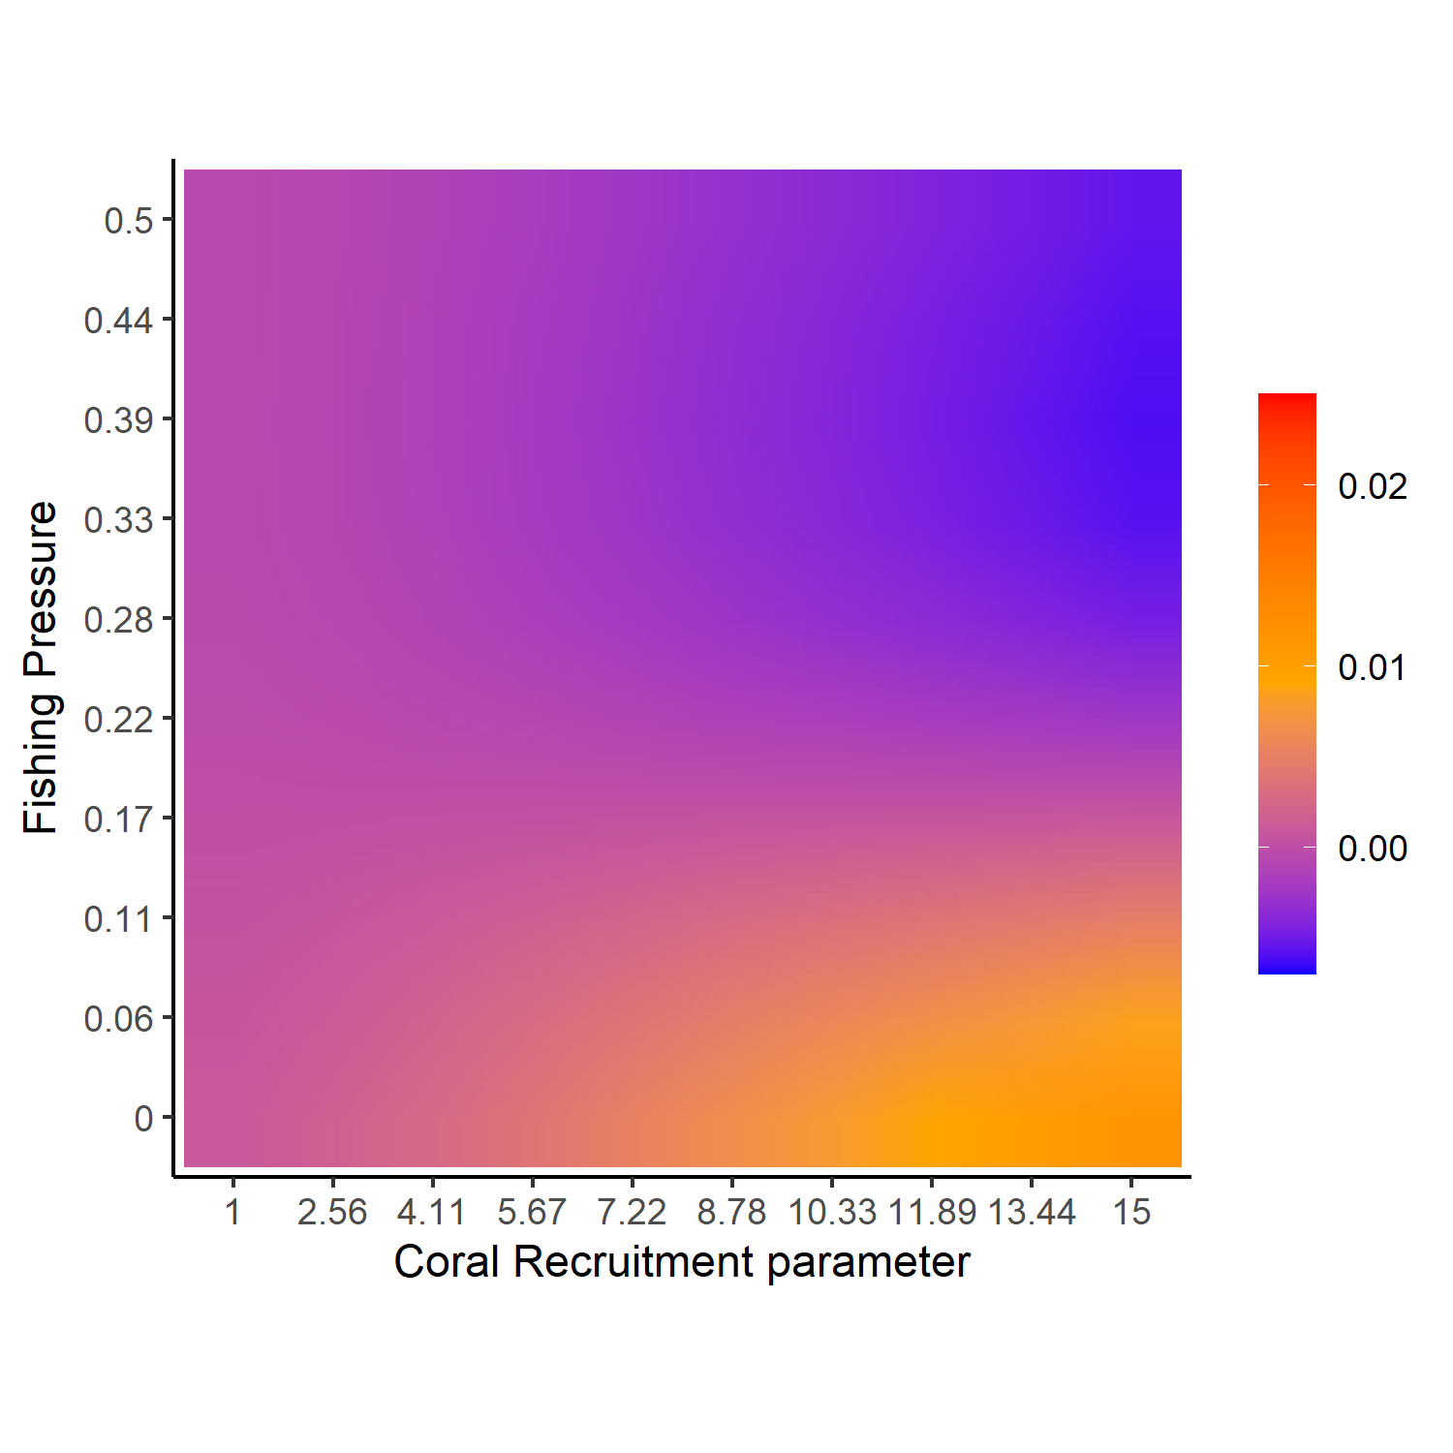
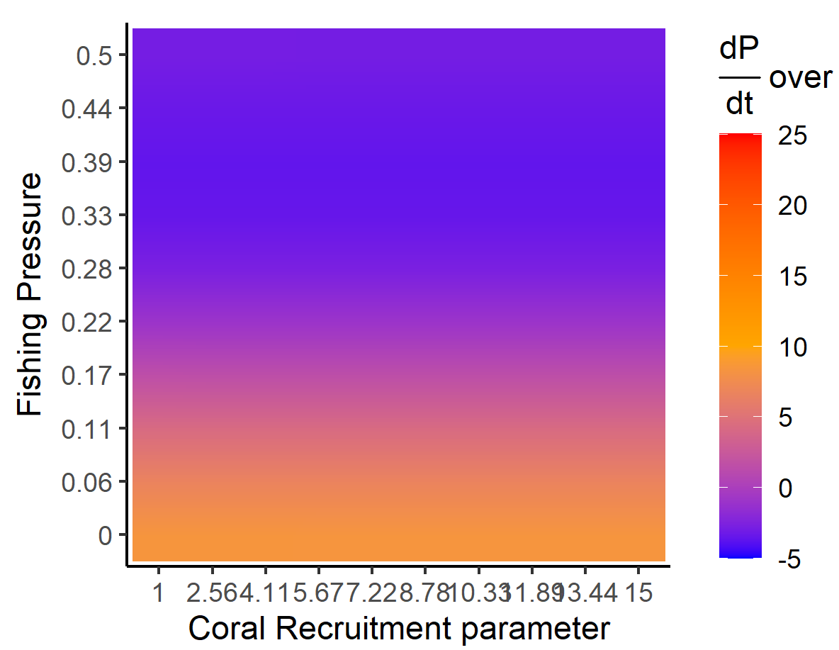
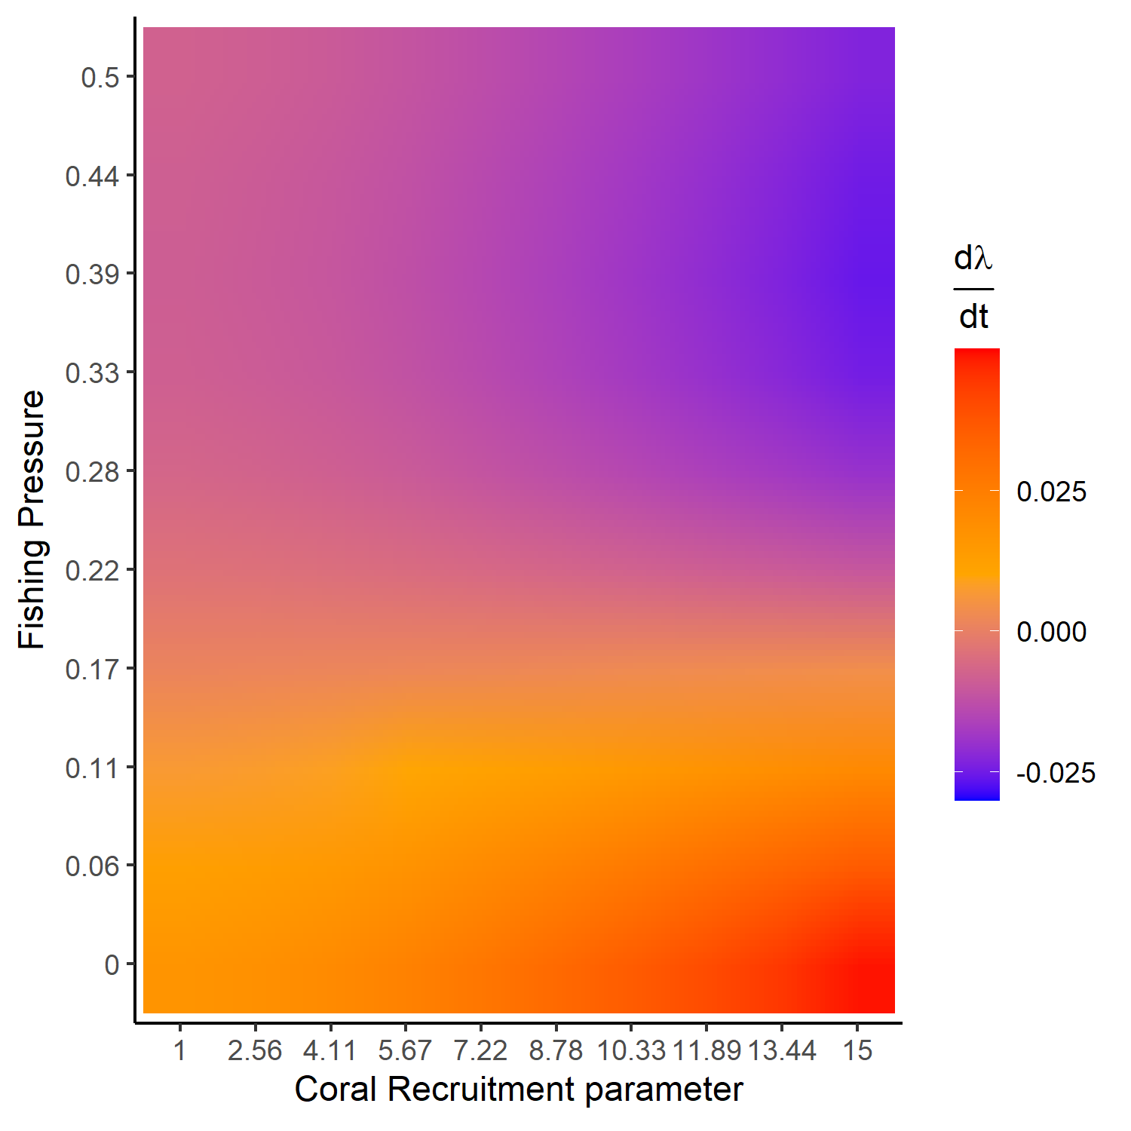
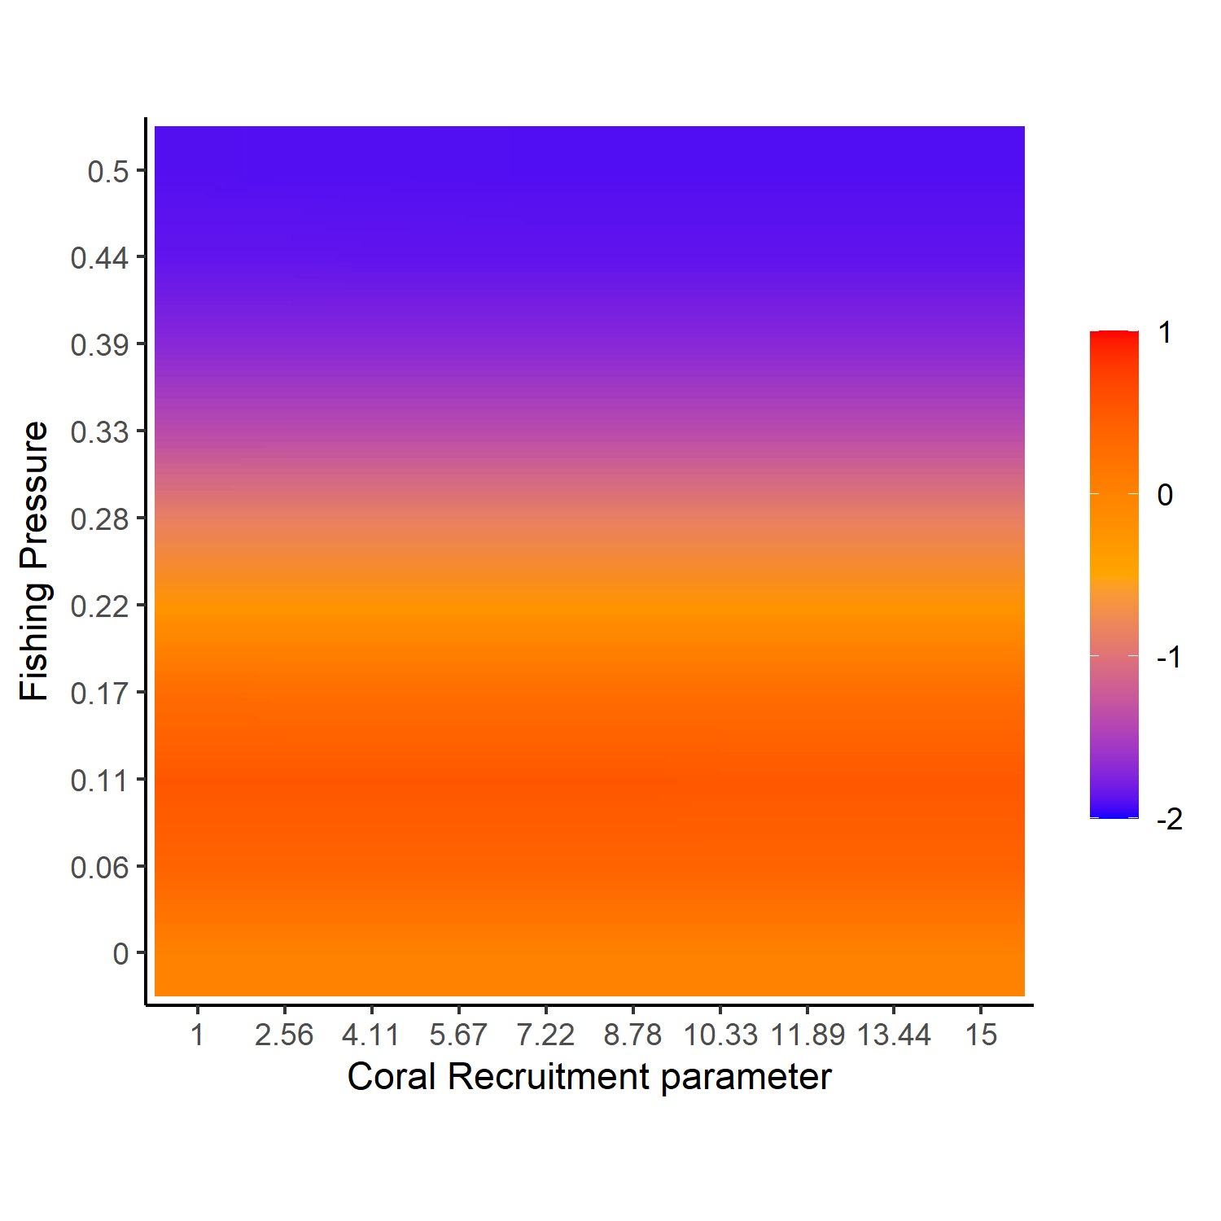

Slide 13
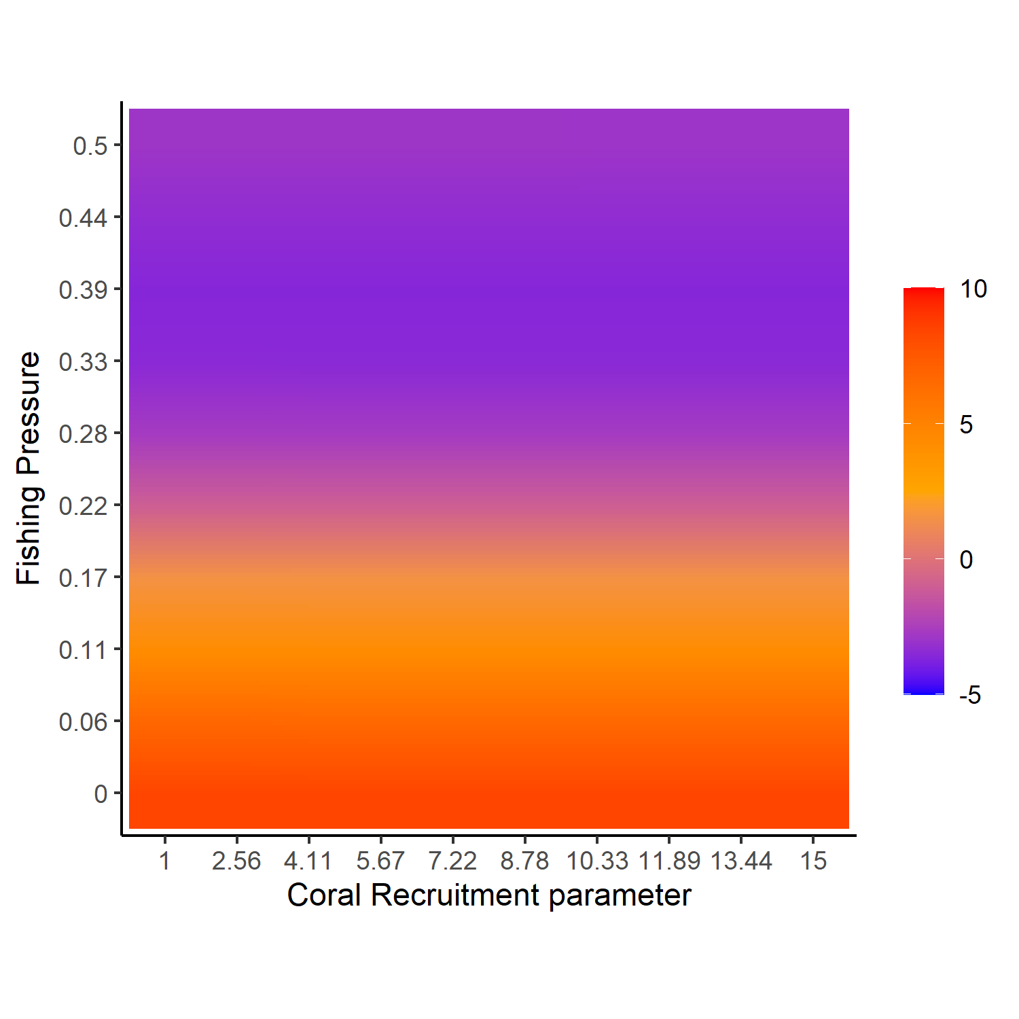
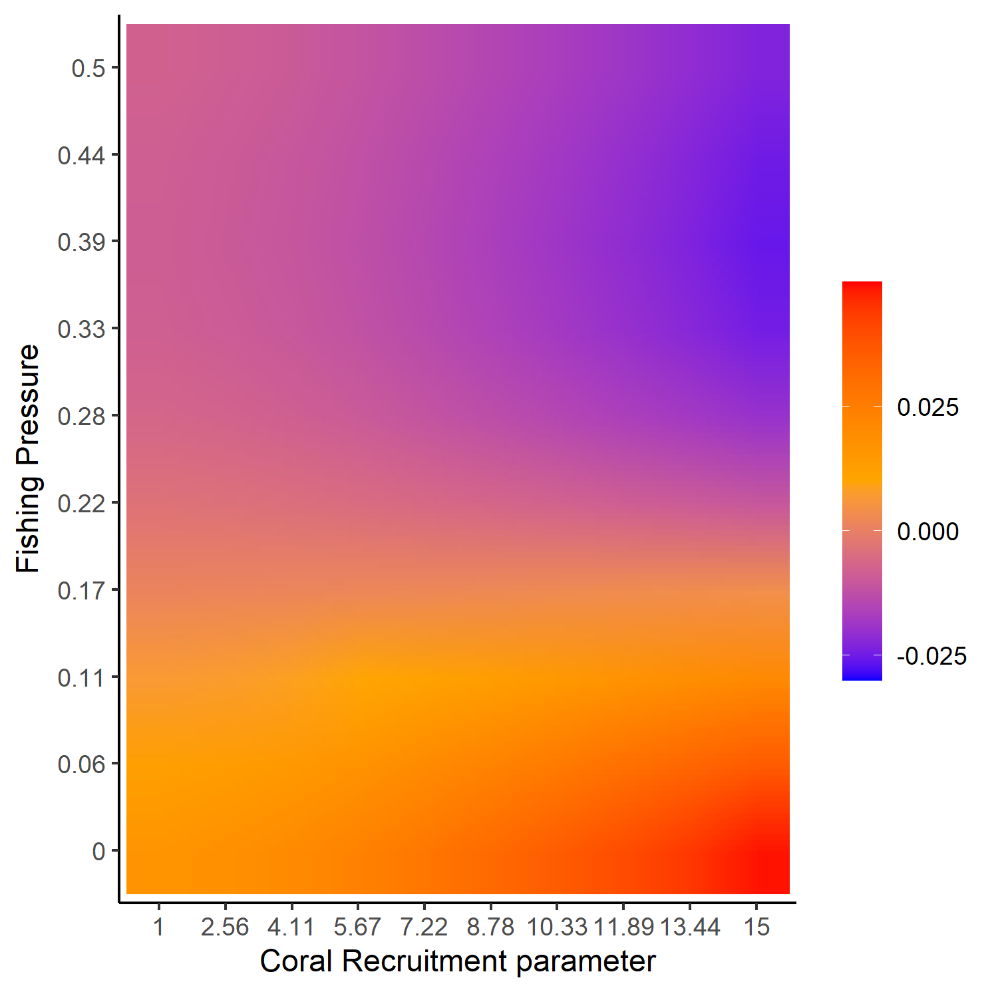
A)
Fish Population Slope over initial 20 years
B)
Harvest Slope over initial 20 years
C)
Lambda Slope over initial 20 years

Slide 14
A)
Fish Population Slope over initial 20 years
B)
Harvest Slope over initial 20 years
C)
Lambda Slope over initial 20 years

Slide 15
A)
Fish Population Slope over initial 20 years
B)
Harvest Slope over initial 20 years
C)
Lambda Slope over initial 20 years

Slide 16
