Slide 1
Introduction to Offensive Security and Ethical Hacking
http://www.free-powerpoint-templates-design.com

Slide 2
Introduction to Cyber Security
Red Team, Ethical Hacker, Pentester
Blue Team, SOC analyst, Security Engineers/ Manager
Defensive
Offensive
Proactive approach through attacking and hacking
Focuses on prevention, detection and response to attacks
Mostly Hand-on and Labs
Mostly Theory and Policy
C|EH, OSCP, GPEN, PNTP CompTIA pentest+
IDN

Slide 3
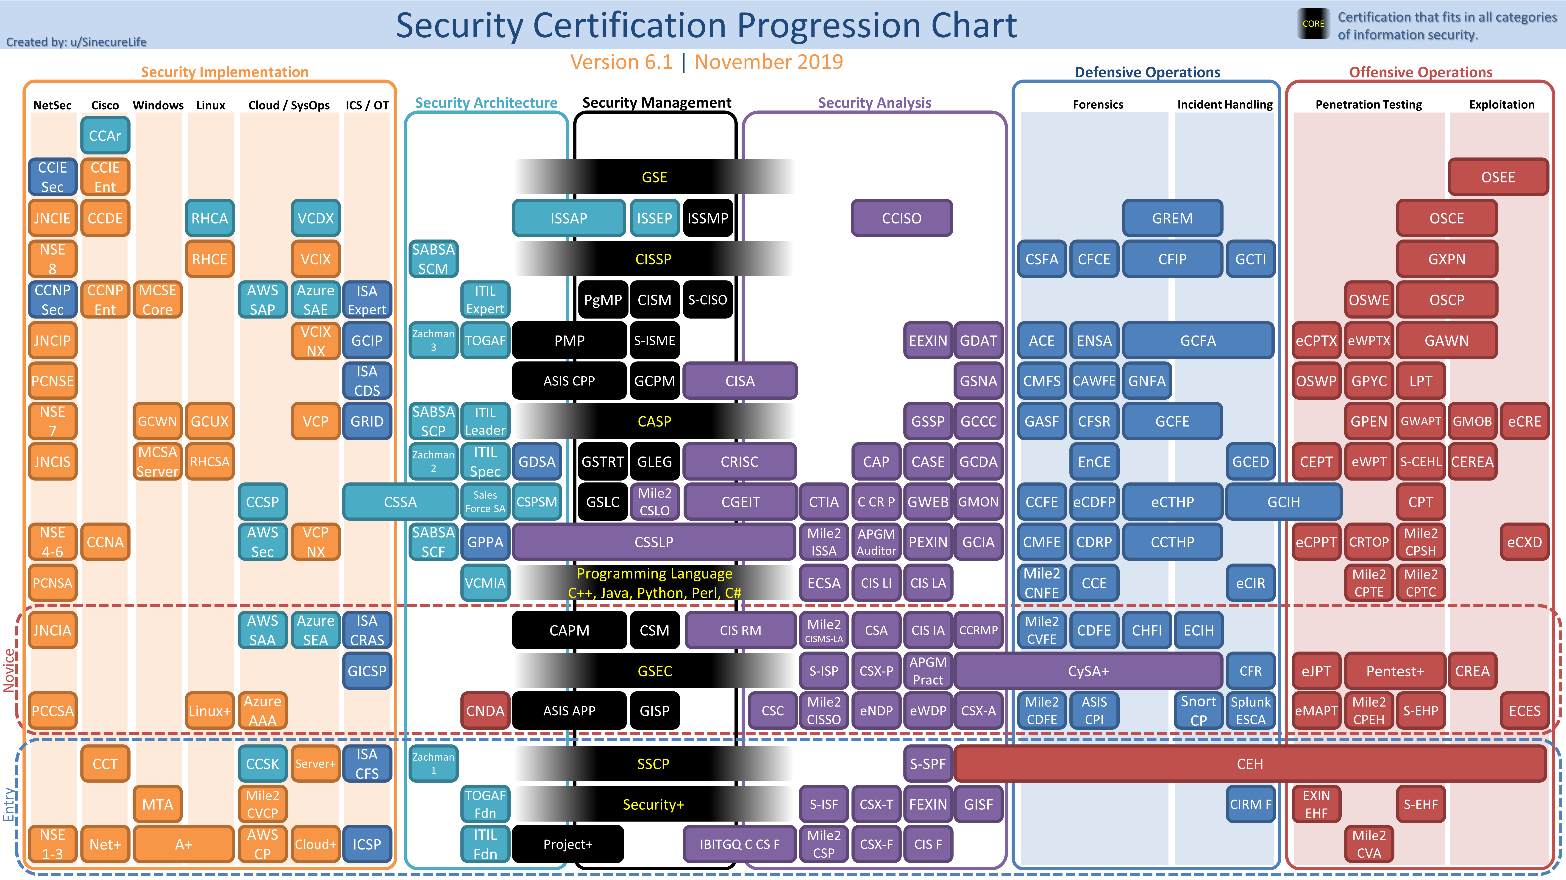

Slide 4
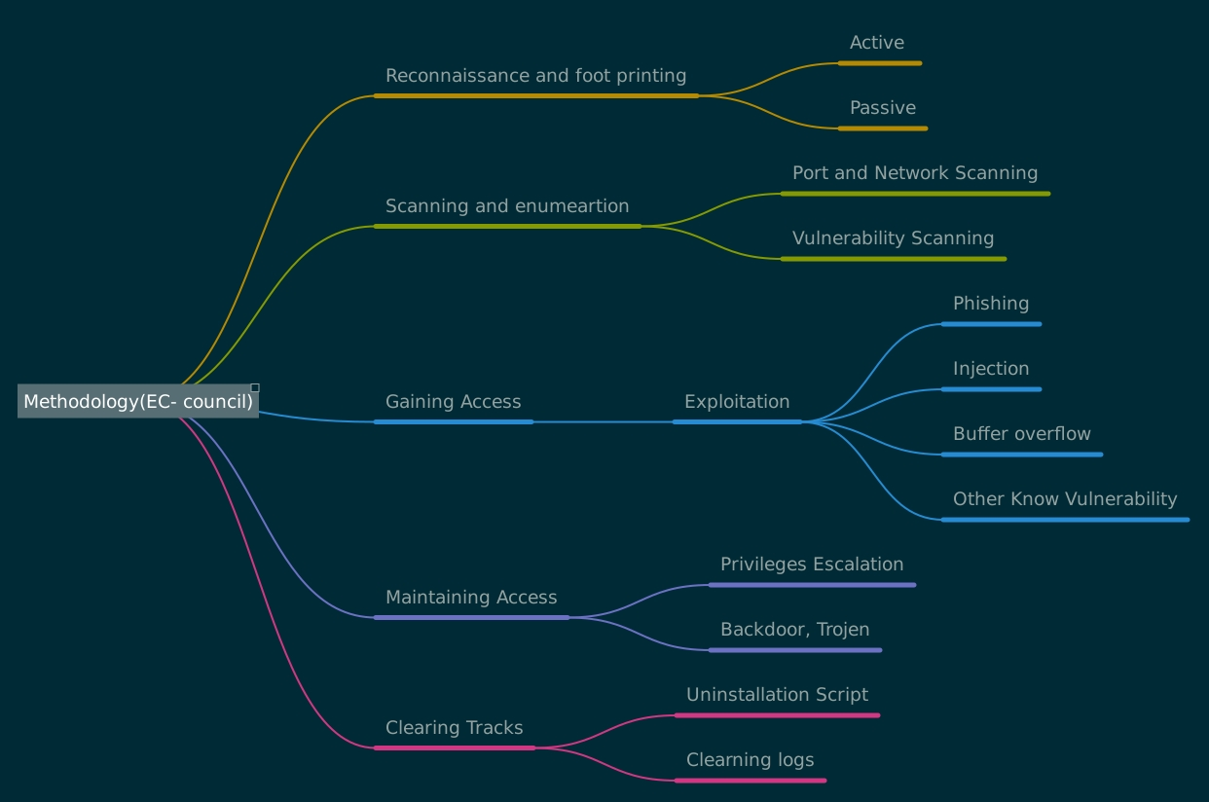

Slide 5
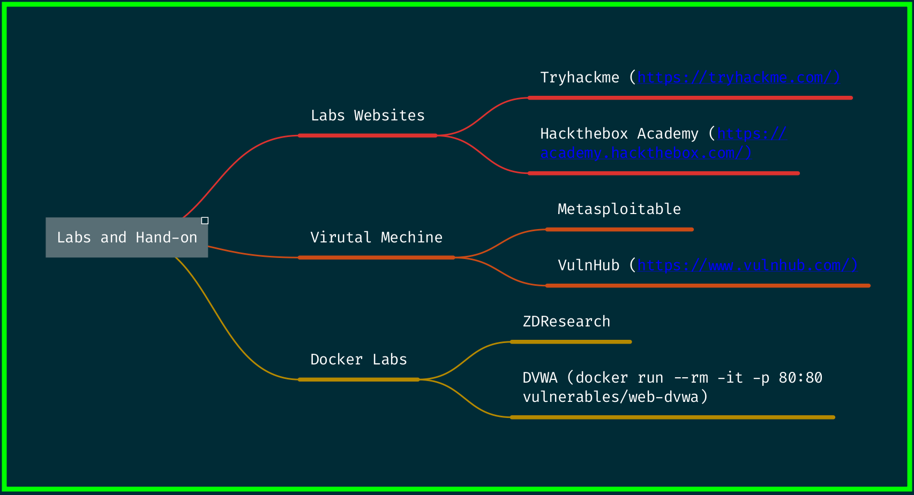
Labs and Hand-on

Slide 6
THANK YOU

