Slide 1
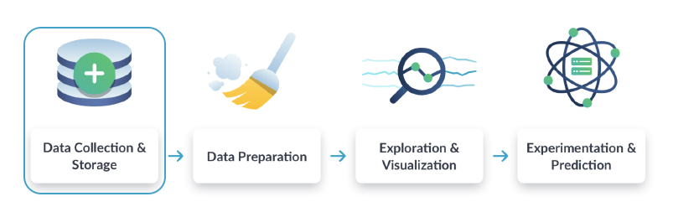
Why Data Engineering
Data engineering is essential for enabling organizations to derive value from their data assets by ensuring data quality, reliability, accessibility, and scalability. It bridges the gap between raw data and actionable insights, empowering businesses to make informed decisions and gain a competitive edge in today's data-driven world.

Slide 2
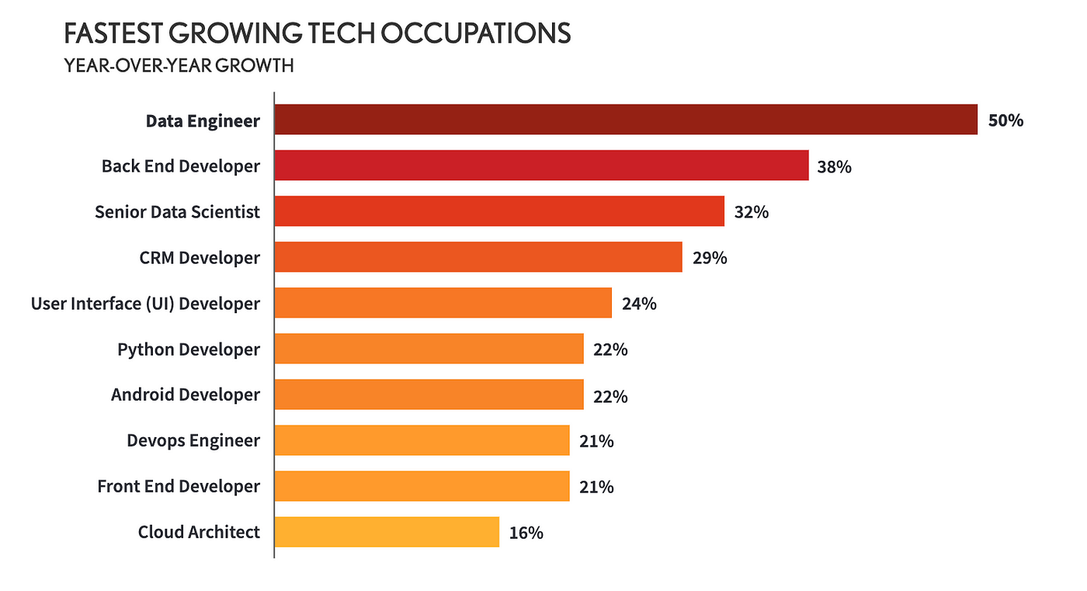
Data Engineer Demand

Slide 3
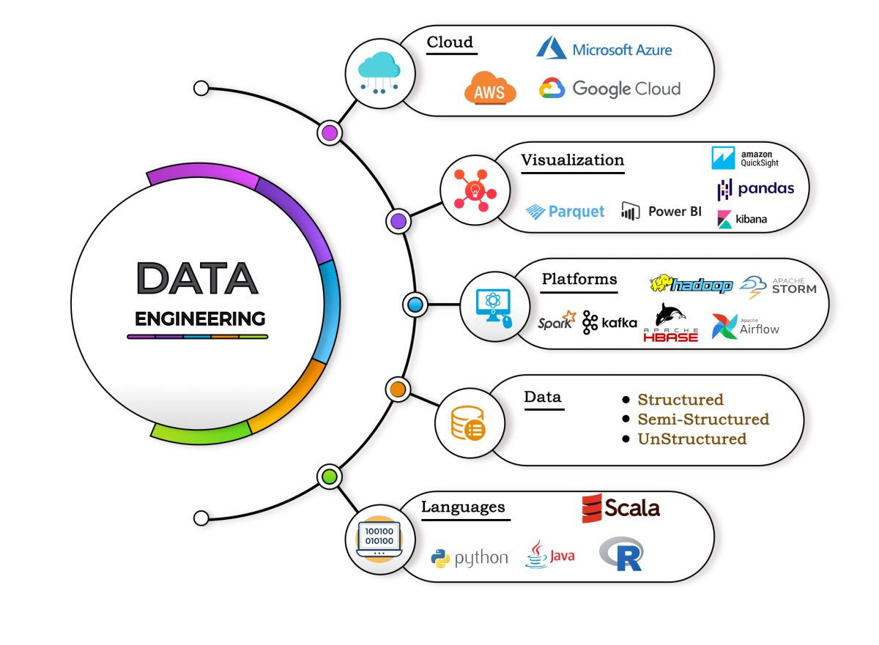
Data Engineering Roadmap

Slide 4
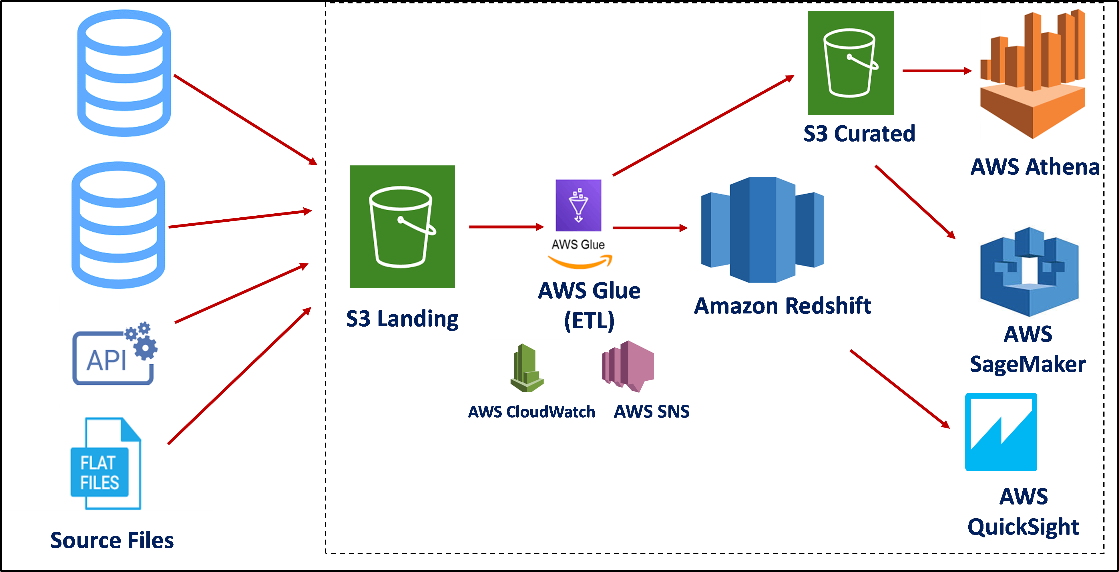
Why AWS for Data Engineering
AWS offers a powerful and flexible platform for data engineering, providing the tools, scalability, security, and cost-effectiveness needed to build robust and scalable data processing pipelines and applications

Slide 5
Project: Serverless Data migration
Scenario: Company X wants to migrate their customer data from an on-premises database to Amazon Redshift, a fully managed data warehousing service provided by AWS. They also want to store a backup of the data in Amazon S3 for archival purposes. The migration process should be serverless to minimize operational overhead and ensure scalability.

Slide 6
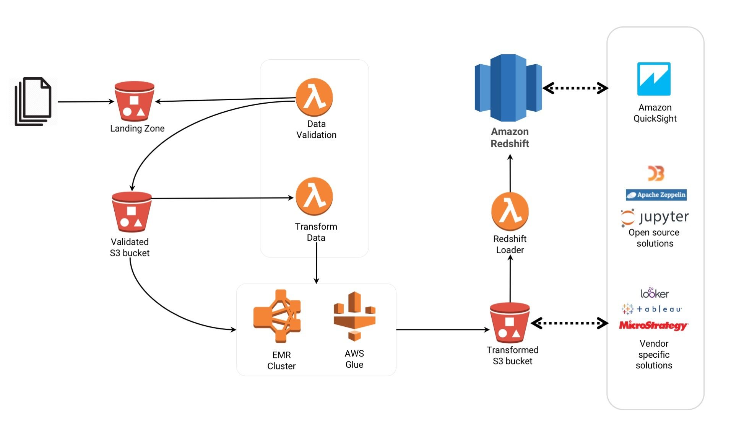
What is ETL
ETL stands for Extract, Transform, Load. It's a process used in data warehousing and data integration to move data from various sources, transform it into a format that is suitable for analysis or reporting, and then load it into a target destination such as a data warehouse or a database.

Slide 7
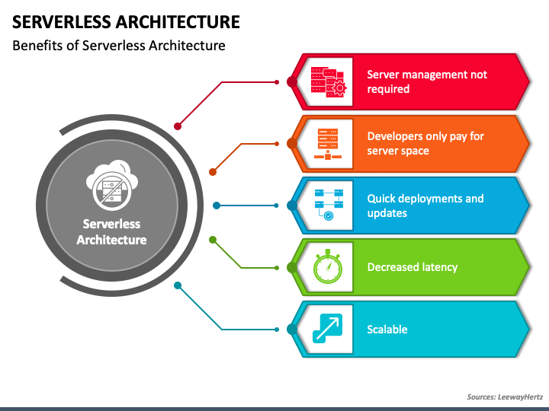
Benefits of Serverless Architecture

Slide 8
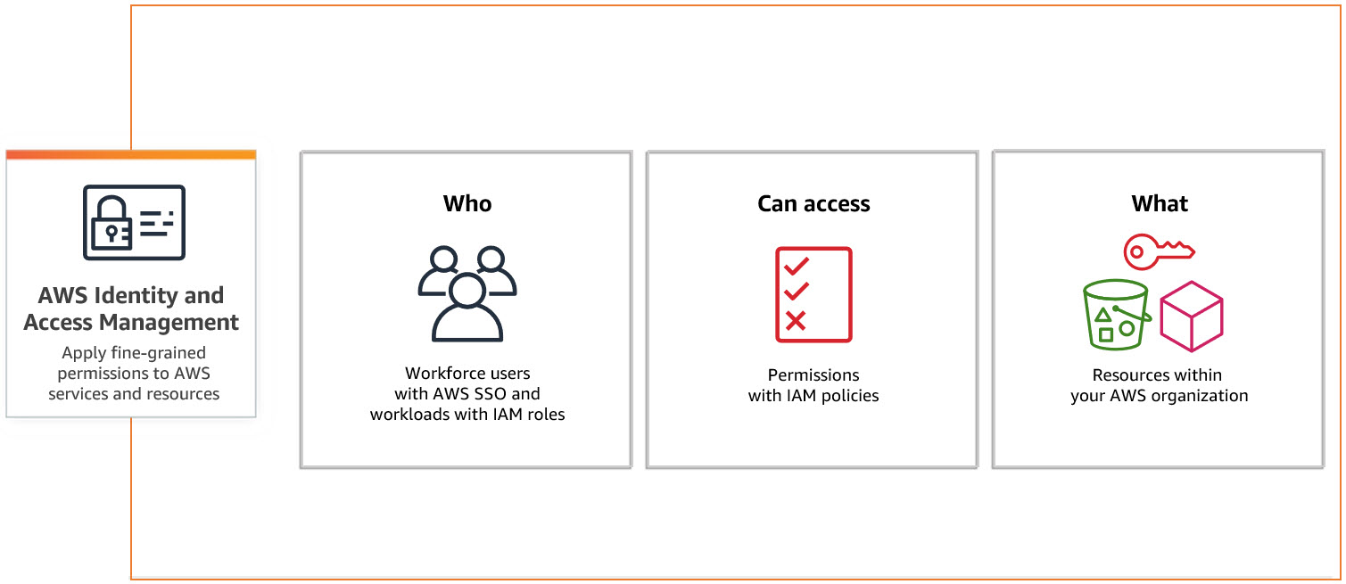
What is IAM
AWS IAM (Identity and Access Management) is a service provided by Amazon Web Services (AWS) that allows you to manage access to AWS services and resources securely. It enables you to control who can access your AWS resources (authentication) and what actions they can perform (authorization).

Slide 9
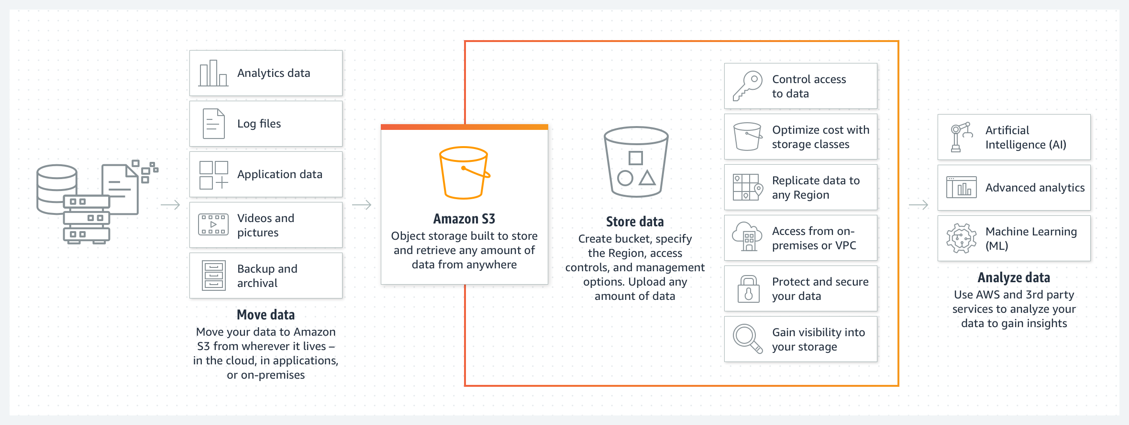
What is S3
S3 stands for Amazon Simple Storage ServiceS3 is designed to store and retrieve any amount of data from anywhere on the web

Slide 10
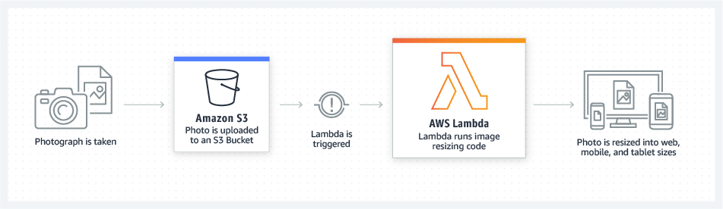
AWS Lambda
Developers commonly use AWS Lambda for tasks such as data processing, real-time file processing, building serverless APIs, handling IoT events, and implementing backend logic for web and mobile applications.

Slide 11
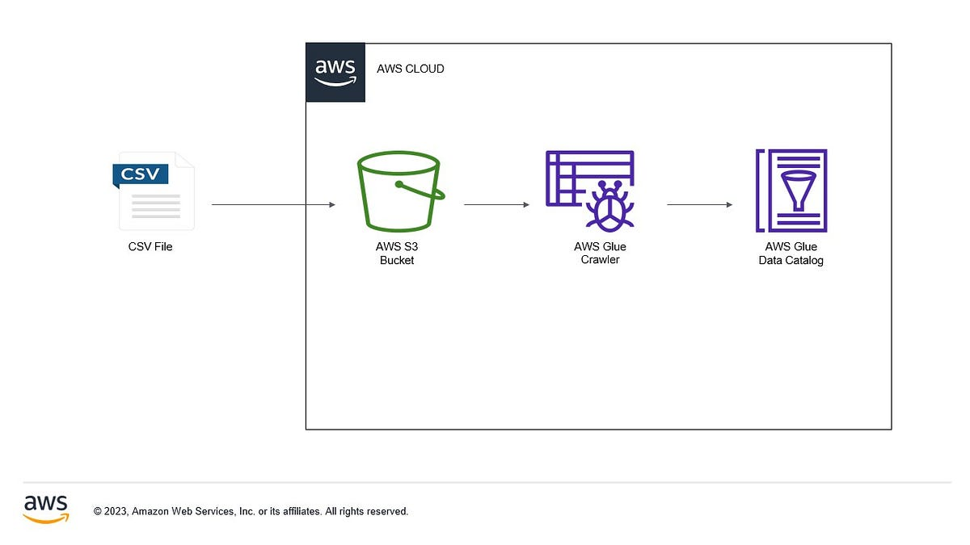
AWS Glue Crawler
By using AWS Glue Crawler, you can automate the process of discovering and cataloging data, which helps in building a centralized metadata repository for your data assets. This metadata catalog can then be used for various purposes such as data governance, data lineage, and data discovery.

Slide 12
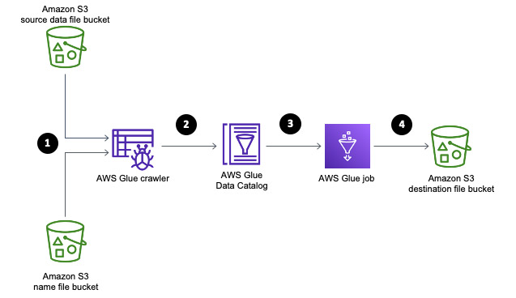
AWS Glue data Catalogue
Overall, the AWS Glue Data Catalog simplifies data discovery, management, and analysis by providing a centralized repository for metadata about your data assets, enabling you to make informed decisions and extract more value from your data.

Slide 13
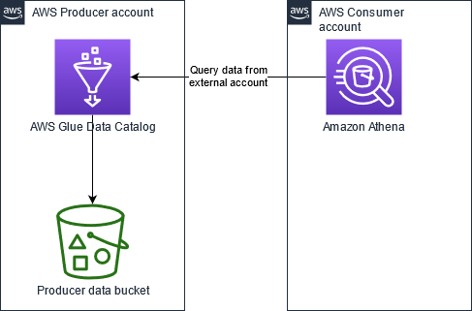
AWS Athena
AWS Athena is commonly used for ad-hoc analysis, data exploration, log analysis, and building interactive dashboards on top of large datasets stored in Amazon S3, providing a cost-effective and scalable solution for querying data without the need for managing infrastructure.

Slide 14
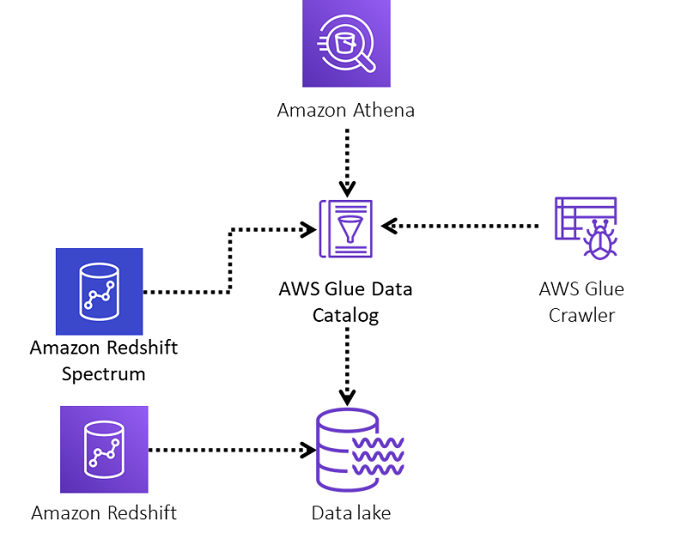
Amazon Redshift
Amazon Redshift is commonly used for data warehousing, data analytics, business intelligence, and reporting applications, providing a scalable and cost-effective solution for storing and analyzing large volumes of data.

Slide 15
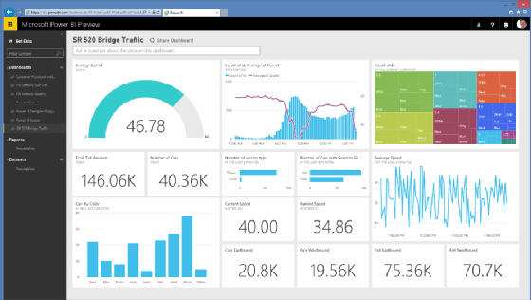
Power BI
Power BI is a business analytics service provided by Microsoft that enables users to visualize and analyze data, share insights across an organization, and make data-driven decisions. It offers a suite of tools for data preparation, data modeling, visualization, and collaboration, making it a comprehensive platform for business intelligence (BI) and analytics.

Slide 16
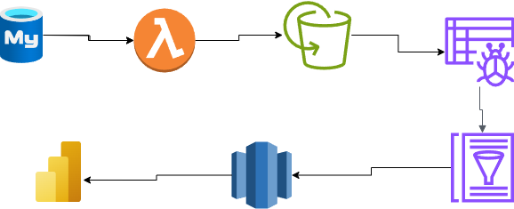
Project: Serverless Data migration

