Slide 1
ENGI 301 Ball Retriever Proposal
9/26/23
Dan Zislis

Slide 2
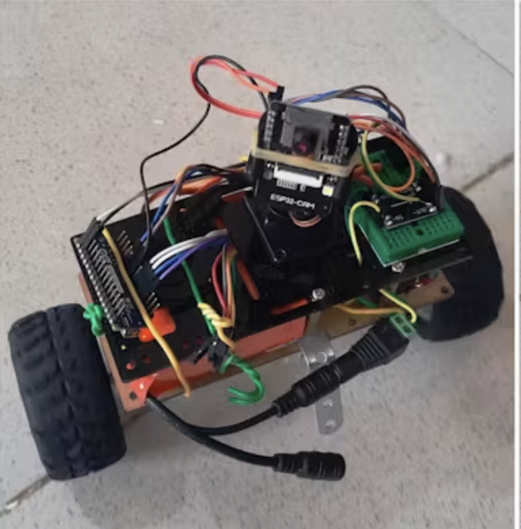
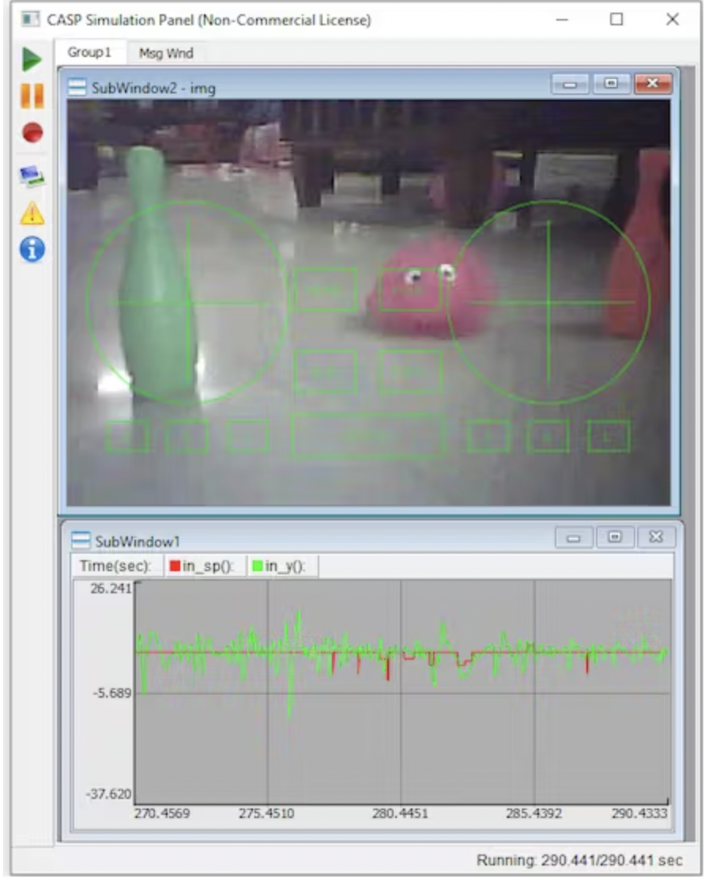
Background Information
ball jig
tennis ball
Automated robots (like Roomba exist), so let’s give them more functionality
It’s annoying to retrieve balls that go out in a sport (soccer, basketball, tennis, etc)
Why not create a robot that returns balls for the player? (for this scope, tennis balls)
Link to hackster,io for self standing: https://www.hackster.io/aadhuniklabs/self-balancing-wifi-controlled-robot-with-pantilt-camera-4b5762
Link to hackster io for RC control inspiration: https://www.hackster.io/lre3/hardware-base-for-a-remote-controlled-fanboat-566de3
What improvements / additions over existing project?
Main addition is to add a ball jig to the robot to guide the ball when moving
RC controllability
Overall Procedure:
Approach Ball with RC
Deploy “ball jig” to capture ball
Move to designated location with ball
Camera vision that can be used to identify ball

Slide 3
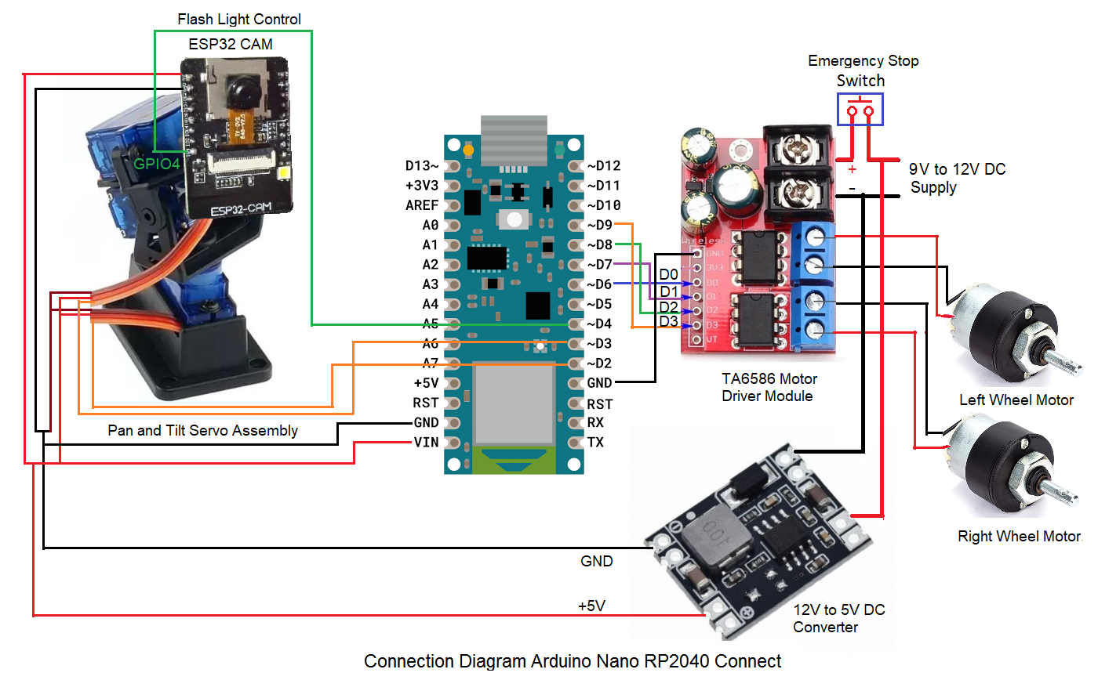
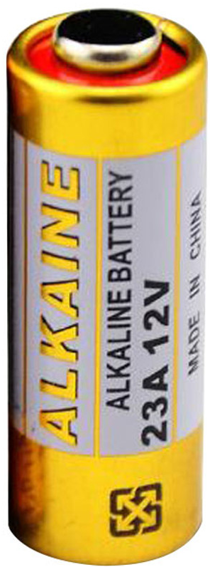
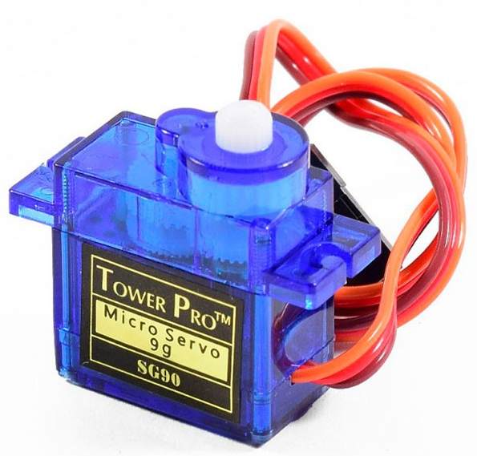
System Block Diagram + Power Block Diagram
ball jig
brown: GND to Converter
red: Vin (+5V)
orange: port on BeagleBone that outputs signal
*Note that this diagram is for arduino nano, would need to be modified for the BeagleBone

Slide 4
Components / Budget
Component | Need to Buy | Link | Cost
DC motors | 2 | https://www.amazon.com/EUDAX-Electric-Magnetic-Propeller-Connector/dp/B08GPPJR1T | $4
Motor Drivers | 2 | https://www.amazon.com/HiLetgo-Stepstick-Stepper-Printer-Compatible/dp/B07BND65C8 | $4.04
12V to 5V Converter | 1 | https://www.amazon.com/MP1584EN-DC-DC-Converter-Adjustable-Module/dp/B08247LRYS/ref=sr_1_19?crid=3TW4R96LPTXJJ&keywords=12+to+5+volt+converter&qid=1695777136&s=industrial&sprefix=12+to+5+volt+convert%2Cindustrial%2C160&sr=1-19 | ~$6
Wifi Sensor (NRF24L01) | 2 | https://www.amazon.com/gp/product/B0829ZQ97G | ~$12
Servos + Wheels | 3 | https://www.amazon.com/FEETECH-Continuous-Rotation-Matching-Helicopter/dp/B0B42KLJ9G | $26 (or can get from OEDK)
ESP32 Camera + USB Camera | 1 | https://www.amazon.com/HiLetgo-ESP32-CAM-Development-Bluetooth-Raspberry/dp/B07RXPHYNM / https://www.amazon.com/Microphone-Calling-Conferencing-Streaming-Computer/dp/B09TKCBWZ2 | $40
Battery (12 V) |  | https://www.amazon.com/Beidongli-Alkaline-Batteries-Endurance-Warranty%E3%80%91/dp/B0BVBC815F/ref=sr_1_20?keywords=12v+battery+pack&qid=1695776859&sr=8-20 | $6 (or can get from OEDK)
Total Budget |  |  | ~$100

