Slide 1
CREATE AI AGENTS CHAMPIONSHIP · BEST YOUTH AI AGENT
Murshid
The AI agent that plans every student's week and gives teachers the full picture
FOUNDER
STAGE
BUILT IN
Sam (Vardan Kapur), Grade 11
Working prototype
Dubai
BEST YOUTH AI AGENT ENTRY
Notes:
Murshid (Arabic for 'guide'). Entry for the Best Youth AI Agent category of the Dubai Chamber of Digital Economy's Create AI Agents Championship. January 2027 submission = prototype + pitch deck + demo video, English only. Source: https://www.dubaichamberdigital.com/en/create-ai-agents (fetched 15 Oct 2026).

Slide 2
MURSHID
BEST YOUTH AI AGENT ENTRY
Nobody sees a student's whole week.
Students juggle every subject, test and fixture alone. Teachers set homework without seeing what else is due.
2
Notes:
The problem in one line. A Grade 11 student has work from several subjects, tests, sport fixtures and activities arriving through different teachers, with no single view of the week. Each teacher sets homework without seeing the rest of the class's load, so deadlines pile onto the same days. Outcome we want: every student on top of their work, every teacher with the full picture.

Slide 3
MURSHID
BEST YOUTH AI AGENT ENTRY
The problem
406,563
1 : 930
Students in Dubai private schools in 2026–27 (KHDA)
Counsellor ratio at Our Own High School
3
Notes:
Who is affected: students (missed or piled-up deadlines), teachers (set work blind to other subjects; struggling students spotted late) and counsellors/parents (no weekly picture). Sources: 406,563 students, up 4.6% from ~388,731 in June 2026, KHDA Media Majlis 1 Oct 2026, reported by Gulf Education 5 Oct 2026: https://gulf.education/dubai-private-school-enrolment-406000-khda-priorities/ . OOW key facts (4,659 students, 5 counsellors; page last updated 18 Apr 2026): https://edcare.ae/schools/our-own-high-school/fees . 4,659 / 5 = 932, rounded to 1:930. Survey data on how often students miss deadlines does not exist yet; it is part of the validation plan.

Slide 4
MURSHID
BEST YOUTH AI AGENT ENTRY
02 · Build
An agent that acts
Murshid reads the timetable and the work that teachers set, plans each week, and acts only with a person's approval.
4
Notes:
Transition from the problem to the agent. Murshid is more than a chatbot: it takes a goal, plans steps, calls tools on real school data and takes actions, with a human approval step for anything that writes or goes outbound.

Slide 5
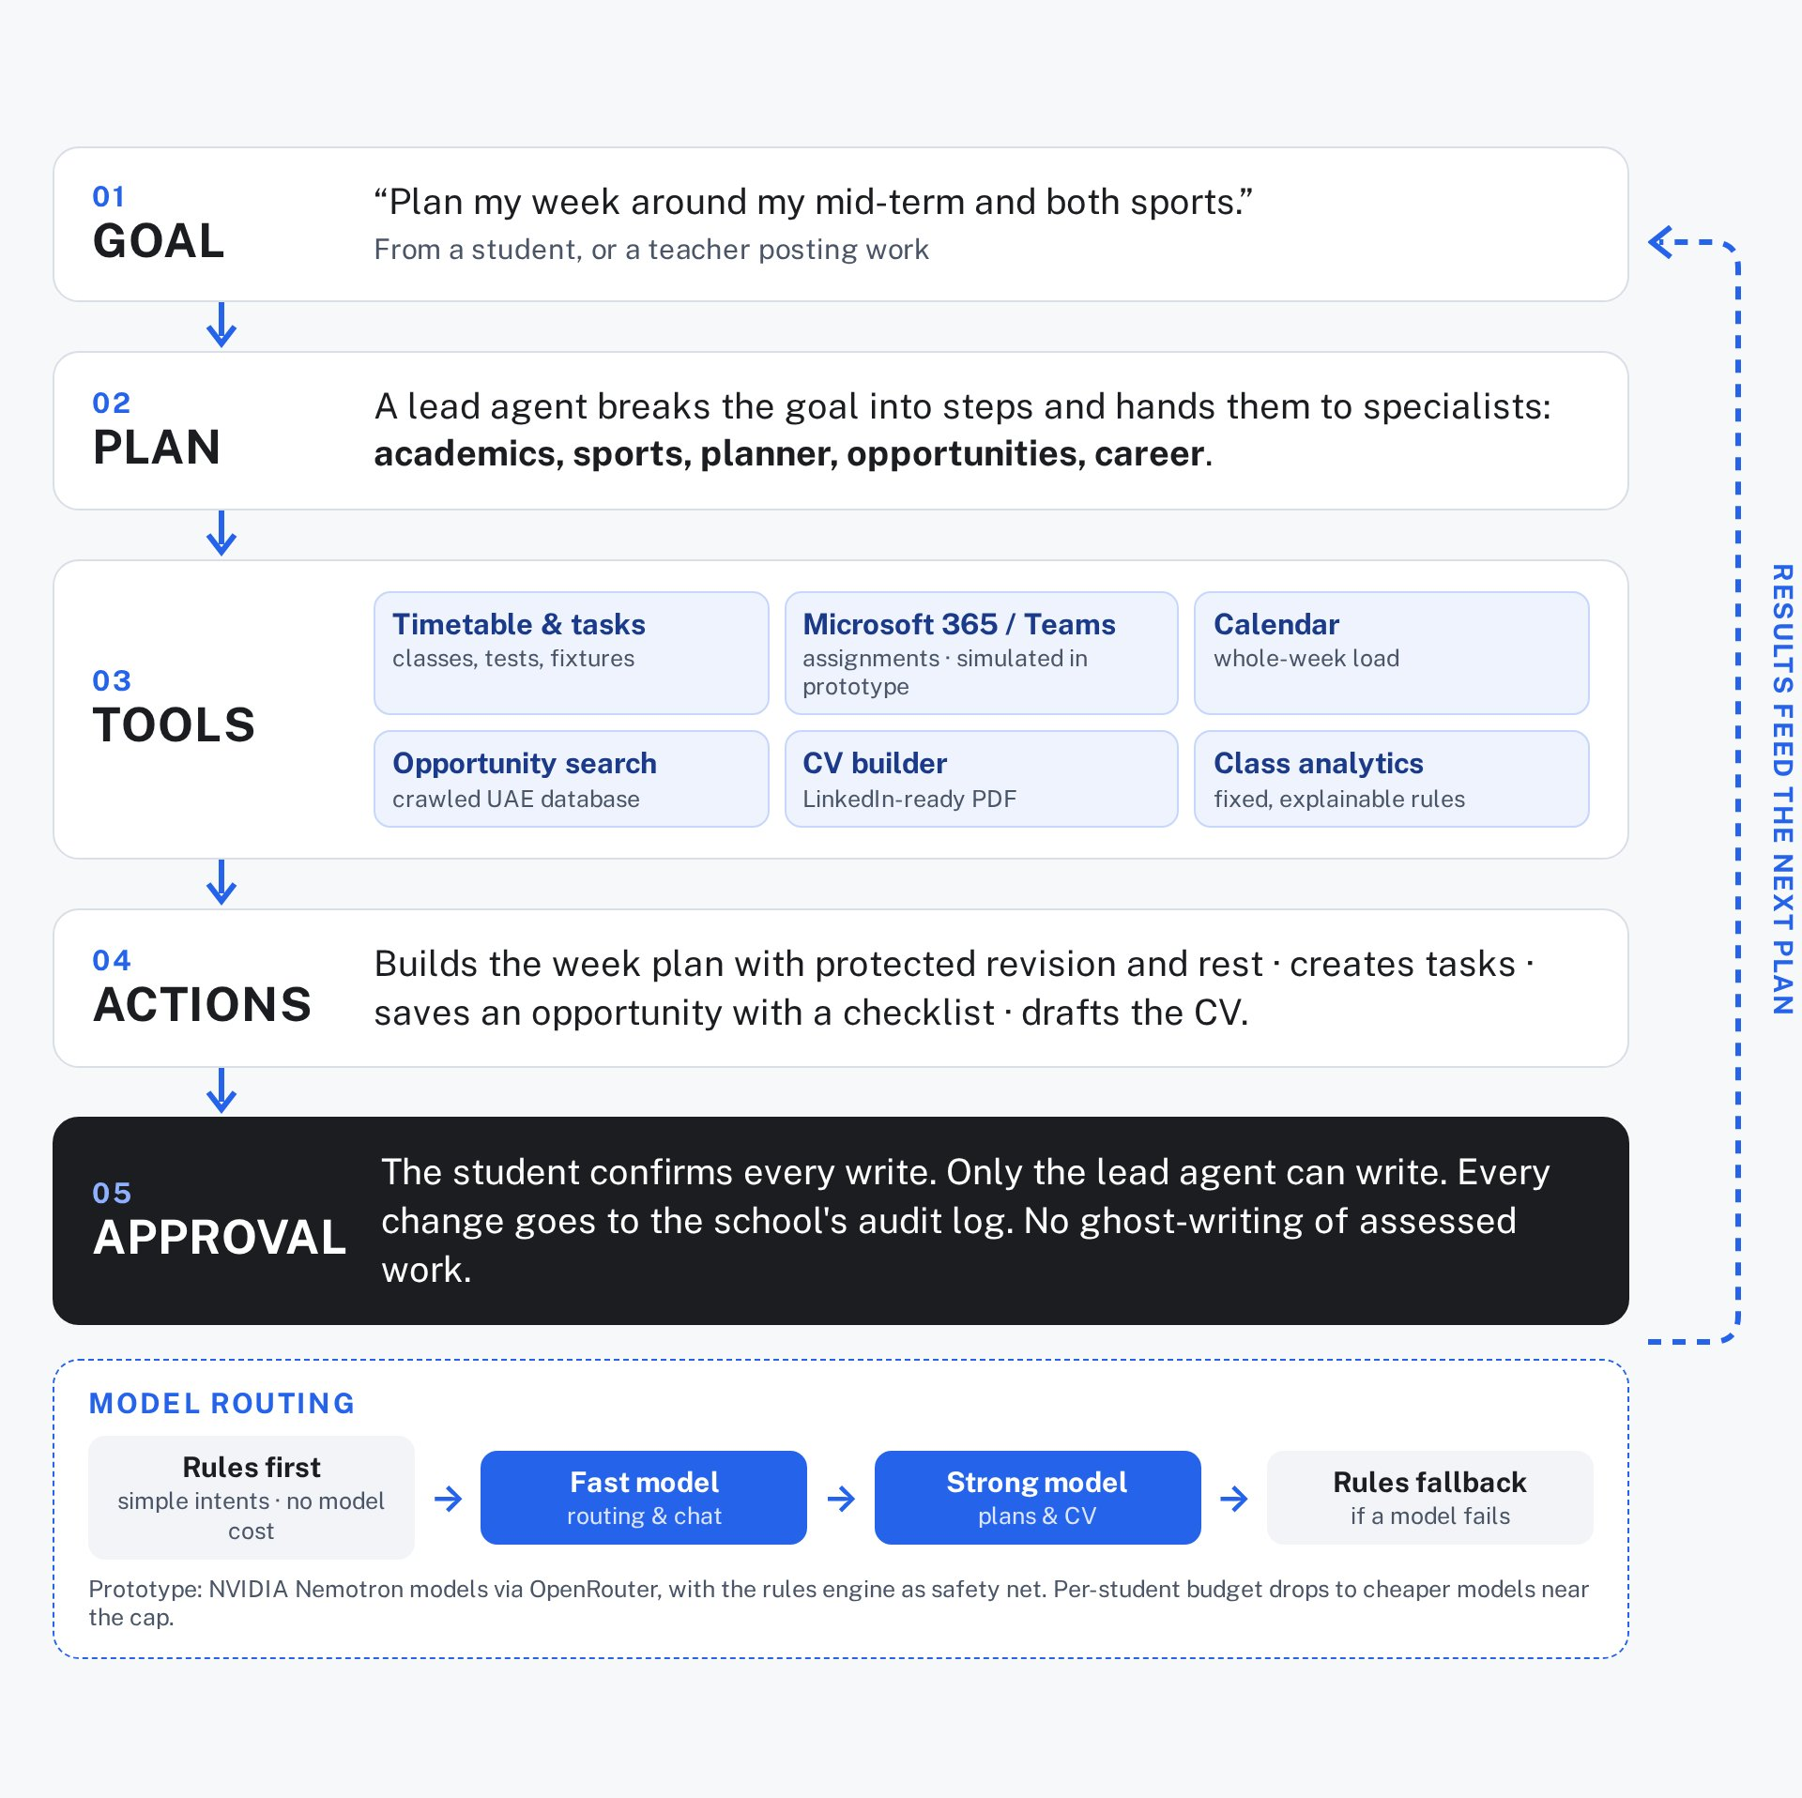
MURSHID
BEST YOUTH AI AGENT ENTRY
How the agent works
Rules route first. Models plan. A person approves every write.
5
Notes:
How Murshid reasons, plans, uses tools and takes action. 1) Goal: e.g. 'plan my week around my mid-term and both sports'. 2) Plan: a lead agent splits the request across specialist sub-agents (academics, sports, opportunities, career/CV, planner, wellbeing). 3) Tools: timetable and tasks, Microsoft 365 / Teams classes and assignments (connector built; sign-in SIMULATED in the prototype), calendar, opportunity search over a crawled UAE database, CV builder (PDF). 4) Actions: build the week plan, create tasks, save an opportunity with a checklist, generate a LinkedIn-ready CV. 5) Guardrails: tools with side effects need the student's confirmation (needs_confirmation in the tool registry); only the lead agent may write; every change is logged in the school's audit log; integrity check stops ghost-writing of assessed work. Model routing: rules handle simple intents at no model cost; prototype uses NVIDIA Nemotron 3 Super / Nemotron 3.5 Lightning on OpenRouter free tier, with the rules engine as fallback when a model fails or hits quota. Production plan: cheap model as router and for chat, a stronger model for heavy planning, per-student budget ledger with economy tier. Source: /workspace/murshid packages/agent-gateway (orchestrator.ts, sub-agents.ts, tools.ts, provider.ts) and docs/simulations/README.md.

Slide 6
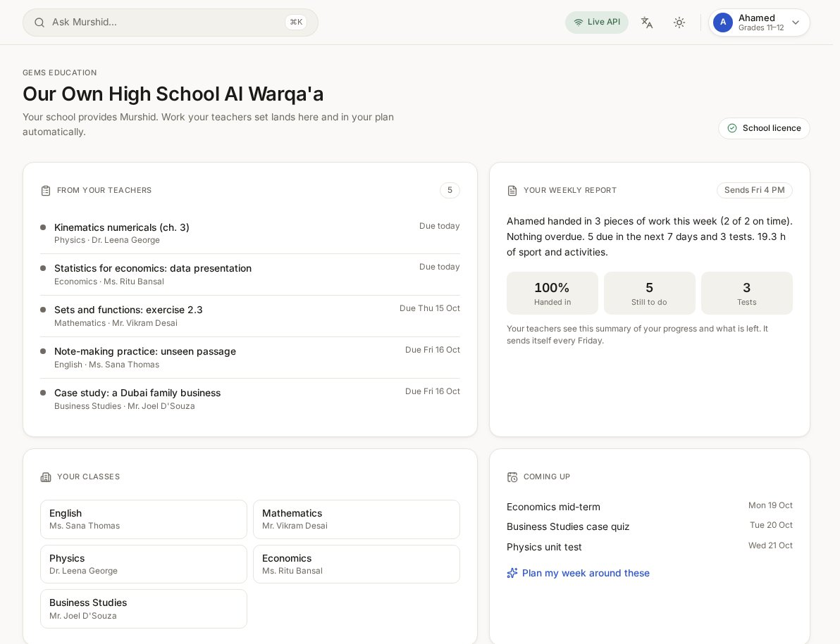
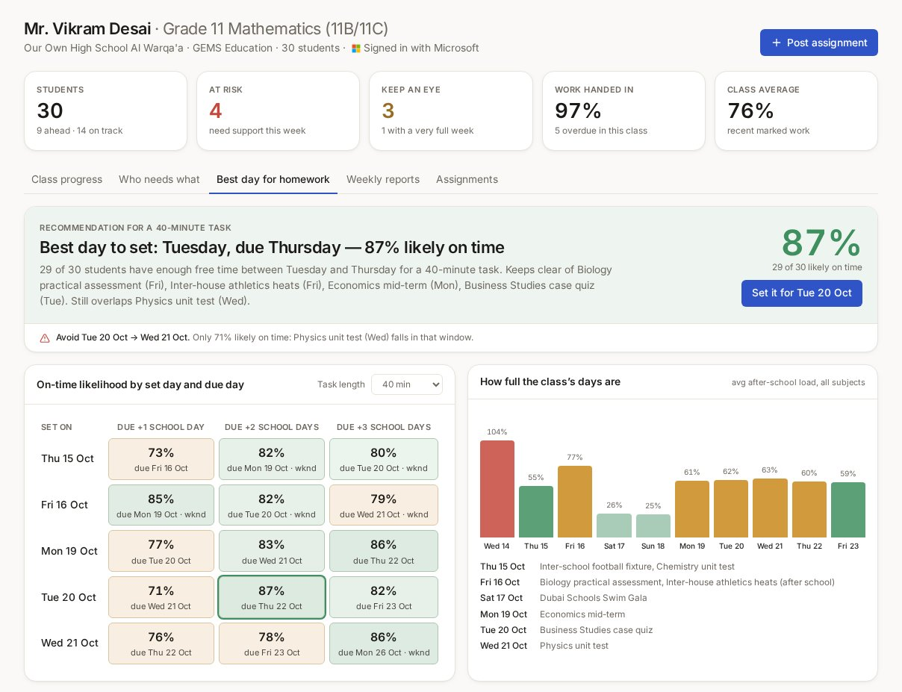
MURSHID
BEST YOUTH AI AGENT ENTRY
What Murshid shows
Student · every teacher's work in one plan
Teacher · best day to set homework
6
Notes:
Real screenshots of the working prototype (docs/submission/screenshots: student-school-page.png, teacher-best-day-for-homework.png), cropped only. All students and teachers are synthetic demo data. 'Signed in with Microsoft' in the teacher portal is SIMULATED: the Microsoft 365 connector interface is built and the Graph scopes exist, but no real Entra ID tenant is connected yet. The 87% on-time figure comes from fixed, explainable rules run on synthetic data, not real students. The teacher portal also has 'Who needs what' (support / more time / core / extension groups) and a class progress report with at-risk flags; shown in the demo video.

Slide 7
MURSHID
BEST YOUTH AI AGENT ENTRY
Proof so far
628
7
10
38
Automated tests passing on 15 Oct 2026
of 7 live-model simulation turns passed
of 10 rules safety-net turns passed
Synthetic Grade 11 students in the demo
7
Notes:
628 tests passed, 4 skipped, from `pnpm -r test` in /workspace/murshid on 15 Oct 2026 (api 132, grade-bands 99, opportunities 76, agent-gateway 67, connectors 61, core 42, db 40, notify 37, web 25, privacy 24, documents 20, admin 5). Simulations: docs/simulations/README.md, runs on 10–11 Oct 2026: Simulation A with live models 7/7 passed (5 turns fully on Nemotron, 2 fell back to rules); rules-only A+B 10/10. Synthetic roster: 38 Grade 11 students in the demo school tenant (docs/SCHOOLS.md). The homework-timing model and class analytics are deterministic rules on SYNTHETIC data; no real student data has been used. These figures show the software works; they are not evidence of customer demand.

Slide 8
MURSHID
BEST YOUTH AI AGENT ENTRY
03 · Validate
Proof then scale
Engineering proof exists today. Customer proof comes from a survey and a proposed school pilot.
8
Notes:
Honest split: what is proven now (the software works under test and simulation) versus what we still have to prove with real students and teachers.

Slide 9
MURSHID
BEST YOUTH AI AGENT ENTRY
Validation plan
QUESTION
METHOD
TARGET
RESULT
Do students need it?
In-app survey (/survey)
20+ students
Results to add
Do teachers need it?
In-app survey (/survey)
3+ teachers
Results to add
Does it help counselling?
Counsellor interview
1+ counsellor
Results to add
Does it change outcomes?
Proposed Grade 11 pilot
On-time hand-ins vs baseline
Results to add
Would anyone pay?
Survey question
Parents and school leaders
Results to add
9
Notes:
No survey or pilot results exist yet; every 'Results to add' cell is a placeholder to fill before submission. Survey runs through the in-app /survey page (being added to the prototype; confirm it is live before running). Pilot is PROPOSED at Our Own High School Al Warqa'a, subject to school approval and parental consent; no partnership or pilot agreement is signed. Impact metric: share of work handed in on time, baseline week without Murshid vs weeks with it; plus teacher time spent on planning, self-reported.

Slide 10
MURSHID
BEST YOUTH AI AGENT ENTRY
Safe by design
UAE law first
Separate tenants
Human in charge
Consent-based processing under the PDPL. Under-13s blocked by a neutral age gate. Guardians for 13–17. No ads.
School data never mixes with family accounts. Teachers see only the classes they teach.
Any action that writes needs the student's approval. Every change goes to the school's audit log.
10
Notes:
UAE PDPL (Federal Decree-Law 45/2021): consent is the default lawful basis and must be easy to withdraw; Executive Regulations still pending. Child Digital Safety law (Federal Decree-Law 26/2025): in force 1 Jan 2026 with one year to comply; no collecting or processing data of under-13s without explicit, documented parental consent, no commercial use or targeted ads, high-privacy defaults, parental controls. Source: Latham & Watkins, 9 Jan 2026, https://www.lw.com/en/insights/uaes-child-digital-safety-law-what-every-digital-platform-and-isp-should-know . Prototype today: packages/privacy has a neutral age gate (MIN_AGE 13, guardian needed under 18), consent records, data-rights export/delete, AI-use log and audit log; tool registry refuses side-effect tools without confirmation. If a school licenses Murshid for under-13 grades, verified parental consent is required before any processing. Planned before the pilot: DPIA, zero-data-retention model settings, UAE-region hosting for student records. Not legal advice.

Slide 11
MURSHID
BEST YOUTH AI AGENT ENTRY
Business model
150
29
79
0.44
AED per student-year · schools (range 120–180)
AED a month · family Plus
AED a month · family Pro
USD AI cost per student-month · estimate
11
Notes:
Annual family options: Plus AED 249 a year, Pro AED 699 a year. Schools first: a school licenses Murshid per student per year; families can buy Plus or Pro directly. Example (illustrative, not a customer): a 1,300-student secondary school at AED 120–150 = about AED 156k–195k a year. AI cost ~USD 0.44 per student per month is an INTERNAL ESTIMATE from /workspace/work/murshid_cost_cheap.py (assumed usage; cheap model mix). Caveat: that mix includes DeepSeek models, which we have ruled out for personal data, so the real figure will be higher; a premium mix estimate is ~USD 1.29 (murshid-model-layer.md). At AED 150/year (~USD 3.40 a month) the cheap-mix AI cost is ~13% of licence revenue. Pricing source: product pricing page (docs/SCHOOLS.md, feature-list.md).

Slide 12
MURSHID
BEST YOUTH AI AGENT ENTRY
Competition
PRODUCT
WHAT IT DOES
WHAT MURSHID ADDS
Abwaab
Curriculum video lessons and study schedules for students
Plans around the school's real work and sport
Classera
School LMS and ERP with an AI assistant
Agent for each student on top of tools schools use
ManageBac+ / Toddle
Planning, assessment and reporting for schools
Workload across subjects and best day to set homework
ChatGPT study mode
Free step-by-step tutor that waits for a prompt
Knows the timetable and acts every week
12
Notes:
Sources (fetched/searched 15 Oct 2026): Abwaab: online learning platform with video lessons, assessments and schedules set by an 'Abwaab Morshed' (similar name: check trademark) https://abwaab.com/en . Classera: 'Learning Super Platform', LMS + ERP + fintech, AI assistant X.SERA, compatible with Microsoft, 12M+ users in 40+ countries https://www.classera.com/en/ and https://appsource.microsoft.com/en-us/product/web-apps/classera.classera . ManageBac+: planning, assessment and reporting for 2,300+ IB/multi-curricula schools https://www.managebac.com/ib-diploma ; Toddle: AI-powered K-12 LMS (planning, assessment, portfolios, reports) https://www.toddleapp.com/product/product-overview/ . ChatGPT study mode: free for logged-in users, step-by-step guidance https://openai.com/index/chatgpt-study-mode/ . 'What Murshid adds' is our positioning, not a claim that competitors lack every feature.

Slide 13
MURSHID
BEST YOUTH AI AGENT ENTRY
Road to May
Jan 2027
Feb 2027
Feb–Mar
Apr 2027
May 2027
Submit prototype, deck and demo video
Real Microsoft 365 sign-in with school IT
Proposed Grade 11 pilot at Our Own High School Al Warqa'a
Live models, zero data retention, security review
Grand Final: fully working agent, live
13
Notes:
Championship timeline (official page): submissions January 2027; 24 semi-finalists and Tech Accelerator from January; semi-final pitch March 2027; 12 finalists announced March; Grand Final first week of May 2027, where finalists must show a fully functional AI agent live, not an MVP. Our milestones: replace the simulated Microsoft sign-in with production Entra ID (auth code + PKCE) and Graph education endpoints (classes, members, assignments; needs EduRoster.ReadBasic + EduAssignments.ReadBasic with admin consent); move from free-tier models to paid models with zero-retention settings; run the proposed pilot only with school approval and parental consent (not yet agreed). Source: https://www.dubaichamberdigital.com/en/create-ai-agents ; docs/SCHOOLS.md.

Slide 14
MURSHID
BEST YOUTH AI AGENT ENTRY
Built by a Grade 11 student for his own classmates.
Sam (Vardan Kapur) · GEMS Our Own High School Al Warqa'a · under 21 · solo founder and builder
14
Notes:
Team: one person. Sam designed and built the whole stack: student web app, teacher portal, API, agent orchestrator, connectors, privacy layer and tests. He is the user: a Grade 11 student at a school of ~4,660 students. Eligible for the Youth category (lead applicant under 21 at registration). Next hires funded by the grant: security review and mobile help (contract). Company: a parent would hold any licence until Sam turns 18.

Slide 15
MURSHID
BEST YOUTH AI AGENT ENTRY
USD 150,000 to go live
The grant takes the prototype live in a real school. We also ask for pilot support from school IT. Try it: LIVE DEMO LINK
BUILD · 45%
TRUST · 25%
PILOT · 30%
Live models, Microsoft 365, mobile
Security review, DPIA, UAE hosting
School pilot, teacher training, setup
15
Notes:
Ask: the USD 150,000 Best Youth AI Agent category grant (each category winner receives USD 150,000; source: https://www.dubaichamberdigital.com/en/create-ai-agents). The 45/25/30 split is a PROPOSED use of funds, to be confirmed by Sam. Pilot support we ask for: an introduction to school IT so Microsoft 365 admin consent and a Grade 11 pilot can be agreed; no pilot is signed today. Replace the placeholder 'LIVE DEMO LINK' with the deployment URL before submission.

