Slide 1
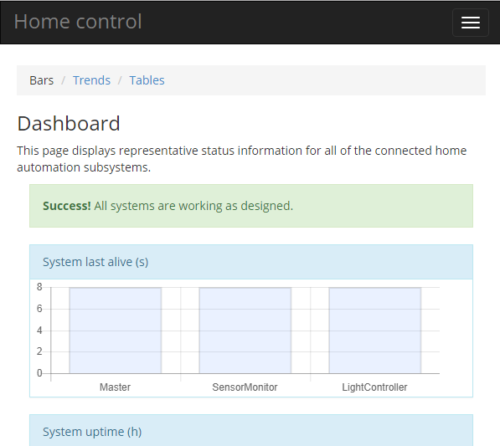
ModuleInterface use case for home control
Weather
monitoring module
Browser on PC/Phone/Tablet
Lighting
control module
MI/PJON bus (wired and/or wireless)
Lighting
control module
Lighting
control module
Heating
control module
Heating
control module
Heating
control module
Access
control module
Access
control module
Ethernet (wired/WiFi)
Access
control module
Other module
Other module
Other module
Master
Web server + database

