Slide 1
School of Computer Science & Engineering
AI Application Development – IA1
MicroSwiftAuto AI

Slide 2
Team Members & Roles
Team Member Name | Role
Mohammed Faizaan Faiz | Team Lead
Lochan Thanigai Murugan Padmashree | Development Lead
Mohammed Touhid | Test Lead
Mudassir Rehman | Customer Contact Lead
Kavya Arora | Developer
Mohsin Lihas | Customer Contact
Notes:
Talk about how they are managing their documents, how google docs does automatic versioning
As them what they know about Android and IoS versions

Slide 3
Modified Problem Statement
Patients struggle to complete insurance claim processes due to complex paperwork and lack of technical knowledge.
This leads to delays, errors, or inability to claim insurance despite eligibility.
Notes:
Talk about how they are managing their documents, how google docs does automatic versioning
As them what they know about Android and IoS versions

Slide 4
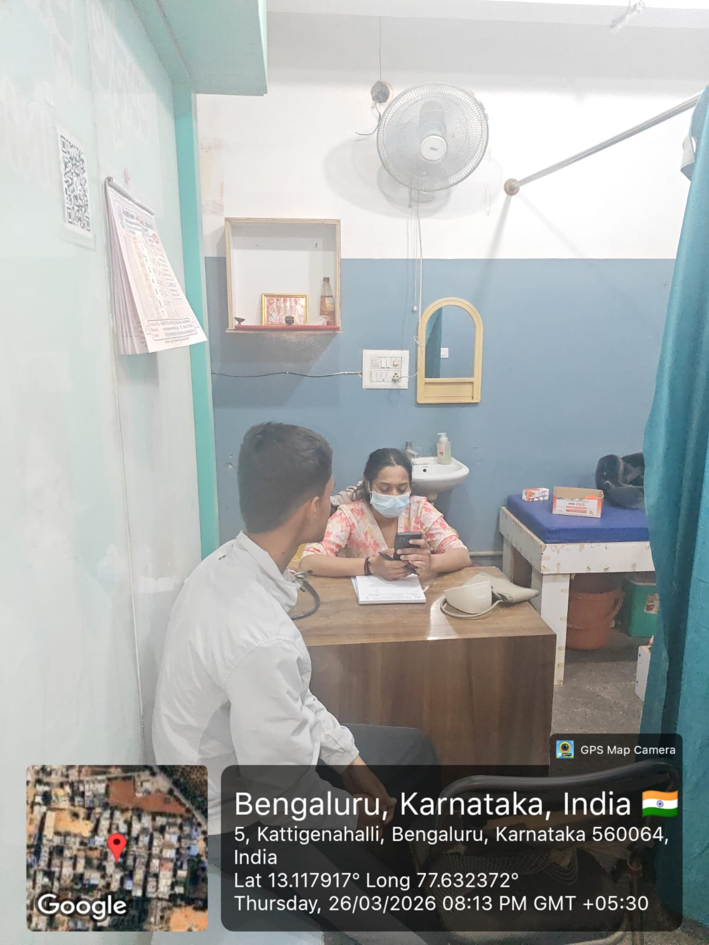
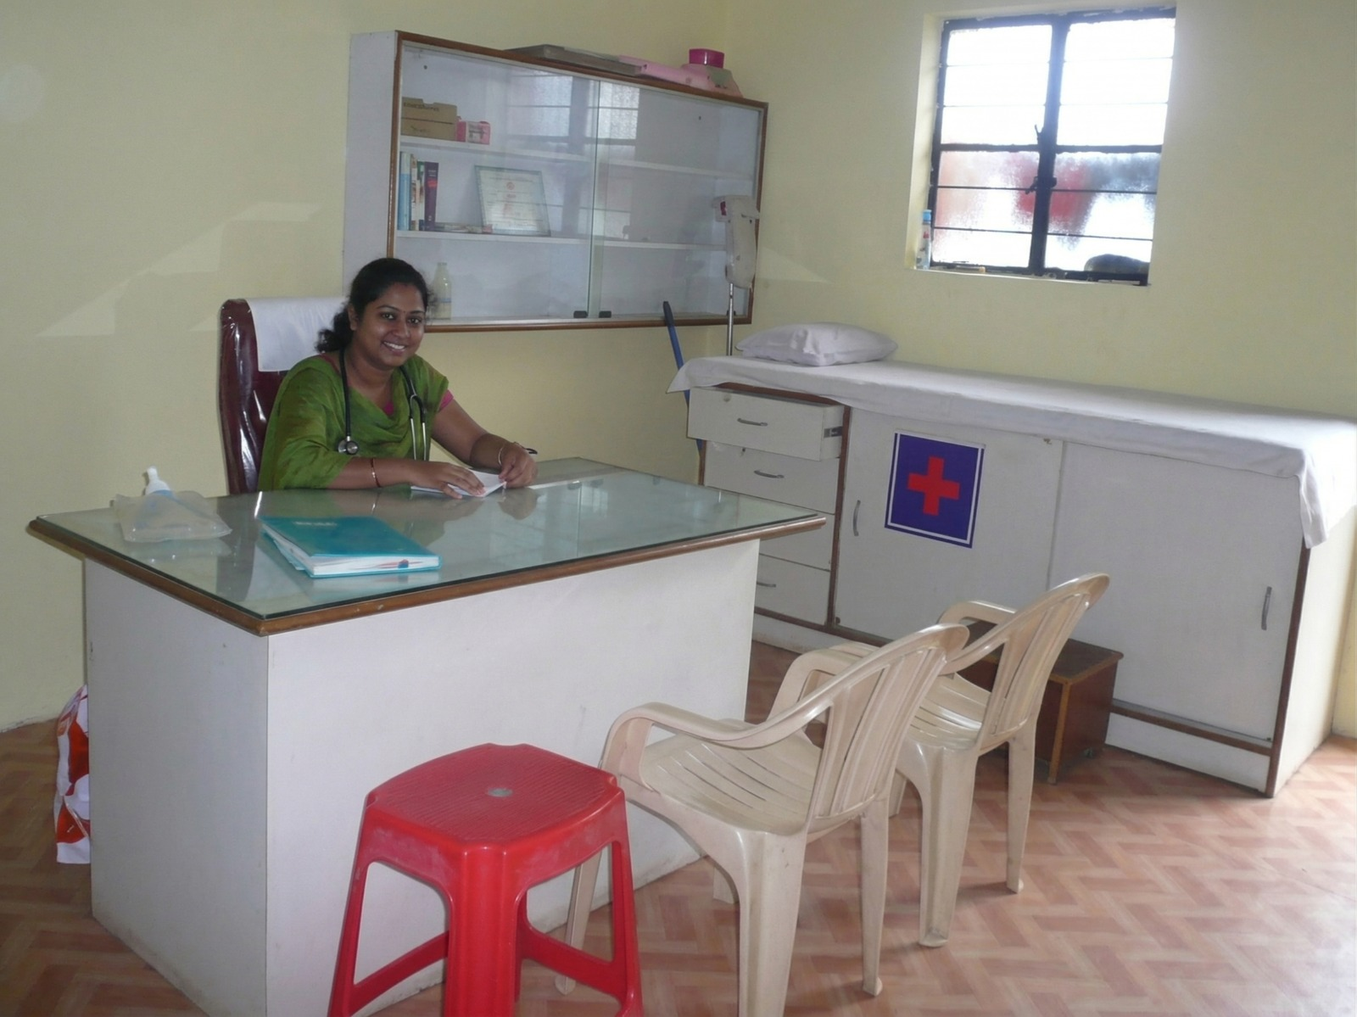
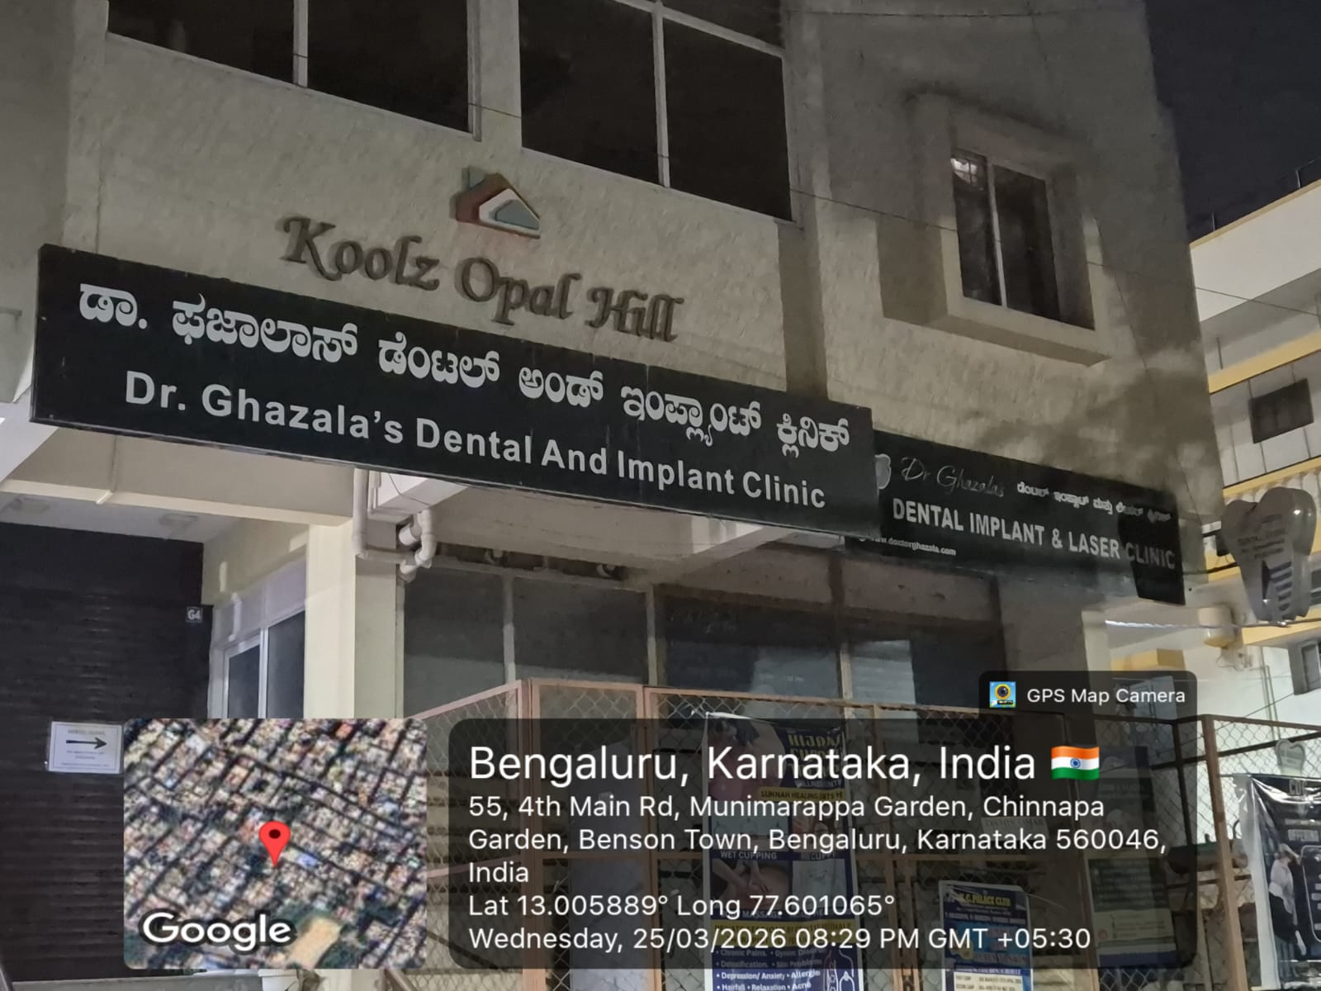
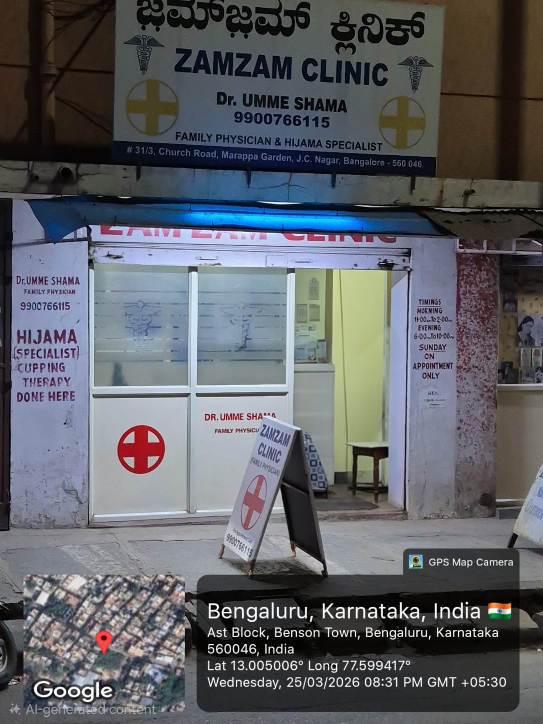
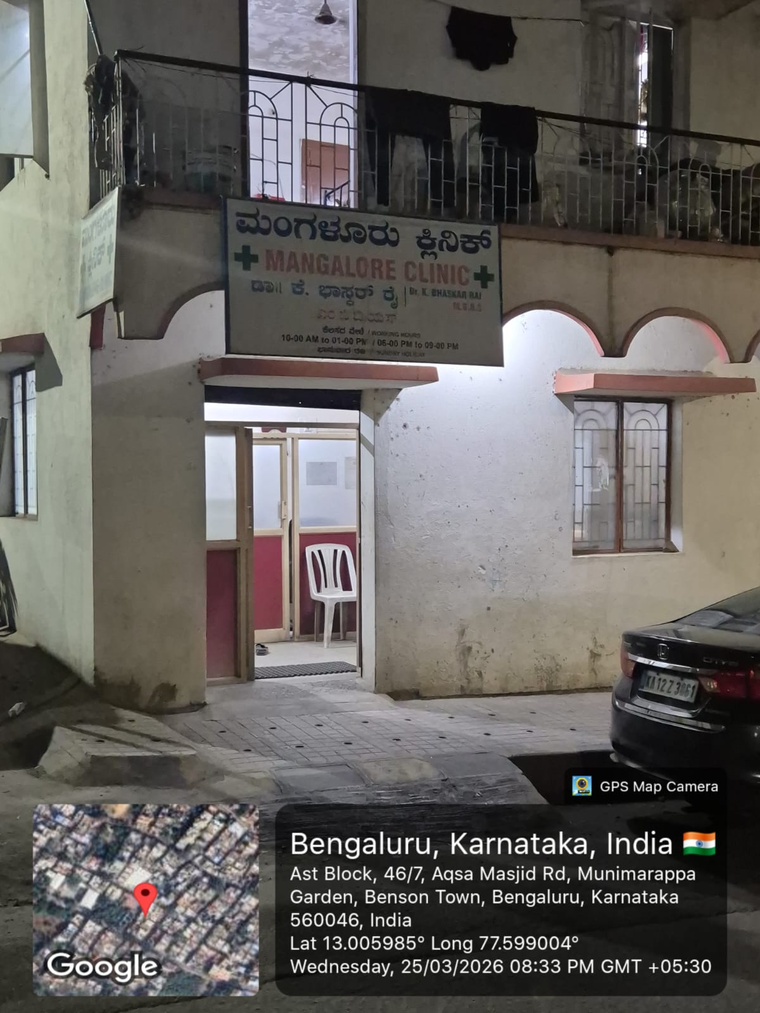
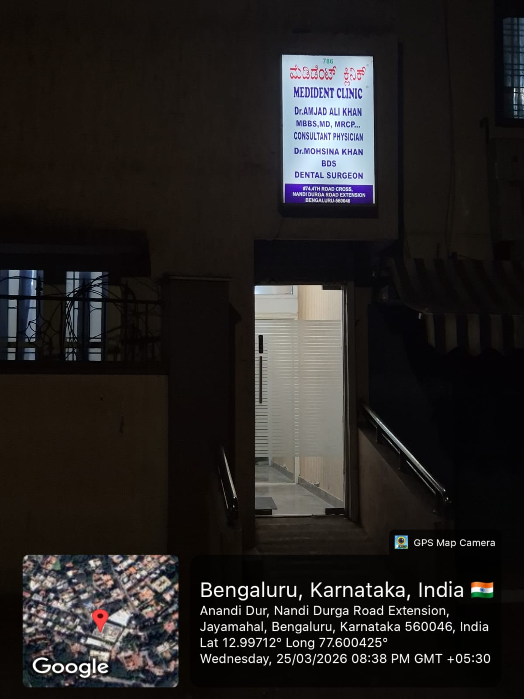
User / Customer Understanding
Notes:
Talk about how they are managing their documents, how google docs does automatic versioning
As them what they know about Android and IoS versions

Slide 5
Ideal Customer Profile (ICP)
Demographic:
Age: 30–70
People with health insurance.
Hospital patients & families.
Clinics and hospitals.
Psycho-graphic:
Struggle with digital tools.
Want faster claim processing.
Prefer guided or automated systems.
Notes:
Only stress on the 1st sentence – the definition
Come back to the 2nd sentence in the end as part of revision

Slide 6
Customer Persona (CP)
Name: Rajesh Kumar
Age: 52
Occupation: Small business owner
Situation:
Hospitalized and insured
Cannot understand claim forms
Depends on hospital staff
Pain Points:
Confusing paperwork.
Fear of rejection.
Time-consuming process.
Notes:
Only stress on the 1st sentence – the definition
Come back to the 2nd sentence in the end as part of revision

Slide 7
Product USP
AI-driven automated claim form filling.
Reduces human errors in documentation.
Faster claim submission process.
Accessible for non-technical users.
Notes:
Only stress on the 1st sentence – the definition
Come back to the 2nd sentence in the end as part of revision

Slide 8
Use Cases & High level Requirements
Use Cases:
Upload medical bills and reports.
Auto-fill insurance claim forms.
Validate entered data.
Suggest missing information.
Submit claim digitally.
Expected Output:
Error-free claim form.
Faster approval process.
Notes:
Only stress on the 1st sentence – the definition
Come back to the 2nd sentence in the end as part of revision

Slide 9
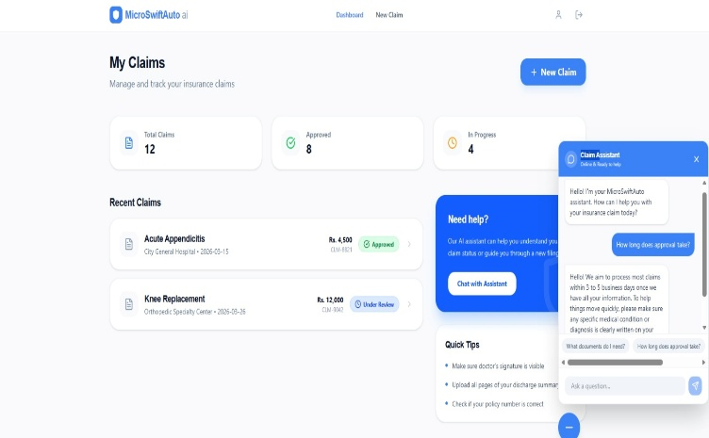
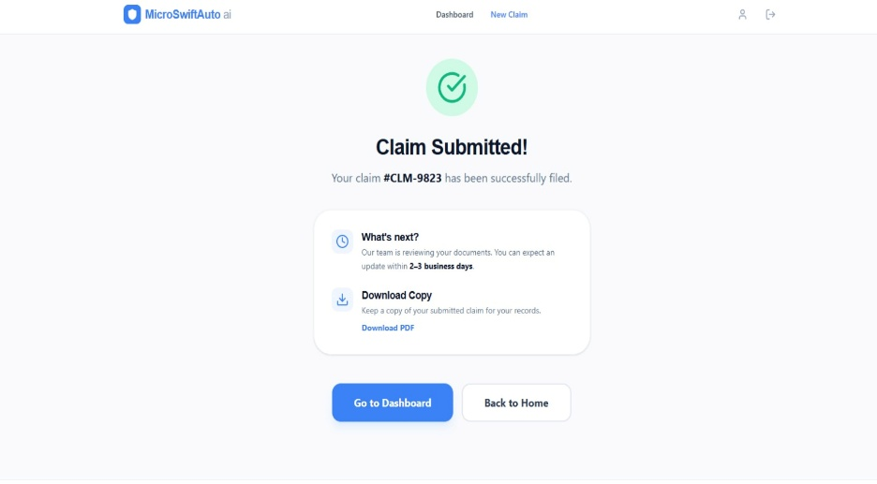
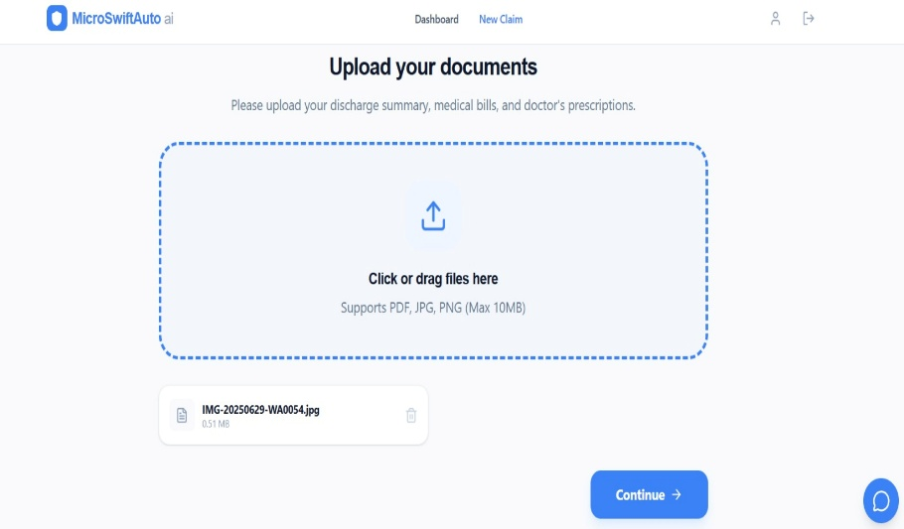
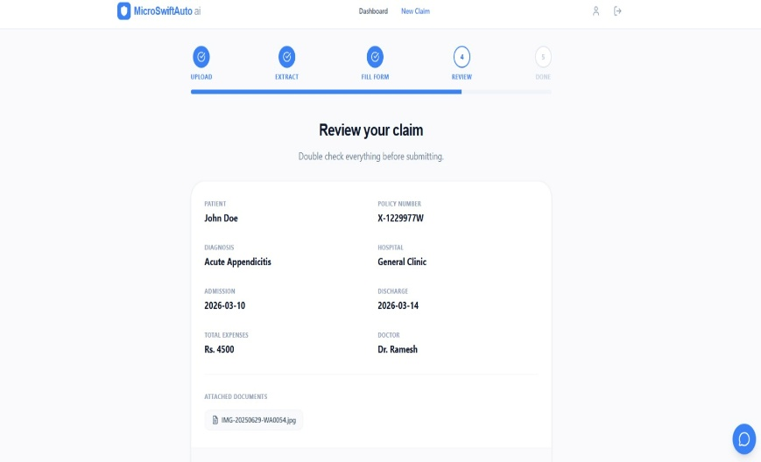
Proof of Concept (PoC) / Prototype Demo
GitHub Repository Link -
https://github.com/d4rk3stV0id/MicroSwiftAuto_AI
Notes:
Only stress on the 1st sentence – the definition
Come back to the 2nd sentence in the end as part of revision

