Slide 1
School of Computer Science & Engineering
AI Application Development – IA1
MicroSwiftAuto AI

Slide 2
Team Members & Roles
Team Member Name | Role
Mohammed Faizaan Faiz | Team Lead
Lochan Thanigai Murugan Padmashree | Development Lead
Mohammed Touhid | Test Lead
Mudassir Rehman | Customer Contact Lead
Kavya Arora | Developer
Mohsin Lihas | Customer Contact
Notes:
Talk about how they are managing their documents, how google docs does automatic versioning
As them what they know about Android and IoS versions

Slide 3
Modified Problem Statement
Patients struggle to complete insurance claim processes due to complex paperwork and lack of technical knowledge.
This leads to delays, errors, or inability to claim insurance despite eligibility.
Please explain to the assessors (this section is just for you to prepare – do not include this in the slide – understand and clearly talk about below)
1. Why you chose this problem
2. Pain faced by the user
3. How many users your team spoke to
4. What questions you asked & their response
Notes:
Talk about how they are managing their documents, how google docs does automatic versioning
As them what they know about Android and IoS versions

Slide 4
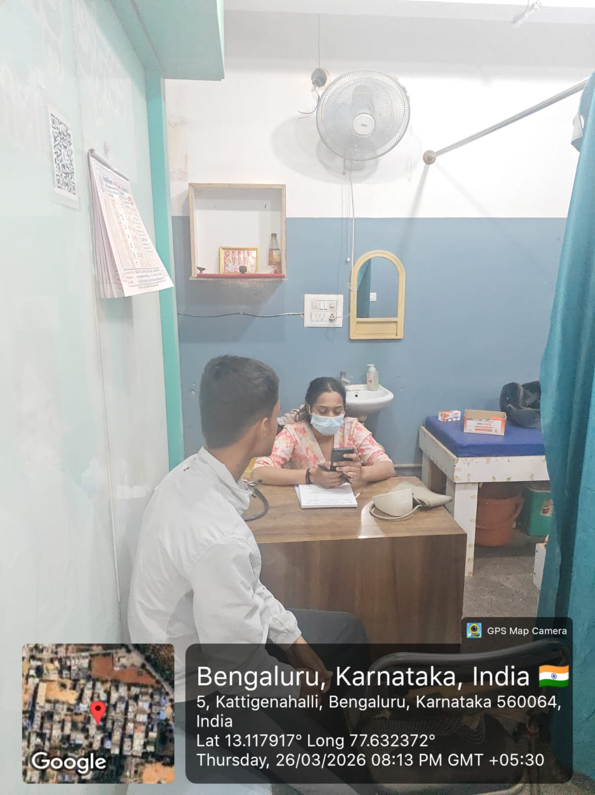
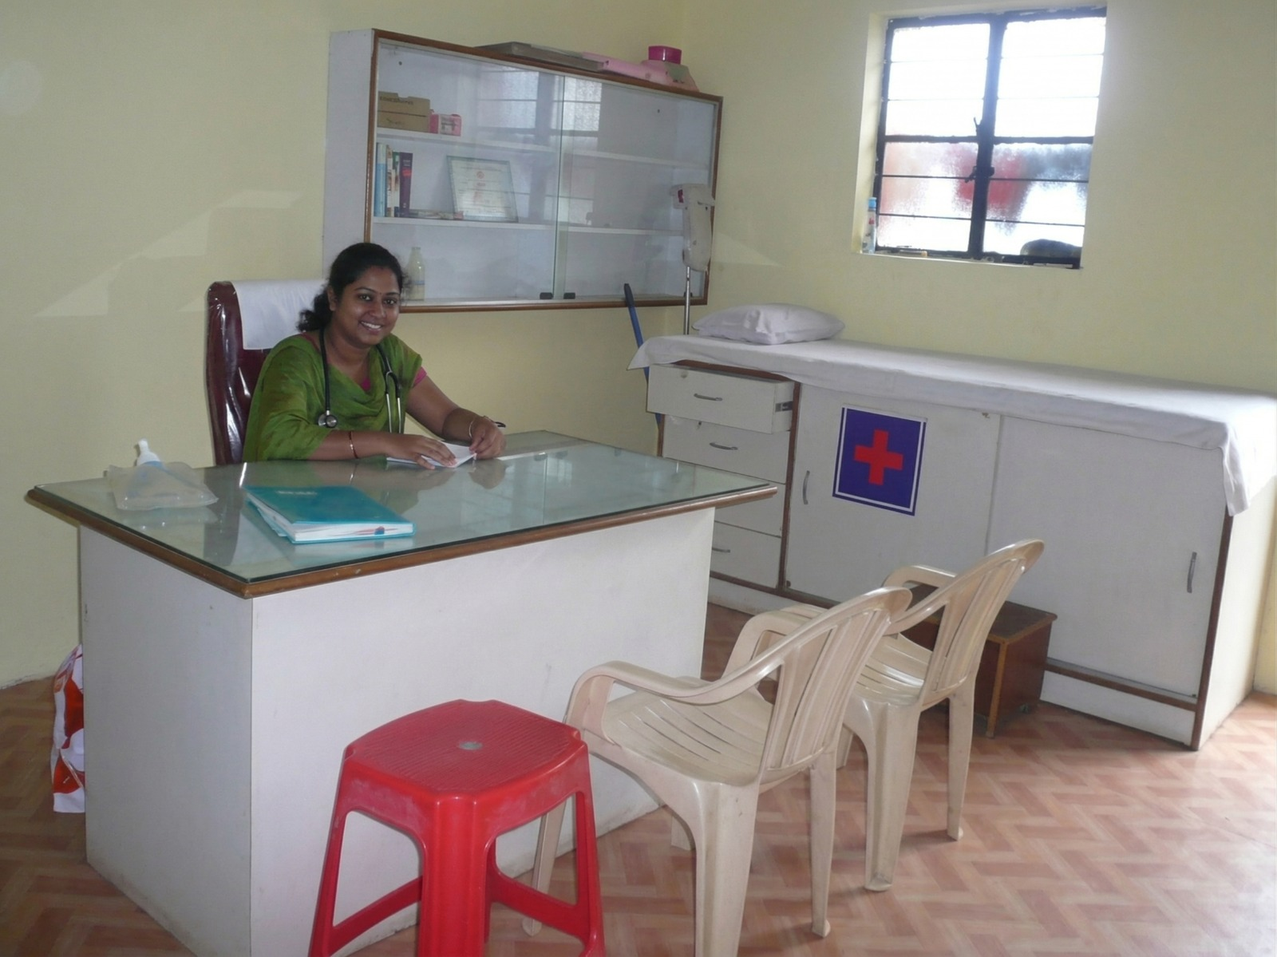
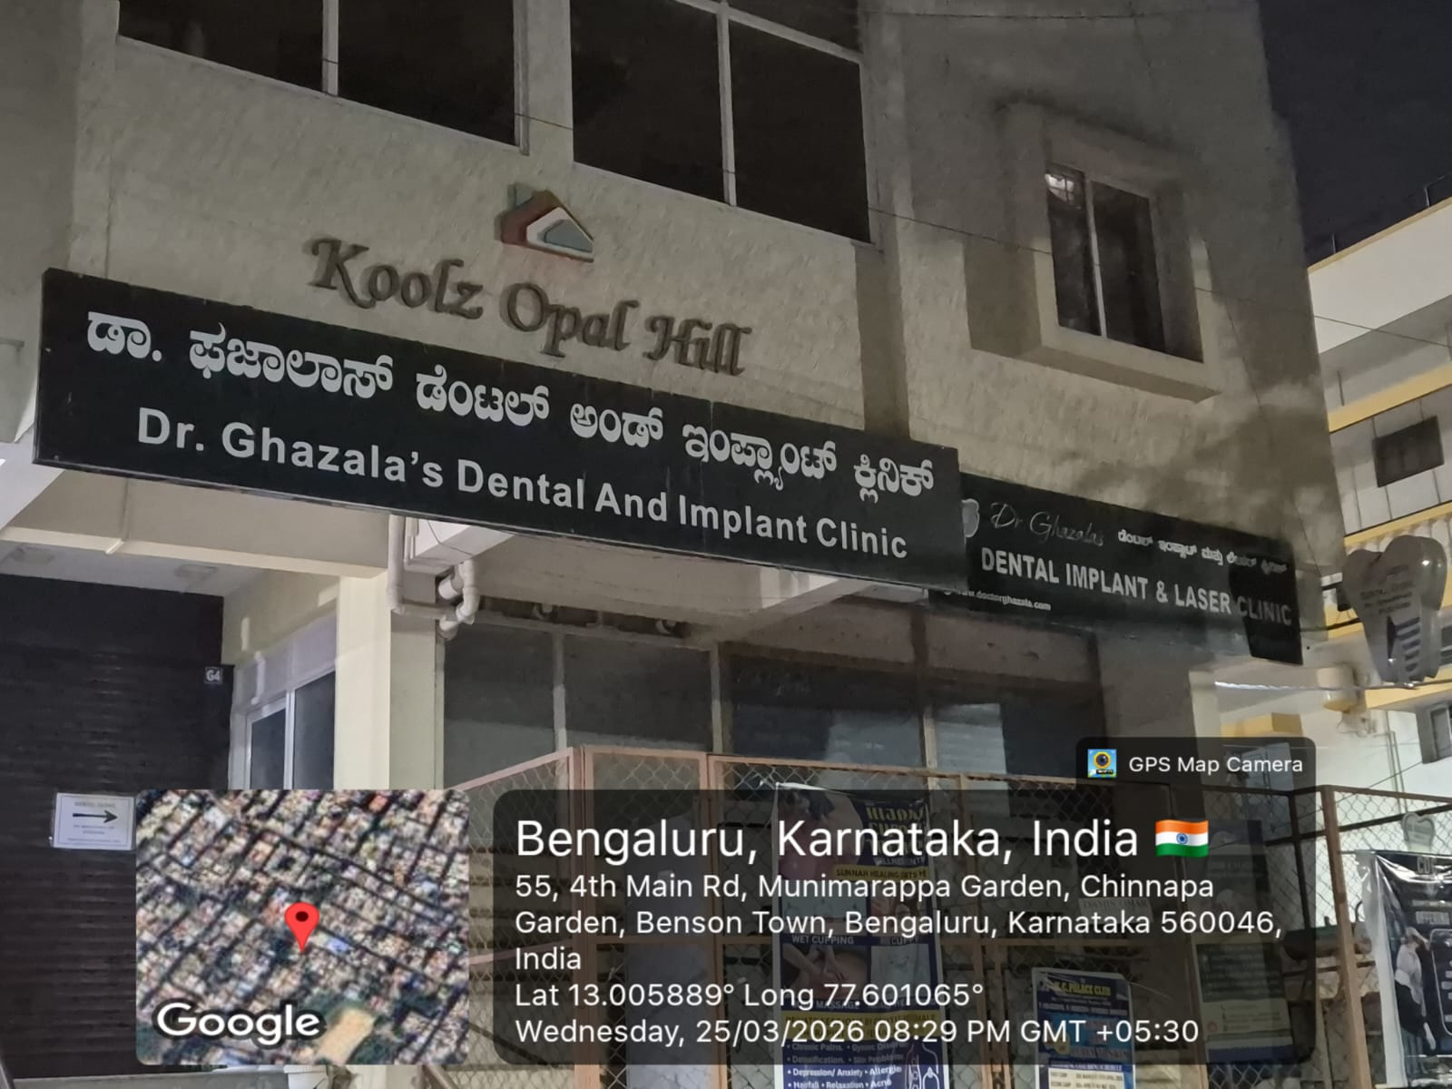
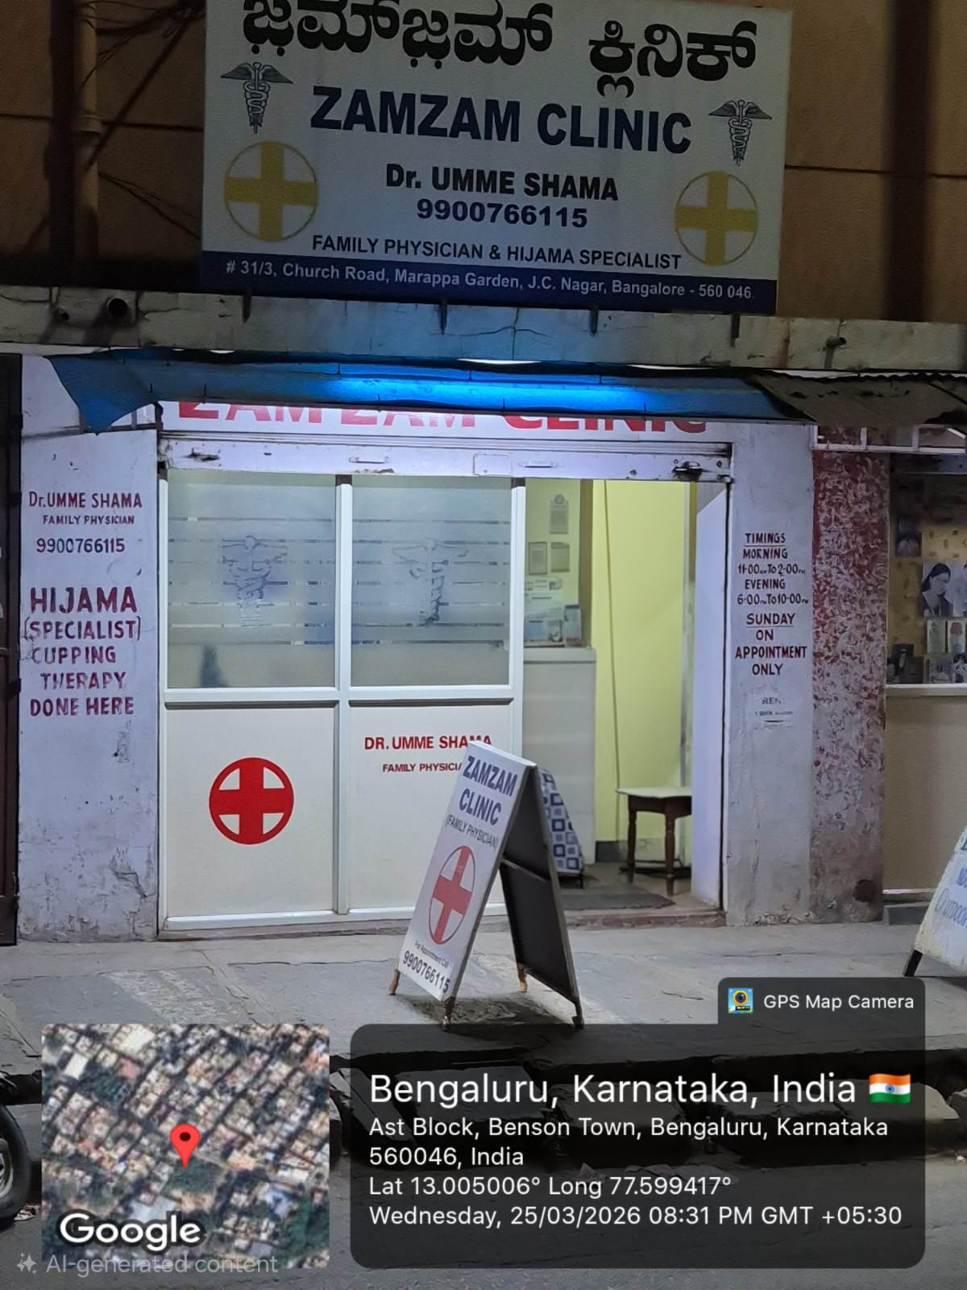
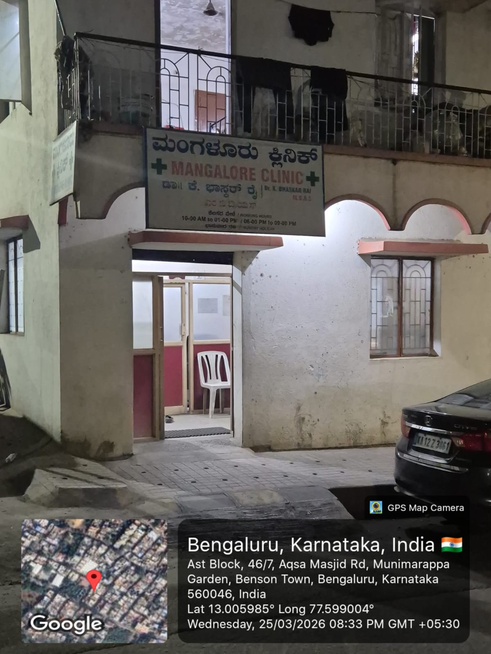
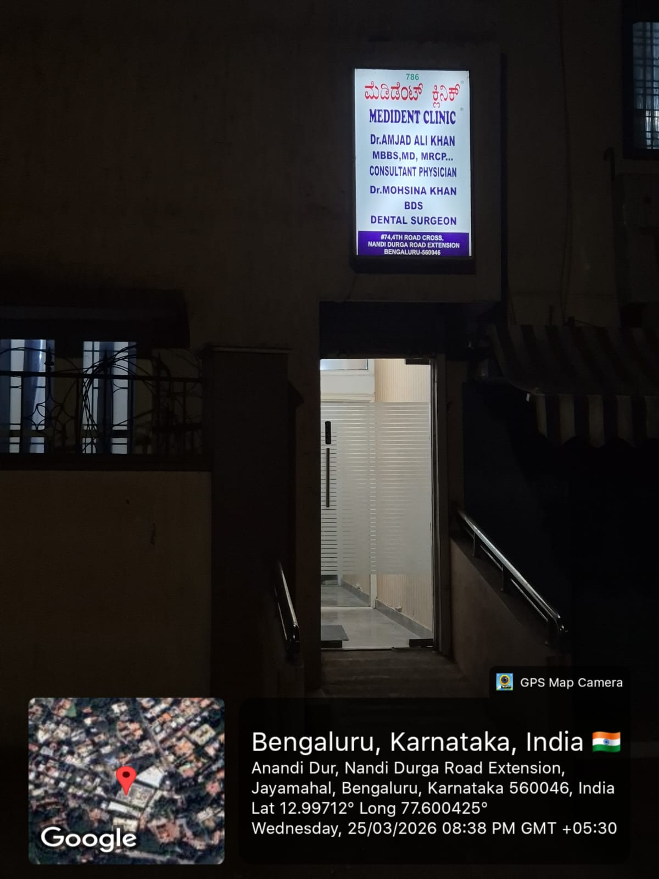
User / Customer Understanding
Paste team members photos with potential customers here
Then, show proof of your interviews – Q&A (Open GitHub go to documents, open this customer interview document and show the assessors)
Notes:
Talk about how they are managing their documents, how google docs does automatic versioning
As them what they know about Android and IoS versions

Slide 5
Ideal Customer Profile (ICP)
Please prepare well as a group, what should be the ICP for your product – do not generate using AI and read it.
*** Be prepared to answer difficult questions here ***
Demographic:
Age: 30–70
People with health insurance.
Hospital patients & families.
Clinics and hospitals.
Psycho-graphic:
Struggle with digital tools.
Want faster claim processing.
Prefer guided or automated systems.
Notes:
Only stress on the 1st sentence – the definition
Come back to the 2nd sentence in the end as part of revision

Slide 6
Customer Persona (CP)
Please prepare well as a group, what should be the CP for your product – do not generate using AI and read it.
*** Be prepared to answer difficult questions here ***
Name: Rajesh Kumar
Age: 52
Occupation: Small business owner
Situation:
Hospitalized and insured
Cannot understand claim forms
Depends on hospital staff
Pain Points:
Confusing paperwork.
Fear of rejection.
Time-consuming process.
Notes:
Only stress on the 1st sentence – the definition
Come back to the 2nd sentence in the end as part of revision

Slide 7
Product USP
*** Please prepare as a group to answer the above. maximum 4 bullet points ****
AI-driven automated claim form filling.
Reduces human errors in documentation.
Faster claim submission process.
Accessible for non-technical users.
Notes:
Only stress on the 1st sentence – the definition
Come back to the 2nd sentence in the end as part of revision

Slide 8
Use Cases & High level Requirements
4 to 5 major use cases on how your customer will use your solution – what input will the customer provide and what output will he expect
Show the requirements document from GitHub and discuss functional, non-functional requirements and acceptance criteria.
Use Cases:
Upload medical bills and reports.
Auto-fill insurance claim forms.
Validate entered data.
Suggest missing information.
Submit claim digitally.
Expected Output:
Error-free claim form.
Faster approval process.
Notes:
Only stress on the 1st sentence – the definition
Come back to the 2nd sentence in the end as part of revision

Slide 9
Proof of Concept (PoC) / Prototype Demo
GitHub Repository Link -
https://github.com/d4rk3stV0id/MicroSwiftAuto_AI
Notes:
Only stress on the 1st sentence – the definition
Come back to the 2nd sentence in the end as part of revision

