Slide 1
InterWasm
An Interpreter for a Subset of WebAssembly written in Java

Slide 2

WebAssembly
WebAssembly (abbreviated Wasm) is a binary instruction format for a stack-based virtual machine.
Wasm enables deployment of native applications (written in C, C++ or Rust) on web clients or servers
Wasm aims execution of programs at near-native speed
Wasm has a text format and a binary format

Slide 3
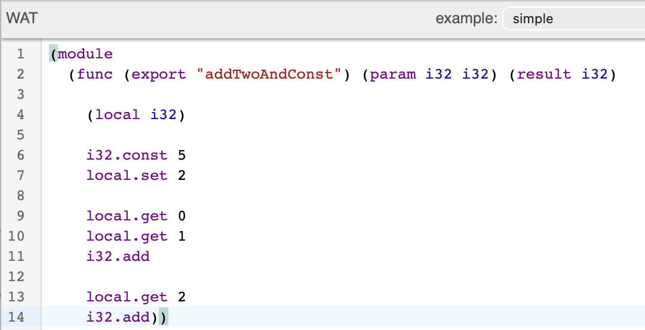
wat - WebAssembly Text Format
Example Wasm module with one function
Function Type (Type Section)
Function Body (Code Section)

Slide 4
wat - WebAssembly Text Format
Function Type
Parameter definition
Definition of return values

Slide 5
wat - WebAssembly Text Format
Function body
Definition of Locals
Instructions

Slide 6
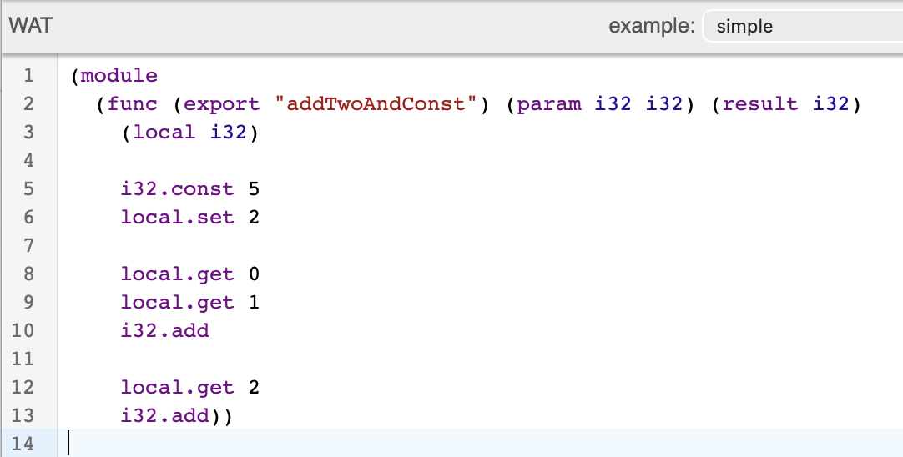
WebAssembly Basics
Function arguments are stored as locals
A function can have multiple return values
Data Types
i32 - 32-bit integer
i64 - 64- bit integer
f32 - 32-bit float
f64 - 64-bit float
funcref - reference to other function
externref - reference to external value
WebAssembly is based on multiple stack-like structures
Operand Stack: Typed stack for operations (where all data types can be stored e.x. i32, f64, …)
Call Stack: Function calls create frames containing locals, parameters, return addresses, and so on.
Control Stack: Blocks, loops, and ifs have structured control frames, where input/output types are validated

Slide 7
wasm - WebAssembly Bytecode
The WebAssebly Bytecode
starts with the magic bytes 0061 736d 0100 0000 (.asm….)
is structured in up to 13 sections. Relevant for our interpreter:
Type Section (ID 1) - contains the function type for all functions
Code Section (ID 10) - contains the function body for all functions
The ordering of the entries in the Type and Code section are used for mapping, e.x. function type 0 has function body 0

Slide 8
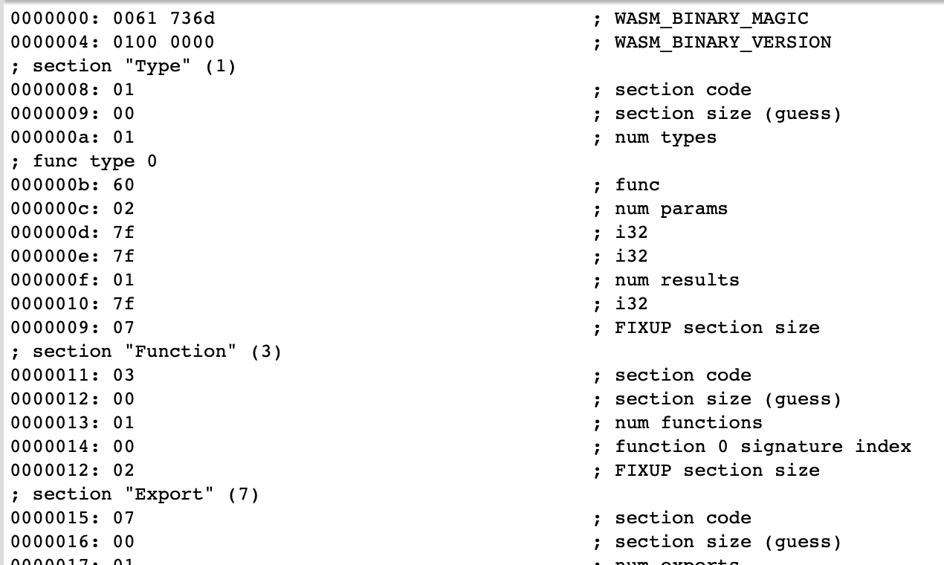
wasm- WebAssembly Bytecode
Bytecode of the shown example module
Magic Bytes
Type Section
…

Slide 9
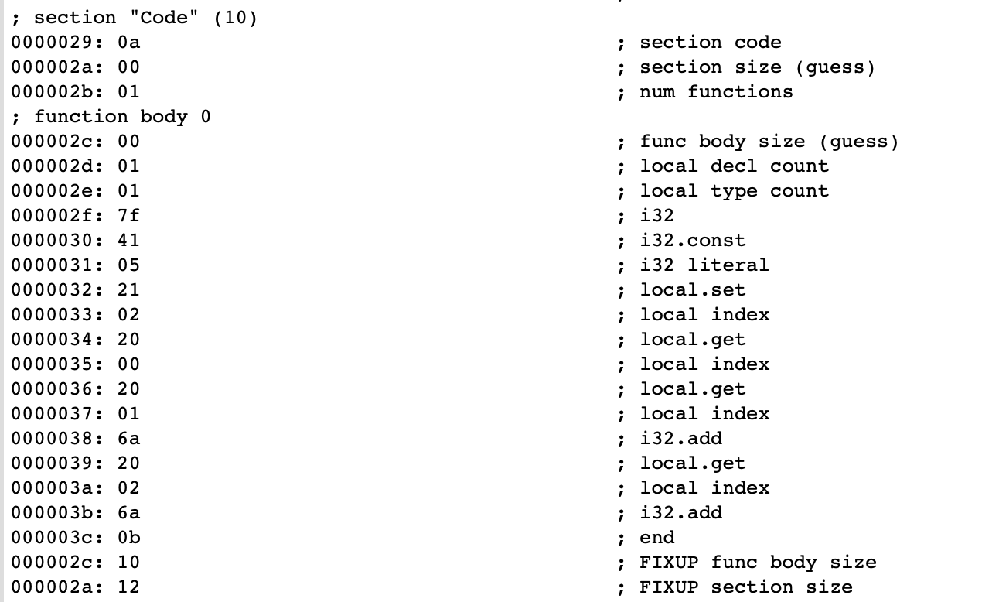
wasm- WebAssembly Bytecode
Bytecode of the code section
Section ID
Amount Functions
Amount Local Types
Amount Locals of First Type
First Type (i32)
Instructions

Slide 10
InterWasm Pipeline
WasmReader.java
Interpreter.java
Internal Java Structure (FunctionDef)
.wasm File
Execution

Slide 11
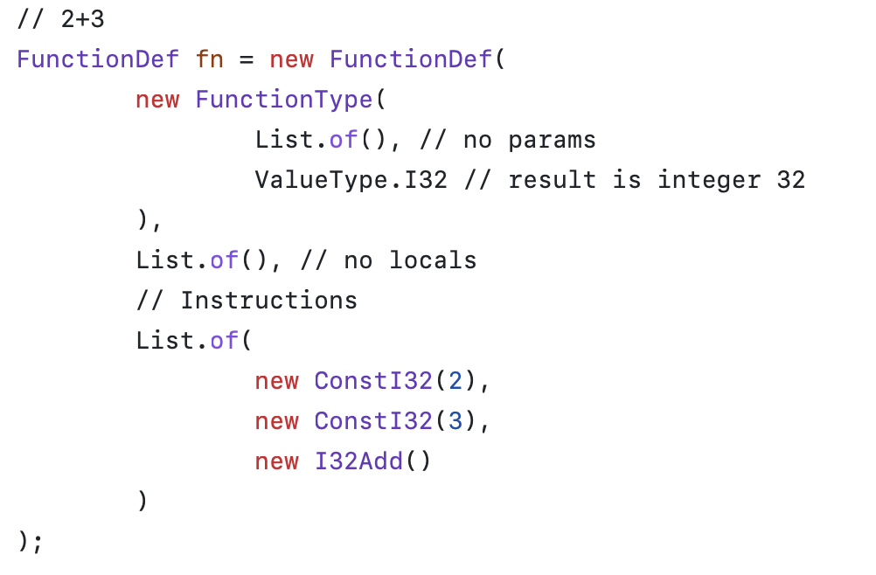
FunctionDef

Slide 12
InterWasm - WebAssembly Subset
InterWasm supports
.wasm files with up to one function
Locals
Passing function arguments
One return value
InterWasm does not support
Host-Functions or imports (e.g. printf)
Memory (storage of raw bytes)
InterWasm only supports a subset of the WebAssembly Instructions (next slide)

Slide 13
Supported WebAssembly Subset
Data Types
i32
Constant Operations
i32.const
Arithmetic Operations
i32.add
i32.divs
i32.mul
i32.rems
i32.sub
Locals Operations
local.get
local.set
local.tee
Control Flow Operations
block
loop
return
if, else end, brif, br
i32 Comparison Operations: eq, eqz, ges, gts, les, lts, ne

Slide 14
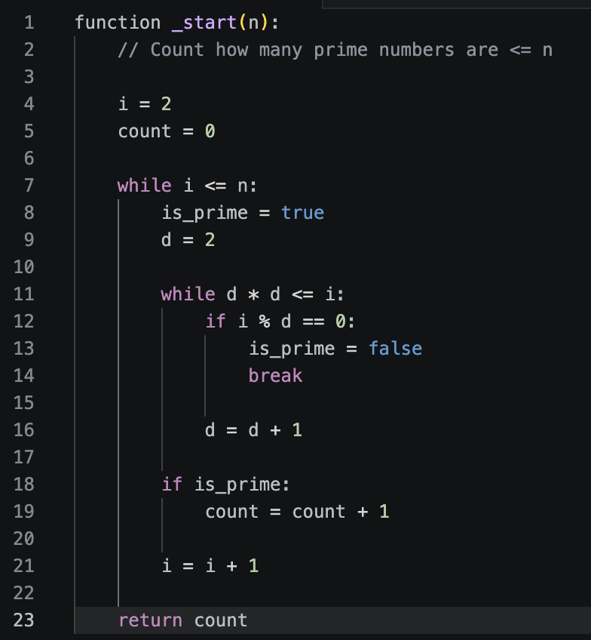
Benchmarking
Counting primes algorithm
Performed with inputs
10 000
100 000
1 000 000
Pseudocode

Slide 15
Performance Comparison
TODO

