Slide 1

Team: Horror Text Miners
David Medina (F11115117)
Kevin Da Rosa (F11115108)
Jaime Colman (F11115107)
Horror Author Recognition

Slide 2
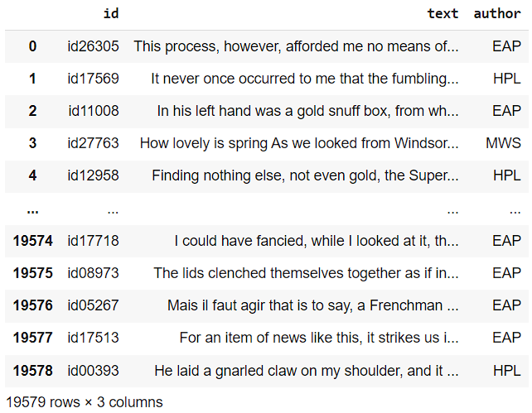
Analysis of the Dataset
This is the panda for the train.csv, where text is labeled to its corresponding author.

Slide 3
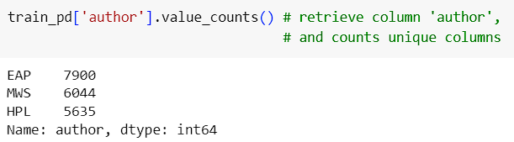
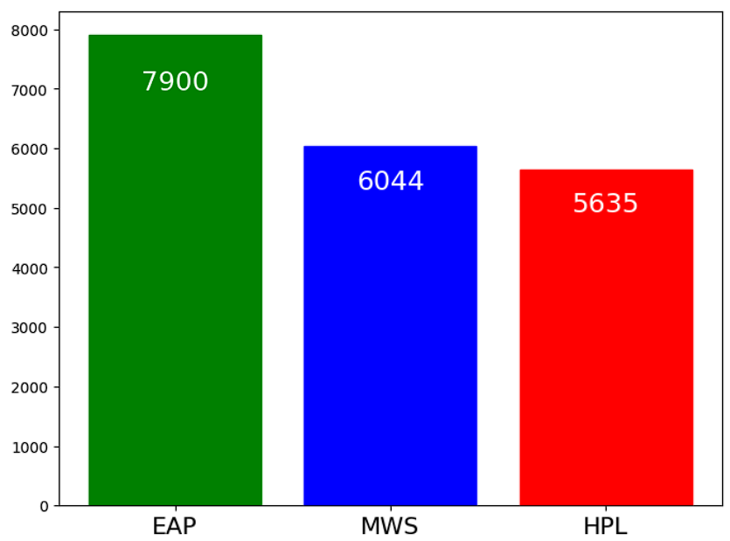
The distribution of texts by author in the given train file

Slide 4
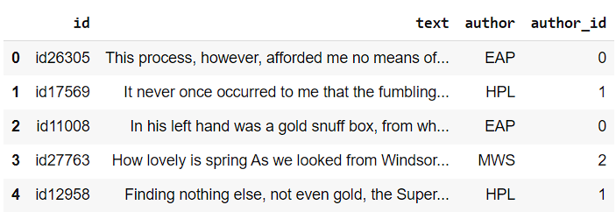
Processing the Dataset
Encoding of author names to numbers. This is relevant in the partition of the train file.

Slide 5
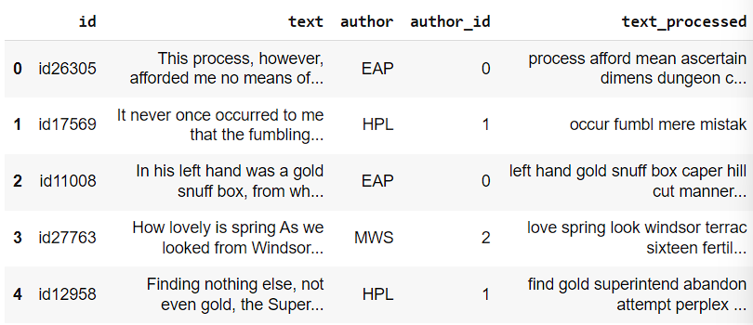
Preprocessing of ‘text’ column
Tokenization
Stopword removal
Apostrophe removal
Stemming
Punctuation removal

Slide 6
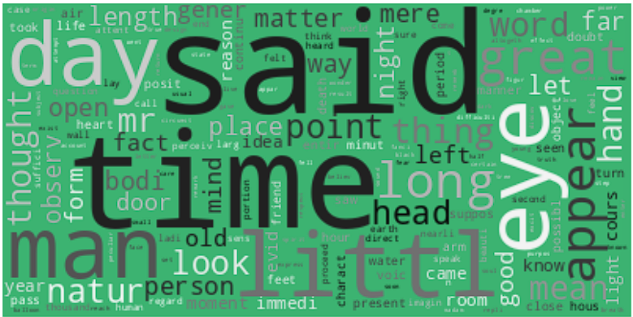
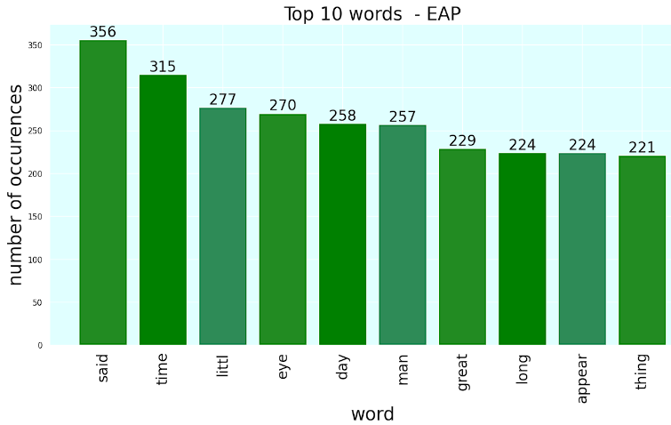
Feature Engineering
EAP - Term Frequency
Notes:
Feature Engineering: abstract features from the dataset, such as amount of commas, punctuations, text length, term frequency, etc. The goal is to abstract those features into numbers so that the models can understand

Slide 7
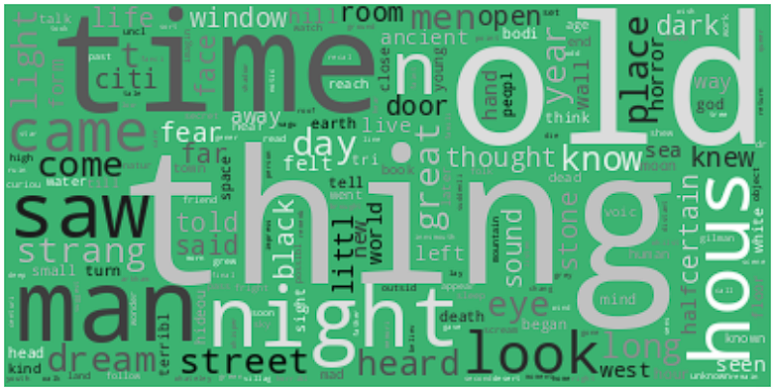
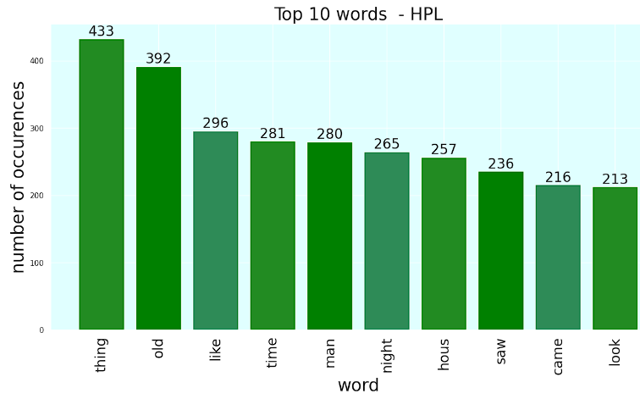
Feature Engineering
HPL - Term Frequency

Slide 8
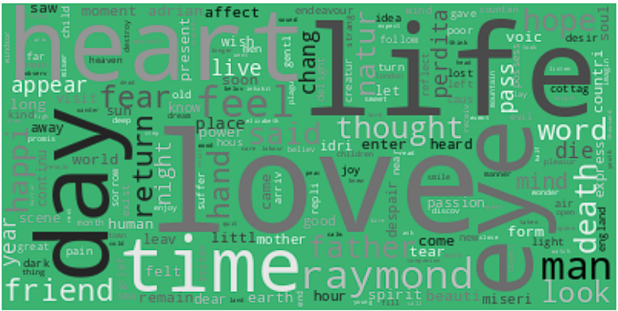
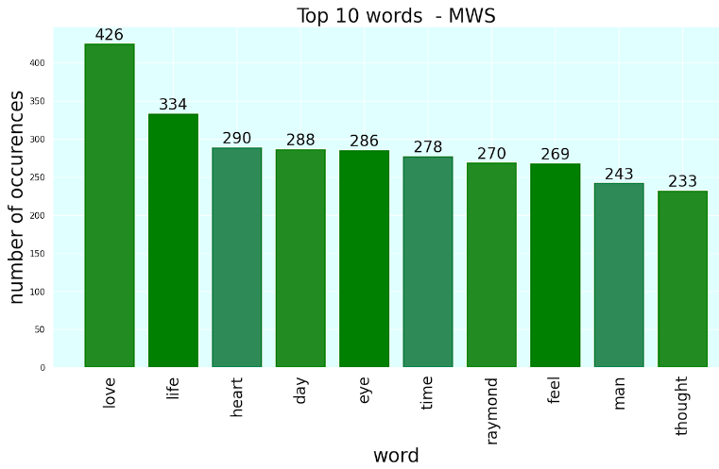
Feature Engineering
MWS - Term Frequency
Take note about the positive words: love, life, heart, hope, etc…
Could apply sentiment analysis as feature

Slide 9
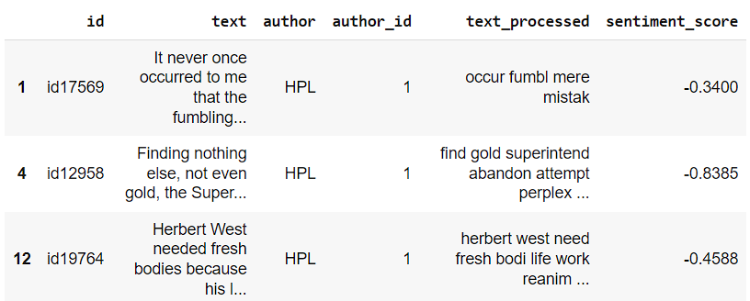
Feature Engineering
HPL - Sentiment Analysis

Slide 10
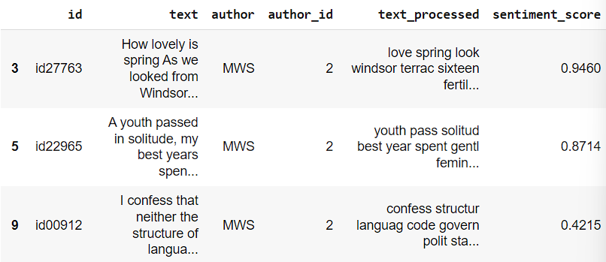
Feature Engineering
MWS - Sentiment Analysis

Slide 11
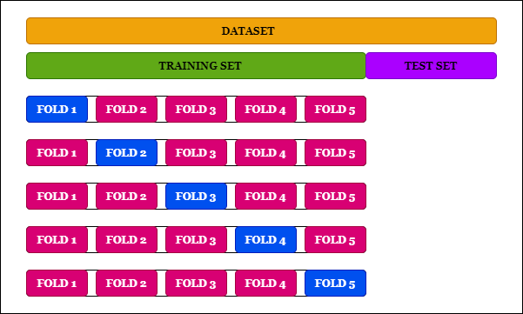
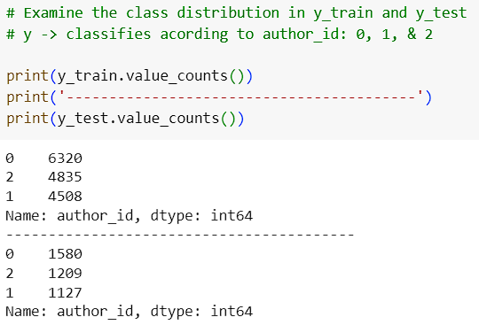
Cross Validation
A resampling technique.
The partition of data into subsets for training and testing.
Notes:
Cross-validation: use a fraction of available data for training, and the rest for testing the dataset.
Term Frequency - Inverse Document Frequency.

Slide 12
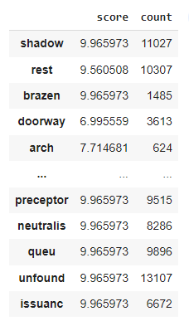
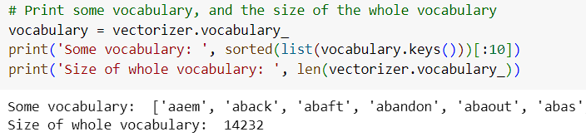
TF-IDF
Is a numerical statistic to quantify the importance of a term in a collections of documents.
Term Frequency (TF).
Inverse Document Frequency (IDF).

Slide 13
Text Classification Models

Slide 14
Naive Bayes using MultinomialNB
Advantages:
Works well with high-dimensional data.
It is computationally efficient and can handle large feature spaces.
Disadvantages:
Can be sensitive to irrelevant features.
May produce biased probability estimates.

Slide 15
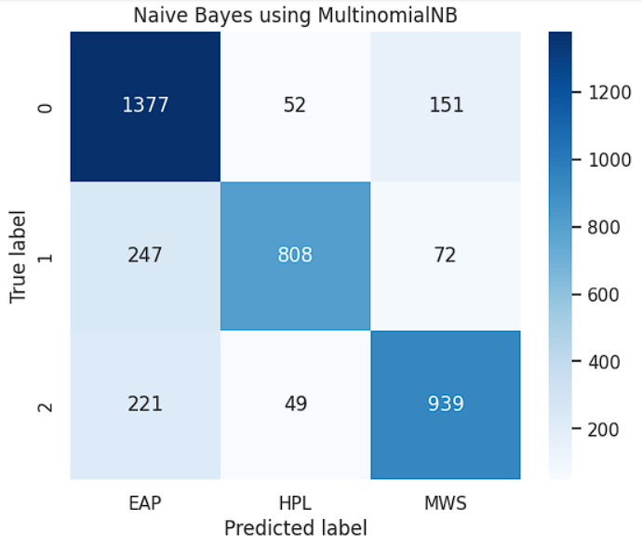
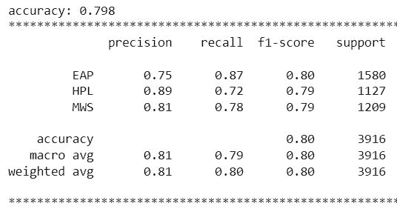
Naive Bayes using MultinomialNB

Slide 16
Logistic Regression
Advantages:
Efficient and fast training process.
Works well with large datasets.
Disadvantages:
Can struggle with complex relationships between features.
May be sensitive to outliers.

Slide 17
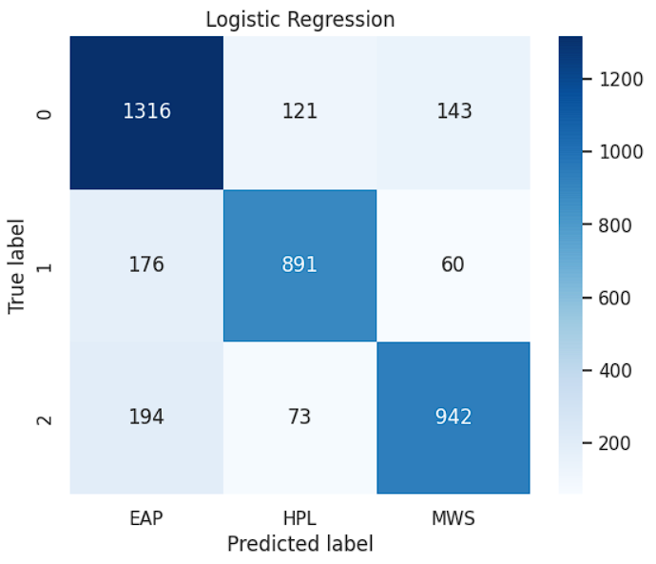
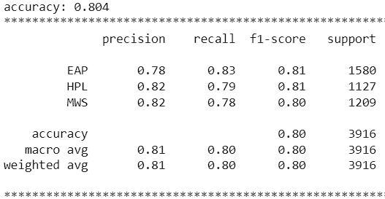
Logistic Regression

Slide 18
K-Nearest Neighbors n = 500
Advantages:
Simple and easy to understand.
Works well with noisy data.
Disadvantages:
Sensitive to the scale of features.
Can be influenced by irrelevant features.

Slide 19
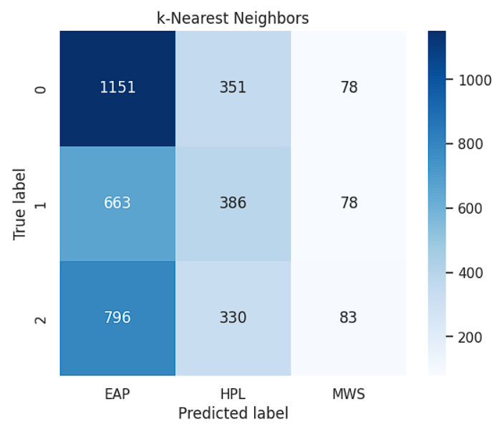
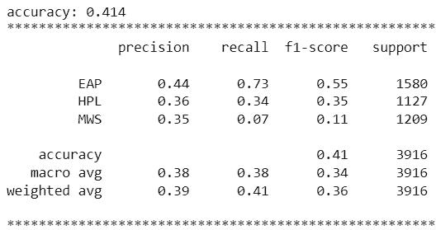
K-Nearest Neighbors n = 500 with Sentiment Analysis

Slide 20
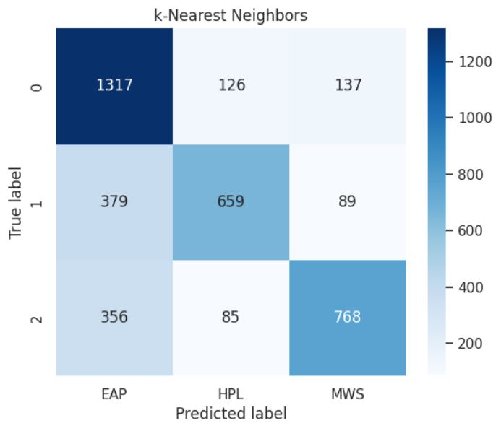
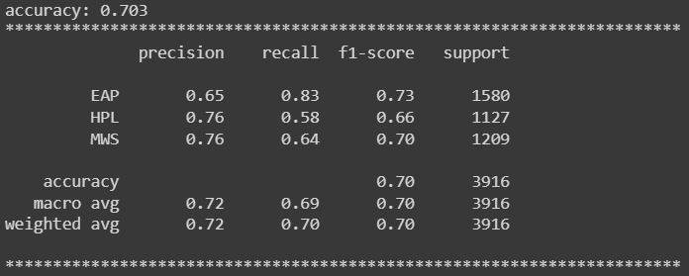
K-Nearest Neighbors n = 500 without Sentiment Analysis

Slide 21
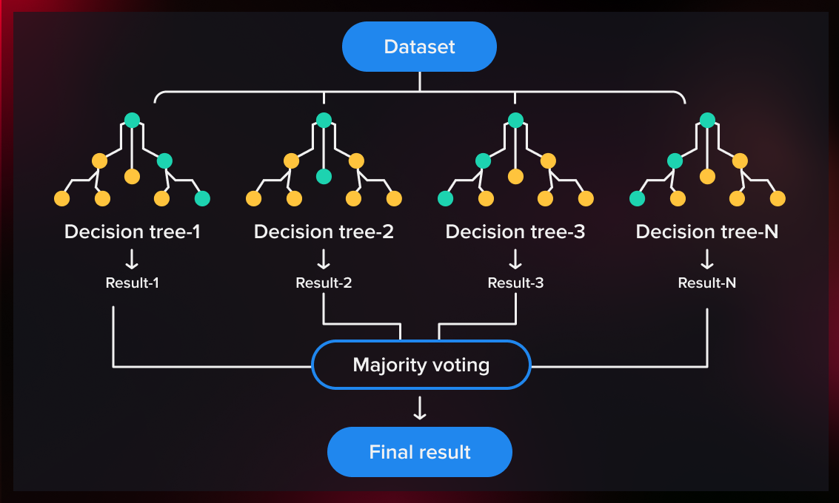
Random Forest
Advantages:
Robust to outliers and noisy data.
Efficient for large datasets.
Disadvantages:
Can be slow during the testing phase.
May overfit if the number of trees is too high.
Notes:
It is a combination of multiple decision trees, where each tree is trained on a random subset of the training data and a random subset of the features.

Slide 22
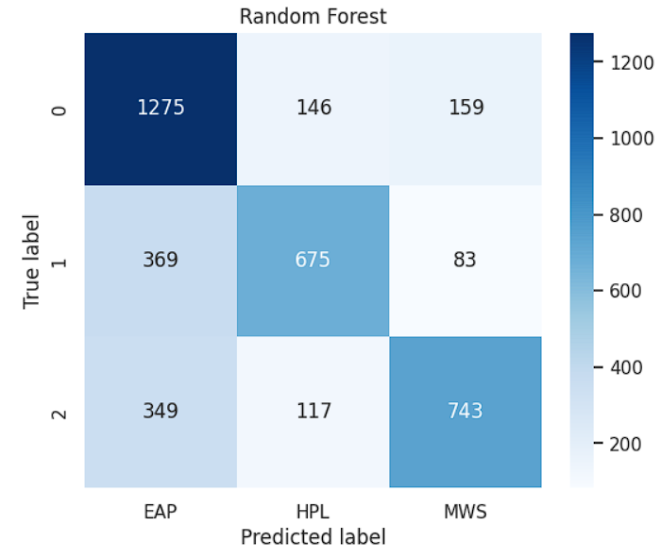
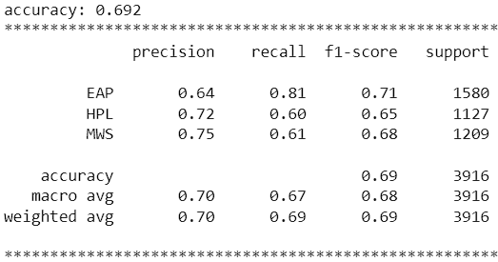
Random Forest

Slide 23
Gradient Boosting
Also known as the statistical prediction model.
It allows the generalization and optimization of the differential loss functions.
Notes:
Gradient Boosting is known for its ability to handle complex, non-linear relationships in data and its capacity to produce highly accurate models. It is widely used in various domains and applications, including regression, classification, and ranking tasks

Slide 24
Gradient Boosting
Advantages:
Can handle complex interactions between features.
Can handle mixed data types.
Disadvantages:
Sensitive to noisy data and outliers.
Potential risk of overfitting if the number of boosting iterations is too high.

Slide 25
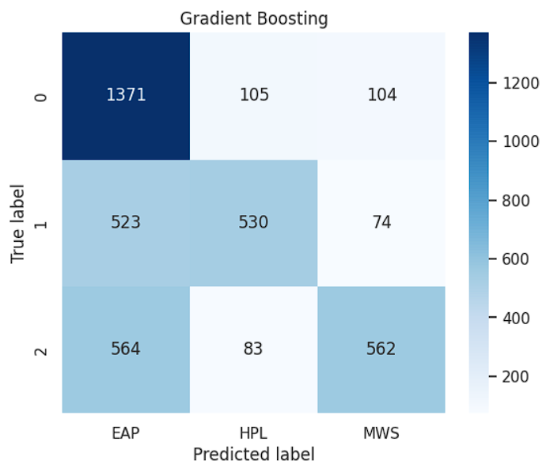

Gradient Boosting

Slide 26

Logistic Regression:
best accuracy: 0.804

Slide 27
Thanks for your attention!

