Slide 1
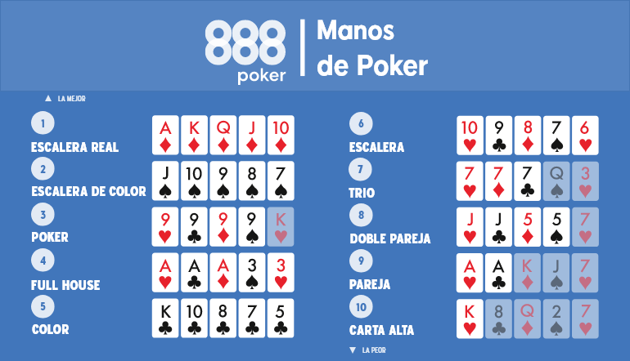
50.11%

Slide 2
42.25%

Slide 3
4.79%

Slide 4
2.11%

Slide 5
0.39%

Slide 6
0.19%

Slide 7
0.14%

Slide 8
0.02%

Slide 9
0.0014%

Slide 10
0.0002%

