Slide 1
Nuances of Java
The finer details of the language

Slide 2
Overview of Topics to Discuss
Warm-up with keywords
Move into data structure nuances
Multi-threading
CDI

Slide 3
Keyword Warm-up
Static Keyword
  Variables (fields) that exists in the class, independent of the instantiated objects (HFJ, 277)
    All instances of the same class share the same static variables
    static final variables are constant
    Can be used to keep track of class things important outside of each individual instantiation
Final Keyword
  Variables values can’t be changed
  Methods can’t be overridden
  Classes can’t be extended

Slide 4
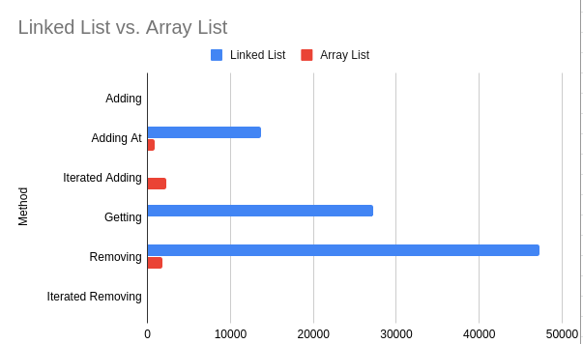
ArrayList Vs. LinkedList
LinkedList and ArrayList are two different implementations of List interface
  LinkedList implements it with a doubly-linked list
  ArrayList implements it with a dynamically re-sizing array
What the textbooks say:
Operation | LinkedList | ArrayList
Add | O(1) | O(1)
Add at Index | O(n) | O(n)
Iterator Add | O(1) | O(n)
Get | O(n) | O(1)
Remove | O(n) | O(n)
Iterator Remove | O(1) | O(n)

Slide 5
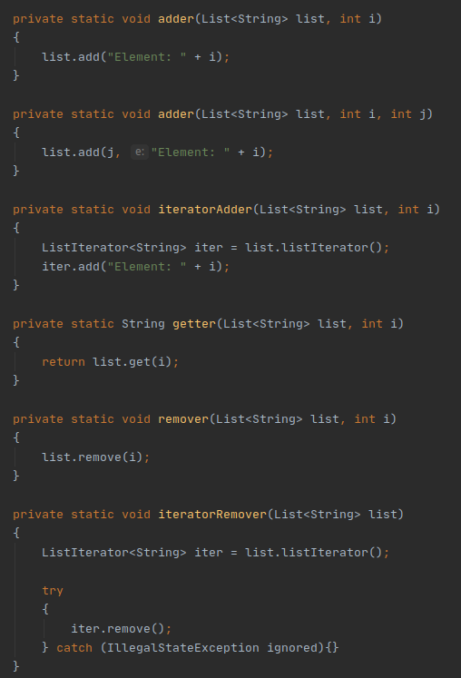
Comparison Methodology

Slide 6
Threading In Java
new Thread(), but then what?
  A thread is a separate call stack (pg. 490)

