Slide 1
IBM University Engagement Project Submission
“Exploring the Power of Agentic AI with IBM Granite and IBM Bob”

Slide 2

Project Tile – Research Agent
Domain of Project – Education
Student Name | Recent Passport Photo | Email ID | Mobile number [WhatsApp]
Arpit Kumar Sharma |  | D61227767@gmail.com | 9455970947

Slide 3
Problem Statement -
Problem Statement : Research Agent
The Challenge
A Research Agent is an AI system designed to assist with academic and scientific research tasks. It can autonomously search for literature, summarize papers, and organize references. Using natural language processing, it understands research questions and retrieves relevant information.
The agent can generate reports, suggest hypotheses, and even draft sections of research papers. It saves time by automating repetitive tasks like citation management and data extraction. Research Agents enhance efficiency, accuracy, and innovation in both academic and industrial R&D.
The Objective
Autonomous Information Retrieval: Efficiently search across diverse digital repositories, databases, and web sources to gather relevant, high-quality data based on user-defined parameters.
Source Evaluation & Verification: Critically assess the credibility, authority, and recency of retrieved sources to filter out misinformation and ensure data integrity.
Contextual Synthesis & Summarization: Distill large volumes of raw information into structured, concise, and coherent summaries tailored to the user's specific research goals.
Iterative Refinement: Adapt search strategies dynamically by analyzing initial findings, identifying knowledge gaps, and executing follow-up queries for deeper exploration.
Structured Output Generation: Deliver finalized research outputs in a clear, well-organized format—complete with proper citations and actionable insights—ready for immediate application.

Slide 4
Proposed Solution -
Proposed Solution: AI-Powered Research Agent
The proposed solution is a multi-agent AI-powered Research Agent built using IBM Bob, IBM watsonx.ai, and Granite Models to provide personalized, real-time research guidance. The system addresses challenges in literature, summarize papers, and organize references through an intelligent, modular architecture.
At its core, the solution uses a Retrieval-Augmented Generation (RAG) pipeline to fetch accurate research data from trusted sources.It uses Granite Model for procesing information.
Modular Multi-Agent Architecture: Implement a specialized task-delegation framework where distinct sub-agents handle query planning, parallel web searching, content scraping, and critical evaluation independently.
Hybrid Retrieval Engine: Combine dense vector embeddings for semantic similarity with sparse keyword indices (BM25) to ensure comprehensive data coverage across both structured and unstructured repositories.
Automated Fact-Checking Layer: Incorporate an evaluation pipeline that cross-references extracted claims against trusted knowledge bases and multi-source consensus to filter out hallucinations and biases.
Persistent Context & Memory: Utilize short-term working memory alongside a vector-based long-term store to maintain historical context, track ongoing research threads, and avoid redundant queries.
Transparent Source Attribution: Embed end-to-end citation tracking to map every synthesized insight directly back to its original source URL or document for seamless auditability.

Slide 5
Technology Used
IBM Bob platform -For designing and orchestrating multi-agent workflows visually.
IBM Grainte model - for eg – ibm-granite-3-2-8b – For natural language understanding, reasoning, and personalization.
IBM Cloud – It provides the infrastructure to build, deploy, and scale the Nutrition Agent efficiently. IBM Cloud enables a reliable, secure, and scalable environment for deploying the Nutrition Agent.
RAG– RAG to fetch real data first, then generate intelligent answers, making the Nutrition Agent more trustworthy and effective.
IBM Watsonx.ai - For model deployment, embeddings, and AI governance.
Vector Database (FAISS/Chroma) – For RAG-based nutritional data retrieval.

Slide 6
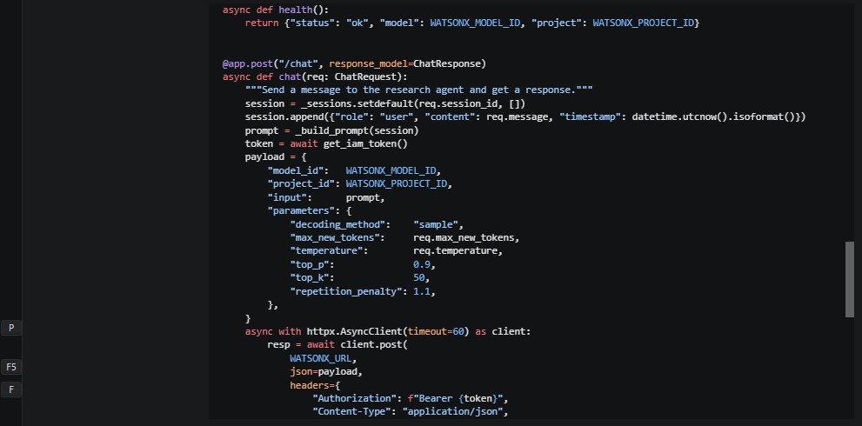
Required Files created using IBM bob -

Slide 7
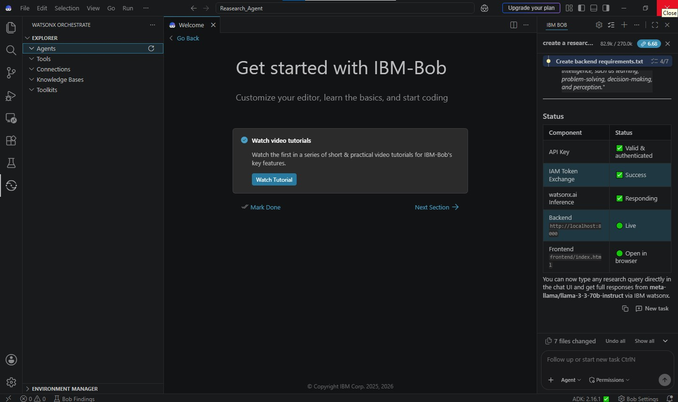
IBM Bob Screenshots:

Slide 8
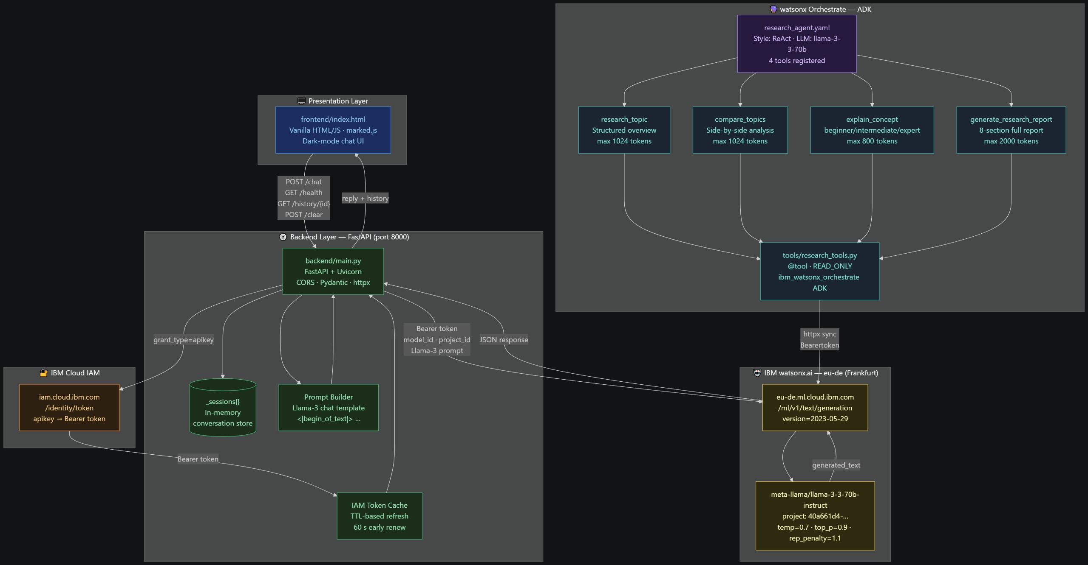
Architecture blueprint for IBM bob:

Slide 9

Role of Agentic AI in the solution
Role of Agentic AI in Nutrition Agent
Autonomous Information Retrieval & Synthesis Instead of relying on static training data or simple search queries, an Agentic AI designs multi-step search strategies. It queries academic databases (like arXiv, PubMed, or Google Scholar), follows citation networks, cross-references sources, and synthesizes large volumes of literature to identify research gaps. Automated Hypothesis Generation & Experimental Design By analyzing existing datasets and literature, agentic systems formulate novel, testable hypotheses. They can draft structured experimental protocols, outline computational workflows, and define parameters and metrics before execution begins. Code Execution & Data Analysis Agentic research assistants write, execute, and debug custom code (Python, R) to process raw data, run statistical models, generate visualizations, and analyze results. If an execution fails or returns an error, the agent self-corrects its code autonomously. Iterative Peer Review & Self-Correction Unlike basic language models, agentic workflows incorporate continuous feedback loops. The agent reviews its own drafts, verifies mathematical or logical consistency against source material, critiques methodology, and refines conclusions before human intervention. End-to-End Task Management & Orchestration The agent decomposes broad, open-ended research goals into structured sequences of sub-tasks. It manages the entire lifecycle—from literature review and data collection to synthesis, formatting, and drafting peer-review-ready paper outlines—acting as an interactive co-researcher.

Slide 10
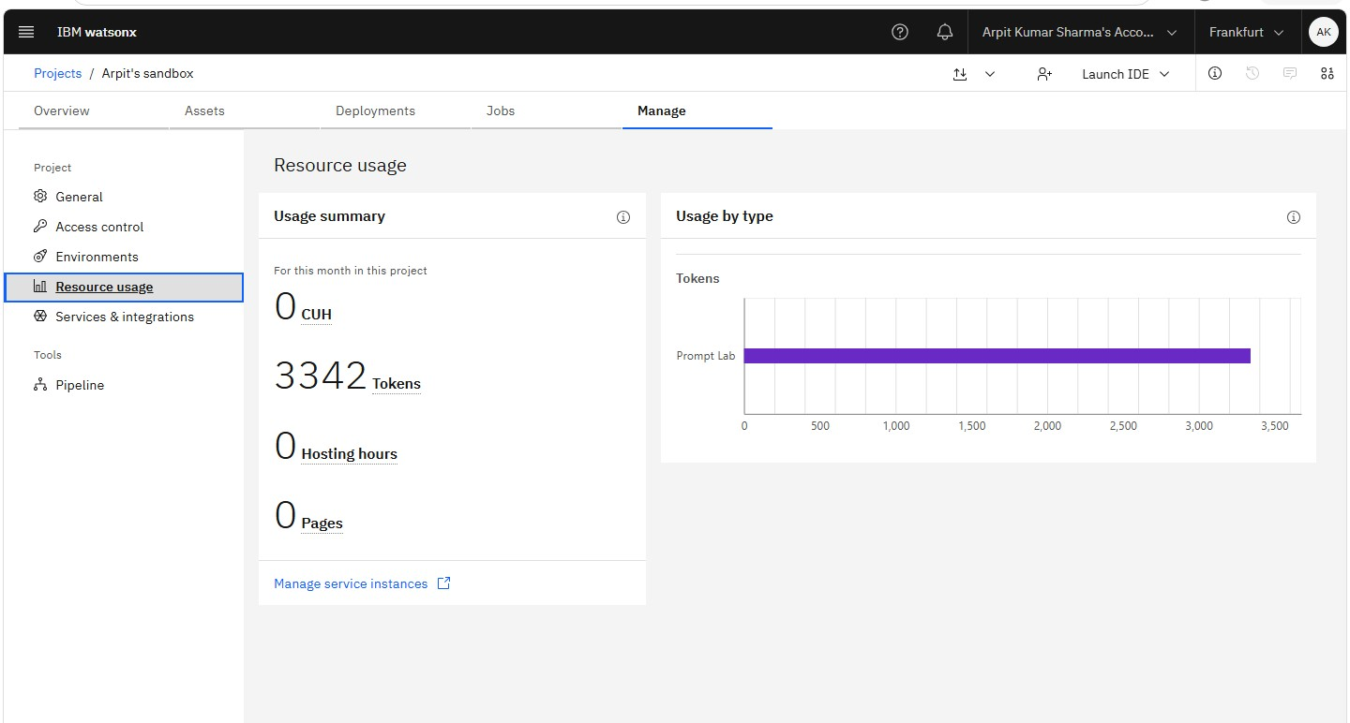
Token Usage
3342 token were used
·
·
·

Slide 11
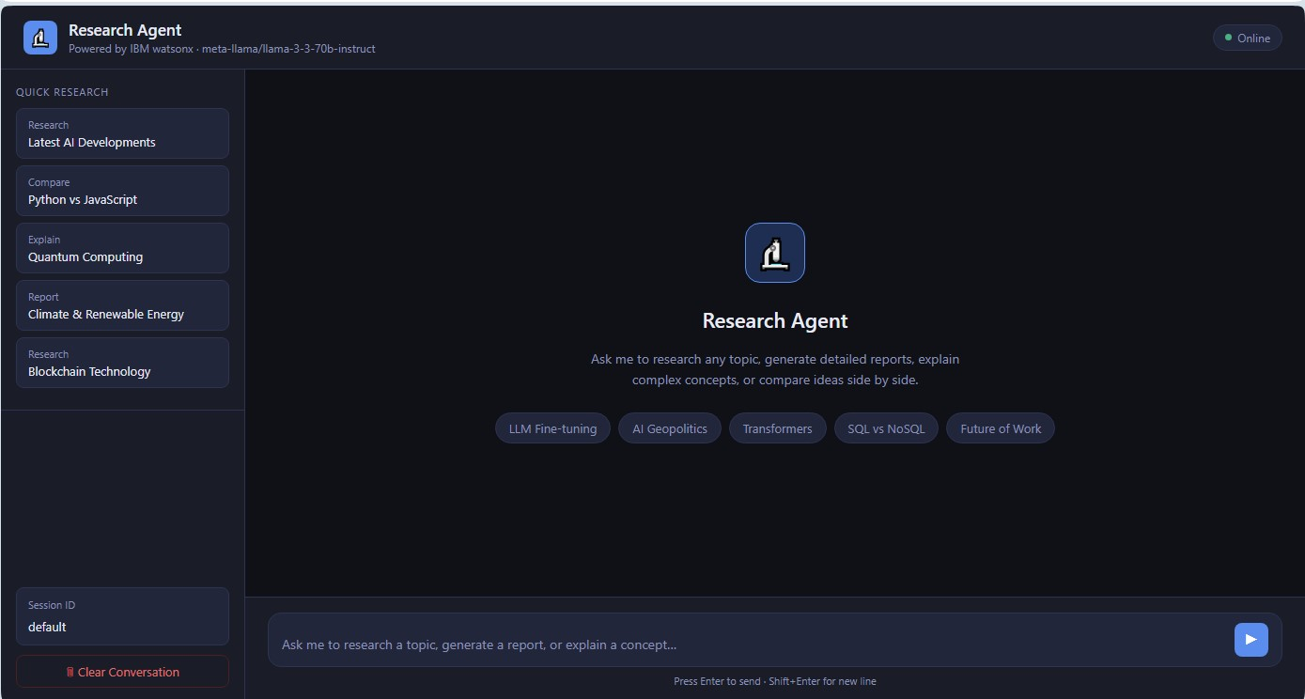
Project Output Screenshot
·
·
·

Slide 12
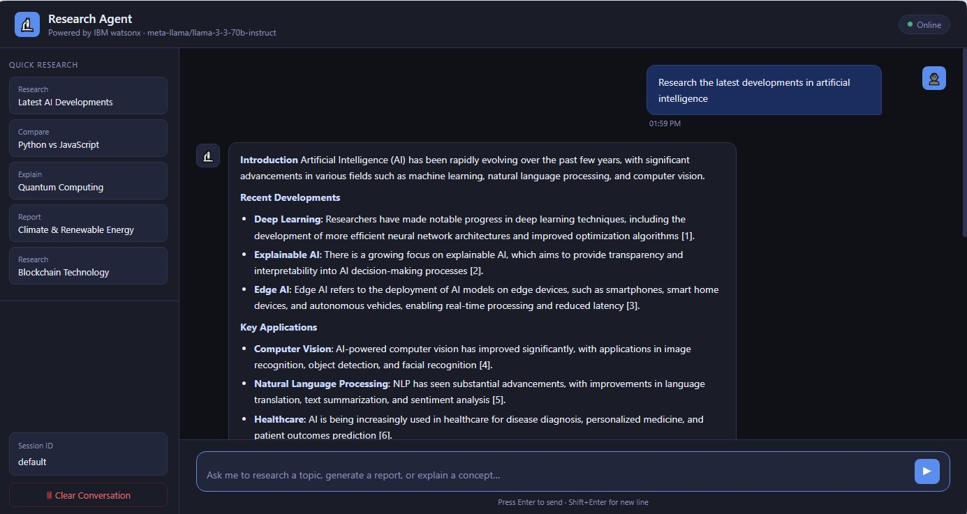
Project Output Screenshot
·
·
·

Slide 13
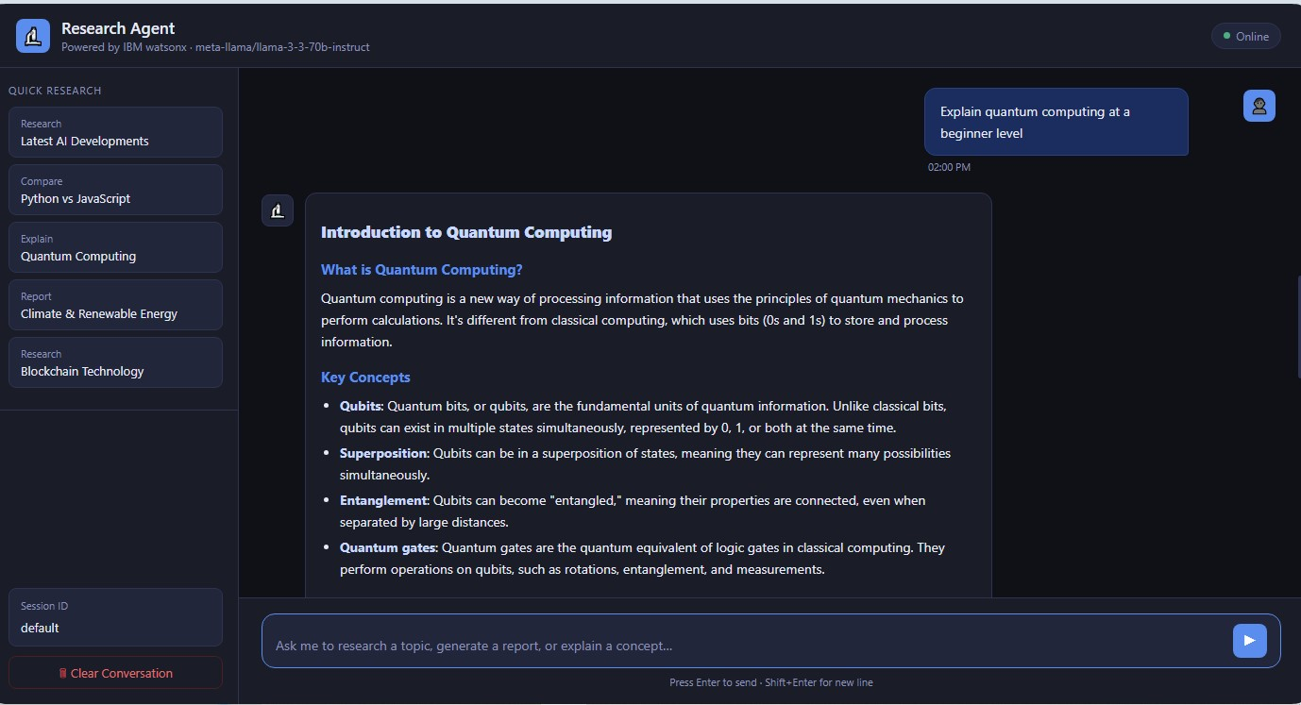
Project Output Screenshot
·
·
·

Slide 14
Novelty and Uniqueness
The proposed Nutrition Agent stands out by combining Agentic AI, RAG, and personalization into a single intelligent system.
Multi-Agent Intelligence – Instead of a single chatbot, multiple specialized agents collaborate to deliver accurate and context-aware nutrition guidance.
RAG-Based Accuracy – Integrates real-time data retrieval with AI generation, reducing misinformation and ensuring trustworthy recommendations.
Hyper-Personalization – Tailors diet plans based on health conditions, cultural preferences, and fitness goals.
Real-Time Feedback Loop – Continuously adapts recommendations based on daily food logs and user behavior.
Multi-Modal Input – Supports text, voice, and image-based meal tracking for better usability.
Preventive Healthcare Focus – Goes beyond diet planning to provide disease-specific nutrition advice.
Scalable & Enterprise-Ready – Built on IBM watsonx.ai with IBM Granite models, ensuring reliability and governance.
This makes the solution a smart, adaptive, and proactive digital nutritionist, not just a static diet recommendation tool.

Slide 15
Git Hub Link
https://github.com/d61227767-sys/IBM_Bob.git
·
·
·

Slide 16
Future Scope
Cross-Platform Enterprise Integration: Expand the research agent's capabilities to embed directly into enterprise workflow suites (such as CRMs, ERPs, and cloud storage repositories), allowing it to autonomously pull proprietary internal data alongside open web findings.
Proactive Self-Correction and Learning: Advance the architecture from reactive query-and-response to continuous background monitoring, enabling the agent to autonomously detect industry shifts, update historical knowledge bases, and alert users to new developments without requiring explicit prompts.
·
·
·

Slide 17
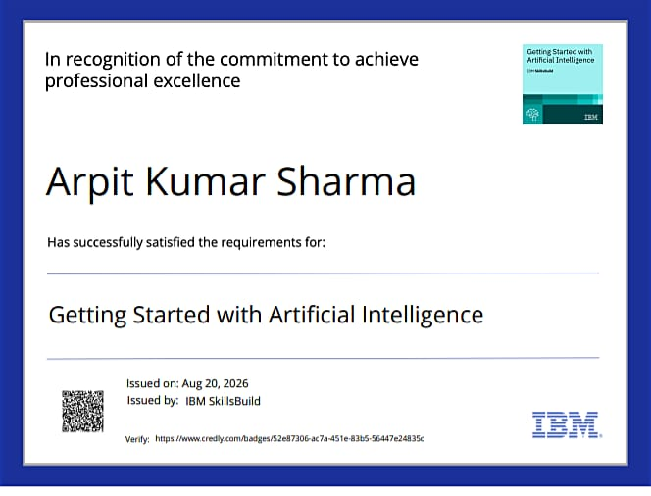
Certificates Earned:
(Getting Started with Artificial Intelligence)

Slide 18
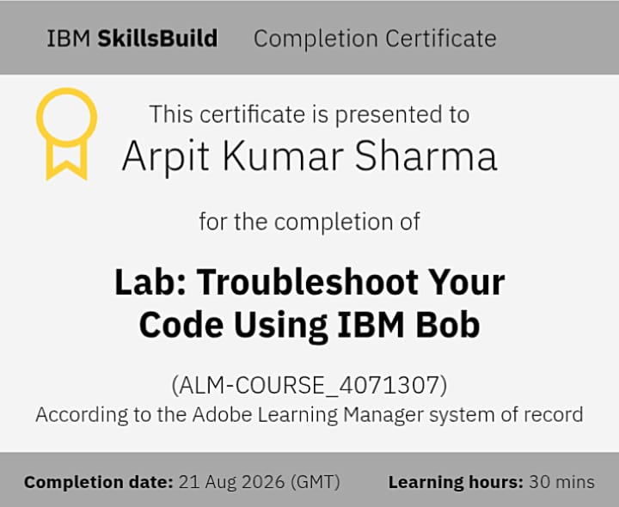
Certificates Earned:​
IBM BOB Certificate

Slide 19


