Slide 1

Project Title –Seasonal Agriculture Performance Analysis
Student Name : Arpit Kumar Sharma
College Name- Ashoka Institute Of Technology and Management
AICTE STU ID : STU61cf1533266dd1640961331

Slide 2

PROBLEM STATEMENT
Agricultural activities are influenced by seasonal variations in environmental conditions, farming practices, resource availability and market conditions.
As a result, agricultural performance may differ from one season to another. However, raw agricultural data does not clearly explain how agricultural performance changes across seasons or what patterns can be observed in different seasonal conditions.
The problem is to analyze the given agricultural dataset and investigate seasonal differences in agricultural performance by identifying meaningful patterns, trends, relationships and variations within the available data.

Slide 3
Project Description This project analyzes agricultural performance across different seasons, regions, and farming conditions. It examines seasonal patterns, trends, resource usage, environmental factors, and economic outcomes. The analysis involves data cleaning, statistical techniques, visualization, and comparison of seasonal performance. The project aims to identify meaningful relationships, variations, and unusual patterns from the dataset. The findings provide evidence-based insights and recommendations to support better seasonal agricultural planning.

Slide 4

WHO ARE THE END USERS?
Farmers
Students
Customers

Slide 5

Technology Used
Pandas
Numpy
Matplotlib
Seaborn

Slide 6
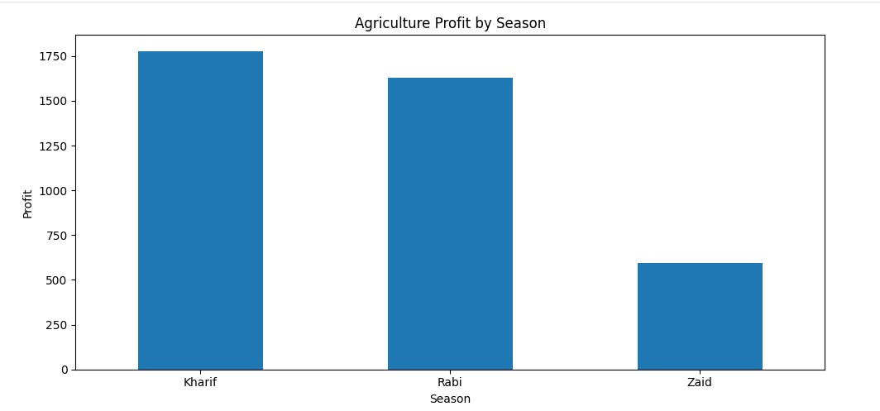
RESULTS
This graph shows the Total Profit in Agriculture By Various Seasons.

Slide 7
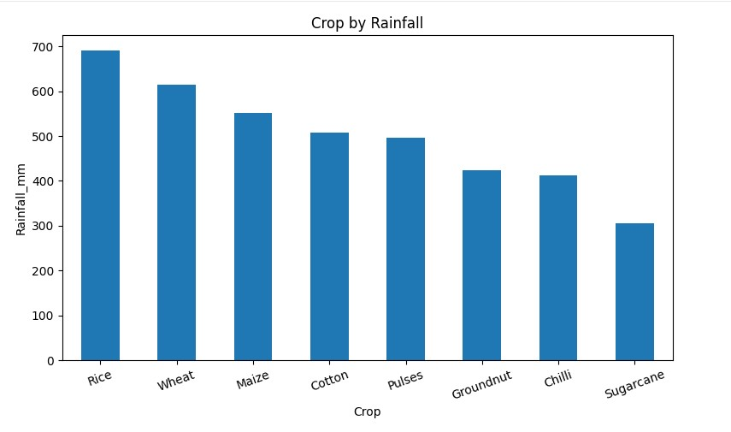
RESULTS
This graph shows the Various Crop By Rainfall in mm.

Slide 8
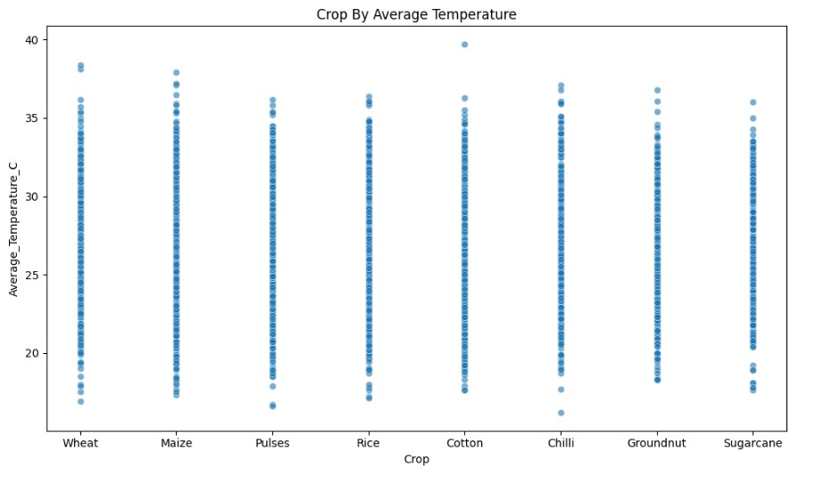
RESULTS
This graph shows Various Crops By their Average Temperature.

Slide 9
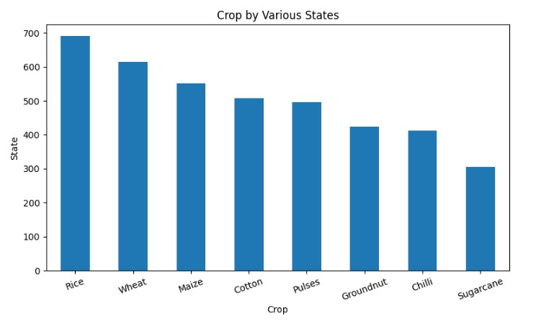
RESULTS
This graph shows the Crops grown By Various States.

Slide 10
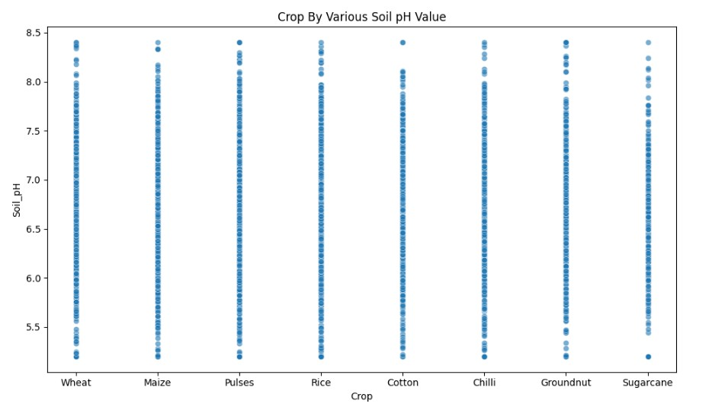
RESULTS
This graph shows Various Crops by their ideal Soil pH values.

Slide 11
Future scope
The project can be extended by analyzing agricultural performance using larger and more diverse datasets across regions and seasons.
Advanced statistical and machine-learning techniques can be applied to improve prediction and identify complex patterns.
Future analysis may integrate real-time environmental,resource,and market data for better insights.
The findings can support more accurate seasonal planning,resource management,and evidence-based decision-making.

Slide 12
GitHub Link
https://github.com/d61227767-sys/VOIS_Arpit_Intern.git

Slide 13

VOIS Course completion certificate - Course name- Data Visualization

Slide 14
Thank you
.
.
Yours Sincerely
Arpit Kumar Sharma

