Slide 2
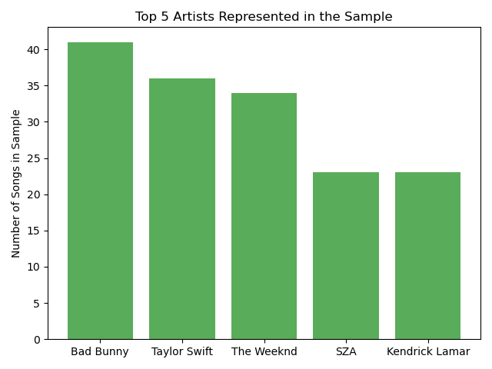
Artist Popularity
Songs in the Sample
952 songs
802 unique artists

Slide 3
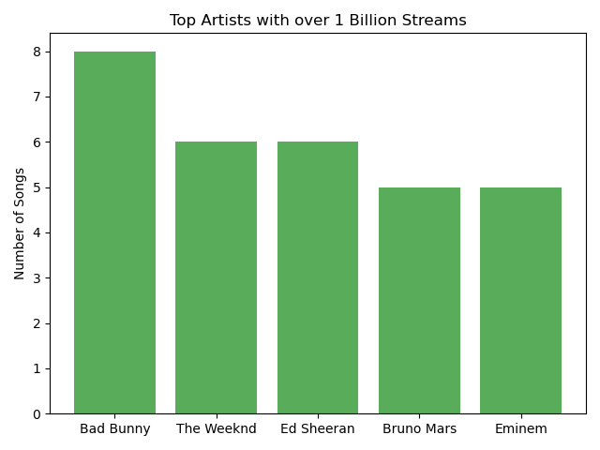
Artist Popularity
Songs with over 1 billion streams
152 songs
137 unique artists

Slide 4
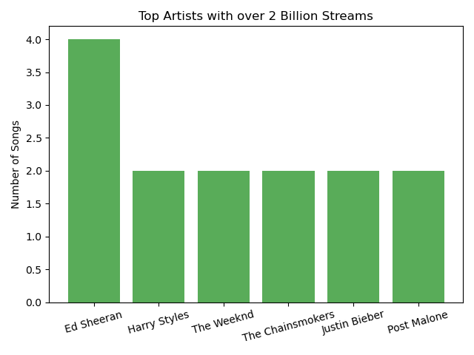
Artist Popularity
Songs with over 2 billion streams
31 songs
33 unique artists
Most streamed song:
Blinding Lights by The Weeknd

Slide 5
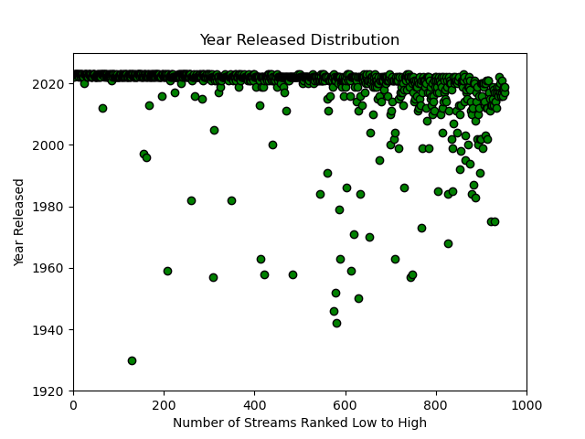
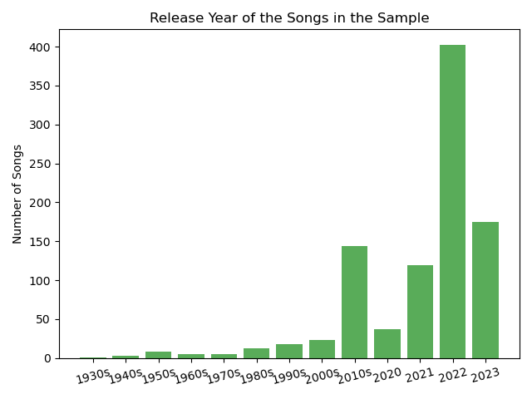
Distribution of Streams by Year Total Sample

Slide 6
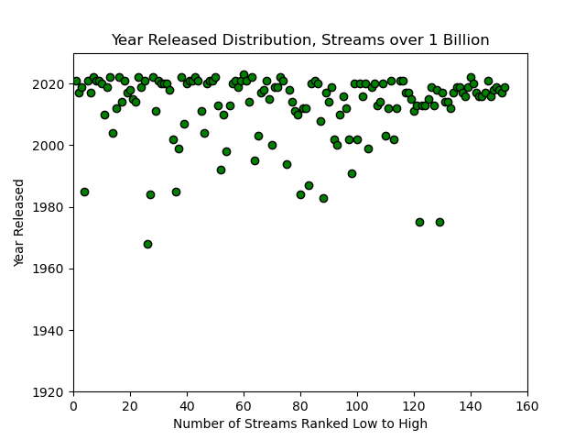
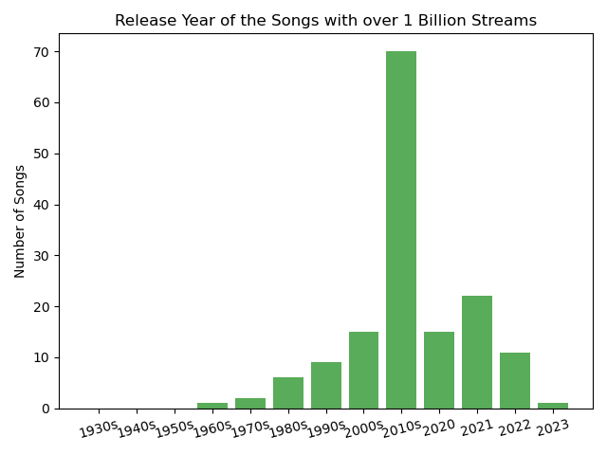
Distribution of Streams by Year Streams over 1 Billion

Slide 7
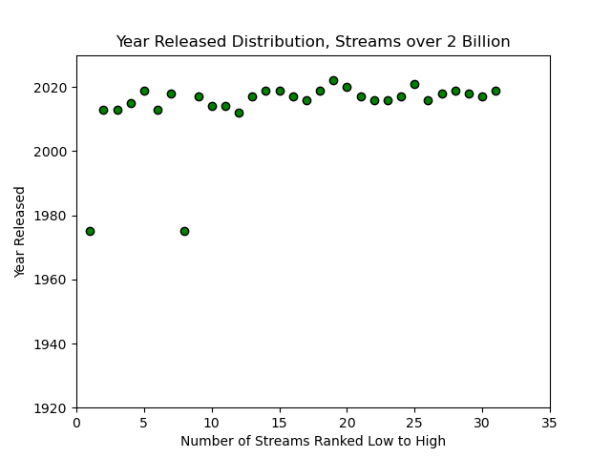
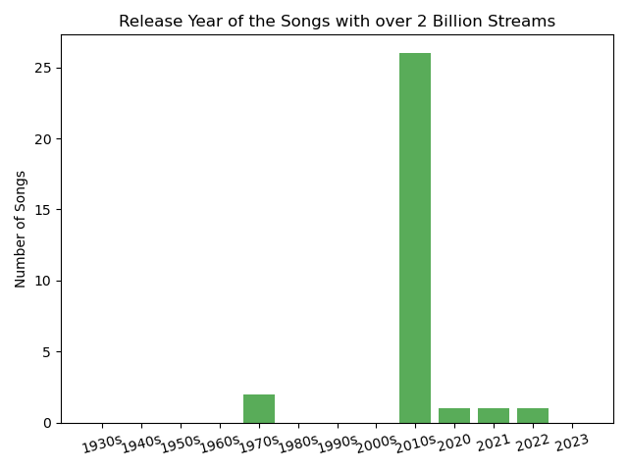
Distribution of Streams by Year Streams over 2 Billion

