Slide 1
Spotify’s Top Streamed Songs of 2023: An Analysis
Austin DeVore
David Kogge
Dan Kramer

Slide 2
The Data
Procured from Kaggle
https://www.kaggle.com/datasets/nelgiriyewithana/top-spotify-songs-2023
Data was collected via the Spotify API
Included characteristics
Track Name
Artist(s)
Release Date
# Streams
Playlists/Charts presence (Spotify, Apple, Deezer, Shazam)
Audio/Musical Features and Characteristics

Slide 3
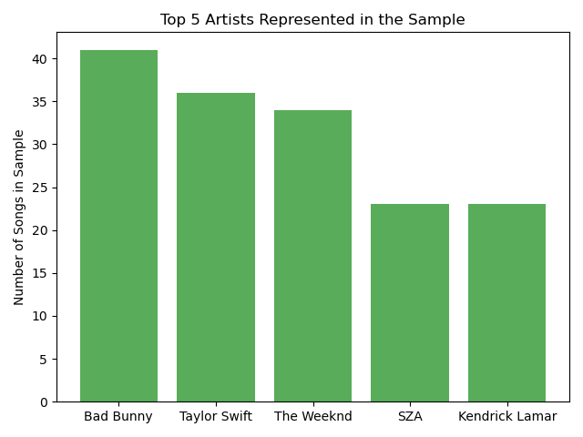
Artist Popularity
Songs in the Sample
952 songs
802 unique artists

Slide 4
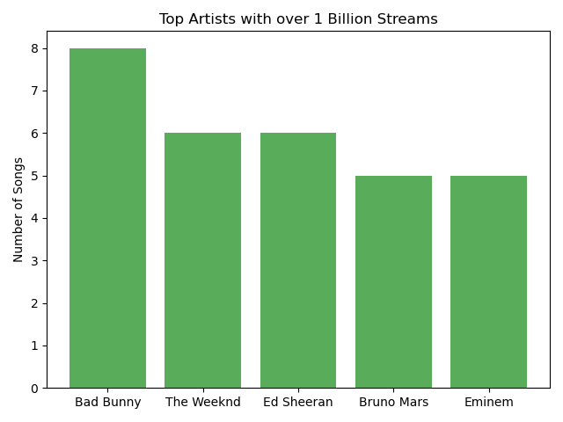
Artist Popularity
Songs with over 1 billion streams
152 songs
137 unique artists

Slide 5
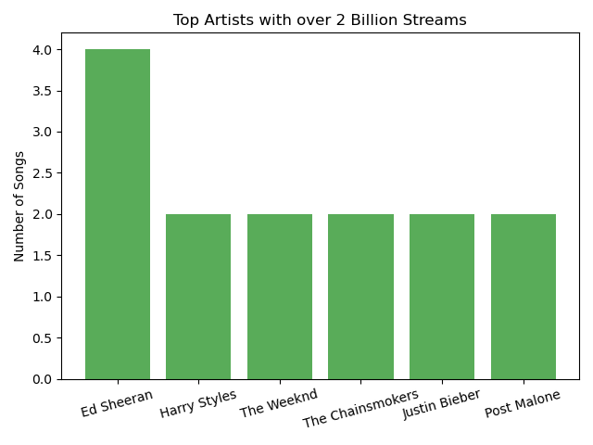
Artist Popularity
Songs with over 2 billion streams
31 songs
33 unique artists
Most streamed song:
Blinding Lights by The Weeknd

Slide 6
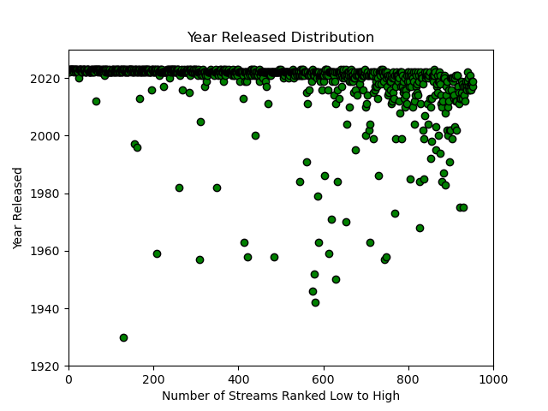
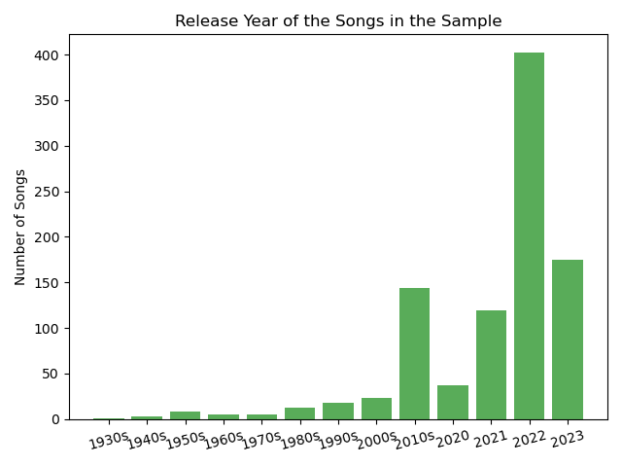
Distribution of Streams by Year Total Sample

Slide 7
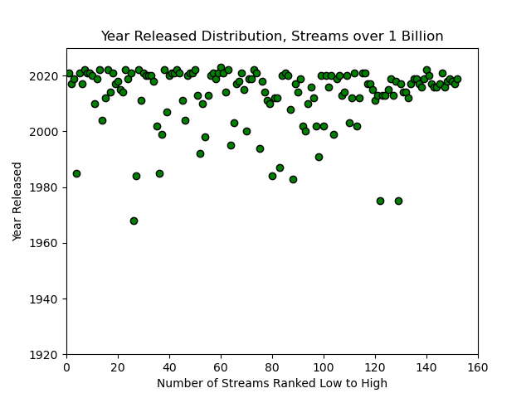
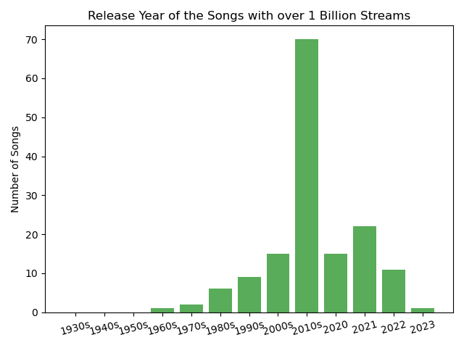
Distribution of Streams by Year Streams over 1 Billion

Slide 8
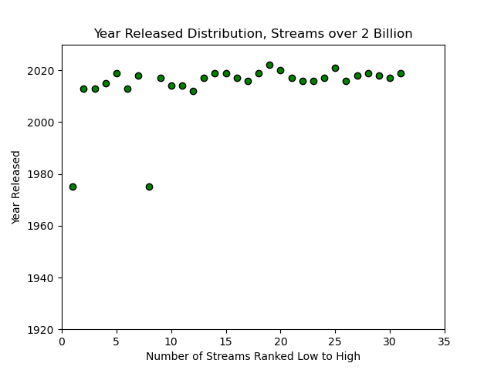
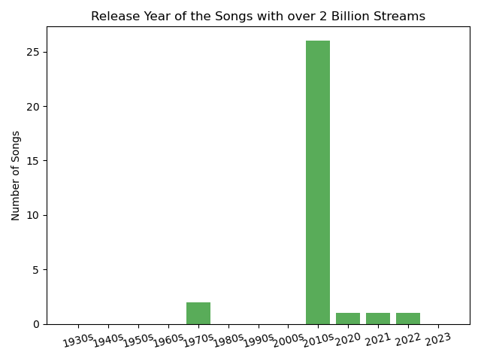
Distribution of Streams by Year Streams over 2 Billion

Slide 9
The Effect of Charts and Playlists
This portion of the project, we wanted to look at the effects that playlists and charts have on how often a song is streamed.
The dataset gave us the count of times a song appears in a playlist for the platforms Spotify, Apple, and Deezer.
The dataset also gave us the ranking of a song on their charts in their respective platform. The platforms are Spotify, Apple, Deezer, and Shazam

Slide 10
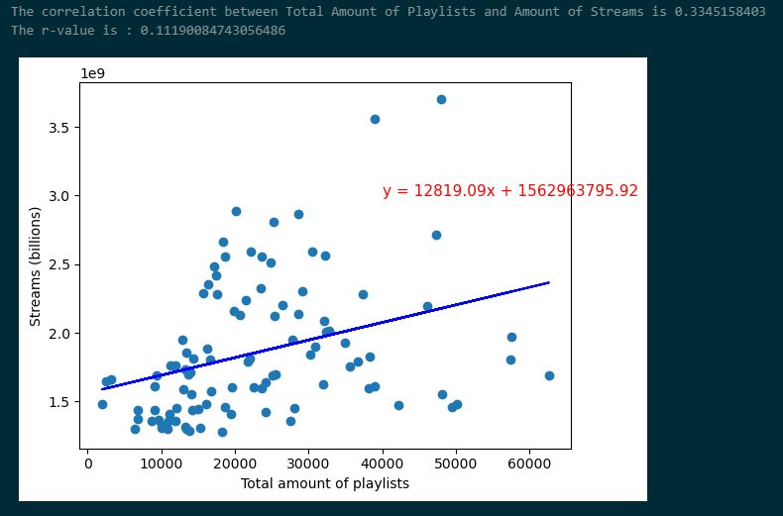
Top 100 streamed songs vs the number of playlists they appear in
I took the top 100 streamed songs of the dataset and compared how many playlists they appear in.
The Person correlation is 0.335 and r-value is 0.111.
We can see there is a weak positive correlation between how many times a song appears in a playlist against how many times the song is streamed.

Slide 11
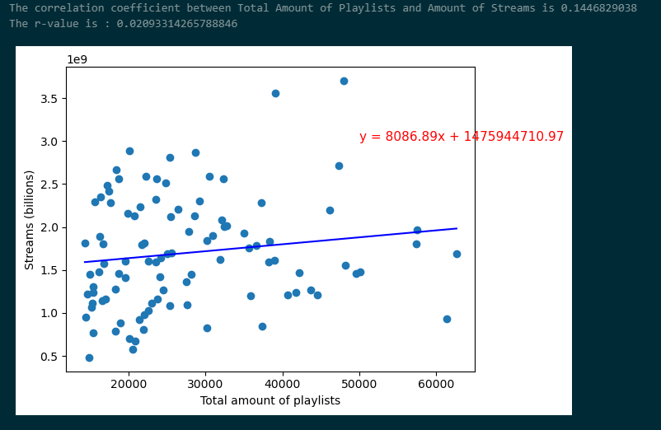
How many times a song is on a playlist vs. how many times the song is streamed
This scatterplot represents the top 100 songs that appeared in playlists from Spotify, Apple, and Deezer.
The Person correlation is 0.145 and r-value is 0.021.
This gives a weak positive correlation that if a song is on more playlists, the song will be streamed more as well.

Slide 12
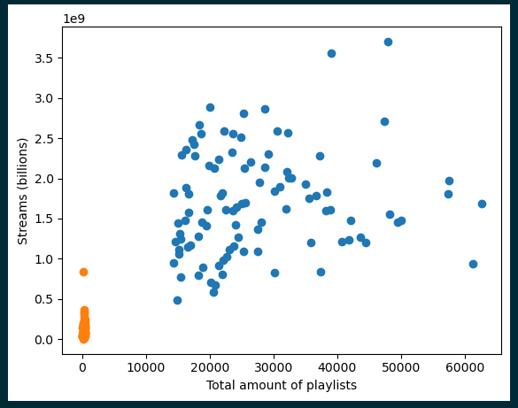
Top 100 songs in playlists vs bottom 100 songs in playlists
This plot represents the top 100 songs in playlists (in blue) and the bottom 100 songs in playlists (in orange).
This shows as the plots are more to the right and on more playlists, they are streamed more as well.
Songs that are less to be on playlists are streamed less as the top streamed song does not reach 1 billion streams.

Slide 13
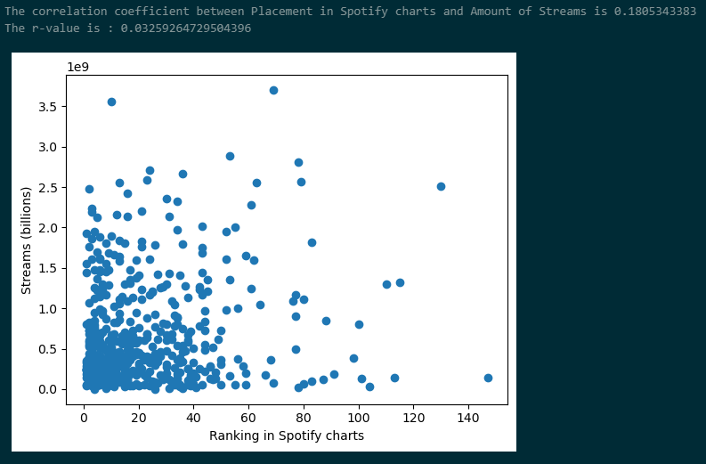
Spotify Charts
As we can see with songs that are higher on the charts (more to the left), they are for the most part have more streams.

Slide 14
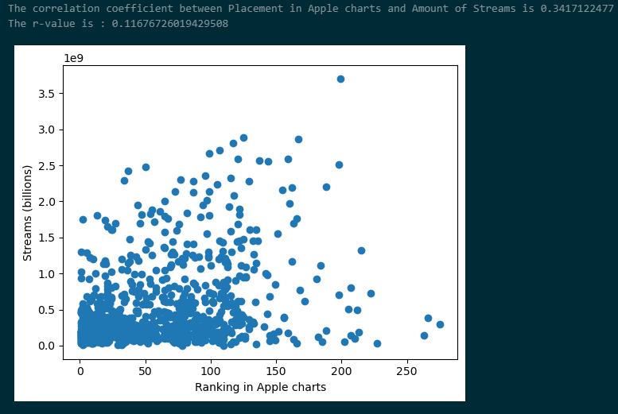
Apple Charts
With Apple it appears to be more spread out as to their placement in the charts vs. the number of times a song is streamed.

Slide 15
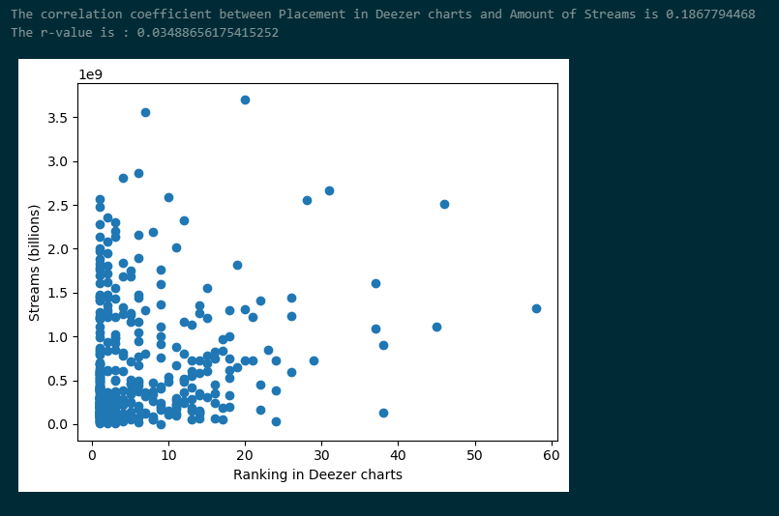
Deezer Charts
With songs that are on the platform Deezer, we can see there is a stronger correlation for when a song is higher on the chart compared to how many times a song is streamed.

Slide 16
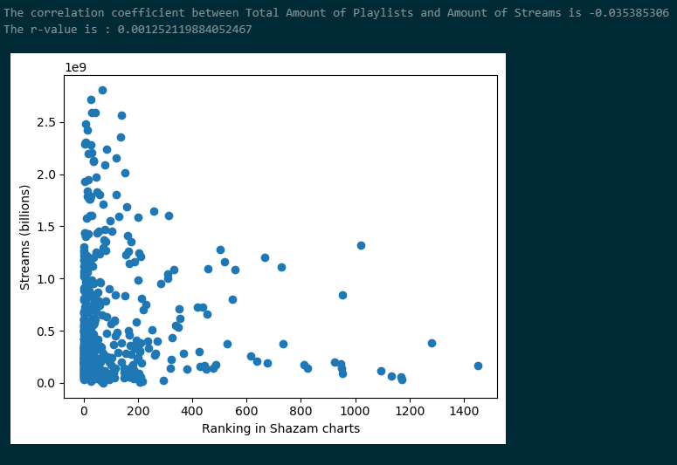
Shazam Charts
Finally, with shazam, this gives us a strong correlation that shows a song higher rated on the chart, the more the song is streamed.

Slide 17
Analysis of Musical Characteristics
Comparing the Top 20 Most Streamed Artists vs. the Entire Dataset
Top Artists account for approximately 27% of included tracks, but received over 36% of streams
Do Top Artists mimic the population, or forge their own path?
Considering Averages
Due to the nature of songs as discrete pieces of content, analysis focuses on median and mode averages vs. mean calculations

Slide 18
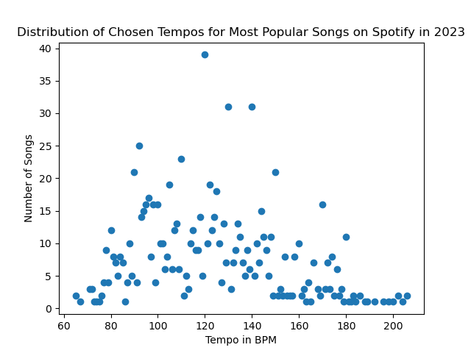
Song Speeds (BPM – Beats Per Minute)
The Top 20 Artist sample is very similar in structure to the data population.
The median BPM for the sample (120bpm) is extremely close to the median BPM of the population (121bpm).
The mode for Top Artists is considerably lower
Top Artists Mode: 90bpm, 7 songs (2.7% of songs in sample)
All Songs: 120bpm, 34 songs (3.6% of songs in population)
Standard Deviation of tempos: 37.462117528776375. p-value=3.927199818891401e-06)

Slide 19
Song Modality – Major vs. Minor
“Major” Associations:
Upbeat
Positive
Happy
Bright
“Minor” Associations:
Slower
Sad
Dark
Mysterious

Slide 20
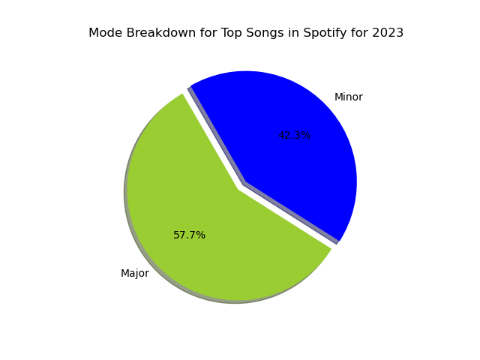
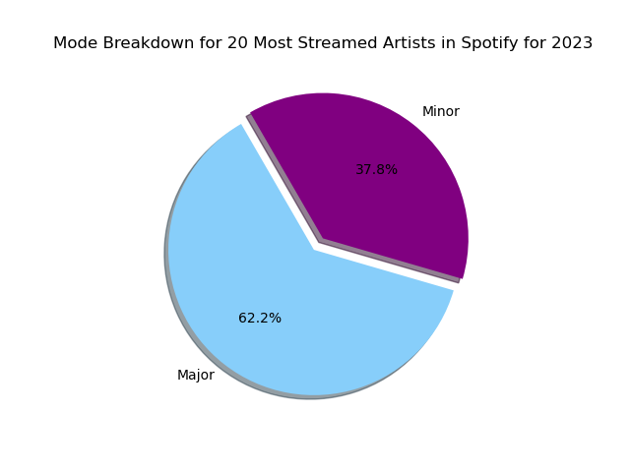
Spotify 2023 Modality Breakdown
Major modality is more popular across both sample and population. The most streamed artists had
a further share of major modality.

Slide 21
Musical Characteristics
Elements of the track as defined by Spotify:
danceability_%: Percentage indicating how suitable the song is for dancing
valence_%: Positivity of the song's musical content
energy_%: Perceived energy level of the song
acousticness_%: Amount of acoustic sound in the song
instrumentalness_%: Amount of instrumental content in the song
liveness_%: Presence of live performance elements
speechiness_%: Amount of spoken words in the song
Given a number representing percentage of presence in a given track
This percentage is also assigned via Spotify

Slide 22
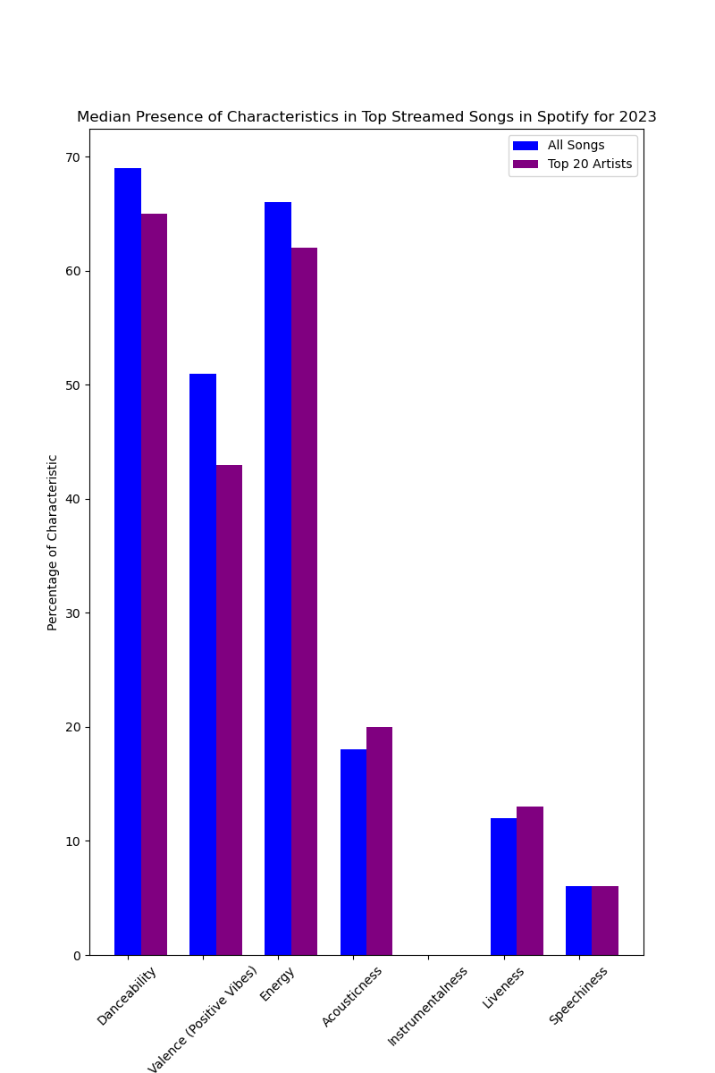
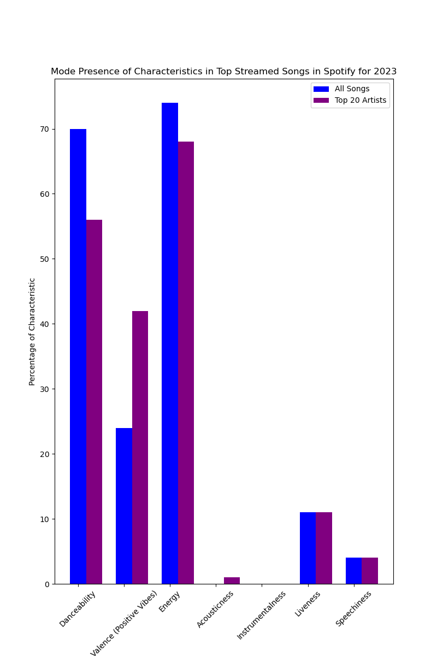
Modes show considerably more variation compared to the median
Danceability, Valence, and Energy are clearly most desired attributes for users
Top Artists’ tracks are not quite so strongly linked to danceability factor

Slide 23
Characteristics - Takeaways
The average song listeners streamed most in 2023 was energetic and danceable, often featuring positive vibes and a major modality.
The average song hovered around 120bpm, which is 2 beats per second – a very comfortable tempo for dancing, without being too demanding.
Top artists’ songs had a little more leeway from the median average, but generally fell in line with the population data.
The most streamed artists may highlight these characteristics, as they captured over a 1/3rd of total streams while making up roughly 1/4th of the data entries.

Slide 24
Next Steps and Limitations
Next Steps for Characteristics
Consider focusing on slices of data to study variations in median
Example: Remove tracks under/over a certain BPM or characteristic % threshold
Study specific artists’ data entries more specifically in comparison to the population
Example: Fully analyze all Taylor Swift or the Weeknd tracks to see if trends deviate from the population
Further Analysis of Tempo Selection Normal Distribution
Study songs outside the standard deviations and how they compare in popularity
Cross reference to most popular artists/songs
Limitations for Characteristics
Definition and assigned percentage of characteristics is not transparent
How can we be certain of these values?
No data available regarding user activity while streaming
Qualitative data and/or user surveys could be helpful in this case
This leads to assumptions of why certain characteristics are more popular than others

