Slide 1
Sequence Game
陳義榮 許育銘 賈本晧

Slide 2
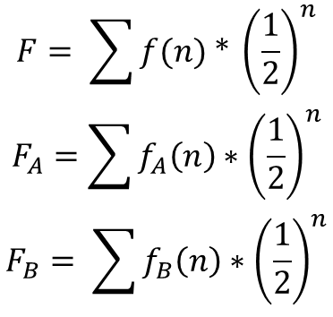
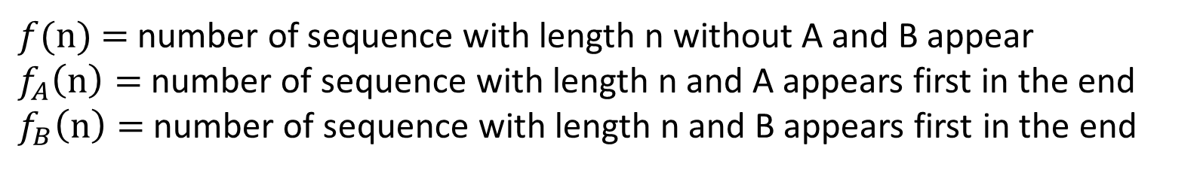
Assume that the first player choose the sequence A, while the second player choose the sequence B.
$f(n)$ $=$number of sequence with length n without A and B appear
$f_{A}\left(n\right)=$number of sequence with length n and A appears first in the end
$f_{B}\left(n\right)=$number of sequence with length n and B appears first in the end
$$F= \sum{f(n) ∗ {\left(\frac{1}{2}\right)}^{n}}$$
$$F_{A}=\sum{f_{A}\left(n\right)∗{\left(\frac{1}{2}\right)}^{n}}$$
$$F_{B}= \sum{f_{B}\left(n\right)∗{\left(\frac{1}{2}\right)}^{n}}$$

Slide 3
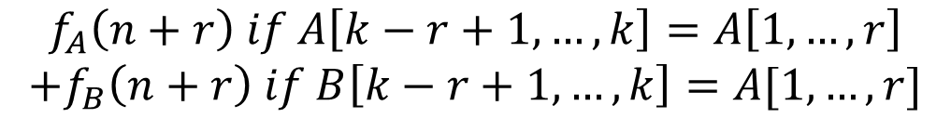

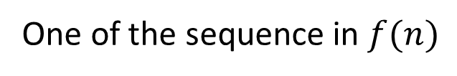
One of the sequence in $f(n)$
Sequence A
$$s_{1} s_{2} s_{3} …… s_{n} a_{1} a_{2} a_{3} …… a_{k}$$
$$a_{1}…… a_{k−2} a_{k−1} a_{k}$$
$$f_{A}\left(n+r\right) if A\left[k−r+1, …,k\right]=A\left[1,…,r\right]$$
$$+f_{B}\left(n+r\right) if B\left[k−r+1,…,k\right]=A[1,…,r]$$

Slide 4
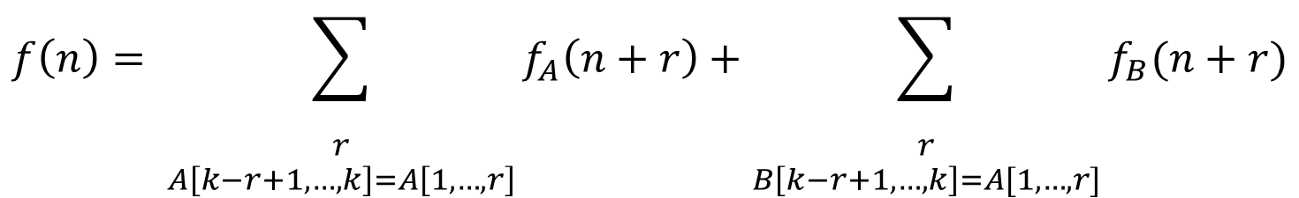
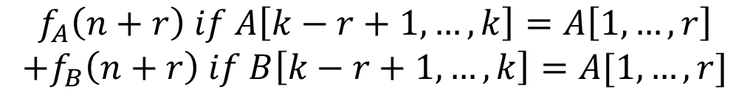
$$f_{A}\left(n+r\right) if A\left[k−r+1, …,k\right]=A\left[1,…,r\right]$$
$$+f_{B}\left(n+r\right) if B\left[k−r+1,…,k\right]=A[1,…,r]$$
$$f\left(n\right)= \sum_{\begin{aligned} \\ r \\ A\left[k−r+1, …,k\right]=A\left[1,…,r\right]\end{aligned}}{f_{A}\left(n+r\right)+\sum_{\begin{aligned} \\ r \\ B\left[k−r+1,…,k\right]=A[1,…,r]\end{aligned}}{f_{B}(n+r)}}$$

Slide 5
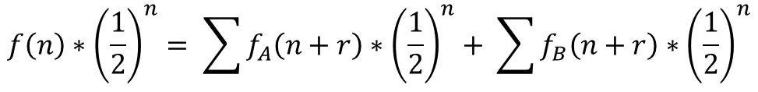
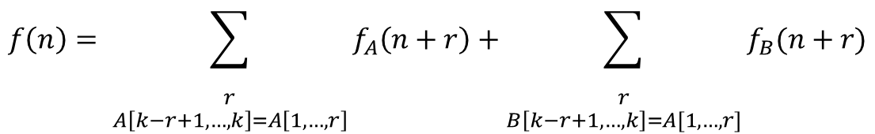
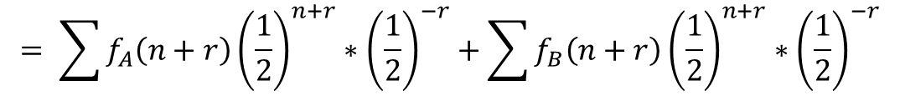
$$f\left(n\right)= \sum_{\begin{aligned} \\ r \\ A\left[k−r+1, …,k\right]=A\left[1,…,r\right]\end{aligned}}{f_{A}\left(n+r\right)+\sum_{\begin{aligned} \\ r \\ B\left[k−r+1,…,k\right]=A[1,…,r]\end{aligned}}{f_{B}(n+r)}}$$
$$f\left(n\right)∗{\left(\frac{1}{2}\right)}^{n}= \sum{f_{A}\left(n+r\right)∗{\left(\frac{1}{2}\right)}^{n}+ \sum{f_{B}\left(n+r\right)∗{\left(\frac{1}{2}\right)}^{n}}}$$
$$= \sum{f_{A}\left(n+r\right){\left(\frac{1}{2}\right)}^{n+r}∗{\left(\frac{1}{2}\right)}^{−r}+\sum{f_{B}\left(n+r\right){\left(\frac{1}{2}\right)}^{n+r}∗{\left(\frac{1}{2}\right)}^{−r}}}$$
$$F= \sum_{n}{f\left(n\right){\left(\frac{1}{2}\right)}^{n}}= \sum_{r}{{\left(\frac{1}{2}\right)}^{−r}\sum{f_{A}\left(n+r\right){\left(\frac{1}{2}\right)}^{n+r}+\sum_{r}{{\left(\frac{1}{2}\right)}^{−r}\sum{f_{B}\left(n+r\right){\left(\frac{1}{2}\right)}^{n+r}}}}}$$

Slide 6
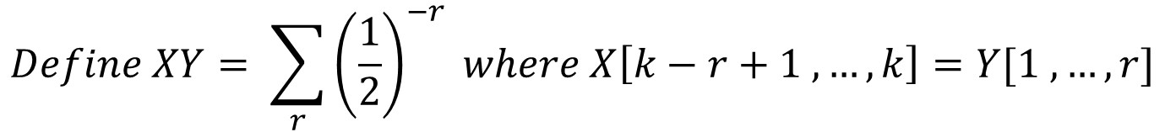
$$F= \sum_{n}{f\left(n\right){\left(\frac{1}{2}\right)}^{n}}= \sum_{r}{{\left(\frac{1}{2}\right)}^{−r}\sum{f_{A}\left(n+r\right){\left(\frac{1}{2}\right)}^{n+r}+\sum_{r}{{\left(\frac{1}{2}\right)}^{−r}\sum{f_{B}\left(n+r\right){\left(\frac{1}{2}\right)}^{n+r}}}}}$$
$$Define XY= \sum_{r}{{\left(\frac{1}{2}\right)}^{−r} where X\left[k−r+1 , …, k\right]=Y[1 , …, r]}$$
$$Then we have F=AAF_{A}+BAF_{B}. Similarily F=BBF_{B}+ABF_{A}$$
$$Thus, F_{A} :F_{B}=BB−BA :AA −AB$$

Slide 7





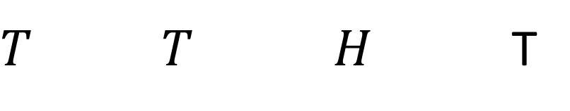
$$For example, A=TTHT, find AA$$
$$T T H T$$
$T T H$T
$$2^{4}$$
$$0$$
$$0$$
$$2^{1}$$

Slide 8



$$A=TTHT, B=THTH, find BA$$
$$T T H T$$
$$T H T H$$
0
$$2^{3}$$
$$0$$
$$2^{1}$$

Slide 9
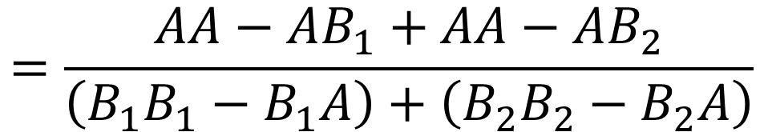
$$F_{A} :F_{B}=BB−BA :AA −AB$$
$$Let A^{′}=A\left[1, 2, 3, …, k−1\right], B_{1}=TA^{′}, B_{2}=HA′$$
$$\max\left(\frac{AA−AB_{i}}{B_{i}B_{i}−B_{i}A}\right)≥\frac{B_{1}B_{1}−B_{1}A}{\left(B_{1}B_{1}−B_{1}A\right)+\left(B_{2}B_{2}−B_{2}A\right)}∗\frac{AA−AB_{1}}{B_{1}B_{1}−B_{1}A}+\frac{B_{2}B_{2}−B_{2}A}{\left(B_{1}B_{1}−B_{1}A\right)+\left(B_{2}B_{2}−B_{2}A\right)}∗\frac{AA−AB_{2}}{B_{2}B_{2}−B_{2}A}$$
$$=\frac{AA−AB_{1}+AA−AB_{2}}{\left(B_{1}B_{1}−B_{1}A\right)+\left(B_{2}B_{2}−B_{2}A\right)}$$

Slide 10

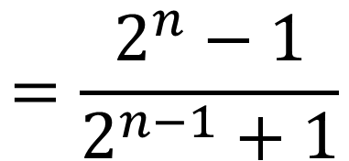

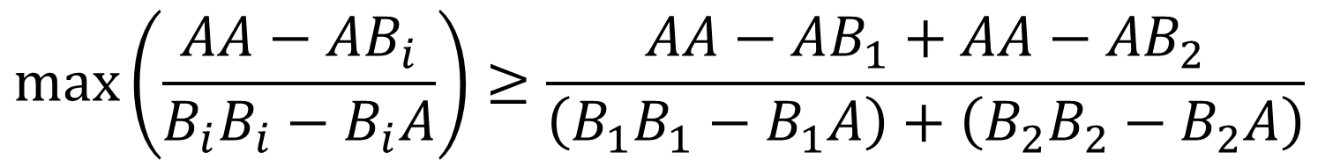

$$Using the facts that$$
$$AB_{1}+AB_{2}=2AA−2^{n+1}+2$$
$$B_{1}B_{1}+B_{2}B_{2}=2^{n}+2A^{′}A^{′}+2$$
$$B_{1}A=B_{2}A=A^{′}A′$$
$$\max\left(\frac{AA−AB_{i}}{B_{i}B_{i}−B_{i}A}\right)≥\frac{AA−AB_{1}+AA−AB_{2}}{\left(B_{1}B_{1}−B_{1}A\right)+\left(B_{2}B_{2}−B_{2}A\right)}$$
$$=\frac{2^{n}−1}{2^{n−1}+1}$$

Slide 11

The Best Strategy of A
$n=3：$
$A=THH,THT, HTH,HTT$
$B will choose TTH,TTH,HHT,HHT, respectively$
$F_{A} :F_{B}=1:2$
$n≥4：$
$A=THH…HTT, HTT…THH$
$B will choose HTHH…HT or THTT…TH, respectively$
$F_{A} :F_{B}=2^{n−1}+1:2^{n}+1$

Slide 12
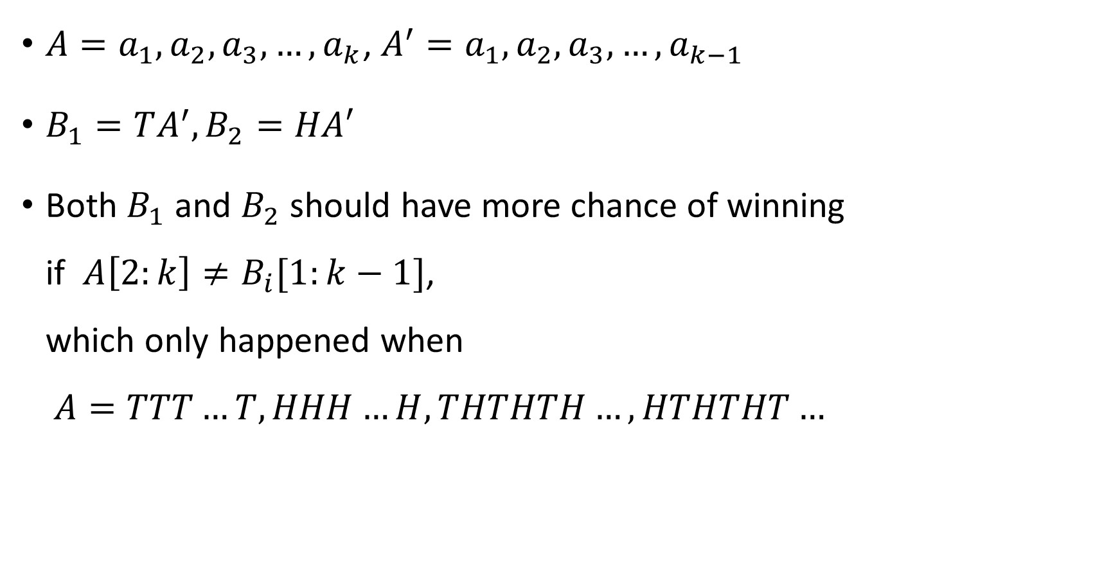
observation
${A=a}_{1},a_{2},a_{3},…,a_{k}$, $A^{′}=a_{1},a_{2},a_{3},…,a_{k−1}$
$B_{1}=TA^{′}, B_{2}=HA′$
Both $B_{1}$ and $B_{2}$ should have more chance of winning if $A\left[2:k\right]≠B_{i}[1:k−1]$, which only happened when $A=TTT…T, HHH…H, THTHTH…, HTHTHT…$

Slide 13
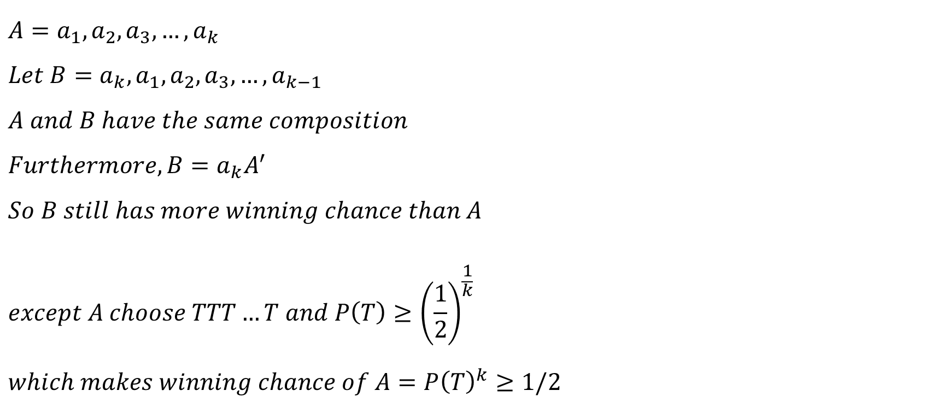
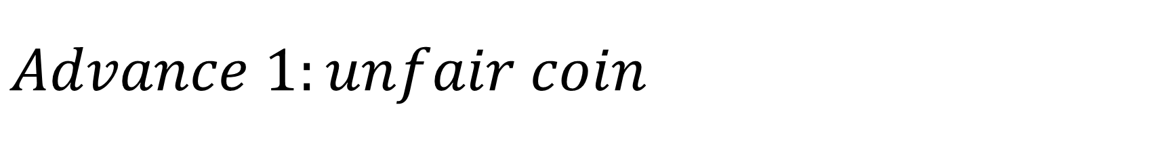

$$Advance 1:unfair coin$$
$${A=a}_{1},a_{2},a_{3},…,a_{k}$$
$$Let B=a_{k},a_{1},a_{2},a_{3},…,a_{k−1}$$
$$A and B have the same composition \\ Furthermore, B=a_{k}A^{′} \\ So B still has more winning chance than A \\ except A choose TTT…T and P\left(T\right)≥{\left(\frac{1}{2}\right)}^{\frac{1}{k}} \\ which makes winning chance of A=P{\left(T\right)}^{k}≥1/2$$
$$exception: \\ when k is an even and A choose HTHT…HT \\ B would choose HHTHTH…THTT \\ B has more winning chance than A \\ it^{′}s easy to verify$$

Slide 14
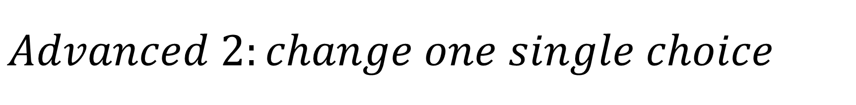
$$Advanced 2:change one single choice$$
k=3
A=000 B=100 A=010 rate=0.5
A=001 B=001 A=000 rate=0.5
A=010 B=001 A=000 rate=0.5
A=011 B=001 A=001 rate=0.5
A=100 B=011 A=101 rate=0.5
A=101 B=100 A=100 rate=0.5
A=110 B=011 A=100 rate=0.5
A=111 B=001 A=110 rate=0.5

Slide 15
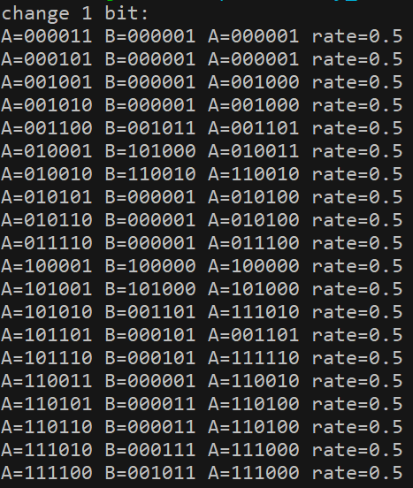
$$Advanced 2:change one single choice$$
k=4
A=1001 B=1000 A=1000 rate=0.5
K=6
A=100001 B=100000 A=100000 rate=0.5
K=7
A=1000001 B=1000000 A=1000000 rate=0.5
K=8
A=10000001 B=10000000 A=10000000 rate=0.5
Etc…

Slide 16
$$Advanced 2:change one single choice$$
How about k=5?
A=01001 B=01000 A=11001 rate=0.53125
A=01010 B=10011 A=01011 rate=0.53125
A=10101 B=01100 A=10100 rate=0.53125
A=10110 B=10111 A=00110 rate=0.53125

Slide 17












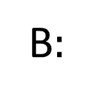


$$Advanced 3:decide in turn$$
$$A:$$
$$T$$
$$H$$
$$H$$
$$T$$
$$T$$
$$…$$
B$:$
$$T$$
$$T$$
$$H$$
$$H$$
$$T$$
$$…$$
$$B has more chance to win$$

Slide 18



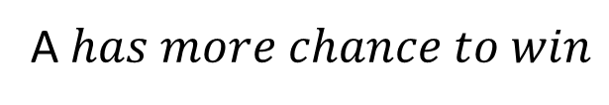


$$Advanced 3:decide in turn$$
$$A:$$
$$T$$
$$T$$
$$H$$
$$H$$
$$T$$
$$…$$
B$:$
$$T$$
$$H$$
$$H$$
$$T$$
$$T$$
$$…$$
A$has more chance to win$

Slide 19


$$Advanced 3:decide in turn$$
$$A:$$
$$T$$
$$T$$
$$T$$
$$T$$
$$T$$
$$…$$
B$:$
$$T$$
$$T$$
$$T$$
$$T$$
$$T$$
$$…$$
$$Both players would only choose tail in each turn$$

Slide 20


$$Advanced 3:decide in turn$$
$$A:$$
$$T$$
$$T$$
$$H$$
$$H$$
$$T$$
$$…$$
B$:$
$$H$$
$$T$$
$$T$$
$$H$$
$$H$$
$$…$$
$$B has more chance to win$$

Slide 21






$$Advanced 3:decide in turn$$
$$A:$$
$$T$$
$$H$$
$$H$$
$$T$$
$$T$$
$$…$$
B$:$
$$H$$
$$H$$
$$T$$
$$T$$
$$H$$
$$…$$
A$has more chance to win$

Slide 22


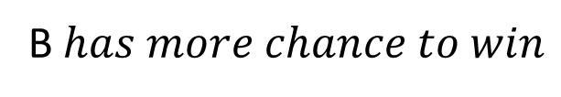

$$Advanced 3:decide in turn$$
$$A:$$
$$T$$
$$H$$
$$H$$
$$T$$
$$H$$
$$…$$
B$:$
$$H$$
$$T$$
$$H$$
$$H$$
$$T$$
$$…$$
B$has more chance to win$

Slide 23


$$Advanced 3:decide in turn$$
$$A:$$
$$T$$
$$H$$
$$T$$
$$T$$
$$H$$
$$…$$
B$:$
$$H$$
$$T$$
$$T$$
$$H$$
$$T$$
$$…$$
A$has more chance to win$

Slide 24

$$Advanced 3:decide in turn$$
$$A:$$
$$T$$
$$H$$
$$T$$
$$H$$
$$T$$
$$…$$
B$:$
$$H$$
$$T$$
$$H$$
$$T$$
$$H$$
$$…$$
$$Both players would head and tail alternately$$

Slide 25
Reference
https://core.ac.uk/download/pdf/81142890.pdf
http://www.math.unl.edu/~sdunbar1/ProbabilityTheory/BackgroundPapers/Penney%20ante/li.pdf
http://www.kurims.kyoto-u.ac.jp/EMIS/journals/EJC/Volume_13/PDF/v13i1r35.pdf
https://github.com/d768092/probability_final

