Slide 1

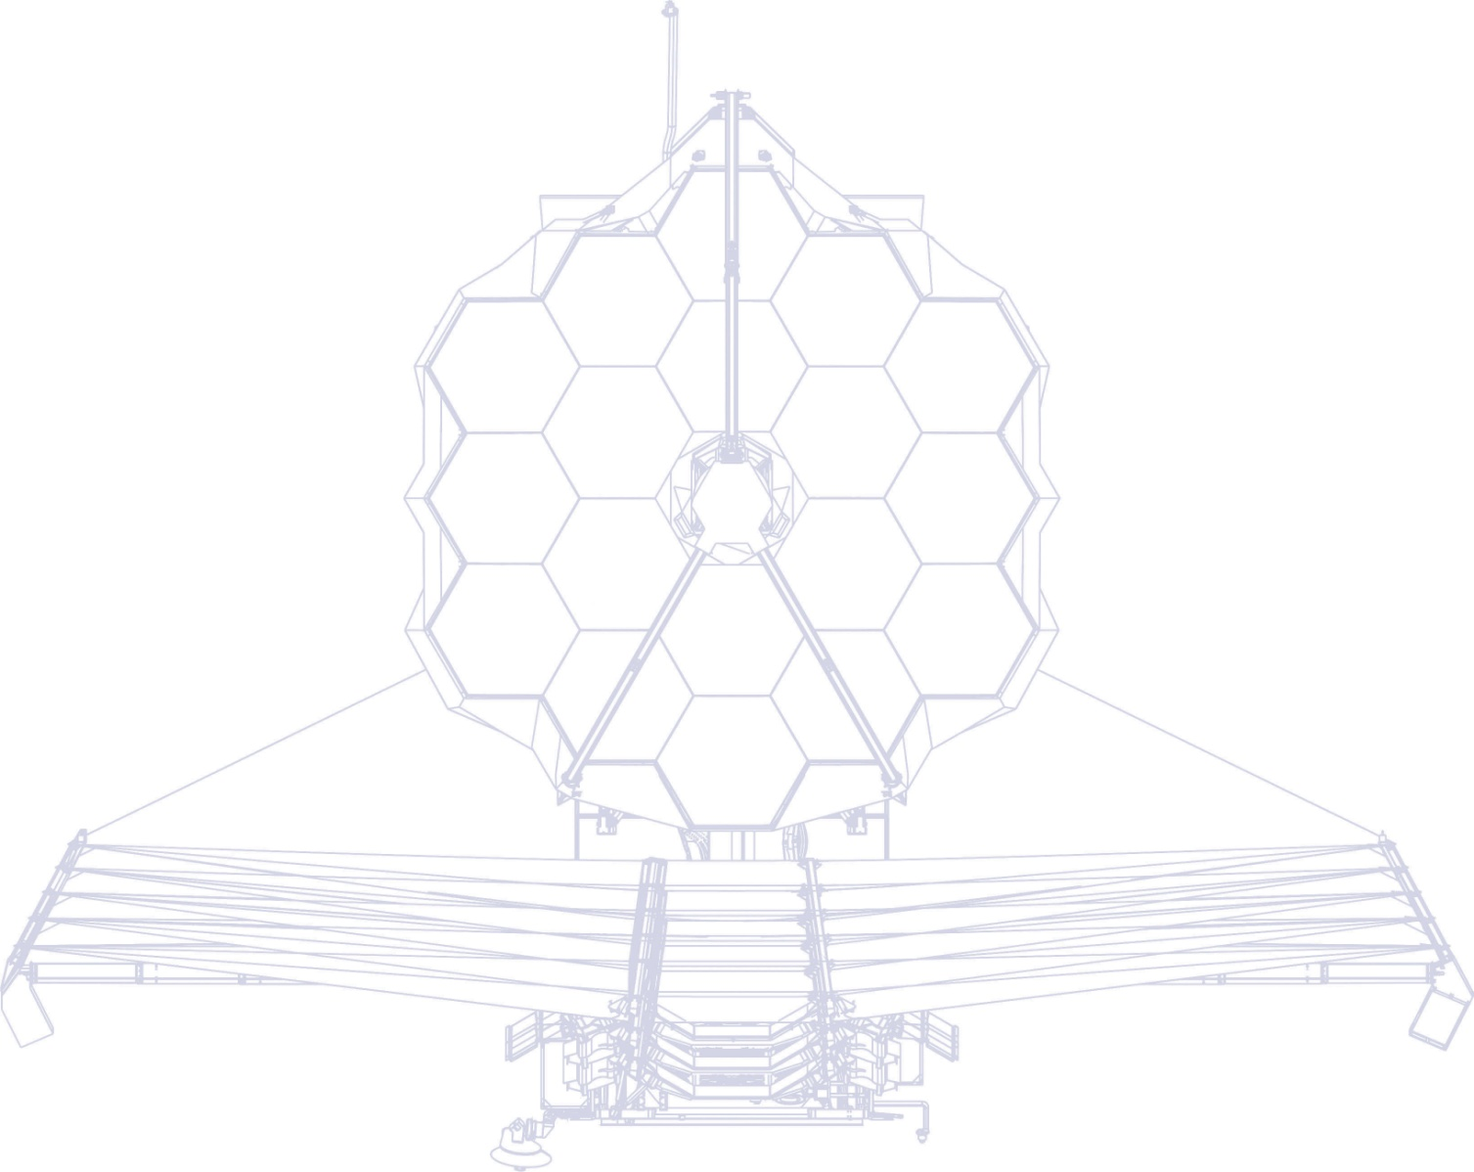

JWST-MIRIM (The MIRI Imager)
Alistair Glasse, UKATC
‘Mastering the Science Instruments and the Observing Modes of JWST’
27th September 2016
See papers in PASP Vol 127, 2015 and go to,
http://ircamera.as.arizona.edu/MIRI/

Slide 2
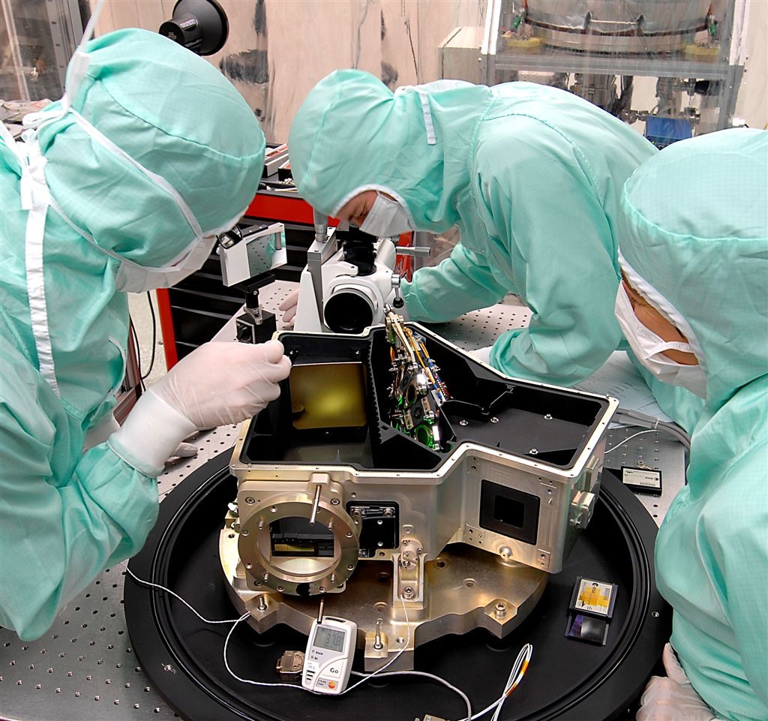
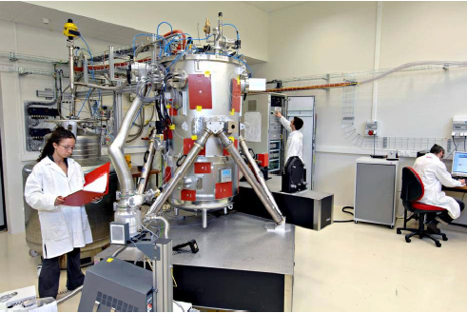
Summary
Designed, built and tested at CEA/Saclay.
Diffraction limited image quality, fully Nyquist sampled longward of λ = 7 μm.
0.11 arcseconds / pixel
Background limited sensitivity.
High throughput.
Low distortion.
Stable and well defined boresight.

Slide 3
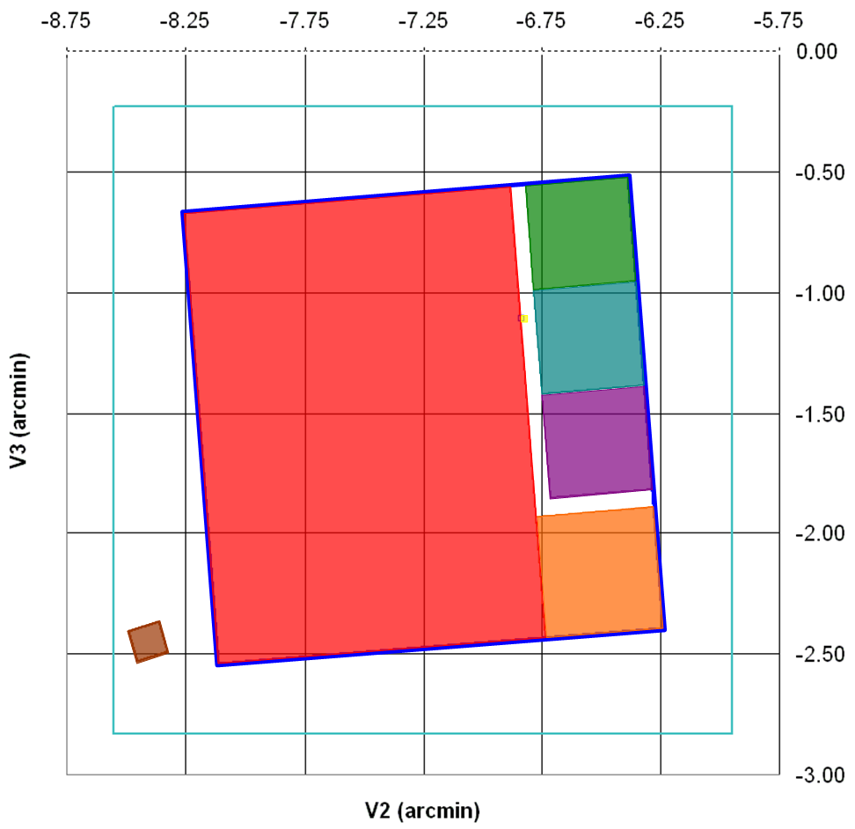
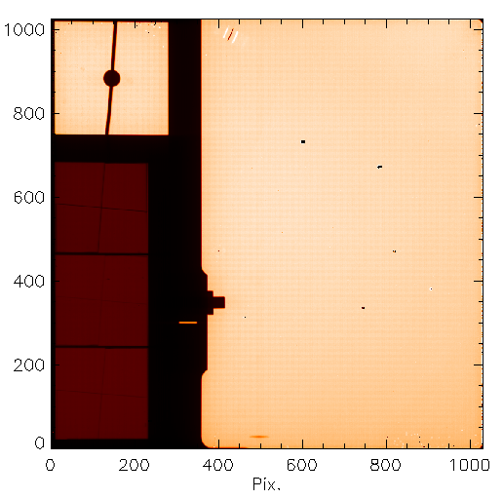
Reminder of MIRI capabilities
MIRI optical configurations map onto the JWST focal plane as follows,
4QPM Coronagraphs
10.65µm
11.4µm
15.5µm
24 x 24 arcsec.
Imager
75 x 113 arcsec
Low Resolution Spectrometer Slit
5 x 0.6 arcsec
Medium Resolution Spectrometer
> 3.5 x 3.5 arcsec
Lyot Coronagraph Mask 23μm
30” x 30”
(arcminutes on sky)
Light falling in the imager field (and the Lyot mask) only sees the filter selected in the MIRI filter wheel.

Slide 4
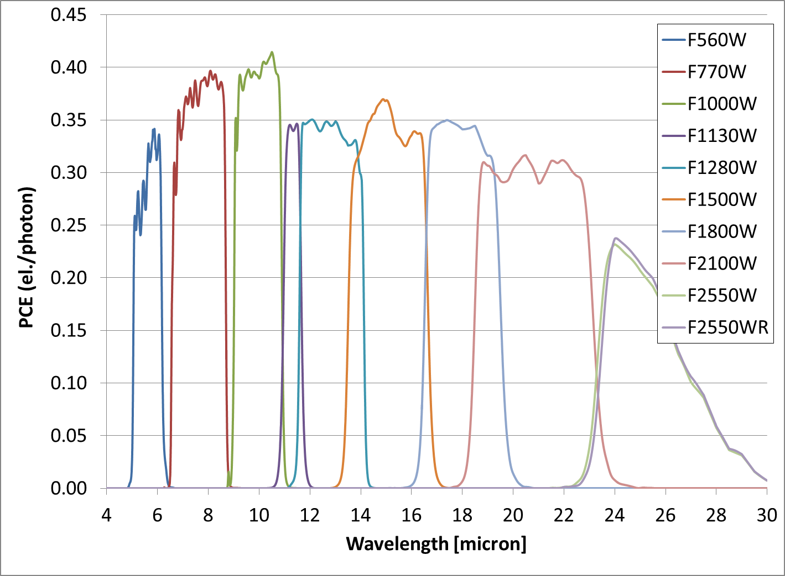
PCE (Photon Conversion Efficiency)
MIRI PCE is the fraction of photons crossing the MIRI Entrance Focal Plane which are detected as photoelectrons. (It does not include photoelectric gain/quantum yield).
It includes a factor of 0.8 to account for Beginning Of Life contamination.

Slide 5
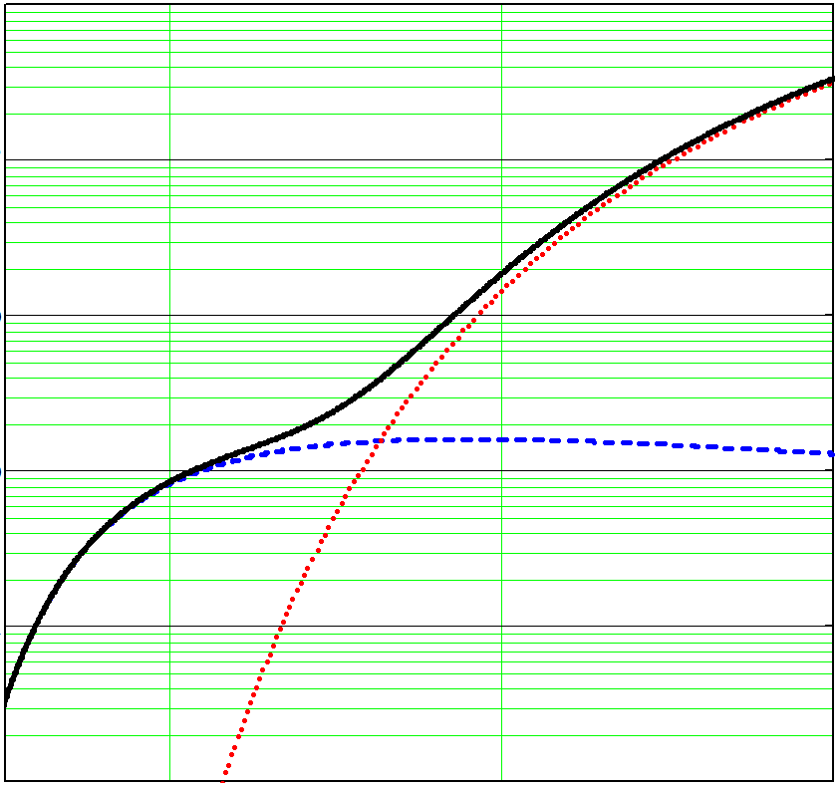
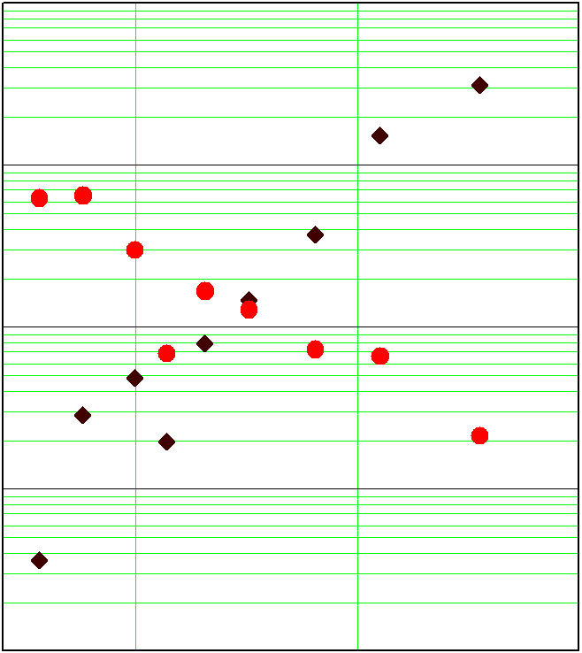
Observatory background and bright source sensitivity
MIRI’s faint source sensitivity limit is set by shot noise on the background radiation from the sky and telescope optics.
This generates a signal at the detector (el / second) which can be compared with the signal collected from a 1 milliJansky point source.
10⁴
10³
10²
10
1
0.1
10⁴
10³
10²
10
1
Total
1 mJy point source
Sky + JWST background
Background flux [MJy sterad⁻¹]
JWST
Photocurrent [electrons sec⁻¹]
Zodiacal light
10 20 30
Wavelength [μm]
10 20 30
Wavelength [μm]
For the imager, the SNR of an observation will be dominated by the source’s own flux for sources brighter than > 1 mJy at short wavelengths.

Slide 6
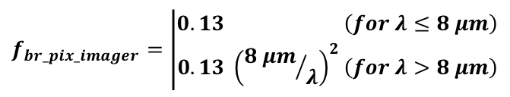
Sensitivity and saturation limits
These sensitivity limits (below) apply to faint sources observed with the FULL imager field of view.
They assume a photometric aperture of radius, r_{phot} = 0.42 (λ / 10 μm) (Note: The full width at half maximum intensity (FWHM) of the point spread function (PSF) is d_{FWHM} = 0.32 (λ / 10 μm).
Filter Name | Wave-length | Band-width | Sensitivity S/N = 10 in 10,000 second on-chip integration. |  | Saturation Limit (F_{bright})
 |  |  | Point Source | Extended Source | Point Source | Extended Source*
 | µm | µm | microJansky | microJansky arcsec⁻² | milliJansky | milliJansky arcsec⁻²
F560W | 5.6 | 1.2 | 0.16 | 0.89 | 13 | 140
F770W | 7.7 | 2.2 | 0.25 | 0.77 | 7 | 75
F1000W | 10.0 | 2.0 | 0.54 | 0.99 | 15 | 103
F1130W | 11.3 | 0.7 | 1.35 | 1.89 | 68 | 366
F1280W | 12.8 | 2.4 | 0.84 | 0.88 | 27 | 113
F1500W | 15.0 | 3.0 | 1.39 | 1.11 | 36 | 110
F1800W | 18.0 | 3.0 | 3.46 | 1.9 | 65 | 138
F2100W | 21.0 | 5.0 | 7.09 | 2.9 | 66 | 103
F2550W | 25.5 | 4.0 | 26.2 | 7.3 | 195 | 206
* The bright limit for extended targets is given by F_{bright_ext} = F_{bright_point} x f_{br_pix_imager} / A_{pix} , where
$$f_{br_pix_imager}=\left|\begin{matrix}0.13 \left(for λ≤8 μm\right) \\ 0.13 {\left({8 μm}/λ\right)}^{2}\left(for λ>8 μm\right)\end{matrix}\right.$$

Slide 7
Update to Sensitivity Predictions
Recent updates to the model of the JWST thermal background (Lightsey) and the expectation of a quantum yield ‘G’ > 1 (Rieke) will require us to revise the sensitivity model at short wavelengths (for all MIRI modes).
We have calculated the impact on sensitivity and saturation limit (for the point source case) to give the values we will aim to have implemented by the ETC.
Filter Name | Wave-length | Band-width | Sensitivity S/N = 10 in 10,000 second on-chip integration. |  |  | Saturation Limit (F_{bright})
 |  |  | Scale factor | PASP | ETC Target | Scale factor | PASP | ETC Target
 | µm | µm |  | microJansky |  |  | milliJansky
F560W | 5.6 | 1.2 | 1.170 | 0.16 | 0.18 | 1.19 | 13 | 11
F770W | 7.7 | 2.2 | 1.118 | 0.25 | 0.28 | 1.12 | 7 | 6
F1000W | 10.0 | 2.0 | 1.088 | 0.54 | 0.59 | 1.06 | 15 | 14
F1130W | 11.3 | 0.7 | 1.087 | 1.35 | 1.46 | 1.04 | 68 | 65
F1280W | 12.8 | 2.4 | 1.126 | 0.84 | 0.95 | 1.01 | 27 | 27
F1500W | 15.0 | 3.0 | 1.163 | 1.39 | 1.62 | 1.00 | 36 | 36
F1800W | 18.0 | 3.0 | 1.122 | 3.46 | 3.88 | 1.00 | 65 | 65
F2100W | 21.0 | 5.0 | 1.065 | 7.09 | 7.55 | 1.00 | 66 | 66
F2550W | 25.5 | 4.0 | 1.028 | 26.2 | 26.9 | 1.00 | 195 | 195

Slide 8
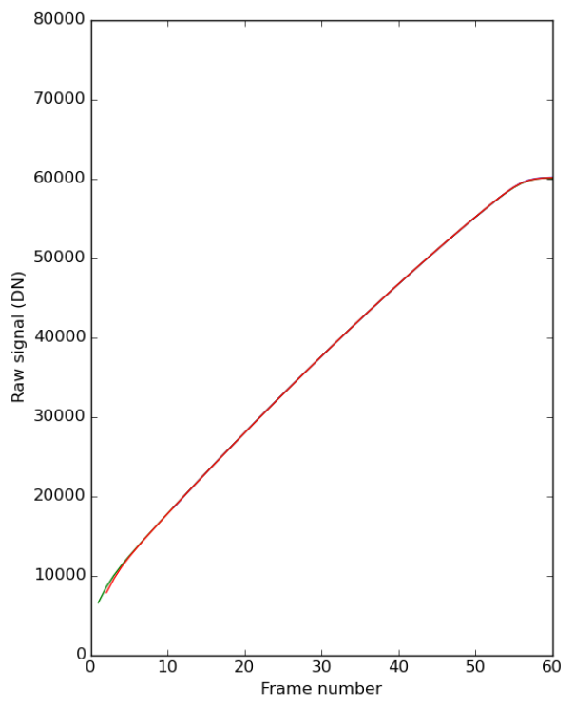
A note on saturation and readout patterns
The MIRI calibration and pipeline reduction strategies are optimised for a minimum of 5 groups/frames per integration.
The quoted saturation limits are based on the point source flux which will fill the brightest pixel to 60 % of the hard saturation limit, using an integration time of 5.6 seconds, comprising a reset followed by 2 FULL frame reads.
(to measure the slope.)
FRAME
READ
RESET
Pixel 1,1
Pixel 1024,1024
Hard Saturation Limit
Nominal Bright Source Limit
Photon flux / Photocurrent
Pixel Address
Signal [DN]
integration
2.8 sec
Measured response
time
time
The potential use of 2 (or 1) frames per integration is under discussion at/with STScI.
The preferred mitigation for bright sources with optimum noise (but reduced field of view) is to use subarrays...

Slide 9
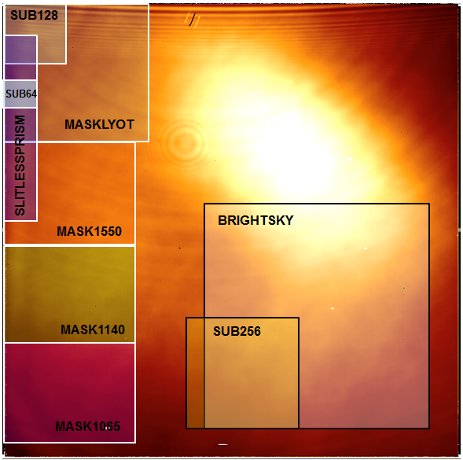
Subarrays for imaging bright targets
The use of subarrays with the imager allows us to increase the bright source / saturation limit at the cost of a reduced field of view.
Subarray | Frame time [sec] | Gain in bright source limit
FULL | 2.775 | 1.00
BRIGHTSKY | 0.865 | 3.21
SUB256 | 0.300 | 9.25
SUB128 | 0.119 | 23.32
SUB64 | 0.085 | 32.65
MASKLYOT | 0.324 | 8.56
MASK1550 | 0.240 | 11.56
MASK1140 | 0.240 | 11.56
MASK1065 | 0.240 | 11.56
SLITLESSPRISM | 0.159 | 17.45
For example, the SUB128 subarray will have a field of 14 x 14 arcseconds and can measure point sources through the F1280W filter with fluxes up to 0.027 Jy x 23.32 = 0.6 Jansky without approaching saturation.

Slide 10
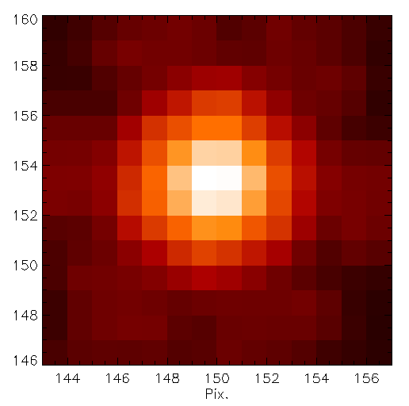
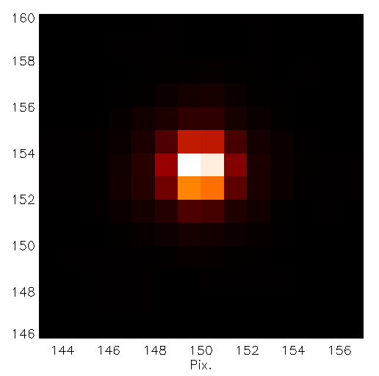
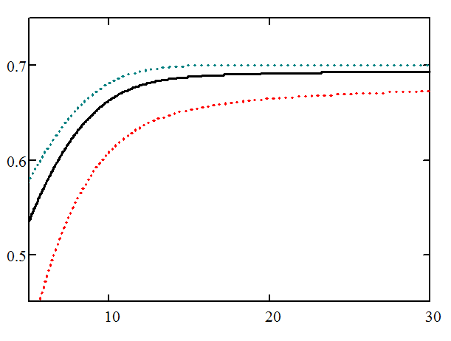
Image sampling and Encircled Energy
What do the image/sampling dimensions look like in practice?
This is an F560W test image from GSFC testing (CV3 campaign, 2013)
Log₁₀ image scale (3 orders of magnitude).
The photometric aperture is predicted to include ~ 58 % of the flux from a point source at F560W.
Linear image scale.
The FWHM of the image is ~ 1.6 pixels. (> 2 pixels for λ > 7 microns).
Fraction of point source flux included in photometric aperture
Best Case
Nominal
Worst case
(Δfocus = 5 mm
Δpupil = 2 %, etc)
14 pixels = 1.54 arcseconds
Wavelength [μm]

Slide 11
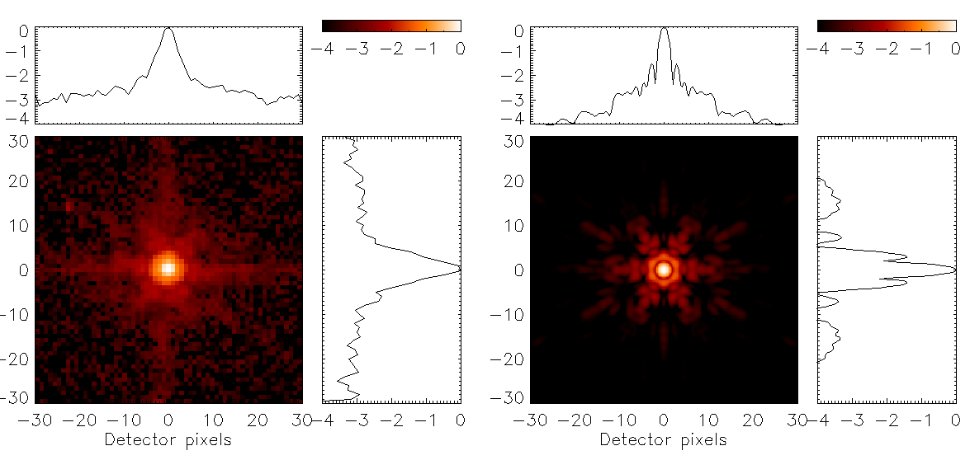
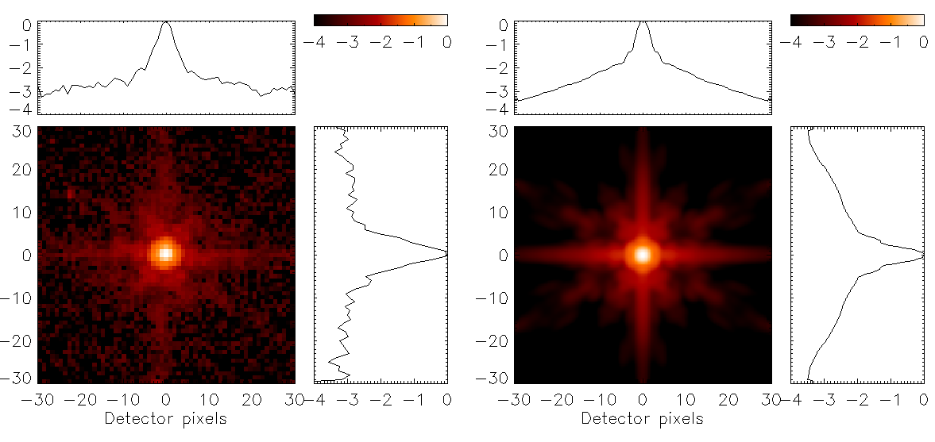
Image quality
MIRI’s PSF is well described at long wavelengths by the JWST’s diffraction profile.
At short wavelengths (F560W, F770W filters) a cruciform pattern appears, at a level comparable to the telescope diffraction spikes. Identified with scattering in the detector.
A model has been developed using PSF and out-of-field straylight test data which predicts that 22 % of the point source light at F560W is scattered into the cross (11 % for F770W).
CV2 F560W image of OSIM IR LED
Model JWST diffraction limited PSF
Model MIRI PSF, including scattering.

Slide 12
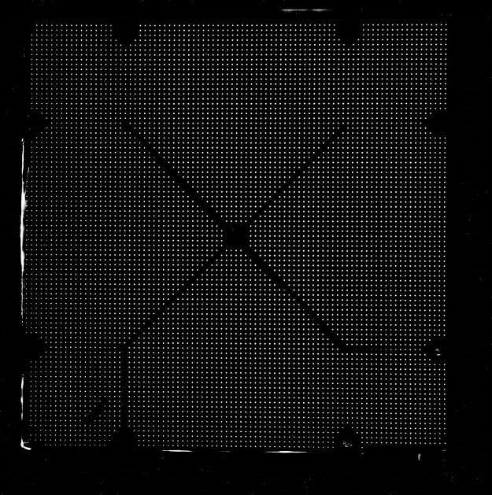
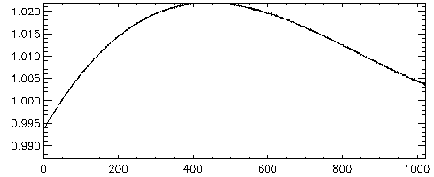
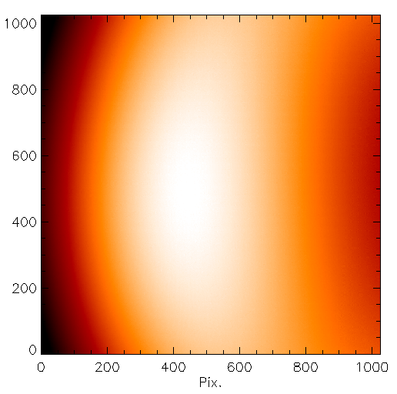
Field distortion
Measured using a 7600 point source grid target plate with at CEA.
The pixel area projected onto JWST focal plane varies by < 4 %.

Slide 13
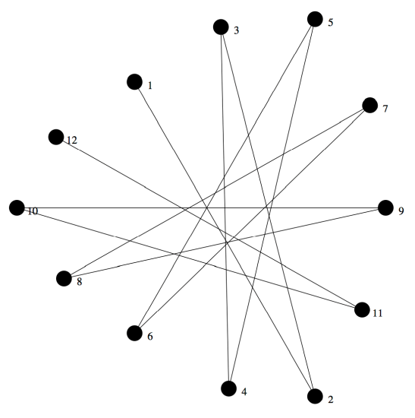
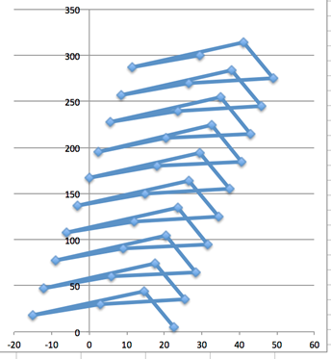
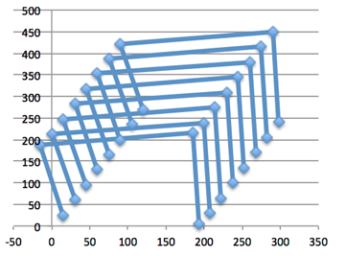
Dither Patterns from the MIRI OCD.
In order to achieve the optimum sensitive performance from MIRI’s detectors, the target must be moved on the detector every few minutes a distance > several λ / D. (several = 6).
In general, the observations will be differenced to remove the background level. This will add noise (√2 for faint sources). This will be budgeted by the ETC.
A range of patterns will be provided, consistent with the support of self-calibration. (measurement of flat field and background levels using ‘empty’ parts of the science data set).
In general they are scaleable and will include a simple 2 point dither.

Slide 14
MIRIM Strengths and Weaknesses
Strengths
Built by heroes.
The MIRIM detector has great cosmetics (less than 300 dead, hot or noisy pixels in the science field).
Does everything we asked for in 2003.
Weaknesses
Columns 385/286 are shorted together.
That’s it.

Slide 15
End

