Slide 1
MIRI Low Resolution Spectroscopy
Sarah Kendrew
European Space Agency (Baltimore)
on behalf of the MIRI Team

Slide 2
Low-resolution Spectroscopy Overview
Design and operating principles
Focal plane locations
LRS testing & data
Preparing an LRS observation: slit vs. slitless
Performance
Strengths & weaknesses
Further reading:
Kendrew et al, PASP 2015 and SPIE 2016: MIRI LRS
Bouchet at al, PASP 2015: MIRI Imager
Glasse et al, PASP 2015: MIRI Sensitivity
Gordon et al, PASP 2015: MIRI Operations

Slide 3
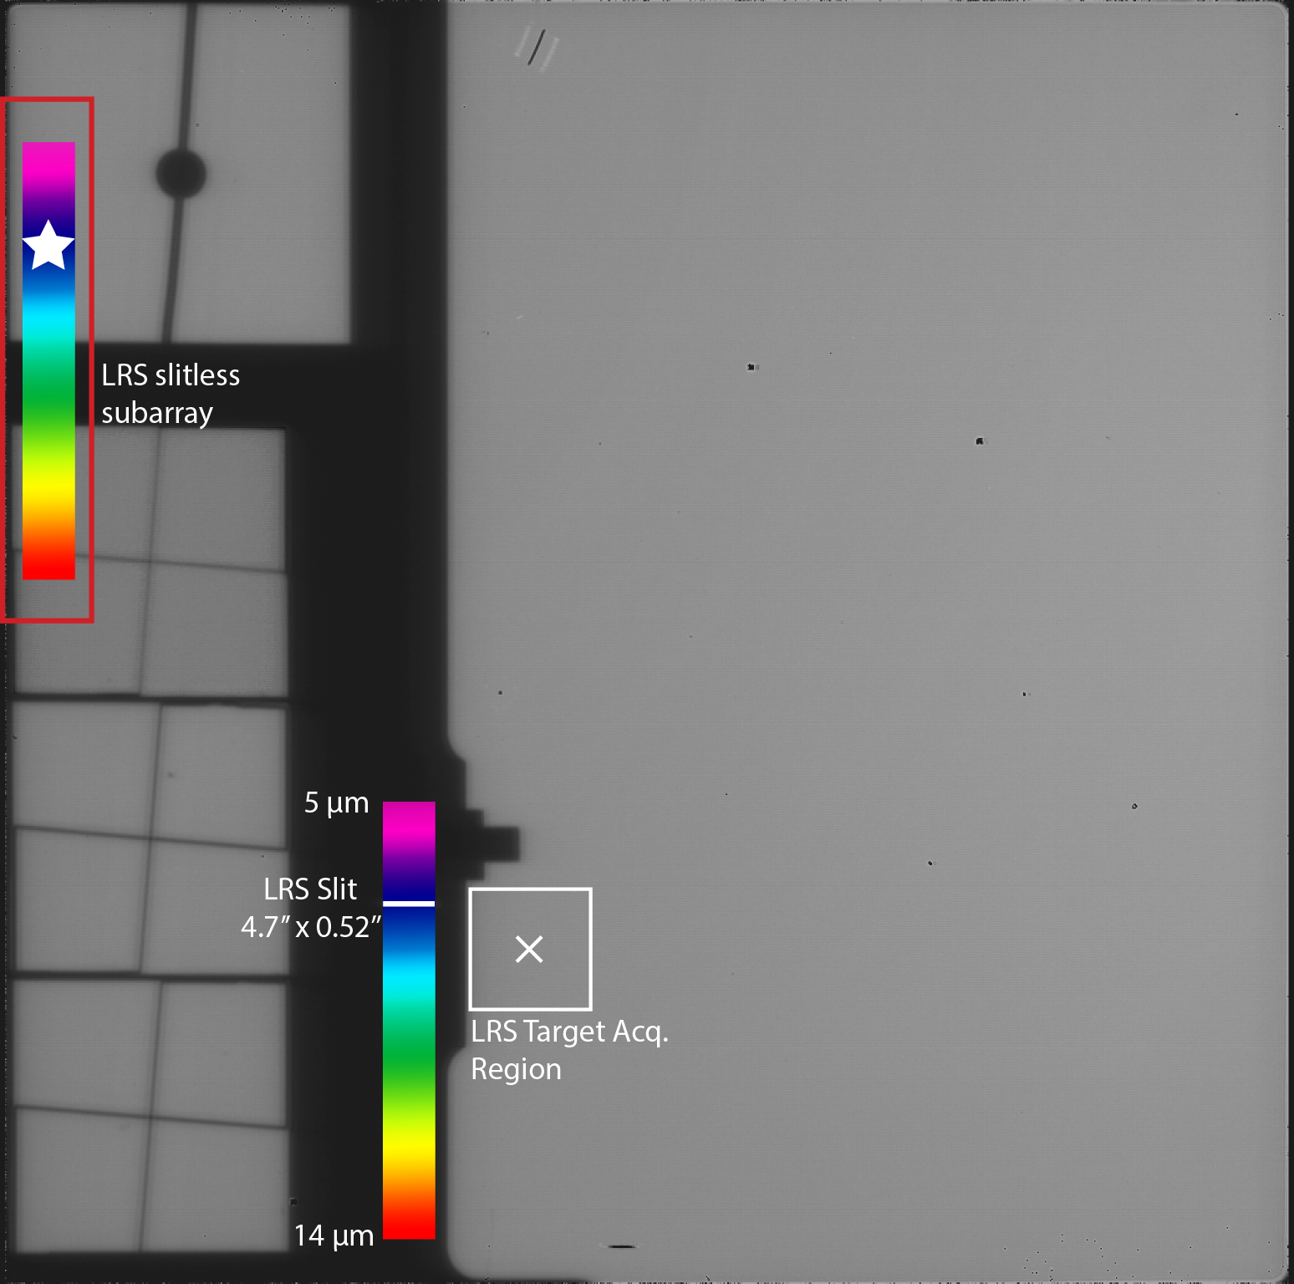
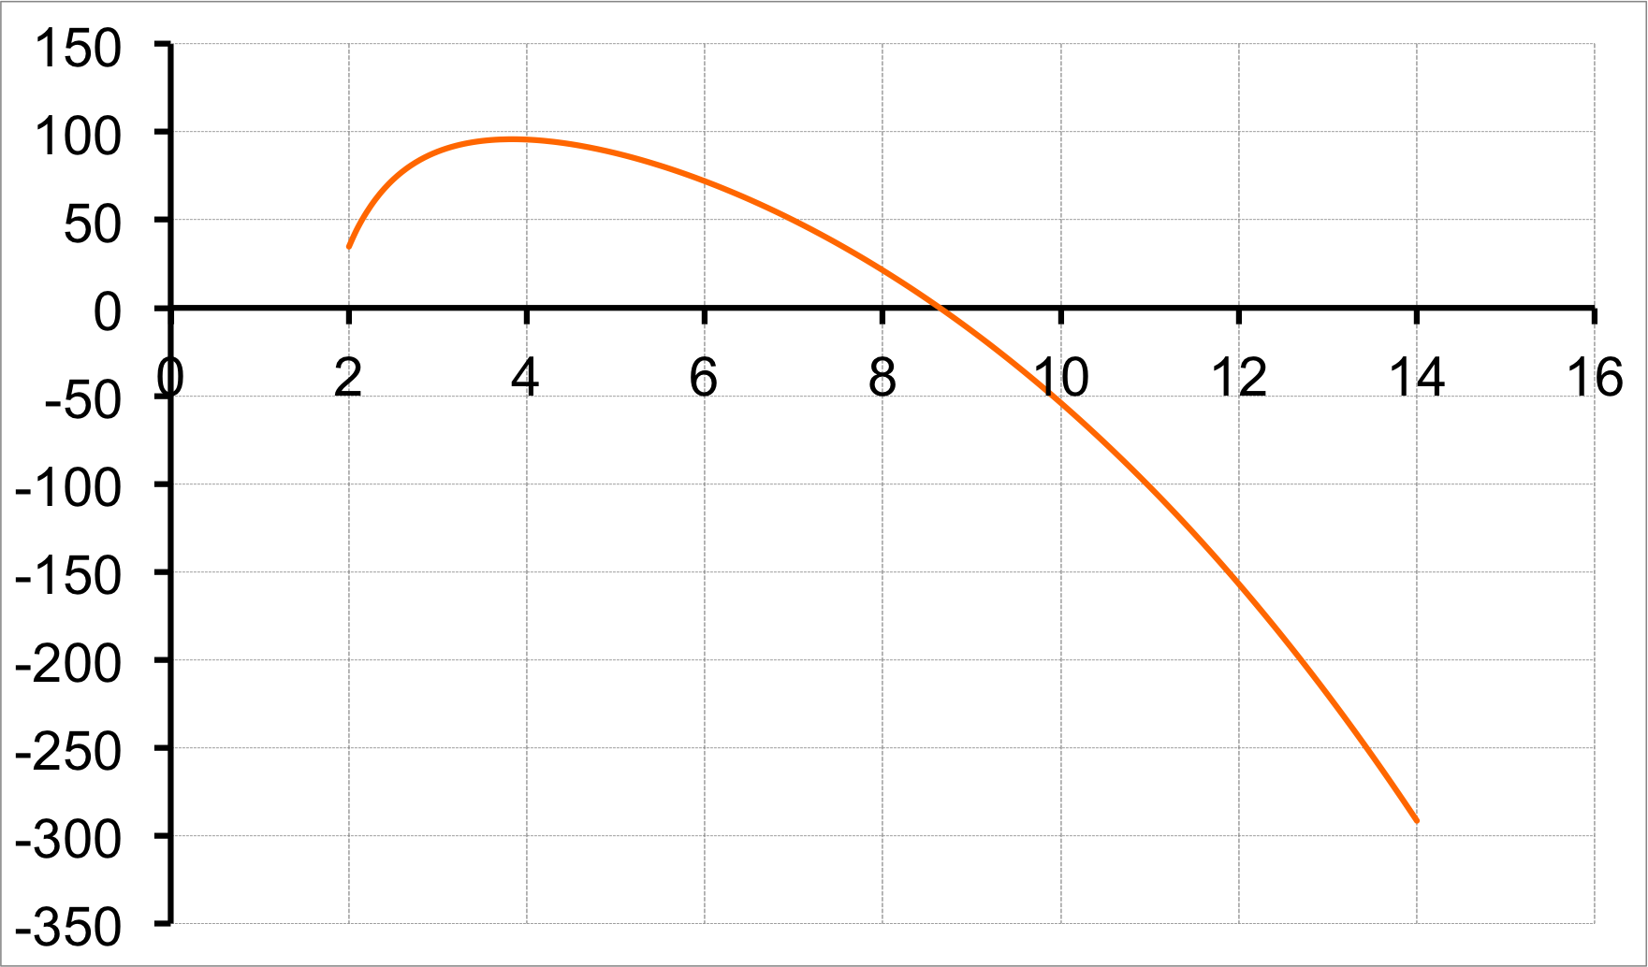
LRS Basics & Design
R ~ 100 spectroscopy of compact sources from 5- (10) 12 µm (~40 to 160 over the 5-10 µm range)
Can be operated in slitted (4.7 x 0.52”) or slitless mode
Shares focal plane with the imager & coronagraph modes
Dispersion via double prism in filter wheel
Imager focal plane
µm
px

Slide 4
Focal plane layout
Slitless spectroscopy:
Fixed pointing position
Subarray readout
Min. frame time 0.16s
Slitted spectroscopy:
Fixed slit location
Full array readout
Imager field not blocked
5-12 µm spectrum dispersed over ~370 px
Dedicated target acquisition region

Slide 5
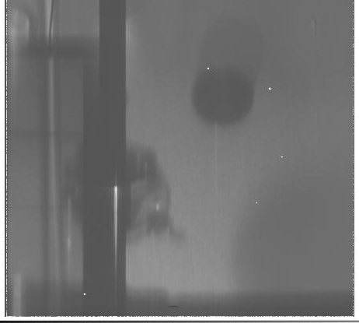

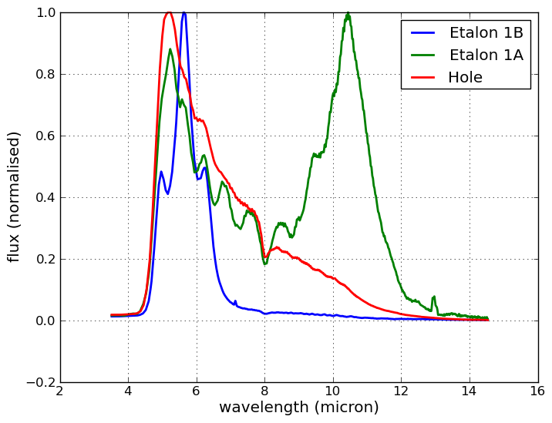
An LRS Spectrum

Slide 6
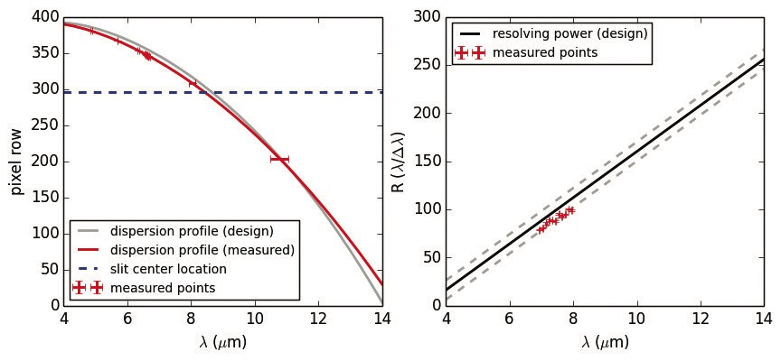
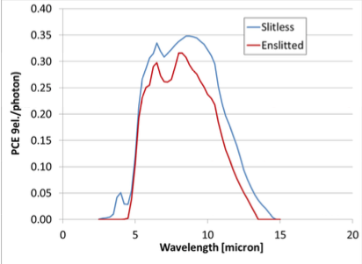
LRS Testing
Numerous test campaigns
MIRI Imager testing @ CEA Saclay, 2009-2010
MIRI flight test campaign @ RAL, 2011
CV campaigns @ Goddard, 2013-2016
JPL detector testing (persistence, subarrays etc
Further analysis & modeling
Sensitivity, PCE, detector yield (see Glasse, Dicken)
PSF modeling
(artefact)

Slide 7
Preparing an LRS observation: SLIT
Source: point or extended
Target acquisition:
Choice of 4 filters
Dedicated TA region
Not compulsory
Dithering
2 along-slit nods
Off-slit background
Read mode FAST/SLOW
Imager focal plane

Slide 8
Preparing an LRS observation: SLITLESS
Choice of slitless mode triggers Time Series Observation operational mode
Dedicated subarray & pipeline branch
Target acquisition (TBD):
Choice of 4 filters (NDF likely)
Centroiding in slitless subarray
NO Dithering
Max exposure time of 3 hours WAIVED
Min. frame time in FAST: 0.17s

Slide 9
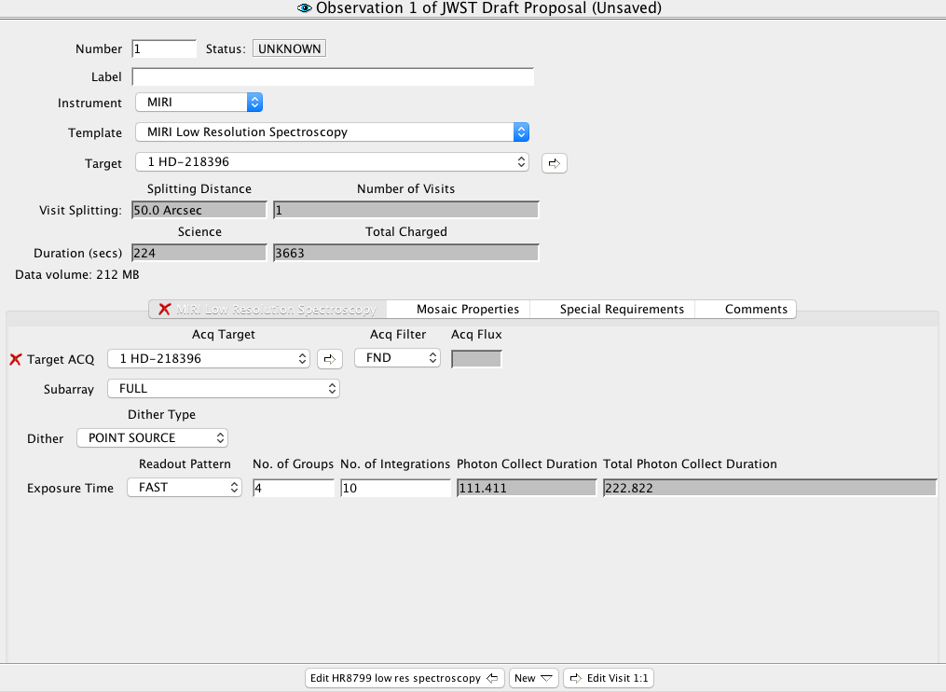
Astronomers Proposal Tool: LRS template
FULL
SLITLESS (SUBPRISM)
Point source
Extended target
SLOW
FAST
NGROUPS currently ≥ 4 (TBD)

Slide 10
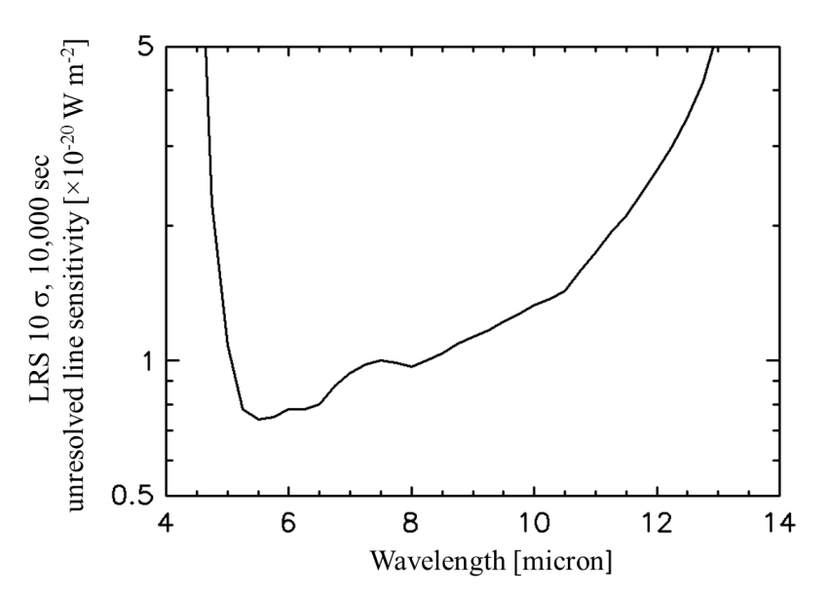
Performance: Line sensitivity (SLIT)
Glasse et al, PASP 2015 (erratum)
SLITLESS sensitivity: Factor ~10 worse
NB: does not yet include revised detector quantum yield

Slide 11
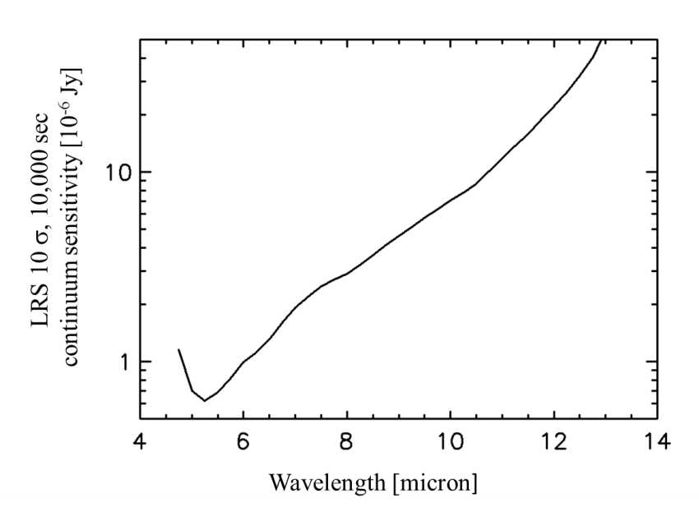
Performance: Continuum sensitivity (SLIT)
Glasse et al, PASP 2015 (erratum)
SLITLESS sensitivity: Factor ~10 worse
NB: does not yet include revised detector quantum yield

Slide 12
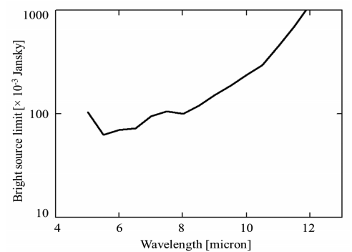
Bright limits (SLIT)
Glasse et al, PASP 2015
SLITLESS MODE: Factor 17 higher
Min value: 63 mJy @ 5.5 µm (K~8)
Assumes 2-frame reads, < 60% full well
Full array FAST mode (frame time ~3s)
NB: does not yet include revised detector quantum yield

Slide 13
Limitations/Open Questions
Slitless/Time Series Observations:
Effect of the turnover in dispersion?
Bright limits
Achievable stability & precision for very short ramps
Calibration data products based on ground test data
Focused on nominal range of 5-10 µm
PSF model not yet optimal
Wavelength calibration for λ < 5 µm and λ > 10 µm has larger uncertainties
µm
px

Slide 14
LRS strengths & weaknesses
STRENGTHS
Built by the same heroes as the MIRI Imager
Meets & exceeds requirements e.g. wavelength coverage
Excellent complement to MRS and NIR spectroscopic modes: low-resolution, instantaneous broad wavelength coverage
Slitless mode offers the ability to perform high-quality time series observations, e.g. suitable for MANY exoplanet host stars
WEAKNESSES (/CAVEATS)
Spectral foldover below 4.5 µm unmitigated for slitless mode
Calibration not yet optimal, especially outside the nominal range

