Slide 1





Summary Single Object & Time Series Spectroscopy Jeff Valenti JWST Mission Scientist Space Telescope Science Institute

Slide 2
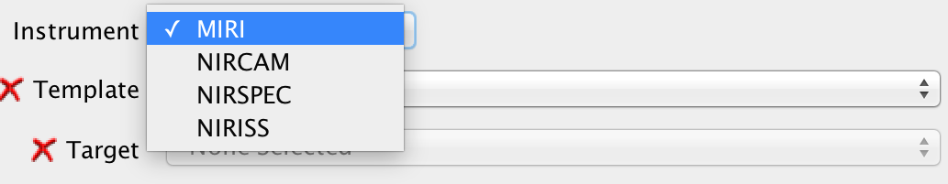
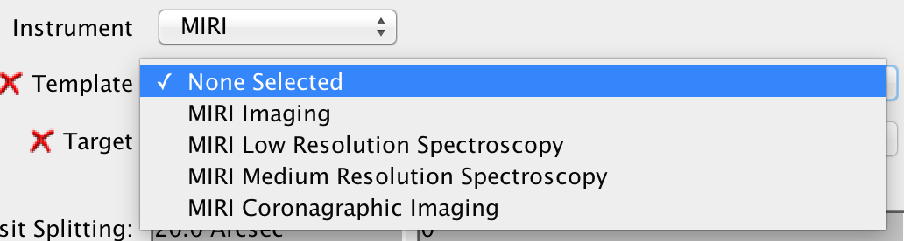
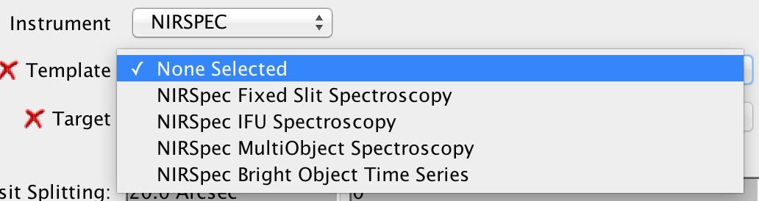
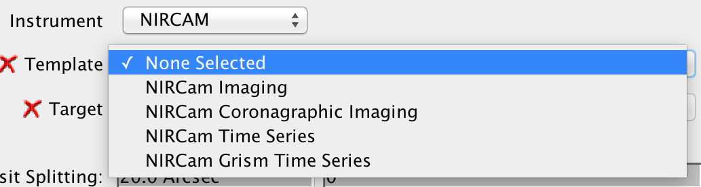
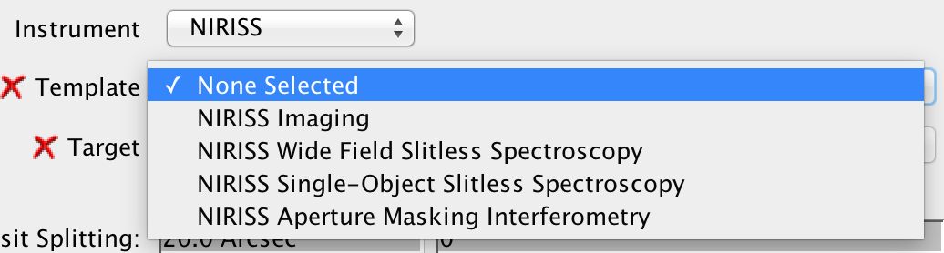
Relevant templates in APT
MIRI
NIRSpec
1
9
3
NIRCam
NIRISS
1
2
16 optical configurations for single object spectroscopy

Slide 3
Wavelength vs. resolution
Wavelength coverage
Continuum slope due to clouds, haze, etc.
Spectral resolution
Detect narrow spectral features
Bin pixels to improve systematics
Wavelength coverage requires more visits

Slide 4
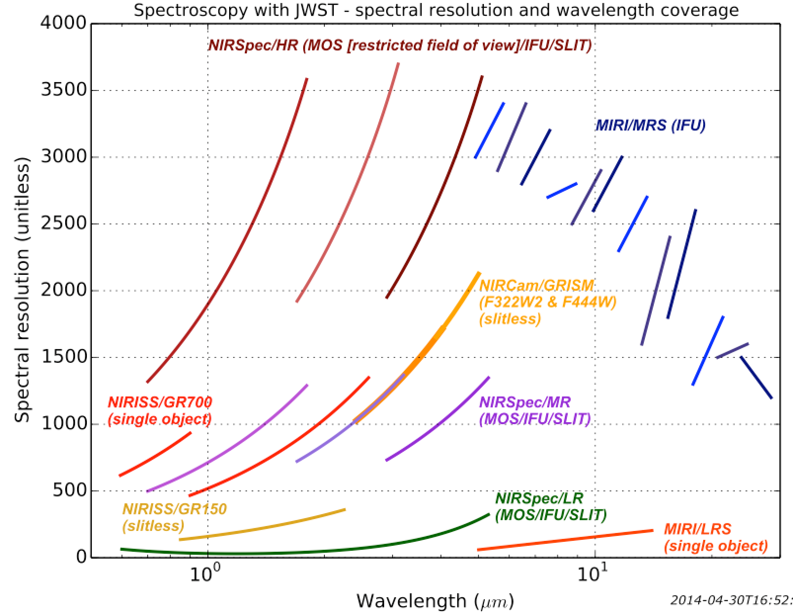
Spectral resolution, wavelength coverage
7 configs 0.7–28 µm R~2700
Original figure from Pierre Ferruit
2 configs 0.6–12 µm R~100
0.6
1
2
3
4
5
7
10
20
Notes:
Full wavelength coverage: 2 settings at low resolution, 7 setting at high resolution
Each setting is a separate transit, eclipse, or phase curve.

Slide 5
Faint targets
Use NIRSpec and MIRI slits.
Wavelength coverage is 0.6-12 µm (2-5 settings).
NIRCam and NIRISS do not have slits.
A slit reduces dispersed background.
Line and continuum sensitivities are better.
NIRSpec is ~2-5x more sensitive than NIRCam.
MIRI slit is ~10x more sensitive than MIRI slitless.

Slide 6
When to use an IFU
Beyond ~12 µm, use MIRI MRS.
No other choice. Diffraction from slice edges.
5-28 µm (3 settings). High resolution.
Below 5 µm, use NIRSpec slits.
Slit spectra have no contamination.
MSA light leaks contaminate IFU spectra.
Contemporaneous calibration takes time.
For 2D spectra, use NIRSpec IFU.

Slide 7
Saturation limits
Inst | Disperser | Filter | λ | Limit | #G | FW | Amp | Subarray
NRS | PRISM | CLEAR | 0.6–5.3 | J>9.8 | 1 | 90% | 1 | 2048x32
 | G140H | F100LP | 1.0–1.9 | J>6.6
 | G235H | F170LP | 1.7-3.1 | J>5.9
 | G395H | F290LP | 2.9–5.2 | J>5.1
NIS | GR700XD |  | 0.6–2.8 | J>7.2 | 1 |  | 1 | 2048x256
 |  |  | 1.0–2.8 | J>6.0 |  |  |  | 2048x80
NRC | GRISMR | F322W2 | 2.4–4.0 | K>4.6 | 2 | 80% | 4 | 2048x64
 | GRISMR | F444W | 3.9–5.0 | K>3.7
MIR | LRS |  | 5.0–12 | K>5.4 | 2 | 60% |  | 416x72
G2V, no saturation at any wavelength

Slide 8
How an aperture affects precision
Target motion changes clipping of PSF wings.
Target drift can cause systematic variations.
Star tracker pixels and mounts, thermal changes.
Flux variations depend on target offset.
NIRSpec has a 1.6" x 1.6" square aperture.
7 mas jitter causes 40 ppm variations [Dorner PhD].
Star tracker errors cause offset along spatial axis.
Optimal extraction not affected by spatial wings.
Use spatial offsets to improve flux precision.

Slide 9
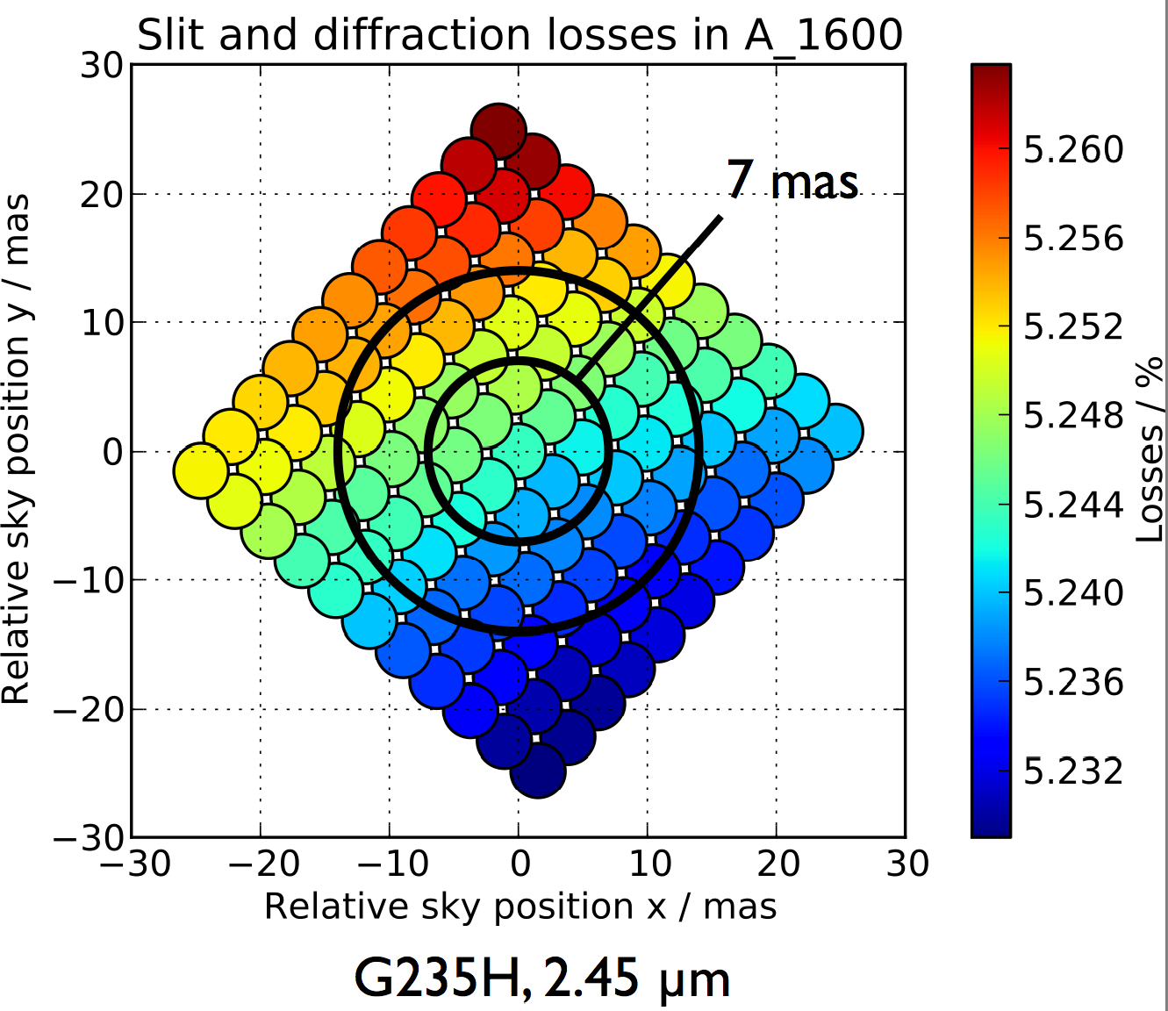
Slit losses in NIRSpec square aperture
1σ Jitter
From PhD thesis Bernhard Dorner

Slide 10
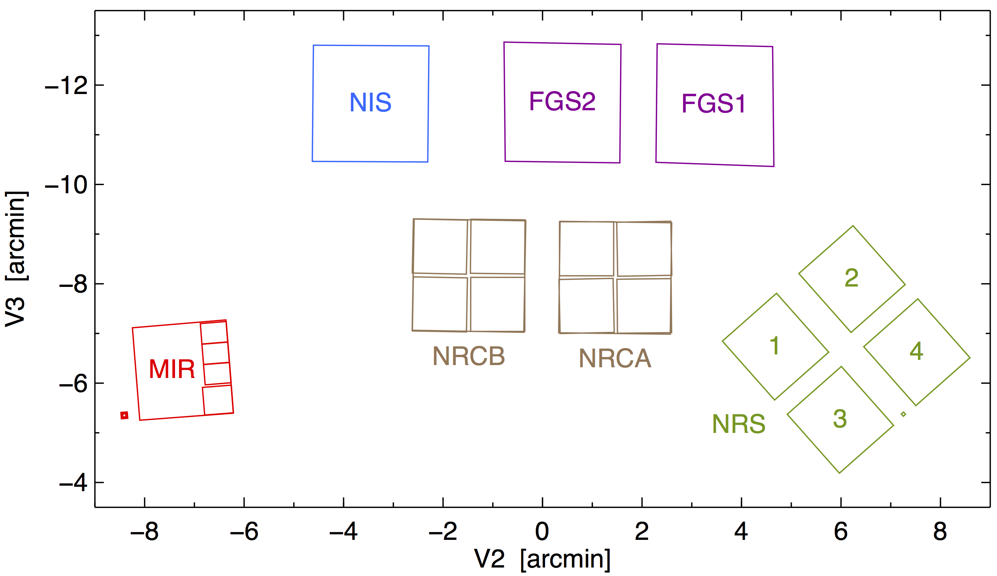
Roll drift is perpendicular to dispersion
Check location of spectrum for NIS and NRC.
Notes:
Four science instruments, one guider, total of 17 detectors.
Numerous modes: imaging, single-object spectroscopy, multi-object spectroscopy, slitless spectroscopy, integral field spectroscopy, coronagraphy, aperture mask interferometry, time series (exoplanet).
Fine Guidance Sense keeps guide star at precise location in the focal plane. 7 mas jitter, 1 axis
Attitude control system uses star trackers to measure observatory roll angle. Roll jitter moves target tangent to radius from guide star.

Slide 11
Slit vs. Slitless
Slit causes flux variations as target moves.
Correct by comparing with spectrum location.
Determine ultimate precision on orbit.
Slitless spectra may be affected by neighbors.
Choose orientation to minimize contamination.
Equal sensitivity to other error sources.

Slide 12
Factors to consider for time series
Wavelength coverage
Spectral resolution
Bright limit
Variable slit losses due to target motion
Contamination by neighboring sources

Slide 13
Additional factors to consider
Bright limit
Spatial smearing
Proximity of spectrum to edge of subarray.
Repeatability of spectrum location.
Magnitude and direction of target motion.

