Slide 1
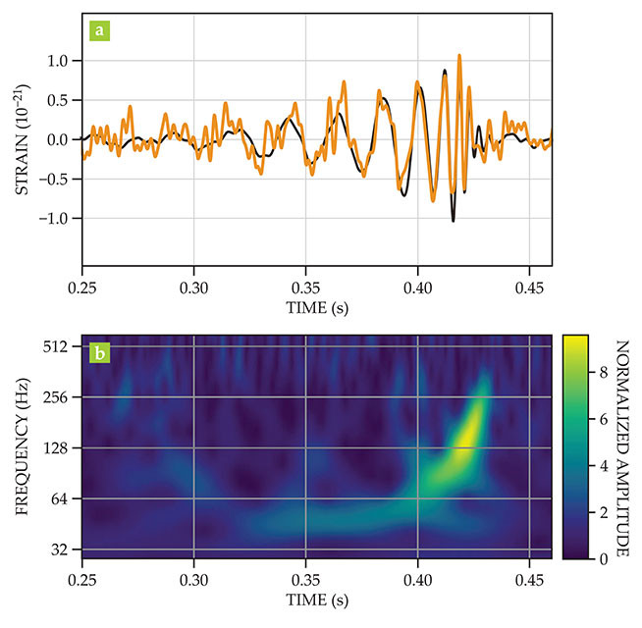
Figure 1. The chirp of GW150914, the first gravitational-wave event to be detected. (a) On 14 September 2015, the two detectors of the Laser Interferometer Gravitational-Wave Observatory observed the effects of gravitational waves: an oscillating change in the separation of test mirrors in their arms. When divided by the length of a detector arm, the separation change is called strain. Shown here are the strain results (orange) taken at the Hanford interferometer (the black curve is a theoretical fit); the data from the Livingston interferometer are remarkably similar. Visual inspection reveals that the frequency and amplitude of the gravitational-wave chirp increase with time. (b) A spectrogram obtained from the Hanford data shows the time–frequency relation explicitly. (Panels adapted from ref. 1.)
Published in: Daniel E. Holz; Scott A. Hughes; Bernard F. Schutz; Physics Today 2018, 71, 34-40.
DOI: 10.1063/PT.3.4090
Copyright © 2018 American Institute of Physics

