Slide 1
ADVECTION-DOMINATED ACCRETION
Ramesh Narayan

Slide 2
Why Do We Need Another Accretion Model?
Black Hole (BH) accretion is not as simple as people originally hoped
Standard thin accretion disk model (Shakura & Sunyaev 1973; Novikov & Thorne 1973) is a great model for some sources
But other sources – and even the same source at different times – are not consistent with the thin disk model
If we want to go beyond empirical data-fitting, we need additional physical models

Slide 3
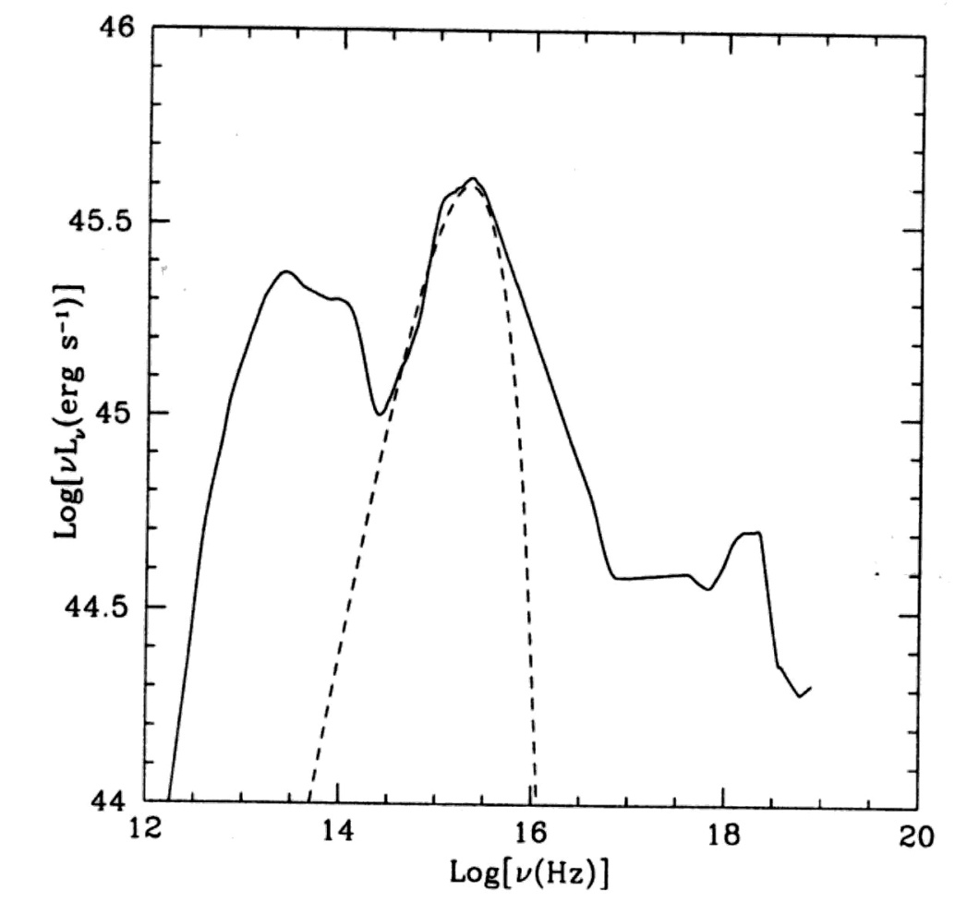
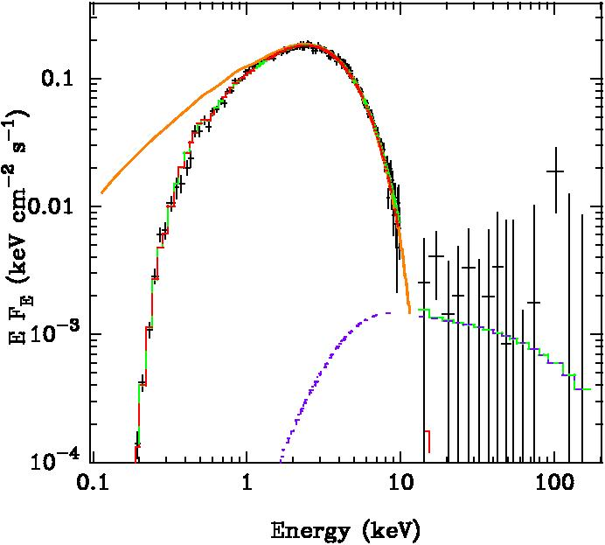
Thin Disk Systems
BBB
Composite quasar spectrum (Elvis 1994)
LMC X-3 in the thermal state (Davis, Done & Blaes 2006)

Slide 4
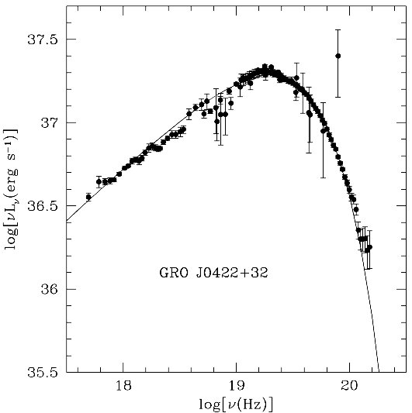
Problem 1
BH XRBs have spectral states other than the Thermal State
Many BH XRBs are seen in the Hard State, with a temperature of ~100 keV
Usually at: L  0.03L_{Edd}
We also have the mysterious Steep Power Law State
The same object can be found in different states
GRO J0422+32 in outburst (Esin et al. 1998)

Slide 5
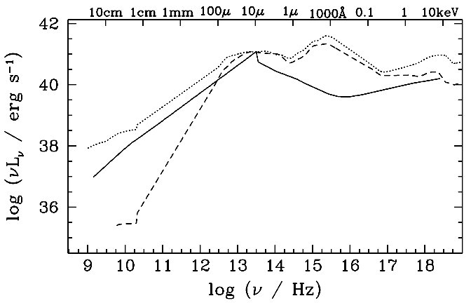
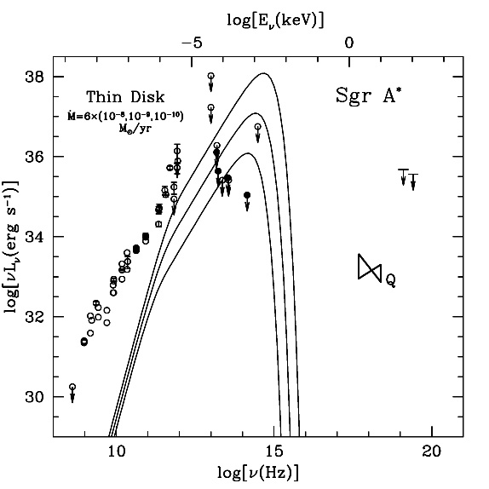
Problem 2
RL AGN
LLAGN
Low-luminosity AGN (LLAGN) do not seem to have a Big Blue Bump in their spectra
(Eracleous et al. 2008 Nemmen et al. 2008)
Lack of BBB is even more obvious in quiescent nuclei, e.g., Sgr A*
RQ AGN
Ho (2005)

Slide 6
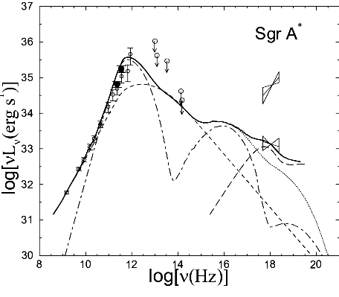
Problem 3
Quiescent nuclei are extremely underluminous:
  Sgr A* has a mass supply rate of about 10⁻⁵ M/yr ~ 10⁻⁴ Mdot_{Edd}, but its luminosity is ~10⁻⁹ L_{Edd}
  Similar situation in the nucleus of virtually every nearby galaxy (Fabian & Canizares 1988)
Sagittarius A* (Yuan et al. 2003)

Slide 7
Problem 4
AGN come in two flavors: radio loud (jet activity) and radio quiet
Radio loud AGN themselves come in two flavors: FRI and FRII
BH XRBs sometimes have jets – steady or impulsive – and sometimes not
Suggests that there are multiple accretion states…

Slide 8
Steady Accretion Solutions
(Frank, King & Raine 2002)
Spherical accretion (Bondi 1952) X (no angular mmtm)
Thin accretion disk (Shakura & Sunyaev 1973; Novikov & Thorne 1973) 
Two-Temperature solution (Shapiro, Lightman & Eardley 1976) X (thermally unstable)
Advection-Dominated Accretion Flow, ADAF (Narayan & Yi 1994, 1995; Abramowicz et al. 1995;…) 

Slide 9
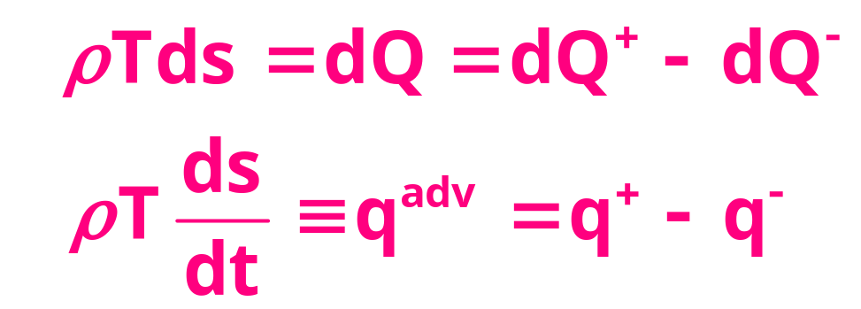
Energy Equation
Accreting gas is heated by viscosity (q⁺) and cooled by radiation (q⁻). Any excess heat is stored in the gas and transported with the flow. This represents “advection” of energy (q^{adv})

Slide 10
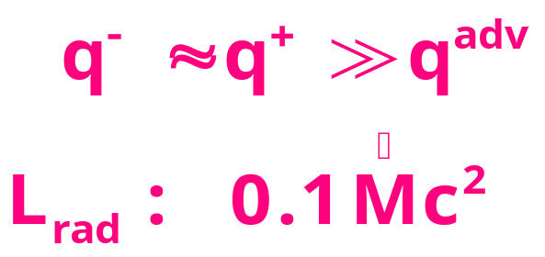
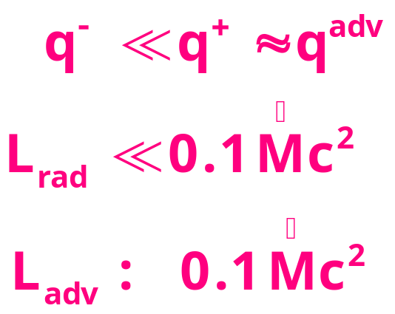
Energy Equation q⁺ = q⁻ + q^{adv}
Thin Accretion Disk
Most of the viscous heat energy is radiated
Advection-Dominated Accretion Flow (ADAF)
Most of the heat energy is advected with the gas

Slide 11
Conditions to have an ADAF
An ADAF is present if
  The gas is unable to radiate its heat energy in less than an accretion time. This requires Mdot  10^{-1.5} Mdot_{Edd}, where Mdot_{Edd} ~ 10⁻⁸ (M/M) M/yr (radiatively inefficient ADAF or RIAF; Narayan & Yi 1995), OR
  The radiation is trapped and unable to escape in less than an accretion time. This requires Mdot  Mdot_{Edd} (slim disk; Abramowicz et al. 1988)
If either condition is satisfied, we have an ADAF
If both conditions are violated, then we have a thin disk

Slide 12
Understanding the Basic Properties of ADAFs
A simple analyical solution would be helpful for understanding the basic qualitative properties of ADAFs
Fortunately such a solution exists

Slide 13
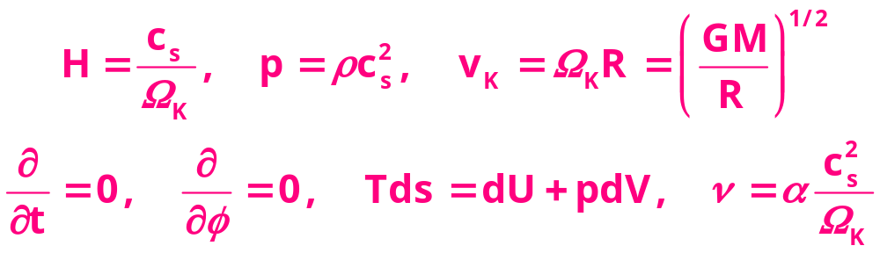
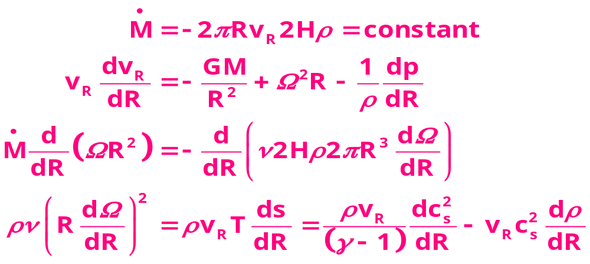
Height-Integrated ADAF Equations

Slide 14
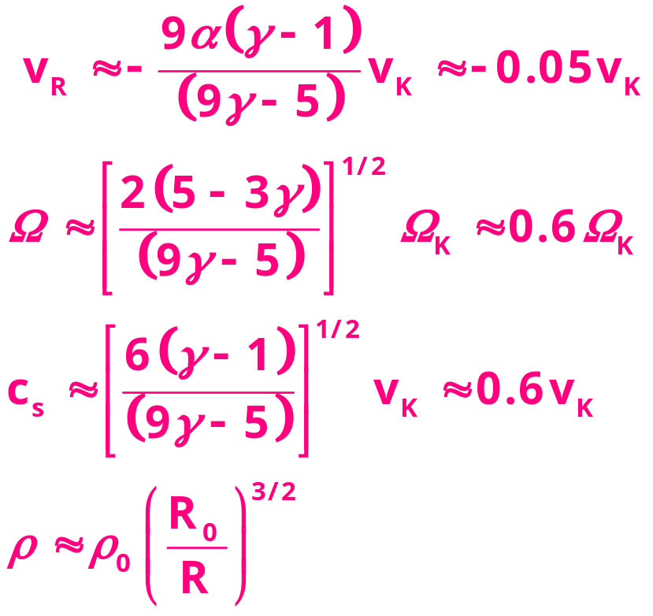
Self-Similar ADAF Solution
Although the ADAF equations look complicated, they have a simple self-similar solution in which all quantities vary as power-laws of the radius (Narayan & Yi 1994)
This solution allows us to understand the key properties of an ADAF
=1.5, =0.1

Slide 15
Limitations of the Self-Similar Solution
Great for physical understanding but not for detailed models
Ignores boundary conditions, so it is not good near boundaries, e.g., near the BH
Probably it is a good representation away from the boundaries

Slide 16
Properties of ADAFs: 1
ADAFs are particularly good at generating powerful winds and relativistic jets
Lecture 3

Slide 17
Properties of ADAFs: 2
Large pressure: c_{s} ~ 0.6 v_{K}
  Very hot: T_{i} ~ 10¹²K/r, T_{e} ~ 10⁹⁻¹¹K (virial, since ADAF loses very little heat)
  Geometrically thick: H/R ~ c_{s}/v_{K} ~ 0.6
  Sub-Keplerian rotation:  < _{K}
Very low density
The ADAF is thermally stable

Slide 18
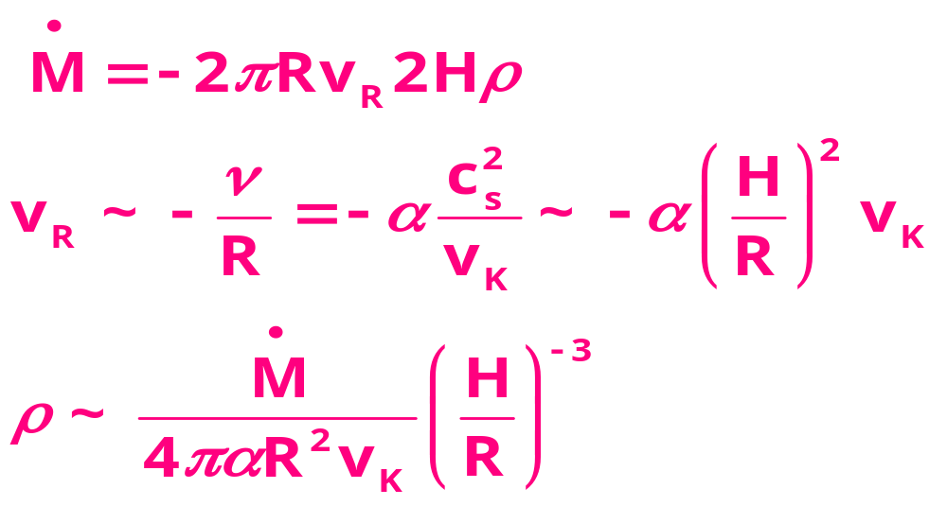
Low Density
For a given Mdot, the density is a very steeply decreasing function of increasing H/R
At the same Mdot, it is possible to have a geometrically thin disk with high density and efficient cooling, as well as a thick ADAF with high density and low optical depth which is radiatively inefficient

Slide 19
Characteristic Spectrum
High temperature plus low optical depth → emission is dominated by thermal synchrotron and/or inverse Compton scattering
Examples:
  Sgr A* : thermal synchrotron (T_{B} > 10¹⁰ K) Quiescent State
  J0422+32 : Comptonization (kT 100 keV) Hard State

Slide 20
Radiation from an ADAF
Hot electrons with temperature >10⁹K radiate primarily via
  Thermal synchrotron
  Thermal bremsstrahlung
  Comptonization:
    Synchrotron self-Compton (SSC)
    External soft photons from disk (EC)
Ions (>10¹¹K)hardly radiate (pion production?)

Slide 21
ADAF Geometry
External
Medium
Optically thin
Very very hot/ non-thermal
Synchrotron, Bremsstrahlung,Compton-scatt.
ADAF
Thin Disk
ADAF

Slide 22
Is Two-Temperature Assumption necessary?
ADAF models in the literature assume that the accreting plasma is two-temperature
Without this assumption electrons become highly relativistic (T_{e}~10¹²K → _{e}>100)
Such relativistic electrons will radiate copiously under most conditions and the flow will be radiatively efficient
That is, we will have a standard thin disk, not an ADAF (actually, once the disk becomes thin, the temperature will fall drastically)

Slide 23
Why is the Plasma Two-Temperature?
Two effects contribute:
Heating rates of ions and electrons are unequal
  Viscous heating may preferentially act on ions (?)
  Compressive heating favors the ions once the electrons become relativistic
Thermodynamic equilibration of ion and electron temperature is prevented by poor Coulomb coupling between the particles (?)

Slide 24
Compressive heating
Effect of adiabatic compression on the temperature of particles:
T ~ ^{(-1)}
Once the gas in an ADAF reaches r<10³ we have kT_{e}>m_{e}c², so electrons become relativistic and →4/3
Beyond this point, T_{i}~^{2/3} whereas T_{e}~^{1/3}
As a result ions heat up more rapidly

Slide 25
ADAF vs Jet
ADAFs are naturally associated with Jets
Observed radiation is a combination of emission from ADAF and Jet
Radiation from thermal electrons likely to be from the ADAF
Radiation from power-law electrons likely to be from the Jet

Slide 26
Properties of ADAFs: 3
Thin disk to ADAF/RIAF boundary occurs at luminosities L ~ 0.01—0.1 L_{Edd}, or Mdot_{crit} ~ 0.01—0.1 Mdot_{Edd} (for reasonable model parameters:  ~ 0.1)
Location of the boundary is consistent with the typical L_{acc} at which BH XRBs switch from the Thermal state to the Hard state

Slide 27
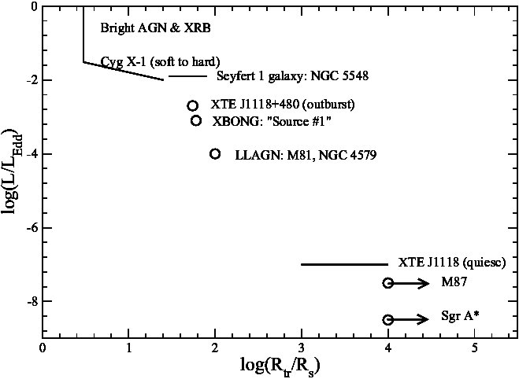
Roughly at luminosity ~0.01-0.1L_{Edd} :
BH XRBs switch from the Thermal state to the Hard state (Esin et al. 1997)
AGN switch from quasar mode to LINER mode (Lasota et al. 1996; Quataert et al. 1999)
Yuan & Narayan (2004)

Slide 28
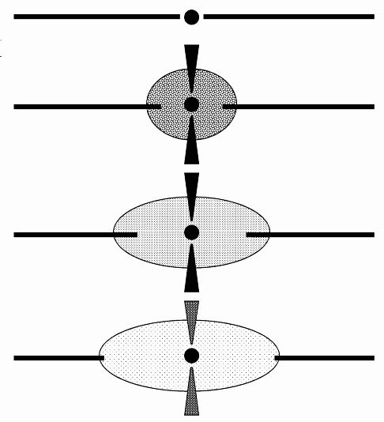
Accretion Geometry vs Mdot
Mdot
Mdot is the primary parameter that determines Thin Disk to ADAF boundary
But there are definite hysteresis effects…
BH spin probably has some effect – perhaps minor?
No idea what to do with SPL

Slide 29
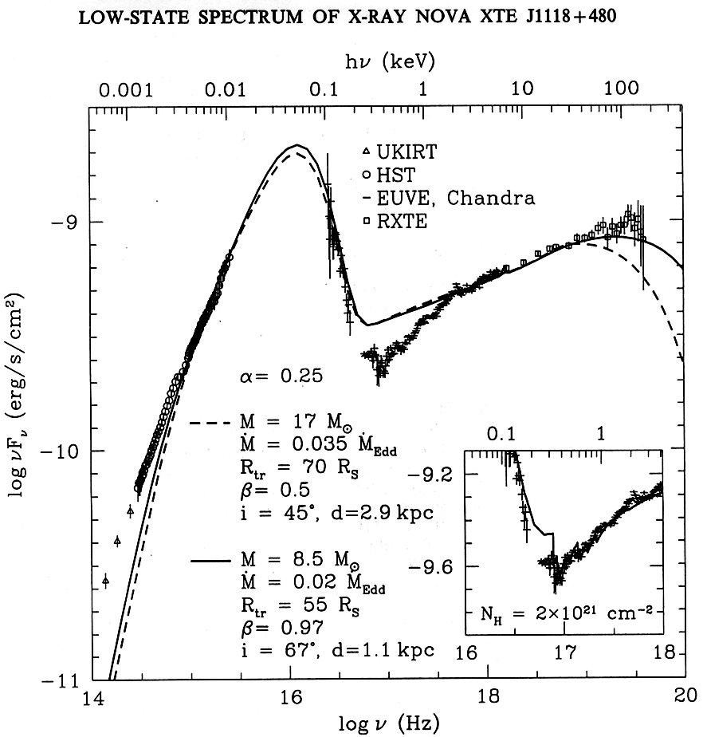
Esin et al. (2001)

Slide 30
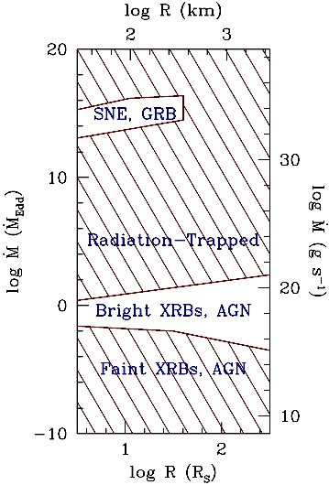
Mdot Regimes: Thin Disk vs ADAF
Thin disk is found in unshaded areas:
  Lower regime corresponds to bright XRBs and AGN
  Upper regime corresponds to SNe and GRBs
ADAF is found in shaded areas:
  Radiation-trapped ADAF (slim disk, Abramowicz et al. 1988)
  Radiatively inefficient ADAF (RIAF, Narayan & Yi 1995).
ADAFs cover huge parameter space
(M = 3M)

Slide 31
ADAFs Are Everywhere
Thin disk systems are bright (high Mdot, high efficiency) and tend to dominate observational programs
ADAFs are much fainter, and harder to observe, but they occupy a very large range of parameter space
Probably >90% (>99%?) of BHs in the universe are in the ADAF phase!
(Narayan & McClintock: New Astronomy Reviews, 51, 733, 2008; astro-ph/0803.0322; Done et al. A&AR, 15, 1, 2007)

Slide 32
ADAFs around Stellar-Mass BHs
ADAFs are found in
  Quiescent State
  Hard State
  Many Intermediate States
  But NOT the Steep Power Law State

Slide 33
ADAFs around SMBHs
Sgr A*
Nearby Giant Ellipticals
LINERs
FRI sources
LLAGN
BL Lacs
Some Seyferts
XBONGs

Slide 34
Modeling ADAF Systems
Preferable to use a global solution rather than self-similar solution
Synchrotron and bremsstrahlung emission are easy to calculate
Comptonization calculation is harder
Expert: Feng Yuan (Shanghai)

Slide 35
Accretion History of SMBHs
Bright AGN have thin disks, LLAGN have ADAFs
SMBHs produce most of their luminosity in the thin disk phase (quasars, bright AGN)
SMBHs spend most of their time (90-99%) in the ADAF phase (quiescence)
In which phase do SMBHs accrete most of their mass? Answer: Thin disk (Hopkins et al. 2005)

Slide 36
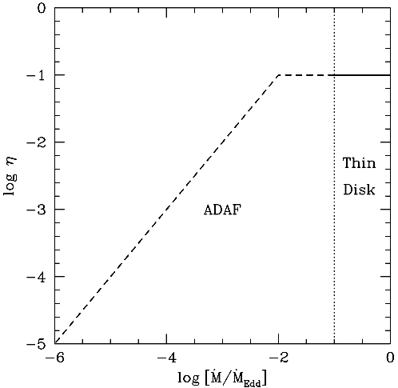
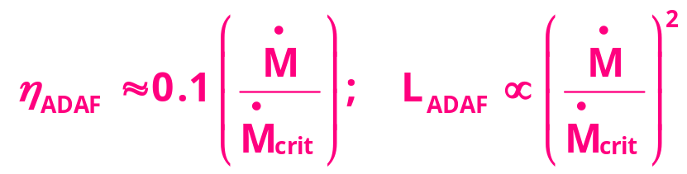
Properties of ADAFs: 4
By definition, an ADAF has low radiative efficiency
Roughly, we expect a scaling (Narayan & Yi 1995)
Extreme inefficiency of Sgr A* and other quiescent BHs is explained (Narayan, Yi & Mahadevan 1995; Narayan, McClintock & Yi 1996; Di Matteo et al. 2000;…)

Slide 37
ADAFs and Black Hole Physics
All accretion flows are potential tools to study the physics of the central BH
ADAFs give us an opportunity to confirm the most basic feature of an astrophysical BH:
The presence of an Event Horizon
Has worked out surprisingly well

Slide 38
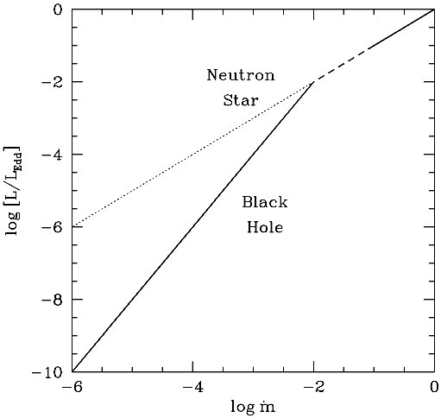
Event Horizon
NS XRBs and BH XRBs in quiescence have ADAFs with most of the energy advected to the center
BH XRBs should swallow the advected energy because they have Event Horizons
NS XRBs should radiate the advected energy from the surface
There should be a very large difference in luminosity
This is a test for the event horizon (Narayan, Garcia & McClintock 1997)

Slide 39
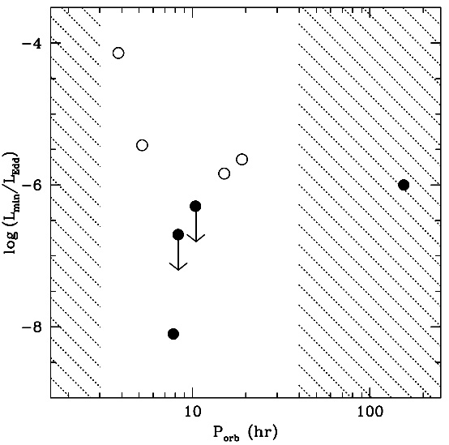
1997

Slide 40
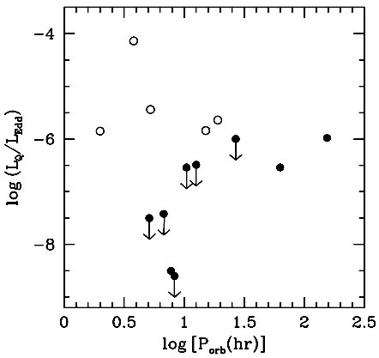
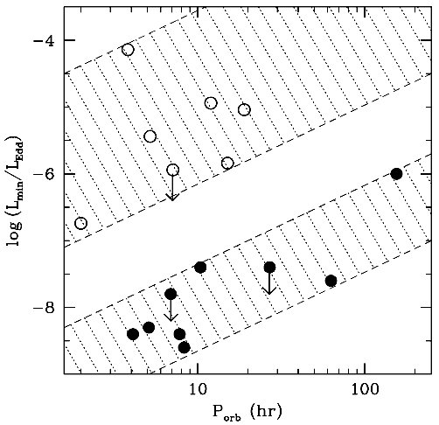
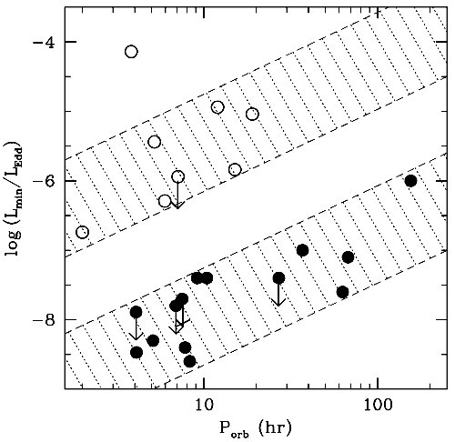
1997
2000
2002
2007

Slide 41
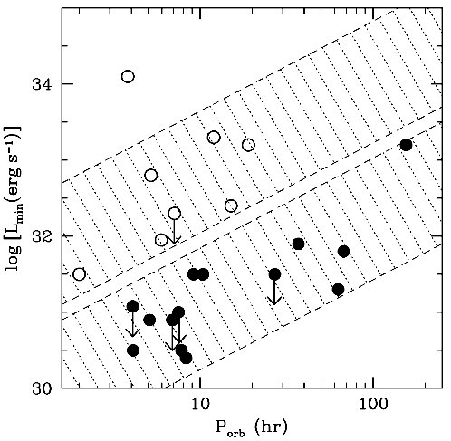
Binary period P_{orb} determines Mdot (Lasota & Hameury 1998; Menou et al. 1999)
At each P_{orb}, we see that L/L_{Edd} is much lower for BH systems. True also for unscaled L values. (Narayan et al. 1997; Garcia et al. 2001; McClintock et al. 2003; …)

Slide 42
The Bottom Line
Extremely strong signal in the data
There is no question that quiescent BHs are orders of magnitude fainter than NSs
Perfectly natural if BHCs have Event Horizons
The effect was predicted!
Other explanations are contrived

Slide 43
But One Key Assumption
The evidence for the EH from quiescent XRBs requires BH and NS systems to have similar accretion rates
That is, P_{orb} has to be a good proxy for Mdot
The argument would be stronger if we could avoid this assumption
We can do this with the Galactic Center

Slide 44
Black Hole Candidate at the Galactic Center
Dark mass ~4x10⁶ M at the Galactic Center (inferred from stellar motions)
A compact radio source Sgr A* is coincident with the dark mass (SMBH)

Slide 45
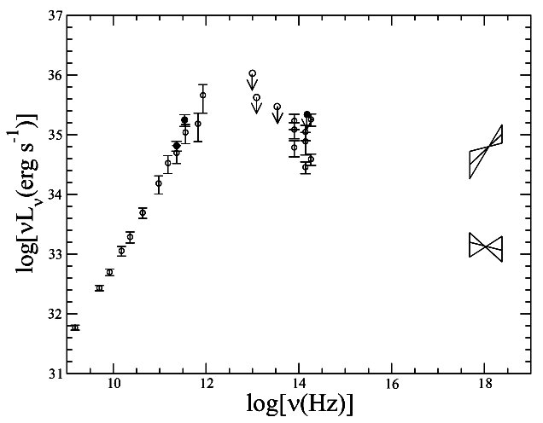
Luminosity and Spectrum of Sgr A*
Sgr A* is a rather dim source with a luminosity of ~10³⁶ erg/s
Most of the emission is in the sub-mm
Is this radiation from the accretion flow or from the surface?

Slide 46
The Surface Will Emit Blackbody-Like Radiation
Any astrophysical object that has been accreting for a long time (~10¹⁰ years) will radiate from its surface very nearly like a blackbody
Because
  Steady state → thermal equilibrium
  Highly optically thick

Slide 47
Sgr A* is Ultra-Compact
Radio VLBI images show that Sgr A* is extremely compact (Shen et al. 2005)
Size < 15GM/c²
Combined with the observed radio flux, this corresponds to a brightness temperature of T_{B}  10¹⁰ K

Slide 48
Brightness Temperature T_{B}
T_{B} is the temperature at which a blackbody would emit the same flux at a given wavelength as that observed
If the source is truly a blackbody, T_{B} directly gives the temperature of the object
If not, then
  temperature of the object is larger: T > T_{B}
  optically thin emission (semi-transparent)

Slide 49
Submm Radiation in Sgr A* is From Optically Thin Gas
Measured mm/sub-mm flux of Sgr A*, coupled with small angular size, implies high brightness temperature: T_{B} > 10¹⁰ K
Blackbody emission at this temperature would peak in  -rays (and would outshine the universe!!): L = 4R²T⁴ ~ 10⁶² erg/s
Therefore, the radiation from Sgr A* must be emitted by gas that is optically thin in IR/X-rays/-rays
Radiation must be from the accretion flow
Cannot be from the “surface” of Sgr A*

Slide 51
Surface Luminosity from an Accretion System
For accretion onto a compact object with a surface we expect
  Considerable radiation from the ‘boundary layer’ where the disk meets the surface
  For a typical thin disk L_{surface} ~ L_{accretion}
  Would be much more for an ADAF

Slide 52
Surface Emission from Sgr A*
Since we know L_{acc} ~ 10³⁶ erg/s, we predict: L_{surface}  10³⁶ erg/s
But where is this radiation?
There is no sign of it!
Could it somehow be hidden?

Slide 53
Expected Spectrum of the Surface Emission
The surface surely will be optically thick
Then the radiation is expected to be essentially blackbody-like (with modest spectral distortions)
We can easily estimate the temperature of the radiation from L_{surface} = (4R²) (T⁴)
For typical radii R of Sgr A*’s “surface,” the radiation is predicted to come out in the IR
No sign of this radiation

Slide 54
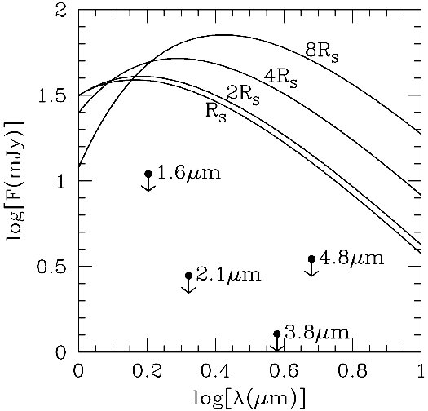
Based on Broderick & Narayan (2006)
All four IR bands have flux limits well below the predicted flux even though model predictions are very conservative (assume radiatively efficient)
→ Sgr A* cannot have a surface → Event Horizon → Black Hole

Slide 55
Summary of the Argument
The observed sub-mm emission in Sgr A* is definitely from the accretion flow, not from the surface of the compact object
If Sgr A* has a surface we expect at least ~10³⁶ erg/s from the surface
This should come out in the IR, but measured limits are far below prediction
Therefore, Sgr A* cannot have a surface
It must have an Event Horizon

Slide 56
Could the Mass be Ejected in a Jet or Outflow?
Could the mass simply escape without falling on the surface?
NO!! The energy source is gravity
Therefore, in order to produce the observed L_{acc}, mass MUST fall on the compact star
If the jet/outflow has a certain mechanical luminosity, then L_{surf}  L_{acc}+L_{mech}
So a jet only increases the predicted L_{surf} and makes the argument stronger

Slide 57
Can Strong Gravity Provide a Loophole?
In some very unusual models of compact stars (gravastar, dark energy star), it is possible to have a surface at a very small radius: R_{star}=R_{S}+R, R  R_{S}
Extreme relativistic effects are expected
Can relativity cause surface emission to be hidden? (Abramowicz, Kluzniak & Lasota 2002)

Slide 58
Effects of Strong Gravity
Radiation may take forever to get out
Surface emission may be redshifted away
Emission may not be blackbody radiation
Emission may be in particles, not radiation
Surface may not have reached steady state
None of these is capable of hiding the surface emission

Slide 59
One Key Assumption
The argument for an Event Horizon in Sgr A* makes one key assumption
  It assumes that the radio/sub-mm radiation is produced by accretion
One way out of an Event Horizon is to say that Sgr A* is powered by something other than accretion

Slide 60
Summary -- ADAFs
The ADAF accretion solution has many properties which are consistent with observations of Hard/Quiescent State:
  Temperature
  Mdot/L_{acc} regime
  Jets
  Low radiative efficiency
Plenty of ADAFs in the universe

Slide 61
Summary – Event Horizon
Several different tests for the presence of Event Horizons in astrophysical BHs
  Many involve ADAFs
  Some do not (Sgr A*, X-ray bursts)
Every test confirms the Event Horizon
We require a very contrived model to get round all the arguments

