Slide 1
Relativistic Jets from Accreting Black Holes
Ramesh Narayan

Slide 2
Jets are Widespread
Relativistic Jets occur widely in accreting black holes (BHs): AGN, XRBs, GRBs
A common robust mechanism must be producing all these Jets
Best Bet: Magnetic field lines anchored on an underlying rotating object, getting wound up into a Spiral Outgoing Wave

Slide 3
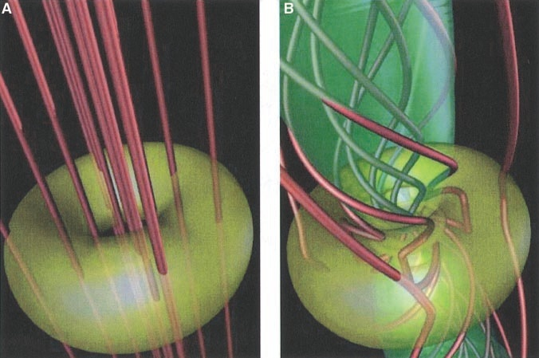
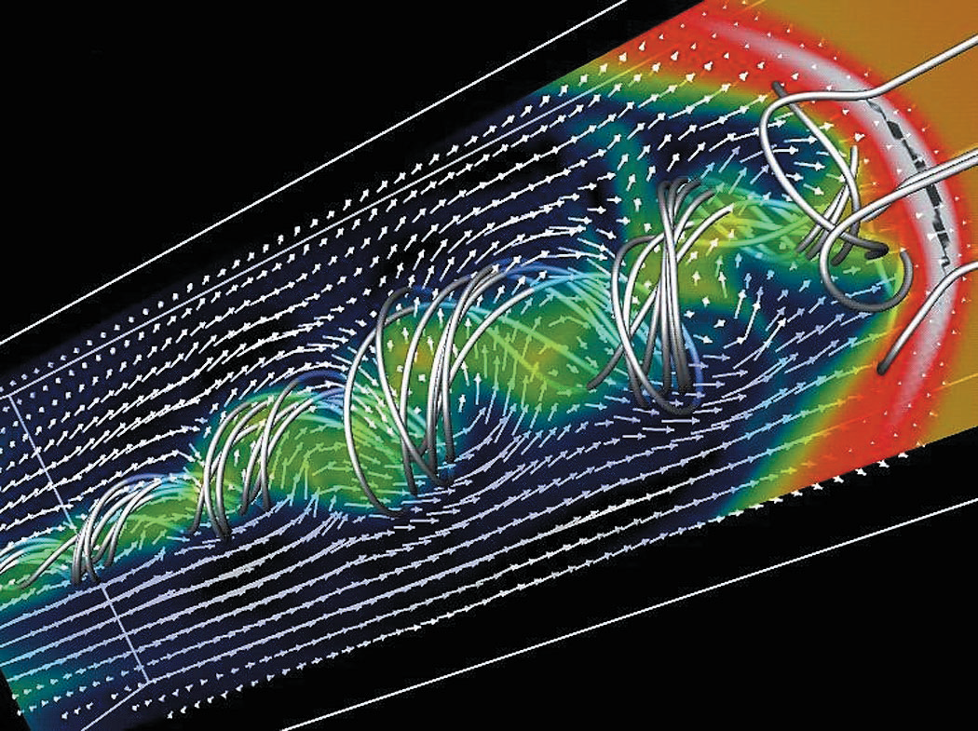
Meier et al. (2001)
Accretion Disk threaded with magnetic field makes a relativistic jet (“Blandford-Payne”)
Spinning BH threaded with field makes jet by dragging space-time (Penrose, “Blandford-Znajek”)

Slide 4
Factors to Consider
Energy source:
Spinning Black Hole
Accretion Disk
System parameters:
BH spin parameter: a/M = a*
Magnetic field strength
Accretion disk state:
Thin Accretion Disk (Shakura-Sunyaev 1973)
Advection-Dominated Accretion Flow: ADAF (Narayan-Yi 1994) (Geometrically Thick Disk)

Slide 5
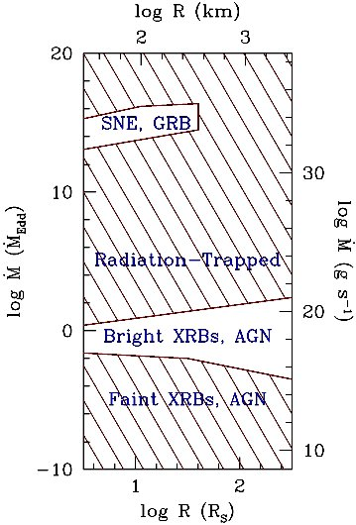
Mdot Regimes: Thin Disk vs ADAF
Thin Accretion Disk:
Thermal state XRBs
Bright QSOs
Geometrically Thick ADAF:
Radiation-trapped ADAF (Slim Disk)
Radiatively inefficient ADAF (RIAF)
Huge parameter space
Narayan & Quataert (2005) (M = 3M)

Slide 6
Numerical Simulations
AccretionsSimulations of varying degrees of complexity have been done over the years
Pseudo-Newtonian hydrodynamics
Pseudo-N magnetohydrodynamics (MHD)
General Relativistic MHD (GRMHD) **
Numerical Relativity with MHD
Good news: GRMHD simulations produce powerful jets from generic initial conditions (Movie from Tchekhovskoy → )

Slide 7
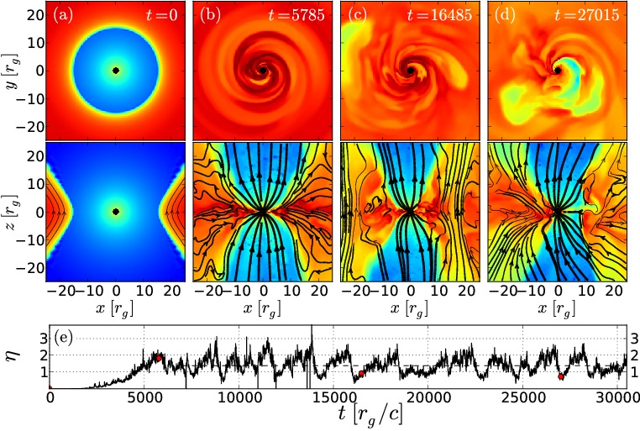
Based on movie shown in the talk: Tchekhovskoy et al. (2011)

Slide 8
First Hint from Simulations
Geometrically thick ADAFs around BHs produce Jets and Winds readily
Geometrically Thin Disks around BHs show no obvious jets or winds
Why do we have this dichotomy?
Better collimation in ADAF?
Magnetic field transported better by ADAF?

Slide 9
Implications for Astrophysics
Jets should be found in two regimes:
Eddington and super-Eddington systems (geometrically thick “slim disks”)
Systems below few percent of Eddington (radiatively inefficient ADAFs)
No Jets between ~3% and ~50% Edd
Consistent with XRBs. But AGN?

Slide 10
Mdot Regimes: Thin Disk vs ADAF
Thin Accretion Disk:
Thermal state XRBs
Bright QSOs
Geometrically Thick ADAF:
Radiation-trapped ADAF (Slim Disk)
Radiatively inefficient ADAF (RIAF)
Huge parameter space
Narayan & Quataert (2005) (M = 3M)

Slide 11
Second Hint from Simulations
GRMHD simulations of thick disks show Two Kinds of Outflows:
Relativistic Jet along field lines connected to the BH (or the ergosphere)
Sub-Relativistic Wind along field lines connected to the Disk
These two outflows have
Different Energy Sources: BH vs Disk
Different Properties
Different Sensitivities to Parameters

Slide 12
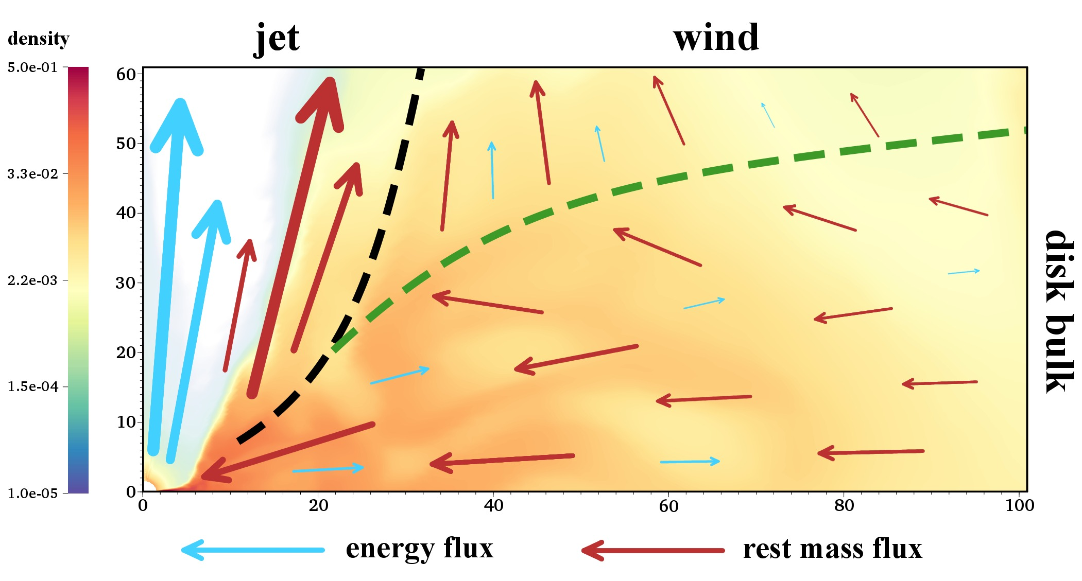
Sadowski et al. (2013)

Slide 13
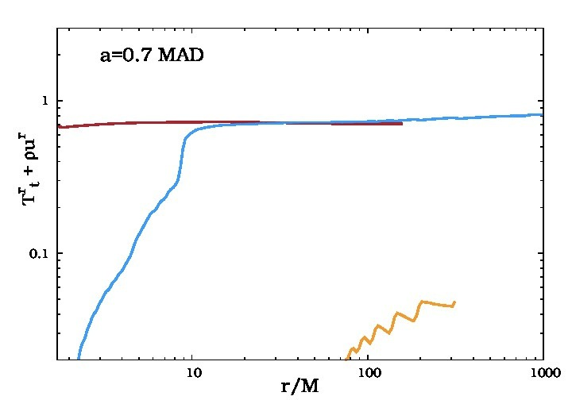
Jet, Wind: Energy Flow vs r
Simulation with a spinning BH: a* = 0.7
Energy Flux in the BH Jet is quite large:0.7(Mdot c²) (highly efficient)
Energy Flux in Disk Wind is only about 0.05(Mdot c²)(modest efficiency)
BH Jet
Disk Wind
Sadowski et al. (2013)

Slide 14
BH Jet
What we know so far from simulations:
BH Jet is Relativistic: γ≥ few
Power source is the BH Spin
Power increases strongly with a*
Power depends strongly on Magnetic Field near BH: Magnetically Arrested Disk (MAD)
>100% Efficiency possible: a* → 1 & MAD
If disk is not in MAD state, power tends to be much less

Slide 15
Importance of Magnetic Field
BH Jet power is very sensitive to magnetic field:
For a given Mdot, there is a maximum amount of Magnetic Flux Φ_{mag} that can be pushed into the BH
System at this limit: Magnetically Arrested Disk (MAD)
GRMHD simulations with thick ADAFs readily achieve MAD limit provided a coherent magnetic flux is available on the outside
Do MAD systems form in Nature? Open question…

Slide 16
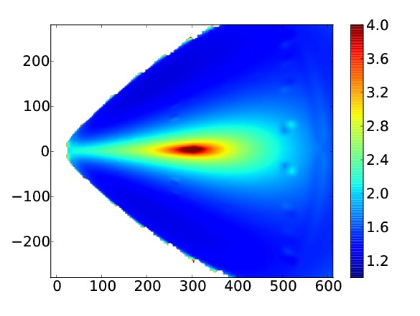
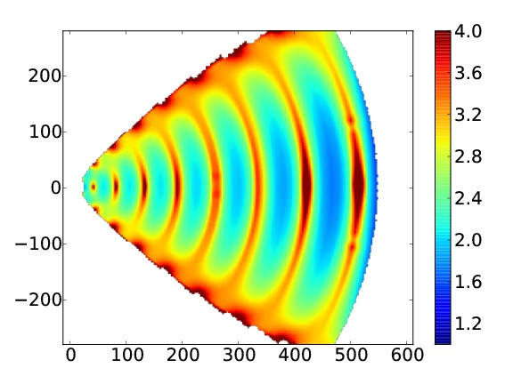
To Be MAD or Not To Be MAD…
Initial conditions with a single coherent loop of weak field give
Magnetically Arrested Disk (MAD)
Many alternating initial loops of field give Standard and Normal Evolution (SANE)
Narayan et al. (2012)

Slide 17
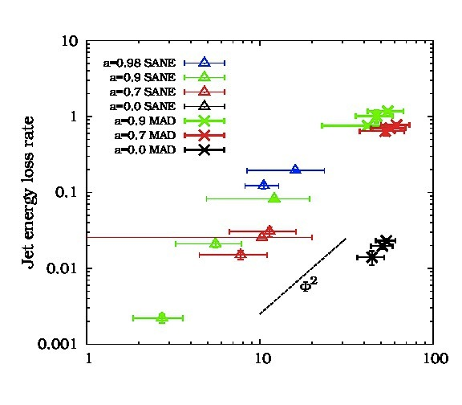
Φ
Sadowski et al. (2013)

Slide 18
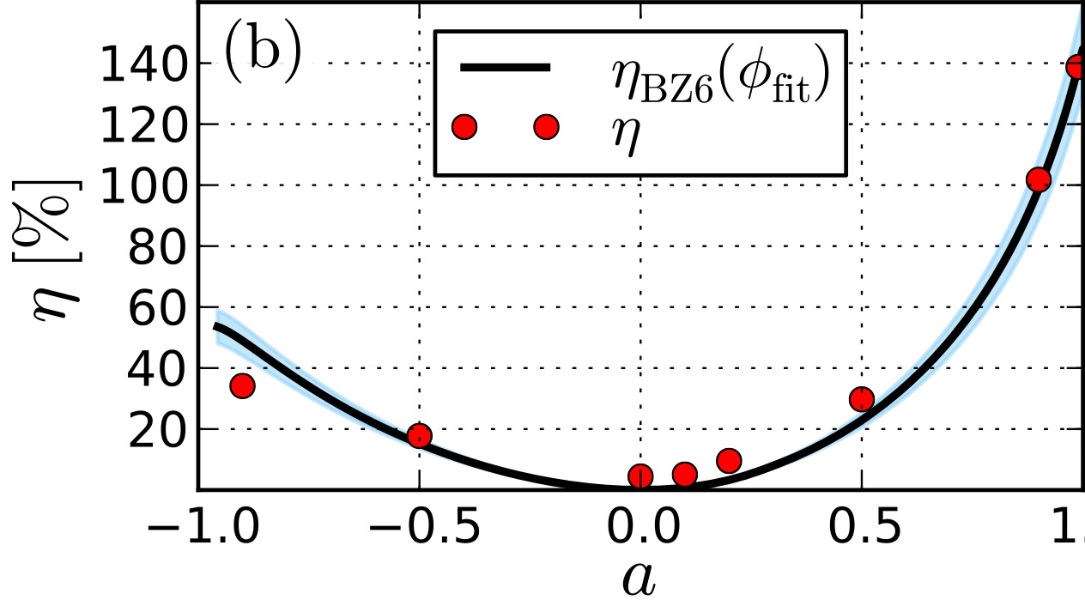
MAD
BH Jet in MAD state has a large efficiency: η = P_{jet}/Mdot c² can even exceed 100% (Tchekhovskoy et al. 2012)
Strong dependence of η on spin parameter a* (retrograde not so good)

Slide 19
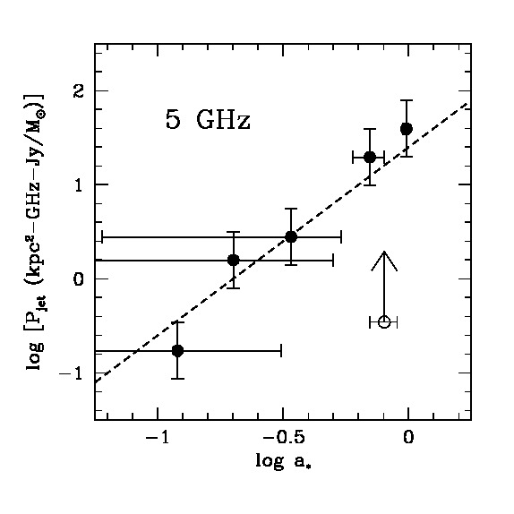
Very intriguing evidence for a Correlation between BH Spin in XRBs and Radio Power of Ballistic Jets near Eddington Limit (slim disk)
Narayan & McClintock ’12
Steiner et al. ’13
Note the huge range of radio jet powers!
Also large errorbars!
Ballistic Jets may be powered by BH Spin

Slide 20
Disk Wind
What we know so far from simulations:
At best only mildly relativistic: β= v/c ~ 0.1-0.2
Power source is mostly the Disk
Power is not sensitive to BH spin
Only modest efficiency, typically <10%
BH Magnetic Flux appears not to be important: MAD not essential
Might explain Garden Variety Jets?

Slide 21

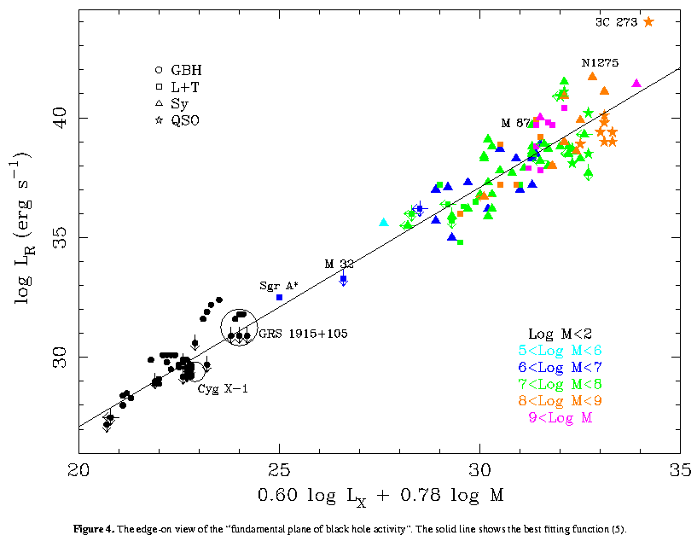
A Fundamental Plane of Black Hole Activity
(Heinz & Sunyaev 2003; Merloni, Heinz & Di Matteo, 2003; Falcke, Kording, & Markoff, 2004)
No a*!
Supermassive
BHs
Stellar-mass BHs

Slide 22
BH Accretion
Thick Disk (ADAF)
BH Jet
Disk Wind
Thin Disk
No Jet
Line-Driven Wind?
Relativistic
Can have Huge Power
Strong Dependence on BH Spin: (Ω_{H})²
Strong Dependence on BH Field: (Φ_{mag})²
Maximum Power: MAD
Sub-Relativistic
Modest Power
Weak Dependence on BH Spin
Weak Dependence on BH Field
Summary
L > 0.5 L_{Edd}
L < 0.03 L_{Edd}

