Slide 1
Data 88: Economic Models
Lecture 10: Macroeconomic Policy, Laws and the Coronavirus

Slide 2
Announcements
There will be no lab this week. We will release a notebook demo that complements lecture, but you do not have to submit anything.

Slide 3
Today’s class
A crash course in Macroeconomic policy: theory and rationale
Monetary and Fiscal Policy during the COVID-19 pandemic
Guest Speaker: Renowned Macroeconomist, John Bates Clark Medalist and UC Berkeley Economics Professor Emi Nakamura!

Slide 4
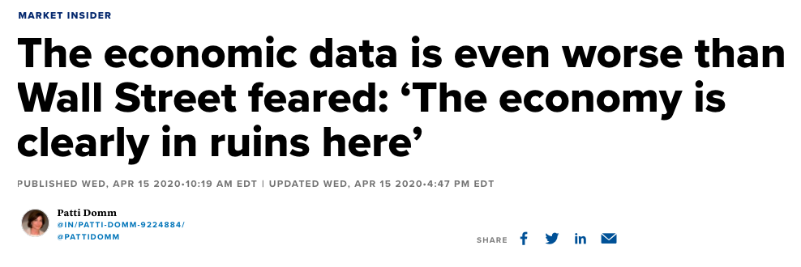
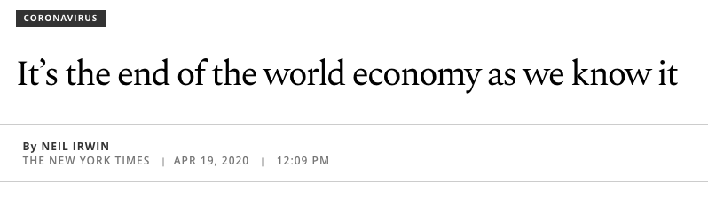
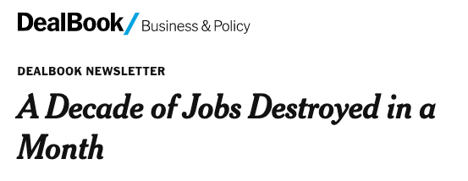

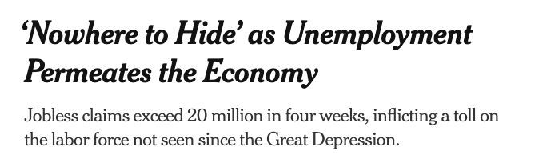
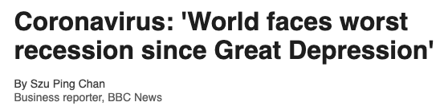
Notes:
https://newfastuff.com/wp-content/uploads/2019/02/KpL5BXw.png

Slide 5
The Fed’s Perspective One Year Ago
“The coronavirus outbreak has harmed communities and disrupted economic activity in many countries, including the United States. Global financial conditions have also been significantly affected. Available economic data show that the U.S. economy came into this challenging period on a strong footing. [...] Market-based measures of inflation compensation have declined; survey-based measures of longer-term inflation expectations are little changed.”
- Federal Open Market Committee, March 15, 2020

Slide 6
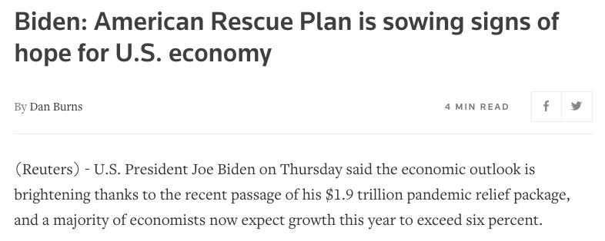
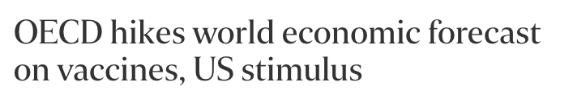
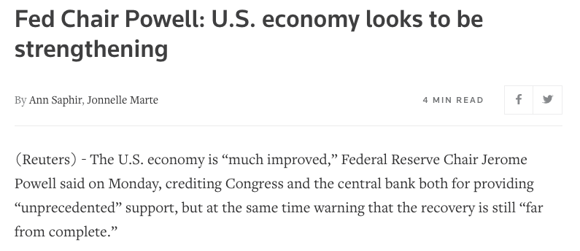
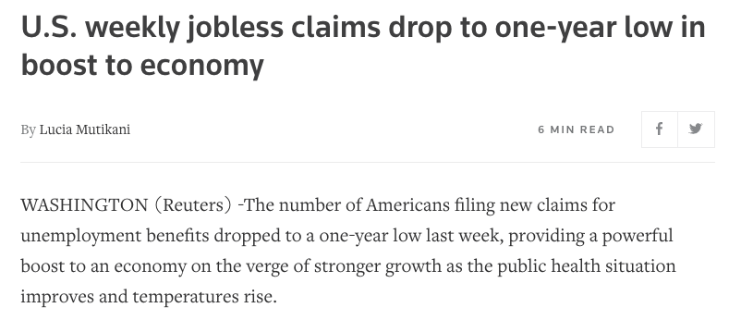
The headlines today

Slide 7
The Fed’s Perspective Today
“Following a moderation in the pace of the recovery, indicators of economic activity and employment have turned up recently, although the sectors most adversely affected by the pandemic remain weak. Inflation continues to run below 2 percent. Overall financial conditions remain accommodative, in part reflecting policy measures to support the economy and the flow of credit to U.S. households and businesses.”
- March 16, 2021

Slide 8
The core macroeconomic indicators
An economist’s way of describing the health of a country’s economy in the short-run
Output (Y): GDP
Inflation (π): Rate of change of prices over a given time period
Unemployment (u): The number (or proportion) of people in the labor force who are without a job and/or actively seeking employment
Real interest rate (r): The cost paid for borrowing money, adjusted for inflation

Slide 9
To the lab notebook:
Macroeconomic Indicators over time and throughout the Pandemic

Slide 10
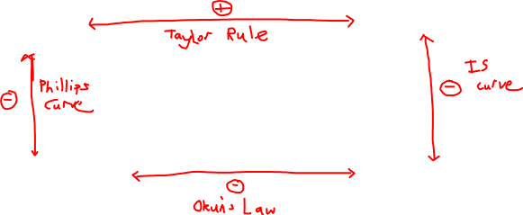
Macroeconomic Laws
Inflation (π)
Unemployment (u)
Real interest rate (r)
Output/GDP (Y)

Slide 11
Back to the lab notebook:
An exploration of the Phillips Curve

Slide 12
Two fundamental tools
Monetary policy: Changes in interest rates and the money supply of a country (the amount of money circulating) as done by the central bank
Fiscal policy: In most countries, this is done by the government through changes in government spending (welfare, stimulus payments, benefits, subsidies) or taxes

Slide 13

Monetary policy
Central banks
The financial institution that controls the production and distribution of money and credit. It exists independently of the rest of the government so it, in theory, won’t be affected by political pressure or partisan gridlock.
They have many functions:
Maintaining smooth changes in prices
Achieving maximum employment
Steady economic growth
Set interest rates (and by extension exchange rates)
Issues and purchases government bonds
Control required reserve ratios
Acts as a lender of last resort

Slide 14
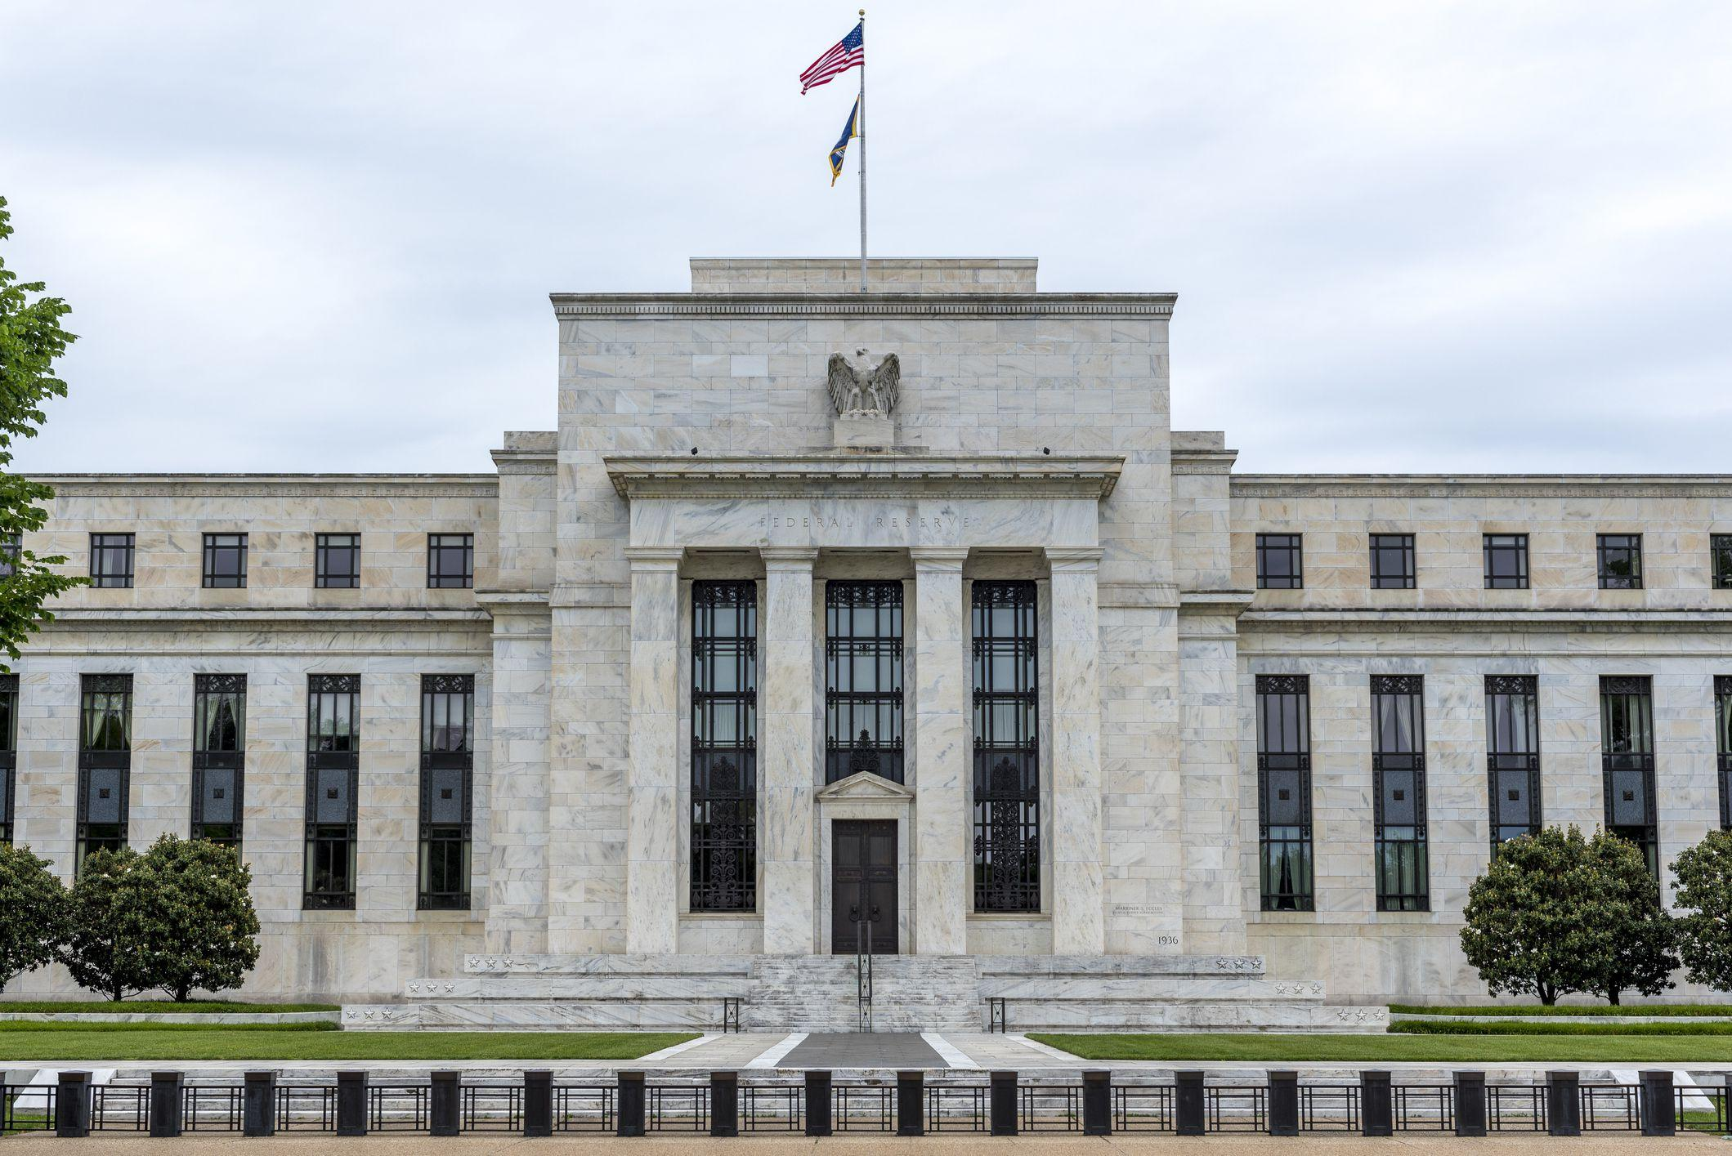

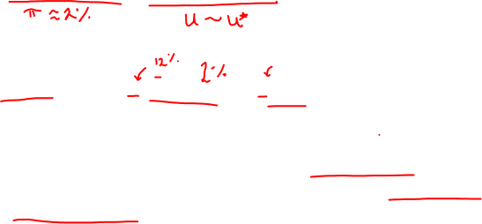
The Federal Reserve
Dual mandate:
Price stability + full employment
Taylor Rule:
The Federal Reserve is committed to using its full range of tools to support the U.S. economy in this challenging time, thereby promoting its maximum employment and price stability goals.
Notes:
https://www.investopedia.com/thmb/jQgcQL_AElY_bBBS58d4wl6s5IA=/2119x1415/filters:fill(auto,1)/united-states-federal-reserve-building--washington-dc--usa-699686820-4fe8a5acea0b451b8998d683dfcd87db.jpg

Slide 15
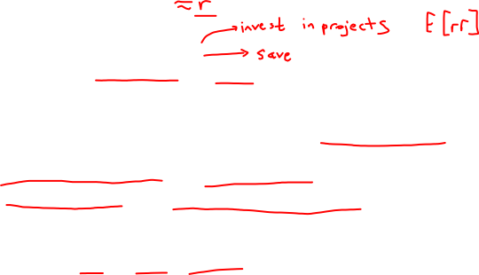
How interest rates affect output, inflation and unemployment
Federal Funds Rate (FFR)
Businesses ⇔ Investment
Consumers ⇔ Consumption vs. saving
Without any external events (ceteris paribus): Fed increases FFR
→ r increases
→ Investment decreases and savings increases
→ Output decreases and unemployment increases
→ Wage inflation decreases
→ Inflation decreases
TLDR: ↑ r → ↓Y → ↑ u → ↓π

Slide 16
Back to the lab notebook:
Modeling FFR decision making through the Taylor Rule

Slide 17

With inflation running persistently below this longer-run goal, the Committee will aim to achieve inflation moderately above 2 percent for some time so that inflation averages 2 percent over time and longer‑term inflation expectations remain well anchored at 2 percent. The Committee expects to maintain an accommodative stance of monetary policy until these outcomes are achieved. The Committee decided to keep the target range for the federal funds rate at 0 to 1/4 percent and expects it will be appropriate to maintain this target range until labor market conditions have reached levels consistent with the Committee’s assessments of maximum employment and inflation has risen to 2 percent and is on track to moderately exceed 2 percent for some time.
Federal Open Market Committee, March 16, 2021

Slide 18
What would happen if interest rates went below 0%?

Slide 19
Zero Lower Bound (ZLB)
The Fed has hit the ZLB, which is the idea that interest rates cannot go negative
Businesses
Consumers/Households

Slide 20
What tools aside from changing the FFR does the Fed have to combat an economic downturn?

Slide 21
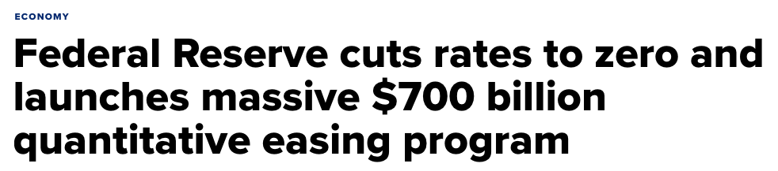
Quantitative Easing (QE)
“In addition, the Federal Reserve will continue to increase its holdings of Treasury securities by at least $80 billion per month and of agency mortgage‑backed securities by at least $40 billion per month until substantial further progress has been made toward the Committee’s maximum employment and price stability goals. These asset purchases help foster smooth market functioning and accommodative financial “conditions, thereby supporting the flow of credit to households and businesses.

Slide 22
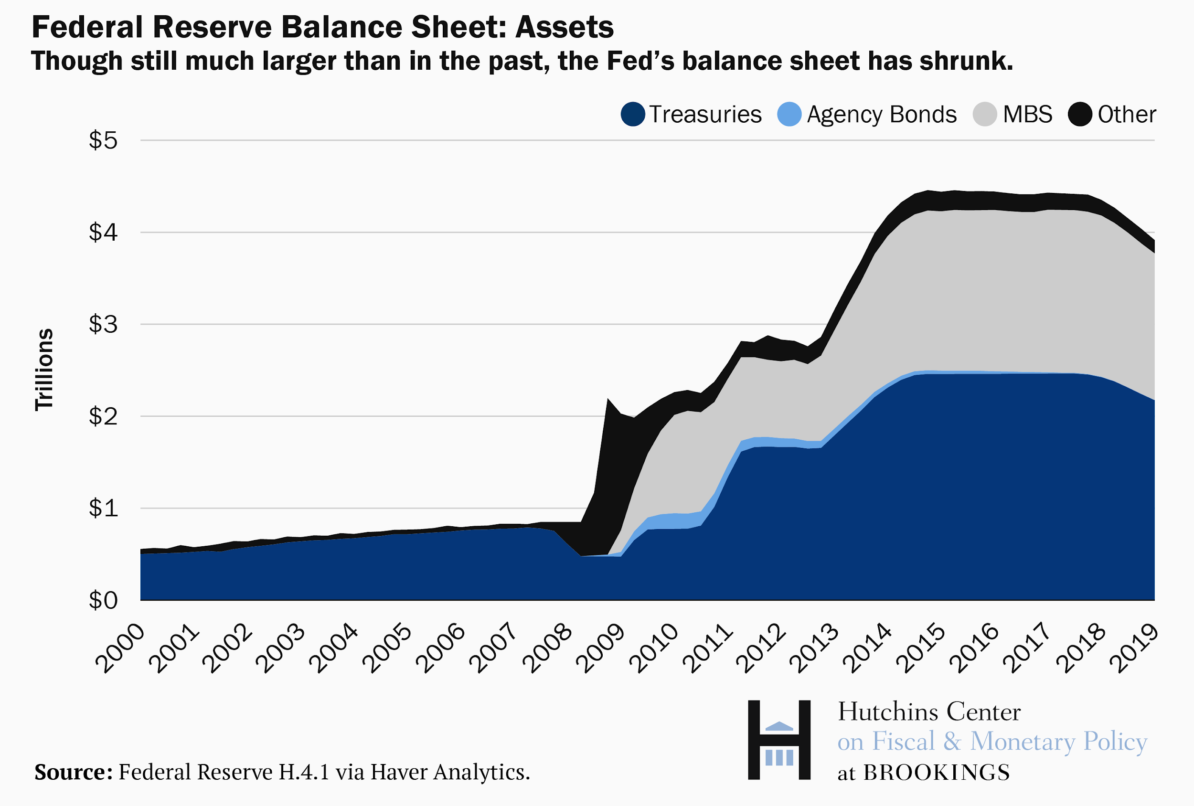
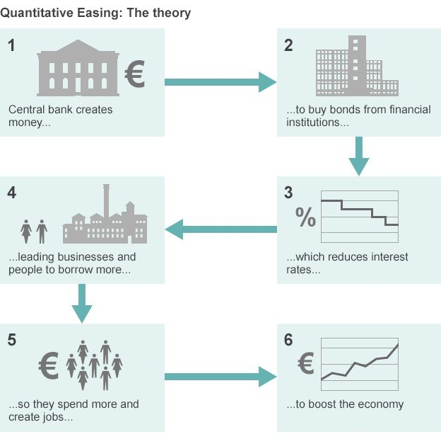

What is QE?
Goal: Increase the money supply and provide banks with liquidity, allowing them to increase lending, while decreasing risk (lower risk premia) and uncertainty in the market
Notes:
https://www.brookings.edu/wp-content/uploads/2019/05/ES_20190517_AmpleReserves_fig1.png
https://ichef.bbci.co.uk/news/624/media/images/80420000/gif/_80420417_quantitative_easing_v4_624in.gif

Slide 23
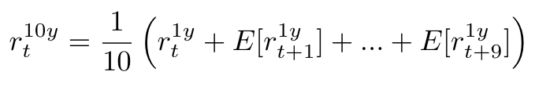

Forward Guidance
“The Committee [...] expects it will be appropriate to maintain this target range until labor market conditions have reached levels consistent with the Committee’s assessments of maximum employment and inflation has risen to 2 percent and is on track to moderately exceed 2 percent for some time.”
Federal Open Market Committee, 11/5/20
Lower expected future short rates → lower current long rates (long rates are average of expected future short rates) → cheaper credit → higher spending

Slide 24

Fiscal Policy
Marginal Propensity to Consume (MPC)
Multiplier Effect: The total change in output is greater than the initial change because of further rounds of spending
Keynes: The government should act as a benevolent social planner during times of high unemployment
Automatic stabilizers = Social Welfare Net
Unemployment insurance, social security payments

Slide 25
Rationale for government stimulus
Which part of society has the largest MPC?
By extension, fiscal stimulus targeted to which income section would yield the greatest change in economic activity?
A: The bottom 20% in incomes
B: The middle class
C: The top 1%

Slide 26
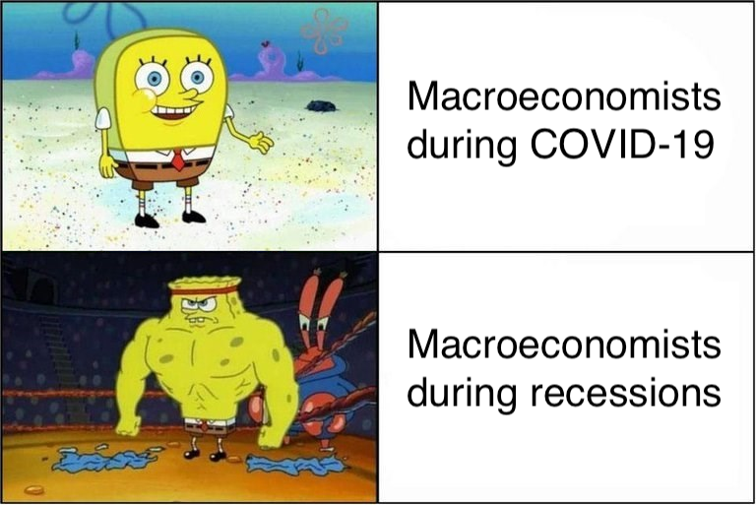

Slide 27
How the pandemic breaks macroeconomic theory
“And this plunge isn’t just quantitatively off the charts; it’s qualitatively different from anything we’ve seen before. … So far this slump mainly reflects the deliberate, necessary shutdown of activities that increase the rate of infection.”
- Paul Krugman, March 2020
Policy during a recession driven by a slump in demand: broad-based economic stimulus
Policy during this pandemic: Helping those who are most in need to survive health-wise and economically
Notes:
https://www.nytimes.com/2020/04/06/opinion/coronavirus-economy.html

Slide 28
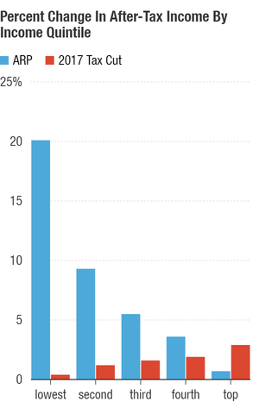
Fiscal Policy in action: American Rescue Plan (2021)
$1.9 trillion fiscal stimulus bill passed by Congress and signed by President Biden in early March
Individuals earning up to $75,000 and couples earning up to $150,000 will receive the full direct payments of $1,400 per person
Federal unemployment insurance payments will remain at $300 per week, extended through Sept. 6
$7.25 billion in new money for the small-business loan program
$128 billion in grants to state educational agencies plus $39 billion in grants to higher education institutions
$4.5 billion for the Low Income Home Energy Assistance Program to help families with home heating and cooling costs and $1.4 billion for programs under the Older Americans Act
The CDC will receive $7.5 billion to track, administer and distribute COVID-19 vaccines; $46 billion will go toward diagnosing and tracing coronavirus infections
Notes:
https://media.npr.org/assets/img/2021/03/10/percent-change-in-after-tax-income-by_chartbuilder_custom-34a5a19f1debf9896b9edacebc18c8daa2889f77-s300-c85.png

Slide 29
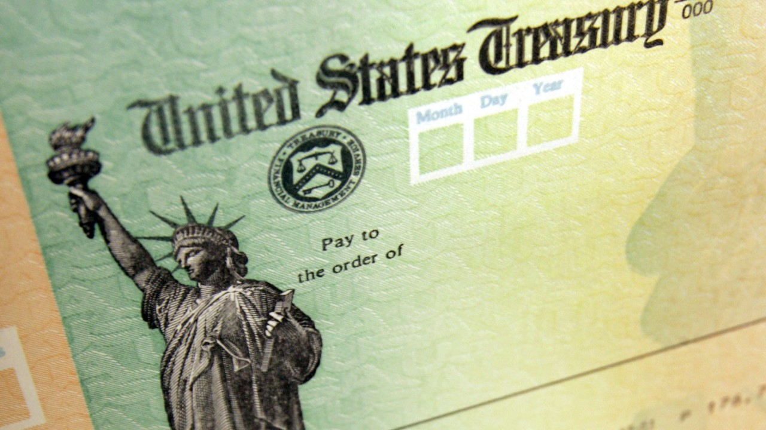
Coronavirus checks
Notes:
https://www.thedenverchannel.com/news/national/coronavirus/irs-deposits-first-round-of-coronavirus-stimulus-checks-into-bank-accounts

Slide 30
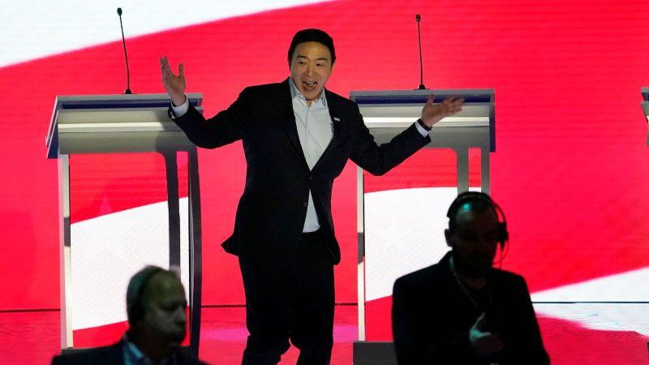
Where do we go from here?
UBI?
$1200 once vs $2000/mo
More comprehensive social welfare net:
Medicare for all?
Lowering Medicare age
Expanding MediCal
More accommodating unemployment benefits?
Inflation from fiscal stimulus?
Ballooning national debt?
Debt defaults? (Greece Eurozone crisis, 2015)
Credit freeze?
Interested in the macroeconomic implications? Take Econ 134 with Professor Emi Nakamura!

Slide 31
Professor Emi Nakamura
Chancellor’s Professor of Economics, UC Berkeley

Slide 32
Friedman’s Permanent Income Hypothesis
A counterclaim to Keynes’ idea of MPC
Assumes consumers are constantly forward-looking: they anticipate future changes in their income and smooth their consumption as appropriate
Why “permanent”?
What does this imply for someone’s MPC? Effectivity of fiscal stimulus?

Slide 33
Onto Lab:
Johnson, Parker and Souleles (JPS) on the economic impact of stimulus payments

