Slide 1
Marketing Effectiveness Results
A large Pharmaceutical Company
April 2, 2018 Jiwan Hwang

Slide 2
Agenda
I. | Objectives
II. | Background and Business Questions
III. | Approach
IV. | Review of Insights and Recommendations
 | i. Historical Contributions and ROIs
 | ii. Recommendations on Optimizing Investment Allocations
 | iii. Additional Insights
V. | Appendix

Slide 3
Objectives
The objectives of today’s meeting are to provide:
Insights and recommendations on the incremental value generated by key marketing tactics
Estimates of historical contributions and ROIs of marketing tactics
Recommendations on improving marketing budget allocations in the future
Insights on a number of specific business questions

Slide 4
Agenda
I. | Objectives
II. | Background and Business Questions
III. | Approach
IV. | Review of Insights and Recommendations
 | i. Historical Contributions and ROIs
 | ii. Recommendations on Optimizing Investment Allocations
 | iii. Additional Insights
V. | Appendix

Slide 5
Background and Business Questions
Background
A large Pharmaceutical Company is interested in marketing performance of its oral anticoagulant drugs.
The business is highly competitive and it is believed that marketing drives a significant portion of the total sales.
Some Stakeholders think that marketing drives 50% or others do 20% of the total business.
Macroeconomics indicator such as unemployment rate has a significant influence
Business Questions
What are the Historical contribution of DTC TV, DTC Display and Detailing?
What are the sales and profit ROIs of DTC TV, DTC Display and Detailing?
What do the sales and gross profit response curves of DTC TV, DTC Display and Detailing look like?
How much should the company spend to maximize the net profit next month?
How much has the competitive DTC TV hurt the business?
What is influence of unemployment rate on Sales?

Slide 6
Financial Information
Gross Profit Margin
Blended GPM = 70% is used
Spend Data
Historical Cost Per Unit numbers are expected to be valid for the next year
 | Unit | Cost Per Unit
TV | GRP | $ 2,500
DPE(Detail) | Count(thousnad) | $ 5,500
Display | Impressions(million) | $ 72,000

Slide 7
Agenda
I. | Objectives
II. | Background and Business Questions
III. | Modeling
IV. | Review of Insights and Recommendations
 | i. Historical Contributions and ROIs
 | ii. Recommendations on Optimizing Investment Allocations
 | iii. Additional Insights
V. | Appendix

Slide 8
Modeling – Initial values and transformation
Test additive formulation:
Initial values :
If the variables has linear relationship (including log transformation) with the response variable in additive model, Use the parameters from results of naive linear regression.
If the variables need power transformation, Calculate the range of parameters assuming 20%-50% contribution from marketing and return proportional to spend size for the three tactics and using range of 0.25-1 for the power.
For Log transformation, Variable + 1 can be applied.
For Power transformation, Variable +0.01 can be applied.

Slide 9
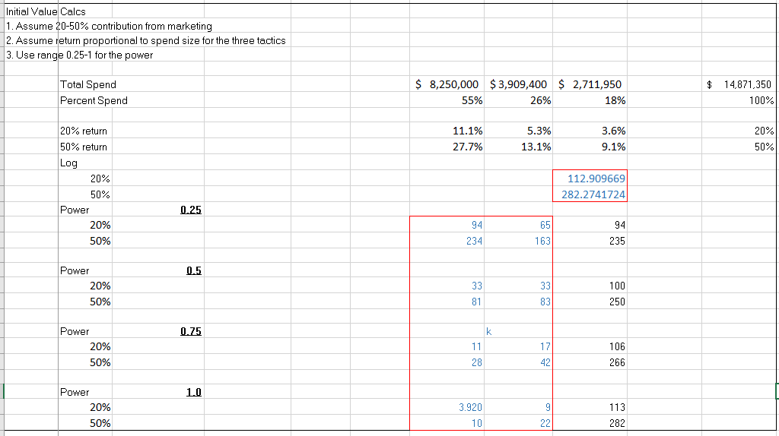
Modeling : Initial values and transformation (Excel)

Slide 10
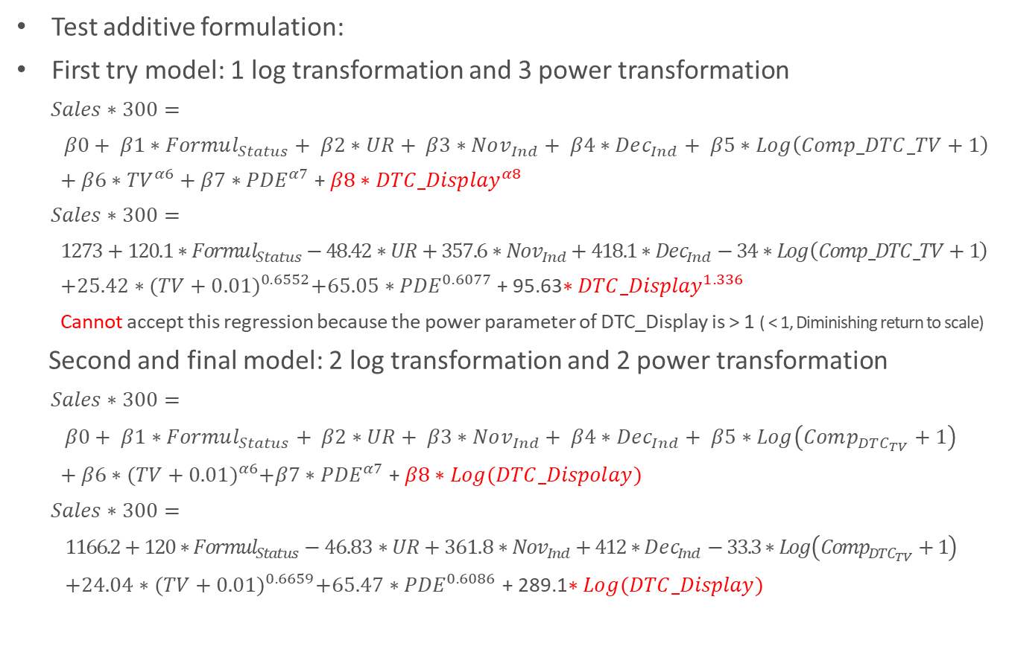
Modeling : Additive Nonlinear regression Model
Test additive formulation:
First try model: 1 log transformation and 3 power transformation
$$Sales∗300=$$
$$β0+ β1∗Formul_{Status}+ β2∗UR+ β3∗Nov_{Ind}+ β4∗Dec_{Ind}+ β5∗Log\left(Comp_DTC_TV+1\right)$$
$+ β6∗{TV}^{α6}+β7∗{PDE}^{α7}$ + $β8∗{DTC_Display}^{α8}$
$Sales∗300=$
$1273+120.1∗Formul_{Status}−48.42∗UR+357.6∗Nov_{Ind}+418.1∗Dec_{Ind}−34∗Log\left(Comp_DTC_TV+1\right)$
$+25.42∗{(TV+0.01)}^{0.6552}+65.05∗{PDE}^{0.6077}$ + 95.63$∗{DTC_Display}^{1.336}$
Cannot accept this regression because the power parameter of DTC_Display is > 1 ( < 1, Diminishing return to scale)
Second and final model: 2 log transformation and 2 power transformation
$Sales∗300=$
$β0+ β1∗Formul_{Status}+ β2∗UR+ β3∗Nov_{Ind}+ β4∗Dec_{Ind}+ β5∗Log\left(Comp_{DTC_{TV}}+1\right)$
$+ β6∗{(TV+0.01)}^{α6}+β7∗{PDE}^{α7}$ + $β8∗Log(DTC_Dispolay)$
$$Sales∗300=$$
$1166.2+120∗Formul_{Status}−46.83∗UR+361.8∗Nov_{Ind}+412∗Dec_{Ind}−33.3∗Log\left(Comp_{DTC_{TV}}+1\right)$
$+24.04∗{(TV+0.01)}^{0.6659}+65.47∗{PDE}^{0.6086}$ + 289.1$∗Log(DTC_Display)$

Slide 11

Modeling : MAPE, $R^{2}$, Durbin Watson Test, and AvP
${MAPE ,R}^{2} and Durbin Watson$
Actual vs Predicted
 | MAPE | R-Square | 1st Order Autocorr. | DW Statistics | DW + p-value | DW - p-value
Naive | 4.14% | 90.28% | 0.262 | 1.408 | 0.0147 | 0.9826
Linear(incl. log) | 4.17% | 90.33% | 0.284 | 1.351 | 0.0101 | 0.9899
Nonlinear | 3.52% | 92.02% | 0.324 | 1.231 | 0.0027 | 0.9973

Slide 12
Agenda
I. | Objectives
II. | Background and Business Questions
III. | Approach
IV. | Review of Insights and Recommendations
 | i. Historical Contributions and ROIs
 | ii. Recommendations on Optimizing Investment Allocations
 | iii. Additional Insights
V. | Appendix

Slide 13
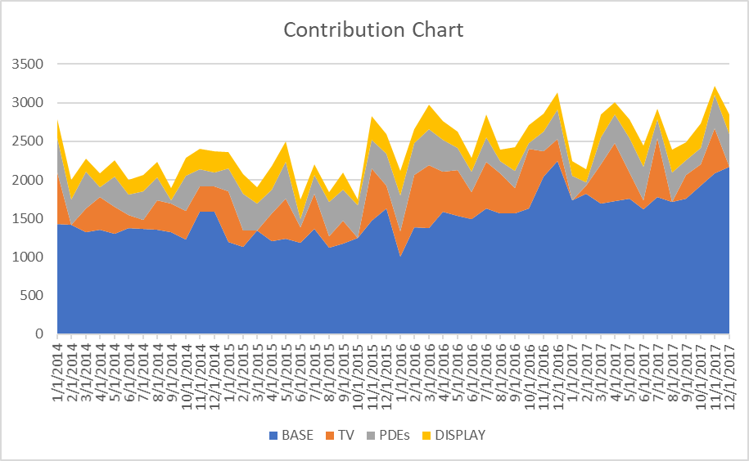
Marketing Contributions
Contributions : 2014-17
Marketing drove ~37.6% of sales in 2014-17
TV drove most contribution of the three marketing tactics followed by PDE and Display

Slide 14
Marketing ROIs and Response Curves
Overall, the marketing returned above the break-even (ROI = 1.87) .
All TV, PDE and Display show healthy average ROIs but TV is the lowest among three.
PDE shows a lot of potential for profitable increase in investment.
Marketing Average ROIs (2014-2017)
 | Spend (1000s) | Sales (1000s) | Gross Profit (1000s) | GP ROI
TV | $ 8,250 | $ 17,537 | $ 12,276 | 1.49
PDEs | $ 3,909 | $ 15,469 | $ 10,828 | 2.77
Display | $ 4,271 | $ 10,889 | $ 7,622 | 1.78
Total | $ 16,430 | $ 43,895 | $ 30,726 | 1.87
Gross Profit Response Curves
Marginal ROI Curves

Slide 15
Recommendations on Optimizing Marketing Investment
The company is planning to spend about $360K for next month, allocating equally among DTC TV, DPE, and DTC Display.
We recommend the following re-allocation to improve the return from $687K to $728K GP
This re-allocation can result in estimated additional $41K of Gross Profit with the same budget over the next 12 months.
 | Investment
TV | $ 120,000
PDE | $ 120,000
Display | $ 120,000
 | Investment
TV | $ 118,242
PDE | $ 150,000
Display | $ 91,758
Profit return :
687K -> 728K
The company is planning to spend about $600K for next month, allocating equally among DTC TV, DPE, and DTC Display.
We recommend the following re-allocation to improve the return from $989K to $1,007K GP
This re-allocation can result in estimated additional $18K of Gross Profit with the same budget over the next 12 months.
 | Investment
TV | $ 200,000
PDE | $ 200,000
Display | $ 200,000
 | Investment
TV | $ 200,000
PDE | $ 250,000
Display | $ 150,000
Profit return :
989K -> 1,007K
 | Investment
TV | $ 200,000
PDE | $ 200,000
Display | $ 200,000

Slide 16
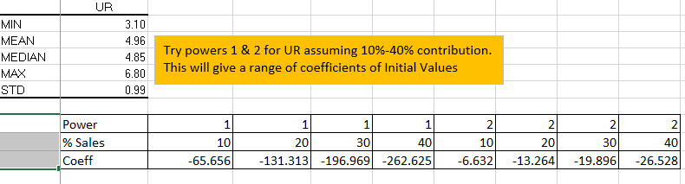
Additional Insights
The competitive DTC TC :
1% increase in the competitive DTC TV decreases 0.33 (= parameter coefficient/100) of the average Sales Amount (= no. of Sales * $300).
Unemployment Rate :
1 unit increase in unemployment rate decreases 46.83 of the average Sales Amount (= no. of Sales * $300) for my nonlinear mode which assumes UR has linear relationship with Sales.
However, we can set up its initial values as below using power transformation and find its coefficient.

Slide 17
Agenda
I. | Objectives
II. | Background and Business Questions
III. | Approach
IV. | Review of Insights and Recommendations
 | i. Historical Contributions and ROIs
 | ii. Recommendations on Optimizing Investment Allocations
 | iii. Additional Insights
V. | Appendix

Slide 18
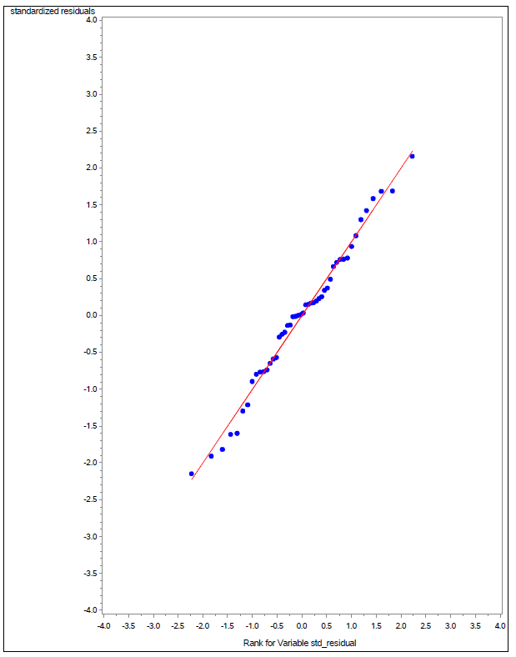
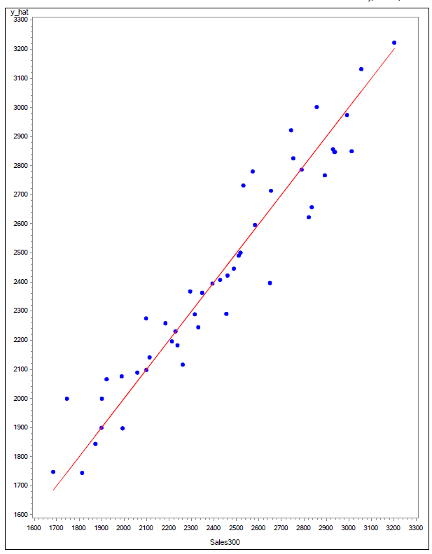
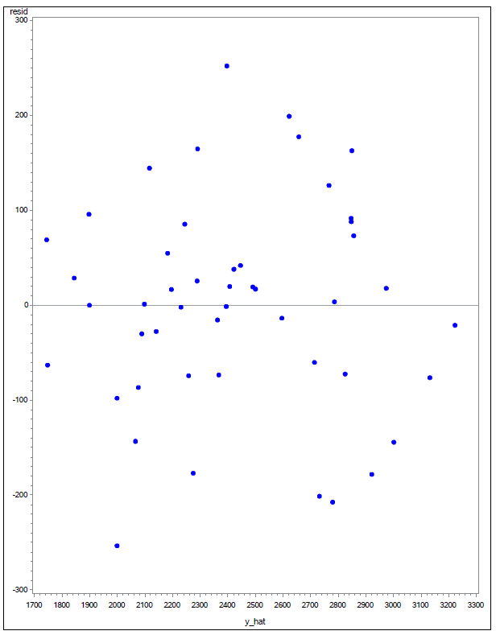
Model Diagnostic : Plots (Residual Analysis)
<Q-Q Plot>
<Actual vs. Predicted Values>
<Residual vs. Predicted Values>

Slide 19
Model Diagnostic : Holdout Test
Holdout model test
Holdout MAPE : 5.11
Actual vs Predicted

Slide 20
The end
Thank you
End of Pages

