Slide 1
EDK2 Training report - 10 15
SW2
Bruce_Wang
2019/10/15

Slide 2
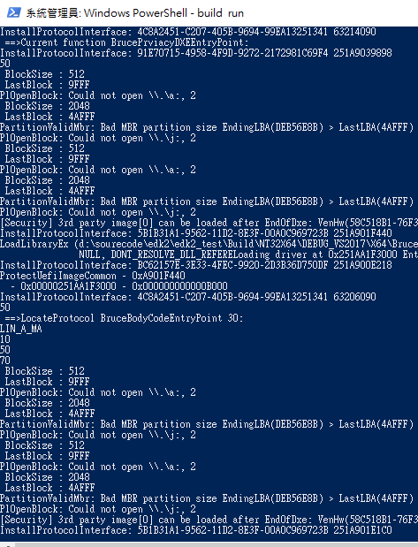
Daily status(1/2)
Done the install and locate for DXE driver
1

Slide 3
Daily status(2/2)
Install value after locate change will not load default after reload
APP can load protocol for use after install protocol
Next Plan
Add API for use in DXE driver
2

