Slide 1
EDK2 Training report - 09 23
SW2
Bruce_Wang
2019/09/23

Slide 2

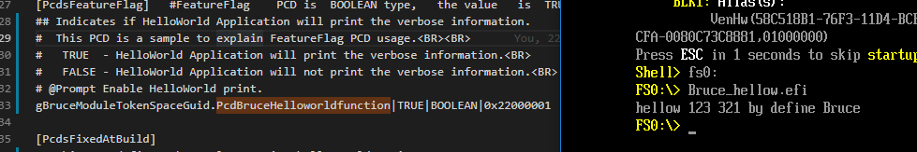
Daily status(1/2)
Successful load .efi and show hellowold
Can’t print string as define, it only show last alpha.
Will spend some time to study
Add L to change define to string
Try to print string by pcd
Add control pcd
Add condition to 2 different print case
Use dsc to re define print string value
If define PcdHelloWorldPrintString into PcdsDynamic can’t re define by dsc PcdsDynamicDefault
1

Slide 3
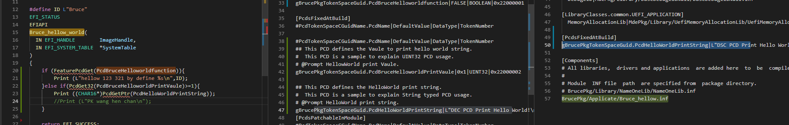
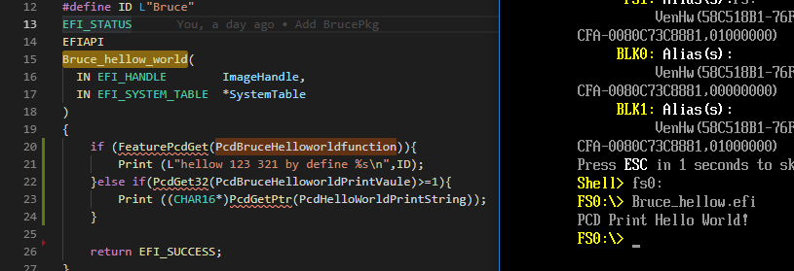
Daily status(2/2)
Next day plan
Starting to DXE driver
2

