Slide 1
EDK2 Training report - 09 18
SW2
Bruce_Wang
2019/09/18

Slide 2
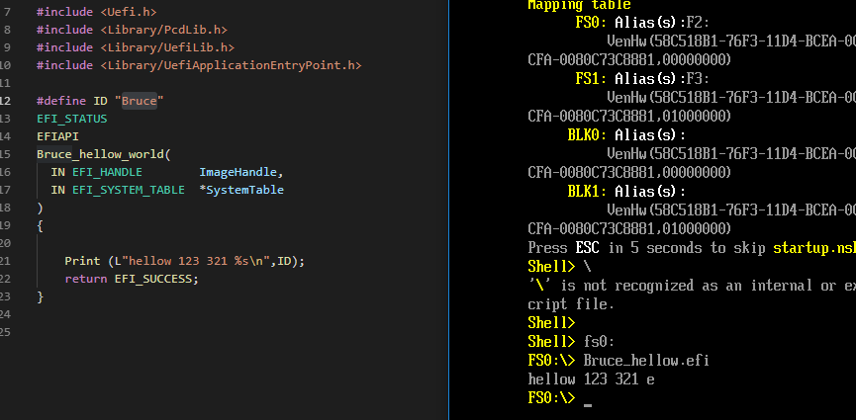
Daily status(1/2)
Add submodule for ppt folder
Start focus adding personal Pkg
Need to notice that when wanna to use Tiano environment it should change active platform to Nt32
Successful load .efi and show hellowold
Can’t print string as define, it only show last alpha.
Will spend some time to study
1

Slide 3
Daily status(2/2)
Next day plan
Add some pcd token to control and show string
2

