Slide 1
EDK2 Training report - 10 14
SW2
Bruce_Wang
2019/10/14

Slide 2
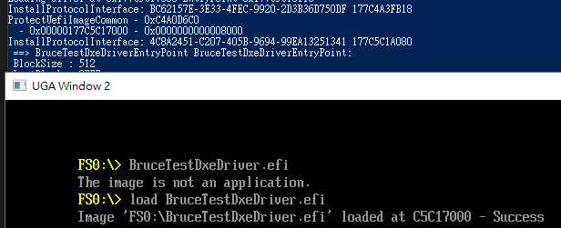
Daily status(1/1)
Initialized DXE driver
Load module can show debug message.
1

