Slide 1
Weekly Report & Discussion
Dingyi Nie
MCL
09/11/2024

Slide 2
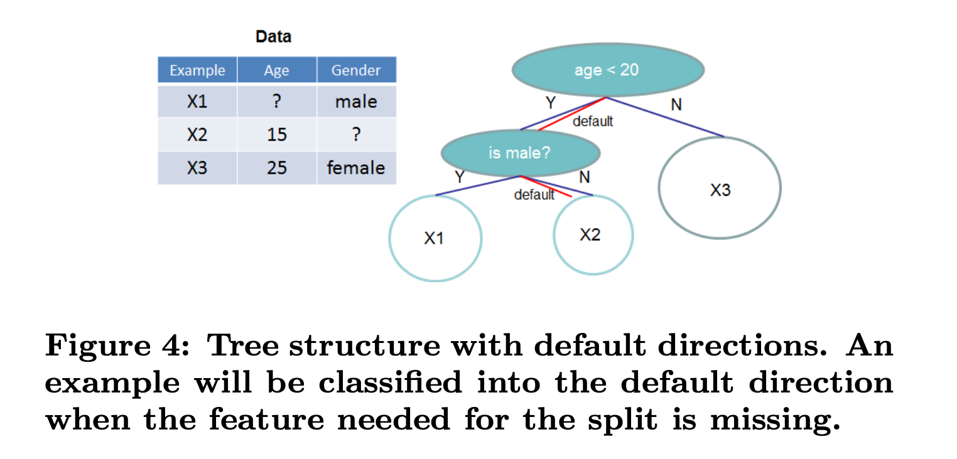
How XGBoost handles input missingness
XGBoost has an inherent sparsity-aware mechanism
Default branch directions for missing values (NaNs) are learned during training in its tree algorithms
The selection of default branch directions will minimizes the loss

Slide 3
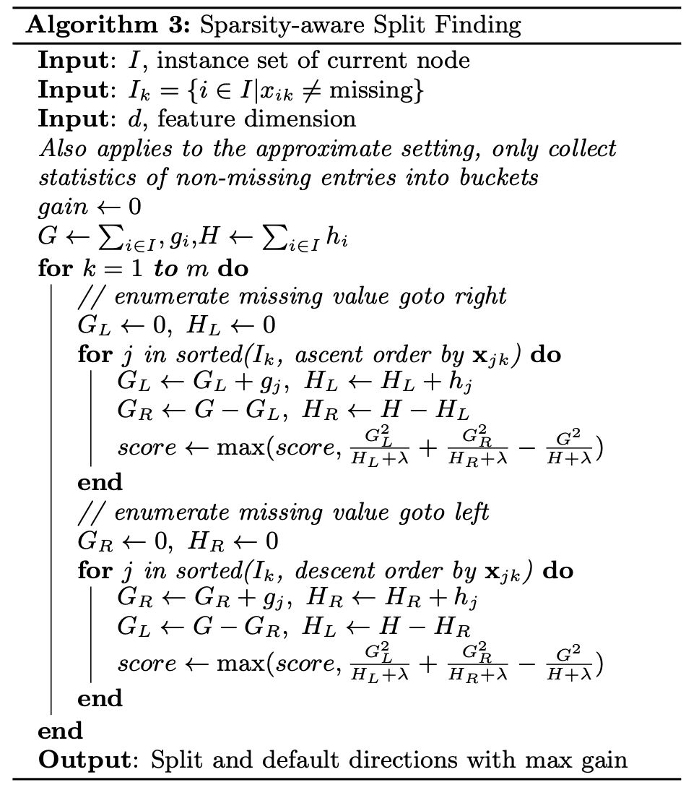
How XGBoost handles input missingness
Enumerate missing values go to right / left
For each branch, select default directions with max gain
Learners’ expressiveness / non-linearity is improved

Slide 4
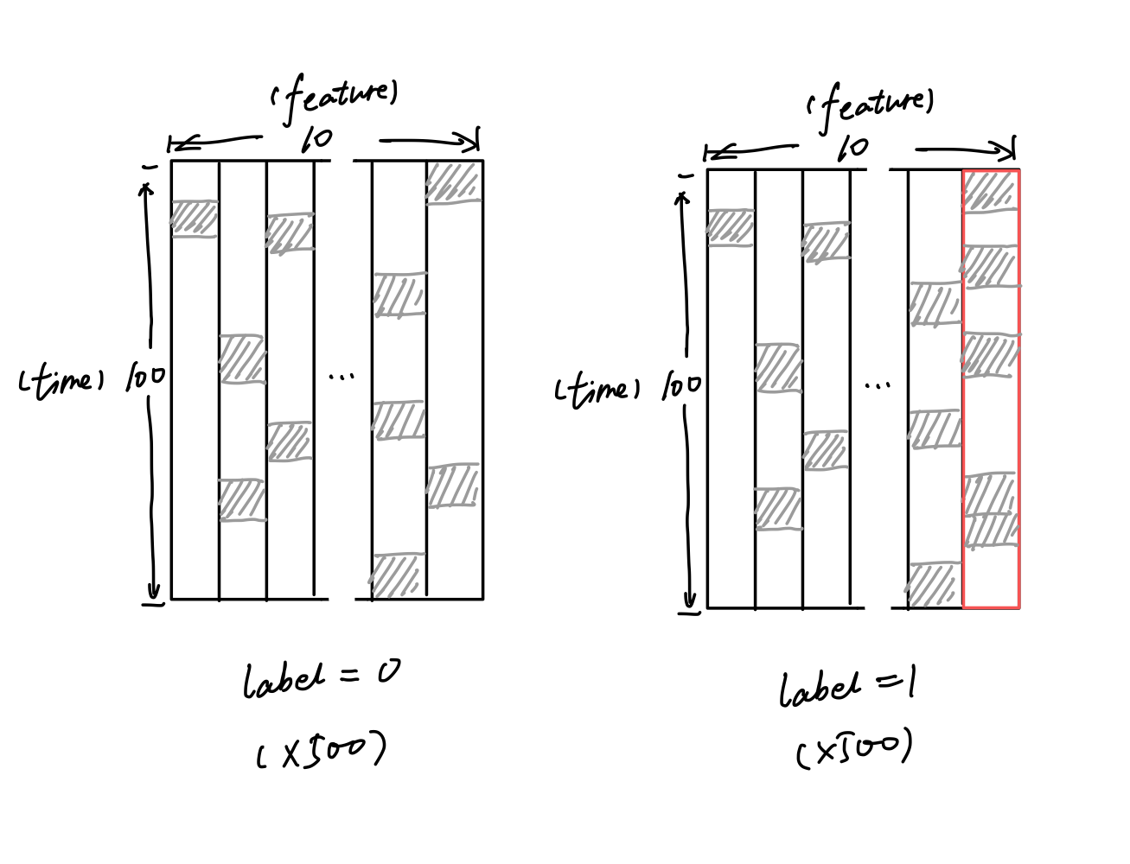
Experiment #1
Objective: to verify XGBoost can capture the correlation between missing rates
Synthetic dataset:
Task: binary classification
1000 episodes in total
500 labeled 0
500 labeled 1
Feature shape: 100 (time axis) by 10 (#features)
Fill-in random values ~N(0,1)
Missing rate = 0.1 (each cell has 10% chance to become NaN)
For episodes of label 1, the last column has a slightly larger missing rate (0.2)

Slide 5
Experiment #1
Split data into 4:1 train-test ratio
Fit an XGBoost classifier to the training data (log loss)
Test the classifier on 4 variations of the test data:
Raw
Zero-imputed
Mean-imputed
Linear-imputed

Slide 6
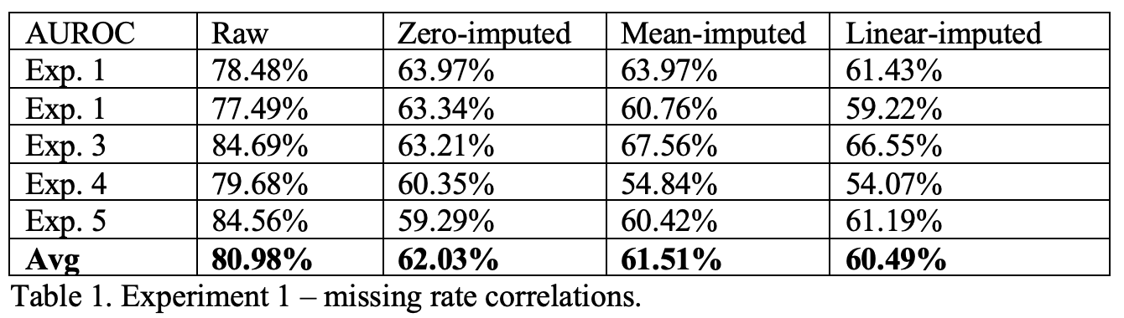
Experiment #1
Results:

Slide 7
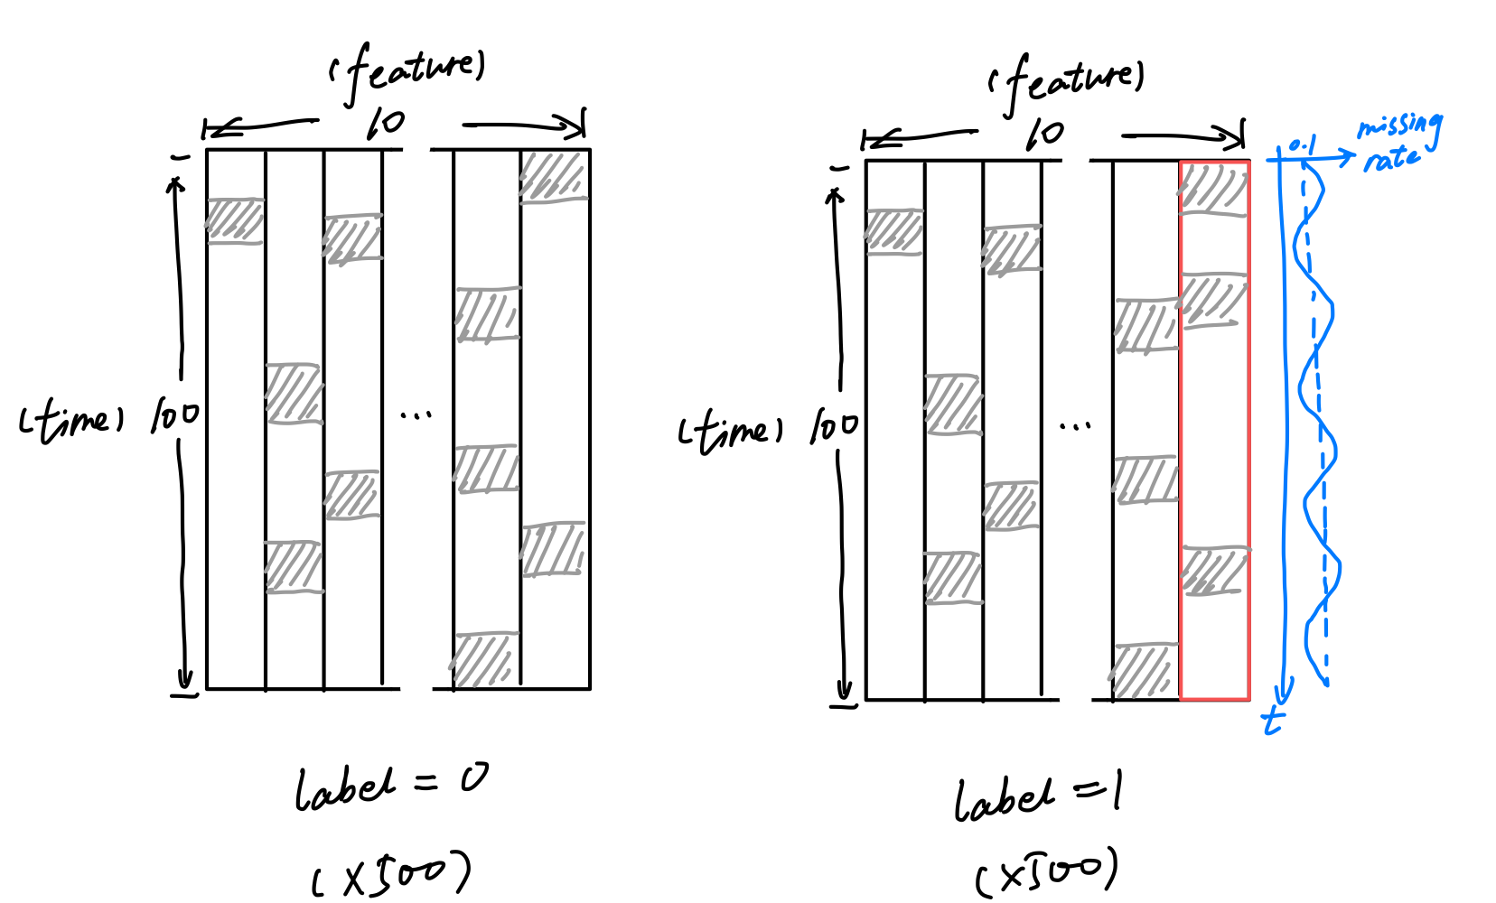
Experiment #2
Objective: to verify XGBoost can capture the temporal pattern of missingness
Synthetic dataset:
Task: binary classification
1000 episodes in total
500 labeled 0
500 labeled 1
Feature shape: 100 (time axis) by 10 (#features)
Fill-in random values ~N(0,1)
Missing rate = 0.1 (each cell has 10% chance to become NaN)
For episodes of label I, the last column has a time-variant periodical missing rate
p(x_{t}=NaN|t) = 0.1 + 0.05 sin(πt)
Missing rate expectation stays the same

Slide 8
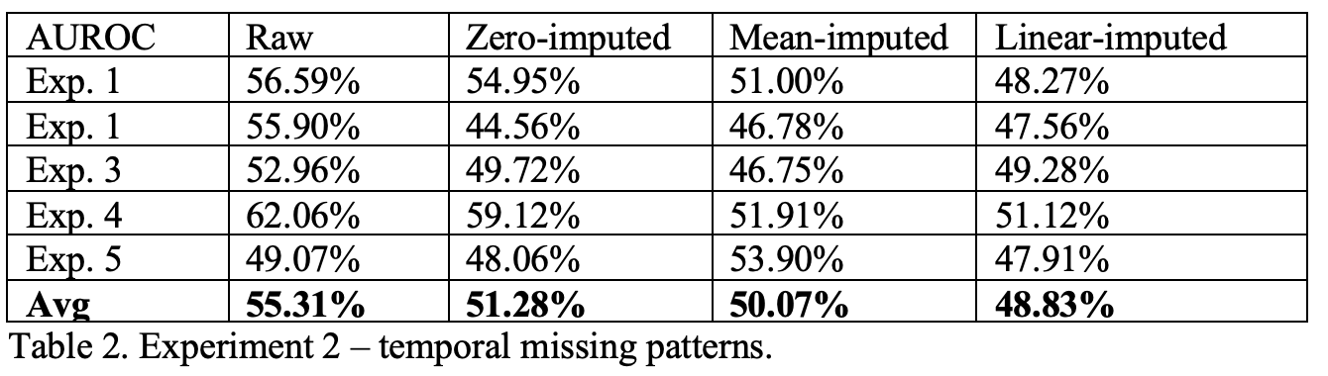
Experiment #2
Results:

Slide 9
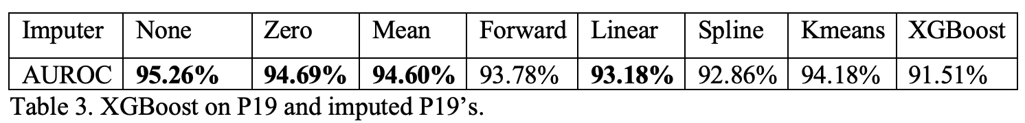
Conclusion
Imputation
+ Make the input well-defined (required by GL tools)
+ Recover temporally smooth input (not necessarily true observations)
- Lose meaningfulness carried by “outliers” (can help XGBoost)
We may consider explicitly passing the missingness info through our GL pipeline

Slide 10
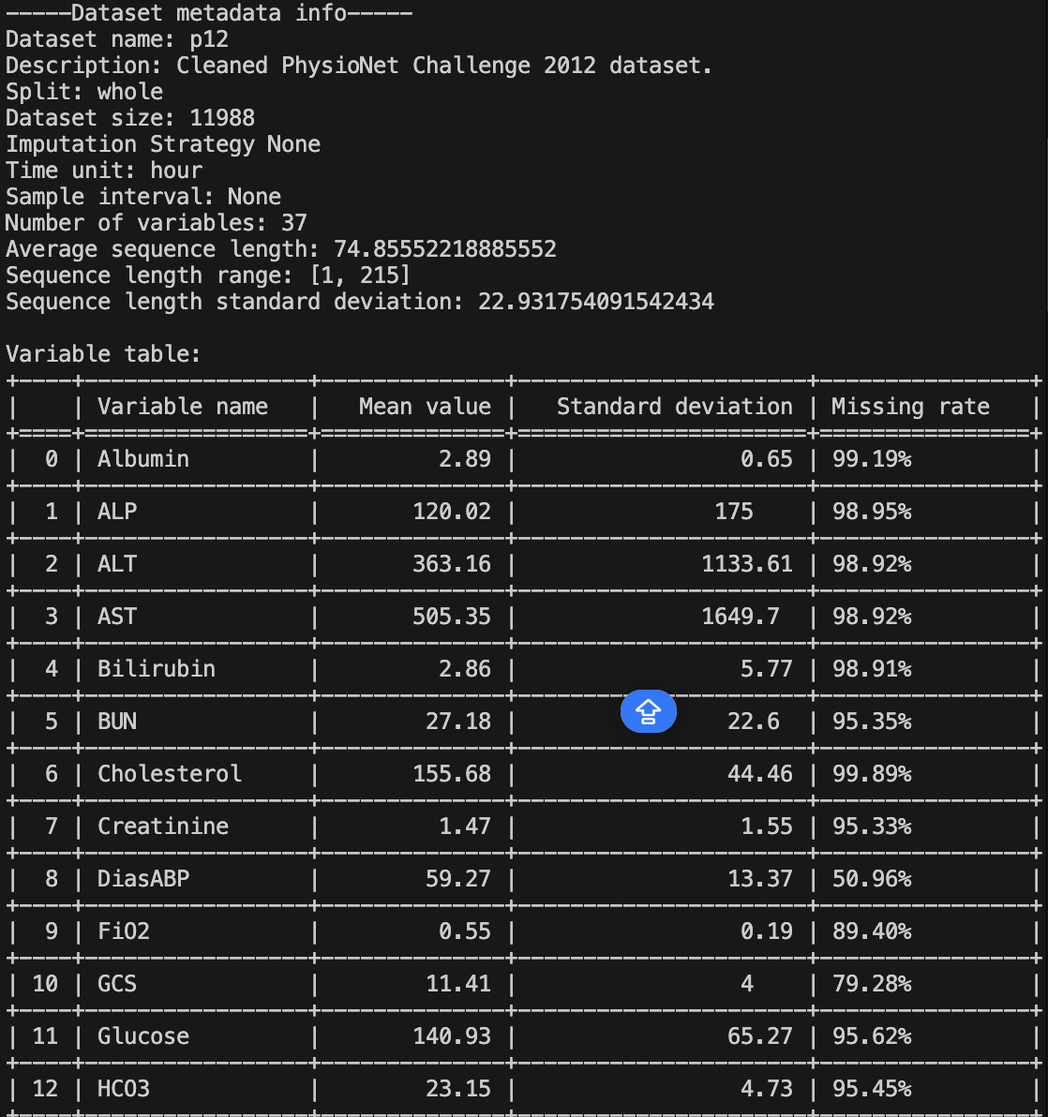
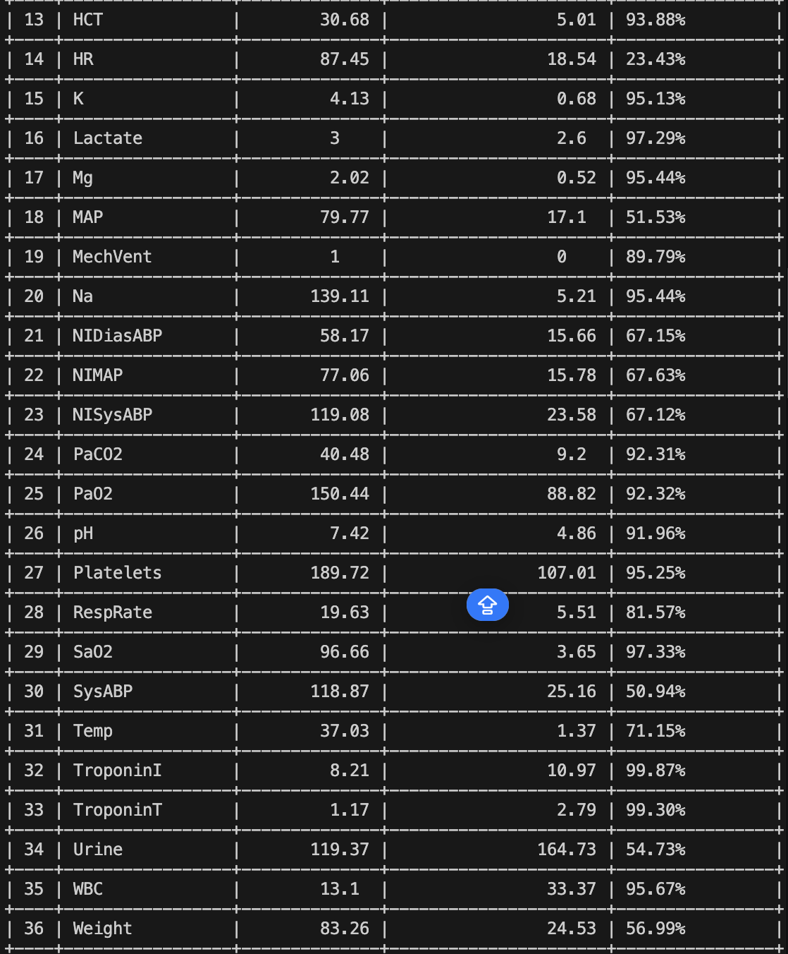
A quick overview on P12
A real-world, biomedical tabular dataset consisting of 12000 episodes
5 outcomes, widely used as labels by previous works:
GRU-D: mortality (binary classification) + 3 other outcomes (multitask)
RAINDROP: ICU length of stay < 3 days? (binary classification)
ViTST: mortality (binary classification)
Irregularly sampled
Missing rates are generally high
Previous deep learning SOTAs are ~85% AUROC on mortality task
XGBoost alone on raw data only (no mask/delta) can achieve ~82% AUROC

Slide 11
Discussion & Feedback

